Slide 1


感恩遇见，相互成就，本课件资料仅供您个人参考、教学使用，严禁自行在网络传播，违者依知识产权法追究法律责任。
更多教学资源请关注
公众号：溯恩英语
知识产权声明

Slide 2

2024. 3 宁波十校应用文 报纸短文
基于议论文文本特征的应用文教学
社会性话题——纸媒 Print Media

Slide 3


假定你是校英语报主编李华，你发现随着信息技术的发展，高中生阅读纸质媒体的热情在逐步减少，请你写一篇英语短文，呼吁学生重拾对纸质阅读的热情。具体内容如下：
1.介绍现状；
2.纸媒的重要性；
3.提出呼吁.
注意：1.词数80左右；2.可适当增加细节，使内容充实，行文连贯。
Embracing the Magic of Print Media
假定你是校英语报主编李华，你发现随着信息技术的发展，高中生阅读纸质媒体的热情在逐步减少，请你写一篇英语短文，呼吁学生重拾对纸质阅读的热情。具体内容如下：
1.介绍现状；
2.纸媒的重要性；
3.提出呼吁.
注意：1.词数80左右；2.可适当增加细节，使内容充实，行文连贯。
Embracing the Magic of Print Media
假定你是校英语报主编李华，你发现随着信息技术的发展，高中生阅读纸质媒体的热情在逐步减少，请你写一篇英语短文，呼吁学生重拾对纸质阅读的热情。具体内容如下：
1.介绍现状；
2.纸媒的重要性；
3.提出呼吁.
注意：1.词数80左右；2.可适当增加细节，使内容充实，行文连贯。
Embracing the Magic of Print Media
假定你是校英语报主编李华，你发现随着信息技术的发展，高中生阅读纸质媒体的热情在逐步减少，请你写一篇英语短文，呼吁学生重拾对纸质阅读的热情。具体内容如下：
1.介绍现状；
2.纸媒的重要性；
3.提出呼吁.
注意：1.词数80左右；2.可适当增加细节，使内容充实，行文连贯。
Embracing the Magic of Print Media
假定你是校英语报主编李华，你发现随着信息技术的发展，高中生阅读纸质媒体的热情在逐步减少，请你写一篇英语短文，呼吁学生重拾对纸质阅读的热情。具体内容如下：
1.介绍现状；
2.纸媒的重要性；
3.提出呼吁.
注意：1.词数80左右；2.可适当增加细节，使内容充实，行文连贯。
Embracing the Magic of Print Media

Slide 4
Content and linguistic features of an argumentation
引简洁（简引材料、提出观点、褒贬分明）
议充分（正反对比、假设因果、点面层进）
联紧扣（明晰原因、直指危害、阐明意义）
结点题（寻找对策、倡议勉励、呼吁号召）
引简洁（简引材料、提出观点、褒贬分明）
议充分（正反对比、假设因果、点面层进）
联紧扣（明晰原因、直指危害、阐明意义）
结点题（寻找对策、倡议勉励、呼吁号召）
Embracing the Magic of Print Media
Para. 1: Current Situation
Para. 2: The Importance of Print Media
Para. 3: The Appeal
Phenomenon
Reasons
Measures
What
Why
How

Slide 5
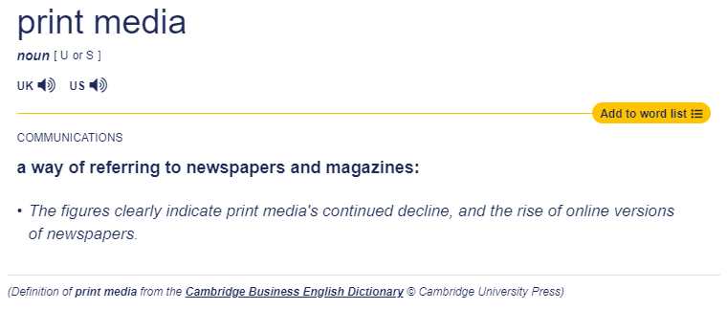
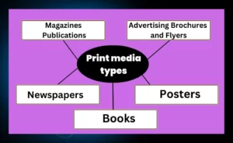
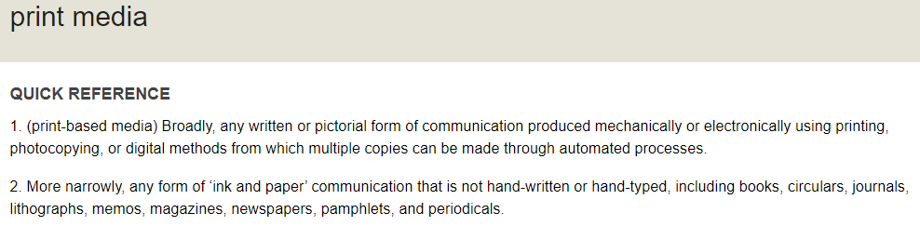

Slide 6

Para. 1 Phenomenon — What
to be complete
to be concise
假定你是校英语报主编李华，你发现随着信息技术的发展，高中生阅读纸质媒体的热情在逐步减少，请你写一篇英语短文，呼吁学生重拾对纸质阅读的热情。具体内容如下：
1.介绍现状；
2.纸媒的重要性；
3.提出呼吁。
reasons behind+ current situation
假定你是校英语报主编李华，你发现随着信息技术的发展，高中生阅读纸质媒体的热情在逐步减少，请你写一篇英语短文，呼吁学生重拾对纸质阅读的热情。具体内容如下：
1.介绍现状；
2.纸媒的重要性；
3.提出呼吁。
With the advance of information technology, high school students are losing their enthusiasm for reading print media.
With smartphones and tablets at their fingertips, for high school students, the allure of electronic devices has overshadowed/ eclipsed/ outshone (使黯然失色) the charm of printed pages.
There’s a declining enthusiasm for print media among high school students with the development of information technology.
表示原因：There’s a tendency of ... due to.../ as.../ because.../ with...

Slide 7
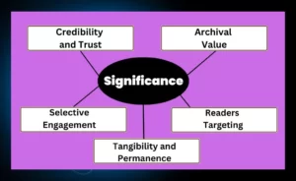
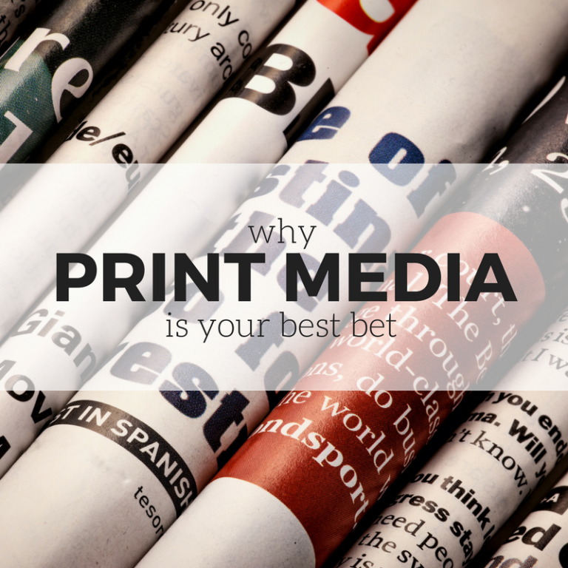
Para. 2 Reasons—Why
(来自T8阅读D篇) choose what we like to read instead of the flattened information provided by smartphone notifications
to be organized
Whether it’s newspapers providing comprehensive news coverage, magazines catering to specialized interests, books fostering knowledge and storytelling, or brochures, flyers, and posters for marketing and communication needs, print media continues to play a vital role in our society by providing tangible, targeted, and engaging content.
结构化：总——分（from general to specific）
From newspapers and magazines delivering current affairs and specialized content to books preserving knowledge and narratives, it offers unique advantages in an increasingly digital world. Its credibility, selective engagement, niche audience targeting, and archival value certainly make for an invaluable medium of communication.

Slide 8
to be clear
Reading physical newspapers, magazines, or books offers a tactile (触感的) experience that digital media can’t replicate (复制). The rustle of turning pages, the smell of fresh ink—these sensory experiences enhance reading comprehension and retention (存放). Moreover, print media encourages a more focused and immersive reading experience, crucial for deep learning and critical thinking.
Reading physical books and newspapers fosters a deeper connection with the material, enhancing comprehension and retention. Furthermore, the tactile experience of turning pages and the serenity it brings are irreplaceable. Print media also encourages mindful reading, free from the distractions of notifications and hyperlinks common in digital media.
Reading physical newspapers, magazines, or books offers a tactile (触感的) experience that digital media can’t replicate (复制). The rustle of turning pages, the smell of fresh ink—these sensory experiences enhance reading comprehension and retention (存放). Moreover, print media encourages a more focused and immersive reading experience, crucial for deep learning and critical thinking.
Reading physical books and newspapers fosters a deeper connection with the material, enhancing comprehension and retention. Furthermore, the tactile experience of turning pages and the serenity it brings are irreplaceable. Print media also encourages mindful reading, free from the distractions of notifications and hyperlinks common in digital media.
to be logical– cohesive devices:
transitional words; pronouns, comparatives, contrasts…
表示并列：and, also, moreover, besides, furthermore, apart from that, in addition...

Slide 9

Para. 3 Appeal — How
to be motivating
to be engaging
Call to action—engage the readers
Therefore, I urge my peers to rediscover the joy of print media. Let’s immerse ourselves in the world of ink and paper, where stories come alive and imaginations take flight. Embrace the magic of print media and let it enrich our lives once again.
Therefore, I urge my peers to rediscover the joy of print media. Let’s embrace the magic of holding a book or newspaper in our hands, feeling the paper beneath our fingertips, and losing ourselves in the written word.
So, come on, guys and gals, let’s bring back our love for print! Dive into a good book, feel the paper, smell the ink, and let your imagination run wild. Embrace the real magic of print media and let it transform your reading experience.

Slide 10
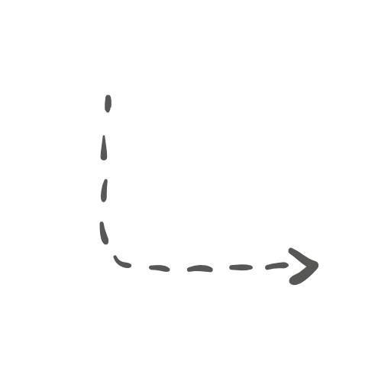
Embracing the Magic of Print Media
表示转折：However,/ Yet,/ But; Instead; Otherwise…
Para. 1: Current Situation— print media is losing favor
Para. 2: The Importance of Print Media
Para. 3: The Appeal
Phenomenon
Reasons
Measures
But this shift is alarming, given the irreplaceable value of print media.
However, the importance of print media, cannot be overstated.
to be logical– cohesive devices:
transitional words; pronouns…
表示结果：Therefore,/ Hence,/ As a result,/ So
to be theme-related
Therefore, I urge my peers to rediscover the joy of print media.
So, come on, guys and gals, let’s bring back our love for print!

Slide 11
A possible version
Embracing the Magic of Print Media
As the digital revolution sweeps through (横扫) our lives, the appeal of screens and the convenience of online content have quietly caused print media to lose its charm (失去魅力). Peeking into our library, we’ll see newspapers gathering dust (积灰), like long-forgotten friends. (Phenomenon)
However, print media offers a unique reading experience (general statement). It encourages a slower and more reflective reading process, allowing readers to digest information more thoroughly (supporting detail 1). Besides, it endows readers with the feel of the pages, the ink smell, and the freedom to flip through pages at our own pace, which offers us an escape into another world and a deeper dive into knowledge (supporting detail 2). (Reasons)
So, let’s bring back the joy of turning pages! Together, we can foster a culture of curiosity and lifelong learning that surpasses (胜过) digital screens. (Appeal/ Conclusion)
Embracing the Magic of Print Media
As the digital revolution sweeps through (横扫) our lives, the appeal of screens and the convenience of online content have quietly caused print media to lose its charm (失去魅力). Peeking into our library, we’ll see newspapers gathering dust (积灰), like long-forgotten friends. (Phenomenon)
However, print media offers a unique reading experience (general statement). It encourages a slower and more reflective reading process, allowing readers to digest information more thoroughly (supporting detail 1). Besides, it endows readers with the feel of the pages, the ink smell, and the freedom to flip through pages at our own pace, which offers us an escape into another world and a deeper dive into knowledge (supporting detail 2). (Reasons)
So, let’s bring back the joy of turning pages! Together, we can foster a culture of curiosity and lifelong learning that surpasses (胜过) digital screens. (Appeal/ Conclusion)
Embracing the Magic of Print Media
As the digital revolution sweeps through (横扫) our lives, the appeal of screens and the convenience of online content have quietly caused print media to lose its charm (失去魅力). Peeking into our library, we’ll see newspapers gathering dust (积灰), like long-forgotten friends. (Phenomenon)
However, print media offers a unique reading experience. It encourages a slower and more reflective reading process, allowing readers to digest information more thoroughly. Besides, it endows readers with the feel of the pages, the ink smell, and the freedom to flip through pages at our own pace, which offers us an escape into another world and a deeper dive into knowledge. (Reasons)
So, let’s bring back the joy of turning pages! Together, we can foster a culture of curiosity and lifelong learning that surpasses (胜过) digital screens. (Appeal/ Conclusion)
Embracing the Magic of Print Media
As the digital revolution sweeps through our lives, the appeal of screens and the convenience of online content have quietly caused print media to lose its charm. Peeking into our library, we’ll see newspapers gathering dust, like long-forgotten friends.
However, print media offers a unique reading experience. It encourages a slower and more reflective reading process, allowing readers to digest information more thoroughly. Besides, it endows readers with the feel of the pages, the ink smell, and the freedom to flip through pages at our own pace, which offers us an escape into another world and a deeper dive into knowledge.
So, let’s bring back the joy of turning pages! Together, we can foster a culture of curiosity and lifelong learning that surpasses digital screens.

Slide 12
What are the advantages of print media?
While print media is important for consumers that hold legitimacy to a high degree, print media also offers several advantages to advertisers, namely:
It can be targeted
Print media can be tailored to a target audience, both in terms of content, design, and distribution. This means that advertisers can focuse their marketing budget on reaching their prospects and making the material relevant and appealing to them.
It creates engagement
Print media creates engagement between the brand and the consumer. By providing amusing copy, interesting articles, and special offers through brochures and newsletters, companies create a connection with their readers that lead to brand awareness and sales.
It can be kept
Ever bookmarked an interesting article, only to forget about it and never read it again? Yep, been there, done that. Unlike webpages, different forms of print media have longer lifespans. Rather than users spending a few seconds on a webpage and then moving to the next shiny thing, magazines and brochures are picked up again and referred back to. They can also be read by family members, friends, and colleagues, maximizing the reach of the marketing campaign.

