Slide 1


感恩遇见，相互成就，本课件资料仅供您个人参考、教学使用，严禁自行在网络传播，违者依知识产权法追究法律责任。
更多教学资源请关注
公众号：溯恩英语
知识产权声明

Slide 2

Unit2 Healthy Lifestyle
Reading and Thinking
Learn to develop good health habits

Slide 3


Lead-in
bad habits
an unhealthy lifestyle

Slide 4
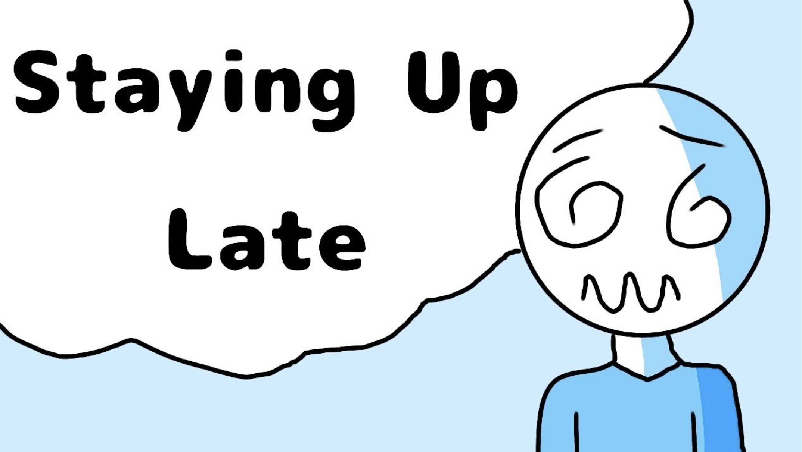
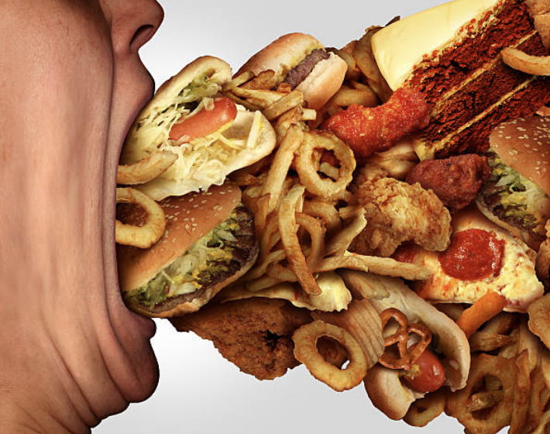

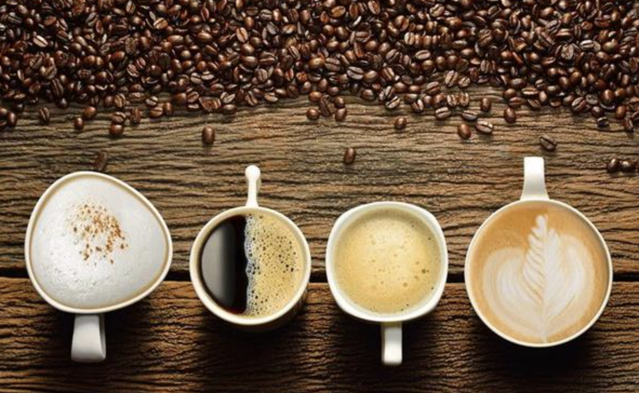

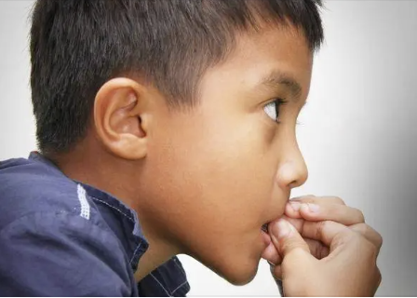
Lead-in
What other bad habits do you have?
staying up late
overeating
overspending
drinking too much coffee
using a phone too much
biting nails
...

Slide 5


Pre-reading：Predict based on the title
means
aim
What's the relationship between these two keywords?

Slide 6
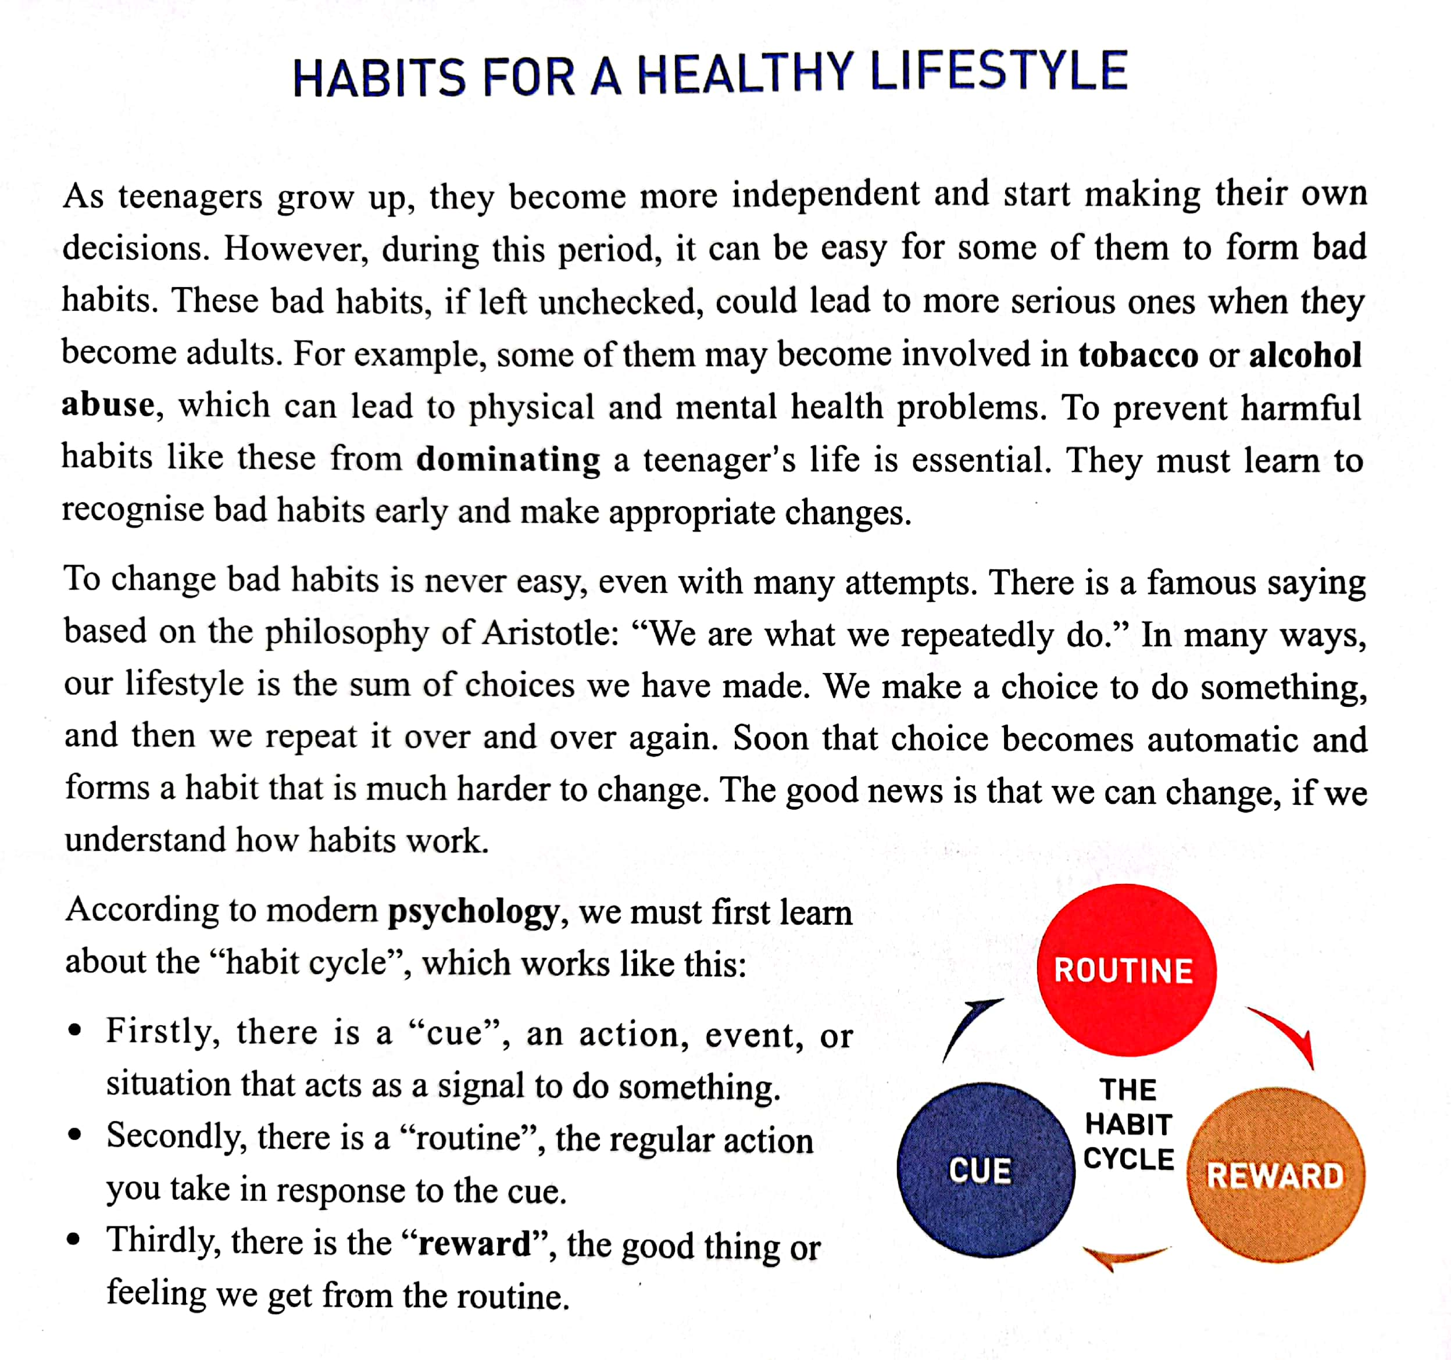
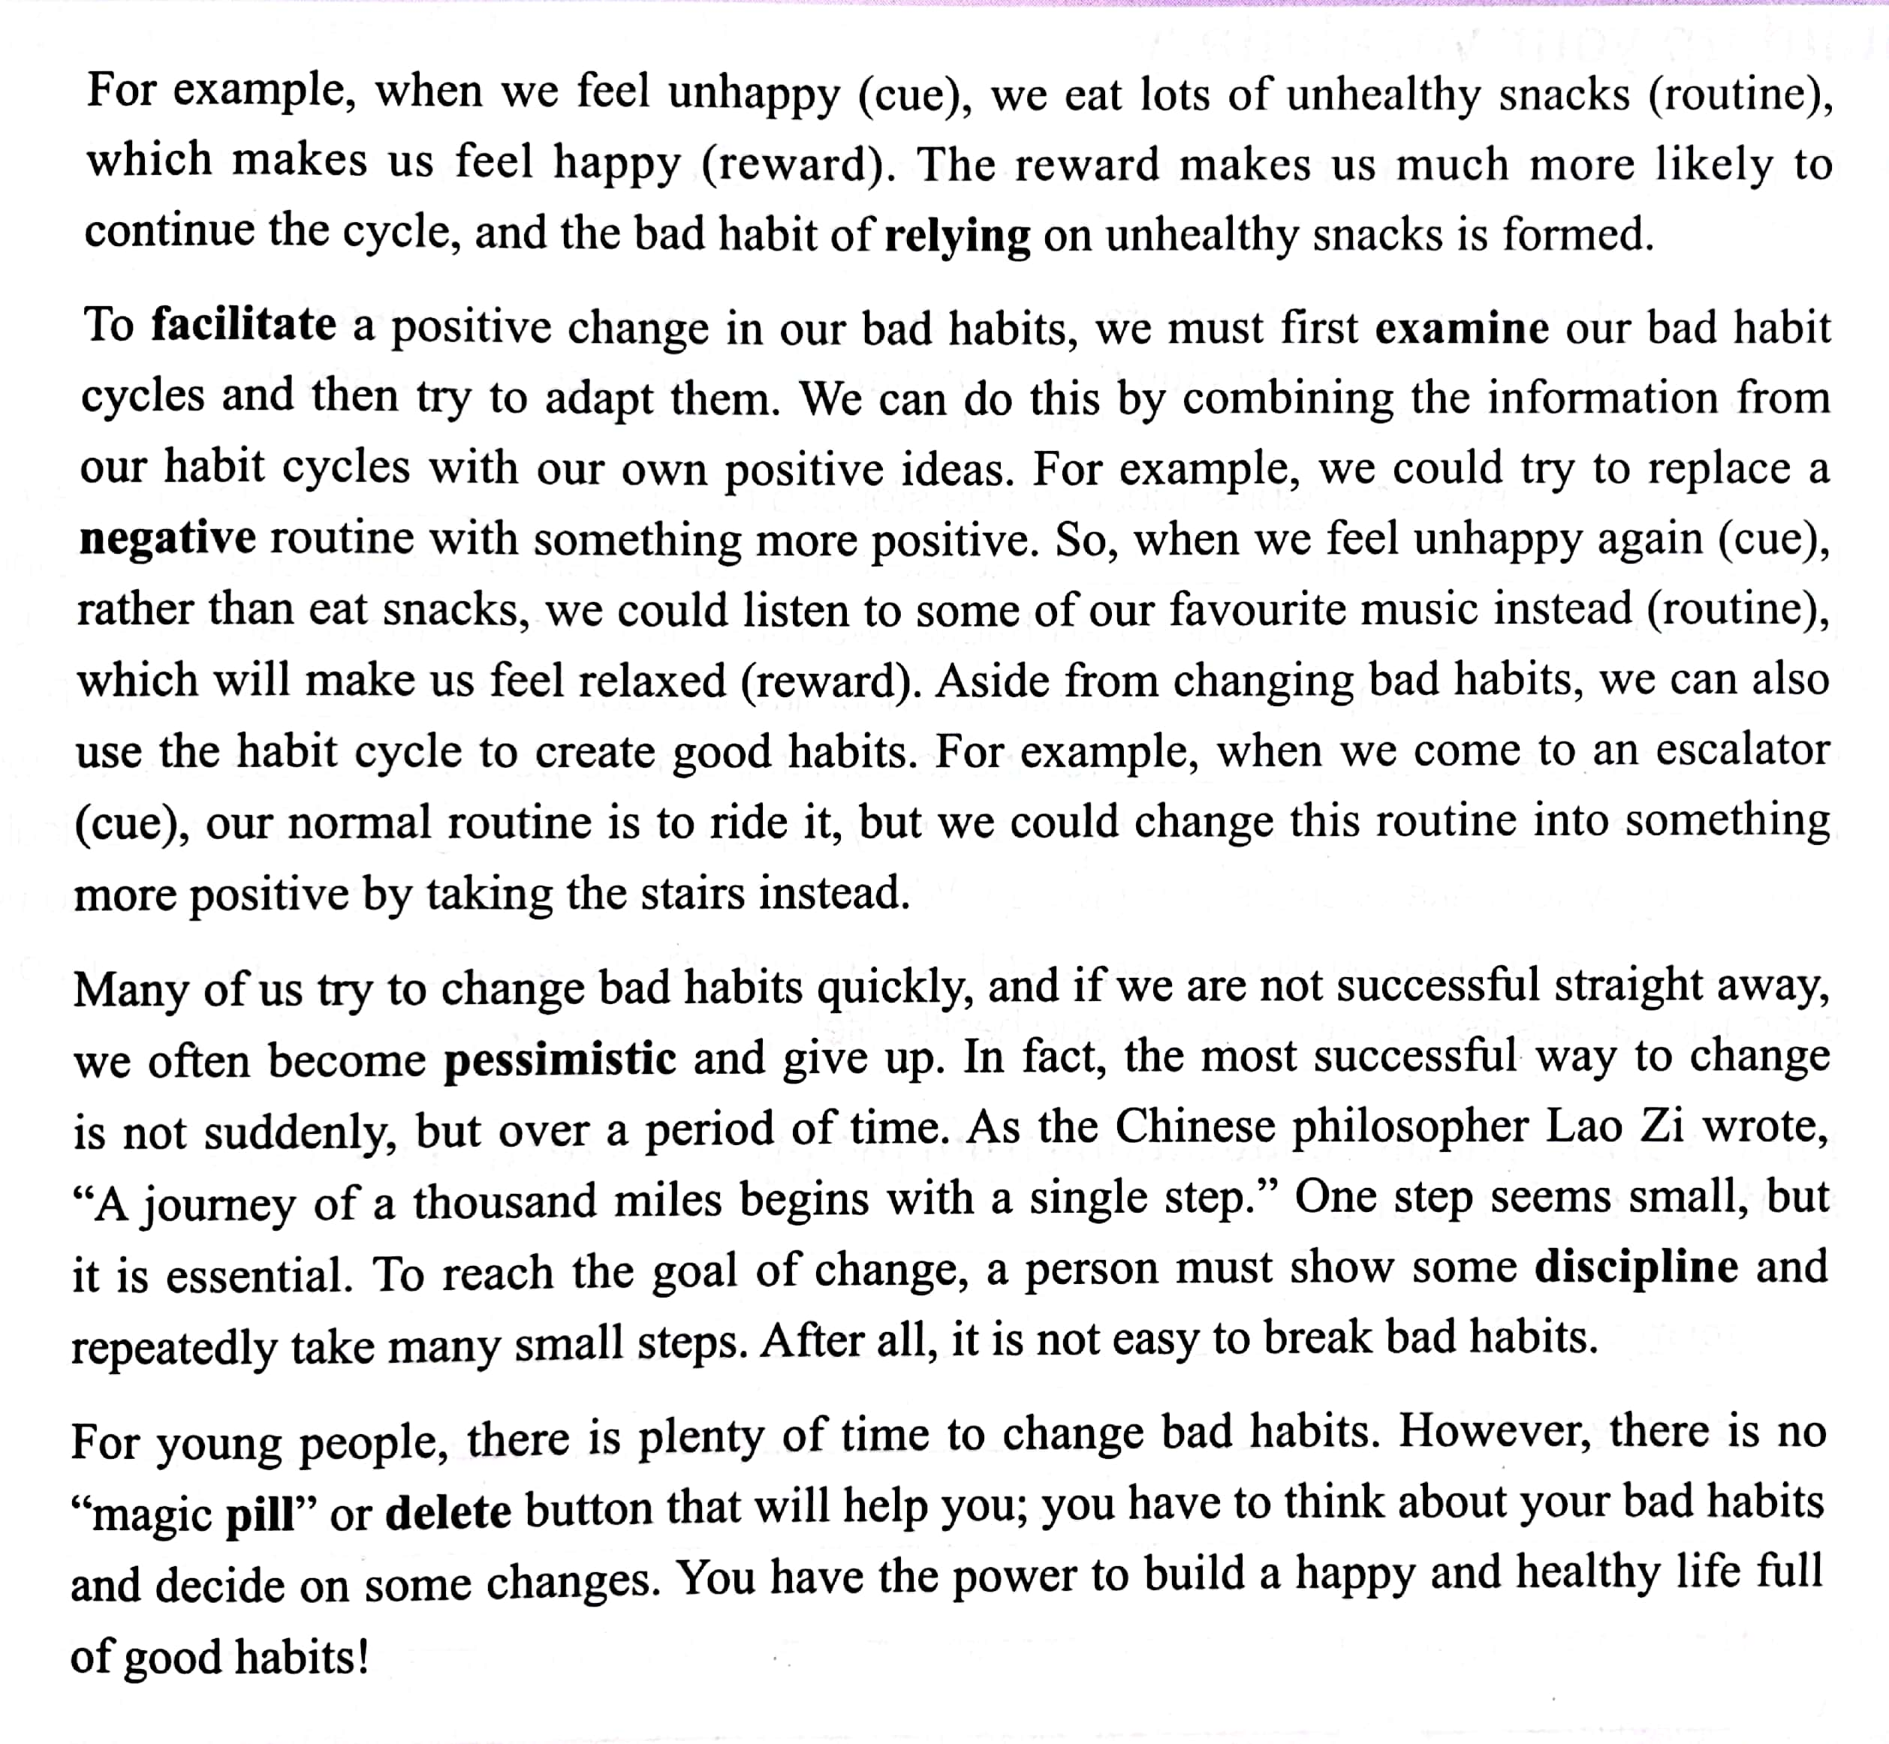






Skimming：Read for main ideas
The influence of bad habits
Theory (The habit cycle)
Appeal for action
The forming of bad habits
Application of the theory
Attention points

Slide 7




Skimming: Read for the structure
The text type
The influence of bad habits
Problem
Narration
The forming of bad habits
Exposition
Argumentation
Theory (The habit cycle)
The purpose
Solution
Application of the theory
To introduce how to change __________ and create __________ by using ________________.
bad habits
good habits
Attention points
the habit cycle
Appeal for action

Slide 8
Scanning
The influence of bad habits
As teenagers grow up, they become more independent and start making their own decisions. However, during this period, it can be easy for some of them to form bad habits. These bad habits, if left unchecked, could lead to more serious ones when they become adults. For example, some of them may become involved in tobacco or alcohol abuse, which can lead to physical and mental health problems. To prevent harmful habits like these from dominating a teenager's life is essential. They must learn to recognise bad habits early and make appropriate changes.
dominating
recognize
Why do bad habits become a serious problem especially for teenagers?
What should teenagers do first to prevent harmful habits from dominating their life?
Which verb did the author use to show the power of bad habits?

Slide 9

Scanning
The forming of bad habits
To change bad habits is never easy, even with many attempts. There is a famous saying based on the philosophy of Aristotle: “We are what we repeatedly do.” In many ways, our lifestyle is the sum of choices we have made. We make a choice to do something, and then we repeat it over and over again. Soon that choice becomes automatic and forms a habit that is much harder to change. The good news is that we can change, if we understand how habits work.
automatic
harder to change
Why is it hard to change habits?
By making comparison
By citing quotations
By giving examples
By listing numbers
How does the author support his idea?
repeat it many times
make a choice
form a habit

Slide 10
Scanning
The forming of bad habits
repeat it many times
make a choice
form a habit
Habits are what we repeatedly do.
“We are what we repeatedly do.”
—Aristotle
We are Habits.

Slide 11
Theory (The habit cycle)
According to modern psychology, we must first learn about the “habit cycle”, which works like this:
• Firstly , there is a “cue”, an action, event, or situation that acts as a signal to do something.
• Secondly , there is a “routine”, the regular action you take in response to the cue.
• Thirdly , there is the “reward”, the good thing or feeling we get from the routine.
Firstly
Make it much clearer
Secondly
Thirdly
Make it much easier to understand
For example, when we feel unhappy (cue), we eat lots of unhealthy snacks (routine), which makes us feel happy (reward). The reward makes us much more likely to continue the cycle, and the bad habit of relying on unhealthy snacks is formed.
For example
Which stage is the key of bad habit forming?
What are three stages of ''the habit cycle''?
How does the author further explain ''the habit cycle''?

Slide 12
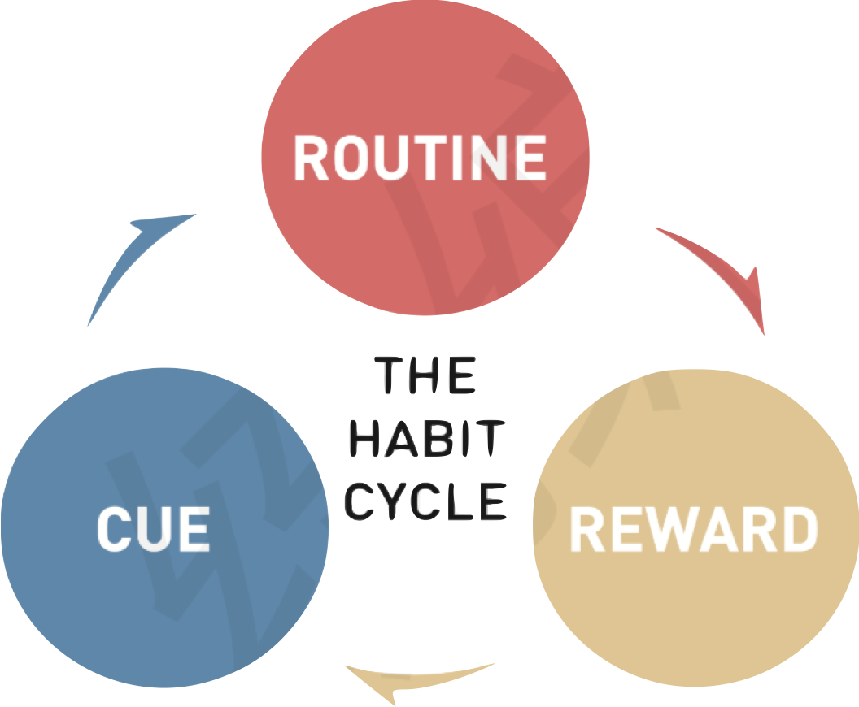
The forming process of the bad habit of eating unhealthy snacks
eat lots of unhealthy snacks
...
feel stressed
feel unhappy
feel happy
Are there any other cue that will make you eat junk food?

Slide 13

Scanning
Application of the theory
To facilitate a positive change in our bad habits, we must first examine our bad habit cycles and then try to adapt them. We can do this by combining the information from our habit cycles with our own positive ideas. For example, we could try to replace a negative routine with something more positive. So, when we feel unhappy again (cue), rather than eat snacks, we could listen to some of our favourite music instead (routine), which will make us feel relaxed (reward). changing bad habits, we can also use the habit cycle to create good habits. For example, when we come to an escalator (cue), our normal routine is to ride it, but we could change this routine into something more positive by taking the stairs instead.
Aside from
logical words!
How does the author explain it's application?
What can we use ''the habit cycle'' to do?
Which stage of ''the habit cycle'' is changed?

Slide 14











change bad habits
...
eating snacks
When we __________again (cue), rather than________(bad routine), we________instead (good routine), and it makes us________ (reward).

Slide 15
change bad habits
create good habits
With the help of ''the habit cycle'', do you think bad habits can be changed or good habits can be formed immediately?

Slide 16
Scanning
Attention points
Many of us try to change bad habits quickly, and if we are not successful straight away, we often become pessimistic and give up. In fact, the most successful way to change is not suddenly, but over a period of time . As the Chinese philosopher Lao Zi wrote, “A journey of a thousand miles begins with a single step.” One step seems small, but it is essential. To reach the goal of change, a person must show some discipline and repeatedly take many small steps. After all, it is not easy to break bad habits.
a period of time
discipline
consistent efforts
What else are needed to break bad habits? Read Para.5 and underline the key words.

Slide 17
Scanning
Appeal for action
For young people, there is plenty of time to change bad habits. However，there is no “magic pill” or delete button that will help you; you have to think about your bad habits and decide on some changes. You have the power to build a happy and healthy life full of good habits!
What does ''magic pill'' or ''delete button'' refer to?
Why does the author use the second person you in the last paragraph?
Who are the target readers of the passage?

Slide 18
Discussion: Let's deal with our bad habits
staying up late
using a phone too much
drinking too much coffee
overeating
overspending
biting nails
...

Slide 19



Homework
Collect a bad habit from your deskmate and write down the cue, routine, and reward. Then come up with an idea of how to break the bad habit.

Slide 20
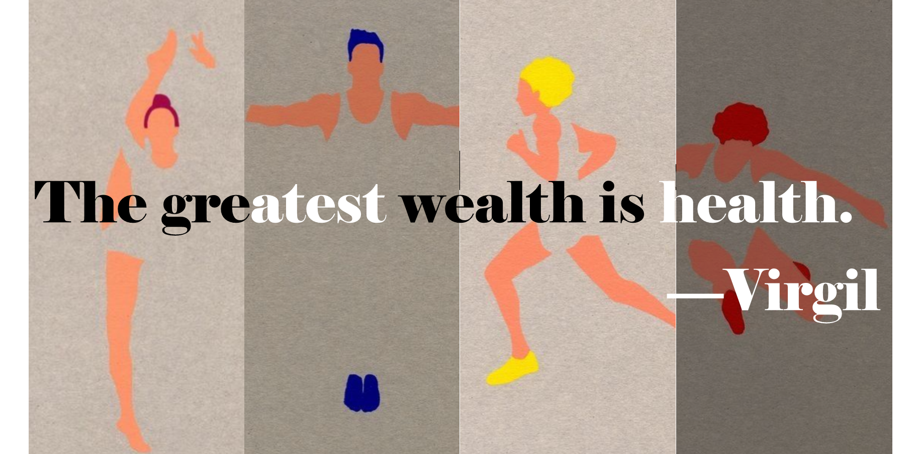
See You Tomorrow

