Slide 1


感恩遇见，相互成就，本课件资料仅供您个人参考、教学使用，严禁自行在网络传播，违者依知识产权法追究法律责任。
更多教学资源请关注
公众号：溯恩英语
知识产权声明

Slide 2
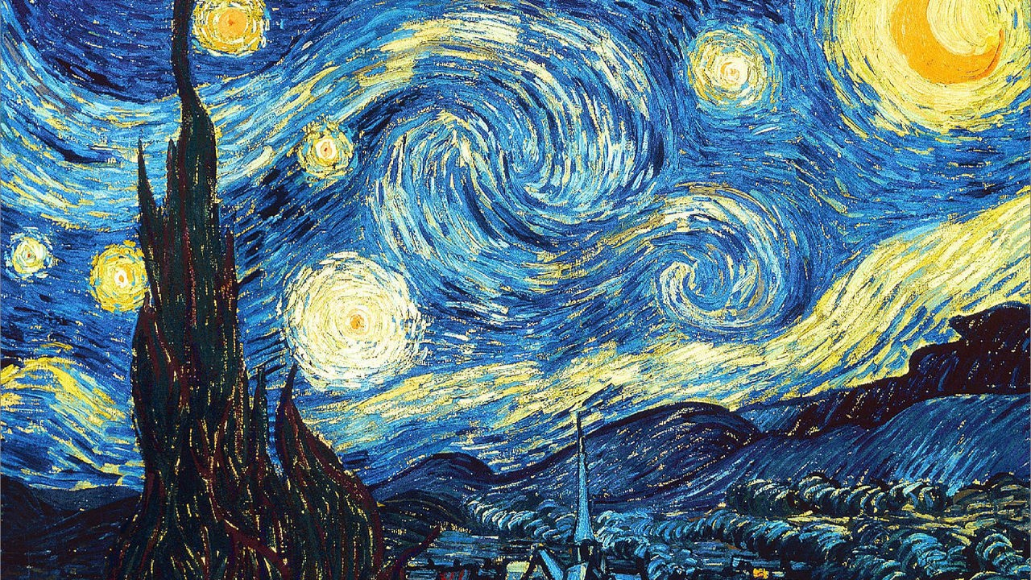
The Starry Night
人教版选择性必三
Unit1 Workbook Reading and Writing

Slide 3

Teaching Objectives
Practice reading skills.
Broaden student’s horizons by allowing them to discuss and analyze a painting.
Discuss how to describe and appreciate a painting.
Be capable to write an essay about describe a drawing or painting that students like.

Slide 4
Lead-in
Look at the following painting and appreciate it.
The Starry Night
——Van Gogh

Slide 5
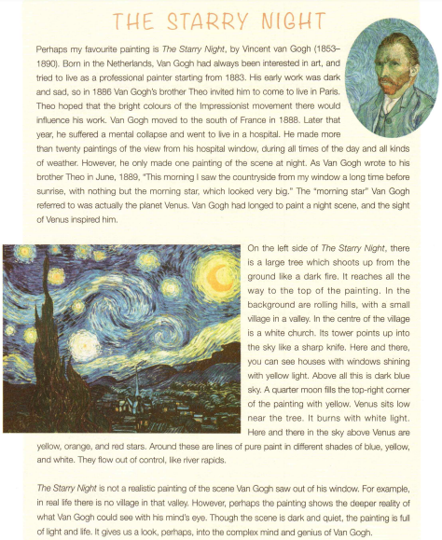
Read for main ideas
Para 1 :
____________________
Background of the work of art
Para 2 :
_____________________
Description of the work of art
Para 3 :
____________________
Review of the work of art

Slide 6

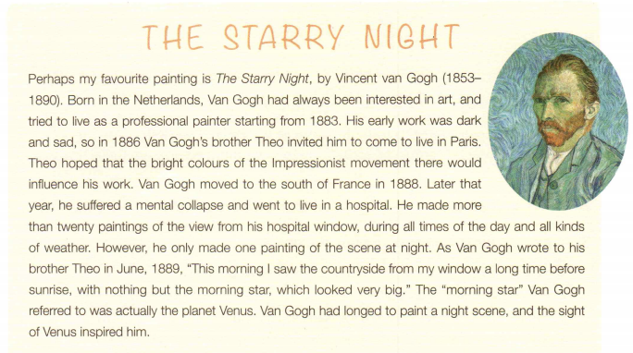
Activity 1. Draw a mind map to show the background of the art according to this paragraph.(pay attention to the time and verbs)

Slide 7
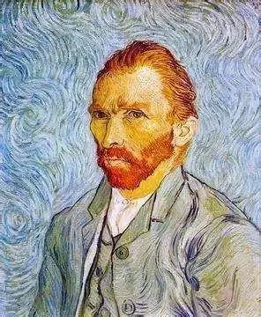
Activity 1 Draw a mind map to show the background of the art according to this paragraph.
paint The Starry Night
move to south of France
suffer a mental collapse
live in a hospital
in June,1889
in 1888
live in Paris
(dark and sad)
live as a professional painter starting
in 1886
born in Netherlands
in 1853
from 1883
Vincent van Gogh

Slide 8
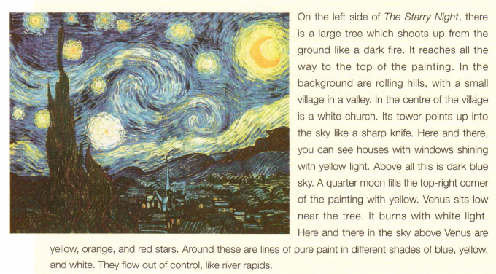
Activity 2 Find the similes that the writer uses to describe the painting.
It shoots up from the ground like a dark fire. 它像一团黑色的火焰从地面升起。
Its towers points up into the sky like a sharp knife. （教堂的）塔尖像一把尖刀直插云霄。
They flow out of control, like river rapids. （不同的色彩）像急流一样失去控制。
Activity 3 What have you learnt to describe a painting according to this paragraph?

Slide 9
Activity 3 What have you learnt to describe a painting according to this paragraph?
When describing a painting, we can follow the spatial order by using on the left side, in the background, in the centre, here and there etc.
In addition, color, light and composition is also what we need to focus on.

Slide 10
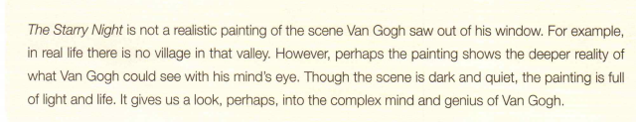
Activity 4 How to review a painting according to this paragraph?
from the general perspective
from where the artist stands
summarize the painting
express the feeling when looking at that piece

Slide 11
Exercise
Exercise 1 Read the passage and write questions for the answers.
(Page 65.)
1. When did Vincent can Gogh decide to try to live as professional painter?
In 1883.
2.
van Gogh’s early work was dark and sad.
3.
The sight of Venus inspired him to paint The Starry Night.
4.
In real life there is no village in that valley.
What was van Gogh’s early work like?
What inspired van Gogh to paint the Starry Night?
How is The Starry Night different from real life?

Slide 12
Exercise
Exercise 2 In groups, discuss your opinions of the painting.
Finish the sentences below.
(Page 65.)
1. The painting makes me feel because______________________ __________________________.
2. I think van Gogh must have felt/been when he made the painting because __________________________________________
3. I like/dislike the painting because_____________________________________
_____________________.
happy and alive
it has lovely bright colors
even though it is a night scene.
very emotional
there is a lot of energy in the brush strokes and color
it has a magical quality that makes me want
to look at it again and again

Slide 13
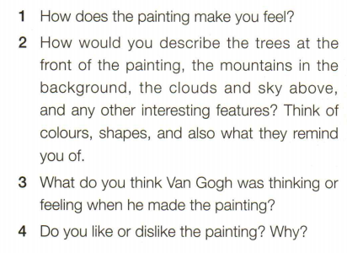
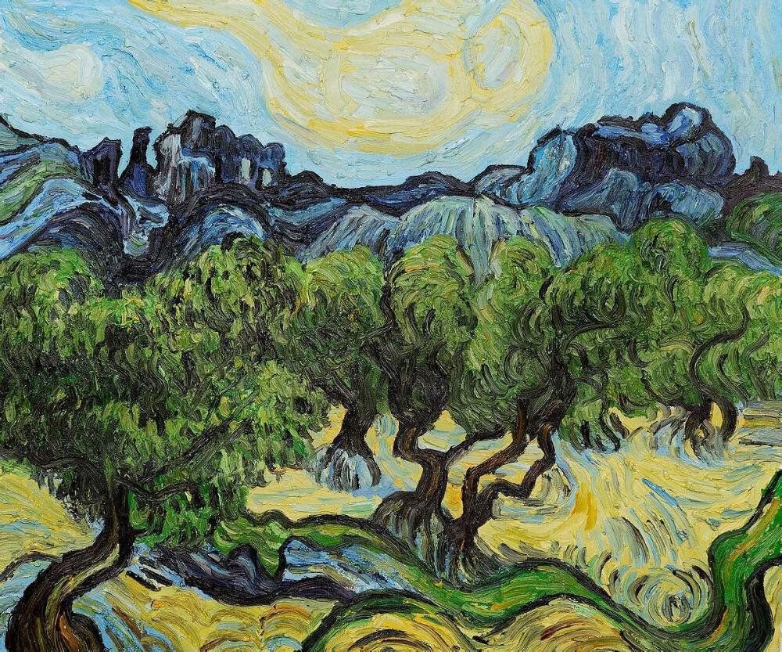
Writing
Exercise 3 Look at the painting on the right and discuss
the questions in groups. (Page 65.)
Olive Trees

Slide 14
Writing
Sample writing
Olive Trees by Vincent can Gogh
At the front of the painting are olive trees growing from the green earth, which looks like rolling waves. The gnarled trunks, branches, and leaves also swirl like waves. Behind, the rolling hills are dark and blue, but they have the same shape and seem to be connected to the ground and trees below. The mountains have strange shape. In the sky is a large cloud , which also has the same shape as the other elements.
Olive Trees
I think Van Gogh was feeling very close to nature and connected to the place when he painted this. It seems he was sitting there and trying to capture the movement and connectedness of nature.
I like this painting because it looks like all the parts are connected part of one big whole. It feels like it is moving with life. It makes me want to go for a walk among the trees. It also accompanies well his other famous painting well his other famous painting, The Starry Night, which I also like very much.

Slide 15
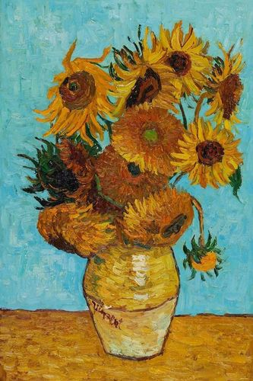
Accumulation
Describe a drawing or painting that you like.
You should say:
1. When you first saw this painting;
2.What the painting is about;
3.Who drew/painted it;
4.And explain why you like this drawing/painting.
Language bits to introduce the topic:
serve similar purposes 有着相似的作用
evoke emotions from sb. 唤醒某人的情感
picture frame 画框
It’s captured/frozen in the frame. 它被定格在了画框里。
Language bits to talk about who drew/painted it:
have a worldwide reputation 举世闻名
has a lasting impact 有着持久的影响力
never cease to captivate me 一直让我着迷
EX:
One such painting is Vincent Van Gogh’s Sunflowers, the painting that has a worldwide reputation and a lasting impact on the art history, the painting that never ceases to captivate me.

Slide 16

Language bits to describe what the painting is about:
a bouquet[buˈkeɪ] of sunflowers 一束向日葵
genre of still life painting 静物画的流派
in full bloom 完全盛开
blow one’s mind 令人惊讶
EX:
If I remember correctly, I first encountered the painting from the textbook, maybe twelve years ago, when I was still in senior high school. The painting basically depicts a bouquet of sunflowers in a vase. It belongs to the genre of still life painting. The sunflowers are in full bloom. It really blows my mind. It is my favorite painting of all time. Why?

Slide 17
Language bits to explain why you like this drawing:
depict things as they are 按照事物本来的面目描绘
approach the subject 着手一个事情
from a different perspective 从另一个角度
see beyond sth. 看透......
sth is animated by sth A 被B赋予了生命力，活力
mimicking 模仿
be mesmerized by 被...着迷
EX:
Well, I suppose one reason would be that it does not intend to depict things as they are. Instead, the artist approaches the subject from a different perspective. I mean, viewers can
see beyond the sunflowers. They can feel that the flowers are animated by colors and style he adopts. In the picture, we can see the interaction and contrast of different colors, mimicking the changing effects of light and shadow. So when I first saw the painting, I was mesmerized by these amazing visual effects. Sometimes if I stare at the painting long enough, I can even see them blossoming one by one.

Slide 18
Language bits to show your understanding about the symbolic meaning:
endearing 讨喜的，令人喜欢的
take on symbolic meaning 有象征意义
visual appeal 视觉上的吸引力
intense emotion 强烈的情感
stir within/inside 情感等在内心里涌动
relate to sb. 与某人产生情感上的共鸣
hold deeper significance 对某人有着更深的意义
Ex:
However, what makes it even more endearing is that it takes on some symbolic meanings. People can see beyond the sunflowers on the canvas, beyond the visual appeal. They feel some intense emotions stirring within. For example, they can feel the painter’ s love for life and yearning for freedom. They can relate to the ups and downs the artist has in life. So it holds deeper significance to me.

Slide 19
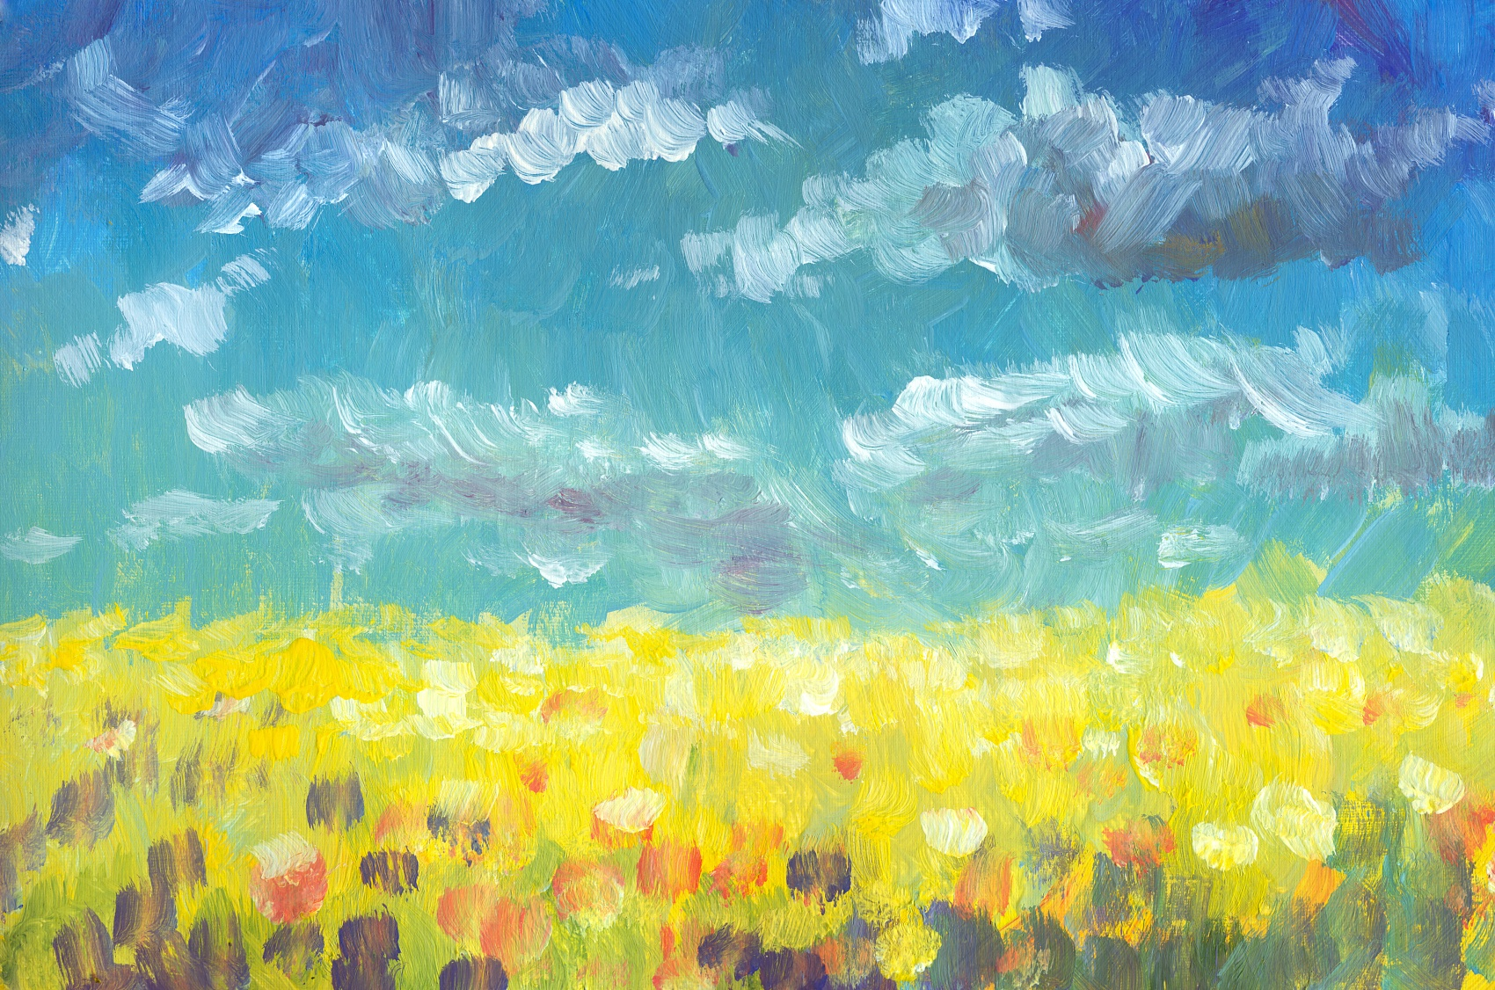
Art is much less important than life,
but what a poor life without it!

