Slide 1


感恩遇见，相互成就，本课件资料仅供您个人参考、教学使用，严禁自行在网络传播，违者依知识产权法追究法律责任。
更多教学资源请关注
公众号：溯恩英语
知识产权声明

Slide 2

B6U2 Video Time

Slide 3
evolve v. /ɪˈvɒlv/v. 逐渐形成，逐步发展
cardiology /ˌkɑːdiˈɒlədʒi/ n. 心(脏)病学
3. neuroscience /ˈnjʊərəʊsaɪəns/ 神经科学
vessel /ˈvesl/ 血管
stroke /strəʊk/ 中风
cholesterol /kəˈlestərɒl/ 胆固醇
medication /ˌmedɪˈkeɪʃn/ 药；药物
in terms of 依据；按照；在…方面
contagious adj. /kənˈteɪdʒəs/ 有感染力的
tickle /ˈtɪkl/ v. 呵痒；胳肢
fuss v. /fʌs/ 吵闹
instinctive /ɪnˈstɪŋktɪv/ adj. 本能的
tease out 探讨；深入研究；梳理清楚
Word bank

Slide 4
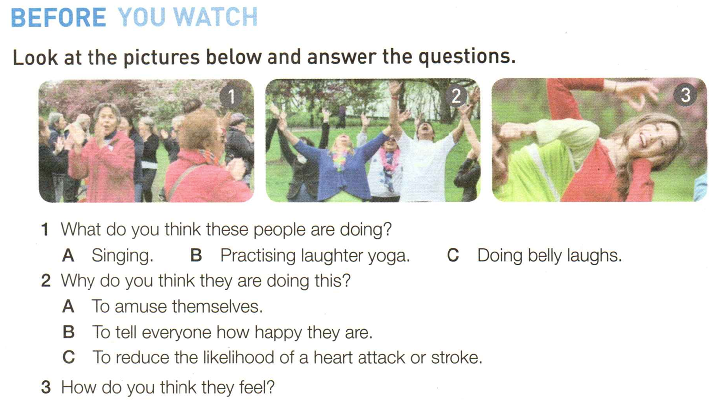
C
C

Slide 5
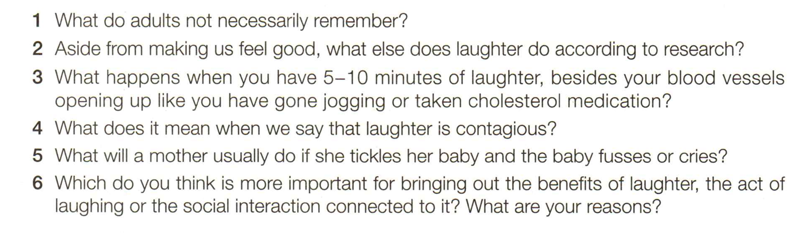
Watch and answer the following questions:

Slide 6


Slide 7
What do adults not necessarily remember?
2. Aside from making us feel good, what else does laughter do according to research?
3. What happens when you have 5-10 minutes of laughter, besides your blood vessels opening up like you have gone jogging or taken cholesterol medication?
Adults don’t necessarily remember how to have fun.
According to research, laughter also has a direct and positive effect on our blood vessels.
When you have 5-10 minutes of laughter you can burn up to 40 calories.

Slide 8
4. What does it mean when we say that laughter is contagious?
5. What will a mother usually do if she tickles her baby and the baby fusses or cries?
6. Which do you think is more important for bringing out the benefits of laughter, the act of laughing or the social interaction connected to it? What are your reasons?
It means that when someone is laughing, we are more likely to laugh too.
She will stop doing it.
I think that the social interaction connected to laughter is more important for bringing out its benefits, because laughter is a social thing and happens when people are communicating with each other. It is harder to laugh and be happy when we are alone.

