Slide 1


感恩遇见，相互成就，本课件资料仅供您个人参考、教学使用，严禁自行在网络传播，违者依知识产权法追究法律责任。
更多教学资源请关注
公众号：溯恩英语
知识产权声明

Slide 2
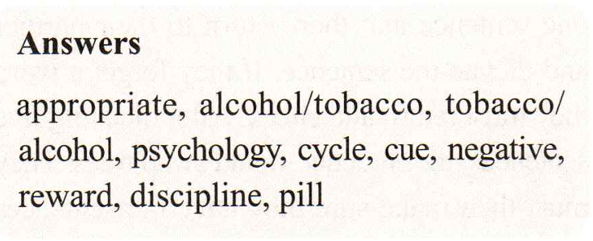
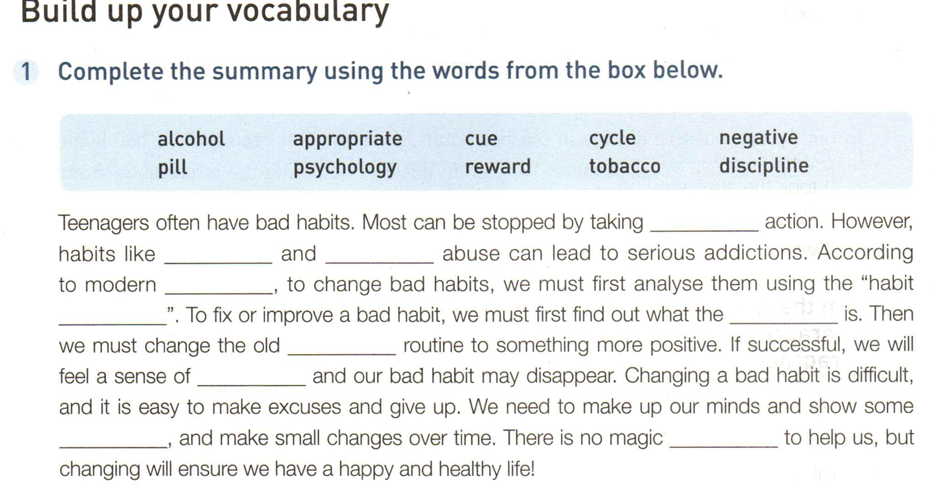
P16
appropriate
alcohol/tobacco and tobacco/alcohol
psychology
cycle
cue
negative
reward
discipline
pill

Slide 3
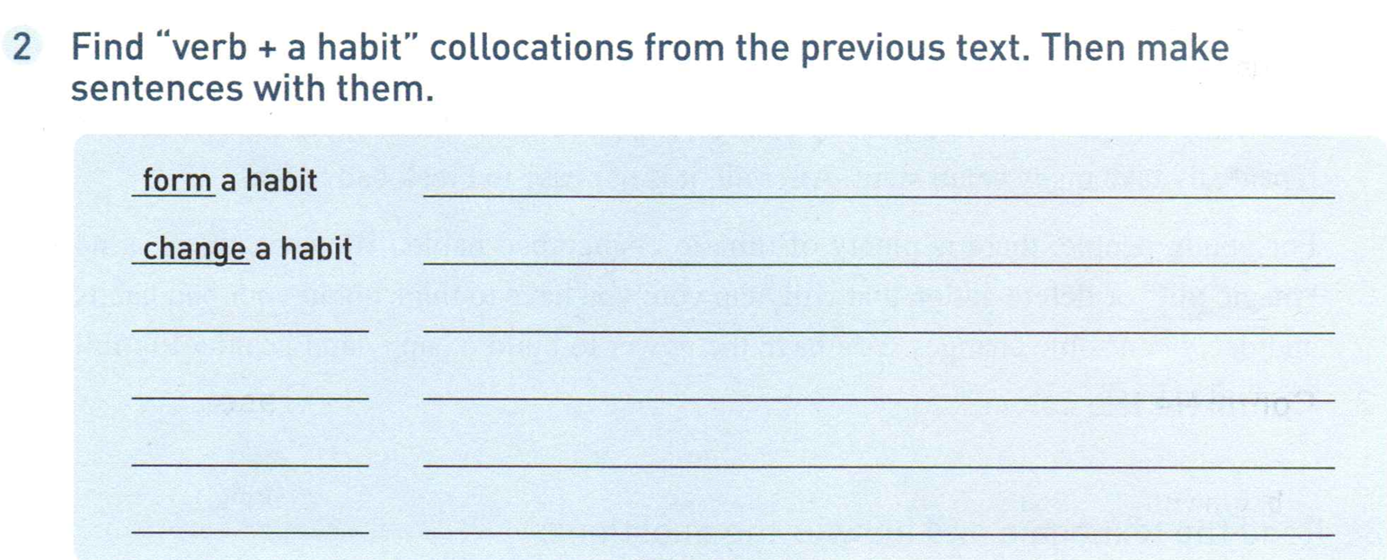
We often form a habit without realizing it.
The expert gave us some tips on how to change bad habits.
prevent a habit
Of course, it is better to prevent a bad habit than break one.
recognize a habit
To recognize a bad habit is the first step.
By examining our habits closely, we can start to understand them.
examine a habit
break a habit
Be disciplined and don’t give up trying to break your bad habits

Slide 4
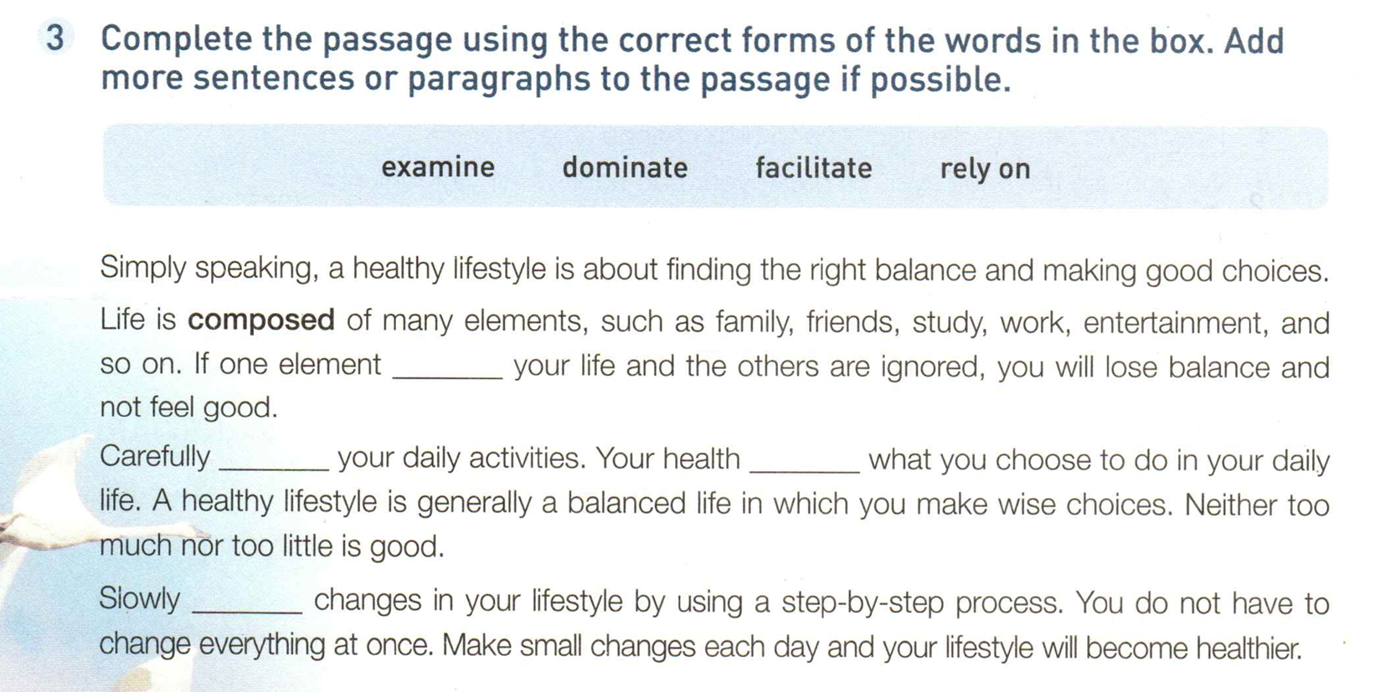
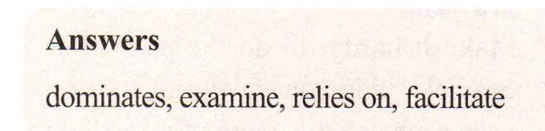
dominates
examine
relies on
facilitate

Slide 5
1. __________(simple) speaking, a healthy lifestyle is about finding the right balance and making good choices.
Simply
=briefly speaking
简而言之
2.一般来说，老年人更愿意选择团队旅游。
3. 坦白地说，动笔之前你需要读更多书。
4.严格来说，这道并不是本地菜。
Generally speaking, elder people are more willing to take a package tour.
Frankly/Honestly speaking, you need to read more before you start to write.
Strictly speaking, this is not a local dish.

Slide 6
2.生活包含很多因素，比如家庭，朋友，学习，工作和娱乐。
Life consists of many elements, such as family, friends, study, work and entertainment.
Life is made up of many elements, such as family, friends, study, work and entertainment.
Life is comprised of many elements, such as family, friends, study, work and entertainment.
Life is composed of many elements, such as family, friends, study, work and entertainment.
整个大学由5个学院组成。
The university is composed of five academic schools.

Slide 7
in which
3. A healthy lifestyle is generally a __________(balance) life ______ _______ you make wise choices.
balanced
1）尽量保持工作与休闲均衡。
2. 小女孩的平衡感很好，是个天生的舞者。
3）她骑车拐弯时失去平衡，摔了下来。
Try to keep a balance between work and relaxation.
n. 均衡，平衡能力
With a great sense of balance, the girl is a born dancer.
balance n. v.
n.余额
She cycled round the corner, lost her balance and fell off.
balanced adj.
你最好核对一下银行结存。
You’d better check your bank balance.
go on a balanced diet
More and more people have come to realize that they should ______________________
(平衡饮食).

Slide 8
Workbook on P 68
Activity 1
1. shaved off 2. made up his mind 3. straight away 4. took control of
5. in response to 6. feeling pessimistic 7. rely on 8. was stressed out
Activity 2
cycle, disciplined, rely, stimulate, dominate, reward
Phrases:
1. in the long term 长远来看
2. for the sake of sb. =for sb’s sake: in order to help somebody/something or because you like somebody/something 为了某人（或某事）起见；因某人（或某事）的缘故

Slide 9
III.
1. 滑了一整天的滑板之后，我感到疲惫不堪。(Skateboard, worn out)
After playing skateboard for a whole day, I felt worn out.
2. 健康顾问查看了我的血液检验结果，怀疑我感染了病毒，建议我要么再做检查，要么立即去看医生。(health consultant, examine, virus, straight away)
1) Seeing the result of my blood test, the health consultant suspected that I was infected with some virus, and advised me to either get my blood examined or go to see a doctor straight away.
2) Seeing the result of my blood test, the health consultant suspected that I was infected with some virus, and suggested I should either get my blood examined again or see a doctor straight away.

Slide 10
doubt suspect
doubt v. to feel uncertain about something; to feel that something is not true, will probably not happen, etc.
怀疑；无把握；不能肯定；认为…未必可能
suspect v. to have an idea that something is probably true or likely to happen, especially something bad, but without having definite proof
疑有，觉得（尤指坏事可能属实或发生）
examine v.
examination n.-- exam

Slide 11
3. 想要提升你的听说读写技能，你不能只靠课堂学习，还需要在课后不断学习和运用。(enhance, rely on)
To enhance your skills in listening, speaking, reading and writing, you not only rely on learning in class, but keep learning and practising after class as well.
4. 由于得了流感，感到眩晕，他不得不躺在床上休息。(flu, dizzy)
Having caught /picked up the flu and feeling dizzy, he had to lie in bed to rest.
5. 十年来，他专注于健康生活方式的研究，终于成了行业内的专家。(absorb)
For the past decade, he has been absorbed in the research on healthy lifestyle, which finally made him an expert in this field.

Slide 12
6. 十几年前，我叔叔在医学院学习外科学。成为一名外科医生后，他每星期都做外科手术。(surgery, surgeon)
Over a decade ago, my uncle majored in surgery in a medical school. Now as a surgeon, he does/performs/carries out surgery every week.
7. 我们的团队由七个人组成。(be composed of )
My team is composed of seven people.

Slide 13
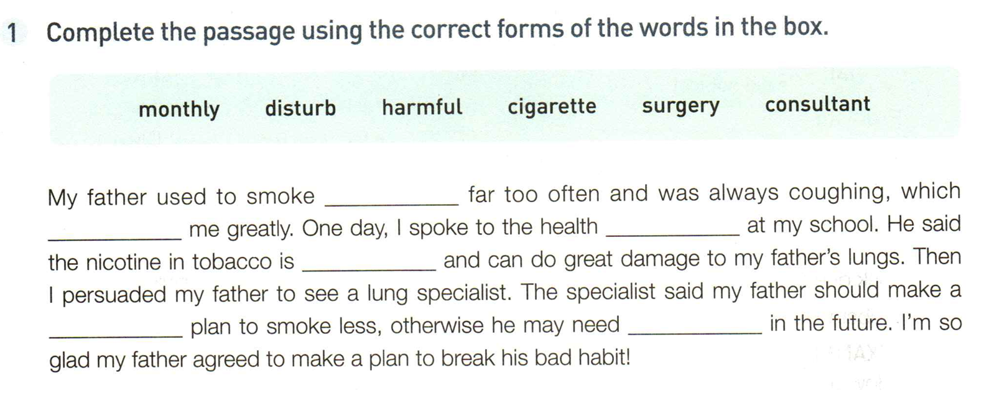
cigarettes
disturbed
consultant
harmful
monthly
surgery
P 22

Slide 14
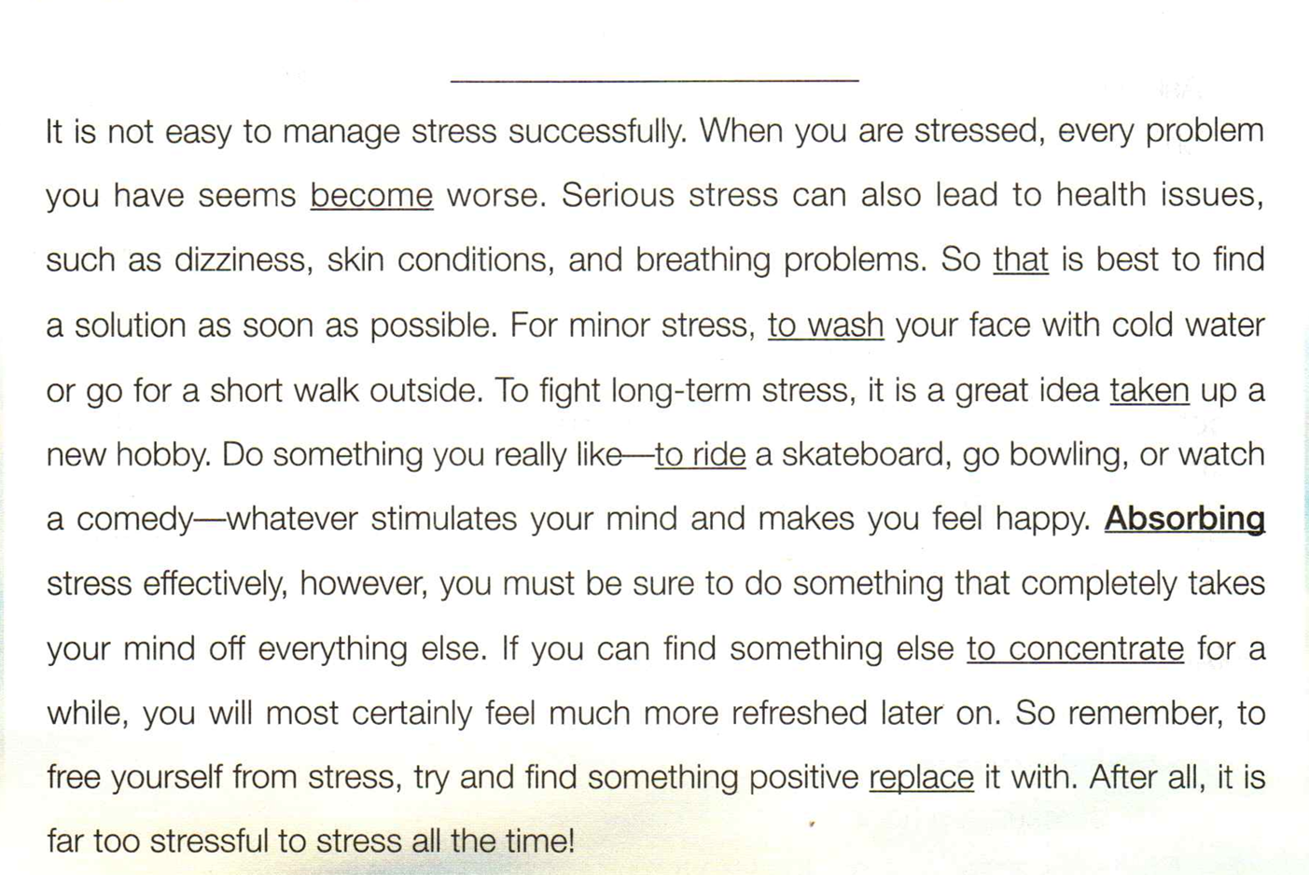
How to Manage Stress
Managing Stress
to become
it
wash
to take
ride
To absorb
to concentrate on
to replace

Slide 15
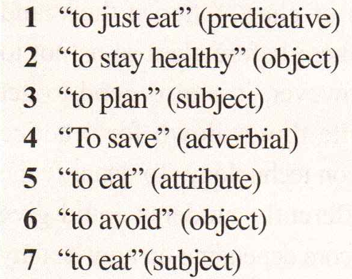
P69
I.
1. to get your parent’s permission
2. to eat a good breakfast
3. hanging out with friends
4. to balance his work and personal life
II.

Slide 16
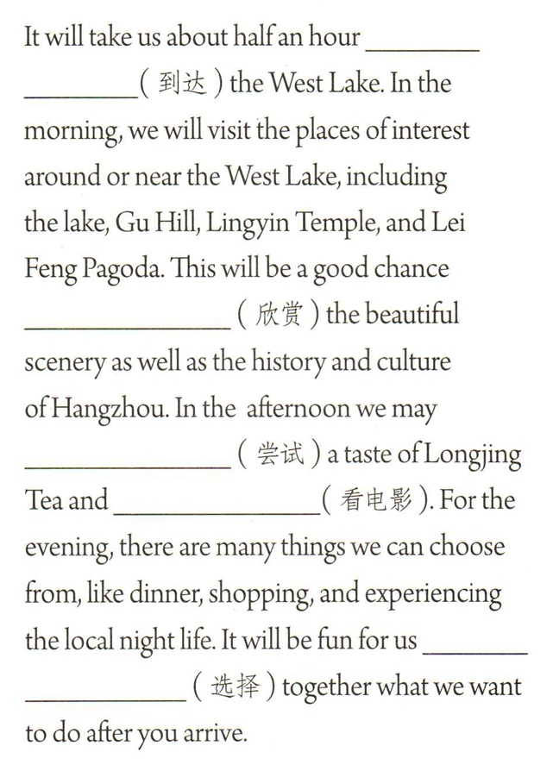
to reach /to get to
to appreciate
have
see a movie
to choose

