Slide 1

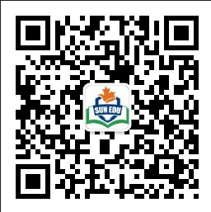
感恩遇见，相互成就，本课件资料仅供您个人参考、教学使用，严禁自行在网络传播，违者依知识产权法追究法律责任。
更多教学资源请关注
公众号：溯恩英语
知识产权声明

Slide 2


基于支架教学理论的应用文写作
基于图表的建议信
—2024深圳市高三第二次调研考试
陕西省礼泉第一中学 高小聪

Slide 3

Contents：
支架式教学理论
应用文试题呈现
搭建目标支架
搭建结构支架
搭建语言支架
6. 搭建范文支架
7. 搭建评价支架

Slide 4
支架理论：
支架式教学法（Scaffolding Instruction）：
根据前苏联著名心理学家维果斯基（Vygotsky,1978）的“最近发展区理论”（Zone of Proximal Development, 简称ZPD）提出的教学法。维果斯基认为学生的发展有两种水平，即：现有水平和可能发展的水平。两者之间的差距就是最近发展区。
针对学生的最近发展区，支架式教学强调教师要为学生的知识建构提供概念框架（conceptual framework），把复杂的学习任务分解，如同搭脚手架一般引导学生一步一步发现和解决学习中的问题，最终掌握要学习的知识，成长为独立的学习者。

Slide 5
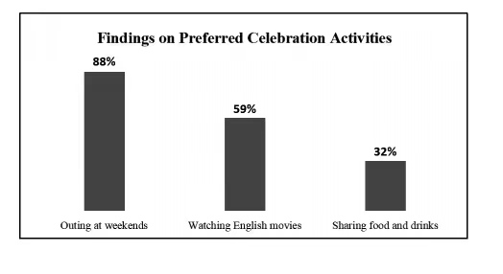
试题呈现：
第四部分写作(共两节，满分40分)
第一节(满分15分)
假定你是李华，你班在校英语戏剧节中获得一等奖，外教James打算为此庆祝，并委托你调查同学们喜欢的方式。
请你根据调查结果，给外教写一封邮件，内容包括:
1.表达感谢;
2.提出个人建议;
3.说明理由。
注意:
1.词数80左右;
2.请在答题卡的相应位置作答。

Slide 6
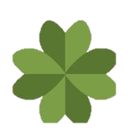
目标支架：
Form:
An e-mail
Writing Style:
A letter of advice
The simple Present Tense
& the simple future Tense
Tenses & Voices:
Active voice & Passive Voice
Prons:
The first, second & third prons
gratitude--- sincere;
suggestion--- polite;
the survey result --- indictive
Mood:
The Purpose of sending an e-mail;
Suggestions based on the survey and reasons ;
Thankfulness and expectation;
points:

Slide 7
结构支架：
What should be included in the letter of advice?
Dear Sir,
Purpose
Beginning:
Express one’s gratitude
and give reasons
Suggestions & Reasons
Structure
Body:
Make suggestions about celebration activities
based on the survey and give reasons
Thankfulness & Expectation
Ending:
Thank you for your support/ Looking forward to the celebration’s coming.

Slide 8
语言支架：
1.Thanks again for your trust and encouragement. I can not/ hardly wait to join in the celebration activity and share success and happiness with you.
1. I’m grateful/thankful/obliged to you for your enthusiam in celebrating our winning the first prize at the English Drama Festival.
写信
目的
前 后
呼 应
2. I hope you will take/follow my advice and am looking forword
to the celebration activity’s coming.
2. I would like to convey/ express/ extend my heartfelt(adj. 衷心的) thanks/ gratitude/ to you for trusting/encouraging me to carry out the survey on the classmates’ preferred celebration activities.
Para1
Para3
信件
结尾
3. It’s nice/ kind/ thoughtful/ considerate of you to make me survey the classmates’ preferred celebration activities and then celebrate our success.
3. The celebtation activities will not only allow us relax ourselves but inspire us in studying English, so I would like to thank you from the bottom of my heart for...

Slide 9
语言支架：
1. “如图所示”
(I).The chart/survey shows/ reveals/represents/sescribes that...
(II). According to / Based on / On the basis of the survey/ chart,...
(III). As is seen/shown/revealed in the chart/ survey...
建议及理由：
1. I am for/ in favor of / in line with... , for one thing,... for another thing...
图表解读
依 据
2. I suggest/ advise/ recommend/ propose outing at weekends/... , which not only ... but also...
2.数据分析句式：
Para2
Para2
(I). The classmates who prefer outing at weekends account for/occupies..., followed by 59% of the classmates who favor watching English films. However, The ones who are willing to share foods and frinks only takes up 32%.
建议
及
理由
3. As far as I’m concerned/ I think/ In one’s view/ opinoin/ Personally, I will follow the majority, Outing enables us to forget our study for a while...
(II). 88% of the classmates choose... while 59% of the classmates prefer..., whereas 32% of them favor...
(III). Compared with the first celebration activity, watching English films and sharing foods and drinks make up 59% and 32% respectively.

Slide 10
范文支架：
Sample Writing2：
Dear James,
Para1.
I hope this email finds you well. I’m writing to extend my heartfelt gratitude/ to you for trusting me to carry out the survey on how the classmates would prefer to celebrate. Here comes the survey result.
Para2.
From the survey, compared with outing at weekends liked by 88% of the classmates, watching English films and sharing foods and drinks make up 59% and 32% respectively. However, of the three ways, some make cross selections. As for me, I will follow the majority, for one thing,...for another thing...
Para3
I hope you will find my suggestion practical and reasonable and looking forward to...
Yours sincerely,
Li Hua
Sample Writing1：
Dear James,
Para1.
I hope this email finds you well. It’s thoughtful of you to plan to celebrate our first prize at the school's English Drama Festival. We are deeply grateful for ...
Para2
According to the survey I have carried out, the results are quite revealing: 88% of the classmates prefer outing at weekends, 59% are into... , while 32% favor ..., and some like two or three celebration ways. Personally, I recommend organizing a weekend outing. This option will not only meet/satisfy the majority’s taste but also allow us to ...
Para3
Thank you again for ... . and I believe that our celebration will be a success.
Yours sincerely,
Li Hua

Slide 11
范文欣赏：
Dear James,
I hope this email finds you well. It’s 1___________(consider) of you to make me carry out the survey 2_____ the classmates would like to celebrate our success at the School English Drama Festival. The results are as follows.
On the 3_______ (base) basis of the survey, outings at weekends and English movie nights 4______________(favor) by 88% and 59% of us respectively, with 32% 5__________
(will) to sharing food and drinks. However, of the three ways, some make cross selections. 6_________(meet) the majority’s interest, I would recommend 7___________(orgnize) organizing an outing, for one thing, we can stay away from the heavy learning pressure for a while and refresh 8___________(we) ourselves ; for another thing, going outing can also 9____________(strength) our friendship and train team spirits.
Thank you once again for your support and I hope that you will take my advice 10_______consideration.
Yours sincerely,
Li Hua
considerate
how
basis
are favored
willing
To meet
orgnizing
ourselves
strengthen
into

Slide 12
评价支架：
Finishing the e-mail, you should see whether
your article is in line with the following hints.
Purpose | Does the purpose of writing clear and evident?
Structure | Does the structure meet the requirements?
Language | Are the sentences correct? Have you used the proper punctuation, lexical chunks, sentence patterns and paragraphs to express yourself?
Content | Have you included all the points ? Are the details suitable?
Tone | Have you shown your sincerity and politeness all through the writing?

Slide 13

在心里种花，人生才不会荒
废，生活不会亏待任何一个心中
有光，全力奔跑的人。
—《人民日报》

