Slide 1



感恩遇见，相互成就，本课件资料仅供您个人参考、教学使用，严禁自行在网络传播，违者依知识产权法追究法律责任。
更多教学资源请关注
公众号：溯恩英语
知识产权声明

Slide 2

2024.4三校联考应用文
“定格校园春光”
之如何描述照片？

Slide 3
假设你是李华，在上周学校举行的“定格校园春光”(Capture Spring on Campus) 摄影大赛中获得一等奖。请向你的英国笔友 David 写信介绍此事，内容包括：
1. 活动目的；
2. 照片描述；
3. 参赛感受。
注意：
1. 写作词数应为 80 个左右；
2. 请按如下格式在答题卡的相应位置作答。
Dear David,
Best regards.
Li Hua
文体：
人称：
时态：
主题：
提纲：
告知信 (to inform/ describe)
第一/二/三人称
一般过去时/ 过去进行时
定格校园春光
Para. 1 Greeting+Writing Purpose
(share)
+ Purpose of the contest
Para. 2 Photo Description
+ Feelings of the contest
Para. 3 Ending

Slide 4
告知信——开头范例
Para. 1 Greeting
+Writing Purpose (share)
  + Purpose of the contest
How’s everything going recently?
Hope this letter finds you well.
I hope this letter finds you in excellent spirits.
假设你是李华，在上周学校举行的“定格校园春光”
(Capture Spring on Campus) 摄影大赛中获得一等奖。请向你的英国笔友 David 写信介绍此事，内容包括：
1. 活动目的；
what to share?
I am thrilled to share with you that I recently claimed the first/ secured the first prize in our school’s “Capture Spring on Campus” photography contest.
I can’t wait/ resist the urge to tell you that I have recently been awarded the first prize in our school’s “Capture Spring on Campus” photography contest.
, whose purpose/ aim/ target was to
, which aimed to...
which aspects?
how to transit?
discover, capture, and appreciate the beauty and vitality of our campus during the vibrant spring season/ springtime (校园春色)
foster students’ enthusiasm for photography (摄影爱好)
theme-related

Slide 5

告知信——结尾范例
which aspects?
Para. 3 Ending
Enclosed/ Attached below is my award-winning photo. Hope you will like it and it can bring a touch of springtime cheer to your day. (分享照片)
How about the spring in your school? Looking farward to your sharing. (询问春色)
I hope this letter gives you a glimpse into the vibrant spring season on our campus. Any similar experiences? Can’t wait to see your sharing. (询问类似活动)
假设你是李华，在上周学校举行的“定格校园春光”
(Capture Spring on Campus) 摄影大赛中获得一等奖。请向你的英国笔友 David 写信介绍此事。
theme-related

Slide 6

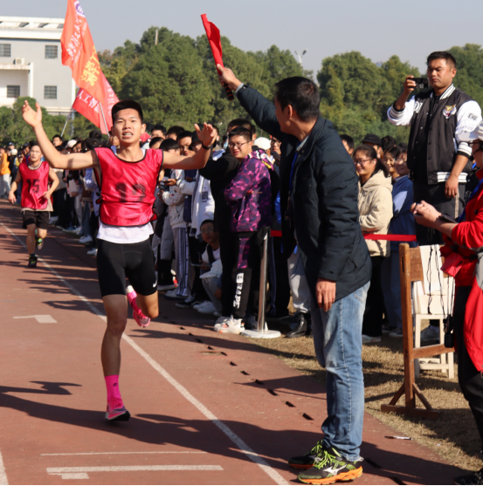
How to describe a photo?
What were they doing?
What’s in the photo?
to summarize
to describe
to detail
to speculate
How were they feeling?
When and where was the photo taken?
This photograph was captured on the playground just as runner number 12 was about to cross the finish line. In this thrilling instant, the runner was speeding down the track, arms pumping, his face etched with steely determination. In the backdrop, the roaring crowd burst into an uproar of cheers as the athlete drew nearer to the finish line. The brilliantly shining sun further added to the electric atmosphere of the race.
This photograph was captured on the playground just as runner number 12 was about to cross the finish line. In this thrilling instant, the runner was speeding down the track, arms pumping, his face etched with steely determination. In the backdrop, the roaring crowd burst into an uproar of cheers as the athlete drew nearer to the finish line. The brilliantly shining sun further added to the electric atmosphere of the race.
This photograph was captured on the playground just as runner number 12 was about to cross the finish line. In this thrilling instant, the runner was speeding down the track, arms pumping, his face etched with steely determination. In the backdrop, the roaring crowd burst into an uproar of cheers as the athlete drew nearer to the finish line. The brilliantly shining sun further added to the electric atmosphere of the race.
This photograph was captured on the playground just as runner number 12 was about to cross the finish line. In this thrilling instant, the runner was speeding down the track, arms pumping, his face etched with steely determination. In the backdrop, the roaring crowd burst into an uproar of cheers as the athlete drew nearer to the finish line. The brilliantly shining sun further added to the electric atmosphere of the race.
This photograph was captured on the playground just as runner number 12 was about to cross the finish line. In this thrilling instant, the runner was speeding down the track, arms pumping, his face etched with steely determination. In the backdrop, the roaring crowd burst into an uproar of cheers as the athlete drew nearer to the finish line. The brilliantly shining sun further added to the electric atmosphere of the race.
This photograph was captured on the playground just as runner number 12 was about to cross the finish line. In this thrilling instant, the runner was speeding down the track, arms pumping, his face etched with steely determination. In the backdrop, the roaring crowd burst into an uproar of cheers as the athlete drew nearer to the finish line. The brilliantly shining sun further added to the electric atmosphere of the race.
This photograph was captured on the playground just as runner number 12 was about to cross the finish line. In this thrilling instant, the runner was speeding down the track, arms pumping, his face etched with steely determination. In the backdrop, the roaring crowd burst into an uproar of cheers as the athlete drew nearer to the finish line. The brilliantly shining sun further added to the electric atmosphere of the race.
How are the elements placed within the photo?
What’s your impression of it?
theme-related

Slide 7
What were they doing?
What’s in the photo?
How were they feeling?
When and where was the photo taken?
to summarize
to describe
to detail
to speculate
How are the elements placed within the photo?
What’s your impression of it?
Use specific adjectives, similes or metaphors for vivid imagery.

Slide 8

Photo Description of Campus Spring
vitality of spring
vigor of students
where what who
on the campus
in front of the library
along the riverside
on the main avenue
on the playground
in a basketball court
flowers were blooming/ blossoming brilliantly/ in their full glory (cherry blossoms/ sakura; Chinese wisteria; tulips)
trees (willow) were shooting/ sprouting with fresh buds
buzzing bees were busily gathering nectar
birds were resting on branches, as if relishing the freshness
students were
fully immersed/ indulged in reading
chatting merrily with excitement playing on their faces
unleashing themselves and pouring out sweat (尽情释放；挥洒汗水)

Slide 9

Feelings of the contest
general- specific
Winning the first prize was undoubtedly a moment of immense pride, validating my efforts (证明我的努力) and inspiring me to continue exploring and documenting (记录) the world through the lens of my camera (相机镜头).
Participating in this contest was an enriching experience. Not only did it endow me with an opportunity to observe our campus with a fresh perspective (以全新的视角), but also navigated me toward searching for those hidden gems of beauty (隐藏的珍宝) that often go unnoticed (未被察觉的).
The process of capturing these moments on camera was both challenging and rewarding, teaching me the importance of patience, attention to detail, and the ability to see the world through a different lens (以不同的镜头).

Slide 10
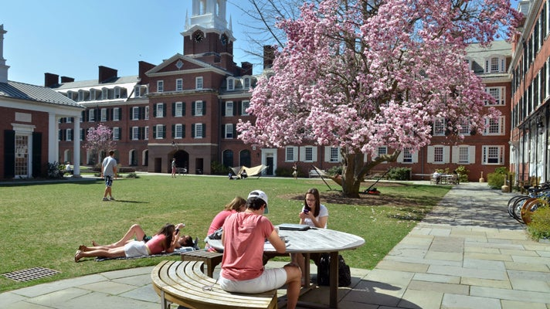
Dear David,
I’m thrilled to tell you that I won first prize in our school’s “Capture Spring on Campus” photography competition, whose aim was to motivate students to appreciate the beauty of nature and capture unforgettable moments of spring on campus.
My winning photo was taken in front of the library, where a cherry blossom tree was blooming. Pink petals were falling gently onto the ground while students sat on the grass reading or chatting. Not only did the winning boost my confidence in pursuing photography as a hobby, but it also inspired me to embrace the hidden beauty in school.
What about the spring on your campus? Looking forward to your reply.
Best regards,
Li Hua

Slide 11
描述照片：
（2023.11杭州一模）假定你是李华，为迎接爱尔兰姐妹学校来访，你校英语俱乐部将举行学生活动图片展，现正向全校学生征集照片。你打算参与，请你写一封邮件，说明相关信息，内容包括：
1. 描述照片内容；2. 选择该照片的理由；3. 表达入选期望。
Dear English Club, I’m Li Hua from Class 1, Senior 3. I would like to submit for the Exhibition an amazing photograph I took last week. It captures a heartwarming scene in a nursing home, where some of my classmates are seen dishing out hot meals and others are engaged in lively conversations with the seniors. All their faces are bright with smiles and glowing with happiness, creating a warm and loving ambiance. This photo can be shown to our international friends as an example of the integration of our school and community. Also, it perfectly exemplifies the beliefs our school values: compassion, empathy, and unity. I hope you will consider my contribution and thank you for your efforts in making the exchange program a memorable one. Attached is the photo. Best wishes! Yours, Li Hua

