Slide 1


感恩遇见，相互成就，本课件资料仅供您个人参考、教学使用，严禁自行在网络传播，违者依知识产权法追究法律责任。
更多教学资源请关注
公众号：溯恩英语
知识产权声明

Slide 2
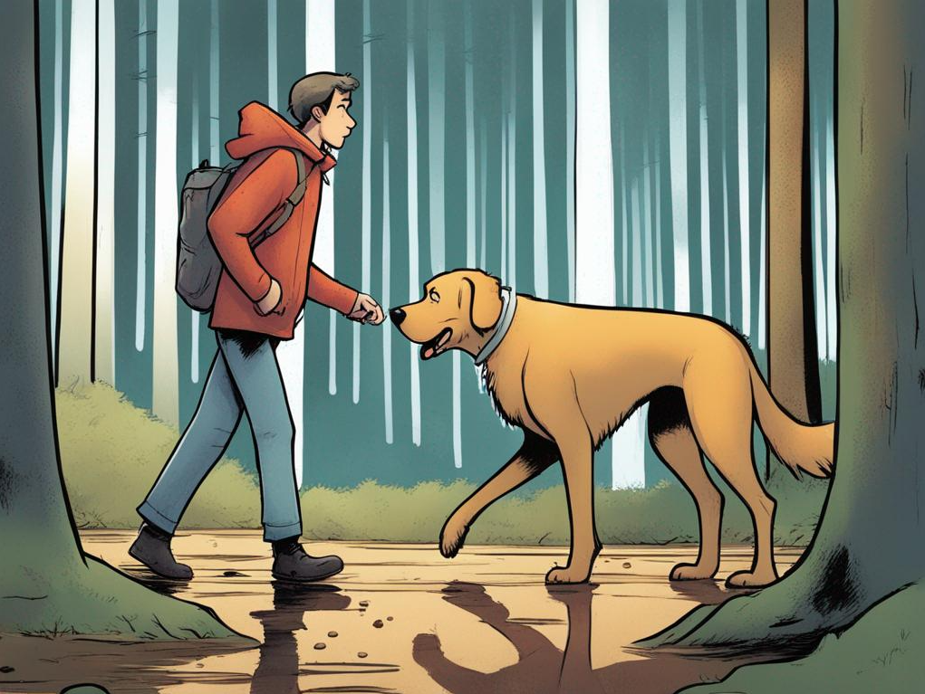

读-思-写
Dog Training
--My Household’s Joint Efforts
2404 杭二 南师大 长郡三校联考读后续写讲评

Slide 3
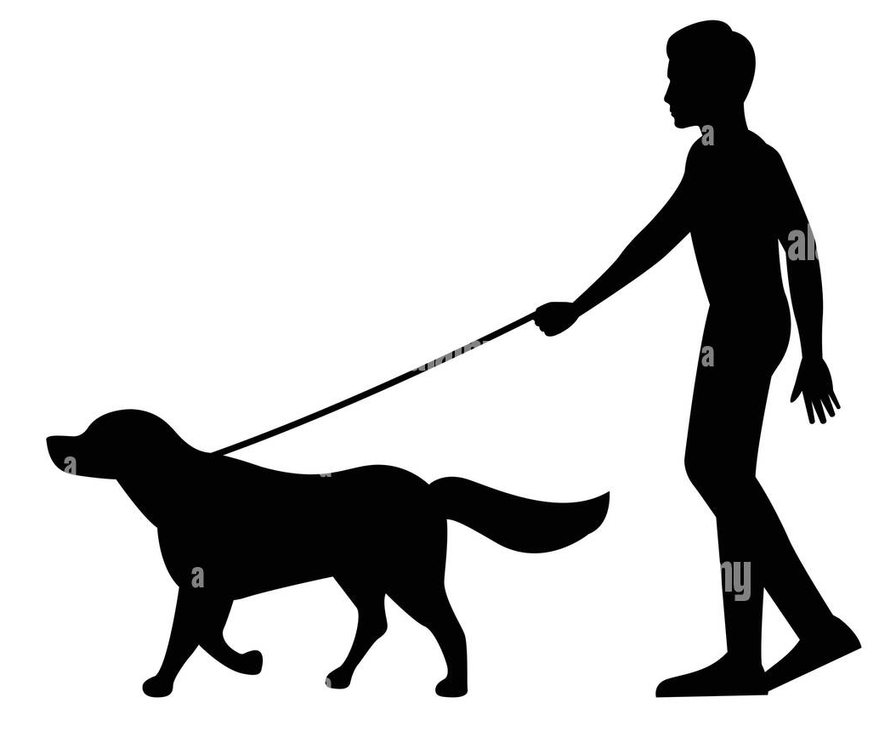
阅读下面材料，根据其内容和所给段落开头语续写两段，使之构成一篇完的短文。
①When I was a kid, my parents and I lived near the forest. They often told me that our family was a team that needed to work together for the household to function smoothly. There was always an abundance of work to do cooking, cleaning, and walking dogs. I volunteered to walk our dog, Max, who had been adopted one month before. I never dared let this giant dog off the lead (牵狗绳), just in case he took off.
②One morning, we were walking along in the forest when Max started pulling on the lead. At first, I was able to hold on despite the wet ground from a recent shower. But the more I tried to stop him pulling, the more it turned into a tug of war. And thanks to the slippery ground, I lost.
③Pulling his lead, Max shot off like a bullet, leaving me screaming behind. I chase him but lost my footing and fell face-first into some mud. I stumbled (踉跄) to my feet but looking ahead, I found him running back towards me. I thought he was going to stop and give me his "Sorry" look. But instead, the dog shot past me and returned after a while.
④As soon as we got home, my mother immediately attended to Max with a warm towel and a doggy treat. I thought seeing me stumbling and covered in mud, I would also get a warm cup of tea and a motherly kiss. Instead, I got a very loud lecture about letting the dog loose in the forest.
⑤I felt frustrated. It wasn't fair that she didn't understand how difficult it was to control Max. I fought back, "Stop lecturing me! Why is everything my fault?" With these words, I stormed into my bedroom and slammed the door shut.
⑥In the evening, I heard my mother call Max and take him out. It wasn't long before I heard my mother screaming and the door opening again.
Para.1: I walked out of my room.
Para.2: Dad stepped in, suggesting that we work together to train Max.
Theme
Characters
Conflict
Time& Location

Slide 4

⑤I felt frustrated. It wasn't fair that she didn't understand how difficult it was to control Max. I fought back, "Stop lecturing me! Why is everything my fault?" With these words, I stormed into my bedroom and slammed the door shut.
⑥In the evening, I heard my mother call Max and take him out. It wasn't long before I heard my mother screaming and the door opening again.
Para.1: I walked out of my room.
Para.2: Dad stepped in, suggesting that we work together to train Max.
What scene would I meet with?
How would I feel/react?
Relate mom
(Relate dad)
Previous- I
Current-Mom
in the forest... a recent shower... stumbling... covered in mud...
frustrated...wasn’t fair...stormed into...slammed
She didn’t understand.
appearance(five senses)...posture
recall...emotional changes...remark
understood... further reaction
(How to solve the problem?)

Slide 5
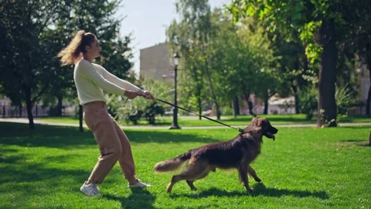
①....There was always an abundance of work to do cooking, cleaning, and walking dogs. I volunteered to walk our dog, Max, who had been adopted one month before. I never dared let this giant dog off the lead (牵狗绳), just in case he took off.
②One morning, we were walking along in the forest when Max started pulling on the lead. At first, I was able to hold on despite the wet ground from a recent shower. But the more I tried to stop him pulling, the more it turned into a tug of war. And thanks to the slippery ground, I lost.
③Pulling his lead, Max shot off like a bullet, leaving me screaming behind. I chase him but lost my footing and fell face-first into some mud. I stumbled (踉跄) to my feet but looking ahead, I found him running back towards me. I thought he was going to stop and give me his "Sorry" look. But instead, the dog shot past me and returned after a while.
Para.2: Dad stepped in, suggesting that we work together to train Max.
Contents
Writing Features
Transition:What’s mom and my reaction?
What did we do?
Relate the theme:
Consent
work scope... work focus... work together
a team...work together... to function smoothly
action description
metaphor, similie

Slide 6

Polish the Language:
Para.1: I walked out of my room.
What scene would I meet with?
Entering the living room, I spotted a completely unexpected scene .
The hallway was slightly dim, which featured Mom’s shaken silhouette at the gate more.
Her screams still echoed in my ears. What came into my eyes then was the embarrassed yet morose look mapping her flushed face.
Transition
Her usually vibrant eyes were wide with shock and disbelief, a stark contrast to the cool and collected image she normally rendered.
Her light brown hair, which always sat neatly atop her head, now sprawled around her face haphazardly; straying strands stuck to her forehead, reminders of the chase.
Her usually spotless clothes dotted with patches of mud and grass, mom appeared as if she had been part of some grand outdoor adventure rather than an evening walk.
Out of breath and disheveled, she was leaning against the doorway in exhaustion.
Back shaken, her posture was like an embattled soldier.
Comparion
& Contrast
Details
Echo&
Subjunctive Mood
Emphasis
Similie
Appearance
Action
& Posture

Slide 7


Polish the Language:
Para.1: I walked out of my room.
How would I feel/react?
Relate mom& dad
Seeing my mother, I felt like a mirror reflecting my own earlier plight, triggered a rush of empathy and guilt. “Let’s clean you up.” I suggested.
This was no triumphant moment for me. Instead, the empathy I felt for my mother was as tangible as the mud stains she was wearing.
Similie
Comparison&
Analogy
Feeling/ Thinking
Pausing a second, she nodded, a small 'thank you' whispered under her breath. The usual authoritative mom was momentarily replaced by a humble figure, extending a seam for understanding.
"So, it's not that easy, is it?" The question fell out of my mouth before I could stop it. Mom cocked her head slightly, a muted sigh escaping her.
Suddenly, the steady sound of footsteps echoed from behind us.
Evolving
Admission
Action
Reactions

Slide 8

Polish the Language:
Para.2: Dad stepped in, suggesting that we work together to train Max.
Brianstorm: How could we make the transition effective?
Echo the theme
Relate other characters
Imitate the writing style
Further interpretation
"We're a team, remember?" he reminded me gently. His voice was calm and reassuring.
Yes, the principle of our household! A grin crept on mom’s face!
Like a conductor harmonizing the orchestra amidst discordant notes, he introduced a vision of unity and collaboration.
He explained that it wasn't just about handling the dog but dealing with unanticipated situations and creating a safer home for all of us

Slide 9


Polish the Language:
Para.2: Dad stepped in, suggesting that we work together to train Max.
Discussion: How did we work the problem out?
Why wasn’t Max obedient?
local
dogs
strange
smells
neighbors
lack of training
Clue in the passage:
①....our dog, Max, who had been adopted one month before.
unfamiliar sights
....
alien noises

Slide 10
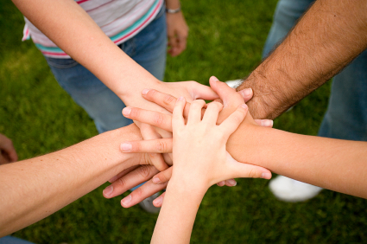
Polish the Language:
Para.2: Dad stepped in, suggesting that we work together to train Max.
teamwork+ new environment
professional guidance+ exchanges
teamwork+ tactics
teamwork+ highlight
teamwork+ changes
We locked the neighborhood park as a training ground in the following weeks, exposing him to different experiences, trying to get Max comfortable around alien noises, unfamiliar sights, smells, fellow dogs, and warm-hearted neighbors.
Max and us, we soon became regulars at the local puppy classes, which not only expose him to other puppies and also enhance our bonds during the exchanges of handy training tips.
Every morning, starting with obedience training, each member of the family would spend time with Max, teaching him the basics like "sit", "stay", "come" and "down".
Our home bustled with energy in the following days. One of the exciting parts of the training was teaching Max the "drop it" command. We cooperated together, uilizing his favorite toys and snacks.
Each of us took turns leading Max's obedience classes, and soon enough, he was displaying remarkable progress- the tug of war battle between us had become a history.

Slide 11
Possible Theme(s):
Clues
①When I was a kid, my parents and I lived near the forest. They often told me that our family was a team that needed to work together for the household to function smoothly.
Para.2: Dad stepped in, suggesting that we work together to train Max.
My father's wisdom in suggesting teamwork wasn't just helping Max but was also bringing us together as a family through shared responsibility.
With efficient teamwork, our household turned struggles into strength, confusion into clarity, and challenges into opportunities.
The journey of training Max wasn't just about making him a socially accepted animal, but also about realizing how precious our collective memories were becoming, woven together with the threads of patience, commitment and family love.
Effective teamwork within our family not just helped navigate Max become a well-trained dog, he also marked his place as an integral part among us.
echo with the given sentence
focus on general development
focus on everyone’s gains
relate main character and focus on its changes

Slide 12
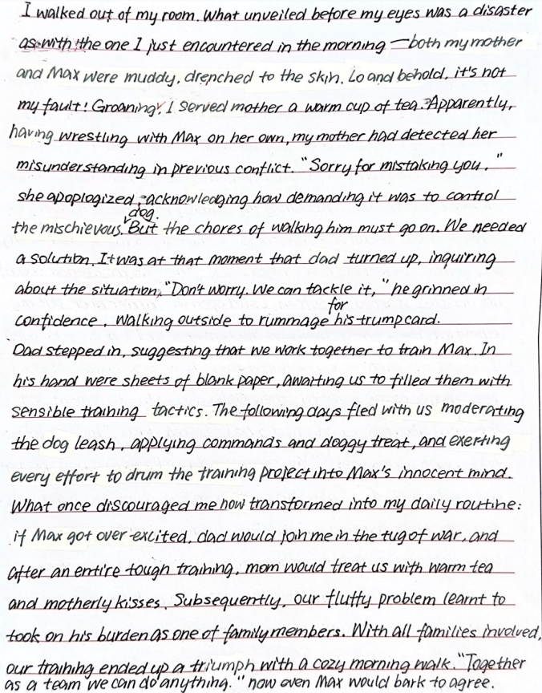

Student’s Writing
描写看到的情景，运用比较修辞协同原文自己遭遇的窘境，有效承接段首句。
内心独白和对母亲的温情之间缺少转折承接；母亲接到热茶也是与前文很好的协同点。修改建议：
While groaning inwardly, I still served mother a warm cup of tea. The warm steam softened her tense.
“detect”小词运用灵动
推进情节，自然流畅
与段二段首句“Dad stepped in,”相矛盾，且来回两次进出的情节没有实际作用。建议dad的出场放在段二，段一末句铺垫衔接。

Slide 13
Student’s Writing
无效描写，父亲取回的纸张也没有起到作用，不承接前文,建议删除。
训狗描写运用动作链，有细节；drum小词运用生动
家人合作有分工，伴随协同原文和母亲态度的转变
比喻，拟人修辞运用
主题句回扣原文主旨，呼应开头细节，体现家庭温情

Slide 14
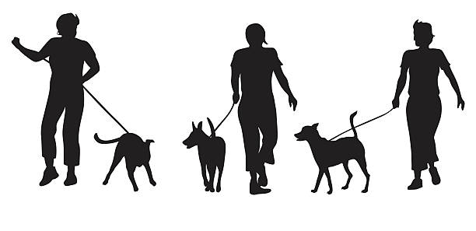
Sample Writing- Teacher’s Version
Para.1 - I walked out of my room. Mom’s shrieks still resounded in my ears. (承接上文)As I entered the living area, an unexpected sight unveiled itself. (地点转场,推进情节)Her clothes muddy, disheveled hair framed a pale face. Evident in her eyes was a mix of astonishment, a touch of depression, but mostly an undeniable exasperation.(外貌情绪描写,排比结构) In the moment, I fought against the urge to blurt out, "Told you so." Instead, my frustrations and angers faded into a wave of empathy. "Mom, let's get you cleaned up."I offered, borrowing her earlier words to Max. (协同妈妈态度)Eyes meeting, mom paused a second and gently uttered, “Thank you and sorry, darling! I think, we need a solution.” (矛盾解决,推进情节)Instantly, a steady voice echoed her.(承接下文)
Para.2 - Dad stepped in, suggesting that we work together to train Max. His wise eyes held a knowing glint, as if indicating an opportunity was detected.(承接段首句,铺垫主旨) It was then that I realized, it made sense. Soon, we tailored a plan to our energetic newcomer.(推进情节,协同Max特征) Leash training marked the key focus given Max's previous escapes. We rallied around him, took turns and taught him to remain by our side and not sprint off at the sound of squirrels or a rustling bush. (动作链协同家庭合作)Days flitted. That evening, I knelt down beside tail-wagging Max. His chocolate-brown eyes blinked in a silent household agreement-No more tug of wars, only companionship and understanding from here on.(时间转场，协同Max特征,呼应主旨)

