Slide 1


感恩遇见，相互成就，本课件资料仅供您个人参考、教学使用，严禁自行在网络传播，违者依知识产权法追究法律责任。
更多教学资源请关注
公众号：溯恩英语
知识产权声明

Slide 2

2024高考
七选五临门一脚
基于选项特点及句际逻辑关系梳理的解题套路
郑素红

Slide 3


解读七选五高考大纲要求
《考试说明》对该题型命题目的的表述“该类题型要求从短文后的七个选项中选出五个能填入文章空处的最佳选项，主要考查考生对文章的整体内容和结构以及上下文逻辑意义的理解和掌握。
该题备选项可分为主旨概括句（文章整体内容）、过渡性句子（文章结构）和注释性句子（上下文逻辑意义）三类。其多余的两个干扰项也往往从这三方面进行设置，例如主旨概括句或过于宽泛或以偏概全或偏离主题，过渡性句子不能反映文章的行文结构，注释性句子与上文脱节等。

Slide 4
解题步骤1： 分析文章结构
1. 总-分
（较为常见）
语篇结构：
2. 总-分-总

Slide 5
1. 有大标题的文章，一般在第一段都会有主题词汇出现，回扣标题的核心名词或动词
Personal Forgiveness
Taking responsibility for mistakes is a positive step, but don’t beat yourself up about them. To err (犯错) is human. ____36____ You can use the following writing exercise to help you do this. （2023-6全国卷I）
本段主题词汇：forgiveness
A. A little self-forgiveness also goes a long way.
D. It’s just as important to show yourself some forgiveness.
七个选项中2个选项有forgiveness 主题词，故36极大可能A， D 中选。

Slide 6
2. 无标题的文章， 第一段都会有主题词汇出现
In the past few years, online learning has become a significant part of the university and college experience. 36. But are all online courses created equal? How can you be sure that digital learning is right for you? 37. We interviewed students and professors to get their advice about online courses. （2024-1首考）
本段主题词汇：online learning= digital learning ; online courses
C. Do you know that online courses are also part of your education?
E. The chief complaint about online courses is that they lack human interaction.
F. If you take an online course, what can you do to ensure the best possible grade?
G. A survey found that 29 percent of college students registered for online courses.
七个选项中4个选项有online courses 主题词，故36，37 在 C、E、F、G 中选。

Slide 7

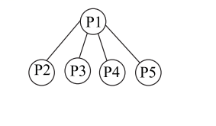
2024年1月浙江省首考原题
In the past few years, online learning has become a significant part of the university and college experience. 36. But are all online courses created equal? How can you be sure that digital learning is right for you? 37. We interviewed students and professors to get their advice about online courses.
The most obvious advantages of online learning is that you can study anywhere and anytime. 38. “I think a point that many people lose sight of is how easy it can be to fall behind schedule,” says graduate student Amanda Bindman. Before choosing to study online, consider whether you’re a self-motivated learner and if the material seems interesting enough to keep you going.
The tip that comes up most often is simple: build online courses into your weekly schedule, just like what you would do with in-person courses. 39. He noted that his online students usually end up with lower grades. It is so easy to let an online course slide, but your grades will suffer as a result. Be sure to schedule set times to watch your lectures, read materials and contribute to online discussion boards.
40. A social connection is often a big part of learning. There are things you can do to ease this problem. Jessica Pink, an undergraduate student, suggests taking online courses with a friend, so you can motivate each other to stay on track. You can also find students on the class discussion board to organize a study group, or schedule in-person meetings with your professor to discuss course concepts.
话题大学生上网课 （总）
（Para1：话题导入+最后一句统领下文
本文结构：总-分
Para2：回扣首段尾句students （分）
从大学生角度来阐述网课的好处
Para3：回扣首段尾句professor （分）
从教授角度来阐述网课利弊
Para3：回扣首段尾句师生 （分）
角度来阐述网课利弊并提出解决举措

Slide 8
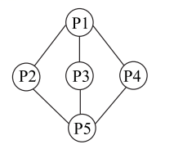
2021年 Music has long been considered to be an enjoyable pastime for many people. 36 The mental health benefits from music can’t be argued. Music could also be helping you with many other health problems behind the scenes.
37 However, for the same reason, music can be very beneficial if one is in pain. By distracting (分心) the mind from the pain, music, people say, can lower stress and anxiety levels. This, of course, can lead to less pain.
Many people enjoy relaxing music in the evening prior to going to bed. 38 While the validity of the idea is still being assessed, the lowered stress can even be tied back to blood pressure. Similarly, according to researchers, listening to just 30 minutes of soft music every day may help with healthy blood sugar levels, through the lowering of stress and anxiety.
When it comes to heart health, there is speculation (推测) that it’s not the style of music, but rather the tempo that makes it so good for your heart health. In one European study, participants listened to music as the researchers monitored their heart rates and blood pressure. 39 On the other hand, when the music slowed, the participants’ stress and anxiety levels became lower and the effects on heart rates appeared to follow suit.
40 But there is a whole range of other health issues that turning up the radio could be beneficial for, which is what makes music so valuable.
首段：引出话题+ 统领下文 总
（Para1：音乐对心理健康和其他健康问题有益 ）
本文结构：
总-分-总
首尾呼应
Para2：音乐缓解疼痛
Para3: 音乐有助于睡眠 分
Para4： 音乐有利于身体健康如心率血压血糖
尾段：呼应首段+ 进行小结 总
（Para5：音乐对总的个人幸福安康好处鲜明，也对其他一系列的健康问题有益—彰显音乐价值。）

Slide 9

2024-4 浙江省金华十校联考
Para1：引入话题---motivation
Have you ever wondered why you want to do something, or what causes people to go through extraordinary pain or personal investment just to achieve a particular outcome? 36 Motivation.
Motivation is the reason for people's actions, goals, and willingness to pursue the goals. Sometimes it seems difficult to find, but we all have that spark at our core. Here are some ways you can turn that spark back into a flame.
37 If your motivation is fading, notice when this starts to happen and what events could have driven it. You'll find that you're more likely to feel bored when you're in certain environments. As you become more aware of this, you can put yourself in situations where you're more likely to thrive.
Keep a thankfulness journal. 38 When they're aware of what they're thankful for, it drives them in specific areas of their lives. Considering this, you may find value in keeping a thankfulness journal where you regularly list blessings.
Design an accomplishment book. Creative people may do well to design an accomplishment book with images of past work and accomplishments as a form of encouragement. It can be as informal or formal as you'd like. It might be a simple scrapbook you keep at your desk, or a professionally printed booklet that you keep by your bed. 39
Get out of the house. If your life consists of going to work, coming home, watching Netflix, and going to sleep, you shouldn't be surprised that you're unmotivated. 40 Stretching yourself will expose you to new ideas, activities, and people, which will either strike up new motivation or rekindle things you have forgotten about.
Para2：提出问题 总
Para3、4、5：如何解决问题 分

Slide 10
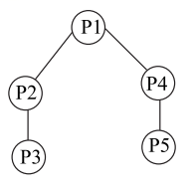
2019 年 全国卷III
In an online class, developing healthy patterns of communication with professors is very important. 36 While I have only listed two of each, there are obviously many other situations that can arise. Students should be able to extend the logic (逻辑) of each to their particular circumstance.
Do's
• 37 Questions about subject content are generally welcomed. Before asking questions about the course design, read the syllabus (教学大纲) and learning management system information to be sure the answer isn't hiding in plain sight.
• Participate in discussion forums (论坛) , blogs and other open-ended forums for dialogue. 38 Be sure to stay on topic and not offer irrelevant information. Make a point, and make it safe for others to do the same.
Don'ts
• Don't share personal information or stories. Professors are not trained nurses, financial aid experts or your best friends. If you are in need of a deadline extension, simply explain the situation to the professor. 39
• Don't openly express annoyance at a professor or class. 40 When a student attacks a professor on the social media, the language used actually says more about the student. If there is truly a concern about a professor's professionalism or ability, be sure to use online course evaluations to calmly offer your comments.
Para1：提出问题：网课学习者在课堂上怎么做？ 总
第一个方面： Para2 + para 3 ：提出问题：网课学习者在课堂上怎么做？ 分
并列关系
第二方面： Para2 + para 3 ：提出问题：网课学习者在课堂上怎么做？ 分

Slide 11
解题步骤2：
关注设空位置，优先做段首题和段尾题
1. 段首 （1题）
2. 段中 （3-4题）
近年来的段中都比较多
设空位置：
3. 段尾 （0-1题）

Slide 12
解题步骤3：关注选项特点，重点关注核心词汇:
名词，形容词，动词，逻辑词，连词，代词
1. 小标题：句式结构与各段一致，与段落主题内容贴合度高；
正确选项的结构特点：
2. 主题句（段首题优先做） ：①与本段段落内容贴合度高；② 段落与段落之间的过渡句 （难题）
3. 段尾 （段尾题优先做）① 与空格前一句有句间逻辑关系 （此类较多）对本段进行小结 （较少）③段落之间衔接 （较少）
所选选项要与本段内容贴合度高

Slide 13
解题技巧4：正确选项
1. 同词/近义词/同根词/ 同畴词（上下义词）复现
选项
词汇
特点
2. 逻辑词（选项中的逻辑词或空格后的句子有逻辑词）或考生利用上中下三个句子的关系，推断句间逻辑关系 （该类题难度较大）
3. 代词
① 选项中出现代词 （主语或宾语或介宾）
原文空格后出现代词
注意1：正确选项可能为： ①逻辑词+词汇复现 ②逻辑词+代词
注意2： 正确选项代入原文后，上下句的协同性可以通过词汇复现来体现，使上下句出现某一意义的重叠。

Slide 14
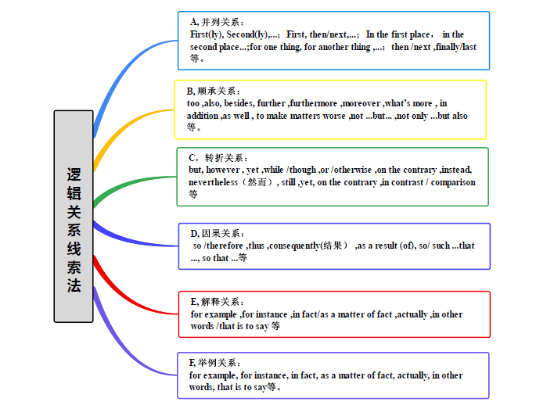
A: 并列关系： and, or, neither…nor…, either…or…, likewise, similarly, equally, in the same way, meanwhile, not …but…; Some…, others; For one thing, for another ; In the first place, in the second place 等。
B: 递进关系：also, too, as well, besides, even, moreover, on top of that …, apart from …, in addition , beyond… not only…but(also)…
C: 转折对比关系：while, whereas, though, although, despite… / in spite of …; but, however, nevertheless otherwise (否则), on the contrary, by contrast, on the other hand （可是）, unfortunately/ unluckily, unlike…, rather than…, instead of…, compared with/ to…
(前面否定句. Instead…) 等

Slide 15
D: 因果关系：because, for, since, as, consequently, therefore, thus, so, as a result, That’s why…;
thanks to/ because of/ due to, for this reason , after all (毕竟) 等。
E: 解释关系：in fact, actually, for example, for instance, in other words, as a matter of fact, that is to say…
Rather, (尤指修正上文时) 更确切地说; It turns out that … (用以回答上文的疑惑)
F: 顺序关系：at first, at last, finally, eventually, at last; in the end ; at length; ultimately,; firstly, to start with, next, second, secondly, then，later, afterwards, subsequently 等

Slide 16
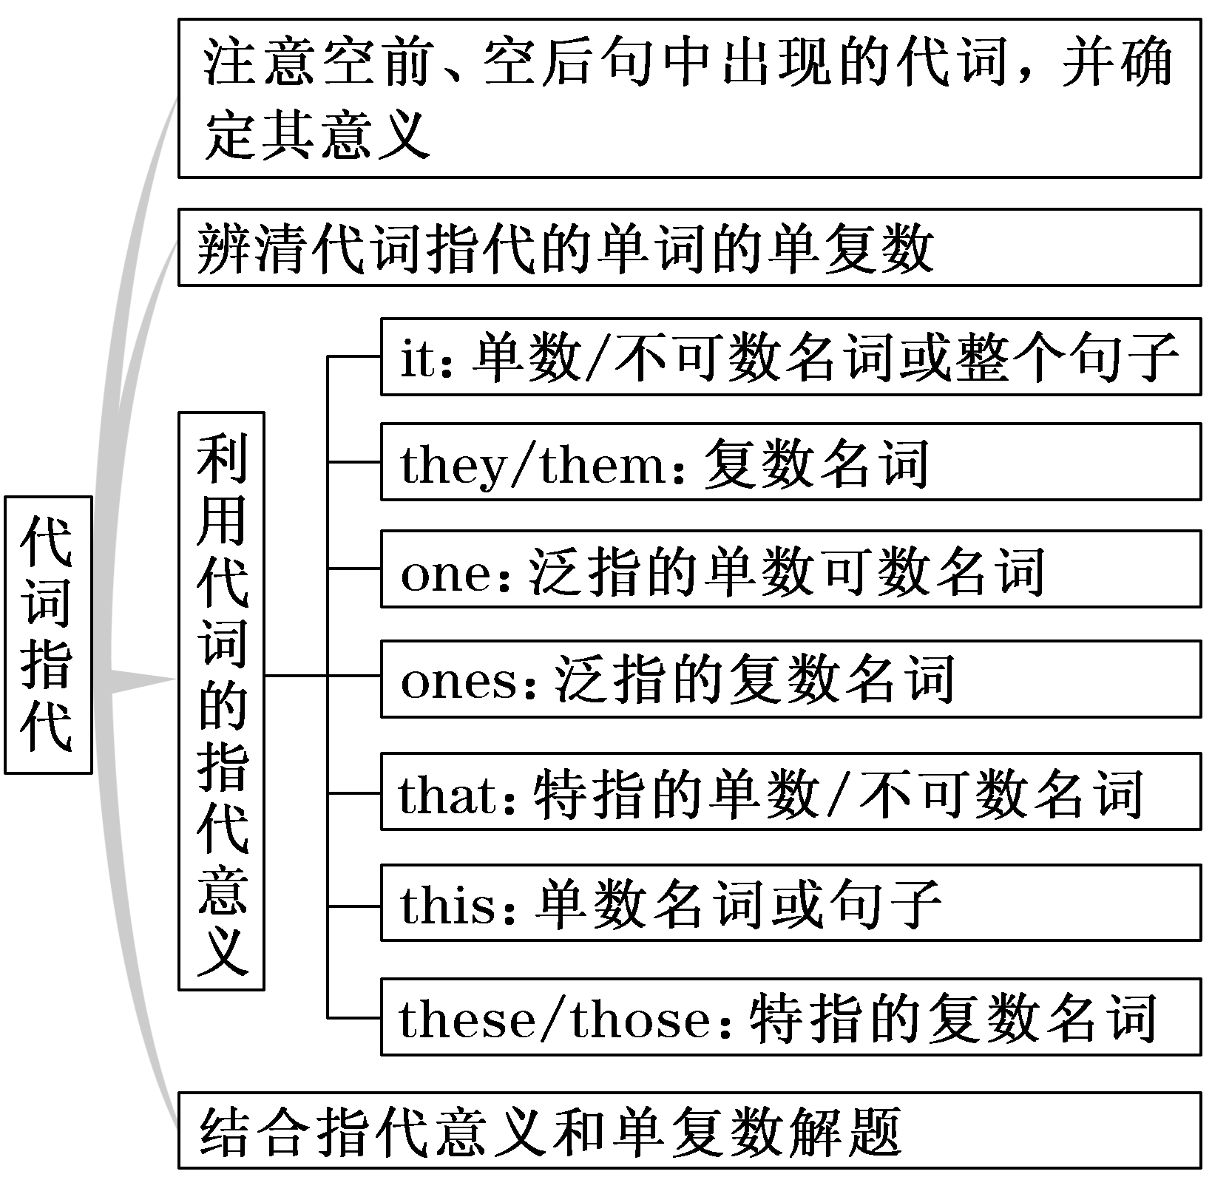
特别注意：It 有可能是形式主语，代替to do sth; doing sth ;that 主语从句等，请注意甄别。此时，看句子与上下文之间的逻辑意义以及是否有相关词汇复现。

Slide 17
解题技巧5：冗余选项如何排除
有两个相似的句式 （祈使句有出现多个的情况）
（可能产生冗余选项）
冗余
选项
特点
2. 有两个选项出现相同的名词，形容词或动词等
（可能产生冗余选项）
3. 选项没有特别鲜明的特征，该句子仍然会出现的核心词汇，但有可能核心词汇与空格所在段落无关或者语义与原文相悖或截然相反。（要准确理解选项句意）

Slide 18
两个或多个选项句式相似或一致，会产生冗余选项
In the past few years, online learning has become a significant part of the university and college experience. 36. But are all online courses created equal? How can you be sure that digital learning is right for you? 37. We interviewed students and professors to get their advice about online courses. （2024-1首考）
C. Do you know that online courses are also part of your education?
E. The chief complaint about online courses is that they lack human interaction.
F. If you take an online course, what can you do to ensure the best possible grade?
G. A survey found that 29 percent of college students registered for online courses.
C 、E 均为疑问句；故大概率 这两个选项中会产生冗余选项。
且C选项这个问题与原文36 空前这个句子矛盾。网上学习已经是大学学习经历的重要部分。是事实，无需质疑。故 C为冗余选项。

Slide 19
34
You would think learning takes more time from you, but actually there are always new ways of doing things that can save you time on daily tasks, freeing you up for the most important. Always be looking for a new way to gain back an hour here or there.
Lighten up.
The world won’t come to an end in most cases just because you left a few things undone. Celebrate progress and keep refining(改进) toward a happy productive existence. 35 . Every completion is a small victory that adds up in a big way. （2022-1浙江首考）
A. Speed up.
B. Be an active learner
C. Stop trying to balance time between them all.
D. Make choices about what is meaningful in your life.
A B C D 均为祈使句；故大概率会产生至少一个冗余选项。

Slide 20
A D 选项均含有与大标题相关的主题词汇，大概率有冗余选项。
Personal Forgiveness
Taking responsibility for mistakes is a positive step, but don’t beat yourself up about them. To err (犯错) is human. ____36____ You can use the following writing exercise to help you do this. （2023-6全国卷I）
A. A little self-forgiveness also goes a long way.
D. It’s just as important to show yourself some forgiveness.
36空前：To err is human.---是人都会犯错。结合大标题推测出：犯错要原谅自己。且36 空后句子结尾 help you do this. = forgive yourself. 因此D为正确选项并顺利排除冗余选项A。

Slide 21
干扰项设置方法之一，利用原文某些词的派生词来进行干扰. B项语义与38 空以及 40空上下文完全背离。
The most obvious advantages of online learning is that you can study anywhere and anytime. 38. “I think a point that many people lose sight of is how easy it can be to fall behind schedule,” says graduate student Amanda Bindman. Before choosing to study online, consider whether you’re a self-motivated learner and if the material seems interesting enough to keep you going.
…
40. A social connection is often a big part of learning. There are things you can do to ease this problem. Jessica Pink, an undergraduate student, suggests taking online courses with a friend, so you can motivate each other to stay on track. You can also find students on the class discussion board to organize a study group, or schedule in-person meetings with your professor to discuss course concepts. （2024-1 浙江省首考）
A. But that doesn’t mean there aren’t deadlines.
B. Your motivation should be your main concern.

Slide 22
真题实战
2023-6 新高考全国卷I

Slide 23
首先观察选项设置的特点：
1. A， D 有相同的 self-forgiveness = show yourself some forgiveness。 E 选项 It doesn’t mean …意味着：如果是段中题，空格后会有 Instead 或 It means …
2. A 选项 also, 意味着前一个句子主语也是 A little self-forgiveness.
A. A little self-forgiveness also goes a long way.
B. Now list all the characteristics you like about yourself.
C. They might even like to have a go at doing the exercise.
D. It’s just as important to show yourself some forgiveness.
E. It doesn’t mean you have to ignore what’s happened or forget it.
F. Whatever it is, no matter how small it might seem, write it down.
G. Whatever the mistake, remember it isn’t a fixed aspect of your personality.
关注：主语；宾语；关键名词，动词等。

Slide 24
Personal Forgiveness
Taking responsibility for mistakes is a positive step, but don’t beat yourself up about them. To err (犯错) is human. ____36____ You can use the following writing exercise to help you do this.
A. A little self-forgiveness also goes a long way.
B. Now list all the characteristics you like about yourself.
C. They might even like to have a go at doing the exercise.
D. It’s just as important to show yourself some forgiveness.
E. It doesn’t mean you have to ignore what’s happened or forget it.
F. Whatever it is, no matter how small it might seem, write it down.
G. Whatever the mistake, remember it isn’t a fixed aspect of your personality.
36 段中题： 结合所给标题，首段点题； this 指代 to show yourself some forgiveness; you/ yourself 呼应 show yourself some forgiveness 中yourself.

Slide 25
In a journal or on a piece of paper, put the heading “Personal strengths.” ____37____ Are you caring? Creative? Generous? A good listener? Fun to be around? They don’t have to be world-changing, just aspects of your personality that you’re proud of.
A. A little self-forgiveness also goes a long way.
B. Now list all the characteristics you like about yourself.
C. They might even like to have a go at doing the exercise.
D. It’s just as important to show yourself some forgiveness.
E. It doesn’t mean you have to ignore what’s happened or forget it.
F. Whatever it is, no matter how small it might seem, write it down.
G. Whatever the mistake, remember it isn’t a fixed aspect of your personality.
37 段中题： personal strengths = the characteristics you like

Slide 26
At the top of a second page, put the heading “Acts of kindness.” On this one, list all the positive things you’ve done for others. It might be the time when you helped a friend with their homework, when you did the ironing without being asked, or when you baked cookies after the family had had a tiring day. ____38____
A. A little self-forgiveness also goes a long way.
B. Now list all the characteristics you like about yourself.
C. They might even like to have a go at doing the exercise.
D. It’s just as important to show yourself some forgiveness.
E. It doesn’t mean you have to ignore what’s happened or forget it.
F. Whatever it is, no matter how small it might seem, write it down.
G. Whatever the mistake, remember it isn’t a fixed aspect of your personality.
38 段末题： acts of kindness ; it 所指是an act of kindeness

Slide 27
You could ask a friend or family member to help add to your list. ____39____ That way, you could exchange thoughts on what makes each of you special and the aspects of your personality that shine through. In fact, don’t wait until you’ve made a mistake to try this — it’s a great way to boost self-confidence at any time.
A. A little self-forgiveness also goes a long way.
B. Now list all the characteristics you like about yourself.
C. They might even like to have a go at doing the exercise.
D. It’s just as important to show yourself some forgiveness.
E. It doesn’t mean you have to ignore what’s happened or forget it.
F. Whatever it is, no matter how small it might seem, write it down.
G. Whatever the mistake, remember it isn’t a fixed aspect of your personality.
39 段中题： acts of kindness ; it 所指是an act of kindeness

Slide 28
It’s something of a cliché (陈词滥调) that most people learn not from their successes but their mistakes. The thing is, it’s true. ____40____ We’ re all changing and learning all the time and mistakes are a positive way to develop and grow.
40 段中题：与上文 The thing is , it’s true. 有轻微转折关系；mistake 为原词复现，话题相关原则。
A. A little self-forgiveness also goes a long way.
B. Now list all the characteristics you like about yourself.
C. They might even like to have a go at doing the exercise.
D. It’s just as important to show yourself some forgiveness.
E. It doesn’t mean you have to ignore what’s happened or forget it.
F. Whatever it is, no matter how small it might seem, write it down.
G. Whatever the mistake, remember it isn’t a fixed aspect of your personality.

Slide 29
真题实战
2. 2023-6 北京卷

Slide 30
首先观察选项设置的特点：
B， F 选项有代词，不可能为段首题。B， D , G 有表衔接的副词；
C. 选项有 重点名词 C. E ；A 可能为冗余选项
A. Higher education has achieved its true potential.
B. Therefore, it’s not highly valued in hiring or promotion.
C. Quality teaching has been an important reputation-building factor.
D. However, the rankings ignore a critical factor: the quality of teaching.
E. Efforts to improve teaching at the university level have recently emerged.
F. They’re even more surprised at how teaching is undervalued by universities.
G. In fact, universities often shift emphasis from teaching to other ranking factors.
关注：主语；宾语；关键名词，动词等。

Slide 31
It’s a joyful and stressful time of year in the United States for students and their families as they make decisions about where to attend college. Families often turn to rankings systems to help make a decision. ____35____
When I talk to families as a scholar of higher education, they’re often surprised that teaching excellence is not counted in rankings. ____36____
35 段尾题： 前后转折；the rankings , the quality of teaching 关键词加持
选项D同时起到段落之间的过渡作用。过渡到第二段，提出teaching quality
A. Higher education has achieved its true potential.
B. Therefore, it’s not highly valued in hiring or promotion.
C. Quality teaching has been an important reputation-building factor.
D. However, the rankings ignore a critical factor: the quality of teaching.
E. Efforts to improve teaching at the university level have recently emerged.
F. They’re even more surprised at how teaching is undervalued by universities.
G. In fact, universities often shift emphasis from teaching to other ranking factors.

Slide 32
It’s a joyful and stressful time of year in the United States for students and their families as they make decisions about where to attend college. Families often turn to rankings systems to help make a decision. ____35____
When I talk to families as a scholar of higher education, they’re often surprised that teaching excellence is not counted in rankings. ____36____
A. Higher education has achieved its true potential.
B. Therefore, it’s not highly valued in hiring or promotion.
C. Quality teaching has been an important reputation-building factor.
D. However, the rankings ignore a critical factor: the quality of teaching.
E. Efforts to improve teaching at the university level have recently emerged.
F. They’re even more surprised at how teaching is undervalued by universities.
G. In fact, universities often shift emphasis from teaching to other ranking factors.
36 段尾题：They 代词= families ; They are even more surprised 句式与上一句相似且递进关系

Slide 33
Emerging research suggests that courses in lower-ranked universities, on average, scored higher on teaching than courses in higher-ranked universities. ____37____ The absence of teaching excellence from the rankings is surprising given the link between high-quality teaching and student success. Quality teaching is one of the most important predictors of a wide range of college outcomes.
37 段中题： 与下文the absence of teaching excellence 形成因果关系
A. Higher education has achieved its true potential.
B. Therefore, it’s not highly valued in hiring or promotion.
C. Quality teaching has been an important reputation-building factor.
D. However, the rankings ignore a critical factor: the quality of teaching.
E. Efforts to improve teaching at the university level have recently emerged.
F. They’re even more surprised at how teaching is undervalued by universities.
G. In fact, universities often shift emphasis from teaching to other ranking factors.

Slide 34
Rankings, however, are only one reason why a low value is placed on teaching in higher education. Administrators often don’t view teaching excellence as a way to increase enrolment (注册) or funding. ____38____ Research shows that the more time instructors spend on teaching, the lower their salary. What is the result？ Many instructors continue to teach using traditional lectures, which lead to lower success rates.
38 段中题： 与上文形成因果关系
A. Higher education has achieved its true potential.
B. Therefore, it’s not highly valued in hiring or promotion.
C. Quality teaching has been an important reputation-building factor.
D. However, the rankings ignore a critical factor: the quality of teaching.
E. Efforts to improve teaching at the university level have recently emerged.
F. They’re even more surprised at how teaching is undervalued by universities.
G. In fact, universities often shift emphasis from teaching to other ranking factors.

Slide 35
____39____ Nevertheless, not much will change until schools with high-quality teaching are rewarded with more resources, higher rankings and increased enrolments. In the long term, universities, organizations that rank schools, and others should work to make teaching a valued, core part of the mission.
39 段首题： topic sentence
A. Higher education has achieved its true potential.
B. Therefore, it’s not highly valued in hiring or promotion.
C. Quality teaching has been an important reputation-building factor.
D. However, the rankings ignore a critical factor: the quality of teaching.
E. Efforts to improve teaching at the university level have recently emerged.
F. They’re even more surprised at how teaching is undervalued by universities.
G. In fact, universities often shift emphasis from teaching to other ranking factors.
Nevertheless, not much will change until schools with high-quality teaching are rewarded with more resources, higher rankings and increased enrolments.
然而，在拥有高质量教学的学校获得更多的资源、更高的排名和更多的入学人数之前，情况不会发生太大变化。

Slide 36
特别说明：
2023-6 北京卷七选五冗余选项的特点：
A. Higher education has achieved its true potential.
高等教育已经发挥了它真正的潜力。
通篇文章都在批判大学排名没有把优质教育纳入排名考虑的因素之内。该选项与原文主题语境相悖。
E. Efforts to improve teaching at the university level have recently emerged.
最近改善大学教学水平的努力已经出现了。
该选项与原文主题语境相悖。

Slide 37
真题实战
3. 2024 -1 浙江省首考卷

Slide 38
首先观察选项设置的特点：
1. C、F 句式相似，可能会有冗余选项；2. C、E、F、G均出现与首段主题相关的主题词 online courses; 3. A 选项有But 且代词that +deadlines加持 ,可能为正确选项；D选项有教授，与 第三段话题涉及的人物有关； E选项根据关键词complaint + lack human interaction 可推知与网络课程的缺点不足有关
A. But that doesn’t mean there aren’t deadlines.
B. Your motivation should be your main concern.
C. Do you know that online courses are also part of your education?
D. Professor Alex Davidson teaches the same course in person and online.
E. The chief complaint about online courses is that they lack human interaction.
F. If you take an online course, what can you do to ensure the best possible grade?
G. A survey found that 29 percent of college students registered for online courses.
关注：主语；宾语；关键名词，动词等。

Slide 39
In the past few years, online learning has become a significant part of the university and college experience. 36. But are all online courses created equal? How can you be sure that digital learning is right for you? 37. We interviewed students and professors to get their advice about online courses.
A. But that doesn’t mean there aren’t deadlines.
B. Your motivation should be your main concern.
C. Do you know that online courses are also part of your education?
D. Professor Alex Davidson teaches the same course in person and online.
E. The chief complaint about online courses is that they lack human interaction.
F. If you take an online course, what can you do to ensure the best possible grade?
G. A survey found that 29 percent of college students registered for online courses.
36 段中题： C、E、F、G均出现与首段主题相关的主题词 online courses;
用研究发现来例证大学生网络课程已经成为大学学习经历的重要部分。

Slide 40
In the past few years, online learning has become a significant part of the university and college experience. 36. But are all online courses created equal? How can you be sure that digital learning is right for you? 37. We interviewed students and professors to get their advice about online courses.
A. But that doesn’t mean there aren’t deadlines.
B. Your motivation should be your main concern.
C. Do you know that online courses are also part of your education?
D. Professor Alex Davidson teaches the same course in person and online.
E. The chief complaint about online courses is that they lack human interaction.
F. If you take an online course, what can you do to ensure the best possible grade?
G. A survey found that 29 percent of college students registered for online courses.
37.段中题： 既要有主题词online course又要与其前的两个问句呼应，说明时 C、D二选一 ； 但是C选项意思为：你知道吗网络课程也是你的教育的一部分。与第一段第一句话相矛盾。而且与选项F中主从句的叙事人称you相呼应；

Slide 41
The most obvious advantages of online learning is that you can study anywhere and anytime. 38. “I think a point that many people lose sight of is how easy it can be to fall behind schedule,” says graduate student Amanda Bindman. Before choosing to study online, consider whether you’re a self-motivated learner and if the material seems interesting enough to keep you going.
A. But that doesn’t mean there aren’t deadlines.
B. Your motivation should be your main concern.
C. Do you know that online courses are also part of your education?
D. Professor Alex Davidson teaches the same course in person and online.
E. The chief complaint about online courses is that they lack human interaction.
F. If you take an online course, what can you do to ensure the best possible grade?
G. A survey found that 29 percent of college students registered for online courses.
结合38 空前：anytime以及38空后behind schedule,” 推测前后有转折关系，且 fall behind schedule 与 选项 deadlines 有词汇关联性,产生语义重叠； that 代替上文you can study anywhere and anytime。故A正确。 正确的选项会有多重特征。

Slide 42
The tip that comes up most often is simple: build online courses into your weekly schedule, just like what you would do with in-person courses. 39. He noted that his online students usually end up with lower grades. It is so easy to let an online course slide, but your grades will suffer as a result. Be sure to schedule set times to watch your lectures, read materials and contribute to online discussion boards.
A. But that doesn’t mean there aren’t deadlines.
B. Your motivation should be your main concern.
C. Do you know that online courses are also part of your education?
D. Professor Alex Davidson teaches the same course in person and online.
E. The chief complaint about online courses is that they lack human interaction.
F. If you take an online course, what can you do to ensure the best possible grade?
G. A survey found that 29 percent of college students registered for online courses.
39.段中题： 空格后He 说明选项内要有其指代的名词，且为男性；his online students 与teaches the same course in person and online贴合。 故D 正确。

Slide 43
40. A social connection is often a big part of learning. There are things you can do to ease this problem. Jessica Pink, an undergraduate student, suggests taking online courses with a friend, so you can motivate each other to stay on track. You can also find students on the class discussion board to organize a study group, or schedule in-person meetings with your professor to discuss course concepts.
A. But that doesn’t mean there aren’t deadlines.
B. Your motivation should be your main concern.
C. Do you know that online courses are also part of your education?
D. Professor Alex Davidson teaches the same course in person and online.
E. The chief complaint about online courses is that they lack human interaction.
F. If you take an online course, what can you do to ensure the best possible grade?
G. A survey found that 29 percent of college students registered for online courses.
40段首题： 空后的 A social connection 近似于 this problem= they lack human interaction ; 针对该问题Jessica Pink 提的各项建议，均为解决lack human interaction 该问题的举措。本段提出问题+问题解决举措。

Slide 44


