Slide 1


感恩遇见，相互成就，本课件资料仅供您个人参考、教学使用，严禁自行在网络传播，违者依知识产权法追究法律责任。
更多教学资源请关注
公众号：溯恩英语
知识产权声明

Slide 2

The World
April 1st-30th, 2024

Slide 3
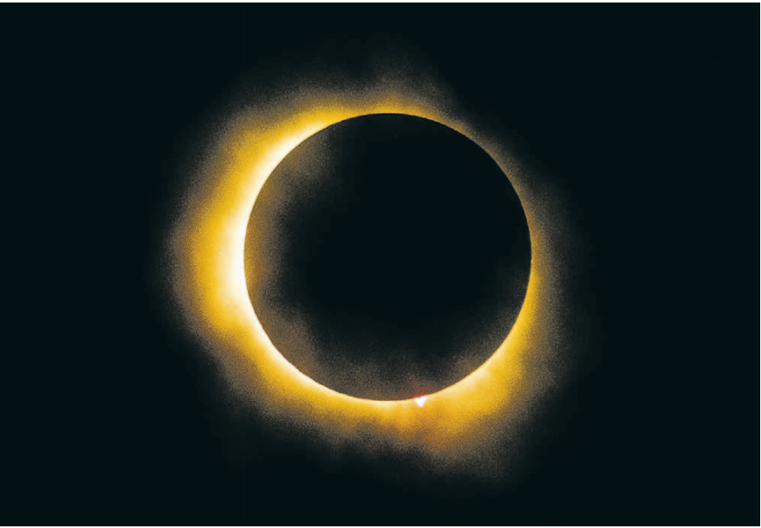
1. Celestial Sight Delights Millions of Spectators
全美盛况！日全食横扫美国大陆！

Slide 4
Text Completion
The Wall Street Journal (9th April 2024 A3)
though/ although/ while
Crowds cheered, some people cried, and ____________________ clouds partly obscured the view in some areas, spectators in the direct path of Monday’s total solar eclipse still got to experience the midday sky grow dark. For some, it was likely ___ once-in-a-lifetime event. In the U.S., it began just before 12:30 p.m. local time near Dallas, and _____ (end) in north-eastern Maine around 4:40 p.m. local time, according to the National Aeronautics and Space Administration.
The last time Shelley Robbins, 52, of Garland, Texas, experienced an eclipse was on her birthday, ___ Aug. 21, 2017. There was a ______ (part) eclipse in her location that day, and Robbins had come to the Dallas Zoo ______ (see) the hippos. “It was just pure silence ___ a moment as we looked up at the sky,” Robbins said. “It was just amazing.”
When she realized Dallas would be in the direct path of this year’s eclipse, she looked at her husband and said they had to go to the zoo to relive the moment. When the zoo was plunged into ________ (dark) at the peak of the eclipse, Jesse Everett, 29, was in the middle of the crowd in front of the _________ (elephant). Many feared the cloudy weather would obscure their view, but the skies cleared in the few minutes of totality. The crowd cheered. One young girl started to cry and clung ___ her mother’s waist.
a
ended
on
partial
to see
for
darkness
elephants
to

Slide 5
Vocabulary
1. obscure: to make it difficult to see, hear or understand sth 使模糊；使隐晦
We mustn’t let these minor details obscure the main issue. 棕熊是杂食动物，抓到什么吃什么。
2. plunge sb./sth. into sth.: to make sb/sth experience sth unpleasant 使经历，使陷入（不快的事情）
There was a flash of lightning and the house was plunged into darkness. 雷电闪过，房子陷入一片黑暗之中。
Translation
雾中景色朦胧。
The view was obscured by fog.
Translation
这条消息立即使他们深感沮丧。
The news plunged them into deep depression.

Slide 6
Translation
Crowds cheered, some people cried, and though clouds partly obscured the view in some areas, spectators in the direct path of Monday’s total solar eclipse still got to experience the midday sky grow dark.
人群欢呼，一些人在叫喊，尽管云层在某些地区遮挡了部分视线，但周一日全食直接路径上的观众仍然可以体验到中午天空变暗。
Many feared the cloudy weather would obscure their view, but the skies cleared in the few minutes of totality. The crowd cheered. One young girl started to cry and clung to her mother’s waist.
许多人担心多云的天气会遮挡他们的视线，但在全食的几分钟内，天空放晴了。人群欢呼起来。一个小女孩哭了起来，搂着妈妈的腰。

Slide 7

2. World of Medicine
医学新发现

Slide 8
Text Completion 1
Reader’s Digest New Zealand (April-May 2024 Page 20)
Hearing Aids May Help People Live Longer
Hearing aids can help reduce mortality risk, according to a study in The Lancet Healthy Longevity journal. One reason is _____ hearing aids can help to prevent or slow the progression of dementia.
The researchers said there _____ nearly a 25 percent difference in mortality risk between regular hearing aid users and never-users. The scientists followed 1863 ___________ (participate) for ten years to determine their mortality status.
Hearing loss is a common and under treated health condition in older adults that has been associated with cognitive decline, dementia and poor physical health.
The scientists did not examine why there was a difference in mortality risk. ________, the increased longevity may ____________ (explain) by the possibility that those who wear hearing aids are more likely ________ (avoid) social isolation and maintain a higher level of activity.
that
was
participants
However
be explained
to avoid

Slide 9
Text Completion 2
Reader’s Digest New Zealand (April-May 2024 Page 20)
Women and Clogged Arteries
Thanks in part to oestrogen’s protective effects, women _________ get atherosclerosis tend to get it later _____ men: between ages 64 and 68 (for men, it’s 52 to 56). But once a woman does have clogged arteries, concluded a study _________ (publish) in European Heart Journal - Cardiovascular Imaging, she may need stronger treatments to avoid a heart attack.
Women’s arteries tend to be _______ (slight) smaller than men’s, and that could explain why the same amount of plaque is a greater threat to their blood flow. That’s worth ___________ (consider) when a patient and her doctor are choosing a treatment plan, along with other factors such as age, severity of the atherosclerosis and other cardiovascular risks such as high cholesterol.
who/ that
than
published
slightly
considering

Slide 10
Vocabulary
1. cognitive: connected with mental processes of understanding 认知的；感知的；认识的
As children grow older, their cognitive processes become sharper. 随着孩子们长大，他们的认知过程也变得越来越敏锐了。
2. clog: to block sth or to become blocked （使）阻塞，堵塞
The narrow streets were clogged with traffic. 狭窄的街道上交通堵塞。
Translation
她的部分认知能力受到了损害。
Some of her cognitive functions have been impaired.
Translation
树叶堵塞了下水道。
Leaves are clogging (up) the drain.

Slide 11
Translation
The scientists did not examine why there was a difference in mortality risk. However, the increased longevity may be explained by the possibility that those who wear hearing aids are more likely to avoid social isolation and maintain a higher level of activity.
科学家们并没有研究死亡风险差异的原因。然而，佩戴助听器的人更有可能避免社交孤立，并保持较高的活动水平，这可能解释了寿命延长的原因。
That’s worth considering when a patient and her doctor are choosing a treatment plan, along with other factors such as age, severity of the atherosclerosis and other cardiovascular risks such as high cholesterol.
当病人和医生在选择治疗方案时，这一点值得考虑，同时还要考虑年龄、动脉粥样硬化的严重程度和其他心血管风险(如高胆固醇)。

Slide 12

3. Gold prices pass $2,400 as global tension rises
金价突破2400美元大关

Slide 13
Text Completion
The Times (April 13 2024 P50)
Gold prices topped $2,400 yesterday and were _____ track for a fourth straight weekly gain, despite hopes straight of cuts in interest rates.
The price of gold has been on a largely uninterrupted rise since midFebruary, when it ______ (cost) about $2,000 an ounce, although it is not clear _______ has driven the increase.
____________ (expect) of interest rate cuts in America, the key upward driver of gold prices, have eased after inflation there was higher than expected. High interest rates typically weigh on gold, making it ___________ (attract) compared with investing in US Treasury bonds.
To further confuse matters, the rally has been driven by buyers who have not ____________ (tradition) made material purchases, while the usual buyers through exchange-traded funds have remained net sellers. At the start of the week, exchange-traded fund holdings stood at ___ four-year low.
Analysts at UBS suggested this week that, given it had been difficult __________ (pinpoint) a single source of buying, the rise could simply be broadly based, spurred by a tense global political landscape. There is also a possibility _____ the rise could be driven by a leveraged play, _______ linked more to activity in the options market than the physical market.
on
cost
what
Expectations
unattractive
traditionally
a
to pinpoint
that
linked

Slide 14
Vocabulary
1. straight: continuously without interruption 连续不断地；一连
They'd won 12 straight games before they lost.
他们在输掉之前已赢了连续12场比赛。
2. spur: to encourage sb to do sth or to encourage them to try harder to achieve sth.
鞭策；激励；刺激；鼓舞
The band has been spurred on by the success of their last single.
最近一张单曲唱片的成功使乐队受到鼓舞。
Translation
他们已经一连工作了16个小时。
They had been working for 16 hours straight.
Translation
那封信激励我行动起来。
I was spurred into action by the letter.

Slide 15
Translation
To further confuse matters, the rally has been driven by buyers who have not traditionally made material purchases, while the usual buyers through exchange-traded funds have remained net sellers.
更让人困惑的是，推动股市上涨的是那些传统上没有进行实质性买入的买家，而通过交易所交易基金买入的通常买家仍是净卖家。
Analysts at UBS suggested this week that, given it had been difficult to pinpoint a single source of buying, the rise could simply be broadly based, spurred by a tense global political landscape.
瑞银(UBS)分析师本周表示，鉴于很难确定一个单一的购买来源，这种上涨可能只是普遍存在的，受到紧张的全球政治形势的刺激。

Slide 16
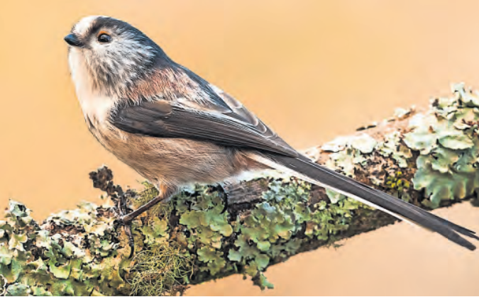
4. Warm winter makes small birds chirpier
暖冬有利于庭院小鸟

Slide 17
Text Completion
The Times (April 12 2024 P18)
People should turn their gardens into a “crucial lifeline” for birds, the RSPB has urged, as its citizen science survey found that a mild winter has boosted one of Europe’s smallest bird species. More than 600,000 people took part in the Big Garden Birdwatch, ________ (count) the species they saw over a weekend in January. The biggest year-on-year rise among the top 20 species was the long-tailed tit, which is about the size of a 50p coin and is vulnerable to cold. Numbers were up 39 per cent owing to the UK having one of the ten _______ (warm) winters on record. The list _________ (top) for the 21st year by the house sparrow, with an average of four ________ (record) in each garden. However, the species has become ___________ (increase) scarce and its numbers are down 60 per cent since 1979. After sparrows, the most-spotted species were blue tits, starlings, wood pigeons and blackbirds.
One reason house sparrows have fared badly is ____ they are a “specialist species’’ that require cavities in homes for their nests. Starlings, which feed on cranefly larvae that are not always available, are struggling too. Blue tits, ________, have increased 24 per cent since the survey started 45 years ago. They are a “generalist”, able ________ (exploit) any type of habitat, and have benefited _____ people putting up bird boxes. Wood pigeons, which were recorded in four in five gardens, have enjoyed ___ “crazy increase” as they have expanded beyond their forest homes. Since 1979, their numbers are up 1,058 per cent.
counting
warmest
was topped
recorded
increasingly
that
however
to exploit
from
a

Slide 18
Vocabulary
1. fare: (~well, badly, better, etc.) to be successful/unsuccessful in a particular situation 成功（或不成功、更好等）
Some later expeditions fared better, though they were no better equipped.
虽然装备并未改善，但后来的一些探险进行得更好。
2. cavity: a hole or empty space inside sth solid
洞；孔；窟窿；腔
If a cavity is large enough, it can lead to tree decay.
如果蛀洞足够大，就会导致树木腐烂。
Translation
该党上次竞选情况很糟糕。
The party fared very badly in the last election.
Translation
有些鸟在树洞里筑巢。
Some birds nest in tree cavities.

Slide 19
Translation
The biggest year-on-year rise among the top 20 species was the long-tailed tit, which is about the size of a 50p coin and is vulnerable to cold. Numbers were up 39 per cent owing to the UK having one of the ten warmest winters on record.
在排名前20位的物种中，同比增幅最大的是长尾山雀，它大约有50便士硬币那么大，很容易受冻。由于英国经历了有记录以来最温暖的十个冬天之一，长尾山雀的数量上升了39%。
They are a “generalist”, able to exploit any type of habitat, and have benefited from people putting up bird boxes. Wood pigeons, which were recorded in four in five gardens, have enjoyed a “crazy increase” as they have expanded beyond their forest homes.
它们是“广幅种”，能够利用任何类型的栖息地，并从人们设置的鸟箱中受益。木鸽随着它们的栖息地扩展到森林之外，它们的数量得以“疯狂增长”，在五分之四的花园中都有发现其身影。

Slide 20
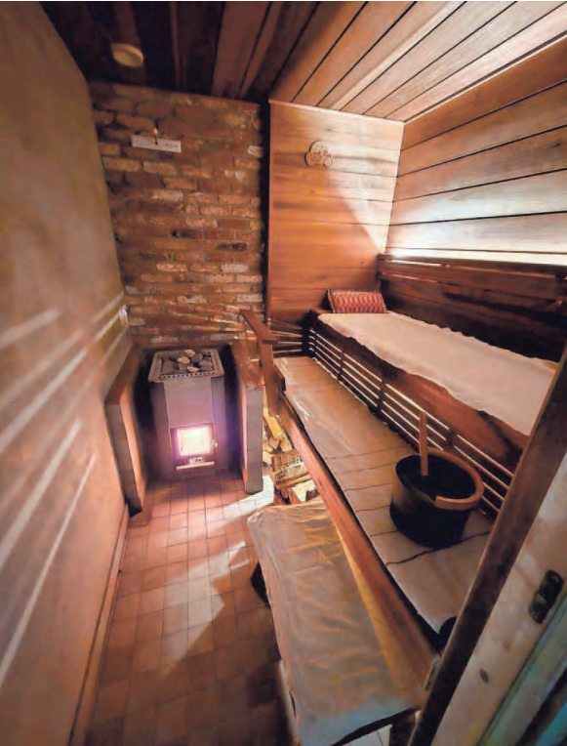
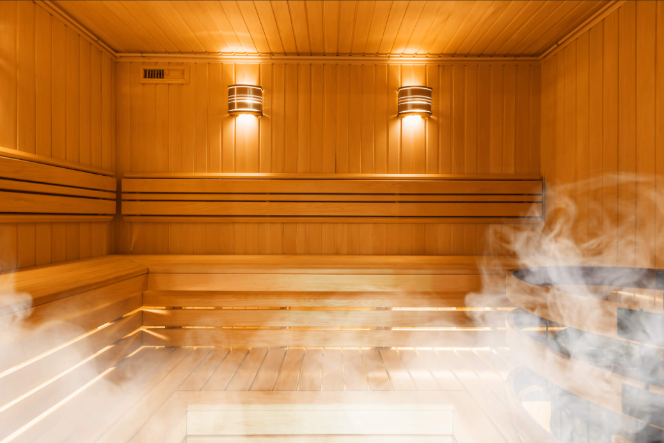
5. In free and easy Finland, happiness is a warm sweat
芬兰人的快乐神器——桑拿浴

Slide 21
Text Completion
USA Today (April 16, 2024 P1A&5A)
HELSINKI − Juuso Raukola uses the sauna in his home every single day. So ___ his wife and children. Raukola’s parents do the same with their sauna, in their house, his friends and work colleagues in theirs. When Raukola and his two brothers met up last month in Finland’s capital _______ (catch) up on the things brothers catch up on when they have not seen each other in a while, they did so in a quiet and unchanging place made of fragrant hard wood, warmed to 175 degrees and _____ easy access for a dip in the Baltic’s icy waters. “Sometimes Finnish people say saunas are like churches. I think that’s a really strong word. Maybe too strong,” said Raukola, 35, __ mechanical engineer, as he or one of his brothers periodically stood up to pour water on hot wood pellets that created a burst of steam that raised the heat and humidity levels in Helsinki’s Kulttuurisauna. “What I think they are trying to say is saunas are where Finnish people go to calm __________; to reset their minds to the ‘zero point’; to process _____ has happened to them in the daytime and to think about ________ (solve).”
Finland has a lot of saunas: an _________ (estimate) 3 million for its population of 5 million, according to government figures. The Nordic country also ________ (routine) scores high in global surveys, indexes and reports that compare countries on various quality of life and good-governance metrics. Last month, Finland ____________ (crown) the happiest country in the world for the seventh year in a row by the United Nations’ World Happiness Report.
do
to catch
with
a
themselves
what
solutions
estimated
routinely
was crowned

Slide 22
Vocabulary
1. dip: a quick swim 游一游；泡一泡
She flicked through a romantic paperback between occasional dips in the pool.
用在泳池里游一阵后歇一阵的几个空当，她翻完了一本平装本言情小说。
2. metrics: a set of numbers that give information about a particular process or activity 指标
Do you have any metrics on the rate of usage for the service?
你有关于服务使用率的指标吗?
Translation
我们早饭前去游一会儿泳吧。
Let’s go for a dip before breakfast.
Translation
该研究包括市场指标。
The study includes market metrics.

Slide 23
Translation
When Raukola and his two brothers met up last month in Finland’s capital to catch up on the things brothers catch up on when they have not seen each other in a while, they did so in a quiet and unchanging place made of fragrant hard wood, warmed to 175 degrees and with easy access for a dip in the Baltic’s icy waters.
上个月，劳科拉和他的两个兄弟在芬兰首都相聚，叙叙旧。他们是在一个安静而不变的地方见面的，这个地方用散发着芬芳的硬木建造，温度高达175华氏度，很容易就能在波罗的海冰冷的海水中畅游。
The Nordic country also routinely scores high in global surveys, indexes and reports that compare countries on various quality of life and good-governance metrics. Last month, Finland was crowned the happiest country in the world for the seventh year in a row by the United Nations’ World Happiness Report.
这个北欧国家在全球调查、指数和报告中也经常得分很高，这些调查、指数和报告比较了各国的生活质量和治理指标。上个月，芬兰连续第七年被联合国“世界幸福报告”评为世界上最幸福的国家。

Slide 24

6. CNN News 04/05/2024

Slide 25

Dictation
A total solar eclipse like this one will not be ______ from the United States again until 2044, so 20 years from now. That’s why we’re seeing so many people scrambling to try to find the best weather and ____________ to see this on Monday. There are a few other things that make this eclipse really unique and the first is the length of time for totality. That’s the moment when the moon completely _________ the sun and that’s when day will literally turn to night, so dark that the stars come out, nocturnal animals come out. That is how dark it gets and so that moment of totality for this eclipse is much longer than it was in ________ eclipses. At the longest point it’ll be about four minutes and 30 seconds, so that’s a good amount of time to really get to soak in the power of nature in our ___________.
Another really unique thing about this eclipse is the fact that it just happens to ____________ a period of peak activity on the surface of the sun, so during that moment of totality things like solar flares or coronal mass ejections are much more likely than in previous eclipses and could just make for some really cool viewing.
But of course with any eclipse, but this one ___________, the weather is always a factor and unfortunately it’s not looking like it’s going to _________ in large parts of the United States along this path of totality. Texas and Arkansas, really the weather not looking great there, but places like southern Missouri and Indianapolis and upstate New York and New England, the weather’s looking pretty good there. So as always before an eclipse, the eclipse _______, the diehards are trying to find that best weather viewing _________ so that they can see this eclipse because again, if you don’t see this one it’s going to be 20 years before you get to see something like this if you live in the United States.
visible
get in position
blocks out
previous
solar system
coincide with
in particular
cooperate
chasers
condition

Slide 26
Vocabulary
1. nocturnal: (of animals) active at night （动物）夜间活动的
When there is a full moon, this nocturnal rodent is careful to stay in its burrow.
月圆之夜，这种夜间活动的啮齿类动物会小心地呆在地洞里不出来。
2. eject: to push sth out suddenly and with a lot of force
喷出；喷射；排出
Used cartridges (弹壳) are ejected from the gun after firing.
空弹壳在射击后从枪里弹出。
Translation
大多数蝙蝠和猫头鹰都是夜行动物。
Most bats and owls are nocturnal.
Translation
机器突然喷出一把硬币。
The machine suddenly ejected a handful of coins.

Slide 27
Translation
A total solar eclipse like this one will not be visible from the United States again until 2044, so 20 years from now. That’s why we’re seeing so many people scrambling to try to find the best weather and get in position to see this on Monday.
像这样的日全食要到2044年才会在美国再次出现，也就是20年后。这就是为什么我们看到这么多人争先恐后地寻找最好的天气，以便在周一看到这一幕。
Another really unique thing about this eclipse is the fact that it just happens to coincide with a period of peak activity on the surface of the sun, so during that moment of totality things like solar flares or coronal mass ejections are much more likely than in previous eclipses and could just make for some really cool viewing.
这次日食的另一个独特之处在于它恰好与太阳表面活动的高峰期相吻合，所以在日全食的那一刻，像太阳耀斑或日冕物质抛射这样的事情比以前的日食更有可能发生，这可能会让你看到一些非常酷的景象。

