Slide 1


感恩遇见，相互成就，本课件资料仅供您个人参考、教学使用，严禁自行在网络传播，违者依知识产权法追究法律责任。
更多教学资源请关注
公众号：溯恩英语
知识产权声明

Slide 2
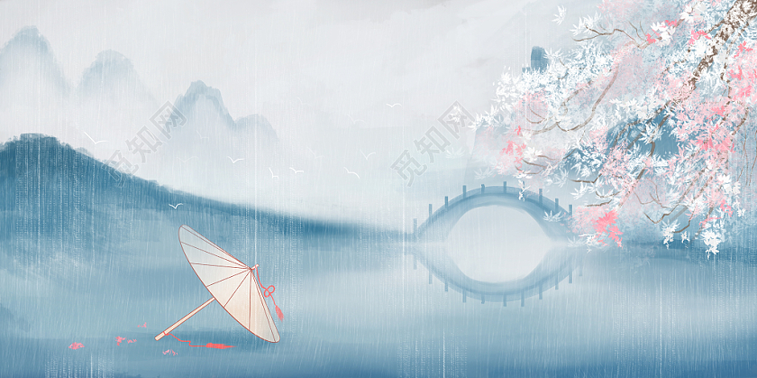
用英语讲好中国故事课例1
千秋诗颂
Alicewu

Slide 3

1. What’s the weather like last night?And How did you feel?
2. Which poem comes to your mind when we describe the rain in Spring?

Slide 4
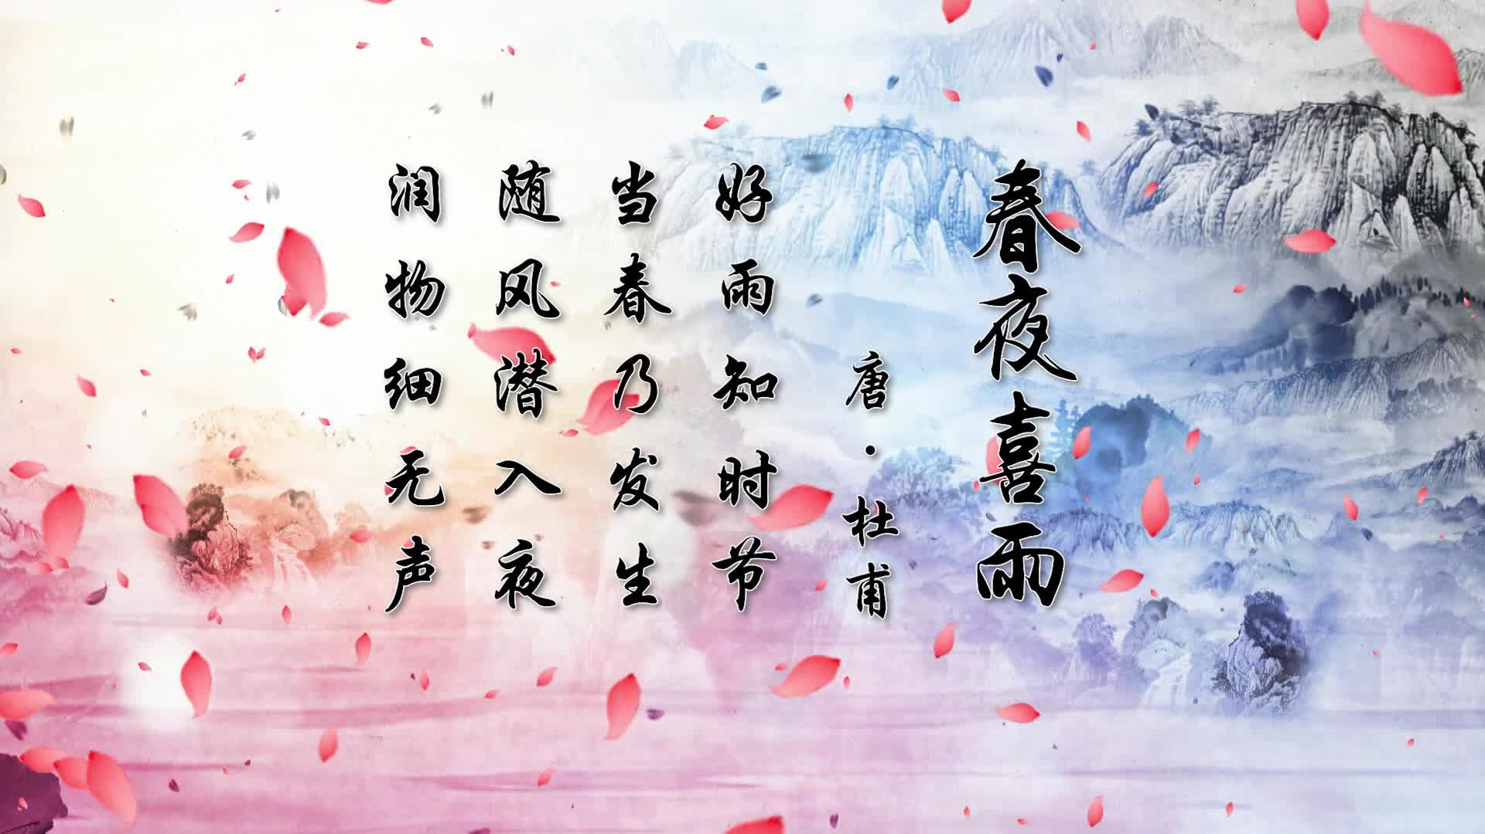
3. Can you recite the rest part of the poem?

Slide 5
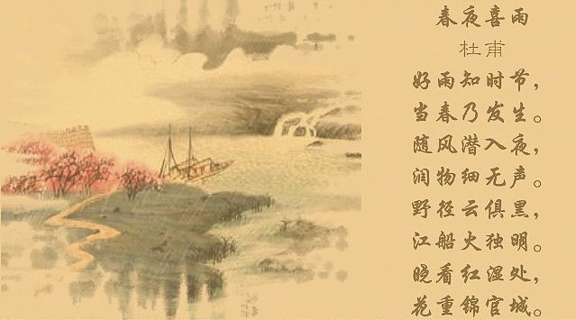

Slide 6
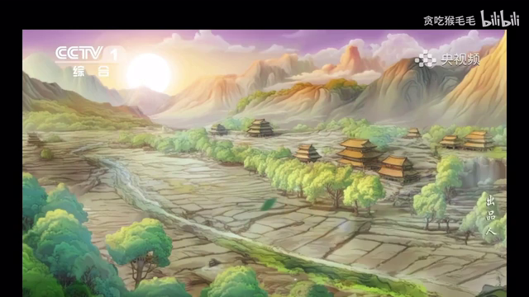
4. What else do you know about the poem?

Slide 7
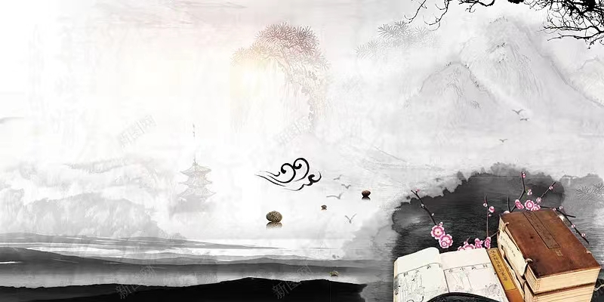
5. What’s the translation of the poem?
Happy Rain on a Spring Night
by Du Fu
Good rain knows its time right;
It will fall when comes spring.
With wind it steals in night;
Mute, it moistens each thing.
Over wild lanes dark cloud spreads;
In boat a lantern looms.
Dawn sees saturated reds;
The town’s heavy with blooms.

Slide 8
Application
假定你是李华，你的英国朋友Tom对描述春雨的中国古诗（Chinese poetry）很感兴趣。他来信请教有关知识。请给他回信，内容包括：
1.具体介绍一首古诗
2.欣赏中国古诗的方法
3.学习中国古诗的感悟
注意：词数100左右；
可以适当增加细节，以使行文连贯。
Step 1 审题：咨询信or 介绍信？
显性要点：
1. 介绍古诗
2. 欣赏方法
3.学习感悟
隐性要点：
1. 来信的原因
2. 回信的目的

Slide 9
Step 2 谋篇布局
Main parts of the letter of introduction
Dear Tom,
Para 1： 来信原因+ 引出古诗
Para 2： 欣赏古诗的方法+学习古诗的感悟
Para3： 回信的目的+期待
Yours,
Li Hua

Slide 10
Step 3 句型升级
Para1 Beginning ：来信原因+引出古诗
1. I was delighted to receive your letter expressing an interest in Chinese poetry that describes the spring rain.
2. I was more than thrilled to receive your letter, learning you ’re fascinated in Chinese poetry....
3. Knowing from your last letter that you have a great passion for Chinese poetry, I can’t wait to introduce the following poem to you.

Slide 11
Step 3 句型升级
Para 2 Body： 欣赏古诗的方法+学习古诗的感悟
1.欣赏古诗的方法
1）要充分欣赏中国诗歌，沉浸在其丰富的意象和象征主义中是至关重要的。注意自然界元素的使用，因为它们往往承载着更深层的含义.（不定式+祈使句）
To fully appreciate Chinese poetry, it is essential to immerse oneself in its abundant imagery and symbolism. Pay attention to the use of natural elements, as they often carry deeper meanings.
2）此外，理解诗歌创作的历史文化背景可以极大地增强你的欣赏能力。
（非谓语作主语+定语从句）
Moreover, understanding the historical and cultural context in which the poem was written can greatly enhance your appreciation.

Slide 12
2.学习古诗的感悟
3）正是通过学习和阅读中国诗歌的个人经历，深深地打动了我，让我意识到了自我反思的重要性以及自然深处的简单之美。（强调句）
It is my personal experience of learning and reading Chinese poetry that has profoundly moved me，showing me the importance of self-reflection and the simple beauty of nature's depth.
4）每一首诗歌都像是通往诗人灵魂的一扇窗户，透过它，我学会了用更具诗意的敏感度来看待世界。 (rhetorical device修辞手法如Metaphor）
Each poem is like a window into the poet's soul, and through it, I've learned to see the world with a more poetic sensibility.

Slide 13
Para 3 Ending： 回信的目的+期待
Here are three common concluding sentence structures used in this letter:
1)Expressing a Willingness to Continue the Conversation:
"I am always here to share and discuss more..."
2)Inviting Further Communication:
"Looking forward to your thoughts..."
3)Closing with a Positive Note:
"I hope this insight has kindled your interest..."
4）我希望这份简短的见解能鼓励你进一步探索中国诗歌的丰富文化，我相信你会在其中发现许多值得欣赏和学习的东西。(并列句）
I hope this brief insight encourages you to dig further into the rich culture of Chinese poetry, and I'm sure you'll find much to admire and learn from it.

Slide 14
Alice下水范文
Dear Tom,
I was delighted to receive your letter expressing an interest in Chinese poetry that describes the spring rain. One of the most celebrated is"Happy Rain on a Spring Night" by Tang Dynasty poet Du Fu,which beautifully shows the quiet arrival and nurturing power of spring showers. Here is the poem:
Good rain knows its time right;
It will fall when comes spring.
With wind it steals in night;
Mute, it moistens each thing.
Over wild lanes dark cloud spreads;
In boat a lantern looms.
Dawn sees saturated reds;
The town’s heavy with blooms.
To fully appreciate Chinese poetry, it is essential to immerse oneself in its abundant imagery and symbolism.Moreover,pay attention to the use of natural elements, as they often carry deeper meanings.It is my personal experience of learning and reading Chinese poetry that has profoundly moved me,showing me the importance of self-reflection and the simple beauty of nature's depth.Each poem is like a window into the poet's soul, and through it, I've learned to see the world with a more poetic sensibility.
I hope this brief insight encourages you to dig further into the rich culture of Chinese poetry, and I'm sure you'll find much to admire and learn from it.
Yours,
Li Hua

Slide 15
2018 年广州一模
类似话题
假定你是李华，你的英国朋友Tom对中国古诗（Chinese poetry）很感兴趣。他来信请教有关知识。请给他回信，内容包括：
1.介绍中国古诗；
2.你学习中国古诗经历和感悟；
3.如何推广中国古诗？
Dear Tom,
I'm delighted to hear about your interest in Chinese poetry, a rich and profound aspect of our cultural heritage. Chinese poetry, with its roots in ancient times, is known for its brevity, depth, and the beauty of its language. It often conveys complex emotions and philosophies through a few choice words, painting vivid images with metaphors .
My own journey with Chinese poetry began in school, where I was captivated by the rhythmic verses and the profound meanings they held. I found solace in the verses of poets like Li Bai and Du Fu, whose works transcend time and speak to the human condition.
Promoting Chinese poetry globally can be achieved through various means. One effective method is through translations that capture the essence of the original work. Additionally, incorporating poetry into language learning curriculums and hosting poetry recitals and competitions can pique interest. Social media platforms are also powerful tools for sharing and discussing these timeless works, making them accessible to a wider audience.
I hope this insight has been helpful, and I look forward to discussing more about this beautiful art form with you.
Warm regards,
Li Hua

Slide 16
类似话题
河南省2023-2024学年高三下学期3月联考
假如你是李华,在英国伦敦一所高中做交换生。上周该校组织了“我眼中的唐诗宋词”演讲比赛,组织者Alisen 邀请你谈谈比赛的观感。请你给Alisen写一封电子邮件,内容包括:
1.对活动的看法;
2.对活动的建议。
Dear Alisen,
I hope this email finds you well. I wanted to share my thoughts on the "My Eyes on Tang Poetry and Song Lyrics" speech contest held last week. It was a truly enriching experience to witness the passion and knowledge our peers have for classical Chinese literature. The event not only showcased the beauty of Tang and Song era poetry but also fostered a deeper cultural exchange among students.
One suggestion for future events might be to include a segment where students could interpret and recite the poems in both English and Chinese. This bilingual approach could enhance understanding and engagement, especially for those less familiar with the original language. Additionally, perhaps we could invite a guest speaker or a poet to provide insights into the historical and cultural context of the poems.
Thank you for organizing such a meaningful event. I'm looking forward to more opportunities to celebrate and learn about our shared cultural heritage.
Best regards,
Li Hua

