Slide 1



感恩遇见，相互成就，本课件资料仅供您个人参考、教学使用，严禁自行在网络传播，违者依知识产权法追究法律责任。
更多教学资源请关注
公众号：溯恩英语
知识产权声明

Slide 2

Z20名校联盟 2024届高三第三次高考 应用文讲评
湖州市滨湖高级中学 沈伊人

Slide 3


Slide 4
观看视频后讨论
Do you have a clear direction in terms of your future career?
Yes, I do have one.
No, I do not have one.
What is your ideal job?
What jobs do you prefer to work on when you have a choice?
Have you had experience with this job before?
Why do you choose the job as your favorite?
What expectations do you have for the job experience?
Do you want to have the experience of your favorite job ?

Slide 5
眼里有题眼
第一节： (满分15分)
假设你是李华。上个月，你参加了学校开展的“职业初体验”（My First Experience in Career）实践活动。现校英文报正向全校学生征集相关稿件。请你写一篇短文投稿，内容包括：
你体验的一项职业；
你的感受。
注意：
写作词数应为80左右；
请按如下格式在答题纸的相应位置作答。
career
noun [ C ]
the job or series of jobs that you do during your working life, especially if you continue to get better jobs and earn more money.

Slide 6
眼里有题眼
第一节： (满分15分)
假设你是李华。上个月，你参加了学校开展的“职业初体验”（My First Experience in Career）实践活动。现校英文报正向全校学生征集相关稿件。请你写一篇短文投稿，内容包括：
你体验的一项职业；
你的感受。
注意：
写作词数应为80左右；
请按如下格式在答题纸的相应位置作答。
experience
Noun [ U ]
(the process of getting) knowledge or skill from doing, seeing, or feeling things.

Slide 7

心中有读者
Q: Who are your target readers?
A: The School’s English Newspaper readers.
High school students
English learners/lovers
Think:
What do they want to find in your article?
What makes them interested in your article?

Slide 8
心中有结构
Paragraph 1 | A brief introduction of the activity: Time Place Participants Purpose
Paragraph 2 | My personal experience: What did I do? How did I do it?
Paragraph 3 | My personal feelings: What did I get/learn? What are my suggestions to my readers?

Slide 9
素材靠积累
Most Popular Jobs in China
Technology jobs (software engineers, data scientists, and artificial intelligence professionals)
Accounting and finance
Hospitality jobs
Teaching jobs (teachers)
Engineering jobs (engineers)
Medicine (doctors)
Marketing
Manufacturing jobs

Slide 10
素材靠积累
gain professional experience
hands-on experience
internship opportunity
career exploration
job shadowing
work placement
vocational training
fieldwork experience
industry insight
professional development
workplace culture
job responsibilities
team collaboration
client interaction
project management
time management skills
work ethics
problem-solving skills
decision-making process
leadership potential
networking opportunities
professional network
job satisfaction
work-life balance
career aspirations

Slide 11
素材靠积累
The daily work of a doctor/teacher/engineer…
Doctor:
Patient Examinations
Treatment Planning
Consultations and Discussions
Record Keeping
Research and Education
Administration
Teacher:
Lesson Planning and Preparation
Teaching Classes
Managing Classroom Behavior
Assessing Student Progress
Collaborating with Other Teachers and Staff
Participating in Professional Development
Engineer:
Project Management and Planning
Design and Development
Analysis and Problem-Solving
Testing and Verification
Documentation
Communication and Collaboration

Slide 12
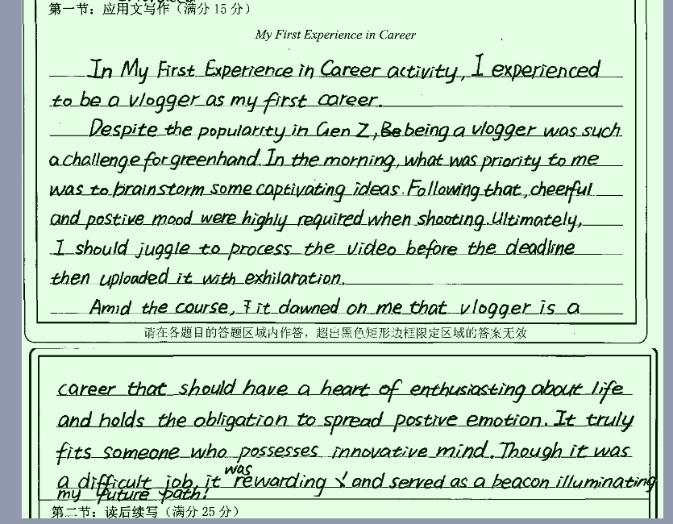
细节出亮点
A challenge for greenhand
In the morning, …
Following that, …
Ultimately, …
A difficult job (but rewarding)

Slide 13
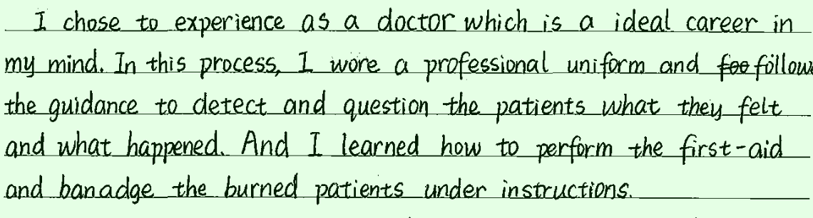
细节出亮点
wear …
detect …
professional uniform
follow the guidance
A doctor
question? (ask is better here)
burned patients …
under instructions
perform …
bandage …

Slide 14
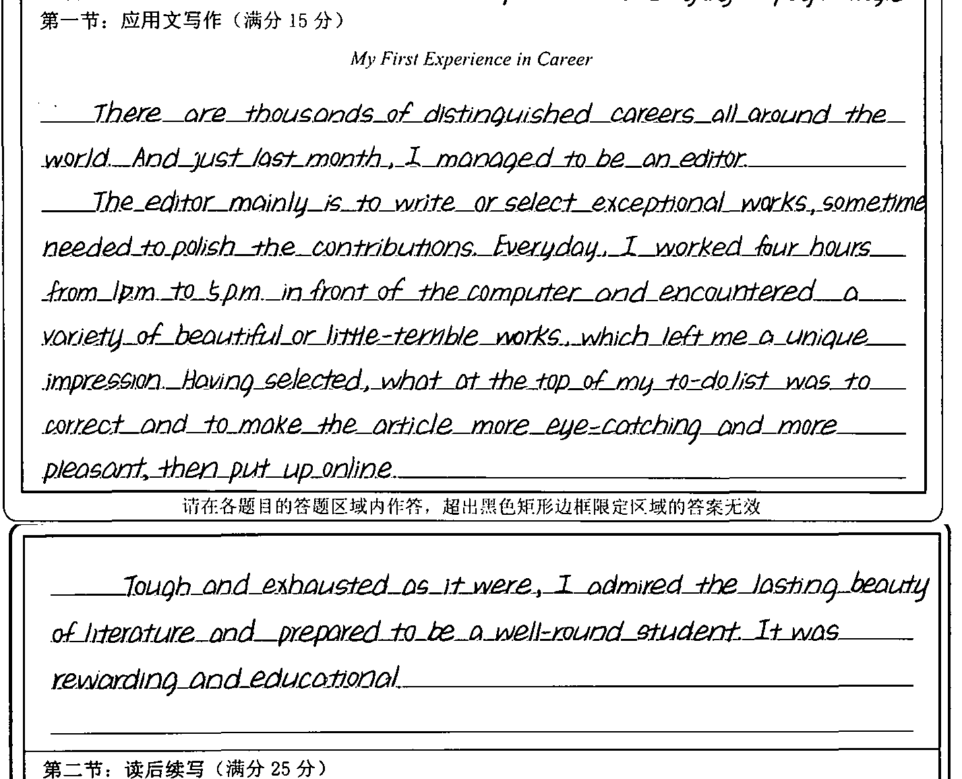
简洁又全面
The daily/routine work
The impressions/feelings
The reflections/suggestions

Slide 15
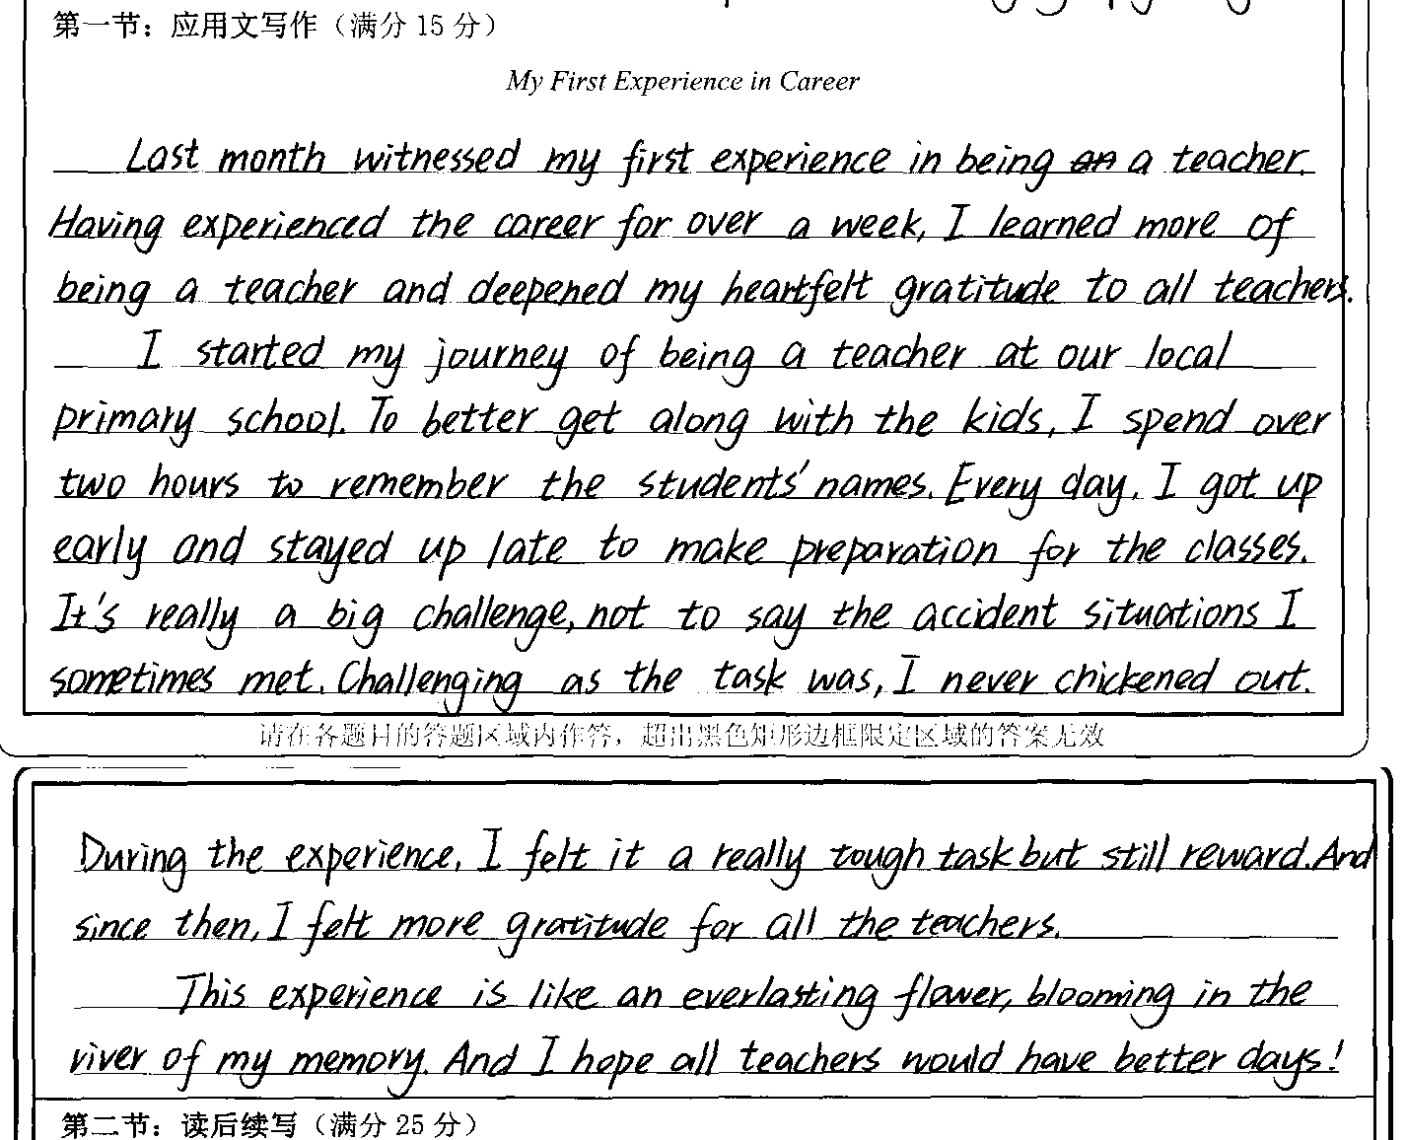
简洁又全面
The daily/routine work
The impressions/feelings
The reflections/suggestions

Slide 16
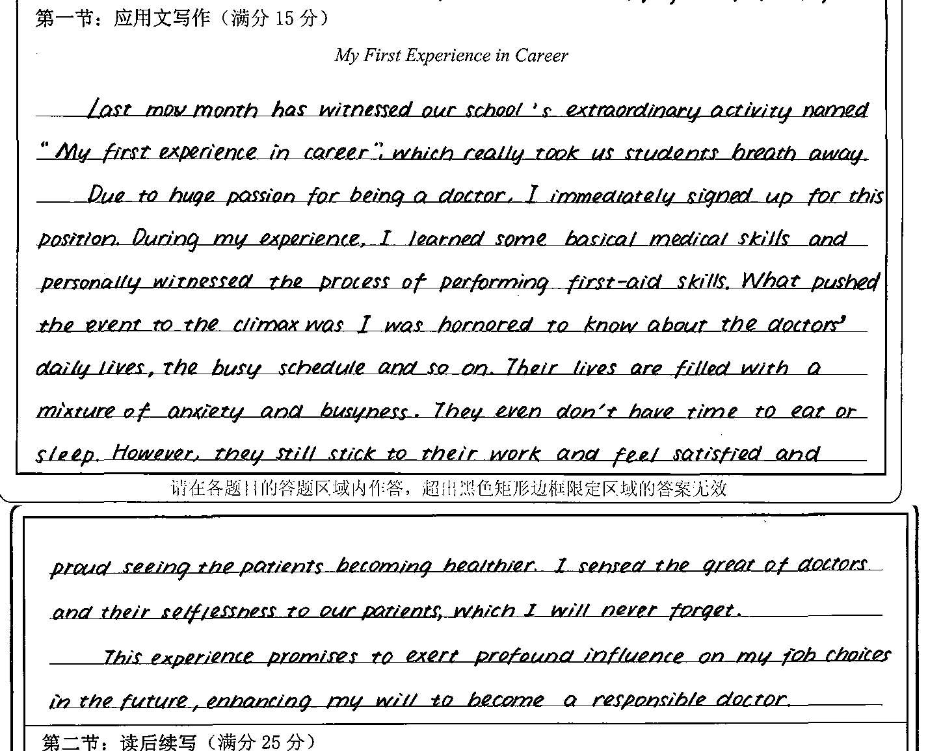
高分作文
13分
Doctor

Slide 17
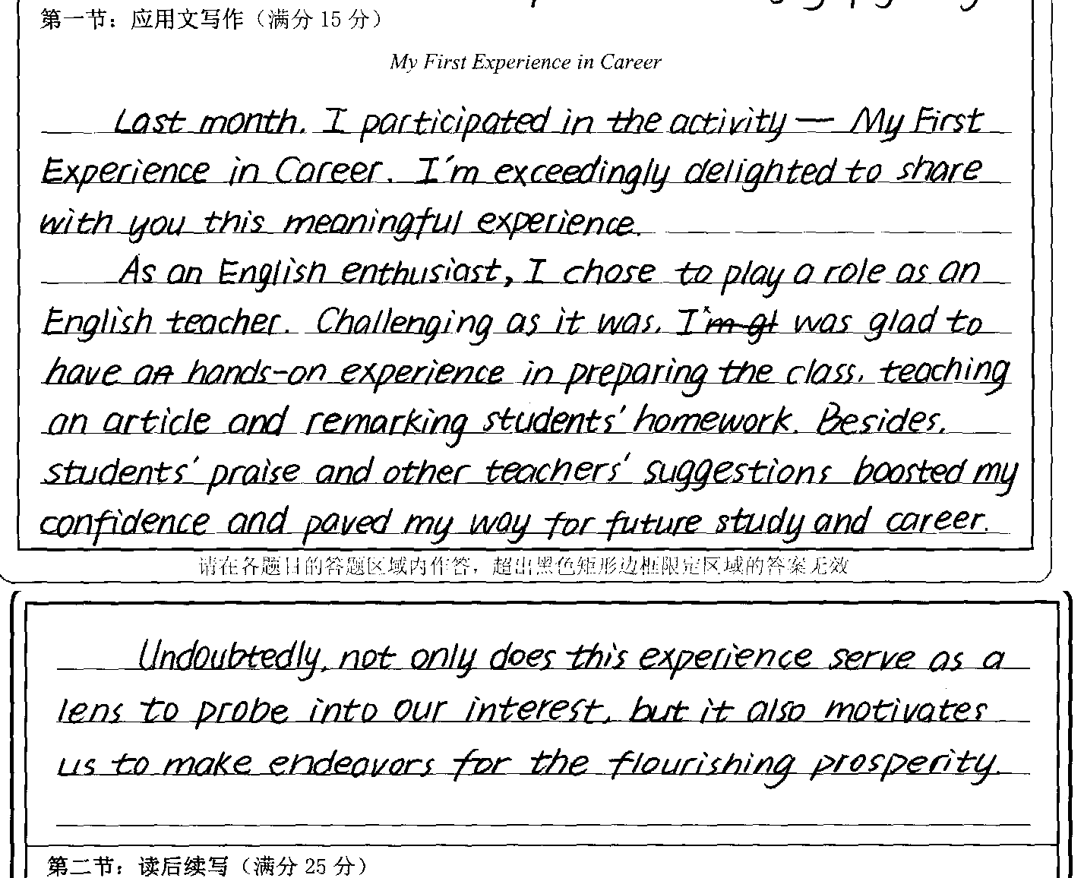
高分作文
12.5分
English teacher

Slide 18
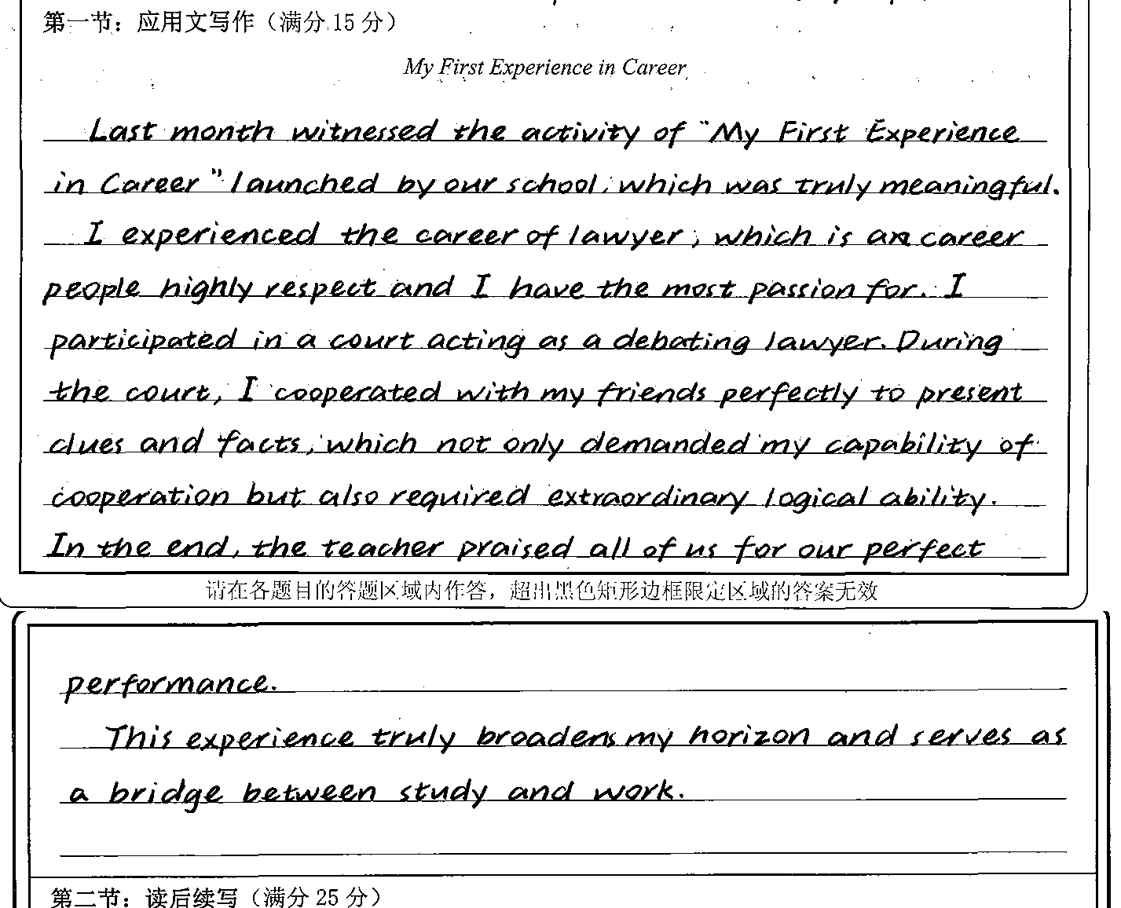
高分作文
12.5分
Lawyer

Slide 19


