Slide 1


感恩遇见，相互成就，本课件资料仅供您个人参考、教学使用，严禁自行在网络传播，违者依知识产权法追究法律责任。
更多教学资源请关注
公众号：溯恩英语
知识产权声明

Slide 2
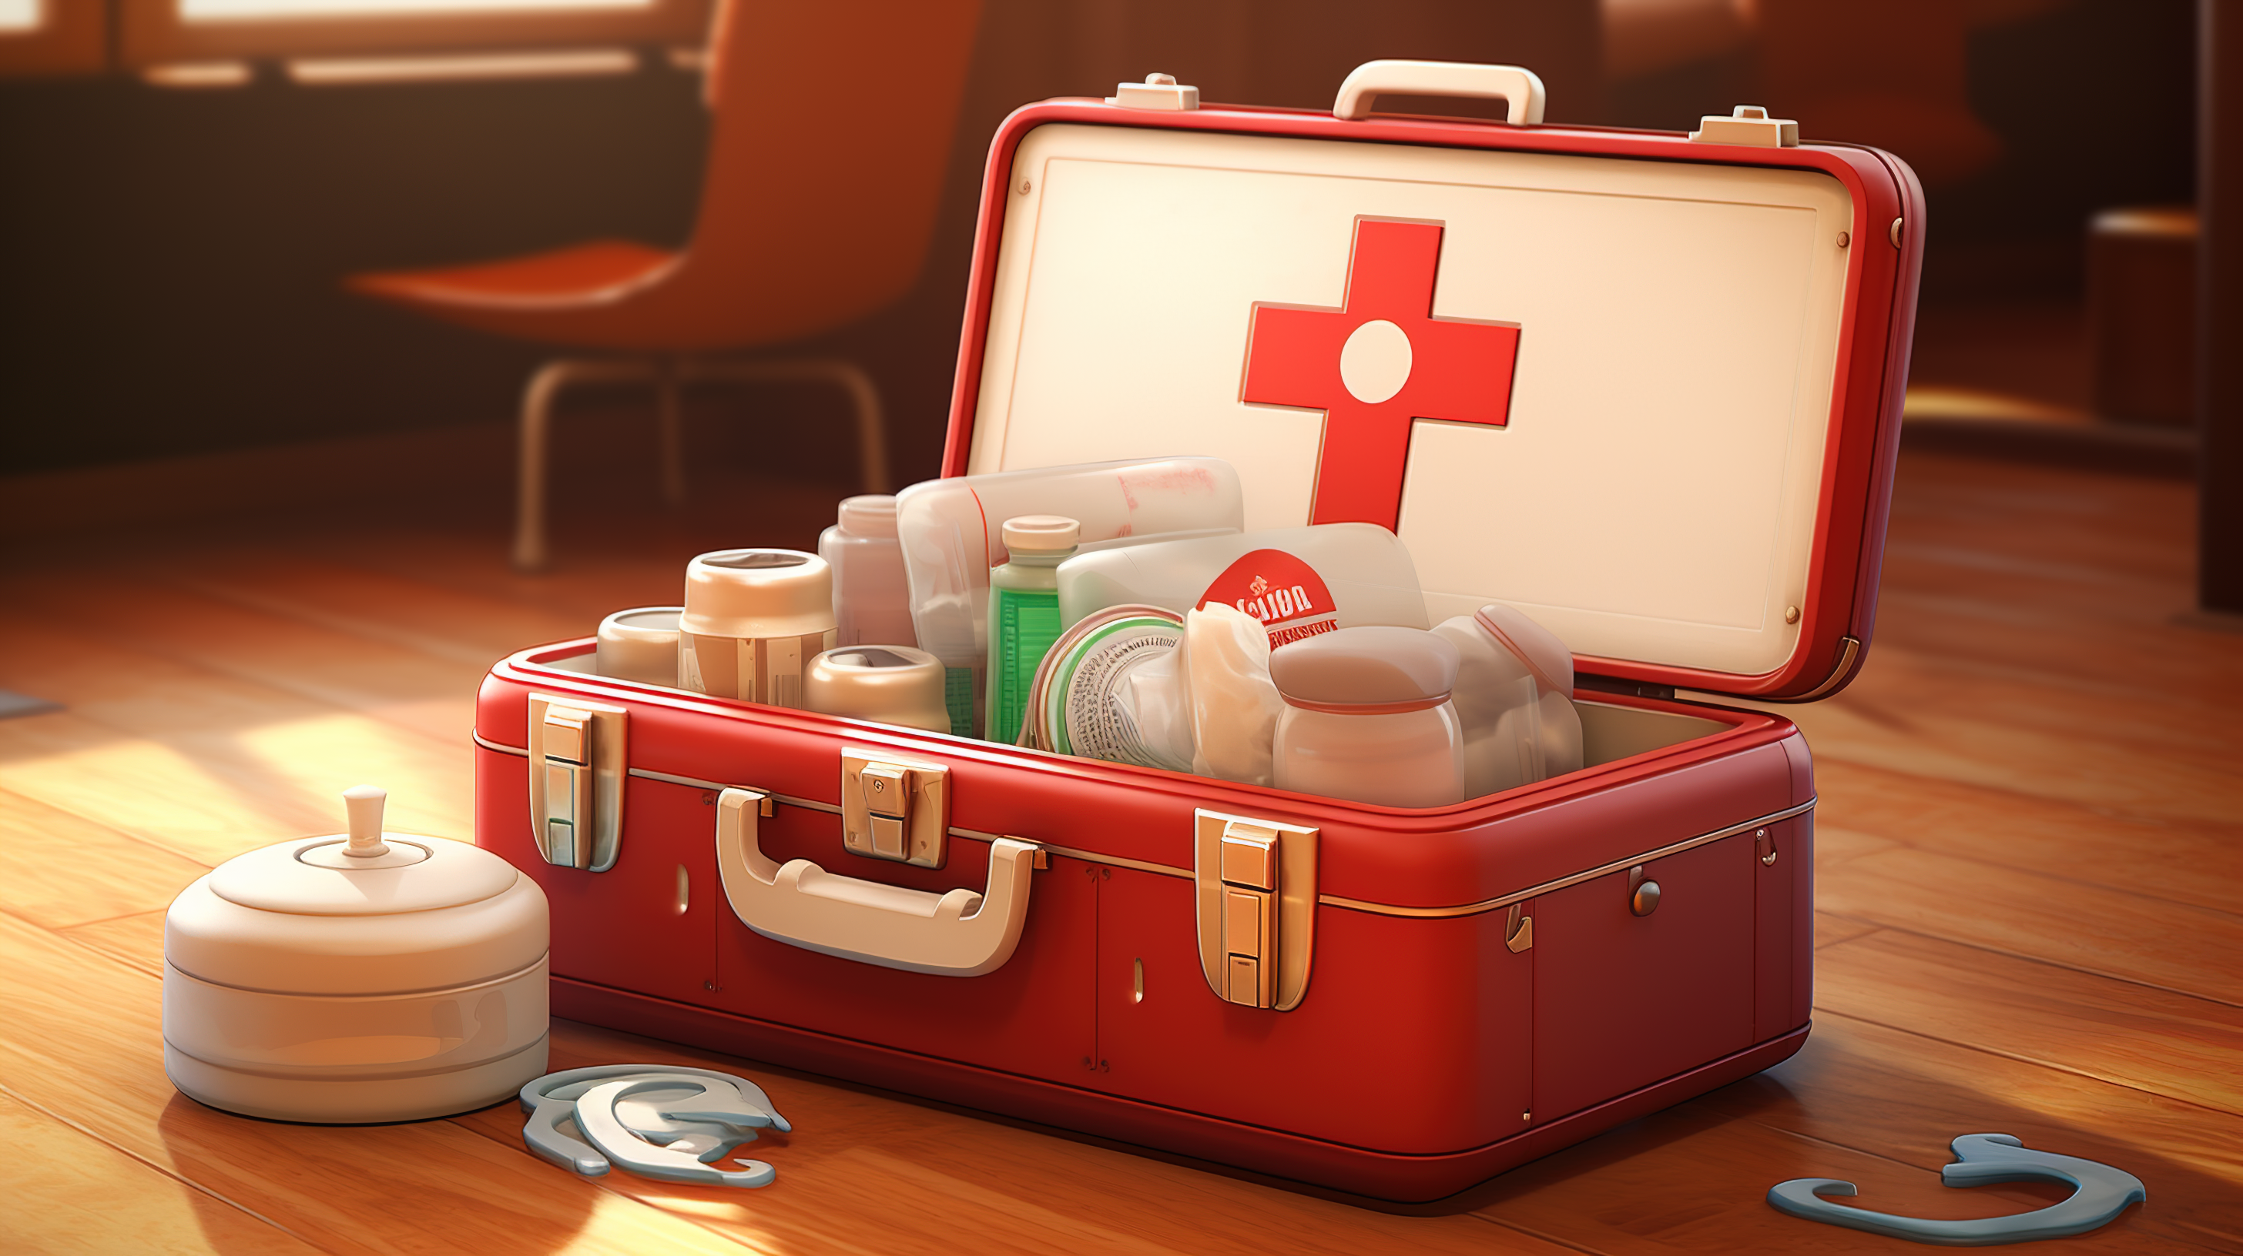
基于主题象征意义的续写文章训练
Z20 急救箱

Slide 3
“Anybody have a bandage (绷带)?” a voice echoed down the dorm hallway. That was a common scene frequently happening in our first week at college when we were all experiencing “forgot-this-or-that.” I had forgot to bring snacks for late-night hunger. Some poor girl in the dorm had apparently forgotten bandages. We all felt a little displaced.
Several months before, I sat at my high school graduation party admiring my gifts and battling waves of post-high school emotions. The usual and beloved inspirational books were lying in disorder around my feet, silently announcing the wealth of wisdom they wished to share. A small pile of personal checks lay nearby. Laundry items, desk supplies, sewing things --all well-intentioned and well-received. They would demonstrate their givers’ thoughtfulness over and over during my college career.
But one gift struck me as strange. I frowned when I opened it. A first aid kit? Inside it were a small packet of pills, pain-killers, creams, ointments (药膏), an insect sprayer (喷雾), a tape, pads of gauze (纱布) and bandages. Who would give that as a gift? “You’ll need that once you’re at school,” Mom pointed out. “You won’t have to chase down the campus nurse for every cough.” I shrugged at this thought.
Not long after, in August, I packed my life into a borrowed truck and slippedthe first-aid kit in with my luggage. I barely thought about it once I reached campus, busy unpacking, book-buying, scheduling and meeting new friends.
One day, I was peacefully sitting in my room, absorbed in preparing my studies. The quiet atmosphere was suddenly broken by a sharp scream, “Anybody have a bandage? Emily got her arm burnt!” The voice echoed through the dormitory hall, instantly throwing residents into a state of confusion and alarm.
注意：1.续写词数应为150左右；2.请按如下格式在答题纸的相应位置作答。
Paragraph 1: I remembered my little first-aid kit.
Paragraph 2: Years later, I received a party invitation from a young friend who was graduating from high school.

Slide 4





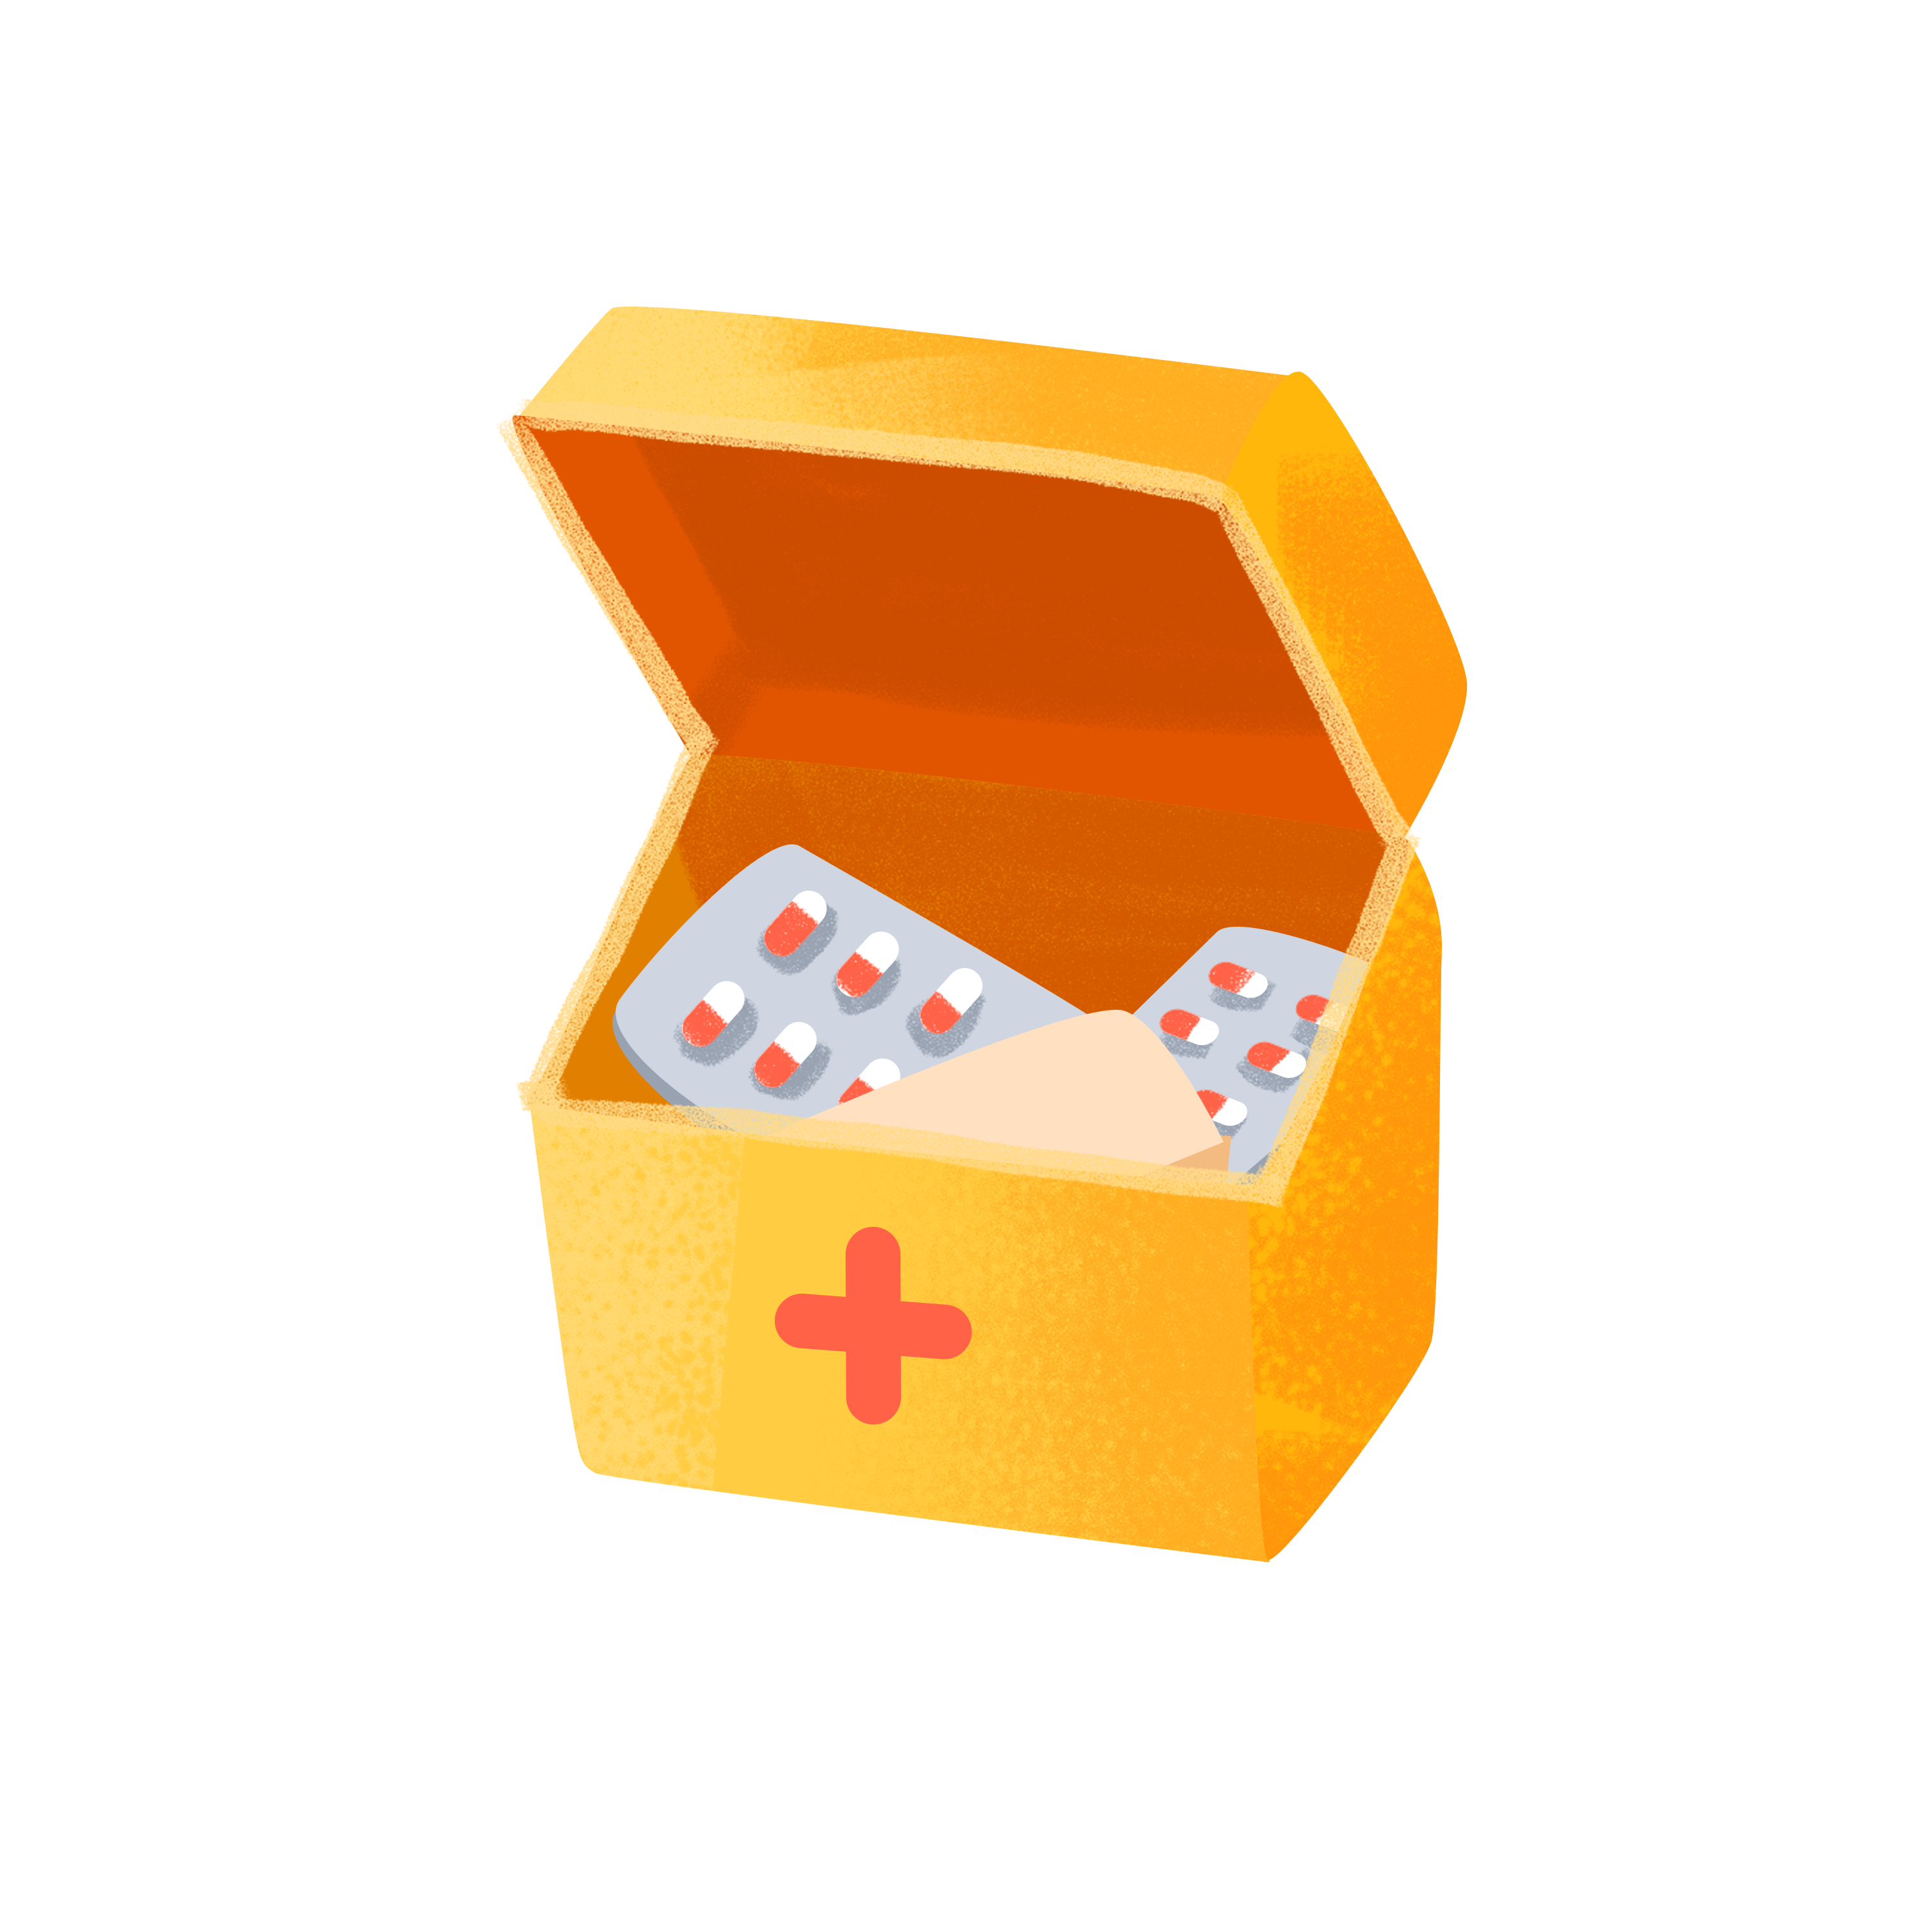
Who are the characters?
How did they interact with each other?
Mom
“You’ll need that once you’re at school,” Mom pointed out. “You won’t have to chase down the campus nurse for every cough.”
Several months before, my high school graduation party
Emily
I
I shrugged at this thought.
timeline
indifferent,
disapproving
Not long after
slipped
barely thought about it
“Anybody have a bandage? Emily got her arm burnt!”
I made many friends in college with the help of my first-aid kit
plotline
Would she change her attitude toward this special first-aid kit?
When? How?
The process of helping Emily with the help of my first-aid kit
One day
para.1

Slide 5

para. 2
I
a young friend
What the symbolic meaning might the first-aid kit have?
I gave a first-aid kit to my young friend as a graduation gift.
Years later
graduation party

Slide 6
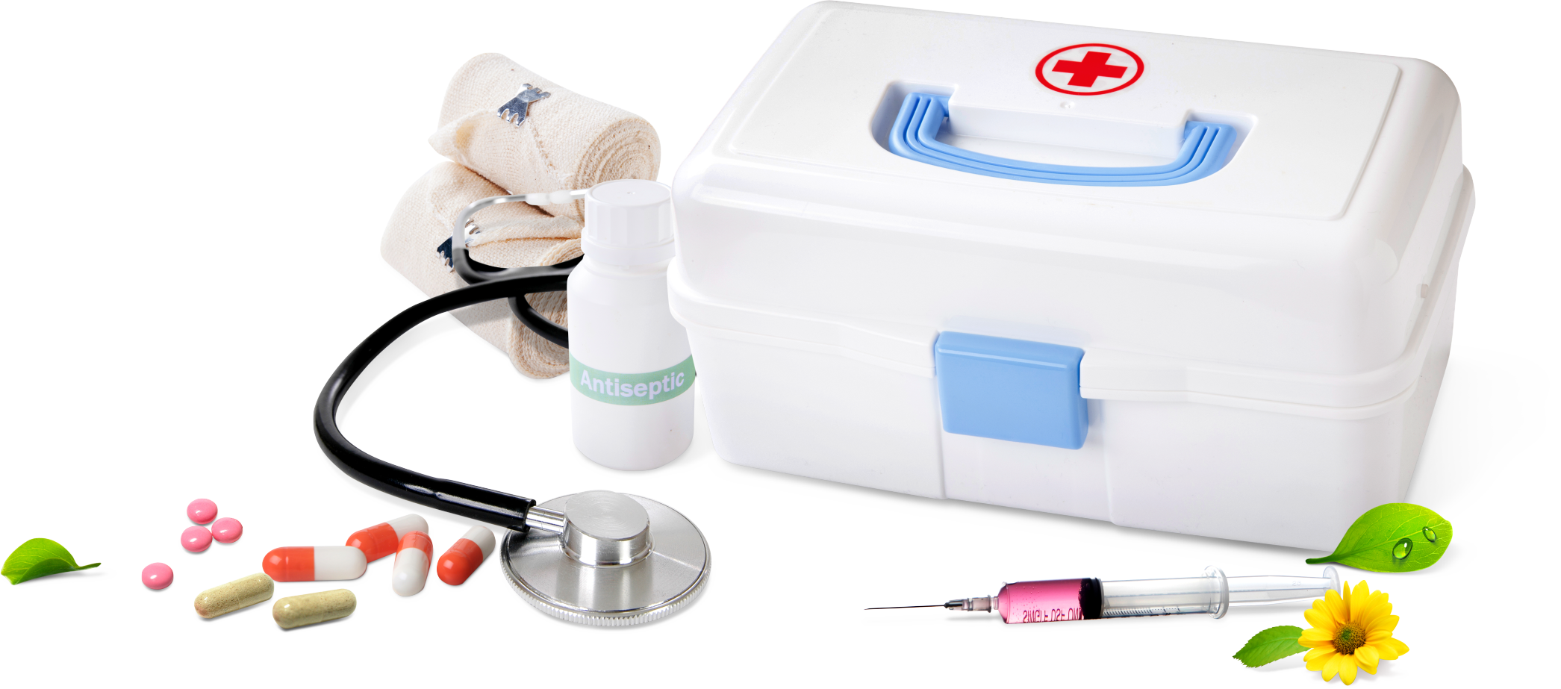
Practical Usage
Symbolic Meaning
medical supplies
an indispensable dormitory staple/ necessity
coming to the rescue for various minor scrapes and ailments people might encounter
a timely lifesaver
providing a sense of comfort and security in a moment of vulnerability

Slide 7
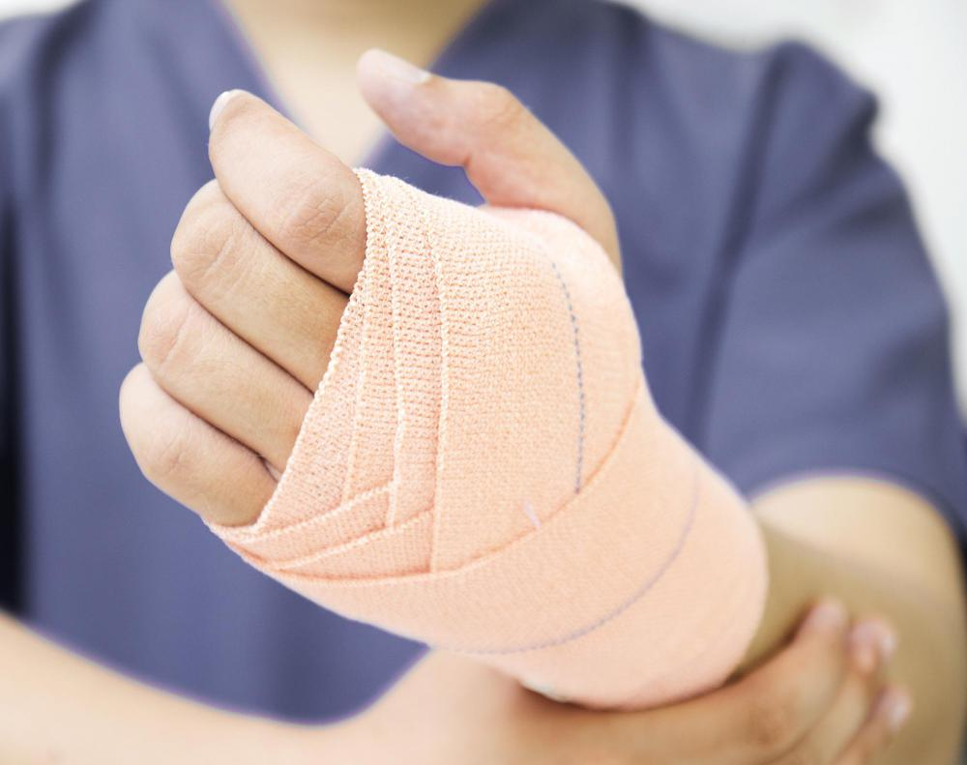
Practical Usage
Symbolic Meaning
a stripe of fabric used especially to cover, dress, and bind up wounds
(a medical supply)
a catalyst (催化剂) for our friendship
a symbol of care, a token of compassion, and a potential bridge to form new friendships
a reminder that simple acts of kindness can create strong bonds between people
reminding us all to be ready to lend a helping hand and, perhaps, forge a lasting friendship

Slide 8
Paragraph 1: I remembered my little first-aid kit.
Paragraph 2: Years later, I received a party invitation from a young friend who was graduating from high school.
The process of helping Emily with the help of my first-aid kit
1. How did I find my first-aid kit?
2. How did I help Emily with her burns?
3. How did Emily react? How about other students?
4. How did my attitude change toward the unexpected gift?
5. How did the first-aid kit change my college life?
I made many friends in college with the help of my first-aid kit
indifferent,
disapproving
admiring,
appreciative
1. What gift did I decide to give? Why?
2. How did I prepare the gift?
3. How did the young friend react?
4. What’s my reflection or feeling? (ending)
I gave a first-aid kit to my young friend as a graduation gift.

Slide 9
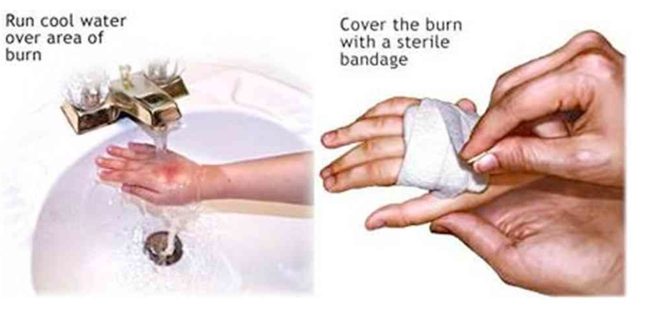
How to treat burns?
“A first aid kit? Inside it were a small packet of pills, pain-killers, creams, ointments (药膏), an insect sprayer (喷雾), a tape, pads of gauze (纱布) and bandages.”
Place the burned area under running cool water for at least 5 minutes to reduce swelling.
Apply a thin layer of burn cream or ointment to the area to soothe it.
Place a sterile (无菌的) gauze pad over the cream or ointment-covered burn.
Secure the gauze in place with tape (胶带).
Wrap a loose bandage around the gauze to keep the dressing in place, ensuring it’s not too tight to avoid restricting blood flow.

Slide 10



Set phrases for reference
匆忙翻找
rifled through
rummaged through
digged through
my mind wandered/ went back to
sth. brought back memories of
I found myself thinking back to...
Memories flooded back to...
My thoughts drifted back to...
I was transported back in my mind to...
思绪回到
her jaw dropped
her eyes widened in surprise
she stared in disbelief at...
she gasped in surprise when...
her face registered a look of disbelief as...
震惊

Slide 11
One possible version:
Paragraph 1: I remembered my little first-aid kit. Grabbing my package in no time, I stormed into the hall where I saw Emily sitting on the floor, her face contorted in pain, her arm reddened and swollen. Kneeling beside her and gently unwrapping the first-aid kit, I quickly yet carefully cleaned the burned area with the antiseptic cream, applied a gauze pad to the burn, and secured it with a bandage. Emily’s eyes were filled with tears, but she still managed a grateful nod. “Thank you,” she whispered, her voice hoarse. “It’s okay,” I reassured her. Soon, many of the other girls heard of my little kit and paid me a visit for various needs. The little gift I had questioned now led me toward new friendships. As it broke diseases, it also broke the ice, allowing me to meet and befriend many in the dorm.
Paragraph 2: Years later, I received a party invitation from a young friend who was graduating from high school. Eager as I was to attend her party, I was at a loss what gift to prepare. Then like a bolt out of the blue, memories of my own party rushed back to me, and I smiled at the opportunity presenting itself. As I drove to the pharmacy, I knew exactly what gift I would give her: a first-aid kit. When I arrived at her party with the very gift for her, her eyes widened in surprise at it, exactly as what I did years ago. I smiled and explained the depth and meaning behind my choice. It was not just a first-aid kit but a chance to be a friend. Knowing the whole story, she took it and winked at me, “Yes, it is bandage for bond”.

Slide 12
下水作文:
Paragraph 1:
I remembered my little first-aid kit. Without wasting a moment, I rummaged through my dorm drawer and pulled it out. Hurriedly, I grabbed the bandages and raced down the hallway towards the source of the commotion. Emily’s arm was badly burned, and she was in obvious discomfort. Without saying a word, I applied ointment to the burn and wrapped the bandage around her arm. Emily’s frown soon softened and her face lit up with gratitude as she repeated “thanks”. In that instant, I appreciated the foresight of the person who had gifted me the first-aid kit. What I had once shrugged off as an odd gift had been transformed into a valuable asset in my dormitory - a lifesaver not just for me, but for my dorm mates as well. We used it repeatedly throughout our college years for various injuries and ailments.
Paragraph 2:
Years later, I received a party invitation from a young friend who was graduating from high school. As I brainstormed gift options, memories of my own graduation and the valuable first-aid kit came flooding back. Inspired by my past experience, I decided to pass on this thoughtful tradition. I carefully put together a first-aid kit, stocked with bandages and other essential medical supplies, just like the one I had received. At the graduation party, I presented the kit to my friend, whose eyes widened in apparent disbelief at my “special” choice. After explaining my own story to her, I could see the appreciation and understanding in her eyes. This time, I knew I had made the right decision, and I bet that the bandages would also become a bond between her and her schoolmates at college, helping to forge lasting friendships.
下水作文:
Paragraph 1:
I remembered my little first-aid kit. Without wasting a moment, I rummaged through my dorm drawer and pulled it out. Hurriedly, I grabbed the bandages and raced down the hallway towards the source of the commotion. Emily’s arm was badly burned, and she was in obvious discomfort. Without saying a word, I applied ointment to the burn and wrapped the bandage around her arm. Emily’s frown soon softened and her face lit up with gratitude as she repeated “thanks”. In that instant, I appreciated the foresight of the person who had gifted me the first-aid kit. What I had once shrugged off as an odd gift had been transformed into a valuable asset in my dormitory - a lifesaver not just for me, but for my dorm mates as well. We used it repeatedly throughout our college years for various injuries and ailments.
Paragraph 2:
Years later, I received a party invitation from a young friend who was graduating from high school. As I brainstormed gift options, memories of my own graduation and the valuable first-aid kit came flooding back. Inspired by my past experience, I decided to pass on this thoughtful tradition. I carefully put together a first-aid kit, stocked with bandages and other essential medical supplies, just like the one I had received. At the graduation party, I presented the kit to my friend, whose eyes widened in apparent disbelief at my “special” choice. After explaining my own story to her, I could see the appreciation and understanding in her eyes. This time, I knew I had made the right decision, and I bet that the bandages would also become a bond between her and her schoolmates at college, helping to forge lasting friendships.
下水作文:
Paragraph 1:
I remembered my little first-aid kit. Without wasting a moment, I rummaged through my dorm drawer and pulled it out. Hurriedly, I grabbed the bandages and raced down the hallway towards the source of the commotion. Emily’s arm was badly burned, and she was in obvious discomfort. Without saying a word, I applied ointment to the burn and wrapped the bandage around her arm. Emily’s frown soon softened and her face lit up with gratitude as she repeated “thanks”. In that instant, I appreciated the foresight of the person who had gifted me the first-aid kit. What I had once shrugged off as an odd gift had been transformed into a valuable asset in my dormitory - a lifesaver not just for me, but for my dorm mates as well. We used it repeatedly throughout our college years for various injuries and ailments.
Paragraph 2:
Years later, I received a party invitation from a young friend who was graduating from high school. As I brainstormed gift options, memories of my own graduation and the valuable first-aid kit came flooding back. Inspired by my past experience, I decided to pass on this thoughtful tradition. I carefully put together a first-aid kit, stocked with bandages and other essential medical supplies, just like the one I had received. At the graduation party, I presented the kit to my friend, whose eyes widened in apparent disbelief at my “special” choice. After explaining my own story to her, I could see the appreciation and understanding in her eyes. This time, I knew I had made the right decision, and I bet that the bandages would also become a bond between her and her schoolmates at college, helping to forge lasting friendships.
下水作文:
Paragraph 1:
I remembered my little first-aid kit. Without wasting a moment, I rummaged through my dorm drawer and pulled it out. Hurriedly, I grabbed the bandages and raced down the hallway towards the source of the commotion. Emily’s arm was badly burned, and she was in obvious discomfort. Without saying a word, I applied ointment to the burn and wrapped the bandage around her arm. Emily’s frown soon softened and her face lit up with gratitude as she repeated “thanks”. In that instant, I appreciated the foresight of the person who had gifted me the first-aid kit. What I had once shrugged off as an odd gift had been transformed into a valuable asset in my dormitory - a lifesaver not just for me, but for my dorm mates as well. We used it repeatedly throughout our college years for various injuries and ailments.
Paragraph 2:
Years later, I received a party invitation from a young friend who was graduating from high school. As I brainstormed gift options, memories of my own graduation and the valuable first-aid kit came flooding back. Inspired by my past experience, I decided to pass on this thoughtful tradition. I carefully put together a first-aid kit, stocked with bandages and other essential medical supplies, just like the one I had received. At the graduation party, I presented the kit to my friend, whose eyes widened in apparent disbelief at my “special” choice. After explaining my own story to her, I could see the appreciation and understanding in her eyes. This time, I knew I had made the right decision, and I bet that the bandages would also become a bond between her and her schoolmates at college, helping to forge lasting friendships.
下水作文:
Paragraph 1:
I remembered my little first-aid kit. Without wasting a moment, I rummaged through my dorm drawer and pulled it out. Hurriedly, I grabbed the bandages and raced down the hallway towards the source of the commotion. Emily’s arm was badly burned, and she was in obvious discomfort. Without saying a word, I applied ointment to the burn and wrapped the bandage around her arm. Emily’s frown soon softened and her face lit up with gratitude as she repeated “thanks”. In that instant, I appreciated the foresight of the person who had gifted me the first-aid kit. What I had once shrugged off as an odd gift had been transformed into a valuable asset in my dormitory - a lifesaver not just for me, but for my dorm mates as well. We used it repeatedly throughout our college years for various injuries and ailments.
Paragraph 2:
Years later, I received a party invitation from a young friend who was graduating from high school. As I brainstormed gift options, memories of my own graduation and the valuable first-aid kit came flooding back. Inspired by my past experience, I decided to pass on this thoughtful tradition. I carefully put together a first-aid kit, stocked with bandages and other essential medical supplies, just like the one I had received. At the graduation party, I presented the kit to my friend, whose eyes widened in apparent disbelief at my “special” choice. After explaining my own story to her, I could see the appreciation and understanding in her eyes. This time, I knew I had made the right decision, and I bet that the bandages would also become a bond between her and her schoolmates at college, helping to forge lasting friendships.
underline the symbolic meaning of the first-aid kit.
对标阅卷：
评分时，应从内容、词汇、语法和语篇结构三个方面考虑，具体为：
(1)续写内容的质量、完整性以及与原文情境的融洽度。
(2)所使用词汇和语法结构的准确性，恰当性和多样性。
(3)上下文的衔接和全文的连贯性。

