Slide 1


感恩遇见，相互成就，本课件资料仅供您个人参考、教学使用，严禁自行在网络传播，违者依知识产权法追究法律责任。
更多教学资源请关注
公众号：溯恩英语
知识产权声明

Slide 2



Slide 3

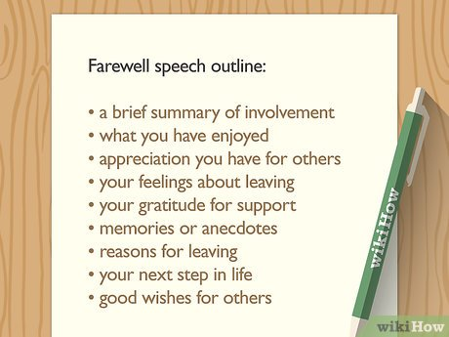

Slide 4
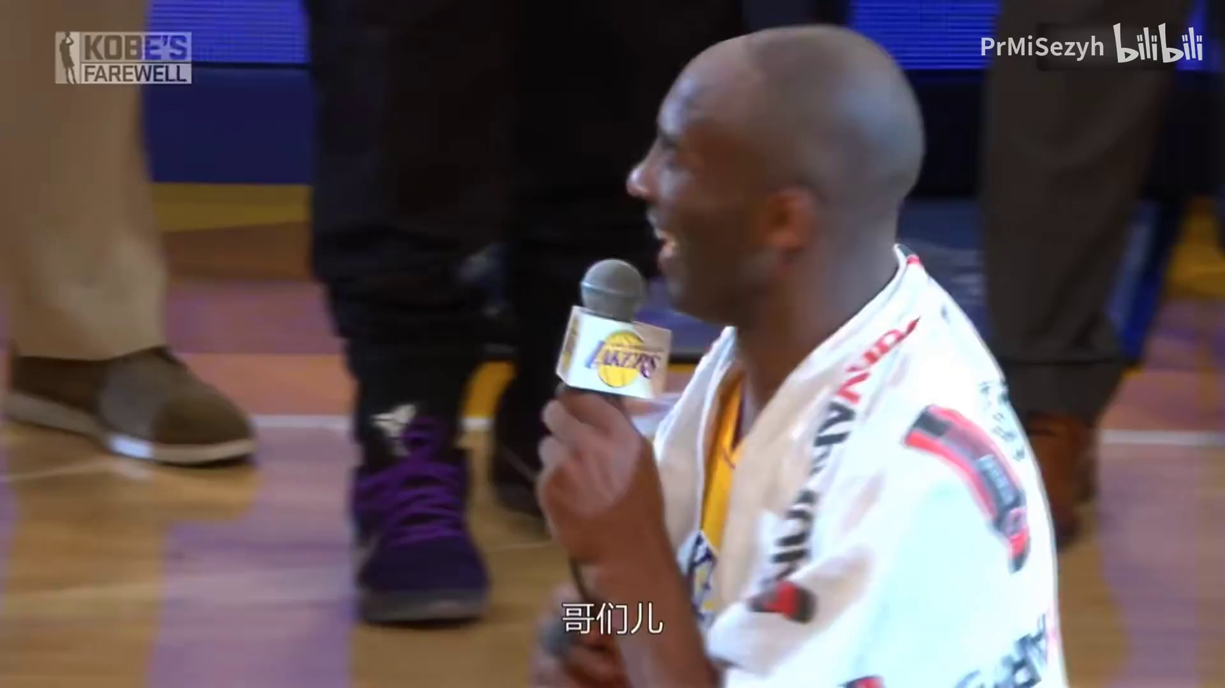

content
language
Harry Truman’s presidential farewell speech, 1953
My fellow Americans,
I am happy to have this opportunity to talk to you once more before I leave the White House.
Next Tuesday, General Eisenhower will be inaugurated as President of the United States. A short time after the new President takes his oath of office, I will be on the train going back home to Independence, Missouri. I will once again be a plain, private citizen of this great Republic.
… During the last 2 months I have done my best to make this transfer an orderly one. I have talked with my successor on the affairs of the country, both foreign and domestic, and my Cabinet officers have talked with their successors. I want to say that General Eisenhower and his associates have cooperated fully in this effort. Such an orderly transfer from one party to another has never taken place before in our history. I think a real precedent has been set.
In speaking to you tonight, I have no new revelations to make--no political statements-no policy announcements. There are simply a few things in my heart that I want to say to you. I want to say "goodby" and "thanks for your help." And I want to talk to you a little while about what has happened since I became your President.
background information
Showing sincerity
Engaging the audience
Using rhetorical devices
memories
(memorable, specific, shared)
appreciation
farewell
wishes

Slide 5



content
（2024 苏锡常镇二模）假定你是某国际学校学生李华，因高三毕业即将退出校篮球队，请你在退队仪式上用英文发表告别演说，内容包括：
1. 回顾往昔；
2. 表示感谢；
3. 祝福球队。
background information
memories
appreciation
farewell
wishes

Slide 6

background information
I feel blessed to have this cherished opportunity to bid farewell to you all before I leave our school basketball team.
How time flies! It’s been three years since I joined you, and it’s time to say goodbye!
Time is fleeting. Hard as it is, I have to leave you, my bros!

Slide 7
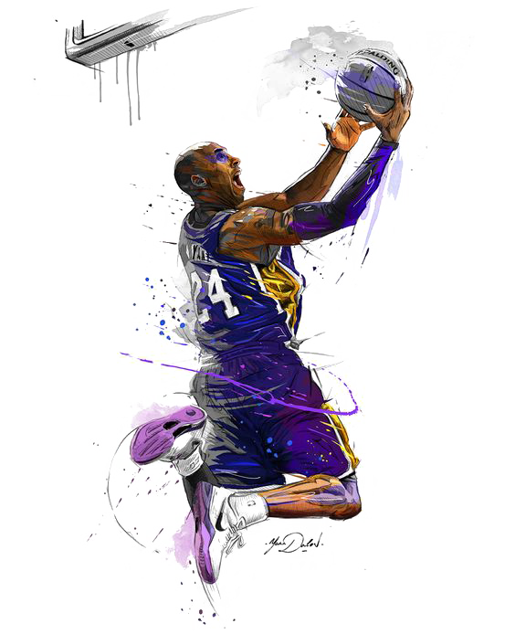
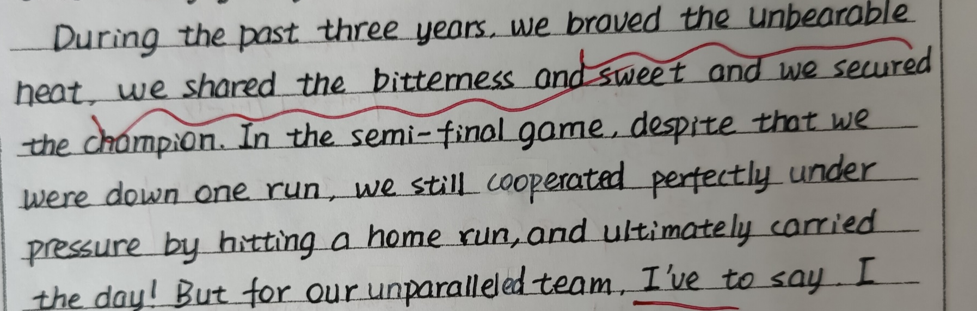
memories
(memorable, specific, shared)
Using rhetorical devices
hit a home run 击出全垒打（棒球比赛）
During the past three years, we have braved the unbearable heat on the basketball court, we have shared the bitterness and sweetness, and we have secured championships in successive matches. In the semi-final, despite being one run down, we still cooperated perfectly under pressure, made a three-point shot, and ultimately won the day!
general
specific
vivid description
(specific nouns & adjectives)
parallelism
examples
contrast

Slide 8
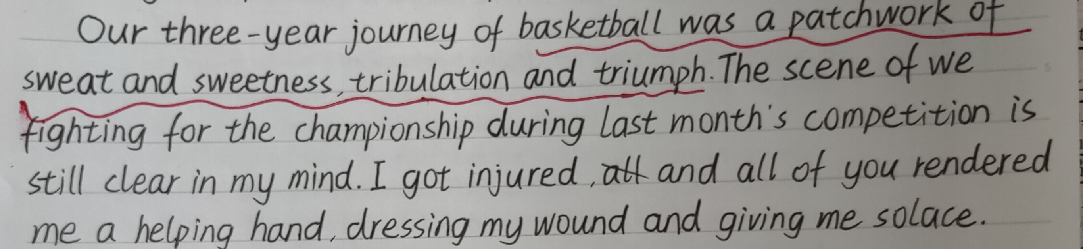

memories
(memorable, specific, shared)
Using rhetorical devices
general
specific
theme-related
Our three-year journey with basketball was a patchwork of sweat and sweetness, tribulation and triumph. The scene of we preparing hard for the championship during last month’s competition is still vivid in my mind. I got injured in the training and all of you, instead of stepping away, rendered my tremendous support and solace. That's when I realized that victory was merely the icing on the cake of our team spirit.
alliteration
contrast
analogy 类比

Slide 9

appreciation
Showing sincerity Engaging the audience
ways to show appreciation
Words fail to convey my heartfelt gratitude to you for...
Without/ But for/ Had it not been for..., we wouldn’t have done...
Hereby I’d like to extend my earnest appreciation to you for...
I feel indebted to you for...
It was ... that...
Our achievements are attributed to every member of the team. Without our collective solidarity, perseverance, and support, we would not have secured a glorious past, a bright present, and a promising future. I am truly blessed to share a common goal with you all.
I am indebted to each and every one of you. Without this exceptional team, I would not have become such a bold and independent warrior.

Slide 10

farewell+ wishes
theme-related
Once again, goodbye, bros! Tomorrow may be challenging, but with your joint efforts, our team will surely turn over a new leaf and usher in an even more glorious future.
Farewell, and may success and happiness follow each one of us on our respective journeys. Thank you.

Slide 11
A possible version:
My dear teammates,
I find it hard to say goodbye. Meanwhile, I feel incredibly fortunate to have spent three years practising with you, (background) which has truly given me some of the best moments of my life. The championship we claimed last semester will serve as a constant reminder of our everlasting friendship. (memories)
It seems impossible to express my gratitude to all of you. All of my coaches and teammates, the influence you have made on me is immeasurable. Your love and care will carry me through what the next chapter has in store for me. (appreciation)
With your passion and commitment, I believe that our team will achieve more feats (功绩) and have a prosperous future. (wishes)

Slide 12
My version:
My dear teammates,
How time flies! It’s pretty hard for me to bid farewell to you all. (background)
Looking back on the cherished time spent with you, we sweated on the basketball court, strove for glorious moments, and savored both the bitterness and bliss during the journey. Every piece of memory remains vivid and will forever echo in my mind. (memories) Though it marks the end of my basketball career here, it heralds (预示着) a new chapter in my life. You have all helped shape me into a better person- my beloved brothers, as well as our diligent coaches. Without you and our joint endeavors, we wouldn’t have achieved so much, nor would we have become such a tight-knit family! (appreciation)
I feel blessed to have you all with me in my high school life. May our paths continue to cross, and may our team soar to even greater heights. Best wishes, and stay in touch! (wishes)
vivid description
(specific nouns & adjectives)
parallelism
alliteration
contrast

Slide 13
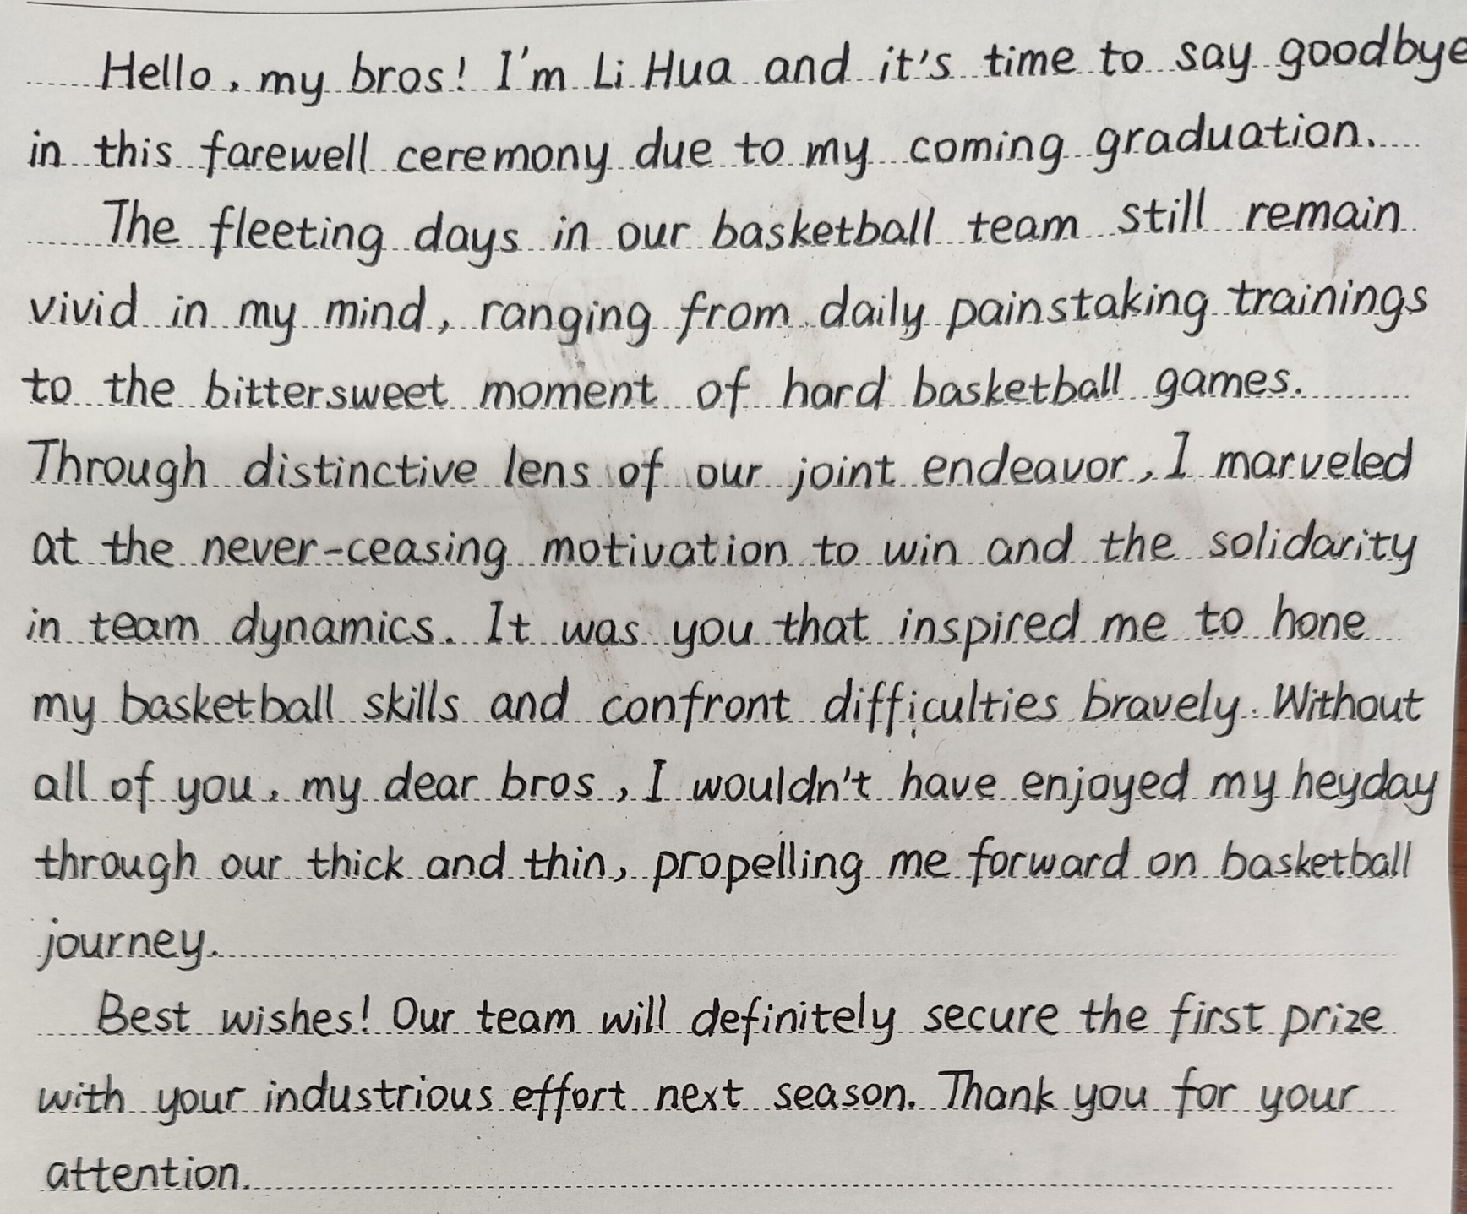
Appreciation:
Showing sincerity
Engaging the audience
Using rhetorical devices

Slide 14


