Slide 1


感恩遇见，相互成就，本课件资料仅供您个人参考、教学使用，严禁自行在网络传播，违者依知识产权法追究法律责任。
更多教学资源请关注
公众号：溯恩英语
知识产权声明

Slide 2


冰雪运动征文
2024年5月湖北省T8联盟压轴卷应用文讲评
海亮高级中学 陈虹

Slide 3
征文写作技巧
PART 01

Slide 4
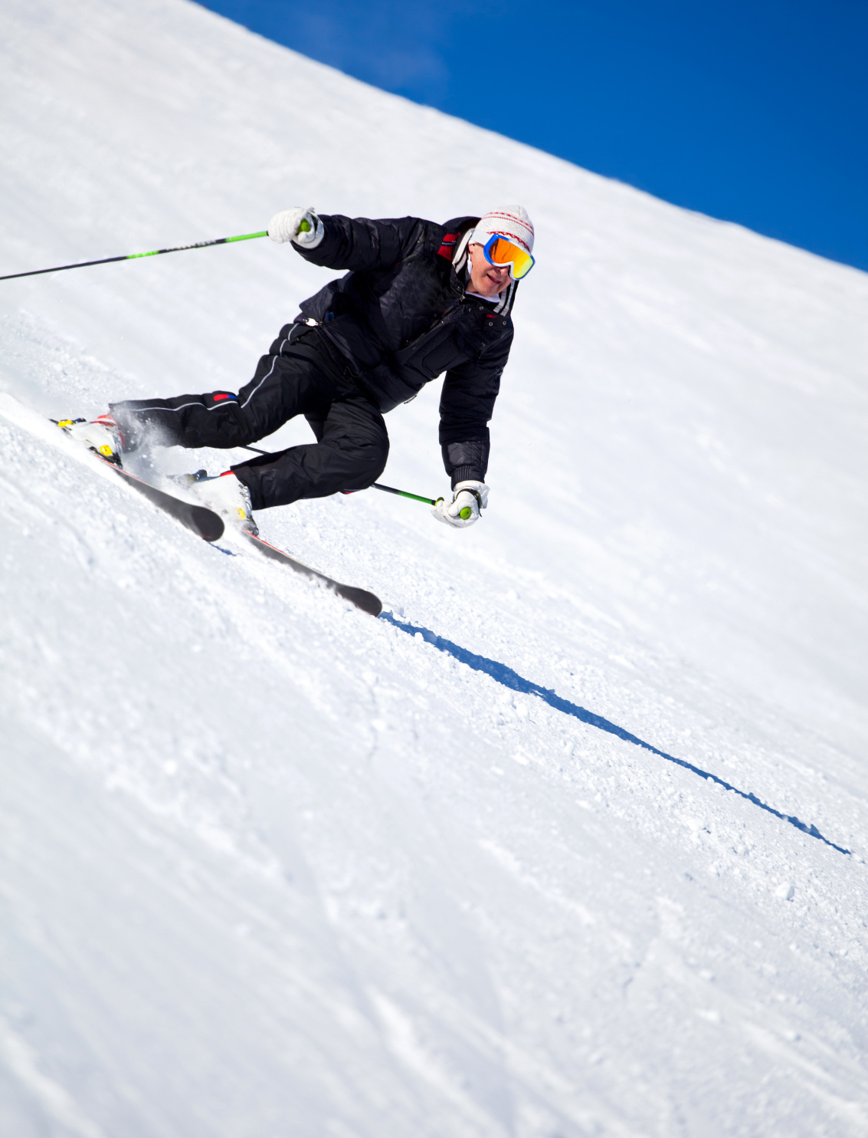

紧扣主题
01
明确主题
在开始写作之前，要明确征文的主题，确保文章内容与主题紧密相关。
02
围绕主题展开
在写作过程中，要紧扣主题，围绕主题展开论述，避免偏离主题。
03
结尾点题
在文章的结尾部分，要再次点明主题，强调文章的中心思想。

Slide 5

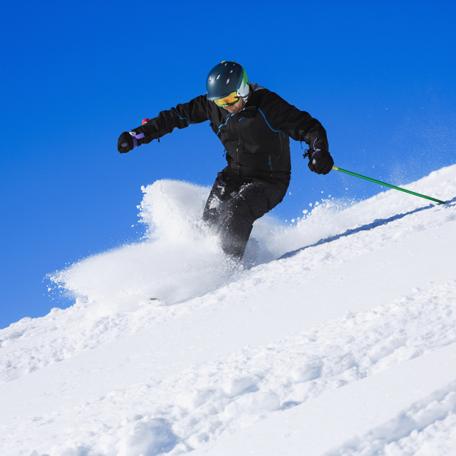

逻辑清晰
明确主题
合理布局
连贯表达
在开始写作之前，明确征文的主题，确保文章内容紧紧围绕主题展开。
合理安排文章的结构，使文章层次分明，逻辑清晰。
在文章中，使用连贯的语言表达，避免出现跳跃性思维，使读者更容易理解文章的内容。

Slide 6
语言地道
01
02
03
使用地道的词汇和表达
注意语法和句型
模仿优秀作品
在写作中，尽量使用地道的词汇和表达，避免使用过于生硬的翻译或过于简单的词汇。
在写作中，要注意语法和句型，避免出现语法错误或句型混乱。
在阅读优秀的冰雪运动征文时，可以模仿其语言风格和表达方式，以提高自己的写作水平。

Slide 7
审题
PART 02

Slide 8
审题
假定你是李华，中国冬奥会后，冰雪运动广受欢迎。你校英语报以此为主题举行征文比赛。请你写一篇短文投稿，内容包括：
1.冰雪运动的好处；
2.冰雪运动时的注意事项。
注意：
1.写作词数应为80左右；
2.请按如下格式在答题卡的相应位置作答。
文体：稿件
人称：第三人称为主
对象：学校师生
时态：一般现在时为主
要点：好处+注意事项

Slide 9
审题
假定你是李华，中国冬奥会后，冰雪运动广受欢迎。你校英语报以此为主题举行征文比赛。请你写一篇短文投稿，内容包括：
1.冰雪运动的好处；
2.冰雪运动时的注意事项。
注意：
1.写作词数应为80左右；
2.请按如下格式在答题卡的相应位置作答。
Topic：“冰雪运动”
related

Slide 10
谋篇布局
PART 03

Slide 11
P1：开门见山-导入主题（投稿主题）
The opening paragraph should introduce the topic, set the tone, and, if possible, entice the editor's interest.
引人入胜的问题
描述性场景
引用名言
稿件类开头
幽默或轻松的开场
统计数据或事实
背景信息
个人故事或经历
设问法

Slide 12
P1：开门见山-导入主题（投稿主题）
The opening paragraph should introduce the topic, set the tone, and, if possible, entice the editor's interest.
The success of the Winter Olympics in China has sparked a surge in the popularity of ice and snow sports, bringing numerous benefits.
背景信息介绍
Have you ever imagined gliding effortlessly across a frozen lake under a crisp winter sky, or carving through powdery snow on a snowy mountain slope—this is the thrill of ice and snow sports!
引人入胜的问题或陈述
The opening of a manuscript-style application essay typically has the following characteristics:
Concise、Clear、Eagaging、Setting the tone
"The highest appreciation is not to victory, but to competition; the joy is not in finishing an endeavor, but in the struggle of accomplishment." Embracing Jess Walter's sentiment, let's delve into the exhilarating world of winter sports, where the spirit of competition and the joy of personal achievement truly come alive
引用或名言
Are you ready to trade the warmth of your home for the exhilarating chill of the slopes? To swap the comfort of the indoors for the breathtaking vistas of a snow-covered mountain? If your answer is a resounding 'yes,' then you're already on the path to discovering the thrilling world of winter sports.
设问法

Slide 13
P2：主题---好处+注意事项
假定你是李华，中国冬奥会后，冰雪运动广受欢迎。你校英语报以此为主题举行征文比赛。请你写一篇短文投稿，内容包括：
1.冰雪运动的好处；
2.冰雪运动时的注意事项。
注意：
1.写作词数应为80左右；
2.请按如下格式在答题卡的相应位置作答。
主要问题： 1. 内容杂乱、语言拖沓
2. 两个要点没有衔接
写作前的brainstorm非常重要，打开自己的思维，言简意赅、点到为止

Slide 14
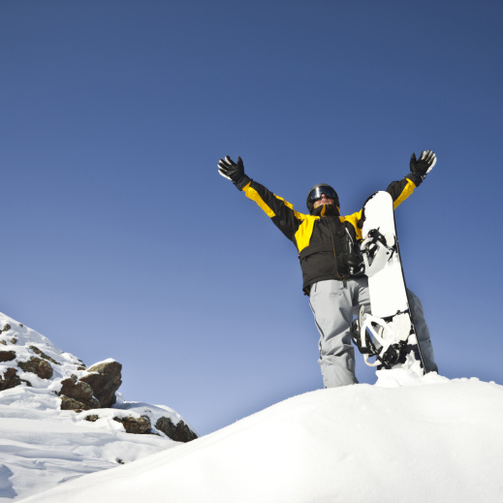
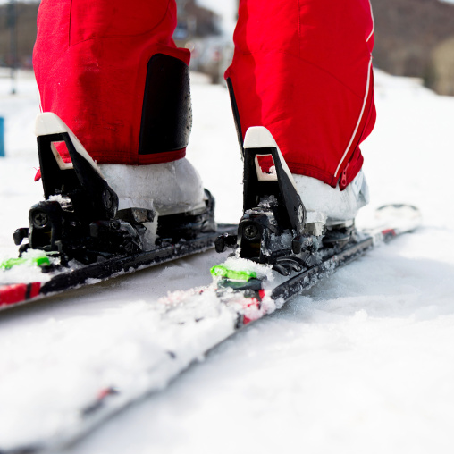
P2：主体---好处+注意事项
好处
boost cardiovascular health
enhance balance and coordination
Body
strengthen muscles
......
release the stress
cultivate the spirit of perseverance
Mind
increase self-confidence
句型：Not only ...but also . Meanwhile.....
....not just ...; it's also ....
....offers ...., from ...to ....
It's an opportunity to ...., to ......., and to .......
......

Slide 15
例：First of all, not only does it enhance physical fitness and promote a healthier lifestyle，but it also fosters teamwork and a competitive spirit among young people. Meanwhile , it presents significant opportunities for the tourism industry.
This serene yet invigorating setting is not just a feast for the eyes; it's also a playground for the body and soul. Engaging in winter sports offers a multitude of benefits, from boosting cardiovascular health to enhancing balance and coordination. It's an opportunity to challenge oneself, to push boundaries, and to revel in the invigorating cold.
Not only do they provide an excellent form of cardiovascular exercise, but they also strengthen muscles and improve balance. Plus, there's the added mental boost of fresh air and scenic beauty, which can significantly reduce stress.

Slide 16
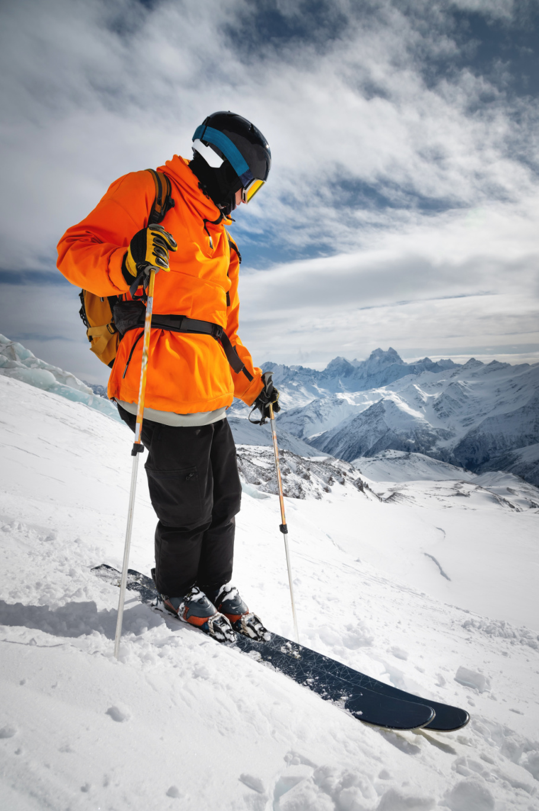
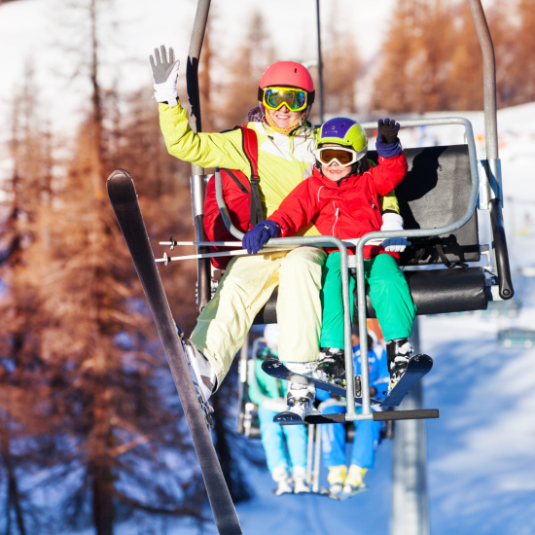
P2：主体---好处+注意事项
注意事项
与上一个要点如何衔接？
follow rules
wear protective equipment
Safety
follow the instructors
......
句型：it is important to...
Always wear ...., be aware of ....., and listen to ......
Remember to equip ... with ...., respect ...., and stay ....
Ensure you ......to enjoying these sports to the fullest.
It's essential to.....
watch the weather
Arrangement
warm up
......

Slide 17
例：However, it is important to prioritize safety by following rules and wearing protective equipment. Respecting the natural environment and preserving ice and snow resources are also crucial.
But remember, safety is the key. Equip yourself with the right gear, stay hydrated, and heed the weather.
But with adventure comes the need for caution. Always prioritize safety: wear layers to stay warm, use protective equipment, and know your limits.
Yet, as you lace up your boots, remember the essentials: proper attire, hydration, and awareness of your surroundings.

Slide 18
P3：结尾
号召行动
稿件类结尾
总结要点
展望未来
启发和感受

Slide 19
P3：结尾
总结性结尾
In essence, embrace winter's thrills, but never overlook safety.
Briefly, winter sports: exhilarating, beneficial, and demanding of caution.
号召性结尾
Let's embrace this trend and ensure the continued growth of ice and snow sports in China!
Let's hit the slopes responsibly. Winter awaits!
展望性结尾
As seasons turn, so do opportunities. Look forward to winter's embrace.
Winter's end marks spring's start. Keep the spirit of sports alive.

Slide 20
优秀范文
PART 04

Slide 21
Version 1:
The success of the Winter Olympics in China has sparked a surge in the popularity of ice and snow sports, bringing numerous benefits.
First of all, Not only does it enhance physical fitness and promote a healthier lifestyle，but it also fosters teamwork and a competitive spirit among young people. Meanwhile , it presents significant opportunities for the tourism industry. However, it is important to prioritize safety by following rules and wearing protective equipment. Respecting the natural environment and preserving ice and snow resources are also crucial.
Let's embrace this trend and ensure the continued growth of ice and snow sports in China!

Slide 22
Version 2:
The charm of winter sports has captivated us since the grand Chinese Winter Olympics.
Engaging in these activities not only strengthens our bodies but also invigorates our spirits. Skiing, for instance, enhances balance and agility, while ice skating improves cardiovascular health.However, with the excitement comes the responsibility to be safe. Adequate preparation is key: dress in layers to retain warmth, and always wear protective gear. Stay hydrated and be aware of your surroundings. Know your limits and listen to experienced guides. By taking these precautions, we can enjoy the thrill of winter sports to the fullest.
In conclusion, winter sports are a fantastic way to stay fit and enjoy the beauty of the season. With safety in mind, let's embrace the frosty fun and make the most of the snowy slopes and icy rinks.

Slide 23
Version 3:
Imagine gliding effortlessly across a frozen lake under a crisp winter sky, or carving through powdery snow on a snowy mountain slope—this is the thrill of ice and snow sports!
With the immense popularity of winter sports following the Chinese Winter Olympics, many are discovering the joys and health benefits of engaging with the frosty elements. Not only do they provide an excellent form of cardiovascular exercise, but they also strengthen muscles and improve balance. However, safety is crutial when partaking in winter sports. Always wear appropriate gear, be aware of your surroundings, and listen to the advice of experienced guides or instructors.
Let's embrace the icy charm and snowy allure, but let's do it wisely and safely.

Slide 24
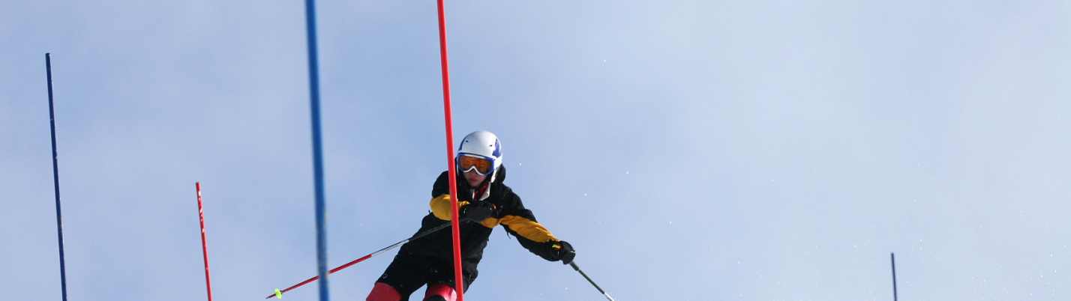
谢谢

