Slide 1


感恩遇见，相互成就，本课件资料仅供您个人参考、教学使用，严禁自行在网络传播，违者依知识产权法追究法律责任。
更多教学资源请关注
公众号：溯恩英语
知识产权声明

Slide 2

2405温州三模应用文讲评 WHEN ENGLISH MEETS THE ARTS -A Contribution To The School English Newspaper

Slide 3
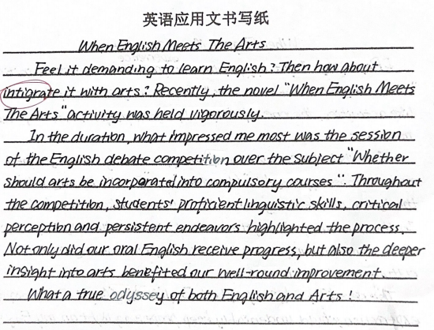
你校英文报就最近举办的“当英语遇上艺术” (When English Meets The Arts) 系列活动开展征文.请你 写一篇短文，分享其中让你印象深刻的一项活动，内容包括： 1.活动介绍；2. 你的感想. 注意：1.写作词数应为80左右；2.请按如下格式在答题纸的相应位置作答。
When English Meets The Arts
After reading the requirements, do you think the following writing a good one on account of its structure and contents? Why and why not?
proper opening?
consistent content?

Slide 4
你校英文报就最近举办的“当英语遇上艺术” (When English Meets The Arts) 系列活动开展征文.请你 写一篇短文，分享其中让你印象深刻的一项活动，内容包括： 1.活动介绍；2. 你的感想. 注意：1.写作词数应为80左右；2.请按如下格式在答题纸的相应位置作答。
When English Meets The Arts
I. Genre:
Compare with the News Report:
A contribution
 | Contribution | News Report
Tense
Person
Position
Language/ voice
past
past
1st.
3st.
subjective
objective
casual
emotional
formal
When English Meets The Arts
II. Structure:
Para.1
Para.2
Para.3
Writing Purpose+ Background
About my impressive activity
Thoughts
share my impressive activity
what, who, how, why
Stick to the title!!!
feeling, expectation...
The activity/ English& Arts

Slide 5
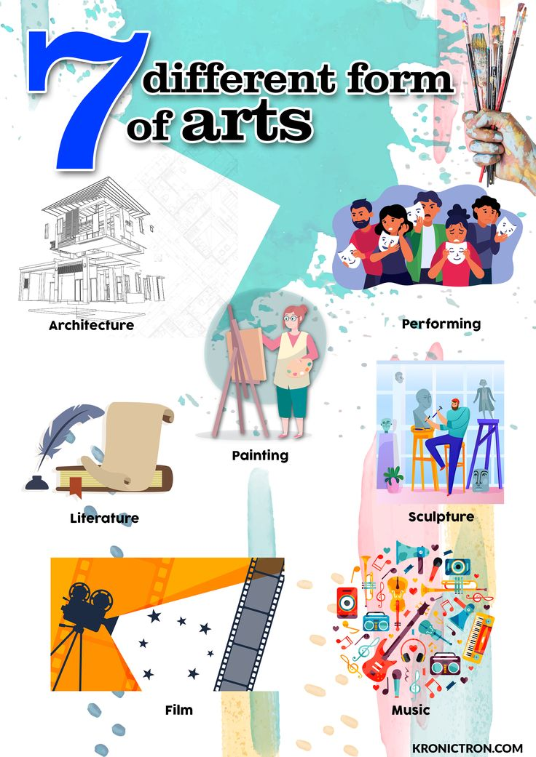

Brainstorm:How could English meet arts?
What are the art forms?
How could English meet them?
Art forms are mediums and practices through which artists express their creativity, emotions and ideas.
- English Drama Showcase
- English Film Appreciation
- Script Writing and Performance
- English Song Choir
- Book Cover Design Contest
- Favorite Artwork Presentation
- English Comics Creation
- Musical Lyrics Salon
- ....

Slide 6
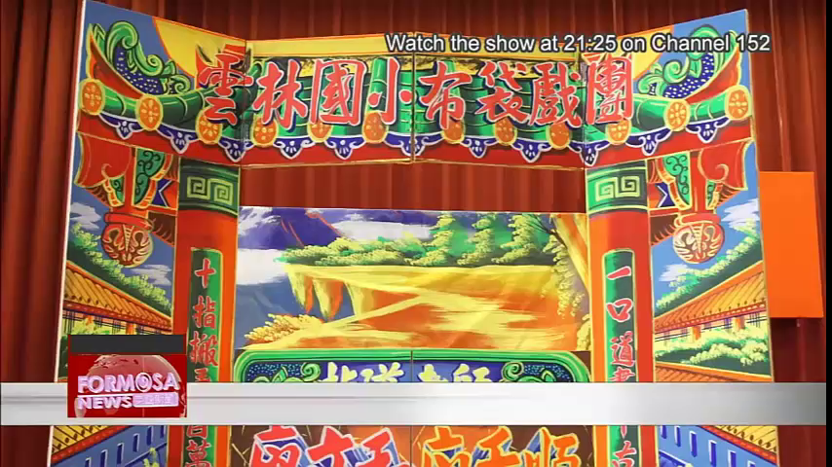
Brainstorm:How could English meet arts?

Slide 7

Brainstorm:How could English meet arts?
Is it enlightening to you?
The Role of English:
The Significance of the Activity:
Merely a tool or a carrier for more?
Merely showcase or inerpret and spread?
Draft your version, exchange the work with your partner’s and check it by the following criteria:
Does Para.1 convey the purpose and tell the background?
Does Para.2 tell the details and highlight both roles?
Does the writing express the deep feeling?

Slide 8
Reference For Language Polish
Proper Opening:
Straightforwardly:
Decorative& Concrete:
Connecting:
Recently, a series event “When English Meets the Arts ” was held at school. The one impressed on me is the English Drama Show.
In the recent remarkable school-wide event, "When English Meets The Arts", the most impressive session for me was the puppet show based on "The Secret Garden".
A remarkable echo from the “When English Meets the Arts” series settling in my memory is the enchanting English Drama Show, a feast of classics and charm of English.
Activity Intro:
Together with the teammates, I interpreted the story in eloquent English while dramatically portraying the narrative through the puppets. [Who, What, Interprete] The dedicated rehearsals refined my English while the committed performance deepened my understanding of of literature and culture. Our innovative performance created a magical ambiance that refreshed the story and captivated everyone’s heart, while the experience also infused in me a new-found appreciation for English as a vibrant art form.[How, Why, Carrier]

Slide 9


Reference For Language Polish
The Ending :
- Tell the feeling and significance either generally or activity-orientedly;
- Combine the two roles;
- Think deeper.
The event was a celebration of how English language could wear various artistic hats, speaking volumes about human wisdom, creativity and imagination.
The poetry recital was a testament to the beauty of the English language, inspiring me to further explore its artistic potential.
In conclusion, this artistic intereaction affirmed English not merely as a tool for communication, but as a vessel for imagination and sentiment. It was indeed an unforgettable.

Slide 10
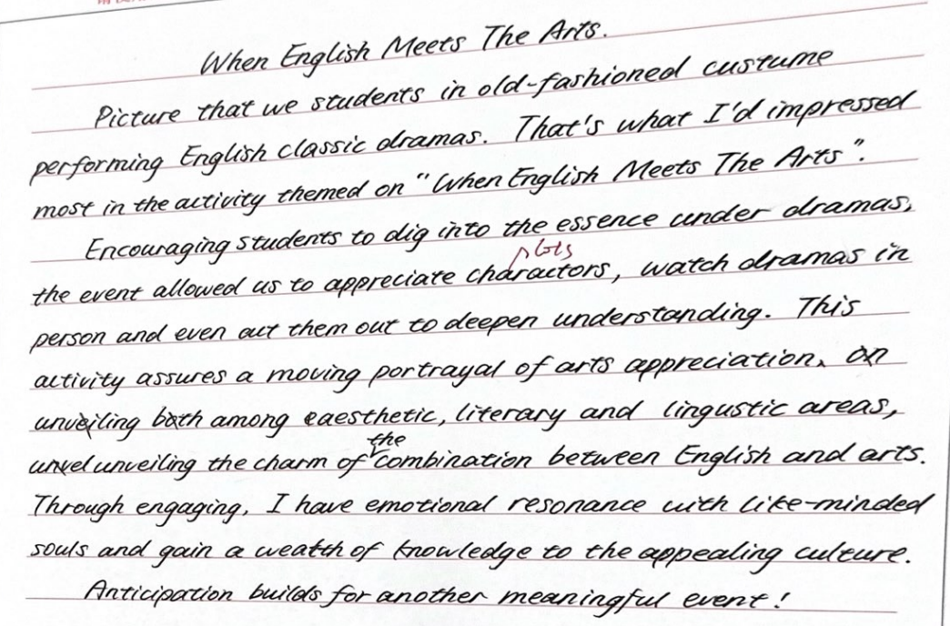
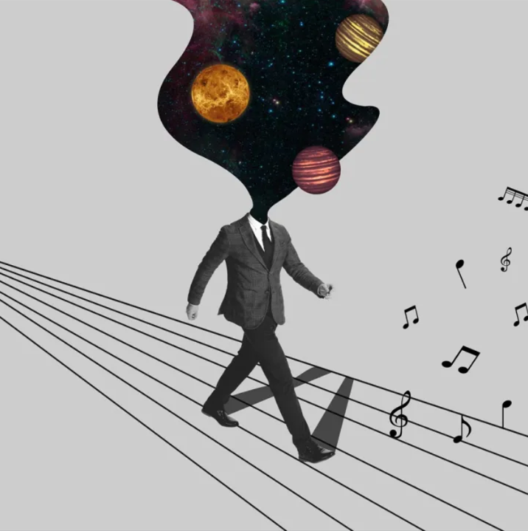
Learn From Peers
生动表达，引起兴趣
前后衔接紧密，扣题到位
活动介绍有细节，总分结合
English与Arts有机结合，相辅相成
表达丰富，用词准确
感受感想有角度

Slide 11

Draw Inferences In The Exam:
【2405 浙江Z20】假设你是李华。上个月，你参加了学校开展的“职业初体验” (My First Experience in Career)实 践活动。现校英文报正向全校学生征集相关稿件。请你写一篇短文投稿，内容包括：
1.你体验的一项职业； 2.你的感受。
注意：
1.写作词数应为80左右；
2. 请按如下格式在答题纸的相应位置作答。
My First Experience in Career

Slide 12

Sample Writing- Official Version
My First Experience in Career
Last month, I had the privilege of participating in our school's initiative, “My First Experience in Career.” It aimed to provide students like me with a glimpse into diverse professions. (background+topic+purpose)
My journey began at a local hospital, where I shadowed as a diligent nurse for a day. Witnessing her interactions with patients, meticulous care, and swift decision-making, I gained a deeper understanding of the immense responsibility and compassion required in this noble profession. It was an eye-opening experience that left me grateful for the healthcare workers who tirelessly save lives. (process+details+feeling)
This practical experience transformed me, increasing my knowledge and igniting ambition. I'm thankful to our school for organizing such a meaningful program and excited for future opportunities. (gains+ feelings)

