Slide 1


感恩遇见，相互成就，本课件资料仅供您个人参考、教学使用，严禁自行在网络传播，违者依知识产权法追究法律责任。
更多教学资源请关注
公众号：溯恩英语
知识产权声明

Slide 2
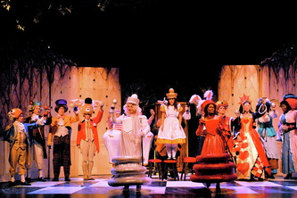


比赛表演类：2024年浙江省五校联盟高三5月联考读后续写讲评
Inner conflict+ Experience + personal growth
郑素红

Slide 3
I stared at myself in the mirror: blue tights, yellow vest, a fish tail trailing behind me, and large eyes sitting at the top of my head. I raised my eyebrows and sighed.
"Mom, I don't think this costume is right," I said. "Maybe the makeup will add something," Mom replied hopefully.
Somehow Mom had convinced me to play the Fish Footman in Alice in Wonderland. I can't say it's been the time of my life.
"What if I forget my lines?" I hesitated.
"Oh Riley, is that what you're afraid of? I know you've been rehearsing for two months, you were the first off-book in your scene, and I couldn't be prouder of you." Mom said, kneeling down and hugging me.
The next day we pulled into the parking lot, and I stepped out of the car, wearing the questionable costume. I shrank inside myself, but Mom pulled me toward the makeup room. When the makeup was done, I looked at myself in the mirror. My jaw dropped.
"Mom! I can't go onstage like this!" I cried.
"Why not?“
“I’d be a laughing stock(笑柄)!”
"Riley, look around you! You're not the only one in an odd costume.“
"What if we just sneak out? No one will miss me." I whispered.
Mom's lips disappeared into a thin line, and I knew I had gone too far. "Riley, I'm going to watch you go out on that stage tonight. And that's the end of it." Then mom disappeared into the audience. I sat there, alone and bored, as the play began and the curtain rose on.

Slide 4
The two boys dressed as Two of Clubs(梅花2)near me chatted casually about this and that. Suddenly, they asked, "You're awfully quiet. Is this your first show?" I tried to respond, but my voice caught in my throat and refused to escape. I coughed and nearly yelled, "YES!“
The Ace of Diamonds(方块A) sitting nearby laughed. "The audience will certainly hear you if you talk that loud. But you might have to clear your throat first," she chuckled. I gave them a weak smile.
"Don't worry about us," the Ace said. "We're only teasing.“
"Yeah," the Two said. "When you've done as many shows as we have, projecting will be second nature to you.“
Para1: When my name was called, I stepped onto the stage uneasily.
Para 2: Suddenly I was determined to make a lasting impression.

Slide 5

Read for elements
characters：
major role: I,
minor roles: my mom , the Ace of Diamonds, the Two of Clubs
(continuation writing, audience could be counted in)
2. narrative perspective: first-person ( I )
3.time： the day before the play ; the day of the play
---continuation part : before the show, during the show and after the show
4.place： at home --- the makeup room---backstage ;
---continuation part : on stage

Slide 6

5.story line
Climax
I met some kind-hearted actors and they tried to relax me while waiting for my turn.
Para1: When my name was called, I stepped onto the stage uneasily.
The play began and the curtain rose on .
The makeup done, I was afraid of being a laughing stalk and even wanted to sneak out.
Para 2: Suddenly I was determined to make a lasting impression.
I found my costume odd.
I spent two month rehearsing.
My mom convinced me to play the Fish Footman
background
Beginning
Ending

Slide 7
Read for conflicts
I stared at myself in the mirror: blue tights, yellow vest, a fish tail trailing behind me, and large eyes sitting at the top of my head. I raised my eyebrows and sighed.
"Mom, I don't think this costume is right," I said. "Maybe the makeup will add something," Mom replied hopefully.
Somehow Mom had convinced me to play the Fish Footman in Alice in Wonderland. I can't say it's been the time of my life.
Conflict1:
My odd costume
Solution1 from mom:
makeup will add something.
Notes:
更多模板亮亮图文旗舰店：https://liangliangtuwen.tmall.com

Slide 8
Read for conflicts
"What if I forget my lines?" I hesitated.
"Oh Riley, is that what you're afraid of? I know you've been rehearsing for two months, you were the first off-book in your scene, and I couldn't be prouder of you." Mom said, kneeling down and hugging me.
Conflict2:
lack of self-confidence
Solution2 from mom:
comfort ， encouragement ，trust
Notes:
更多模板亮亮图文旗舰店：https://liangliangtuwen.tmall.com

Slide 9
The next day we pulled into the parking lot, and I stepped out of the car, wearing the questionable costume. I shrank inside myself, but Mom pulled me toward the makeup room. When the makeup was done, I looked at myself in the mirror. My jaw dropped.
"Mom! I can't go onstage like this!" I cried.
"Why not?“
“I’d be a laughing stock(笑柄)!”
"Riley, look around you! You're not the only one in an odd costume.“
"What if we just sneak out? No one will miss me." I whispered.
Mom's lips disappeared into a thin line, and I knew I had gone too far.
"Riley, I'm going to watch you go out on that stage tonight. And that's the end of it." Then mom disappeared into the audience. I sat there, alone and bored, as the play began and the curtain rose on.
Conflict3:
My fear of being a laughing stock
Solution3 from mom:
determination
Notes:
更多模板亮亮图文旗舰店：https://liangliangtuwen.tmall.com

Slide 10
The two boys dressed as Two of Clubs(梅花2)near me chatted casually about this and that. Suddenly, they asked, "You're awfully quiet. Is this your first show?" I tried to respond, but my voice caught in my throat and refused to escape. I coughed and nearly yelled, "YES!“
The Ace of Diamonds(方块A) sitting nearby laughed. "The audience will certainly hear you if you talk that loud. But you might have to clear your throat first," she chuckled. I gave them a weak smile.
"Don't worry about us," the Ace said. "We're only teasing.“
"Yeah," the Two said. "When you've done as many shows as we have, projecting will be second nature to you.“
Conflict4:
I was nervous .
Solution4 from other actors:
Keep relaxed and speak clearly and loud
Notes:
更多模板亮亮图文旗舰店：https://liangliangtuwen.tmall.com

Slide 11
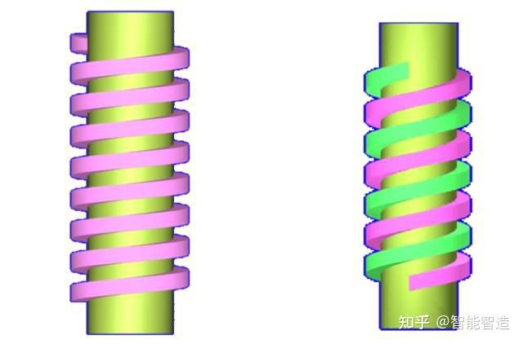
story line
Emotion line
negative
conflict1
self-doubt
分析故事线与情感线
conflict2
self-negativity
conflict3
anxiety
conflict4
nervousness
Good ending
Confidence
positive

Slide 12
Read for clues and echoes
hidden clues | echoes
Somehow Mom had convinced me to play the Fish Footman in Alice in Wonderland. I can't say it's been the time of my life. "What if I forget my lines?" I hesitated. "Oh Riley, is that what you're afraid of? I know you've been rehearsing for two months, you were the first off-book in your scene, and I couldn't be prouder of you." | 1. Now I can definitely say that playing the Fish Footman has always been the time of my life. Loud and clear lines flowed out of my mouth fluently. My two-month rehearsal paid off! No sooner had the curtain fallen down than my mom made her way to backstage. She knelt down , hugged me tightly and pressed a kiss on my forehead. “I’m super proud of you!” She exclaimed in thrill.

Slide 13
Read for clues and echoes
hidden clues | echoes
"Mom! I can't go onstage like this!" I cried. "Why not?“ “I’d be a laughing stock(笑柄)!” "Riley, look around you! You're not the only one in an odd costume.“ … I sat there, alone and bored, as the play began and the curtain rose on. | Magically, though wearing my odd costume, I felt I was a shining star on the stage instead of a laughing stock. 5. The play came to an end eventually. The audience burst out excited cheers and thunderous applauses exploded in the auditorium as the curtain fell down.

Slide 14
hidden clues | echoes
The two boys dressed as Two of Clubs(梅花2)near me chatted casually about this and that. Suddenly, they asked, "You're awfully quiet. Is this your first show?" I tried to respond, but my voice caught in my throat and refused to escape. I coughed and nearly yelled, "YES!“ The Ace of Diamonds(方块A) sitting nearby laughed. "The audience will certainly hear you if you talk that loud. But you might have to clear your throat first," she chuckled. I gave them a weak smile. "Don't worry about us," the Ace said. "We're only teasing.“ | A constant stream of lines flew out of my throat and my voice rose and fell clearly when I played the Fish Footman. 5. As I glanced at my new partners, they gave me encouraging nods with bright smiles on their face.

Slide 15
Plot the continuation writing
Para1: When my name was called, I stepped onto the stage uneasily.
Para 2: Suddenly I was determined to make a lasting impression.
Link1: How did I feel? ( by using 5 senses) How did I step onto the stage? ( by using exaggeration ，simile, personification etc. ）
Body: What did I see on the stage? ( the audience, mom, the new friends I just chatted with) What came into my mind?
Link2: Who made me determined? What inspired me ?

Slide 16
Plot the continuation writing
Para1: When my name was called, I stepped onto the stage uneasily.
Para 2: Suddenly I was determined to make a lasting impression.
Link3: What did I do to make a lasting impression?
Body: How did the audience react to my performance? What about mum? What about the Ace of Diamonds and the Two of Clubs?
Ending-A: Echo 1: Now I can definitely say that playing the Fish Footman has always been the time of my life.
Ending-B: What lesson did I learn from this experience?

Slide 17
Para1: When my name was called, I stepped onto the stage uneasily. It was my turn to show my performance but I was nervous to death! Heart racing fast and palms sweating profusely, I dragged myself to the center of the stage like a snail as if my two legs were filled with heavy lead! Then the spotlight shone on me, its intense heat and blinding light fueling my tension. Scanning through the sea of faces, I could sense the eager and expectant look from the passionate audience. Among them, eyes shining with pride and joy， my mom signaled a V -sign to me, mouthing “You can do it!”. As my eyes fell on my new friends on the stage, they gave me encouraging nods with bright smiles across their faces. They trusted me unconditionally!

Slide 18
Para 2: Suddenly I was determined to make a lasting impression. Thanks to my two month’s rehearsal, loud and clear lines flowed out of my mouth fluently. I put more enthusiasm into my performance, using exaggerated gestures, vivid expressions and expressive varied voices. The audience started to laugh, responding actively and positively, which gave me tremendous confidence. Totally immersed in the role of the Fish Footman, I forgot my embarrassment about the odd costume. And before I knew it, my scene was over. The thrilled audience burst into cheers and thunderous applauses exploded in the auditorium. I eventually conquered my fear. Now I can definitely say that playing the Fish Footman has always been the time of my life. （回扣式结尾）

Slide 19
Para 2: Suddenly I was determined to make a lasting impression. Thanks to my two month’s rehearsal, loud and clear lines flowed out of my mouth fluently. I put more enthusiasm into my performance, using exaggerated gestures, vivid expressions and expressive varied voices. The audience started to laugh, responding actively and positively, which gave me tremendous confidence. Totally immersed in the role of the Fish Footman, I forgot my embarrassment about the odd costume. And before I knew it, my scene was over. The thrilled audience burst into cheers and thunderous applauses exploded in the auditorium. I eventually accomplished my performance and breathed a sigh of relief. As it turned out, practice makes perfect. My constant efforts paid off !（哲理式结尾）

Slide 20
Para 2: Suddenly I was determined to make a lasting impression. After taking a deep breath, I began to deliver my lines, my voice shaky initially but gradually growing more natural and fluent. Clear and loud speech plus my odd costume made the Fish Footman look so vivid and funny. The audience started to laugh, responding actively and positively, which gave me tremendous confidence. Time ticking by, my scene was over. As the thrilled audience burst into cheers and thunderous applauses exploded in the auditorium, mom made her way to backstage. She hugged me tightly and pressed a kiss on my cheek, exclaiming in surprise, “ You made it. I couldn’t be prouder of you.” (情景式结尾）

Slide 21
Para 2: Suddenly I was determined to make a lasting impression. After taking a deep breath, I began to deliver my lines, my voice shaky initially but gradually growing more natural and fluent. Clear and loud speech plus my odd costume made the Fish Footman look so vivid and funny. The audience started to laugh, responding actively and positively, which gave me tremendous confidence. Time ticking by, my scene was over. The audience applauded excitedly, cheering for my first successful performance. Mom, eyes twinkling with tears of joy and pride, thumbed up to me. It was my mom’s determination and positive mentality that urged me to get out of my comfort zone and try something that I had never done before.
(感悟式结尾）

Slide 22
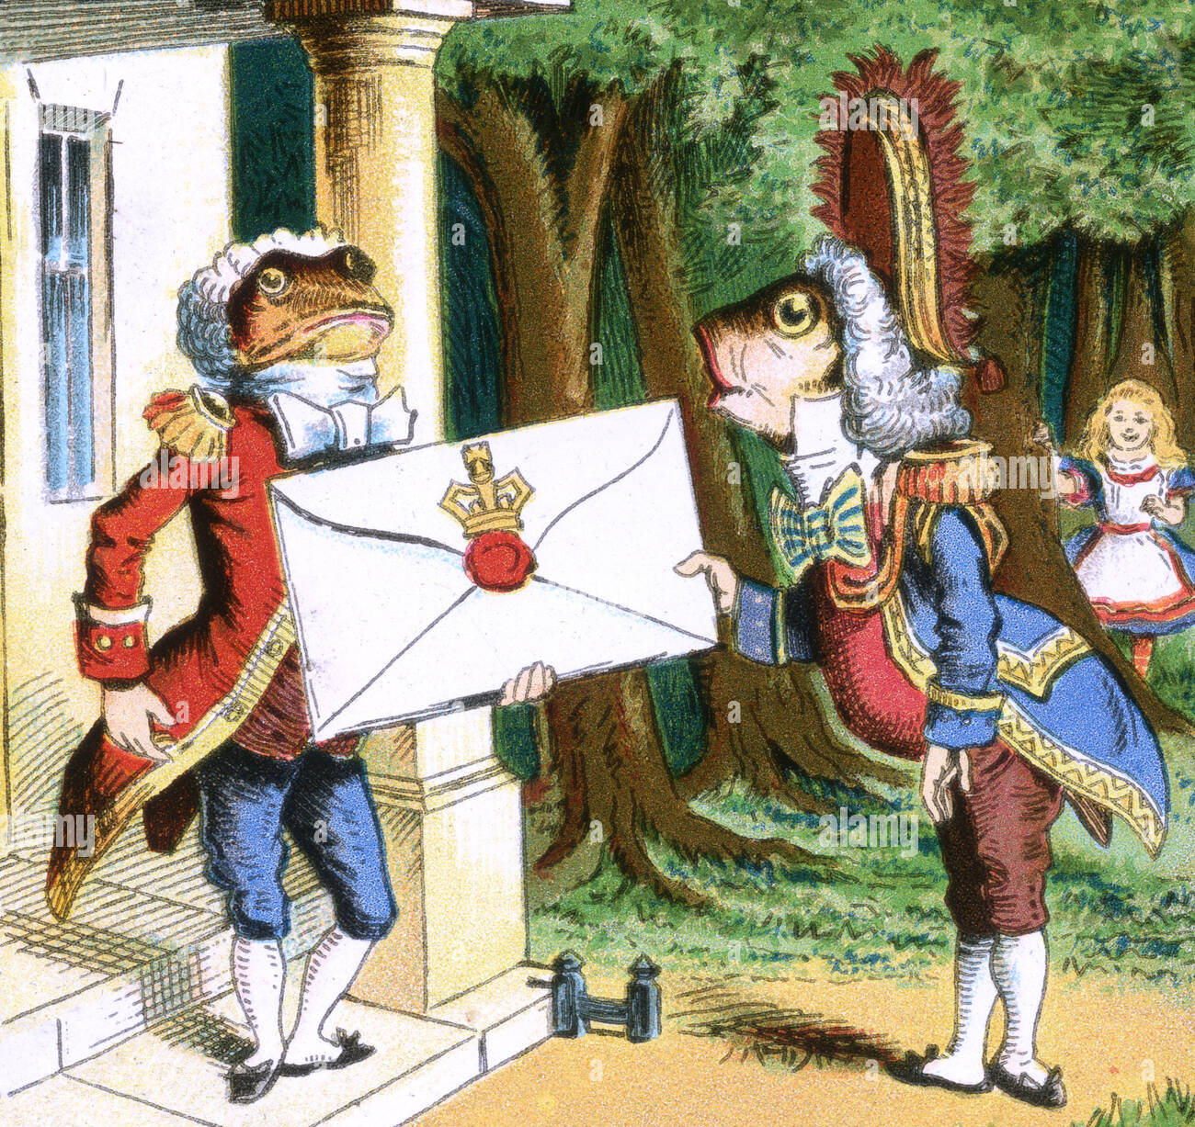

Slide 23

比赛或表演类续写构思
赛（表演）前：紧张的准备或紧张的心理描写
赛（表演）中：主角的言行反应；配角的言行反应；前文是否暗示有新的困难出现？
如何推动情节走向结局？（依据比赛或表演进程的特点进行构思）
赛（表演）后：主角成功（大多数是成功的）+配角或观众的反响+成功的感悟
主角失败 （鲜有失败）+配角的安慰或感动于主角的坚持不懈+
虽然失败或失利，我们仍然可以从失败中学到教训
比赛或表演类语料库 ---参考文字稿

