Slide 1


感恩遇见，相互成就，本课件资料仅供您个人参考、教学使用，严禁自行在网络传播，违者依知识产权法追究法律责任。
更多教学资源请关注
公众号：溯恩英语
知识产权声明

Slide 2

Small Waste, Big Problem
人教版选择性必三
Unit3 Workbook
Reading and Writing

Slide 3

Teaching Objectives
Practice reading skills.
Promote discussion while broadening students’ knowledge of environmental protection.
Raise students’ awareness of marine environmental protection.
Fuel students’ passion to take actions to protect our sea.
Accumulate more expressions how to protect our environment.

Slide 4
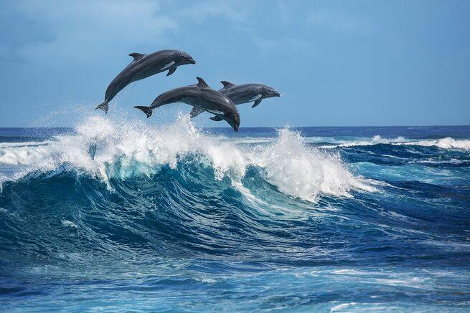
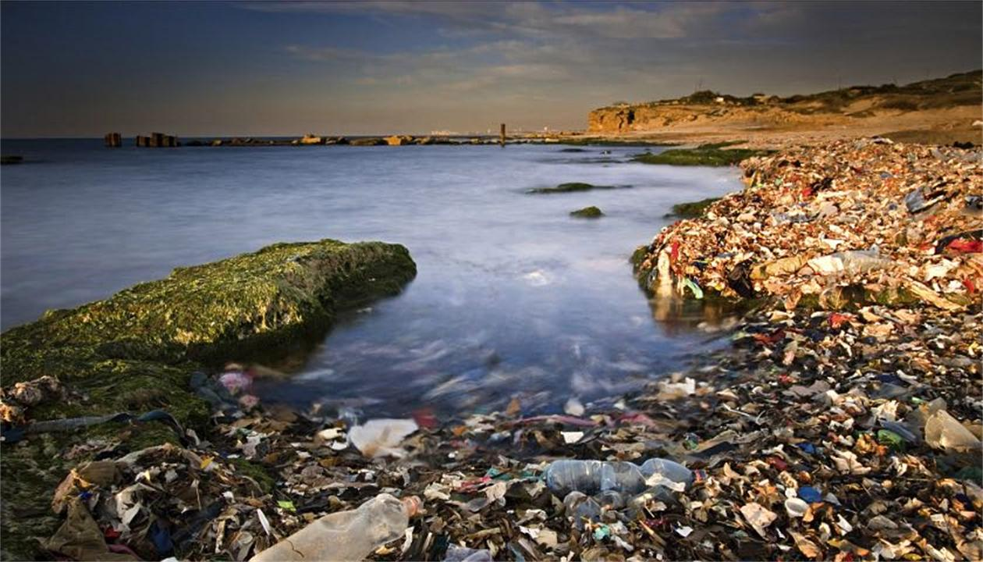
Lead-in
What is your impression of the ocean?
Do you know Marine pollution?
It’s a new term which has burst into people’s vision with the increasingly serious destruction and exploitation of the ocean by human beings. Marine pollution includes two aspects: Seawater pollution and damage to Marine ecology.

Slide 5

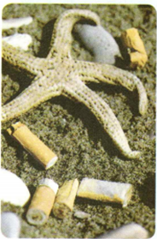
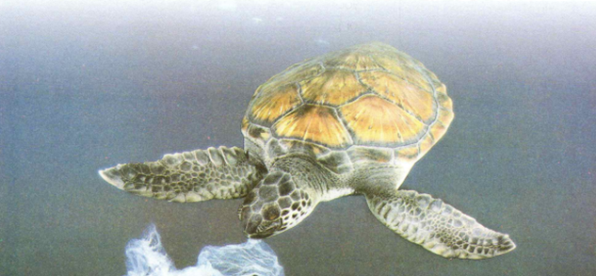
Pre-reading
According to the title and illustrations, what do you think the passage is
mainly about?
Cigarette butts
Plastic bags

Slide 6

Pre-reading
1.What does the title mean? Can you name some other small pieces of trash?
The title means that although each piece of waste is small, lots of it together is causing big problems. Other small litter items include chewing gum, packaging from things such as sweets, snacks, and sandwiches, lids from bottles and cans, disposable cutlery, and bathroom items such as razors and cotton buds.
2.What are the effective solutions to the problems?
The effective solutions are to reduce the use of these things, dispose of them properly, and reuse and recycle them whenever possible.

Slide 7

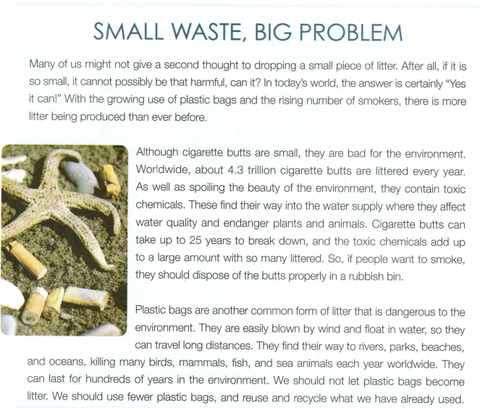
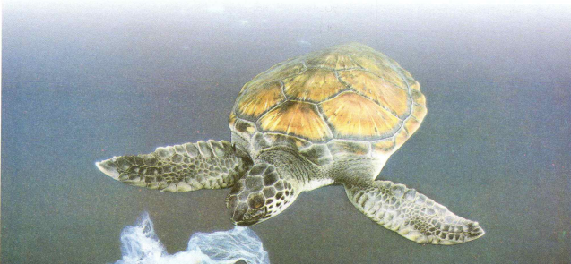
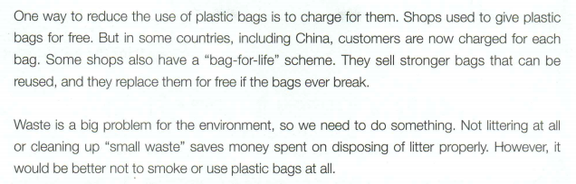
Read for main idea
Read for structure
P1
Small pieces of litter can be harmful.
General
P2
Cigarette butts are bad for the environment.
P3
Plastic bags are bad for the environment.
Specific
Problem
P4
To deal with the problem of waste
Solution

Slide 8
Read the text and complete the table.
Paragraph | Main idea | Important details
1 | Small pieces of litter can be harmful. | Plastic bags and litter from smokers increased
2 | Cigarette butts are bad for the environment.
3 | Plastic bags are bad for the environment.
4 | To deal with the problem of waste
Butts are small but there are trillions of them. They contain toxic chemicals and take 25 years to decompose.
Plastic bags are easily blown by wind and carried by water, so they find way to rivers, oceans, parks, beaches and kill birds, mammals, fish, and sea animals. They can last for hundreds of years. We should use fewer plastic bags, and reuse and recycle them. Some shops charge for bags and have a bag-for-life scheme.
Cleaning up “small waste” saves money but it’s best not to litter or use these things at all.

Slide 9
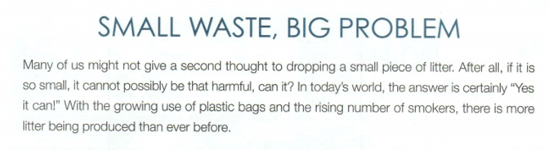
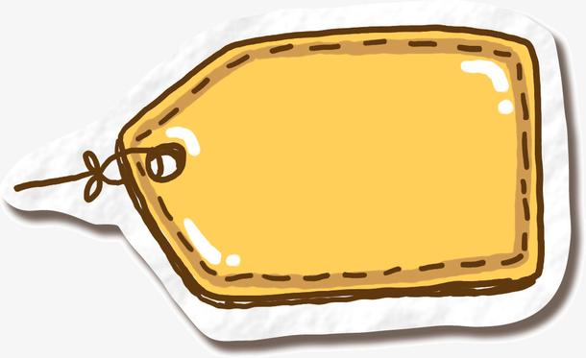
What’s the figure of speech used in this paragraph ?
Rhetoric question.
It’s a question that followed by an answer, whose purpose is to cause reader’s attention.
Ex: Popularity? It’s glory’s small change.
名望吗？那是光荣的零头而已。

Slide 10
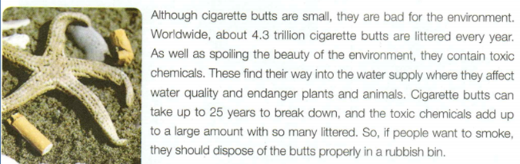
What do you know from the two figures?
What negative effects of cigarette butts are mentioned in this paragraph?
large quantities
spoil/ruin/destroy/wreck/cause damage to the beauty of the environment
have considerable influence on environment
4.3 trillion
25 years
hard to break down
lead to worse water quality and endanger/pose a threat to plants and animals
poisonous

Slide 11
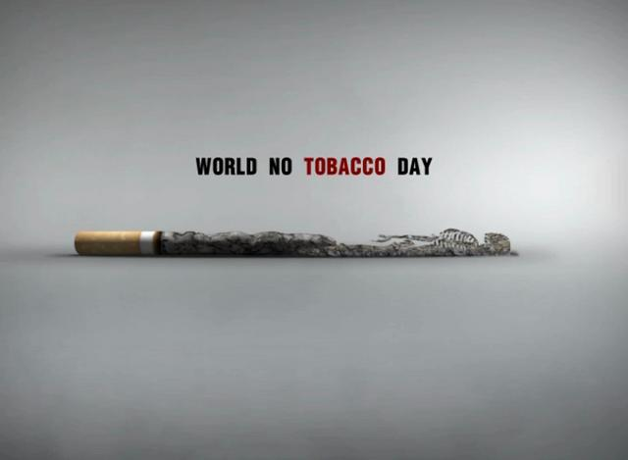
What measures are supposed to be taken to improve current situation?
appeal to more people to quit smoking
raise public’s awareness of the negative effects of cigarette butts on environment
call on the government to raise the tax on cigarette…

Slide 12
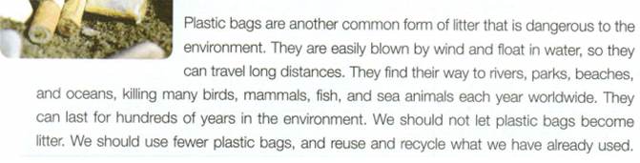
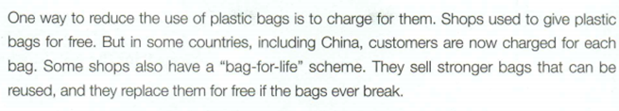
1.What characters do plastic bags have ?
Light
ubiquitous
(can be seen everywhere)
hard to break down
long-standing
2.What steps can human beings take to cope with this common form of litter?
reduce the usage of plastic bags
reuse and recycle
charge for them
3.How does the author introduce what China has done to plastic bags?
The author gives examples and employs a contrast between now and the previous time.
4.After reading this paragraph, what would you like to do with plastic bag?

Slide 13


Brainstorm
What can we human beings do to guard the sea?
what countries can do
establish sound legal and regulatory system
improve the maritime management system
enhance the environmental monitoring system
formulate marine protection strategies and plans…
have a high awareness of marine environmental protection
reduce the use of plastics
clean up the rubbish on the beach
report the behavior of polluting seawater in daily life…
what we can do

Slide 14

Free talk
Imagine you are a leader of your community, what proposals would you put forward to improve the environment?
If I was a community leader, I would first put forward a proposal to educate the community about the waste problem. I would talk to businesses about the items they sell and encourage them and the community to use items that could be reused or recycled easily. Then I would make sure there were plenty of places to dispose of waste correctly.

Slide 15
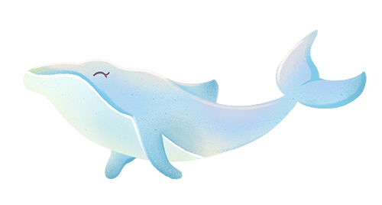
Assignment
Make a poster about the use of plastic bags or littering.
Tips for you
1.Think about what information you will put on the poster and what message you want to convey.
2.Decide the essential parts of your poster: headline , body , and signature. Make sure your headline attracts the readers’ attention and your message is clear and impressive.
3.Choose a few good pictures for your poster.
4.Present your poster to the class or put it up in the classroom.

Slide 16
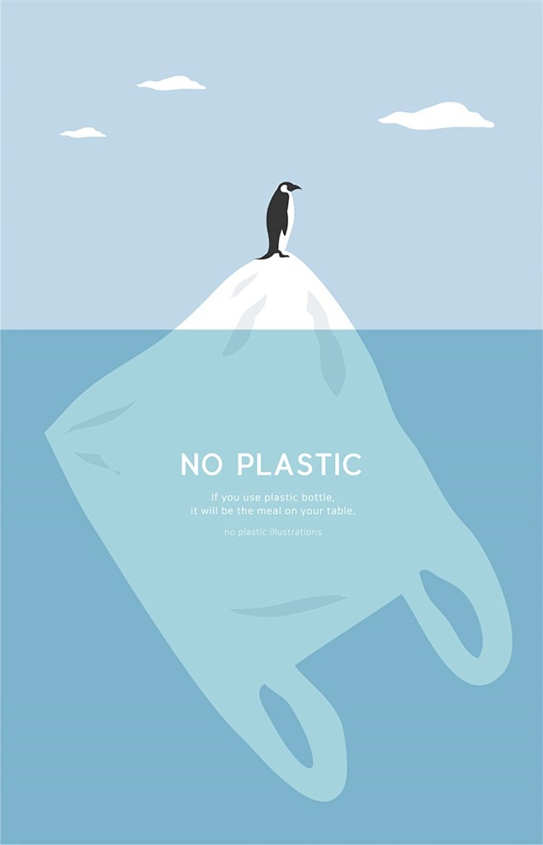
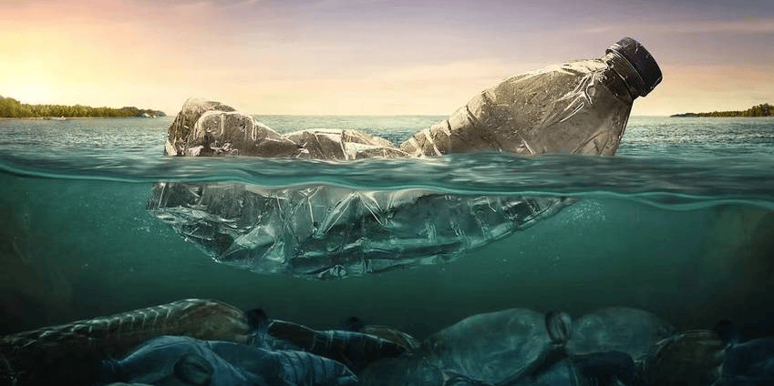
Say No to Plastic Bags!
Many plastic bags end up in rivers and the sea.
They kill fish and other sea creatures.
Plastic gets into our food.
Together we can solve this problem:
Reuse plastic bags again and again!
Put all bags in the recycling bin!
Take a reusable bag with you everywhere!

Slide 17
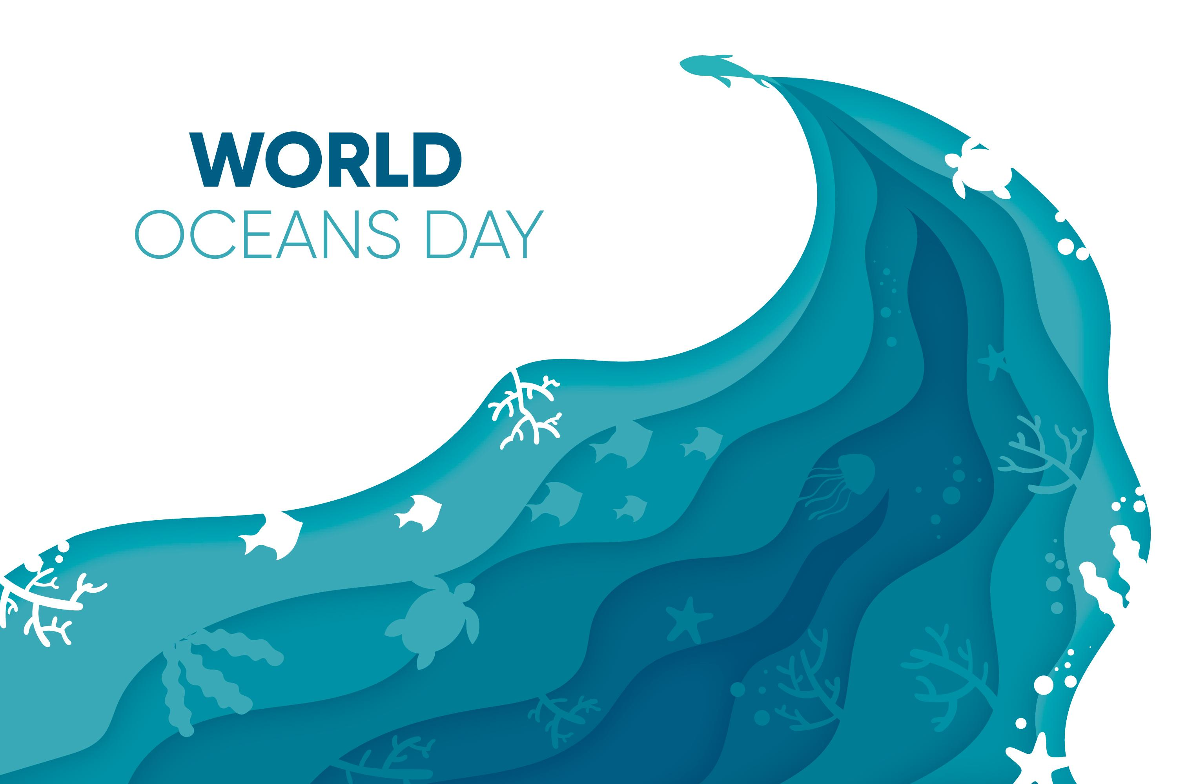
June,8

