Slide 1


感恩遇见，相互成就，本课件资料仅供您个人参考、教学使用，严禁自行在网络传播，违者依知识产权法追究法律责任。
更多教学资源请关注
公众号：溯恩英语
知识产权声明

Slide 2



2024年高考必胜
4个锦囊助力高考圆梦
—— 浙江省 常山一中 吴俊峰

Slide 3


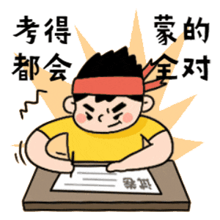
新高考的路径优化
—— 成功或许不可复制，但一定有迹可循，找到最优化的解题路径和考试节奏，突破思维瓶颈，优化关键能力
01

Slide 4
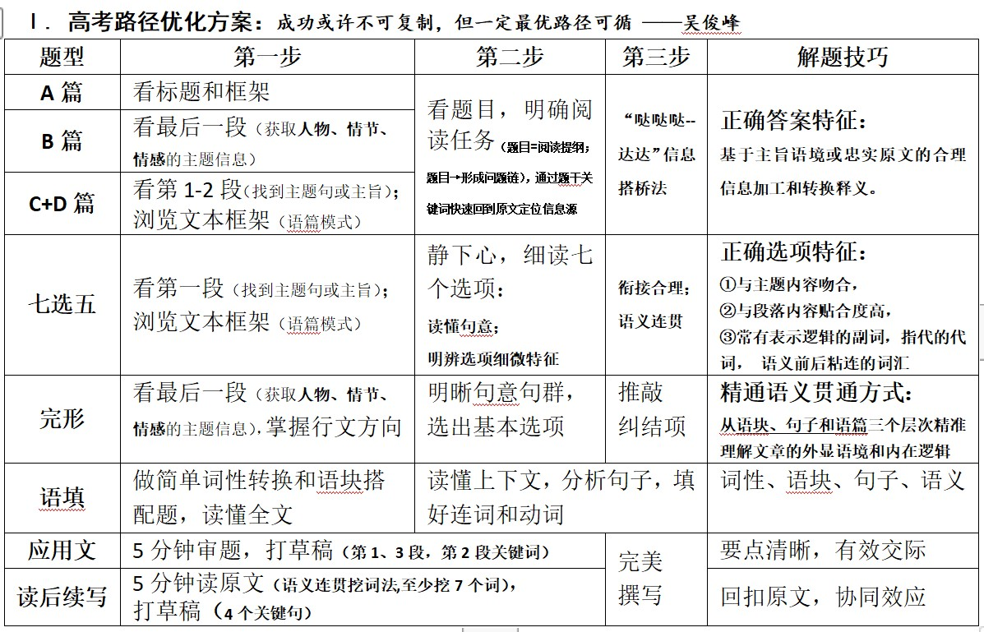
新高考路径优化
突破思维瓶颈，优化关键能力

Slide 5

幸运星
阅读理解满分思维策略
—— 建构主题语境，精通词义延伸方式和过程
02

Slide 6
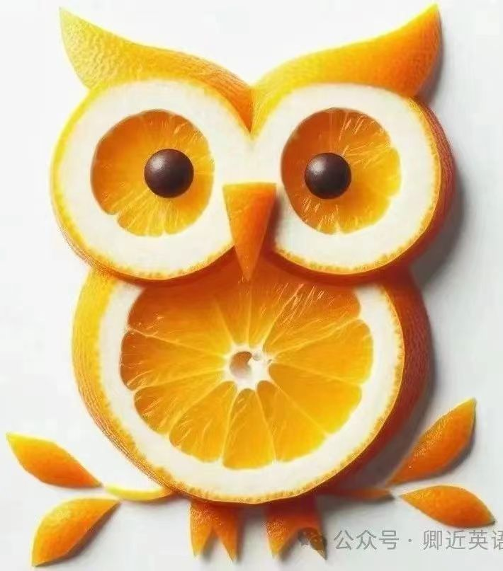

阅读理解满分思维策略——精通词义延伸方式和过程
2023年英语高考全国卷应用文写作试题的新动向预示着今后英语写作教学应着重培养以下几方面能力：
用英语描述事件、描述个人经历和事物特征的能力；
描述、概括真实的经验和事实的能力；
传递信息、论证观点、表达情感的能力；
对观点、事件、经验进行阐释和评论的能力等。
因此，今后的英语写作教学既要关注如何写，更要关注写什么；既要关注写作结果，更要注重写作过程；既要关注写作的准确性，更要关注写作的流畅性；既要有适当的模仿和借鉴，但更要有创造，要使学生能够用英语进行真实表达。
①主题句本身会包含核心话题和决定语篇发展方向的控制性信息，主要陈述部分则需要将控制性信息进行语义延展，为支撑主题句服务。
②利用关键词重复来突出并强化主旨。核心关键词存在复现的关系，围绕同一主题前后呼应，形成词汇链和语义链，使文本语际间实现语义上的衔接和连贯。
③利用语义场保证主题和语义传递取得统一（信息流flow的桥梁通道）。 阅读过程中要善于扫描同词/同话题词，建构语义场，搭建信息流flow的通道。尤其注意paraphrase(释文，改述，换说)的地方往往是题眼。
“哒哒哒--达达”信息搭桥法
Notes:
联系 系统 真实挑战
应用 迁移
大概念不是法则，从左到右，先算个位后算十位，从低位到高位。 乘除法规则运算：先分后合
最核心的是什么？
基于知识技能 高于知识技能 的思想 理念 认识 准则
自主学习能力
选择不同的工具进行测量，能够准确表示。高楼 大树 不能测量可以选择参照物估测。
真实的 挑战性
教室的高 楼房的高
大概念可以是各种形式的体现：一个词、一个短语、一个句子或者一个问题
站位很高，长远的目标，指向学生核心素养，抓住大概念，抓住基本问题，实现预期结果和目标

Slide 7
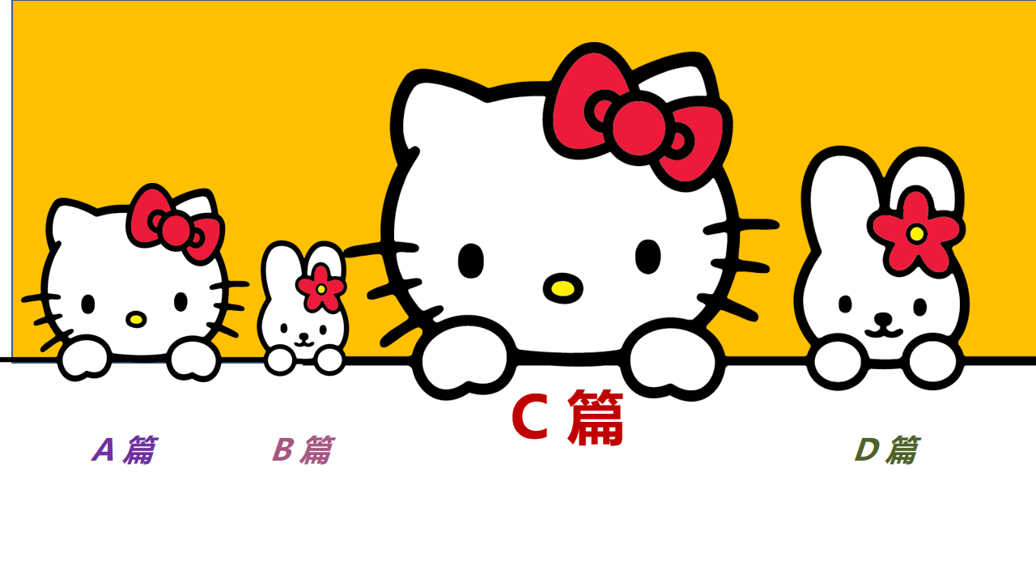
2023年6月全国新课标I卷C篇阅读理解高分突破思维策略
The goal of this book is to make the case for digital minimalism, including a detailed exploration of what it asks and why it works, and then to teach you how to adopt this philosophy if you decide it’s right for you.
To do so, I divided the book into two parts. In part one, I describe the philosophical foundations of digital minimalism, starting with an examination of the forces that are making so many people’s digital lives increasingly intolerable, before moving on to a detailed discussion of the digital minimalism philosophy.
Part one concludes by introducing my suggested method for adopting this philosophy: the digital declutter. This process requires you to step away from optional online activities for thirty days. At the end of the thirty days, you will then add back a small number of carefully chosen online activities that you believe will provide massive benefits to the things you value.
In the final chapter of part one, I’ll guide you through carrying out your own digital declutter. In doing so, I’ll draw on an experiment I ran in 2018 in which over 1,600 people agreed to perform a digital declutter. You’ll hear these participants’ stories and learn what strategies worked well for them, and what traps they encountered that you should avoid.
The second part of this book takes a closer look at some ideas that will help you cultivate (培养) a sustainable digital minimalism lifestyle. In these chapters, I examine issues such as the importance of solitude (独处) and the necessity of cultivating high-quality leisure to replace the time most now spent on mindless device use. Each chapter concludes with a collection of practices, which are designed to help you act on the big ideas of the chapter. You can view these practices as a toolbox meant to aid your efforts to build a minimalist lifestyle that works for your particular circumstances.
精通词义延伸方式和过程
核心关键词存在复现的关系，实现语义上的衔接和连贯， 通过adopt this philosophy的复现，我们可知minimalism与 declutter同义，并建构语义场“ step away from， a small number of.., replace...”解释所猜词义“Clear-up.”
29. What does the underlined word “declutter” in paragraph 3 mean?
A. Clear-up. B. Add-on. C. Check-in. D. Take-over.

Slide 8
2023年6月全国新课标I卷C篇阅读理解高分突破思维策略
The goal of this book is to make the case for digital minimalism, including a detailed exploration of what it asks and why it works, and then to teach you how to adopt this philosophy if you decide it’s right for you.
To do so, I divided the book into two parts. In part one, I describe the philosophical foundations of digital minimalism, starting with an examination of the forces that are making so many people’s digital lives increasingly intolerable, before moving on to a detailed discussion of the digital minimalism philosophy.
Part one concludes by introducing my suggested method for adopting this philosophy: the digital declutter. This process requires you to step away from optional online activities for thirty days. At the end of the thirty days, you will then add back a small number of carefully chosen online activities that you believe will provide massive benefits to the things you value.
In the final chapter of part one, I’ll guide you through carrying out your own digital declutter. In doing so, I’ll draw on an experiment I ran in 2018 in which over 1,600 people agreed to perform a digital declutter. You’ll hear these participants’ stories and learn what strategies worked well for them, and what traps they encountered that you should avoid.
The second part of this book takes a closer look at some ideas that will help you cultivate (培养) a sustainable digital minimalism lifestyle. In these chapters, I examine issues such as the importance of solitude (独处) and the necessity of cultivating high-quality leisure to replace the time most now spent on mindless device use. Each chapter concludes with a collection of practices, which are designed to help you act on the big ideas of the chapter. You can view these practices as a toolbox meant to aid your efforts to build a minimalist lifestyle that works for your particular circumstances.
搭建信息流flow的通道
善于扫描同义词/同话题词，快速捕捉一些意义相同、相似、相反的词，联系在一起，建构语义场，促进语篇理解，秒杀正确答案。
”strategies worked well, what traps... avoid“形成语义场，与 ”Practical“同义信息匹配。
“ participants’ stories”与“examples ”形成同义信息匹配。
30. What is presented in the final chapter of part one?
A. Theoretical models. B. Statistical methods. C. Practical examples. D. Historical analyses.

Slide 9
2023年6月全国新课标I卷C篇阅读理解高分突破思维策略
The goal of this book is to make the case for digital minimalism, including a detailed exploration of what it asks and why it works, and then to teach you how to adopt this philosophy if you decide it’s right for you.
To do so, I divided the book into two parts. In part one, I describe the philosophical foundations of digital minimalism, starting with an examination of the forces that are making so many people’s digital lives increasingly intolerable, before moving on to a detailed discussion of the digital minimalism philosophy.
Part one concludes by introducing my suggested method for adopting this philosophy: the digital declutter. This process requires you to step away from optional online activities for thirty days. At the end of the thirty days, you will then add back a small number of carefully chosen online activities that you believe will provide massive benefits to the things you value.
In the final chapter of part one, I’ll guide you through carrying out your own digital declutter. In doing so, I’ll draw on an experiment I ran in 2018 in which over 1,600 people agreed to perform a digital declutter. You’ll hear these participants’ stories and learn what strategies worked well for them, and what traps they encountered that you should avoid.
The second part of this book takes a closer look at some ideas that will help you cultivate (培养) a sustainable digital minimalism lifestyle. In these chapters, I examine issues such as the importance of solitude (独处) and the necessity of cultivating high-quality leisure to replace the time most now spent on mindless device use. Each chapter concludes with a collection of practices, which are designed to help you act on the big ideas of the chapter. You can view these practices as a toolbox meant to aid your efforts to build a minimalist lifestyle that works for your particular circumstances.
抓住关键词复现与呼应
核心关键词存在复现的关系，围绕同一主题会前后呼应，形成词汇链，使文本语际间实现语义上的衔接和连贯，文末 that works for your particular circumstances与首段 if you decide it’s right for you呼应，与选项A的as needed信息同义匹配。
而且，尾段呼应了首段的how to adopt，与collection of practices，a toolbox 构建语义场，与选项A的Use them信息同义匹配。
31. What does the author suggest readers do with the practices offered in part two?
A. Use them as needed. B. Recommend them to friends.
C. Evaluate their effects. D. Identify the ideas behind them.

Slide 10
2023年6月全国新课标I卷C篇阅读理解高分突破思维策略
The goal of this book is to make the case for digital minimalism, including a detailed exploration of what it asks and why it works, and then to teach you how to adopt this philosophy if you decide it’s right for you.
To do so, I divided the book into two parts. In part one, I describe the philosophical foundations of digital minimalism, starting with an examination of the forces that are making so many people’s digital lives increasingly intolerable, before moving on to a detailed discussion of the digital minimalism philosophy.
Part one concludes by introducing my suggested method for adopting this philosophy: the digital declutter. This process requires you to step away from optional online activities for thirty days. At the end of the thirty days, you will then add back a small number of carefully chosen online activities that you believe will provide massive benefits to the things you value.
In the final chapter of part one, I’ll guide you through carrying out your own digital declutter. In doing so, I’ll draw on an experiment I ran in 2018 in which over 1,600 people agreed to perform a digital declutter. You’ll hear these participants’ stories and learn what strategies worked well for them, and what traps they encountered that you should avoid.
The second part of this book takes a closer look at some ideas that will help you cultivate (培养) a sustainable digital minimalism lifestyle. In these chapters, I examine issues such as the importance of solitude (独处) and the necessity of cultivating high-quality leisure to replace the time most now spent on mindless device use. Each chapter concludes with a collection of practices, which are designed to help you act on the big ideas of the chapter. You can view these practices as a toolbox meant to aid your efforts to build a minimalist lifestyle that works for your particular circumstances.
核心概念模糊时：围点打援
第28题涉及本篇的核心概念，是阅读障碍词块，我们可以先放下，做后面的题，相信核心关键词存在复现的关系，围绕同一主题会前后呼应，形成词汇链，使文本语际间实现语义上的衔接和连贯，让核心概念逐渐明朗清晰。
28. What is the book aimed at?
A. Teaching critical thinking skills. B. Advocating a simple digital lifestyle.
C. Solving philosophical problems. D. Promoting the use of a digital device.

Slide 11
核心概念模糊时：围点打援，成合围之势
2023年英语高考全国卷应用文写作试题的新动向预示着今后英语写作教学应着重培养以下几方面能力：
用英语描述事件、描述个人经历和事物特征的能力；
描述、概括真实的经验和事实的能力；
传递信息、论证观点、表达情感的能力；
对观点、事件、经验进行阐释和评论的能力等。
因此，今后的英语写作教学既要关注如何写，更要关注写什么；既要关注写作结果，更要注重写作过程；既要关注写作的准确性，更要关注写作的流畅性；既要有适当的模仿和借鉴，但更要有创造，要使学生能够用英语进行真实表达。
2023年6月全国新课标I卷CD篇均出现小众话题——“ digital minimalism”，“wisdom of crowds” effect，话题不熟无相关背景知识，信息缺省认知不足，
单词不明核心概念模糊，导致语篇发展方向不清晰，阅读难度增大。
解决核心概念模糊需要进行信息“搭桥”，建议考生采取“围点打援”的阅读战术，先攻克单点信息题，激活语篇的已有信息，不断创造关联性，并通过已有信息激活概念之间的照应关系，建立话语之间的语义关联，成合围之势，统一认知世界，获得语篇或话语的连贯性，如C篇28题“ digital minimalism”，我们可以先做后面的题，构建核心概念的语义场“adopt this philosophy, a small number of carefully chosen online activities, a sustainable digital lifestyle, replace the time most now spent on mindless device use. ”，让核心概念逐渐明朗清晰，最后攻克之。
Notes:
联系 系统 真实挑战
应用 迁移
大概念不是法则，从左到右，先算个位后算十位，从低位到高位。 乘除法规则运算：先分后合
最核心的是什么？
基于知识技能 高于知识技能 的思想 理念 认识 准则
自主学习能力
选择不同的工具进行测量，能够准确表示。高楼 大树 不能测量可以选择参照物估测。
真实的 挑战性
教室的高 楼房的高
大概念可以是各种形式的体现：一个词、一个短语、一个句子或者一个问题
站位很高，长远的目标，指向学生核心素养，抓住大概念，抓住基本问题，实现预期结果和目标

Slide 12

读后续写
语篇衔接的三个“一定”
—— 基于语义连贯，谋划两段首句，衔接推进语篇协同：第一、二段开头，要有段首句的名词或动词，实现语义连贯；第一段结尾，要有与第二段段首句中的同词或同义词，实现无缝衔接；第二段结尾，要呼应原文中体现主题或伏笔的关键词，实现主题升华。
03

Slide 13
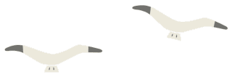
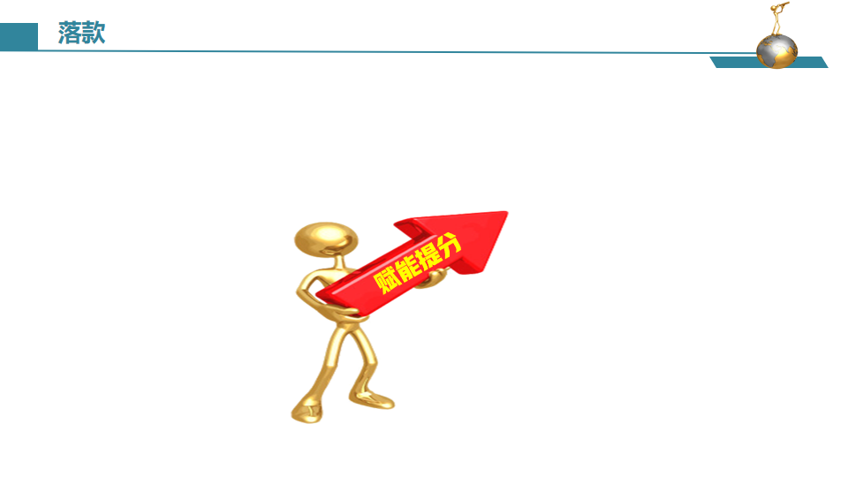



读后续写 语篇衔接的三个“一定”
根据衔接连贯理论，通过词汇的有效衔接（词汇同现或词汇复现）实现语义连贯和逻辑衔接。
第一段结尾
①一定要有与第二段段首句中的同词或同义词。
②实现无缝衔接
第一、二段开头
①一定要把段首句的名词或动词（尤其是后半句），用在写作开头，实现语义连贯。
②力争高分开头
第二段结尾
①一定要呼应原文中体现主题或伏笔的关键词。
②实现主题升华
Notes:
联系 系统 真实挑战
应用 迁移
大概念不是法则，从左到右，先算个位后算十位，从低位到高位。 乘除法规则运算：先分后合
最核心的是什么？
基于知识技能 高于知识技能 的思想 理念 认识 准则
自主学习能力
选择不同的工具进行测量，能够准确表示。高楼 大树 不能测量可以选择参照物估测。
真实的 挑战性
教室的高 楼房的高
大概念可以是各种形式的体现：一个词、一个短语、一个句子或者一个问题
站位很高，长远的目标，指向学生核心素养，抓住大概念，抓住基本问题，实现预期结果和目标

Slide 14

语篇衔接的三个“一定”_{(以2021年6月浙江高考读后续写“我的假日薪水”为例)}
原文（第一段 第二段） | My dad, George, only had an eighth grade education. A quiet man, he didn’t understand my world of school activities. From age 14, he worked. And his dad, Albert, took the money my dad earned and used it to pay family expenses. I didn’t really understand his world either： He was a livestock trucker, and I thought that I would surpass_{（超过）}anything he had accomplished by the time I walked across the stage at high school graduation.
第一段 | When I brought my paycheck home — it was $119 — my dad wanted to talk to me. “Good for you, breadwinner!” He said, an absolute gaiety spreading across his face. ..... .... Then, he gripped my wrist, with his eyes full of love. “Now that you have grown up, and I'm sure you will manage your money successfully!”
第二段 | I was surprised that my dad allowed me to use the money as I wished. I jumped a mile. my mouth wide open in amazement. After a pregnant pause, we began to laugh together, ideas of buying new shoes, a football and a basketball flooded into my mind. ... ....At exactly that moment, I understood why my father let me have the money—it was his expectation for my future, his encouragement and quiet love. And that was something I never surpass.

Slide 15
语篇衔接的三个“一定”_{(以2022年1月浙江高考读后续写“与学霸做项目”为例)}
原文_{（第一段）} | When Dr. Henderson was assigning(指定) project mates for his psychology class, I secretly hoped he would pair me with my best friend or at least a classmate I could have some fun with.
第一段 | We started to meet regularly to draw up plans. At first it seemed that he dominated our discussion for he was familiar with the topic, but I was the opposite. ..... .... We parted the day before analysis discussion with confidence for our project but when I returned the next morning, he was nowhere to be found. That fact struck me feeling desperate. He didn’t come either in the following days.
第二段 | One day I got word that he was admitted to hospital for a serious disease. It was the day before deadline and I drowned myself doing analysis and preparing for the presentation. Hearing the word, I dashed to the hospital and found him, my dear teammate. ... .... My seemingly single-minded and cold teammate and I, together, achieved something satisfying, and had fun but more than fun.

Slide 16

应用文写作版面设计、情感策略及优化措施
—— 强调对应用性和创造性能力的考查，引导学生在语言学习过程中注重辨析语言和文化中的具体现象，梳理和概括信息，从自己的视角正确评判周围事物和观念，创造性地表达自己的观点和想法。
04

Slide 17
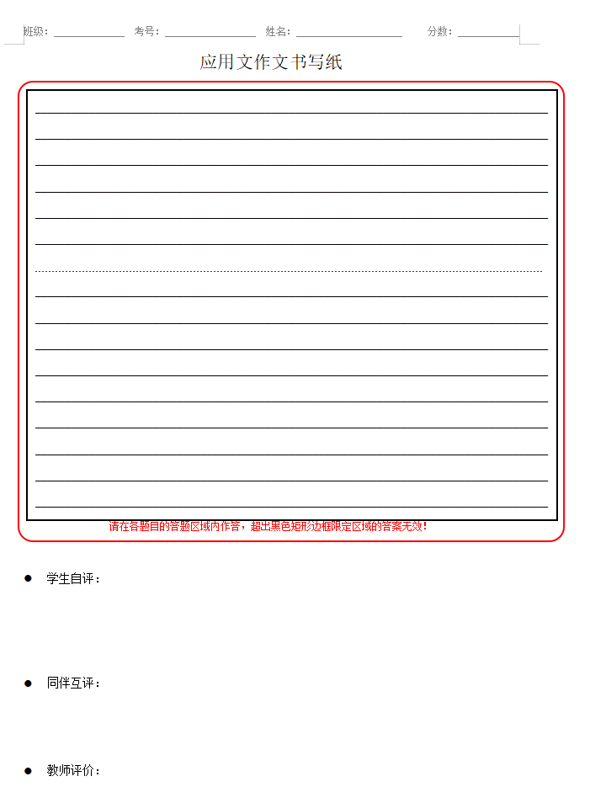
应用文写作版面设计、情感策略及优化措施
应用文正反面，7+9共16行。
如果是信件，16-3，学生可写13行；
其他文体，学生可写14行，太多无益。
虎头、豹尾、猪肚：
第一段：交代写作背景和写作目的
+拉近情感（求共情）
第二段：要点齐全
逻辑清晰
语义连贯
渗透目的
第三段：套路结语
+祝愿鼓励（画大饼）
每行约11-12词
分为三段
1. 写信背景和目的+拉近情感（求共情）
（3行，打草稿）
2. 主要内容
（一般三个要点）
（7-8行，关键词打草稿）
3. 套路结语+祝愿鼓励（画大饼）
（2-3行，打草稿）
共计13-14行
文章主旨
Notes:
联系 系统 真实挑战
应用 迁移
大概念不是法则，从左到右，先算个位后算十位，从低位到高位。 乘除法规则运算：先分后合
最核心的是什么？
基于知识技能 高于知识技能 的思想 理念 认识 准则
自主学习能力
选择不同的工具进行测量，能够准确表示。高楼 大树 不能测量可以选择参照物估测。
真实的 挑战性
教室的高 楼房的高
大概念可以是各种形式的体现：一个词、一个短语、一个句子或者一个问题
站位很高，长远的目标，指向学生核心素养，抓住大概念，抓住基本问题，实现预期结果和目标

Slide 18

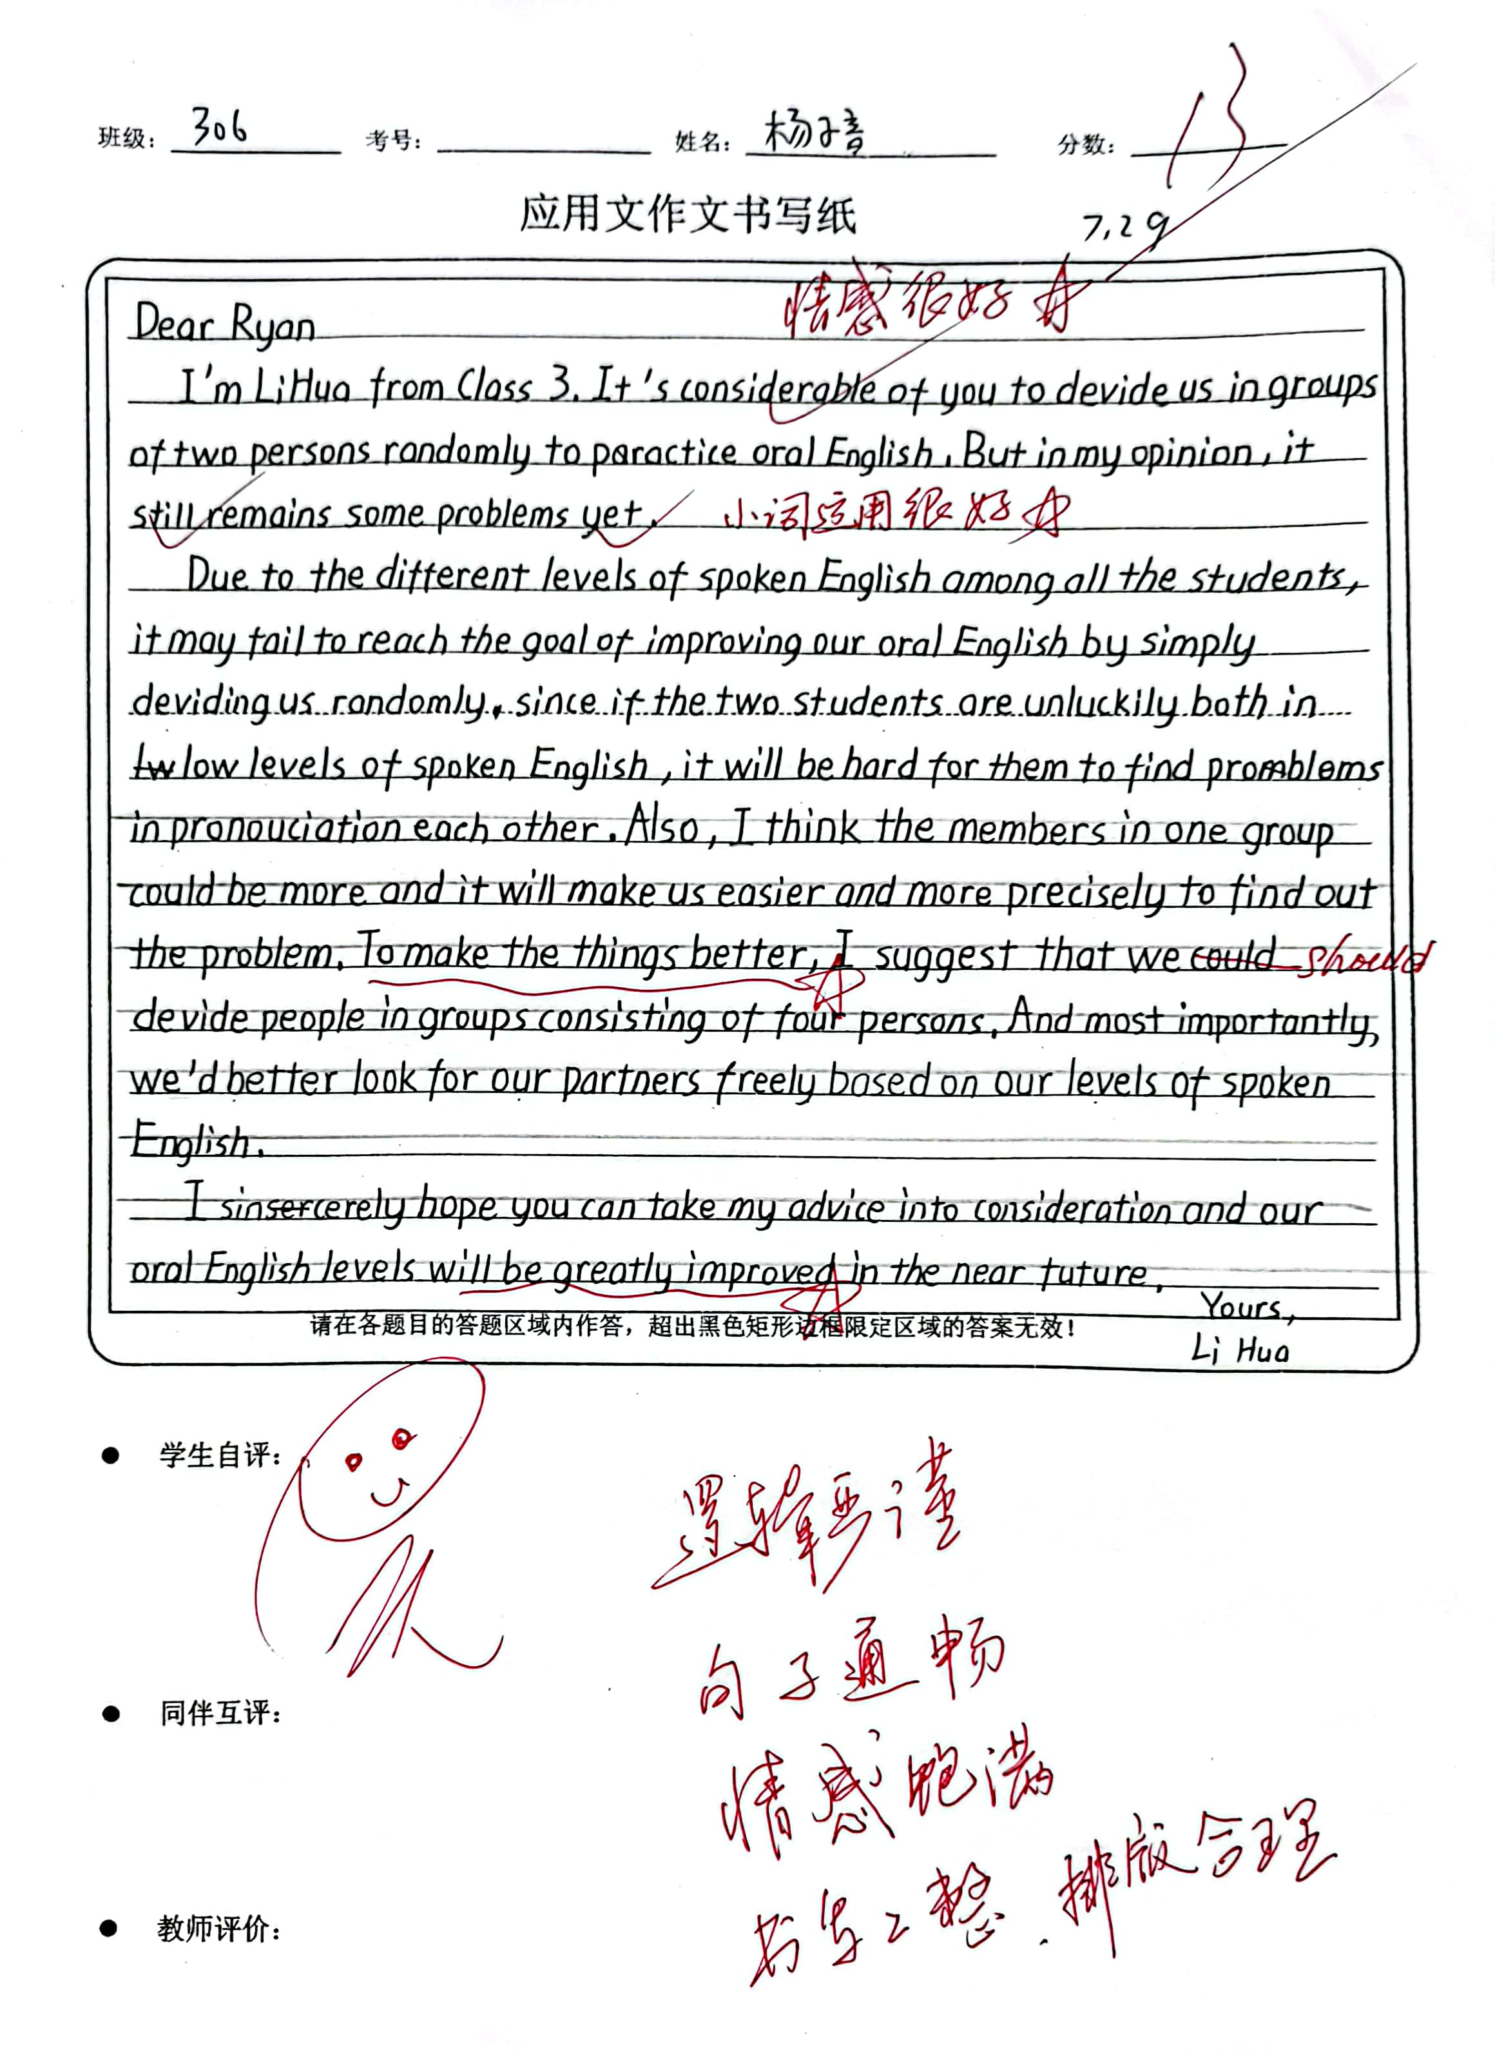

2023年6月全国高考新课标I卷应用文真题
溯恩英语 2023年6月全国高考新课标 I &Ⅱ卷卷应用文讲评
试题呈现 Unique presentation | 观点有理有据 Clear levels | 语言准确丰富 Complete points | 语篇合理建构 Logic bridges | 交际真实得体 Authentic emotions
假定你是李华，外教Ryan准备将学生随机分为两人一组，让大家课后练习口语，你认为这样分组存在问题。请你给外教写一封邮件，内容包括； 1. 说明问题； 2. 提出建议。

Slide 19
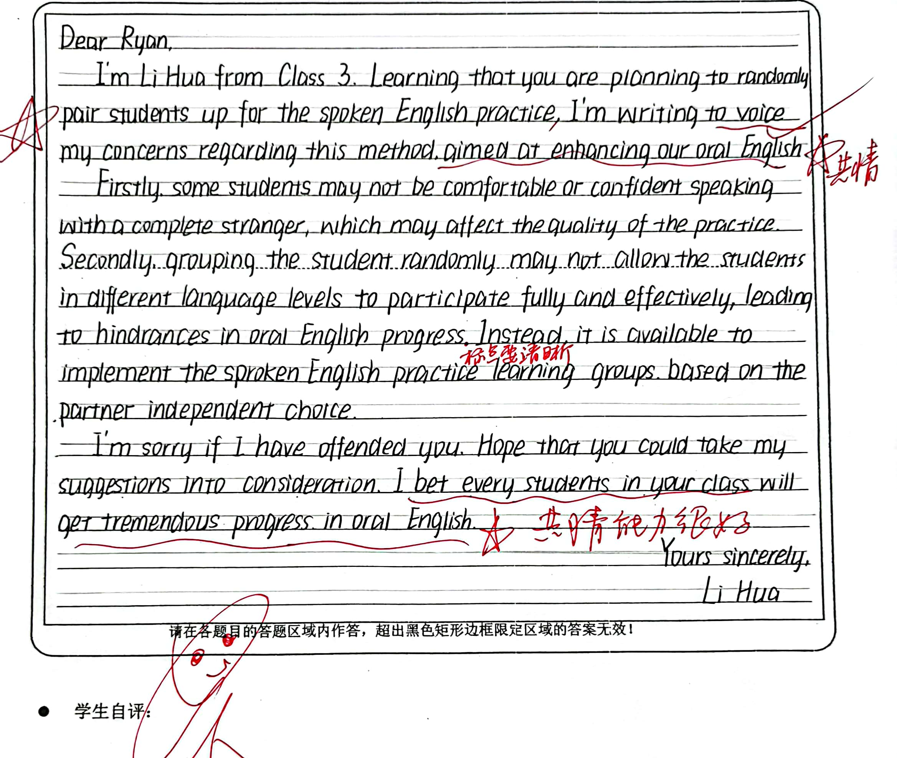
2023年6月全国高考新课标I卷应用文真题
溯恩英语 2023年6月全国高考新课标 I &Ⅱ卷卷应用文讲评
试题呈现 Unique presentation | 观点有理有据 Clear levels | 语言准确丰富 Complete points | 语篇合理建构 Logic bridges | 交际真实得体 Authentic emotions
假定你是李华，外教Ryan准备将学生随机分为两人一组，让大家课后练习口语，你认为这样分组存在问题。请你给外教写一封邮件，内容包括； 1. 说明问题； 2. 提出建议。

Slide 20
