Slide 1


感恩遇见，相互成就，本课件资料仅供您个人参考、教学使用，严禁自行在网络传播，违者依知识产权法追究法律责任。
更多教学资源请关注
公众号：溯恩英语
知识产权声明

Slide 2

Get the clue!
----How to complete a cloze test

Slide 3

Learning Objectives:
By the end of the class, the students will be able to:
1. identify and master the three strategies of getting the clue in cloze tests to infer the keys;
2. analyse the context of a cloze test and explain the strategies used for inferring your true answers;
3. put three strategies into practice and infer true answers of the cloze test without multiple choices;
4. improve their logical inference ability and train their thinking ability while doing the language learning ability.

Slide 4
A poem: I am afraid
You say that you love rain,
but you open your umbrella when it rains...
You say that you love the sun,
but you find a shadow spot when the_____ shines...
You say that you love the wind,
but you _______your windows when wind blows...
This is ______ I am afraid;
You say that you love me too...
the same words原词重现
sun
close
adversative relation转折关系
why
causal relation因果关系

Slide 5
研真题 抓线索
Analyse and discover the clues in the following samples and then infer your answers and reasons

Slide 6
研真题 抓线索
1.（2021年新高考I卷）I’d 45. minimum wage.
.......This was the sort of work that made you 55.appreciate the dollars you earned and respect those who did the work, he told me.
45.A. offer B. earn C. set D. suggest
原词复现the same word

Slide 7
研真题 抓线索
2. (2015年课标卷)As an inexperienced teacher, I tried every means to get them to be ____, but in vain…Amazingly, the children fell silent.
A. glad B. safe C. kind D. quiet
近义词复现synonym

Slide 8
研真题 抓线索
3. (课标卷)After giving shouts of wildly wrong guesses， the professor smiled a thin, dry smile, announced the ______ answer...
A. ready B. possible C. correct D. difficult
反义词复现antonym

Slide 9
研真题 抓线索
4. (2021年课标卷)He taught her how to rely on her other ____, especially her hearing…
A. feelings B. organs C. skills D. senses
上下义复现hyponymy
表意义概括的词汇，它们的词义包括了下义词的词义。
如：animal是sheep,tiger,wolf,dog等的上义词(superordinate)；sheep,tiger等词则是animal的下义词(hyponym).

Slide 10
研真题 抓线索
5. (2015年陕西卷)Three of those rich men and their servants were travelling together on a road when they came to a very ____ village. The first could not stand seeing the poverty…
A. faraway B. different C. poor D. ancient
同根词复现cognate

Slide 11
研真题 抓线索
原词复现the same word
近义词复现synonym
词汇复现
Lexical Repetition
反义词复现antonym
上下义复现hyponymy
同根词复现cognate

Slide 12
研真题 抓线索
1. (2019全国卷III) We see the sky is blue, but down in the valley it’s darker ——it’s like on a __44__ day.
A. cloudy B. normal C. different D. warm
2. (2017浙江卷) The books are in every language --- new books, ancient books, _______ a book on the history of Iraq that is seven hundred years old.
A.then B.still C.even D.rather
3.（2022年新高考II卷) It might sound like one long, expensive 42.vacation , but the couple has an unusual way to make their travel 43 .
A. safe B. busy C. helpful D. affordable

Slide 13
研真题 抓线索
4. (2022新高考I卷) I tied a rope around his waist to keep him near to our spot...He was uncomfortable and his crying let the whole campground know it. So ______ tying him up, I just keep a close eye on him.
A.due to B. instead of C. apart from D. as for
5. (2021年全国II卷) Burchill was 41.staying at the hotel on business and planning to 42.visit some friends in the area. They had asked him to 43.bring some pepperoni(辣香肠) from back east. So he 44.___ a suitcase full of pepperoni.
A. filled B. locked C. abandoned D. lost
6. (2016年北京卷)On January 31, a musher（牧羊人） named Seppala had to cross a frozen body of water called Norton Sound. It was the most ____ part of the journey. Norton Sound was covered with ice, which could sometimes break up without warning. If that happened, Seppala might fall into the icy water below.
A. shameful B. boring C. dangerous D. foolish

Slide 14
研真题 抓线索
1. (2019全国卷III) We see the sky is blue, but down in the valley it’s darker ——it’s like on a __44__ day.
A. cloudy B. normal C. different D. warm
并列关系coordinating relation
标志词有：and, meanwhile, at the same time, not only…but also…, either…or… neither… nor…等

Slide 15
研真题 抓线索
2. (2017浙江卷) The books are in every language --- new books, ancient books, _______ a book on the history of Iraq that is seven hundred years old.
A.then B.still C.even D.rather
递进关系progressive relation
标志词有：and,furthermore,in addition, besides,moreover,what’s more等

Slide 16
研真题 抓线索
3.（2022年新高考II卷) It might sound like one long, expensive 42.vacation , but the couple has an unusual way to make their travel 43 .
A. safe B. busy C. helpful D. affordable
转折关系：adversative relation
标志词有still,but,yet,nevertheless,though，in fact,as a matter of fact 等

Slide 17
研真题 抓线索
4. (2022新高考I卷) I tied a rope around his waist to keep him near to our spot...He was uncomfortable and his crying let the whole campground know it. So ______ tying him up, I just keep a close eye on him.
A.due to B. instead of C. apart from D. as for
对比关系contrast relation
标志词有：instead of,on the contray, on the other hand 等

Slide 18
研真题 抓线索
5.(2021年全国II卷) Burchill was 41.staying at the hotel on business and planning to 42. visit some friends in the area. They had asked him to 43.bring some pepperoni(辣香肠) from back east. So he 44._______ a suitcase full of pepperoni.
A. filled B. locked C. abandoned D. lost
因果关系casual relation
标志词有：so,therefore,hence,
thus,accordingly,consequently等

Slide 19
研真题 抓线索
6. (2016年北京卷)On January 31, a musher（牧羊人） named Seppala had to cross a frozen body of water called Norton Sound. It was the most ____ part of the journey. Norton Sound was covered with ice, which could sometimes break up without warning. If that happened, Seppala might fall into the icy water below.
A. shameful B. boring C. dangerous D. foolish
解释关系:explanatory relation
表现形式：1.通过某些动词mean, be, suggest等，
2.通过某些符号（冒号和括号等）
3.关联词for example/instance, namely, that is to say等

Slide 20
研真题 抓线索
并列关系coordinating relation
递进关系progressive relation
转折关系adversative relation
逻辑关系
Logical Relation
对比关系contrast relation
因果关系casual relation
解释关系explanatory relation

Slide 21
原词
same word
近义词
synonym
反义词
antonym
词汇复现
lexical repetitionn
上下义词
hyponymy
同根词
cognate
并列关系
coordinating relation
递进关系
progressive
relation
转折关系
adversative
relation
clue
线索
逻辑关系
logical relation
对比关系
contrast
relation
因果关系
casual
relation
解释关系
explanatory
relation
动作线(action)
语境
context
情感线(emotion)
固定搭配或概念常识(phrase/common sense)

Slide 22
研真题 抓线索
动作线
1.Ellie was the daughter of our next-door neighbours, and our mothers __1__ us before we were a month old. We spent nearly all our free time with each other. We __2__ each other so well that we could communicate without saying a word.
1. A. introduced B. promised C. taught D. protected
2. A. recognized B. realized C. knew D. hated
关注动作的先后顺序来确定答案

Slide 23
研真题 抓线索
情感线
2.Ellie and I had both always done well in school, and I __1__ didn’t want to get into trouble with my parents. Besides, cigarettes(香烟）smelled __2__ and made me cough.
A. only B. certainly C. so D. even
A. good B. delicious C. bad D. nice
关注形容词和副词带有的感情色彩

Slide 24
研真题 抓线索
固定搭配或概念常识
3.When I called Ellie,she made some excuse to get off the phone...I had lost her.
Throughout most of high school,I was lonely.My decision not to drink or smoke or lie to my parents caused me a lot of pain.But I don’t regret(后悔).I know now that being yourself is never worse than not being yourself.I spent much of my high-school years studying,and it paid _______ when I got into my favorite collge.
A. for B. up C. out D. off
关注故事背景并根据常识来确定选项
pay for为...支付
pay up 付清款项
pay out 花掉，花费
pay off 获得回报

Slide 25
原词
same word
近义词
synonym
反义词
antonym
词汇复现
lexical repetitionn
上下义词
hyponymy
同根词
cognate
并列关系
coordinating relation
递进关系
progressive
relation
转折关系
adversative
relation
clue
线索
逻辑关系
logical relation
对比关系
contrast
relation
因果关系
casual
relation
解释关系
explanatory
relation
动作线(action)
语境
context
情感线(emotion)
固定搭配或概念常识(phrase/common sense)

Slide 26
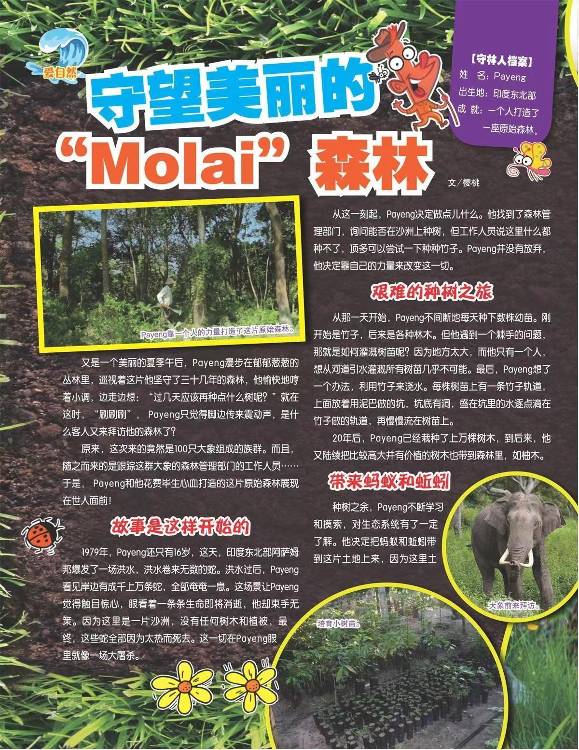
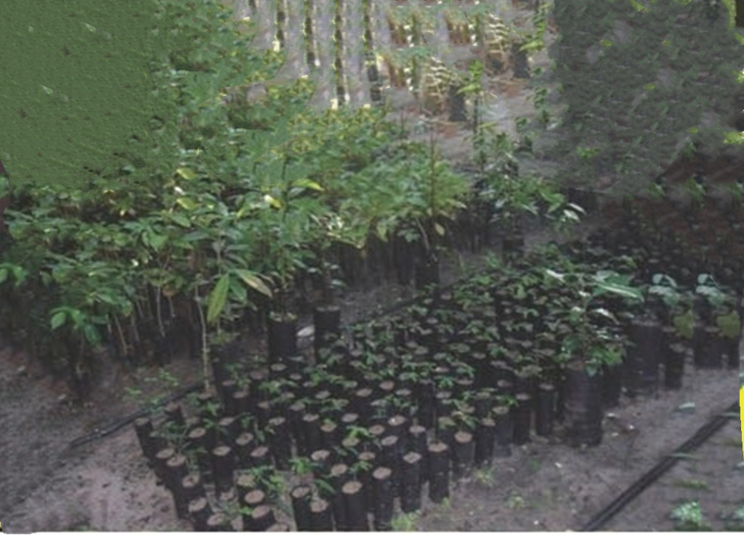
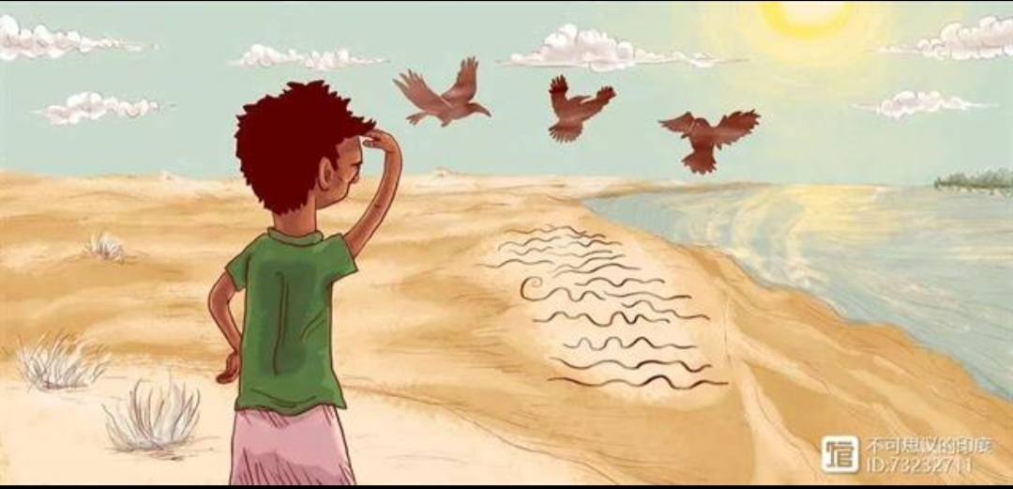
做真题，理逻辑 （2020年全国I卷）
1.What’s the type of the article?
人与自我
人与社会
人与自然
2.What’s the main idea of the article?
Molai insisted on planting trees to build a shelter for animals and plants.
3.What does the article want to convey?(attitudue)
We should protect nature and our homeland.

Slide 27
做真题，理逻辑 choose the clozes and categorize them
常识
常识
Molai grew up in a tiny village in India. The village lay near some wetlands which became his second ______(1). He learned the value and beauty of ______(2) there from a very young age. When he was 16, Molai began to notice something ___________(3) happening around his home. A flood had hit the area earlier that year and the ________(4) it caused had driven away a number of birds. __________(5), the number of snakes had declined as well. He__________(6) that it was because there weren’t enough trees to protect them from the _______(7). The solution, of course, was to plant trees so the animals could seek __________(8) during the daytime. He turned to the ________(9) department for help but was told that nothing would grow there. However, Molai went looking on his own and _____________(10) a nearby island where he began to plant trees. _________(11) young plants in the dry season was _______(12) for a lone boy. Molai built at the ______(13) of each sapling（幼树）a bamboo platform, where he placed earthen pots（陶罐） with small holes to _________(14) rainwater. The water would then drip on the plants below. Molai _________(15) to plant trees for the next 37 years, His efforts have resulted in 1,360 acres of naturally-grown land that has become home to many plants and animals.
home
nature
disturbing
情感
damage
并列关系
Besides
递进关系
realized
动作
heat
因果关系
shelter
因果关系
常识
forest
discovored
并列关系/动作
常识/动作
Watering
tough
情感
top
反义词
动作
collect
continued
动作

Slide 28
原词
same word
近义词
synonym
反义词
antonym
词汇复现
lexical repetitionn
13
上下义词
hyponymy
同根词
cognate
并列关系
coordinating relation
递进关系
progressive
relation
转折关系
adversative
relation
clue
线索
4.10
5
逻辑关系
logical relation
对比关系
contrast
relation
因果关系
casual
relation
解释关系
explanatory
relation
7.8
6.10.11.14.15
动作线(action)
语境
context
情感线(emotion)
3.12
1.2.9.11
固定搭配或概念常识(phrase/common sense)

Slide 29
依线索，填真题 finish five clozes and categorize them
Over the past 38 years, Mr. Wang has pretended to be someone else many times, and has even learned to 1. different dialects（方言）, leading to him being described as an “Oscar-winning actor”. The 60-year-old is not an actor, but a 2. However, he is more devoted to his “ 3.role ” than any real actor. In the 1990s, a group of thieves often sold stolen goods with the help of some beggars. To look into the 4.case ，Wang disguised（伪装）himself and 5._joined the beggars．Dirty shorts and old shoes gave him the 6.appearance of a real beggar and his convincing dialect soon won him the 7. trust of the beggars. “I often 8.invited them to drink alcohol. Once they were 9. , they began to talk a lot,” Wang said. “I’d then 10.excuse myself to use the toilet, 11. note down what the beggars said, and send the 12. information to my teammates.” Wang, who is often in 13.dangerous situations, is also a judo（柔道）master． “As long as I get close enough, no criminal can 14. from me,” he said. Wang’s 15. won him several honors, including a National May Day Labor Medal and 11 Citations of Merit, Paris.
speak
搭配/常识
policeman
转折关系
同根词
drunk
escape
动作
courage
情感

Slide 30
1. | A.teach | B.compare | C.assess | D.speak
2. | A.lawyer | B.doctor | C.policeman | D.businessman
3. | A.role | B.study | C.family | D.audience
4. | A.mirror | B.case | C.future | D.question
5. | A.interviewed | B.joined | C.arrested | D.assisted
6. | A.challenge | B.experience | C.appearance | D.freedom
7. | A.vote | B.sympathy | C.permission | D.trust
8. | A.invited | B.forced | C.helped | D.expected
9. | A.drunk | B.deserted | C.bored | D.lost
10. | A.guide | B.persuade | C.excuse | D.allow
11. | A.refer to | B.note down | C.ask about | D.miss out
12. | A.plan | B.agreement | C.direction | D.information
13. | A.awkward | B.dangerous | C.unfortunate | D.strange
14. | A.separate | B.recover | C.escape | D.hear
15. | A.courage | B.honesty | C.kindness | D.optimism

Slide 31
homework:
Review what you have learned today and finish the cloze test in your paper.

Slide 32
研真题 抓线索
原词
same word
近义词
synonym
反义词
antonym
词汇复现
lexical repetitionn
上下义词
hyponymy
同根词
cognate
并列关系
coordinating relation
递进关系
progressive
relation
转折关系
adversative
relation
clue
线索
逻辑关系
logical relation
对比关系
contrast
relation
因果关系
casual
relation
解释关系
explanatory
relation
动作线(action)
语境
context
情感线(emotion)
固定搭配或概念常识(phrase/common sense)

Slide 33
Thank you for your listening!

