Slide 1


感恩遇见，相互成就，本课件资料仅供您个人参考、教学使用，严禁自行在网络传播，违者依知识产权法追究法律责任。
更多教学资源请关注
公众号：溯恩英语
知识产权声明

Slide 2



2024年高考必胜
高考开胃菜，语填人人爱
—— 浙江省 常山一中 吴俊峰

Slide 3



单词层次：
词性是句法功能的基础
—— 语法填空的差异主要体现在不同词性
对应不同的句法功能，因此词性的潜意识运用和词性的明晰定位是语法填空的基础。
01

Slide 4


高频考点：形容词变副词的基本规律
rarely
1.^{(2023年全国新课标I卷)}No matter where I buy them, though, one steamer is __ (rare) enough.
2.^{(2023年全国新课标II卷)}So, what are they learning? （basic）, how to describe a panda’s life.
3.^{（2022-新高考 Ⅱ 卷）}When he looked down, he ____ _ (accidental ) slipped and fell over the edge.
4.^{（2020-全国III）}As the small boat moved, 68 (gentle) along the river he was left speechless by the mountains being silently reflected in the water.
Basically
accidentally
gently
形容词变副词的基本规律：
1.绝大多数辅音字母加e结尾的形容词直接加-ly 如：politely; widely; wisely; rudely; nicely 但truly例外
2.以辅音字母加le结尾时,去e加y 如：simply; terribly; gently; possibly; comfortably;considerably; probably; incredibly
3. 以“y”结尾的，且读音为 / i /， 先将“y”改成“i”，再加“ly” 如：happily; heavily; angrily; busily 但是如果读音为 / ai /， 直接加ly，如： shy---shyly
4.以ic 结尾的词，加ally 如：economically; basically; scientifically; automatically; energetically; 但publicly 例外。

Slide 5
易错考点：类似-ed/-ing结尾的形容词变副词
1.^{（2021-新高考 I 卷）}The hot spring at the foot of the mountain is something you must try after the climb. It will 58 (undoubted) help you get refreshed!
undoubtedly
词性的判断: undoubted的副词修饰动词help，类似-ed/-ing结尾的形容词变副词的有：
confusedly迷茫地； worriedly焦虑地；excitedly兴奋地； hurriedly赶紧； repeatedly反复； reportedly据报道；undoubtedly毫无疑问；unexpectedly出乎意料地
amazingly令人吃惊的是; surprisingly令人惊讶的是; interestingly有趣的是; accordingly相应的; increasingly越来越多地; seemingly表面上; unknowingly不知不觉地; unfailingly不屈不挠地; untiringly不倦地; frighteningly 可怕地; embarrassingly尴尬地; charmingly迷人地

Slide 6
易错考点：特殊的词形转换→→变名词
curiosity
1.^{（2021-新高考 I 卷）}Filled with 64 (curious), the artist packed his bags and left.
2.^{（2019 全国卷3）} When they were free from work，they invited us to local events and let us know of an interesting 66 （compete）to watch，together with the story behind it.
3.^{(2016-10-浙江卷)}Magically, that show remains the Great Jason's best 65 _ ______(perform) to this day.
competition
performance
pronounce; explain; describe ;acquire; recognize; compete; occupy
→→
anxious; various; curious; generous; necessary
→→
dead; deep; wide; long; true; young；high; weigh; laugh
→→
wise; free; bore
→→
fail; press; depart; expose; mix； invite; prepare
→→
pronunciation; explanation ; description; acquisition; recognition; competition;occupation
anxiety; variety; curiosity; generosity; necessity
death; depth; width; length; truth; youth；height; weight; laughter
wisdom; freedom; boredom(厌烦)
failure; pressure; departure; exposure _{(暴露)}; mixture; invitation; preparation;

Slide 7
易错考点：特殊的词形转换→→变形容词
1.^{（2018年6月 浙江卷）}The obvious one is money; eating out once or twice a week may be 62
(afford) but doing this most days adds up.
2.^{（2021-全国乙）}•Provide 68 (finance) aid and other benefits for local peoples.
3.^{(2018全国卷I)} Running is cheap, easy and it’s always 69 (energy).
4.^{（2023-1-浙江卷）}The hutongs they formed were orderly, lined by 61 (space) homes and walled gardens.
affordable
financial
energetic
spacious
globe; benefit; finance, face
→→
hero; enthusiasm; energy; fantasy; tragedy; science
→→
access; horror; terror; sense; response
→→
economy; electricity; history; chemistry; physics; politics; classic; medicine
→→
shine; noise; scare; fun; sun; fog; hunger; anger
→→
global; beneficial; financial; facial
heroic; enthusiastic; energetic; fantastic; tragic; scientific
accessible; horrible; terrible; sensible; responsible
economical; electrical; historical; chemical; physical; political; classical; medical;
shiny/shining; noisy; scary; funny; sunny; foggy; hungry; angry

Slide 8

语块层次：
语块是快速解题的关键
—— 语块融合了语法、语义和语境的优势,
具有特定的表达功能, 可作为整体储存和提取，提升语法填空的速度和准确率。
02

Slide 9

快速提取“固定搭配”信息 —— 抽象名词具体化
1.^{（2021-新高考 I 卷）}While you’re in China, Mount Huangshan is 65 must to visit!
2.^{（2023-新高考 I 卷）}The meat should be fresh with 63_____ touch of sweetness and the soup hot, clear and delicious.
3.^{(2017-6 –浙江卷)} For Pahlsson, its return was___65___wonder.
词性的判断: must在此处做名词，表示“必须做、看、听的事”。考查根据上下文语境正确使用冠词的能力， a must to visit 意为“一处必须去的地方”。
a touch of sth 作为短语，意为“一丝......，一点.....”. 如: a touch of love 一丝爱意；a touch of luck 一点儿运气；a touch of kindness 一点儿好意；with a touch of vinegar有点刻薄
抽象名词前加 a/an 可使抽象名词具体化, 表“一场、一次、一件”。
如: a success一件成功的事或一个成功的人；a wonder奇迹，奇事
a surprise一件令人惊讶的事；a pity一件遗憾的事；
an honour 引以为荣的人/事；a comfort 令人欣慰的人/事
Being able to afford drink would be comfort in those tough times.
a
a

Slide 10
快速提取“固定搭配”信息—— 冠词固定搭配
1.^{（2021-全国甲）}It took us about 3 hours to go all 48 way around the Xi’an City Wall.
2.^{(2018全国卷III)}I'm face-to-face with the gorilla, who begins screaming at 62 top of her lungs.
3.^{（2016全国卷Ⅱ）}Give your body and brain a rest by stepping outside for 68 while, exercising, or doing something you enjoy.
4. ^{（2019-6浙江卷）}Everybody wears _57__ same style of clothes.
Keys:1.the; 2.the; 3.a; 4.the
不定冠词a/an常考固定搭配 ：①突然; ②每周一次; ③不知所措, 茫然; ④参观, 拜访; ⑤节食; ⑥让某人搭便车; ⑦在……方面有天赋; ⑧与……谈话; ⑨在…起重要作用
^{①}all of a sudden; ^{②}once a week; ^{③}at a loss; ^{④}be on a visit; ^{⑤}be/go on a diet;
^{⑥}give sb a lift; ^{⑦}have a gift for...; ^{⑧}have a word with...; ^{⑨}play an active part in
定冠词常考的固定搭配：①此刻, 目前; ②当场; ③前几天; ④同时; ⑤中肯, 切题; ⑥从长远来看；⑦一看见…； ⑧打抓身体部位
the
the
the
the
the
①at moment; ②on spot; ③ other day; ④at same time; ⑤to point;
⑥in long run/term ⑦at sight of ⑧hit him the head/ shoulder/back ；hit him the face /eyes/right leg；catch/ seize /grab him the collar/ arm/ neck
the
the
on
in
by

Slide 11
快速提取“固定搭配”信息—— 英语习语
1.^{（2018全国卷I）}If you are time poor, you need run for only half the time to get the same benefits as other sports, so perhaps we should all give 70 a try.
下列短语中 it 本身词义模糊，只是帮助构成习语:
①保持优秀成绩；继续干下去; 坚持 ②及时抵达；成功; 达到预定目标 ③完成它; 应对（处理） ④别紧张; 别着急; 凡事看开些; 放松 ⑤明白了；做到 ⑥注意; 保证; 务必 ⑦正如某人所说 ⑧试一试；尝试一下
^{①} keep it up; ^{②} make it; ^{③} manage it; ^{④} take it easy; ^{⑤} get it; ^{⑥} see to it that; ^{⑦} as sb put it ^{⑧} give it a try
下列的固定短语中，名词要用复数：
①同某人吵架, ②情绪低落 ③成为废墟 ④衣衫褴褛 ⑤有礼貌 ⑥向某人问候
words
ruins
①have (word) with sb ② in low (spirit) ③in (ruin)
④in (rag) ⑤have good (manner) ⑥ give one's (regard)to sb
spirits
rags
manners
regards

Slide 12
快速提取“固定搭配”信息—— 介词常考固定短语搭配
Keys: 1.to 2. by 3.on
1.^{（2019年6月浙江卷）}The answer 61 this question is not clear.
2.^{(2023-新高考 I 卷)} There you will find them prepared differently-more dumpling and less soup, and the wrappers are pressed 60____ hand rather than rolled.
3.^{（2020-全国III）}The artist was finally humbledby the greatest artist 70 earth, Mother Nature.
1. “in/ at+名词” 表示 “在进行，从事; 处于...状态”
2. “be of + value等抽象词”，说明“作用、重要性和意义”等。
“be of + 度量、形状、颜色、大小的名词”，说明主语的特征，前常用different, all, the same, this, that, a(n)等来修饰。
3. “to one's +名词”表示“对...感到...”
4. “in+名词”表示情绪状态
5. by 表示交通方式
6. at 表示速度、价格、利率
7. to 表示“建筑构件”、“方法，答案”或“回复, 反应”
1. on show/ display/ sale/ strike/ duty/ trial
at work/ war/ table/ play / sea / peace
in order/ control/ danger/ sight
2. be of value/ importance/ use/ color/ age/ size/
height/ weight/ shape/type/ kind/ quality
3. to one's joy/ surprise/ pleasure/ sorrow/
4. in surprise/ alarm/ terror/ horror/ delight
5. by air/ bicycle/ boat/ bus/ car/ plane/ train
6. at a high/low price/speed；at a speed of …
7. the entry/ entrance/ exit/ approach/ access/
answer/ key/ way/ solution/response/ reply to

Slide 13

高频考点：宾语补足语
astonished
1.^{（2021-新高考 I 卷）}Strange, isn’t it? But that’s how nature is — always leaving us 60 。 (astonish).
2.^{（2023-新高考 I 卷）}yet two seems greedy, so I am always left 65 (want) more next time.
wanting
宾语与其补足语有逻辑上的主谓关系，它们一起构成复合宾语。
一句话让你牢记宾补：The war made him a soldier / homeless/ in poverty/ separated from his family/ go through hardships and sufferings / it impossible for him to go on with his research. 战争使他成为一名战士_{名词}/无家可归_{形容词}/穷困潦倒_{介宾短语}/与家人分离_{分词}/历尽艰辛_{不带to的动词不定式}/他无法继续他的研究_{it做形式宾语，宾补为形容词}。
leave sb/sth +宾补to do/doing/done 作为习惯用法，意为“让某人或某物处于某种状态（将要/正在/已经）”: 设空处说明us的状态，所以用 astonished表“使人感到震惊”。

Slide 14
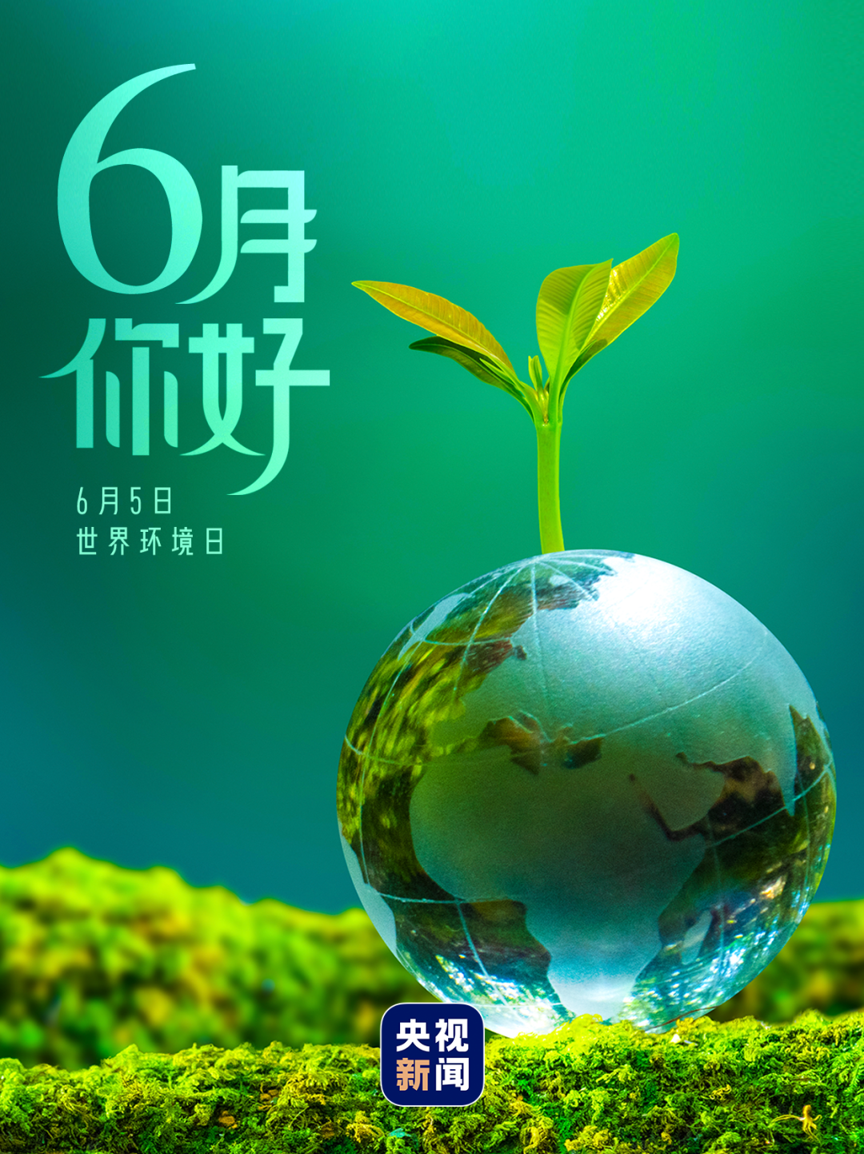
句子层次：
句子是基于语篇的统一
1. 熟悉五种基本句型；
2.警惕逗号粘连错误，掌握“一个句子一个谓，两个句子连词成对，没有连词用非谓”的句式特点；
3.立足语篇语境，研判谓语动词和非谓语动词及其形态。
03

Slide 15
高频考点：快速判断三大从句的连接词
1.^{（2021全国 I 卷）} 56 is so breathtaking about the experience is the out-of-this-world scenes.
2.^{(2019年6月浙江卷)}On the edge of the jacket, there is a piece of cloth 58 gives off light in the dark.
3. ^{(2020-全国 III)} In ancient China lived an artist 61 paintings were almost lifelike.
4. ^{(2020-7-浙江卷)}they began to depend less on 57 could be hunted or gathered from the wild.
what
that/which
whose
what
定语从句的连接词作成分，有意义（指代定语从句所修饰先行词的意义）
定语从句缺主语、 宾语， 填关系代词 which, that, who 或 whom，指代先行词的意义
定语从句缺定语， 填关系代词 whose， 指代先行词的名词所有格
定语从句缺状语， 填关系副词 where, when 或 why 指代“介词in/on/for+先行词”的意义
名词性从句还原其前世的简单句：
特殊疑问句：特殊疑问词 变成从属连词引导名从，保留特殊疑问词意义和成分。
一般疑问句：增加从属连词 if/ whether表“是否”，保留其一般疑问句的意义。
陈述句： 增加从属连词that, 不充当任何成分且无意义，只起连接作用，保留其陈述句的意义。
状语从句句子结构和意义完整，根据前后句间的意义和逻辑关系填连接词，表时间、地点、条件、原因、结果、目的、让步、比较、方式

Slide 16
易错考点：语意和句式的连贯
1. ^{（2019 全国卷3）}On our way to the house，it was raining 61 hard that we couldn't help wondering how long it would take 62 （get）there.
2.^{（2016-10-浙江卷）}Drinking my iced coffee I ran my fingers along the streets 57 the hotel to the opera hall.
3.^{（2017-全国2）}It ran for just under seven kilometers and allowed people to avoid terrible __61_ _ (crowd) on the roads above as they travelled to and ___62__ work.
4.^{（2021-6浙江卷）}Although Mary loved flowers, 62 she nor her husband was known as a gardener.
so
to get
from
crowds
from
neither
语意和句式的连贯，要求读懂句意，连接上下文（填入无提示词），如：
1.so/such…that… 2.from…to…, /to...from...
3.prefer…to.../would rather...than... 4. either…or… / neither…nor…/ both…and...
5.It is/was…that...(强调句型) 6.not only… but…
7.not…but... 不是......而是...... 8.比较级…than.….
9.one...the other.../ some...others…/one ...another... 10. not ...until... 直到……才……

Slide 17
易错考点：语意和句式的连贯
5.^{（2018年11月浙江卷）}It is possible 63 caffeine may cause birth defects in humans, too.
6. ^{(2016-全国I)}so that while one is being bottle-fed, 70 ____ other is with mum-she never suspects.
that
the
语意和句式的连贯，要求读懂句意，连接上下文（填入无提示词），如：
11.whether ...or... 不论……还是……
12.Though/Although/As..., but..._{(只能用一个连词，考试往往考前面的让步连词)}
13.It is adj. for sb to do sth 某人做某事是……的
14. It is no wonder that... 难怪……
15. It is no use doing sth 做某事是没有用的
16. It can’t be denied that... 不可否认……
17. It is likely/possible that... 有可能......
18. sb find it adj. to do sth 某人觉得做某事是……
19. There is no need to do sth 没有必要做某事
20. There is no doubt/denying that... 毫无疑问/无可否认……
21. There is no point in doing sth 做某事毫无意义
22. was/were doing sth when... 正在做某事， 突然……
23. was/were about to do sth when... 正要做某事， 突然……
24. was/were on the point of doing sth when... 正要做某事，突然……
it做形式主语或形式宾语

Slide 18
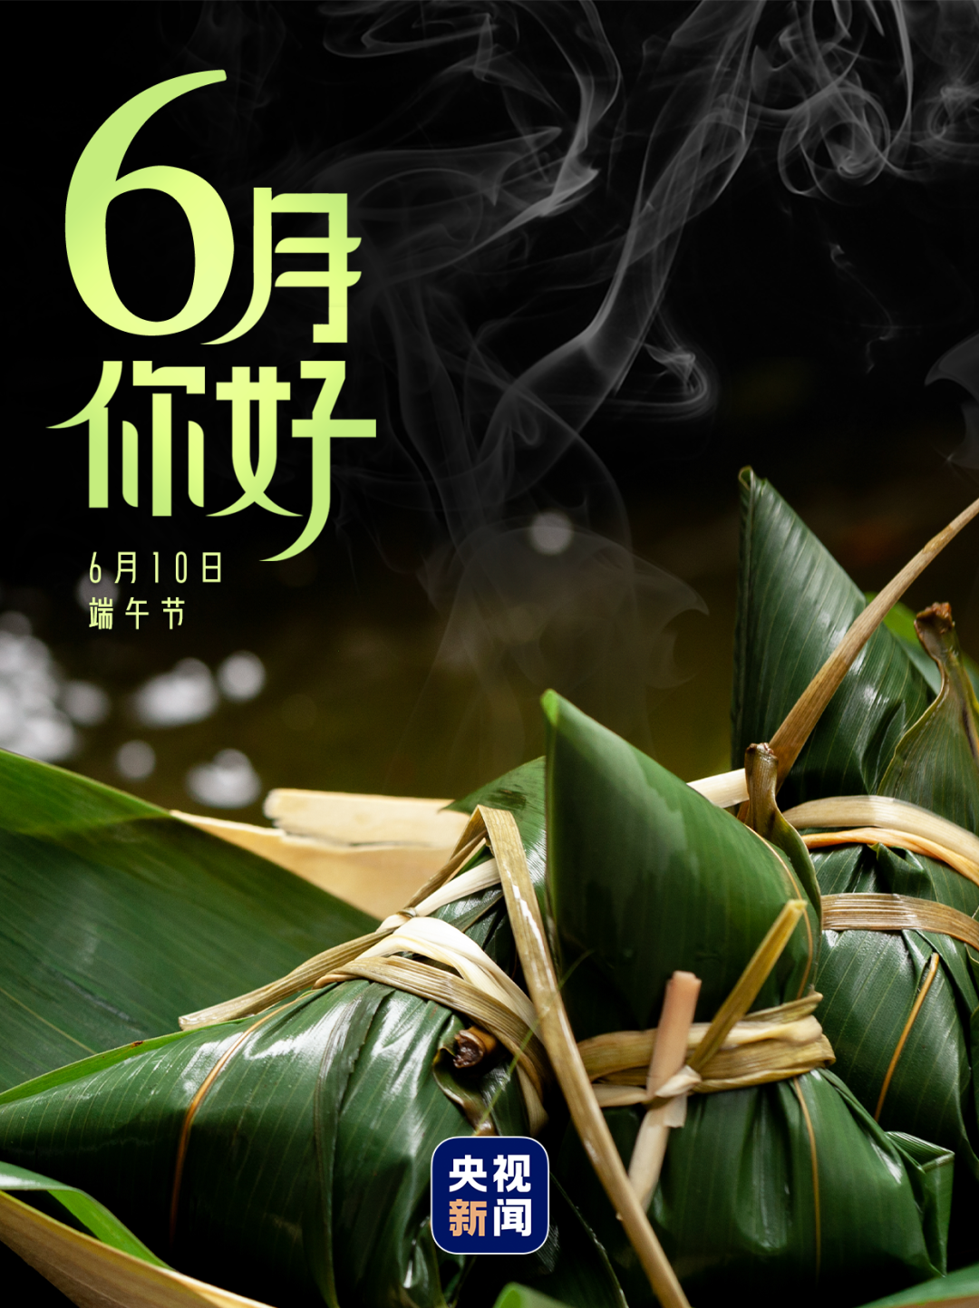
语篇层次：
理解句际连贯和句内逻辑
—— 考生需强化语境运用和语篇分析的能力，来增强文本的理解。在正确理解语篇主旨大意的基础上，关注具体语境中不同词语、句子与整个篇章结构之间的联系，加强对词法、句法以及语篇知识的综合运用。
04

Slide 19

注重上下文语境照应和内在逻辑
1.^{（2022年1月浙江卷）}Cobb, for her part, started to ask conference organizers who invited her to speak 62 she could do so remotely; about three-quarters of 63 time, they agreed. When the answer was no, she declined the 64 (invite).
whether
the
invitation
本句长难句的难点是62题，主要体现在定语从句的划分，并读懂语义，借助上下文语义场（they agreed和the answer was no），得出语义为“询问是否可以远程操作”。62题错误率很高，主要原因是考生忽略了语篇，没有在主题意义的引领下，进行整体把控和分析，忽视了下文中的形似语境的照应和提示。
2.^{（2021-新高考 I 卷）}As the song goes, this long and winding road “will never disappear”, and it will always stick in the visitor’s memory. It sure does in 64 (I).
mine
句际逻辑形成语义连贯: 本题很好地体现语法填空“突出语篇，强调运用”的命题特点，上句“ it will always stick in the visitor’s memory”,设空处句中does指代上句中的stick，形成语义连贯，在这种句际逻辑和语境中in mine指代in my memory, 自然简洁，语气通畅。

Slide 20
注重上下文语境照应和内在逻辑
3.^{（2022年6月浙江卷）}Blind people recognize shapes with their 60 (exist) senses, in a way similar to that of 61 (sight) people, says Ella Striem-Amit, a Harvard scientist.
分析句子时需要将当前加工的词汇整合到局部语境和整体语境中，在语境中分析语篇意义的连贯性时需要考生调动自己的认知推理能力来推导出语篇中隐含的连贯关系和内在逻辑。
Blind children tend to be more passive in this area of motor development than sighted children._{失明的孩子在动作发展这一方面往往比不失明的孩子更加被动。}
The museum has special facilities for blind and partially sighted visitors. _{博物馆有专门设备供失明和视力有缺陷的参观者使用。}
Keys: 60.existing 61. sighted

Slide 21
注重上下文语境照应和内在逻辑
4.^{（2017年11月浙江卷）}Another nice thing is that you learn both new words and 64 (they) use unconsciously, meaning that you will tend to use the words 65 (learn) this way in conversations almost automatically.
Keys: 64.their 65. learned
65题解题关键是“meaning that”的解释关系，unconsciously与automatically同义复现，因此下文的the words learnt this way指的是上文 learn both new words and their use unconsciously。
5.^{(2019年6月浙江卷)}One study in America found that students' grades 62 (improve) a little after the school introduced uniforms. But some students didn't want ____63_____ (wear) the uniform. Other American studies showed no _____64____(connect) between uniforms and school performance.
Keys: 62.improved 63. to wear 64.connection(s)
62题improve既可作及物动词又可作不及物动词，根据下文showed no connection between uniforms and school performance可知，成绩的提升与校服无关，是一种自然的提升，可判断improve此处为不及物动词，不用被动。此题易误填were improved.

Slide 22
注重语境照应和内在逻辑——_{and 表并列关系}
1.^{（2020 年全国Ⅰ卷）} Chinese researchers hope to use the instruments onboard Chang’e -4 __66___ （ find）and study areas of the South Pole-Aitken basin.
2.^{（2016 年全国Ⅱ卷）} If you feel stressed by responsibilities at work, you should take a step back and identify （识别） those of __61_ _（great） and less importance.
3.^{（ 2016 年 全 国 Ⅲ 卷 ）} Confucius believed knives would remind people of killings and ___49___ （be） too violent for use atthe table.
1.由 and study 可知， 前面应是 find 才并列一致， 但句中前面已有谓语动词 hope, 所以 find 应为非谓语，做目的状语， to find and study并列。
3.空格所给动词前有 and， 根据并列一致， be 应与前面的某个词一致； 根据意思“孔子认为刀会让人们想起杀戮”，“（刀） 用在餐桌上太暴力”， 可知 be ... 和前面的 would remind 共用一个主语 knives，故填 were。 此题易误填 being， be 或 was。。
Keys:1.to find 2. greater 3.were

Slide 23
注重语境照应和内在逻辑——and/or 表并列关系
4.^{（2014 年全国Ⅱ卷）} There were many people waiting at the bus stop, 64 some of them looked very anxious and disappointed.
5.^{（2021新高考 I 卷）}Though it is the only unnatural thing on your way up the mountain, still it highlights the whole adventure 62 offers a place where you can sit down to rest your 63 (ache) legs.
and
and
and 前后的并列成分， 词性相同， 谓语动词的时态一致， 非谓语动词的形式也一致， 利用并列一致的平行结构原则，很容易解题。 但需要我们仔细推敲，准确判断并列对象，只有正确判断并列对象，才能正确解题。
句内逻辑形成语义连贯:本句考查句内逻辑，and连接两个并列谓语“highlights”“offers”。

Slide 24
注重语境照应和内在逻辑——and/or 表并列关系
6. ^{(2023年全国高考新课标I卷)}To eat one, you have to decide whether 57 (bite) a small hole in it first, releasing the stream and risking a spill (溢出), 58 to put the whole dumpling in your mouth, letting the hot soup explode on your tongue.
7.^{（2020-6-山东卷）}They kept their collection at home until it got too big 37 until they died, and then it was given to a museum.
8.^{（2020-6-山东卷}）visitors can play with computer simulations and imagine 42 （they） living at a different time in history or 43 （walk）through a rainforest.
to bite
or
or
walking
5 本句长难句的难点是whether引导的宾语从句的分析和内在逻辑的理解：to bite a small hole in it first, releasing the stream and risking a spill 与to put the whole dumpling in your mouth, letting the hot soup explode on your tongue为并列的选择关系，连词whether...or...体现了语意和句式的连贯。
7. imagine living ... or walking...

Slide 25

书写卷面：
规范书写是语填得分前提
1.看准题号再答题，以免把答案填错位。
2.看清所给单词，不要把已给出的单词抄错。
3.不要在答案上涂改，可划掉，重新写。
4.有大小写拼写错误的均不给分
05

Slide 26
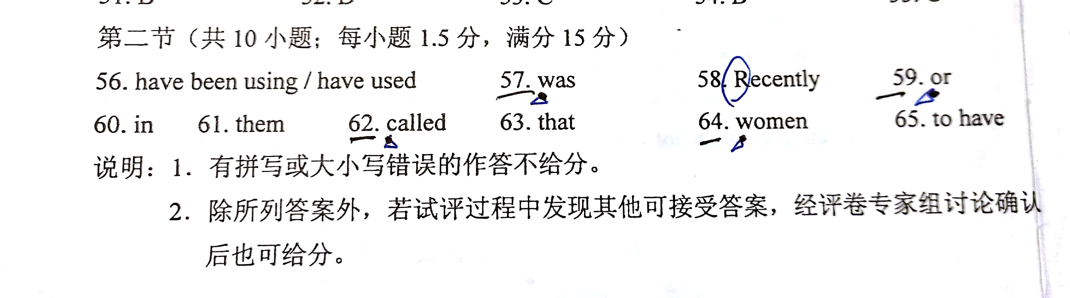
有大小写拼写错误的均不给分
2018年11月浙江卷
特别注意
大写和小写
多检查大小写，尤其是Cc Ss Ww Ii Oo Pp Yy Jj

Slide 27
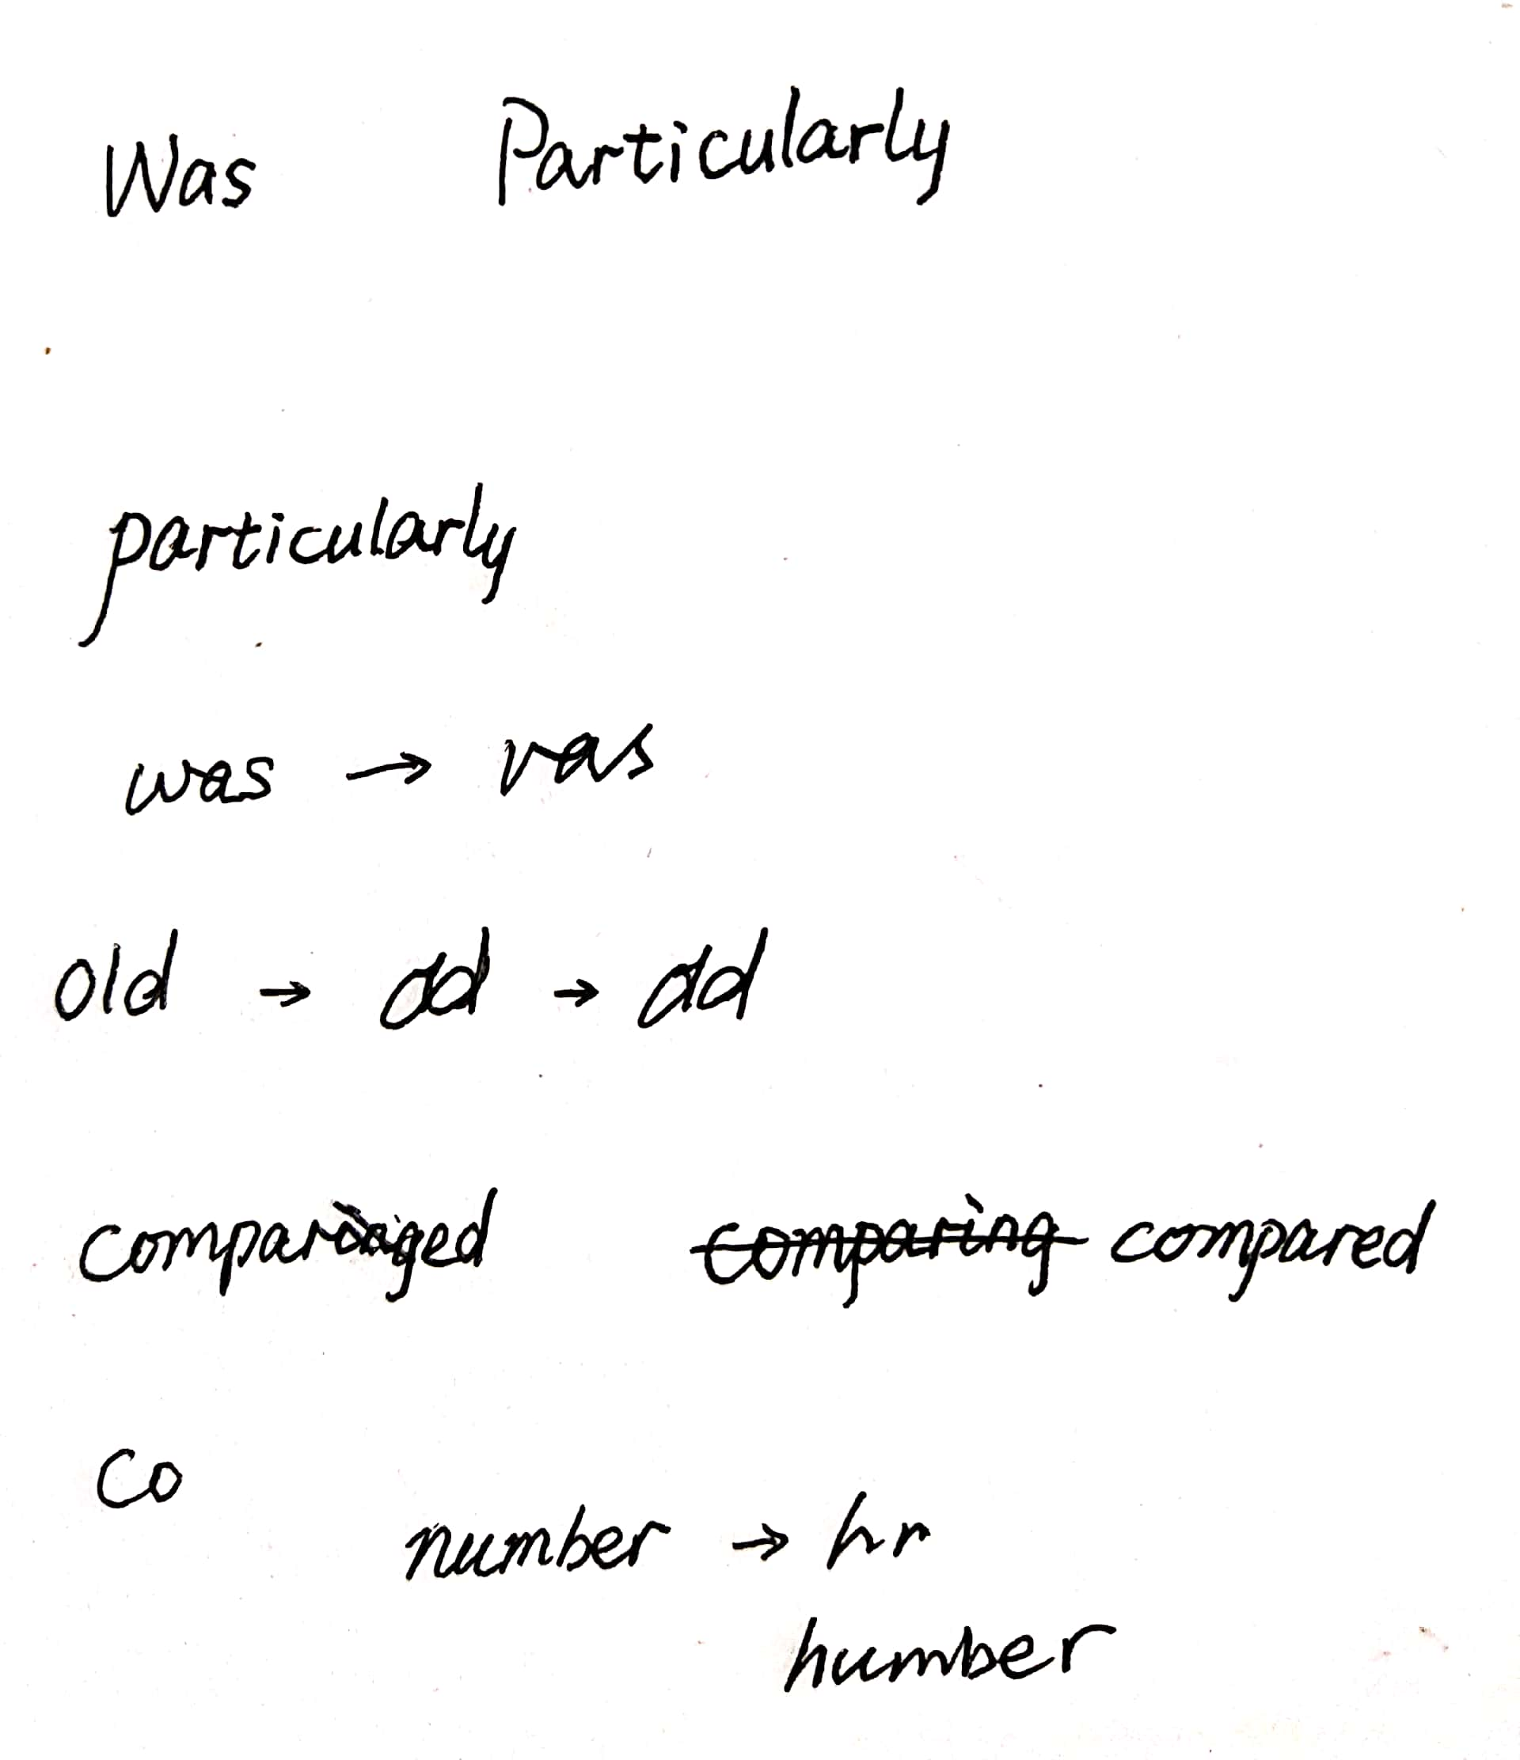
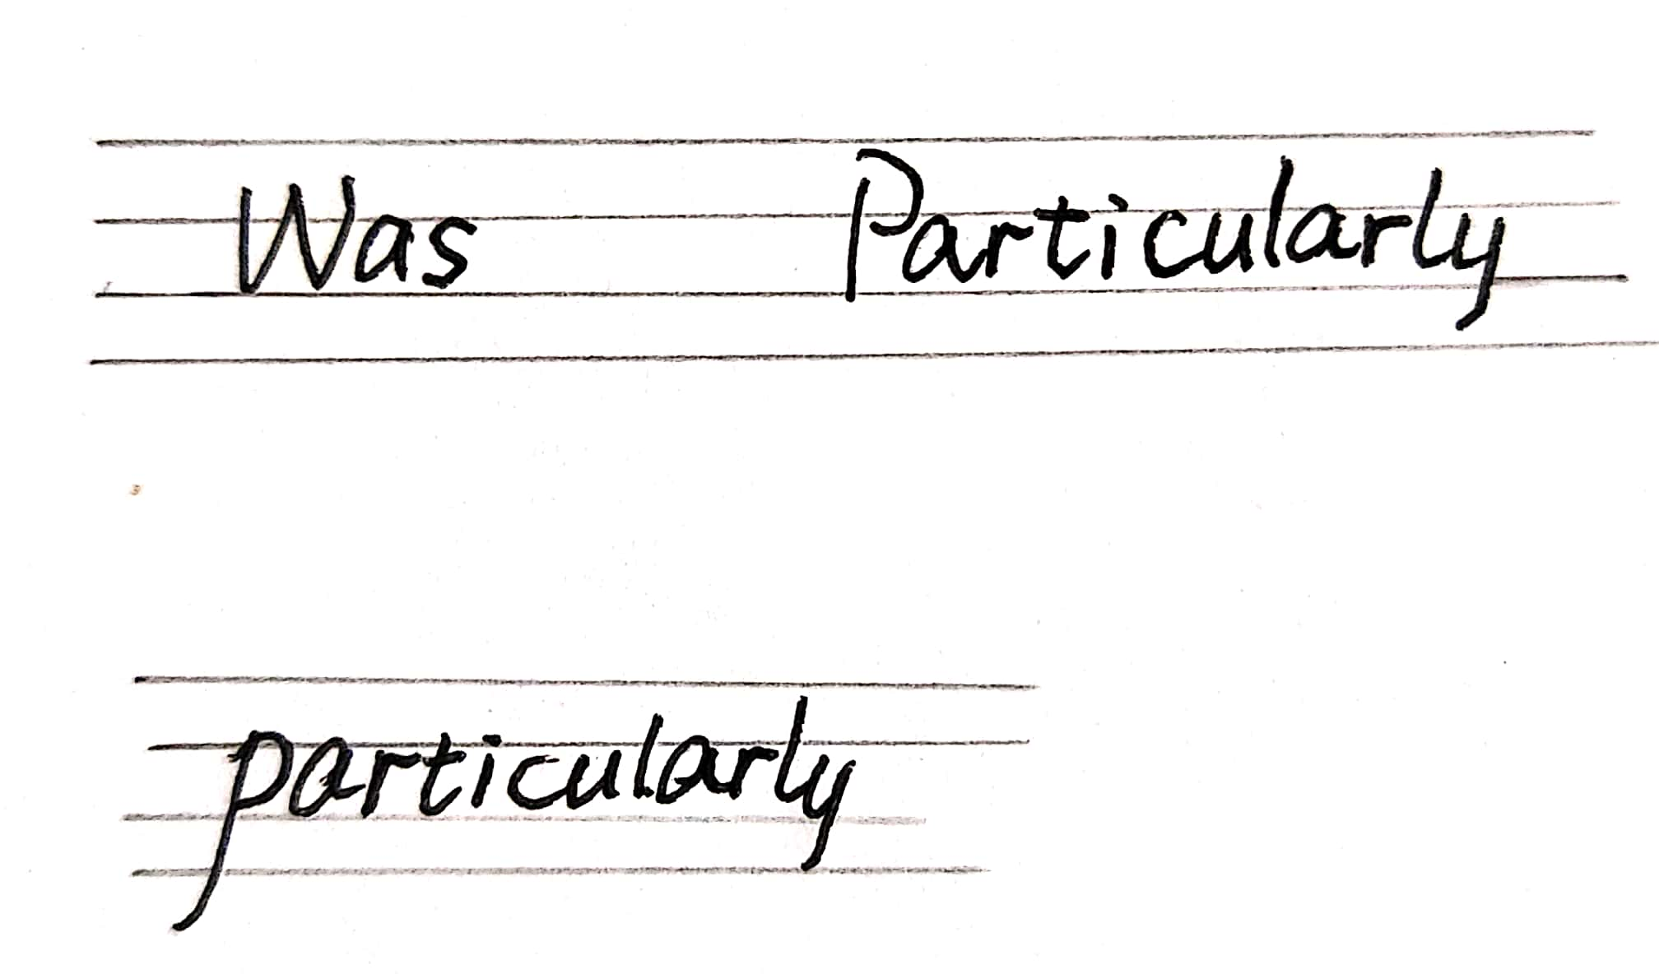

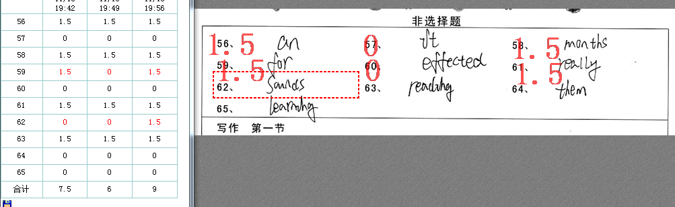
规范书写，有大小写拼写错误的均不给分
有大小写拼写错误的均不给分，如小写的首字母w、c、o、p上格超出相邻的第二个字母一个格位，视为大写不给分。
大写看上限，不看下限。

Slide 28
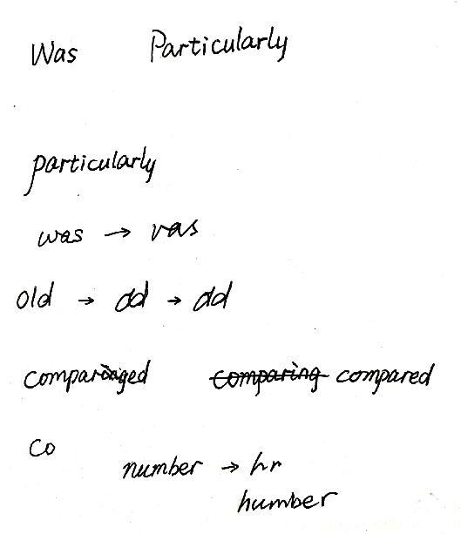
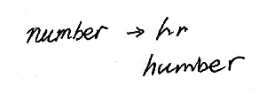
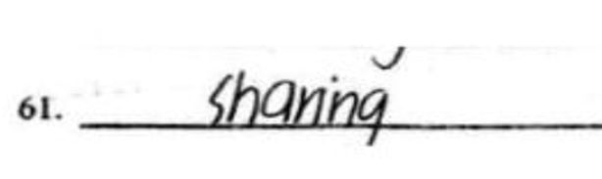

规范书写，不要连写
有拼写错误不给分，如把u写成v,把n写成h不给分。但如果书写习惯不规范，综合语法填空中该生其他部分的书写习惯，可以判别其书写的原意，根据实际情况判分。
字母粘连完全不可辨识不得分，但依据笔势可以辨别可以算得分。
字母书写不规范，
r/i连在一起。

Slide 29


规范书写，合理涂改
某个答案写成另外一个词汇，但学生意识到错误将其一部分划去，但有些字母未划去，结果与改正后的单词容易令评卷者联想到另个错误词汇， 不得分。
拼写过程中考生意识到错误，通过划线等手段划去，将正确拼写写在周边恰当位置，得分。
书写极不规范，个别字母令评卷老师误认为另外一个词汇的，不得分，如"elder". 原答案是“older .

Slide 30
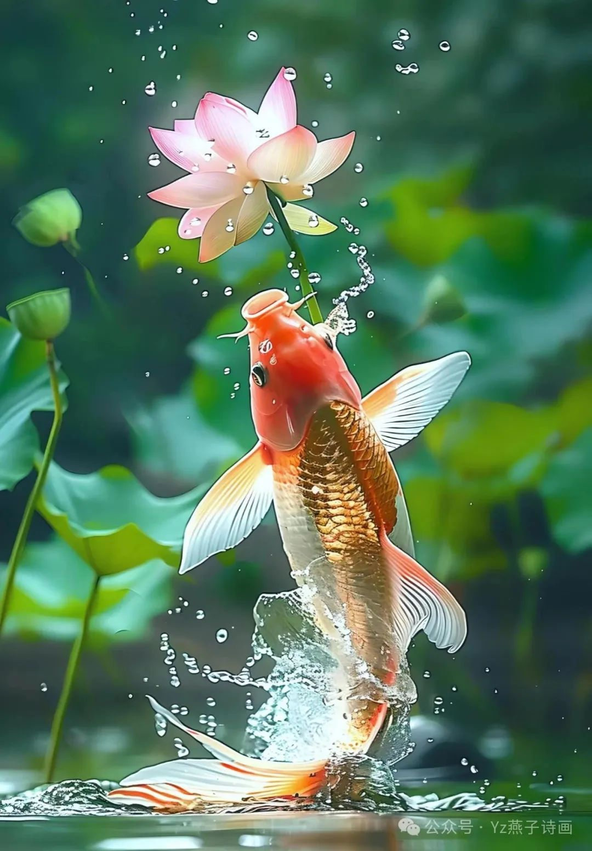
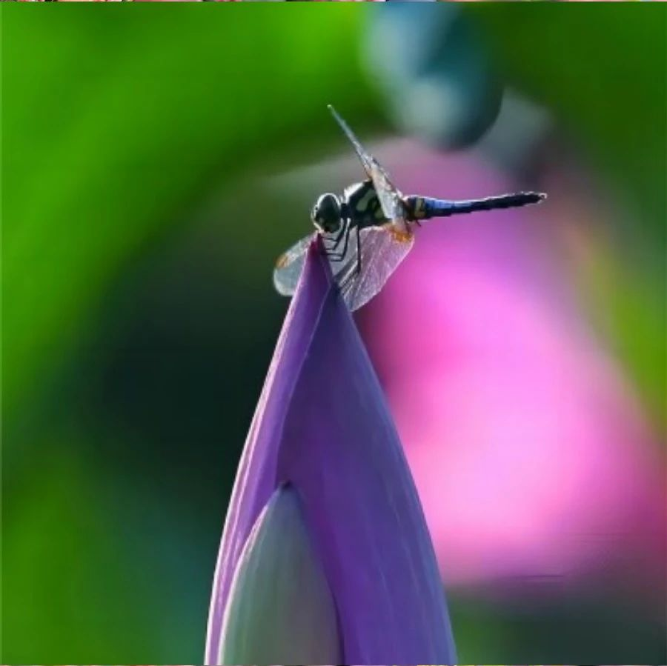
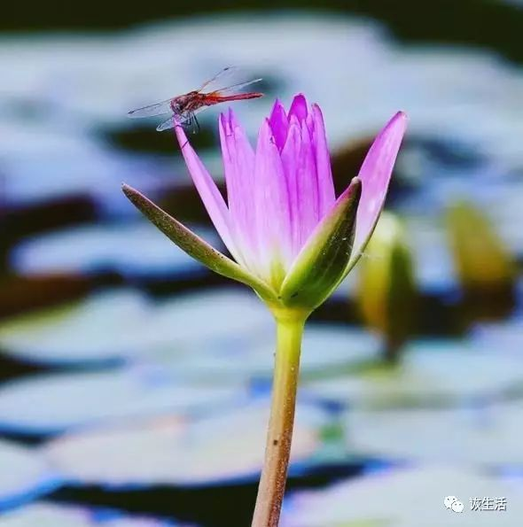
小荷已露尖尖角， 莘莘学子待高考!
6月
你好
6月21日
夏至

