Slide 1

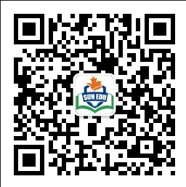
感恩遇见，相互成就，本课件资料仅供您个人参考、教学使用，严禁自行在网络传播，违者依知识产权法追究法律责任。
更多教学资源请关注
公众号：溯恩英语
知识产权声明

Slide 2

2024年高考必胜系列
主题语境下的应用文变式备考策略

Slide 3


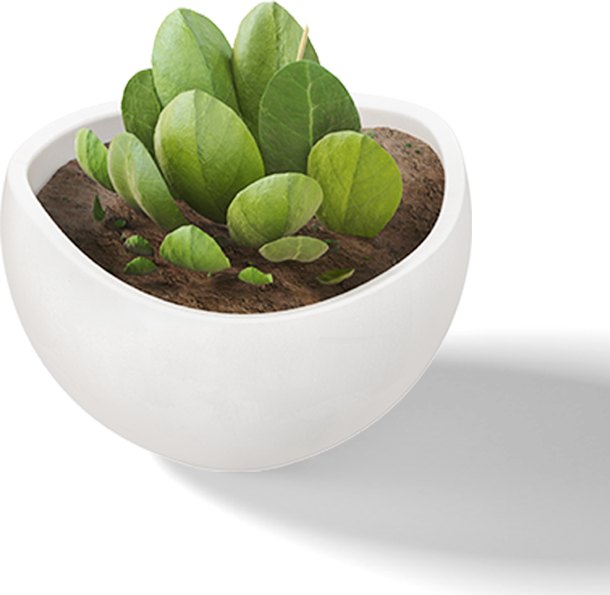
目
录
01
理论基础
02
写作案例
CONTENTS
03
备考提示

Slide 4

PART 01
理论基础

Slide 5
理论基础
《普通高中英语课程标准》强调，主题语境为语言学习规约主题学习范围或搭建意义语境。在英语课程中，学生探究主题意义应该是教学的内核，是学生语言学习的基础和最重要内容。中华人民共和国教育部也明确指出普通高中英语课程内容需具备六要素：主题语境、语篇类型、语言知识、文化知识、语言技能和学习策略。其中，主题语境是放在首位的要素，彰显了主题语境在英语教学中的重要性。
杜威提出，实际的情境是激发学生思维的主要因素、语言的使用无法脱离情境发生。程晓堂（2018）也指出基于主题意义的英语学习是学习语言的关键。主题语境可以为培养学生英语学科核心素养奠定基础（梅德明、王蔷，2018）。语境决定语言运用的准确性及得体性（王初明，2017）。语言学习不但学习其词汇和语法，且需要通过参与真实生活情境中的问题解决活动来实现，主题意义学习的重要性体现在语言的习得是基于意义学习的语言学习（王蔷，2016）。
添加标题

Slide 6

在高三复习阶段，教师可以尝试选择某一个主题语境进行应用文的变式训练，如我们所熟悉的中国传统文化为主题，可以由此展开不同的应用文体裁训练，例如告知信、邀请信、活动报道、演讲稿等。
在基于主题语境的应用文变式训练下，学生不仅能进行主题语境的相关话题词汇和表达的操练，而且能加深对各种应用文体裁结构(structure)、细节(details)和表达(language)的异同的理解。

Slide 7

PART 02
写作案例

Slide 8
2024届T8联考高三第二次学业质量评价（2024.3）
假定你是李华，毕业在即，你校英文报举办了以“An Unforgettable Activity in High School” 为主题的征文活动。请你写一篇英文短文投稿，分享一次你参加过的校园活动。内容包括：
1. 活动内容；
2. 活动感受。
添加标题
应用文变式分为体裁变式和内容变式，以以上T8联考的应用文为抓手，尝试将此篇应用文进行变式操练。

Slide 9
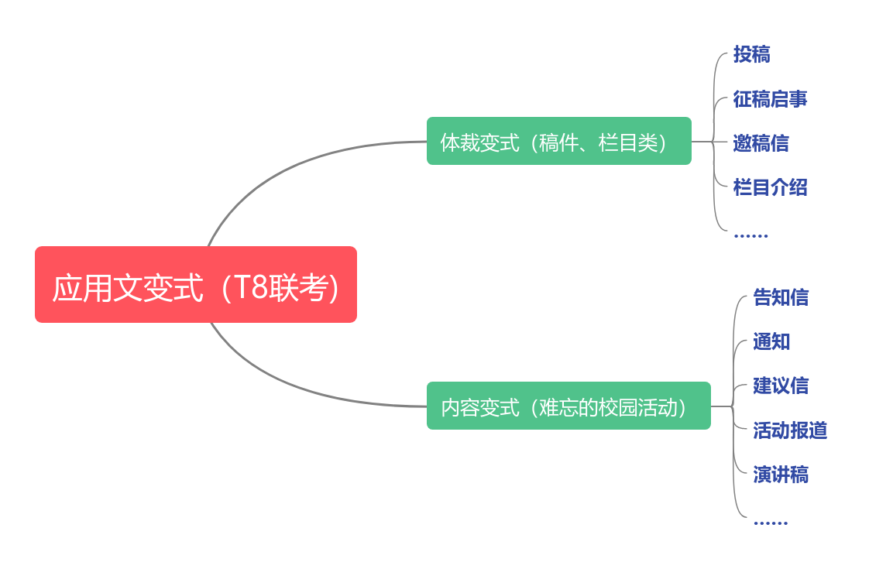
添加标题

Slide 10
变式1：体裁变式（聚焦栏目、稿件类体裁）
【投稿】假定你是李华，毕业在即，你校英文报举办了以“An Unforgettable Activity in High School” 为主题的征文活动。请你写一篇英文短文投稿，分享一次你参加过的校园活动。内容包括：1. 活动内容；2. 活动感受
【征稿启事】假定你是校英文报主编李华，毕业在即，英文报举办了以“An Unforgettable Activity in High School” 为主题的征文活动。请你写一篇征稿启事，鼓励同学们来稿分享自己参加过的校园活动。内容包括：1. 活动目的；2. 稿件内容；3. 稿件要求
【邀稿信】假定你是校英文报主编李华，毕业在即，英文报举办了以“An Unforgettable Activity in High School” 为主题的征文活动。请你给来自英国的交换生Tom写一封邀稿信，邀请他分享自己参加过的一次校园活动。内容包括：1. 发出约稿邀请；2. 说明稿件内容；3. 说明稿件要求
【栏目介绍】假定你是校英文报主编李华，毕业在即，英文报开设了以“An Unforgettable Activity in High School” 为主题的征文栏目。请你写一篇栏目介绍，内容包括：1. 开设目的；2. 栏目内容；3. 欢迎投稿

Slide 11
【投稿】假定你是李华，毕业在即，你校英文报举办了以“An Unforgettable Activity in High School” 为主题的征文活动。请你写一篇英文短文投稿，分享一次你参加过的校园活动。内容包括：1. 活动内容；2. 活动感受
投稿
An Unforgettable Activity in High School
My high school has witnessed many colorful activities in the past 3 years, among which the coming-of-age ceremony is especially unforgettable.
Present at the ceremony were all we students from Grade 3, along with our parents and teachers. It kicked off with an inspiring speech delivered by our president, which conveyed congratulations and anticipations about our future. Then came a series of activities, ranging from expressing gratitude to our parents and teachers to making a promise of being responsible for the adulthood. The highlight was when we walked through the coming-of-age gate.
The ceremony has been rooted in my mind as a reminder that I should shoulder my responsibility as an adult.
添加标题

Slide 12
语料积累
邀请对方写稿
1.invite/ask sb.to do sth. 邀请某人做某事
2.write anarticle for 为……写一篇文章
3. I’d like to ask you to write an article for ourschool’s English newspaper.
我想请你为我们学校英文报写一篇文章。
4. I’m writing to ask you to wrtie an article for the column of ... of our school’s English newspaper.
我写信想邀请你为我们学校英文报的…栏目写一篇文章。

Slide 13
语料积累
栏目介绍+稿件具体要求（稿件内容、篇幅、交稿日期等）
1. with the aim/purpose of doing sth. 目的是为了……
2. be aimed at doing sth. / aim to do sth. 旨在……
3. make/help sb. know sth. about…./have a better understanding of...帮助某人了解某事
4. introduce sth. to sb. 使某人了解某事
5. set up columns/sections to publish 设定栏目来刊登……
6. be popular among sb./ gain great pupularity among... 受到……欢迎
7. welcome articles about...欢迎关于……的稿件
8. welcome you to contribute to...欢迎你向……投稿
9. be relevant with.../ be related to...和……有关
10. be expected to/ be required to...被要求
11. hand in/ submit one’s contribution交稿
12. the deadline is.../ be due to.../ no later than...截止到……

Slide 14
语料积累
栏目介绍+稿件具体要求（稿件内容、篇幅、交稿日期等）
1. The ...section where you are expected to contribute articles in our newspaper is very popular among/with us students.
2. It carries articles written by ... concerning/regarding....
3. Would you please write something about/concerning the...
4. We would especially welcome articles about ....
5. You can write anything relevant so long as it’sinteresting and informative.
6. 400 words would be fine./The article is supposed to be within 400 words./ The article should be no more than 400 words.
7. Could we have your article before June 28? /We wonder if it is practicable to have it before June 28.

Slide 15
【征稿启事】假定你是校英文报主编李华，毕业在即，英文报设立了以“An Unforgettable Activity in High School” 为主题的新栏目，面向全体同学征稿。请你写一篇征稿启事，鼓励同学们来稿分享自己参加过的校园活动。内容包括：1. 活动目的；2. 稿件内容；3. 稿件要求
征稿启事
Contributions wanted
With the purpose of reminding students of the beautiful memories in high school and strengthening their friendship, a new column called “An Unforgettable Activity in High School” has been launched in our newspaper. We’re looking to have your contributions.
Your articles are expected to highlight the most unforgettable activity during the high schoo life, be it the sports meeting where all the athletes compete for the honor of the class or the Chinese culture week which immerses students in the atmosphere of traditional Chinese culture. The article is supposed to be within 300 words. Anyone interested is welcome to submit your works to newspaper@126.com before the end of this month.
We’re looking forward to your contributions!
添加标题

Slide 16
【邀稿信】假定你是校英文报主编李华，毕业在即，英文报设立了以“An Unforgettable Activity in High School” 为主题的新栏目。请你给来自英国的交换生Tom写一封邀稿信，邀请他分享自己参加过的一次校园活动。内容包括：1. 发出约稿邀请；2. 说明稿件内容；3. 说明稿件要求
邀稿信
Dear Tom,
With the purpose of reminding students of the beautiful memories in high school and strengthening their friendship, a new column called “An Unforgettable Activity in High School” has been launched in our newspaper. I’m writing to invite you to write an article for this column.
Your article is expected to share the most unforgettable activity during the high school life, be it the sports meeting where all the athletes compete for the honor of the class or the Sino-UK culture week which helps students gain deeper insights into the two cultures. The article is supposed to be within 300 words. We wonder if it is practicable to have your article before June 28.
I’ll appreciate it very much if you could accept my invitation. Looking forward to your contribution!
Yours,
Li Hua
添加标题

Slide 17
【栏目介绍】假定你是校英文报主编李华，毕业在即，英文报开设了以“An Unforgettable Activity in High School” 为主题的征文栏目。请你写一篇栏目介绍，内容包括：1. 开设目的；2. 栏目内容；3. 欢迎投稿
栏目介绍
With the purpose of reminding students of the beautiful memories in high school and strengthening their friendship, a new column called “An Unforgettable Activity in High School” has been launched in our newspaper.
This column serves as a platform for all the students to share the most unforgettable activity in their high school life, including the sports meeting where all the athletes compete for the honor of the class or the Chinese culture week which immerses students in the atmosphere of traditional Chinese culture. Students can talk about the most impressive moment and their personal feelings and comments about this experience.
All the students are welcome to contribute to this column. Please join us and we’re eager to embark on this wonderful journey with you!
English Newspaper
添加标题

Slide 18
变式2：内容变式（聚焦“一次难忘的校园活动之成人礼”)
【投稿】假定你是李华，毕业在即，你校英文报举办了以“An Uforgettable Activity in High School” 为主题的征文活动。请你写一篇英文短文投稿，分享一次你参加过的校园活动。内容包括：1. 活动内容；2. 活动感受
【告知信】假定你是校学生会主席李华，毕业在即，上周你校学生会为高三学子举办了一场成人礼仪式。请你写一封信给你的外国友人Tom, 告知他此次活动的相关细节。内容包括：1. 活动目的；2. 活动内容； 3.活动感受
添加标题
【通知】假定你是校学生会主席李华，毕业在即，学生会即将为高三学子举办一场成人礼仪式。请你以学生会的名义写一则通知，内容包括：1. 活动目的；2. 活动时间和地点；3.活动内容
【活动报道】假定你是校学生会主席李华，毕业在即，学生会于上周为高三学子举办了一场成人礼仪式。请你为该活动写一则报道，内容包括：1. 活动目的；2. 活动内容 3. 活动意义
【演讲稿】假定你是校学生会主席李华，毕业在即，你将代表高三学子在成人礼仪式上发言。请你写一则发言稿，内容包括：1. 表达对老师的感谢；2. 对成人的理解 3. 展望未来

Slide 19
【告知信】假定你是校学生会主席李华，毕业在即，上周你校学生会为高三学子举办了一场成人礼仪式。请你写一封信给你的外国友人Tom, 告知他此次活动的相关细节。内容包括：1. 活动目的；2. 活动内容； 3.活动感受
告知信
Dear Tom,
How is everything going recently. I’m writing to share with you some relavant details about the coming-of-age ceremony held by our school last week.
Aimed at reminding students of the beautiful memories in high school and strengthening their friendship, this coming-of-age ceremony included a variety of actvities. It kicked off with an inspiring speech delivered by our president, which conveyed congratulations and anticipations about our future. Then came a series of activities, ranging from expressing gratitude to our parents and teachers to making a promise of being responsible for the adulthood. The highlight was when we walked through the coming-of-age gate.
The ceremony has been rooted in my mind as a reminder that I should shoulder my responsibility as an adult.
Yours,
Li Hua

Slide 20
通知
【通知】假定你是校学生会主席李华，毕业在即，学生会即将为高三学子举办一场成人礼仪式。请你以学生会的名义写一则通知，内容包括：1. 活动目的；2. 活动时间和地点；3.活动内容
Notice
With the purpose of reminding students of the beautiful memories in high school and strengthening their friendship, a coming-of-age ceremony for senior 3 students will be held by the Students’ Union.
This ceremoy will take place on Thursday afternoon in the school’s auditorium, where all the senior 3 students will get involved as well as their teachers and parents.This ceremony will include a variety of actvities. It will kick off with an inspiring speech delivered by our president, which will convey congratulations and anticipations about students’ future. Then comes a series of activities for students, ranging from expressing gratitude to the parents and teachers to making a promise of being responsible for the adulthood. After that, all the students will walk through the coming-of-age gate, which will be the highlight of the ceremony.
Your active participation is highly ancitipated!
Students’ Union
添加标题

Slide 21
【活动报道】假定你是校学生会主席李华，毕业在即，学生会于上周为高三学子举办了一场成人礼仪式。请你为该活动写一则报道，内容包括：1. 活动目的；2. 活动内容 3. 活动意义
活动报道
The coming-of-age ceremony
Last week witnessed a meaningful coming-of-age ceremony held by the Students’ Union for all the senior 3 students.
This ceremony aimed to reminde students of the beautiful memories in high school and strengthen their friendship. All the senior 3 students participated in this ceremony together with their teachers and parents. It kicked off with an inspiring speech delivered by our president, which conveyed congratulations and anticipations about our future. Then came a series of activities, ranging from expressing gratitude to our parents and teachers to making a promise of being responsible for the adulthood. The highlight was when students walked through the coming-of-age gate.
This ceremony was of great significance in that it served as a reminder for the students of the responsibilites they should shoulder as adults.
添加标题

Slide 22
【演讲稿】假定你是校学生会主席李华，毕业在即，你将代表高三学子在成人礼仪式上发言。请你写一则发言稿，内容包括：1. 表达对老师的感谢；2. 对成人的理解 3. 展望未来
演讲稿
Good morning, everyone!
It is a privilege for me to deliver a speech at this special moment on behalf of all the senior 3 students.
The past three years have witnessed our growing up from a teenager to an adult. I’d like to express our heartfelt to all the teachers. It is all the teachers who have imparted knowledge to us, enlightened our mind and broadened our horizons. Adulthood opens up a new dimension in our life, which transforms our role in school, family and society. It also symbolizes more commitments and responsibilites we need to take from now on.
Boys and girls, it’ s time for us to embark on a new journey and we will surely add new glamour to the world with our action! Thank you!
添加标题

Slide 23

PART 03
备考提示

Slide 24
备考提示: SDL模式在应用文写作中的运用
根据话题
整合语料
(language)
仔细审题拟定结构(structure)
02
01
恰当运用
相关语料(language)
研读要点
拓展细节 (details)
04
03

Slide 25
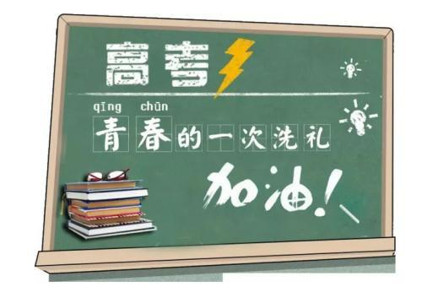
高考加油！

