Slide 1


感恩遇见，相互成就，本课件资料仅供您个人参考、教学使用，严禁自行在网络传播，违者依知识产权法追究法律责任。
更多教学资源请关注
公众号：溯恩英语
知识产权声明

Slide 2

The World
May 1st-31st, 2024

Slide 3
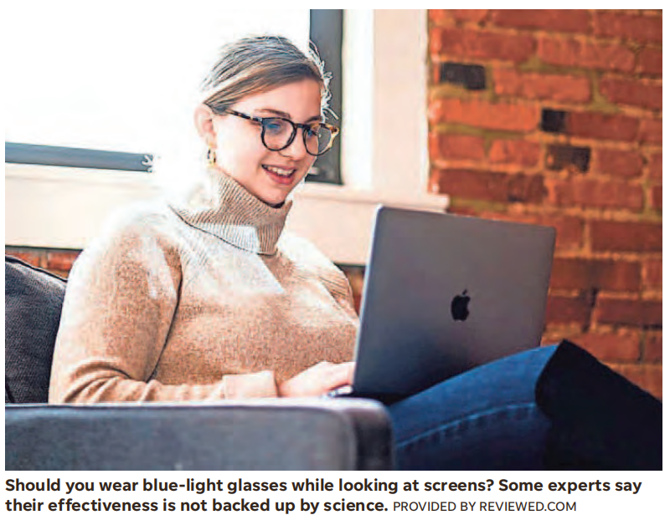
1&2. How effective are blue light glasses? 蓝光眼镜是智商税吗？

Slide 4
Text Completion
USA Today (May 20, 2024 P2A)
As our lives move ___________ (increase) online, the number of minutes a day we spend staring at laptops, phones and tablets has skyrocketed. In response, many have taken to donning a pair of lenses specifically designed to block out the blue light ________ (emit) from our screens.
But are they really effective? And how _________ (damage) is the blue light anyway? Here’s what experts had to say.
Do blue light glasses really work?
“They mostly don’t work for the things that they’re advertised for,” says Dr. Craig See, an ophthalmologist with the Cleveland Clinic. Blue light glasses are largely marketed as a ________ (solve) to eye strain and as a protectant for the retina. Their ____________ (effect) is not backed up by the science, however. ______ they are successful in blocking blue light, blue light is not necessarily something that needs to be filtered out for ocular health. “At this point in time there’s really not enough science or evidence to support or deny the benefits of disease-causing problems with blue light,” says Dr. Ronald Benner, president of the American Optometric Association. He calls studies on the subject “contradictory and inconclusive.”
Blue light, ______ is low-wavelength and high energy, does behave differently on the eye, See says, and in large doses can cause harm to the retina. However, as Benner points out, screens are not ___ unique example of blue light exposure. Indirect sunlight by itself produces 25 times the blue light a typical screen does, and direct sunlight produces 250 times as much. Still, blue light can suppress our natural melatonin production, ________ (make) it hard to sleep if there is increased screen exposure at night. So while the glasses will not protect you from long-term retina damage, and may not safeguard _______ eye strain, they can be a useful tool for screen use in the evenings.
increasingly
emitted
damaging
solution
effectiveness
While
which
a
making
against

Slide 5
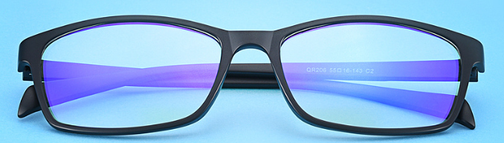
Reading Comprehension
1. What does the underlined word “skyrocket” in paragraph 1 mean?
A. Change into a different form.
B. Rise quickly to a very high level.
C. Decrease suddently to a historic low.
D. Become extremely difficult to understand.
2. Which of the following statements is correct according to the text?
A. Craig See believes blue light glasses can protect against eye strain.
B. Blue light glasses cannot filter out blue light as they’re advertised for.
C. Being exposed to too much blue light has a bad effect on the eye.
D. Smartphone screens produce much more blue light than sunlight does.

Slide 6
Text Completion
USA Today (May 20, 2024 P2A)
What are the benefits or negatives of blue light glasses?
One potential benefit could be better sleep. High-energy blue light, when it hits the retina, stimulates cells in the brain, essentially _______ (turn) them on, Benner explains. “In the evening times, having the blue light filter on and blocking that so that we’re not suppressing the melatonin production might be a _________ (benefit) aspect,” he says. That’s a concern that also could _____________ (address) by limiting exposure. Both Benner and See advise shutting off screens before bed. ____ for the negatives, Benner says there is “probably very little direct harm,” but reminds us that “we’re not sure about the benefits yet.”
Using blue light glasses as ‘computer glasses’
If your eyes are struggling with prolonged contact with screens, there may be another answer. “The thought is not so much that screens start to bother our eyes because of the blue light, _____ is much more likely is that the eyes get dry,” See says. When we focus ___ something, we stop blinking so much, and our eyes get dry, creating strain. He recommends the 20-20-20 rule as a remedy: Every 20 minutes, look at something 20 feet away for about 20 seconds to give your eyes ___ break. “Eye muscles are fatigued just like leg muscles are fatigued,” Benner says. Some blue light glasses do have a +1 prescription on their lens ___________ helps with up-close focus, See says. “That part may be helping.”
Is it OK to wear blue light glasses every day?
There is no evidence to suggest that blue light glasses ____ (be) doing harm, so wearing them every day will not likely be a detriment to your health. That_____ (say), if you experience headaches or other bothersome symptoms related to your sight, your first stop should be the optometrist’s office.
turning
beneficial
be addressed
As
what
on
a
which / that
are
said

Slide 7
Reading Comprehension
3. What does the underlined word “remedy” in paragraph 2 mean?
A. Break. B. Regulation.
C. Concentration. D. Cure.
4. Which of the following statements is correct according to the text?
A. Blue light glasses are the best option to limit blue light exposure at night.
B. Blue light glasses are not so helpful with up-close focus.
C. Blue light is probably not the major reason why eye strain happens.
D. Wearing blue glasses all day long causes trouble to the eyes.

Slide 8
Vocabulary
1. don: to put clothes, etc. on 披上；穿上；戴上
The crowd threw petrol bombs at the police, who responded by donning riot gear.
人群向警察扔汽油弹，警察则穿上了防暴衣。
2. suppress: to prevent yourself from having or expressing a feeling or an emotion
抑制；控制；忍住
Ultraviolet light can suppress human immune responses.
紫外线能抑制人体免疫反应。
Translation
他穿上短上衣出去了。
He donned his jacket and went out.
Translation
她按捺不住怒火。
She was unable to suppress her anger.

Slide 9
Vocabulary
3. fatigue: a feeling of being extremely tired, usually because of hard work or exercise 疲劳；劳累
She continued to have severe stomach cramps, aches, fatigue, and depression.
她仍然患有严重的胃痉挛，感觉疼痛、疲乏、抑郁。
4. detriment: the act of causing harm or damage; sth that causes harm or damage
伤害；损害；造成伤害（或损害）的事物
Kids spend too much time on schoolwork, to the detriment of other activities.
孩子把太多的时间用于做作业，影响了他们参加其他活动。
Translation
这个事故是驾驶员疲劳所致。
The accident was caused by driver fatigue.
Translation
他全身心地投入工作结果损害了他的健康。
He was absorbed in his job to the detriment of his health.

Slide 10
Translation
Blue light glasses are largely marketed as a solution to eye strain and as a protectant for the retina. Their effectiveness is not backed up by the science, however. While they are successful in blocking blue light, blue light is not necessarily something that needs to be filtered out for ocular health.
蓝光眼镜在很大程度上是作为一种解决眼睛疲劳和保护视网膜的方法而推销的。然而，它们的有效性并没有得到科学的支持。虽然它们可以成功地阻挡蓝光，但为了眼部健康，蓝光不一定需要过滤掉。
Blue light, which is low-wavelength and high energy, does behave differently on the eye, See says, and in large doses can cause harm to the retina. However, as Benner points out, screens are not a unique example of blue light exposure.
See说，波长低、能量高的蓝光在眼睛上的表现确实不同，而且大剂量蓝光会对视网膜造成伤害。然而，正如Benner所指出的，屏幕并不是唯一一个蓝光暴露的例子。

Slide 11
Translation
If your eyes are struggling with prolonged contact with screens, there may be another answer. “The thought is not so much that screens start to bother our eyes because of the blue light, what is much more likely is that the eyes get dry,” See says. When we focus on something, we stop blinking so much, and our eyes get dry, creating strain.
如果你的眼睛因长时间接触屏幕而感到不适，或许还有另一个答案。See说：“这种想法并不是说屏幕会因为蓝光而影响我们的眼睛，更有可能的是眼睛会变干涩。”当我们专注于某件事时，我们会停止频繁眨眼，眼睛会变干，产生紧张感。
There is no evidence to suggest that blue light glasses are doing harm, so wearing them every day will not likely be a detriment to your health.
没有证据表明蓝光眼镜有害，所以每天戴蓝光眼镜不会对你的健康造成损害。

Slide 12

3. News From the WORLD OF MEDICINE 医学新知

Slide 13
Text Completion
Reader’s Digest (June 2024 P36)
Breathing for Blood Pressure
Chances are that, ______ you have respiratory problems, you don’t think much about your breathing—it just _______ (happen). But your breathing can affect the health of your entire body, and a new study from Florida State University suggests that _____ you breathe can even lower your blood pressure. In the study, healthy adults with slightly ________ (elevate) blood pressure were asked to breathe through the nose for five minutes and then through the mouth for five minutes, while at rest. Their blood pressure measurements were lower when they inhaled and exhaled through the nose only. The researchers hope that future studies will help determine just how to use these ________ (find) to help people manage or improve hypertension.
The Exercise That Takes Years off Your Brain
Most people work out to improve their bodies, ____ one popular workout may have a powerful effect on brain health too. Tai chi is a form of exercise popular among older adults who want to improve their balance, mobility and general ______ (fit). Now it turns out that this ancient Chinese art may also help keep the brain young. ____ Oregon study of more than 300 people in their mid-70s with mild memory loss found that practicing tai chi for six months led to improved scores on memory tests, equivalent to _______ (gain) three to six years of brain health. The researchers believe that it’s the combination of physical movement and the mental challenge of memorizing and executing sequences—much like learning a new dance routine—____ is responsible for the effect.
unless
happens
how
elevated
findings
but
fitness
An
gaining
that

Slide 14
Vocabulary
1. respiratory: connected with breathing 呼吸的
If you smoke then the whole respiratory system is constantly under attack.
如果抽烟，整个呼吸系统就会一直受到损害。
2. equivalent: equal in value, amount, meaning, importance, etc.
（价值、数量、意义、重要性等）相等的，相同的
His party has just suffered the equivalent of a near-fatal heart attack.
他所在的政党刚刚经历了一次类似心脏病突发般几近致命的打击。
Translation
他有严重的呼吸问题。
He has severe respiratory problems.
Translation
八公里约等于五英里。
Eight kilometers is roughly equivalent to five miles.

Slide 15
Translation
In the study, healthy adults with slightly elevated blood pressure were asked to breathe through the nose for five minutes and then through the mouth for five minutes, while at rest. Their blood pressure measurements were lower when they inhaled and exhaled through the nose only.
在这项研究中，研究人员要求血压稍有升高的健康成年人在休息时先用鼻子呼吸5分钟，然后再用嘴呼吸5分钟。当他们只通过鼻子吸气和呼气时，他们的血压测量值较低。
An Oregon study of more than 300 people in their mid-70s with mild memory loss found that practicing tai chi for six months led to improved scores on memory tests, equivalent to gaining three to six years of brain health. The researchers believe that it’s the combination of physical movement and the mental challenge of memorizing and executing sequences—much like learning a new dance routine—that is responsible for the effect.
俄勒冈州对300多名75岁左右的轻度失忆老人进行的一项研究发现，练习太极六个月可以提高记忆力测试的分数，相当于让大脑健康了三到六年。研究人员认为，这是身体的运动和记忆与执行动作顺序的脑力挑战的结合（就像学习一种新的舞蹈套路一样）造成了这种效果。

Slide 16
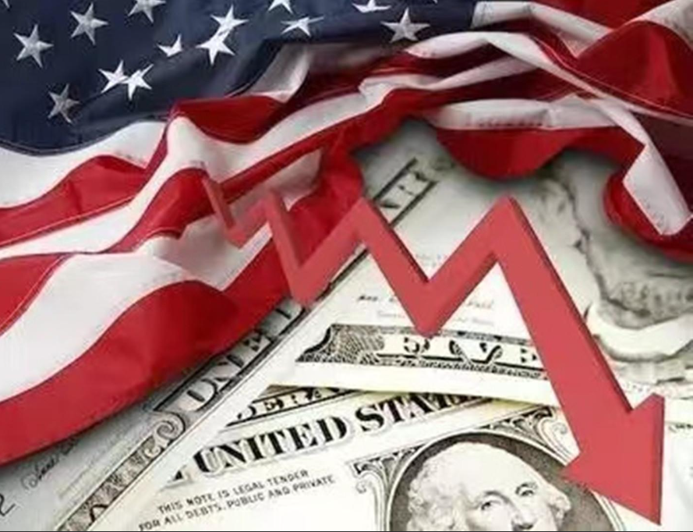
4. Consumers curb growth in first quarter
美第一季度经济增速放缓

Slide 17
Text Completion
The Washington Post (May 31st, 2024 A14)
The U.S. economy grew more slowly in the first quarter than __________ (previous) estimated after downward revisions to consumer spending and a key measure of inflation ticked down, _______ (keep) the Federal Reserve on track to possibly begin cutting interest rates at least once before the end of the year.
Gross domestic product — the broadest measure of economic activity — grew at an 1.3 percent annualized rate from January through March, the Commerce Department reported Thursday, down _____ the advance estimate of 1.6 percent and notably ______ (slow) than the 3.4 percent pace in the final three months of 2023.
The first-quarter growth downgrade ________ (suggest) that the U.S. central bank’s aim of gradually cooling the economy through high interest rates is having ___ effect as consumers increasingly balk at higher prices, although it remains uncertain ___________ the weakening trend in inflation will continue. Corporate profits dropped for the first time in a year, falling 0.6 percent to $3.39 trillion from the fourth quarter’s record high.
“The downward revision to economic _______ (grow) as well as smaller downward revisions to inflation make the Fed a little more likely _______ (start) reducing interest rates by September,” said Bill Adams, the chief _________ (economy) at Comerica Bank. “With the economy operating in low gear, a margin of slack capacity is opening up, and consumers are feeling less flush.”
previously
keeping
from
slower
suggests
an
whether / if
growth
to start
economist

Slide 18
Vocabulary
1. downward: moving or pointing towards a lower level 下降的；向下的
She was trapped in a downward spiral of personal unhappiness.
她陷入了个人不幸的旋涡难以自拔。
2. balk: to be unwilling to do sth or become involved in sth because it is difficult, dangerous, etc. 畏缩；回避
Many parents may balk at the idea of paying $500 for a pair of shoes.
许多做父母的可能不愿出500元钱买一双鞋。
Translation
拥有房屋所有权者人数减少的趋势可能会持续。
The downward trend in home ownership is likely to continue.
Translation
面对动物实验，哪怕是生物专业的大学生也会畏缩。
Even biology undergraduates may balk at animal experiments.

Slide 19
Translation
The U.S. economy grew more slowly in the first quarter than previously estimated after downward revisions to consumer spending and a key measure of inflation ticked down, keeping the Federal Reserve on track to possibly begin cutting interest rates at least once before the end of the year.
美国第一季度经济增速低于此前的预期，此前消费者支出数据被下修，一项关键通胀指标也有所下降，这使得美国联邦储备委员会有可能在年底前至少开始一次降息。
The first-quarter growth downgrade suggests that the U.S. central bank’s aim of gradually cooling the economy through high interest rates is having an effect as consumers increasingly balk at higher prices, although it remains uncertain whether the weakening trend in inflation will continue.
美国第一季度经济增长预估下调表明，美央行通过高利率逐步为经济降温的目标正在发挥作用，因消费者对物价上涨越来越望而却步，不过通胀趋弱的趋势是否会持续仍不确定。

Slide 20
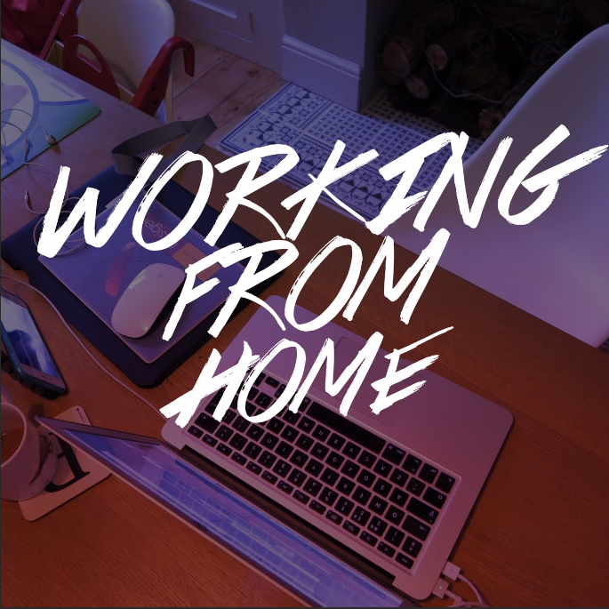
5. Full-time WFH can make you fat and depressed
全职居家办公会使人变胖和抑郁？

Slide 21
Text Completion
The Times (May 25, 2024 P4)
Working from home all week _________ (increase) the risk of being overweight and depressed, a study has revealed, with hybrid staff the happiest and healthiest. Analysis of 5,000 employees from several UK businesses found that those who work ________ (remote) five days a week took twice as many sick days on average compared with those going into the office. Staff with a hybrid working pattern — splitting their time ________ home and commuting in — were the happiest, healthiest and had the highest productivity levels at work.
____ report, by the health insurer Vitality, found 12 per cent of people who are fully remote suffered __________ (depress), compared with 10 per cent of full-time office workers and 8 per cent of hybrid workers. Only 20 per cent of hybrid workers were obese compared with 25 per cent of those working from home full time, and 24 per cent of full-time office staff. People who stayed at home were also more likely to have joint or back pain, ______ can be caused by hunching over a laptop all day. Some 87 per cent of those working from home had at least one musculoskeletal condition, compared with 80 per cent of hybrid workers and 78 per cent of office workers.
Hybrid __________ (employ) took the fewest sick days, averaging five a year, compared with ten for those working from home. They also reported the _______ (high) productivity, and were less likely to say that health issues _________ (include) anxiety and depression had an impact on their capacity to work. Experts said this reflected the greater “flexibility and variety” _______ (offer) by hybrid working, with employees more engaged in their jobs when not dreading the “monotony” of being at the same desk for five days in a row or wasting hours a day commuting.
increases
remotely
between
The
depression
which
employees
highest
including
offered

Slide 22
Vocabulary
1. hunch: to bend the top part of your body forward and raise your shoulders and back 弓身；弓背；耸肩
He got out his map of Yorkshire and hunched over it to read the small print.
他拿出约克郡地图，弓身趴在上面努力看清那些细小的字体。
2. dread: to be very afraid of sth; to fear that sth bad is going to happen
非常害怕；极为担心
I’m dreading Christmas this year.
今年我非常害怕过圣诞节。
Translation
她身体前倾，伏在写字台上。
She leaned forward, hunching over the desk.
Translation
这是他一直最担心的时刻。
This was the moment he had been dreading.

Slide 23
Translation
Analysis of 5,000 employees from several UK businesses found that those who work remotely five days a week took twice as many sick days on average compared with those going into the office. Staff with a hybrid working pattern — splitting their time between home and commuting in — were the happiest, healthiest and had the highest productivity levels at work.
对来自英国几家企业的5000名员工的分析发现，那些每周远程工作5天的员工平均请病假的时间是那些在办公室工作的员工的两倍。拥有混合工作模式的员工——居家办公和上下班结合——是最快乐、最健康的，工作效率也最高。
Experts said this reflected the greater “flexibility and variety” offered by hybrid working, with employees more engaged in their jobs when not dreading the “monotony” of being at the same desk for five days in a row or wasting hours a day commuting.
专家表示，这反映出混合办公方式提供了更大的“灵活性和多样性”，员工在不用担心连续5天坐在同一张办公桌前或每天浪费几个小时上下班的“单调”时，会更投入工作。

Slide 24
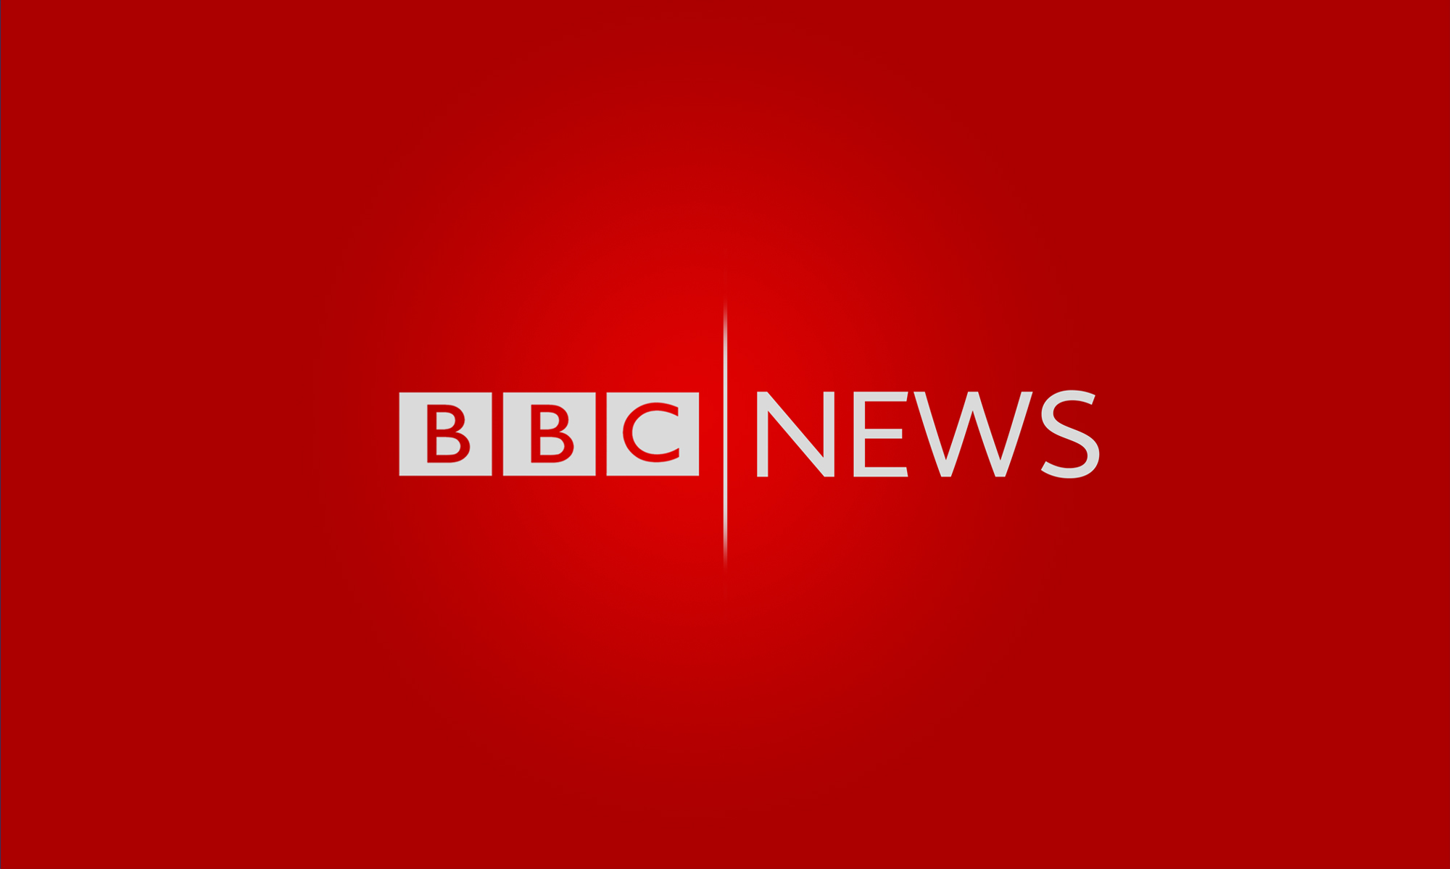
6. BBC News 05/31/2024

Slide 25

Dictation
BBC News with Sue Montgomery. Algeria has said it will present a _____ UN resolution, calling for an ____ to the killing in Rafah in southern Gaza. The move was announced after a closed meeting of the Security Council at which Sunday’s deaths at a displaced persons camp were discussed. The US has vetoed ________ resolutions and says the Israeli operation in Rafah has not crossed its red lines though it called the deaths ____________.
Our correspondent Tom Bateman says the US position is _______ to change.
I think the issue here is, we’ll see a repeat pattern that we’ve seen the United Nations, which has been largely that the US will veto anything that it thinks it ____________, that goes against its own policy towards Israel. And that has been largely to continue to give Israel a diplomatic shield at the UN although we did start to see that phrase somewhat in the last 6 weeks or so. But I think when it comes to the _____ of Rafah, you’re not gonna see the Americans allow that resolution to go forward in the form it seems that the Algerians are currently _________.
Israel has continued its assault. Palestinian health officials say _________ were killed by ______ on another camp in al-Mawasi west of Rafah.
draft
end
previous
heartbreaking
unlikely
disagrees with
issue
proposing
  21 people
  strikes

Slide 26
Vocabulary
1. veto: to stop sth from happening or being done by using your official authority 行使否决权；拒绝认可；禁止
The President vetoed the economic package passed by Congress.
总统否决了国会通过的一揽子经济计划。
2. assault: the act of attacking a building, an area, etc. in order to take control of it
攻击；突击；袭击
US soldiers began the ground assault when the order was finally given.
当命令最终下达的时候，美军士兵开始发动地面进攻。
Translation
修建大坝的计划已被环境保护局否决。
The plan for the dam has been vetoed by the Environmental Protection Agency.
Translation
凌晨时分向首都发起了攻击。
An assault on the capital was launched in the early hours of the morning.

Slide 27
Translation
Algeria has said it will present a draft UN resolution, calling for an end to the killing in Rafah in southern Gaza. The move was announced after a closed meeting of the Security Council at which Sunday’s deaths at a displaced persons camp were discussed.
阿尔及利亚表示将提交一份联合国决议草案，呼吁结束在加沙南部拉法的杀戮。这一决定是在安理会举行非公开会议后宣布的，会上讨论了星期天在一个流离失所者营地发生的死亡事件。
I think when it comes to the issue of Rafah, you’re not gonna see the Americans allow that resolution to go forward in the form it seems that the Algerians are currently proposing.
我认为，当涉及到拉法问题时，你不会看到美国人允许该决议以阿尔及利亚人目前提议的形式进行。

