Slide 1



感恩遇见，相互成就，本课件资料仅供您个人参考、教学使用，严禁自行在网络传播，违者依知识产权法追究法律责任。
更多教学资源请关注
公众号：溯恩英语
知识产权声明

Slide 2
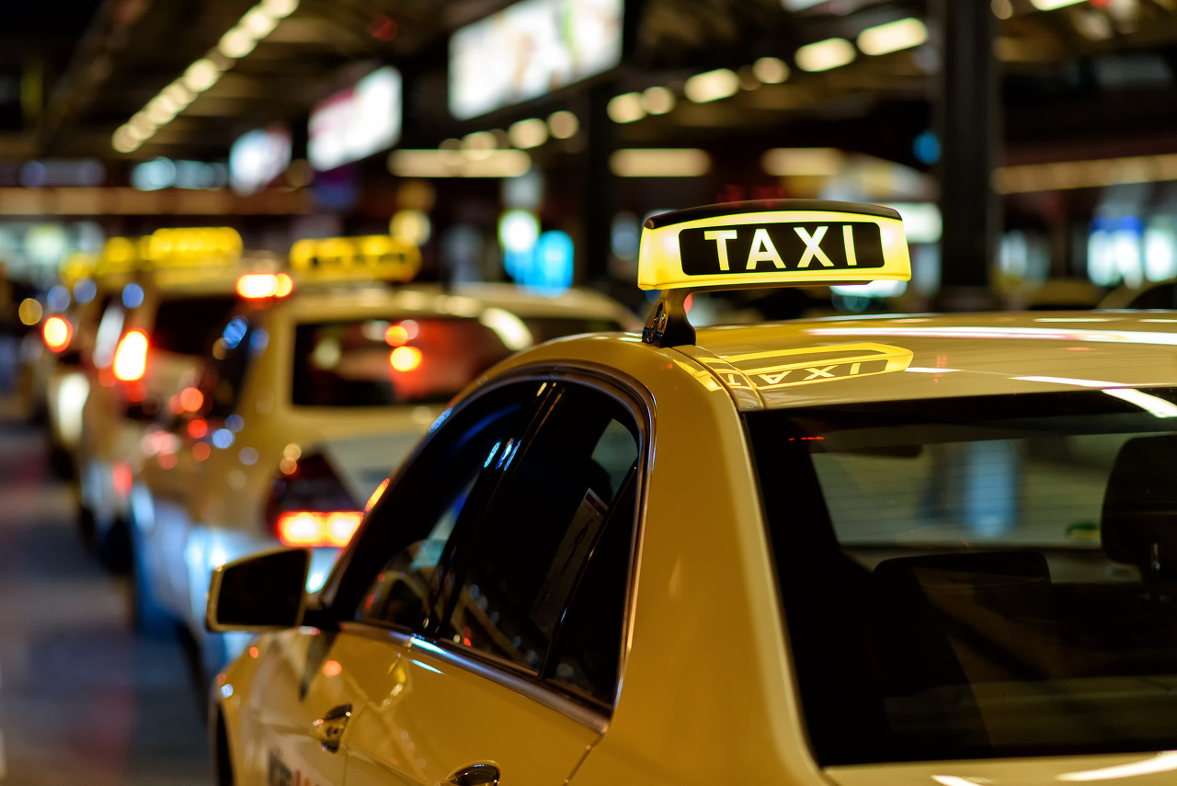
维也纳之约
2024届全国卷I
Conflicts-Experience -Reflection
郑素红

Slide 3

I met Gunter on a cold, wet and unforgettable evening in September. I had planned to fly to Vienna and take a bus to Prague for a conference. Due to a big storm, my flight had been delayed by an hour and a half. I touched down in Vienna just 30minutes before the departure of the last bus to Prague. The moment I got off the plane, I ran like crazy through the airport building and jumped into the first taxi on the rank without a second thought.
That was when I met Gunter. I told him where I was going, but he said he hadn't heard of the bus station. I thought my pronunciation was the problem, so I explained again more slowly, but he still looked confused. When I was about to give up, Gunter fished out his little phone and rang up a friend. After a heated discussion that lasted for what seemed like a century, Gunter put his phone down and started the car.
Finally, with just two minutes to spare, we rolled into the bus station. Thankfully, there was a long queue still waiting to board the bus. Gunter parked the taxi behind the bus, turned around, and looked at me with a big smile on his face. "'We made it, "he said.
Just then I realised that I had zero cash in my wallet. I flashed him an apologetic smile as I pulled out my Portuguese bankcard. He tried it several times, but the card machine just did not play along. A feeling of helplessness washed over me as I saw the bus queue thinning out.
At this moment, Gunter pointed towards the waiting hall of the bus station. There at the entrance, was a cash machine. I jumped out of the car, made a mad run for the machine, and popped my card in, only to read the message, "Out of order. Sorry."
Para1 ：I ran back to Gunter and told him the bad news.
Para2： Four days later, when I was back in Vienna, I called Gunter as promised.

Slide 4
I met Gunter on a cold, wet and unforgettable evening in September. I had planned to fly to Vienna and take a bus to Prague for a conference. Due to a big storm, my flight had been delayed by an hour and a half. I touched down in Vienna just 30minutes before the departure of the last bus to Prague. The moment I got off the plane, I ran like crazy through the airport building and jumped into the first taxi on the rank without a second thought.
That was when I met Gunter. I told him where I was going, but he said he hadn't heard of the bus station. I thought my pronunciation was the problem, so I explained again more slowly, but he still looked confused. When I was about to give up, Gunter fished out his little phone and rang up a friend. After a heated discussion that lasted for what seemed like a century, Gunter put his phone down and started the car.
Finally, with just two minutes to spare, we rolled into the bus station. Thankfully, there was a long queue still waiting to board the bus. Gunter parked the taxi behind the bus, turned around, and looked at me with a big smile on his face. "'We made it, "he said.
Just then I realised that I had zero cash in my wallet. I flashed him an apologetic smile as I pulled out my Portuguese bankcard. He tried it several times, but the card machine just did not play along. A feeling of helplessness washed over me as I saw the bus queue thinning out.
At this moment, Gunter pointed towards the waiting hall of the bus station. There at the entrance, was a cash machine. I jumped out of the car, made a mad run for the machine, and popped my card in, only to read the message, "Out of order. Sorry."
I
anxious honest
Analyze Characters
responsible warm-hearted friendly professional
Gunter

Slide 5
I met Gunter on a cold, wet and unforgettable evening in September. I had planned to fly to Vienna and take a bus to Prague for a conference. Due to a big storm, my flight had been delayed by an hour and a half. I touched down in Vienna just 30 minutes before the departure of the last bus to Prague. The moment I got off the plane, I ran like crazy through the airport building and jumped into the first taxi on the rank without a second thought.
That was when I met Gunter. I told him where I was going, but he said he hadn't heard of the bus station. I thought my pronunciation was the problem, so I explained again more slowly, but he still looked confused. When I was about to give up, Gunter fished out his little phone and rang up a friend. After a heated discussion that lasted for what seemed like a century, Gunter put his phone down and started the car.
Finally, with just two minutes to spare, we rolled into the bus station. Thankfully, there was a long queue still waiting to board the bus. Gunter parked the taxi behind the bus, turned around, and looked at me with a big smile on his face. "'We made it, "he said.
Just then I realised that I had zero cash in my wallet. I flashed him an apologetic smile as I pulled out my Portuguese bankcard. He tried it several times, but the card machine just did not play along. A feeling of helplessness washed over me as I saw the bus queue thinning out.
At this moment, Gunter pointed towards the waiting hall of the bus station. There at the entrance, was a cash machine. I jumped out of the car, made a mad run for the machine, and popped my card in, only to read the message, "Out of order. Sorry."
Conflict 1: I tried to catch the last bus to Prague
Analyze conflicts
solution1: jumped into the first taxi on the rank
Conflict 2: Gunter didn’t hear my destination clearly.
solution 2: Gunter got help from his friend and started his car.
Conflict 3: I had no cash to pay the taxi fee .
solution 3: I used my bankcard.
Conflict 4: The card machine and the cash machine went wrong .
Solution4: ?
Conflict 5: The bus was about to start/ set off .
Solution45: ?

Slide 6
Read for elements
characters：I the taxi driver (Gunter)
2. narrative perspective: first-person ( I )
3. time：a cold, wet and unforgettable evening in September
4. place： in Vienna --- at a bus station ;
---continuation part : at the bus station

Slide 7

5.story line
Climax
The bus was about to set off.
I had no cash to pay him and the two card machines went wrong.
Para1 ：I ran back to Gunter and told him the bad news.
The drive Gunter tried every means to help me make it to the bus station.
I jumped into the first taxi on the rank on arrival.
Para2： Four days later, when I was back in Vienna, I called Gunter as promised.
Due to a big storm, my flight had been delayed by an hour and a half.
I had planned to fly to Vienna and take a bus to Prague for a conference.
background
Ending
Beginning

Slide 8
Read for clues and echoes
hidden clues | echoes
I met Gunter on a cold, wet and unforgettable evening in September. I had planned to fly to Vienna and take a bus to Prague for a conference. Due to a big storm, my flight had been delayed by an hour and a half. I touched down in Vienna just 30minutes before the departure of the last bus to Prague. The moment I got off the plane, I ran like crazy through the airport building and jumped into the first taxi on the rank without a second thought. | 1. What happened on that September cold, wet and unforgettable evening served as a beautiful reminder that trust brings people closer and make the world a better place to live in. Noticing the bus was about to start, Gunter urged me to board the last bus to Prague in case I should miss the conference.

Slide 9
Read for clues and echoes
hidden clues | echoes
I met Gunter on a cold, wet and unforgettable evening in September. I had planned to fly to Vienna and take a bus to Prague for a conference. Due to a big storm, my flight had been delayed by an hour and a half. I touched down in Vienna just 30minutes before the departure of the last bus to Prague. The moment I got off the plane, I ran like crazy through the airport building and jumped into the first taxi on the rank without a second thought. | 3. We arranged to meet on the taxi rank of the Vienna airport, where I took his taxi and had a remarkable encounter with this humble but amazing taxi driver. 4. I jumped into his car, expressed my heartfelt gratitude and eventually paid off my previous debt.

Slide 10
Read for clues and echoes
hidden clues | echoes
Just then I realised that I had zero cash in my wallet. I flashed him an apologetic smile as I pulled out my Portuguese bankcard. He tried it several times, but the card machine just did not play along. A feeling of helplessness washed over me as I saw the bus queue thinning out. | Fearing that I would miss the bus, I promised to Gunter that I would come back to Vienna in four days and I would call him. After leaving him my mobile phone number, I hurried onto the bus, waving goodbye to him and feeling so sorry for being unable to pay the due taxi fee.

Slide 11
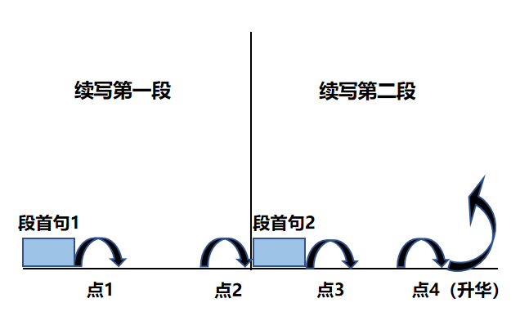
Plot Continuation
点1：位于续写第一段段首，流畅衔接前面的故事（常与原文最后一段呼应）和第一段段首语；
点2：位于续写第一段段尾，流畅衔接第二段段首句；
点3：位于续写第二段段首，续写衔接第二段段首语；
点4：文章结尾升华，给予读者正能量，揭示和强调主题。

Slide 12
Think ?
To show Gunter’s remarkable quality.
At this moment, Gunter pointed towards the waiting hall of the bus station. There at the entrance, was a cash machine. I jumped out of the car, made a mad run for the machine, and popped my card in, only to read the message, "Out of order. Sorry."
Para1 ：I ran back to Gunter and told him the bad news.
Para2： Four days later, when I was back in Vienna, I called Gunter as promised.
Question: Since I had no cash, I couldn’t pay Gunter the taxi fee. How could I board the bus with no cash for the bus fare?
Possible answer: Though Gunter didn’t get the taxi fee, he even fished out some cash from his pocket and bought a ticket for me.

Slide 13
Plot the continuation story
Para1 ：I ran back to Gunter and told him the bad news.
Para2： Four days later, when I was back in Vienna, I called Gunter as promised.
Link1: How did Gunter react? What did he said to me?
Body: How did I feel? What did Gunter do? With no cash, how
could I take the bus to Prague?
Link2: What did I promise?
Link3: What did Gunter say ? How did Gunter feel?
Body: What did I do? How did I feel?
Theme: What lesson did the experience demonstrate?

Slide 14
Design link1
At this moment, Gunter pointed towards the waiting hall of the bus station. There at the entrance, was a cash machine. I jumped out of the car, made a mad run for the machine, and popped my card in, only to read the message, "Out of order. Sorry."
Para1 ：I ran back to Gunter and told him the bad news.
Link1A: When he heard it, his expression changed slightly but seeing my apologetic look on my face, Gunter reassured me, “ It’s not a big deal. ”

Slide 15
Design link1
At this moment, Gunter pointed towards the waiting hall of the bus station. There at the entrance, was a cash machine. I jumped out of the car, made a mad run for the machine, and popped my card in, only to read the message, "Out of order. Sorry."
Para1 ：I ran back to Gunter and told him the bad news.
Link1B: Breathless and sweaty, I stole a secret look at the bus, sighing with a sinking heart as I would definitely miss the bus because of my silly mistake.

Slide 16
Design link1
At this moment, Gunter pointed towards the waiting hall of the bus station. There at the entrance, was a cash machine. I jumped out of the car, made a mad run for the machine, and popped my card in, only to read the message, "Out of order. Sorry."
Para1 ：I ran back to Gunter and told him the bad news.
Link1C: However, the terrible news that I couldn’t withdraw any cash from the cash machine didn’t bother Gunter at all. Instead, smiling at me, he wished me good luck, ready to run his car to pick up another passenger.

Slide 17
Design link2
Para1 ：I ran back to Gunter and told him the bad news.
Para2： Four days later, when I was back in Vienna, I called Gunter as promised.
Link2: With the bus about to start, after saying numerous sorry and thanks to Gunter, I asked him to leave me his phone number promising I would call him after the important conference in Prague
and pay him the due taxi fee. Thanks to Gunter’s understanding and generosity, I made it to Prague and attended the conference on schedule.

Slide 18
Design link3
Para2： Four days later, when I was back in Vienna, I called Gunter as promised.
Link3A: It was just too wonderful to hear his warm and friendly voice over the phone, which infused my heart with mixed emotions.
Apparently, he was over the moon when he got an unexpected call from me ---an odd passenger .

Slide 19
Design link3
Para2： Four days later, when I was back in Vienna, I called Gunter as promised.
Link3B: No sooner had he blurted out “hello” than his familiar, warm and reassuring voice came into my ears. Undoubtedly, when I explained my intention, he sounded more astounded than happy as if he couldn’t believe what he heard on the phone.

Slide 20
Design ending
Para2： Four days later, when I was back in Vienna, I called Gunter as promised.
EndingA:
Echo 1： （幽默式结尾）
Speeding to the conference venue in Vienna, I said jokingly that this time I had prepared enough cash to pay his taxi fee.

Slide 21
Design ending
Para2： Four days later, when I was back in Vienna, I called Gunter as promised.
EndingB: （人与人之间美好的信任）
What happened on that September cold, wet and unforgettable evening served as a beautiful reminder of how trust can bring people closer together.

Slide 22
Design ending
Para2： Four days later, when I was back in Vienna, I called Gunter as promised.
EndingC: （我的一诺千金）
I proved to the generous , warm-hearted taxi driver that I am a man of integrity and Gunter deserved to be repaid and respected.

Slide 23
Design ending
Para2： Four days later, when I was back in Vienna, I called Gunter as promised.
EndingD: （奇妙际遇，成就奇缘）
The unforgettable encounter between Gunter and me formed a close bond/ friendship. That stressful and chaotic situation would stick in my memory for ever/ would be engraved in my heart, which taught me that mutual trust is the seed that blossoms into deep and lasting connections.

Slide 24
Para1 ：I ran back to Gunter and told him the bad news. Breathless and sweaty, I stole a secret look at the bus, sighing with a sinking heart. Definitely, I would miss the bus because of my silly mistake. It was too terrible to picture the coming disaster of not being able to attend the conference. Never in my wildest dream had I imagined that my inability to pay him didn’t bother him at all. Instead, he fished out some cash, rushed to purchase me a bus ticket and urged me to board the bus to Prague. Overwhelmed with an enormous sense of gratitude , I was almost moved to tears. With the bus about to start, after saying numerous thanks to Gunter, I asked him for his phone number, promising I would call him after the important conference in Prague and pay him the due taxi fee. Thanks to Gunter’s understanding and generosity, I made it to Prague and attended the conference on schedule.

Slide 25
Para1 ：I ran back to Gunter and told him the bad news. When he heard it, his expression changed slightly but seeing my apologetic look on my face, Gunter reassured me, “ It’s not a big deal. ” Feeling extremely embarrassed and not knowing what to do with the unexpected situation, I was in a new dilemma. What I never expected was that he smiled warmly at me, shrugging his shoulders and straightforwardly responding “OK. The ride is free since you have no cash.” Noticing the bus was about to start, Gunter even urged me to board the bus to Prague in case I should miss the conference. After asking for his phone number, I jumped onto the bus and waved goodbye to Gunter. Moved to tears, I promised that I would be in Vienna for another conference in four days and that I would call him and pay him the taxi fee!

Slide 26
Para2： Four days later, when I was back in Vienna, I called Gunter as promised. No sooner had he blurted out “hello” than his familiar, warm and reassuring voice came into my ears. Undoubtedly, when I explained my intention, he sounded more astounded than happy as if he couldn’t believe what he heard on the phone. We arranged to meet on the taxi rank of the Vienna airport, where I took his taxi and had a remarkable encounter with this humble but amazing taxi driver. As his car approached me, he invited me in, a wide smile blossoming on his face. I jumped into his car, expressed my heartfelt gratitude and eventually paid off my previous debt. Speeding to the conference venue, I said jokingly that this time I had prepared enough cash to pay his taxi fee. （回扣式+幽默式结尾）

Slide 27
Para2： Four days later, when I was back in Vienna, I called Gunter as promised. No sooner had he blurted out “hello” than his familiar, warm and reassuring voice came into my ears. Undoubtedly, when I explained my intention, he sounded more astounded than happy as if he couldn’t believe what he heard on the phone. We arranged to meet on the taxi rank of the Vienna airport, where I took his taxi and had a remarkable encounter with this humble but amazing taxi driver. As his car approached me, he invited me in, a wide smile blossoming on his face. I jumped into his car, expressed my heartfelt gratitude and eventually paid off my previous debt. What happened on that September cold, wet and unforgettable evening served as a beautiful reminder of how trust can bring people closer together. （感悟哲理式结尾）

Slide 28
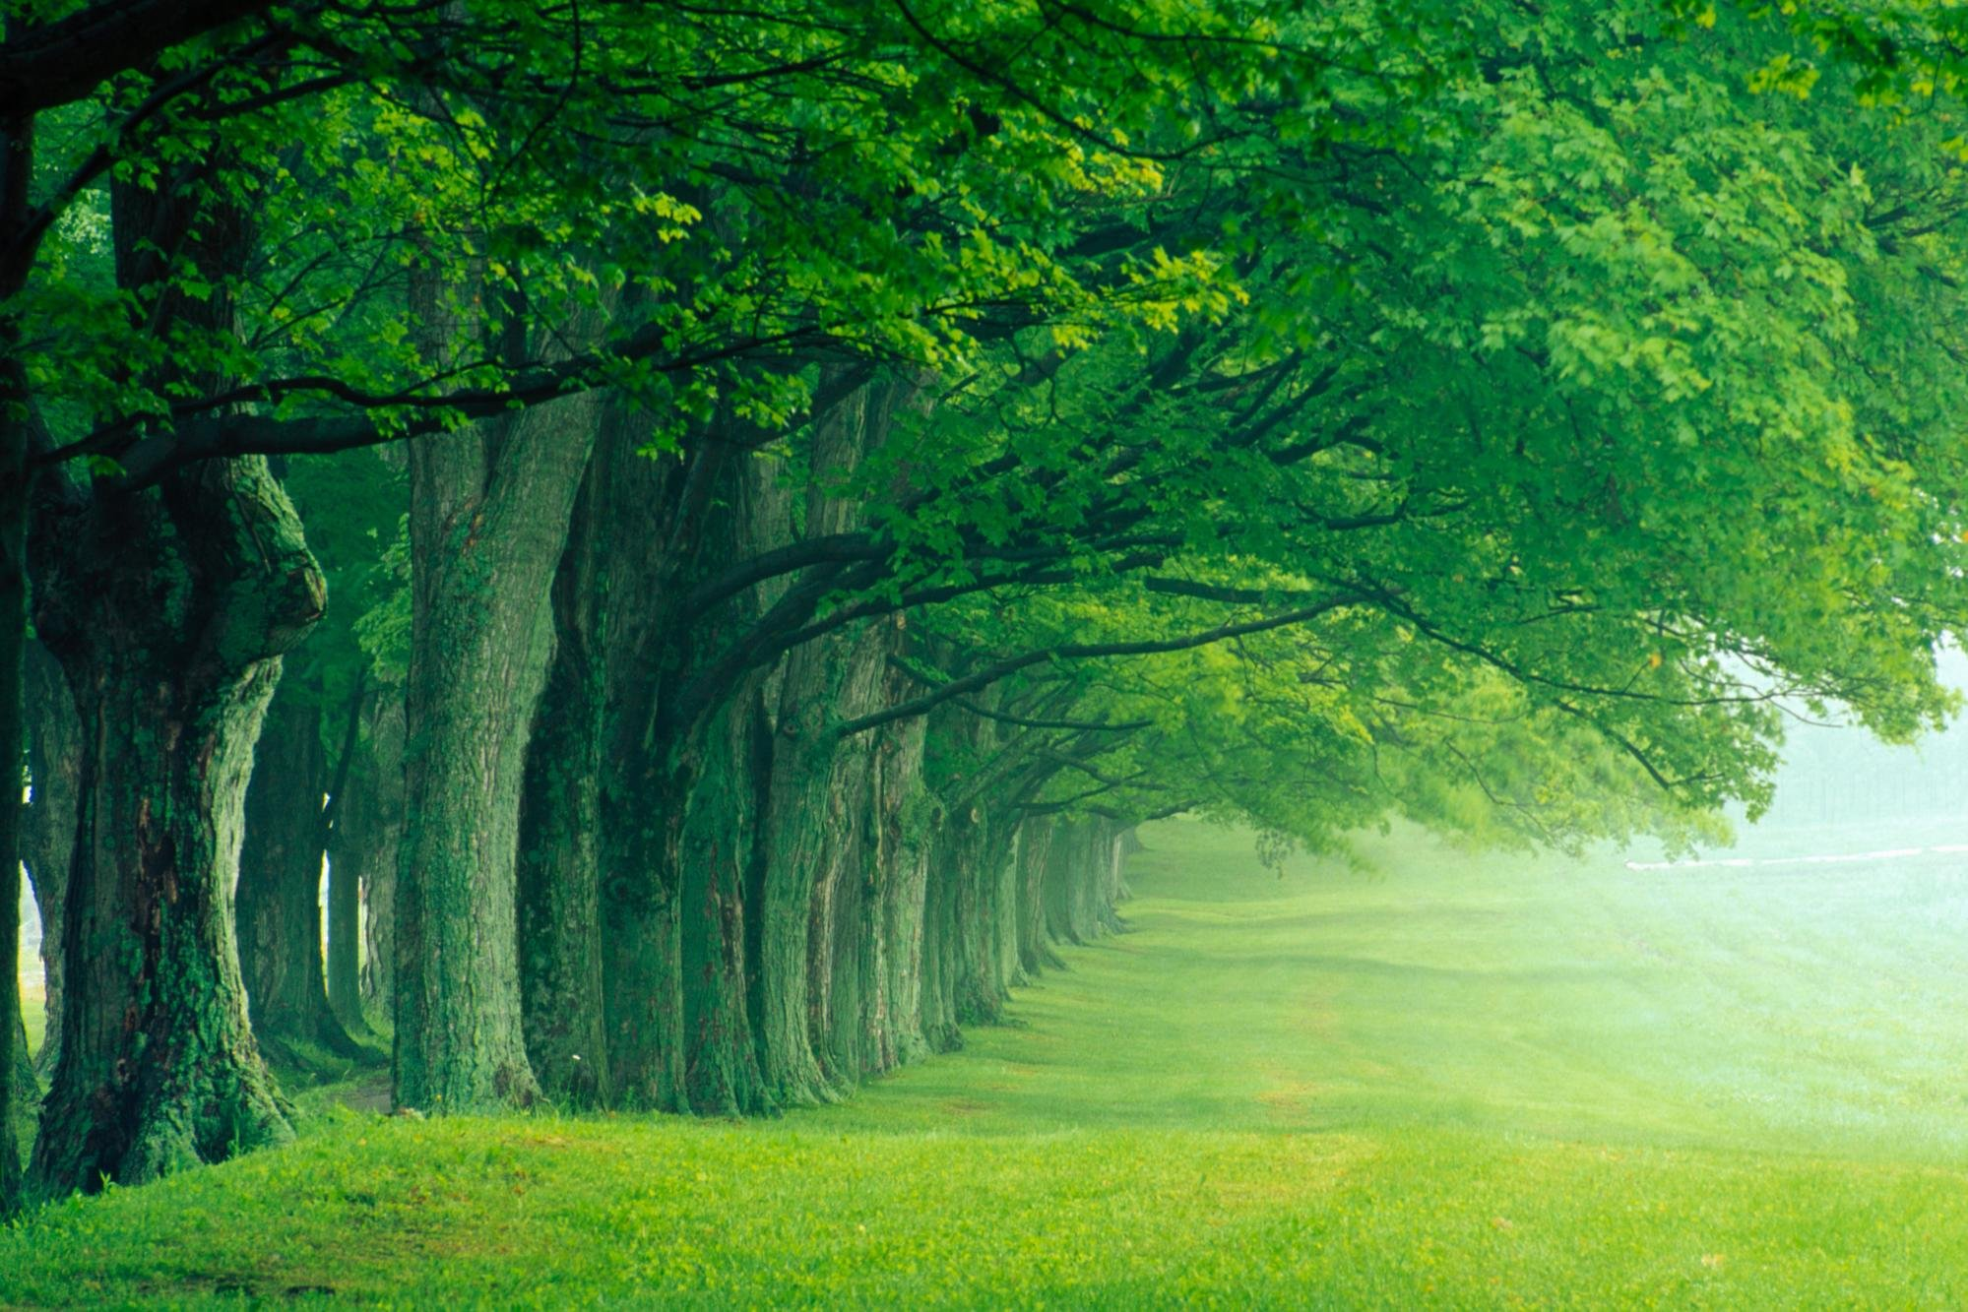
人与社会
人与社会主题意义下的续写文本故事类型：人际交往 （家人，恋人，邻里， 同学，同事，陌生人 等）
该主题意义下的续写文本叙事具体体现为：人际交往；社区服务；家庭关系；友情培养；职场竞争；
人与社会主题往往与人与自我主题糅合一起，通过“陷入困境，友好帮助，矛盾化解，等来铺排叙事；
本文为：陌生人司机 友好帮助我赶到汽车站 结果我没钱支付打的士的费用。但我信守诺言，最终支付了车费，成就了一段了美好的际遇。

Slide 29

Promise is debt.

