Slide 1


感恩遇见，相互成就，本课件资料仅供您个人参考、教学使用，严禁自行在网络传播，违者依知识产权法追究法律责任。
更多教学资源请关注
公众号：溯恩英语
知识产权声明

Slide 2

2024高考英语全国甲卷应用文
Alicewu

Slide 3
Contents
  句型升级&下水文
2
4
  审题
1
  谋篇布局
3
同类拓展演练

Slide 4
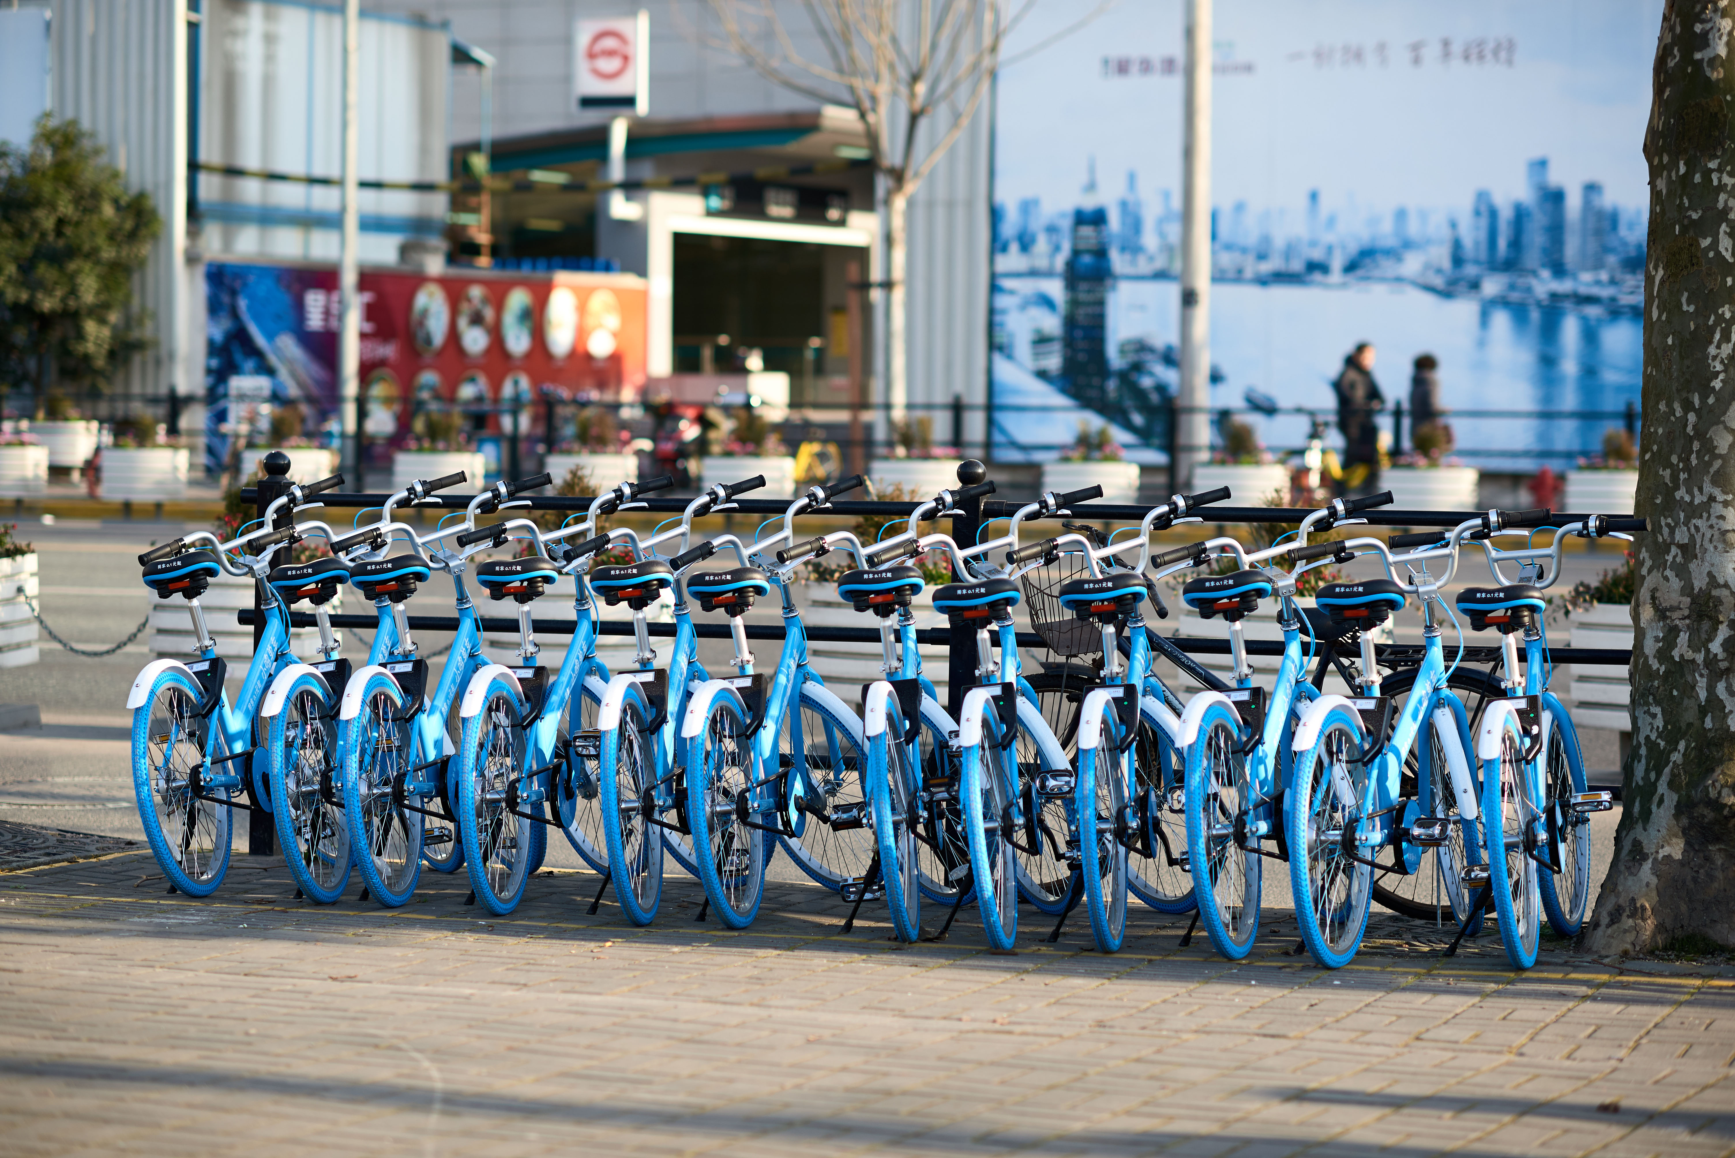
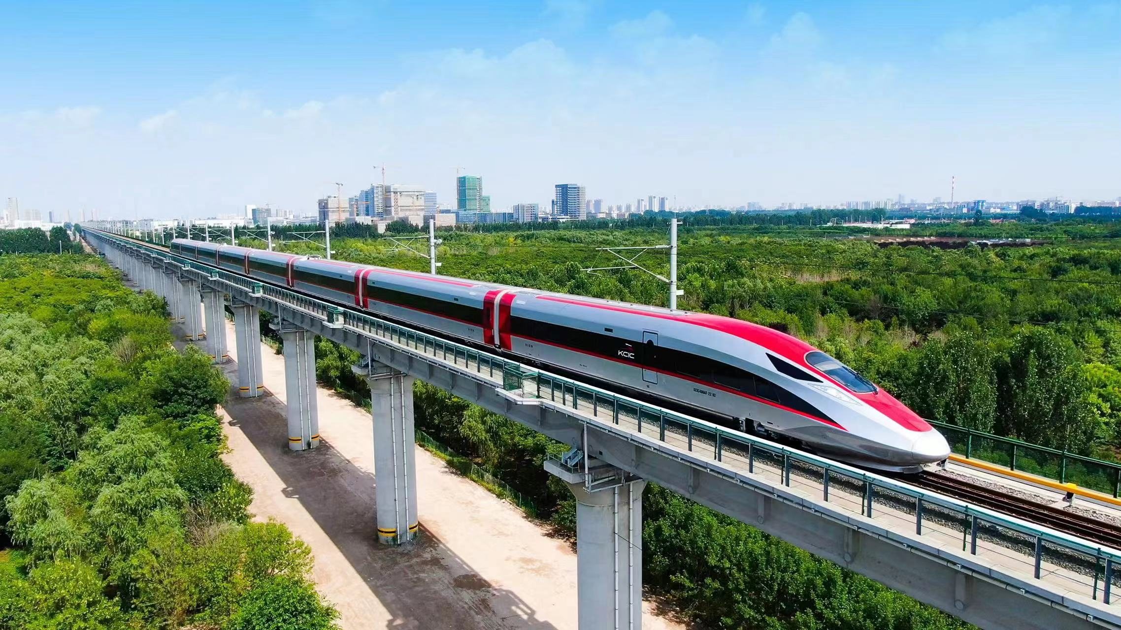
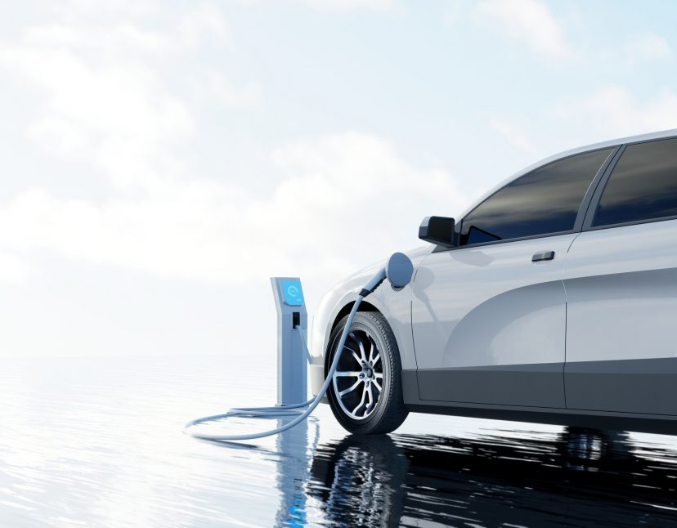
英语课上需要展示课题，根据以下图片，以“Development of Transport in China”为题，写一篇发言稿。
注意：
1. 词数100左右；
2. 请按如下格式在答题卡的相应位置作答。
Development of Transport in China
shared bicycles
high-speed train
electronic vehicles

Slide 5
Step 1 审题
体裁
写作对象
人称
时态
写作目的
要点
意识
发言稿
英语课上需要展示课题，根据以下图片，以“Development of Transport in China”为题，写一篇发言稿。
1.共享单车;
2.高铁;
3.新能源汽车。
你的英语课同学和老师
第三人称
一般现在时+现在完成时
向听众介绍中国交通发展的现状，展示其影响。
包括共享单车、高铁和新能源汽车的发展情况，以及它们如何促进了中国的现代化和可持续发展。
读者意识和主题意识

Slide 6
读者意识？
指的是作者在写作过程中对目标受众的了解和考虑。这包括了解读者的兴趣、知识水平、价值观和需求。
考虑到听众可能对中国的交通发展有一定的了解，但可能需要更深入的信息，因此需要在演讲中适当地解释术语、提供背景信息，并使用具体的例子来帮助听众更好地理解和吸收信息。
主题意识？
指作者对演讲或写作主题的清晰认识和深入理解。这包括对主题的重要性、复杂性和多维度的理解。
1.在“Development of Transport in China”这个主题中，主题意识意味着要全面地介绍中国交通发展的各个方面，包括共享单车、高铁和新能源汽车，并探讨它们如何影响经济、环境和社会。
2.主题意识还涉及到在演讲中保持焦点，确保所有讨论的点都紧密围绕主题展开，避免偏离主题。

Slide 7
Step 2 谋篇布局
Main parts of a speech
Para 1： 发言稿开场白+ 发言主题
Para 2：详细介绍共享单车、高铁和新能源汽车的发展情况 及其影响
Para3： 抒发爱国情怀

Slide 8
Step 3 句型升级
Para1 Beginning ：发言稿开场白+ 发言主题
1.Today, I am honored to present to you a journey through the remarkable evolution of transportation in China. Allow me to take you through the transformative impact of shared bicycles, the high-speed rail network, and new energy vehicles.
2. Today, I take pride in showcasing the strides China has made in transportation.
From shared bicycles to high-speed trains and new energy vehicles, each innovation is a testament to our nation's commitment to progress and sustainability.
3. Today, I am thrilled to share with you the remarkable progress China has made in the field of transportation over the past few decades. In the forthcoming moments, we will dig into the transformative impact of shared bicycles, the high-speed rail network, and new energy vehicles .

Slide 9
Step 3 句型升级
Para 2 Body：详细介绍共享单车、高铁和新能源汽车的发展情况 及其影响
1.共享单车
1）让我们从共享单车开始，它是一种从草根阶层兴起的现象，已经发展成为城市流动性和环境意识的象征。（祈使句+同位语+定语从句）
Let us begin with the shared bicycles, a grassroots phenomenon that has blossomed into a symbol of urban mobility and environmental consciousness.
2）它们不仅缓解了交通拥堵，还培养了一种对地球共同负责的文化。
（并列句+倒装句）
Not only have they alleviated/ eased/reduced/relieved traffic congestion but also fostered a culture of shared responsibility for our planet.

Slide 10
2.高铁
3）高铁系统是中国工程实力的证明，以前所未有的速度和效率连接着国家的广阔地域。（非谓语-ing）
The high-speed rail system stands as a testament to China's engineering prowess, connecting the vast expanse of the country with unprecedented speed and efficiency.
3.新能源汽车
4）在政府的支持下，新能源汽车的兴起引领中国在全球绿色交通革命中走在前列。
（过去分词作状语）
The rise of new energy vehicles, backed by government support, is leading China in a global green transportation revolution.

Slide 11
Para 3 Ending： 抒发爱国情怀
5）目睹这些成就，我感到无比自豪。（it作形式主语+无灵主语）
As we witness these achievements, it fills me with immense pride.
6）它们象征着我们国家的力量和韧性，推动我们走向民族复兴——这是我们都自豪能参与的旅程。(非谓语作结果状语从句+定从）
They symbolize our nation's strength and resilience, driving us towards national rejuvenation—a journey we are all proud to be part of.

Slide 12
Step 3 下水文
Today, I am thrilled to share with you the remarkable progress China has made in the field of transportation over the past few decades.In the forthcoming moments, we will dig into the transformative impact of shared bicycles, the high-speed rail network, and new energy vehicles .
Let us begin with the shared bicycles, a grassroots phenomenon that has blossomed into a symbol of urban mobility and environmental consciousness. Not only have they alleviated/ eased/reduced/relieved traffic congestion but also fostered a culture of shared responsibility for our planet. Moving forward, the high-speed rail system stands as a testament to China's engineering prowess, connecting the vast expanse of the country with unprecedented speed and efficiency. Most importantly, the rise of new energy vehicles, backed by government support, is leading China in a global green transportation revolution.
As we witness these achievements, it fills me with immense pride. They symbolize our nation's strength and resilience, driving us towards national rejuvenation—a journey we are all proud to be part of. Thank you for your listening.

Slide 13
Step 4 同类拓展演练
2024年成都三诊
近年来，中国的交通发展极大地改善了人民的生活，你校将举办以“Transportation Development Is Changing Our Life” 为主题的英语演讲比赛，请写一篇演讲稿参赛。
注意：词数100词左右。
Ladies and gentlemen,

Slide 14
Ladies and gentlemen,
Today, I stand before you to speak on a subject that has not only transformed our landscapes but also the very fabric(结构）of our daily lives – the development of transportation.（引入主题）
Over the past few decades, we have witnessed an era of unprecedented（史无前例的） progress. 举例High-speed trains have shrunk distances, bridges have connected once isolated regions, and the application of smart cars has revolutionized personal mobility. This evolution has not only made our journeys faster and safer but has also opened up new horizons for economic growth and social interaction.
The impact on our lives is profound. 影响It has brought families closer by reducing travel time, it has broadened our perspectives by making diverse cultures more accessible, and it has fostered a sense of global community by making the world feel smaller.
As we embrace these changes, let us also remember the importance of sustainability. Our transportation systems must continue to evolve, not just in speed and efficiency, but also in their ability to protect our environment for future generations.（倡议）Thank you for your listening.

Slide 15

Thank you

