Slide 1


感恩遇见，相互成就，本课件资料仅供您个人参考、教学使用，严禁自行在网络传播，违者依知识产权法追究法律责任。
更多教学资源请关注
公众号：溯恩英语
知识产权声明

Slide 2
2024年6月全国Ⅰ卷应用文
公园美术课
浙江省衢州第一中学 徐荣仙

Slide 3
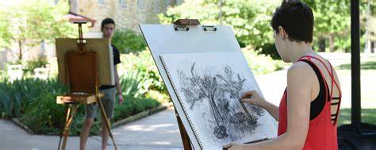
5. 应用文解题技巧
三 段
四 步
审主题（写什么）
审体裁（怎么写）
审时态（为什么）
审人称（写给谁）
审内容（要点齐全）
①写作目的
②正文内容
③总结陈词
①审题
②草稿
③正文
④检查
腹稿、大纲式草稿
要点完整、内容贴切、体裁正确
词汇丰富、句式多样、语言自然
避免要点不全，直接降档处理
避免低级错误：人称、单词拼写、不规则动词变化形式、单复数、主谓一致、时态、语态、冠词
避免主语单一
避免总是简单句叠加
避免卷面涂改不清失分

Slide 4
假定你是李华，你们班上周五在公园上了一节美术课，请给
英国好友Chris写一封邮件分享你的经历，内容包括:
1.你的作品内容2.你的感想 .
审主题（写什么）
审体裁（怎么写）
审时态（为什么）
审人称（写给谁）
审内容（要点齐全）
经历：一般过去时；感想：一般过去时、一般现在时、一般将来时（展望未来）
①审题
英国好友Chris 语气 随意、非正式

Slide 5
基于类似话题的课本单元主题（新教材必修一 － 选择性必修四）
单元议题（宏观） | 相关单元
Nature | History and Traditions (Unit4 必修二) Fascinating Parks (Unit3 选择性必修一) Journey Across a Vast Land (Unit4 选择性必修二)
Art | Music (Unit5 必修二) Art (Unit1 选择性必修三) Poems (Unit5 选择性必修三)

Slide 6
来自课文的相关素材
有机会干......
给我快乐
放飞心情
给我力量、让我放松
给我希望和满足感
使我内心受到鼓舞
让音乐成为生活的一部分
have an opportunity to do...
bring me happiness
make my spirits fly like a kite
give me strength and bring me relief
give me hope and a sense of satisfaction
feel encouraged
make music a part of my life

Slide 7
来自课文的相关素材
绘画
素描
油画
水彩画
风景画
静物画
人体素描
...的目的是为了展示...
......的亮点是......
painting
drawing、sketch
Oil-painting
Watercolor painting
landscape
Still Life
Figure Drawing
...the aim of ...is to display...
the highlight of...
This painting, showing high mountains, trees, and houses covered in snow, was made with extraordinary skill.
These works were intended to spread Buddhism and they are of exceptional beauty and quality.
Some poems tell a story or describe a certain image in the reader’s mind. Others try to convey certain feelings such as joy and sorrow.

Slide 8
来自课文的相关素材
对......有很大的影响
给人以激情和灵感
宁静的风光
绵延的群山点缀着牛羊
视觉的盛宴
感受阳光洒在你身上
呼吸着鲜花的芬芳
用歌声迎接新的一天
......组成的乐章
have a great influence on...
excite and inspire sb
peaceful landscape
rolling green hills dotted with sheep and cattle
feel the sun in your skin
breathe in the sweet scent of fresh flowers
greet the new day with their morning song
...make up the music of...

Slide 9
Challenges for the paracitcal writing:
1. What content should be covered in my painting?
2. What theme does my painting want to convey?
3. How to describe my painting?
4. What does the class impress me most?
5. What did I gain from the class?
content
Your thoughts / feelings

Slide 10
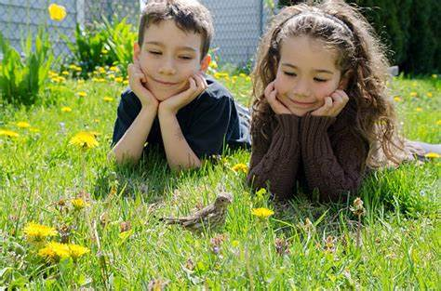
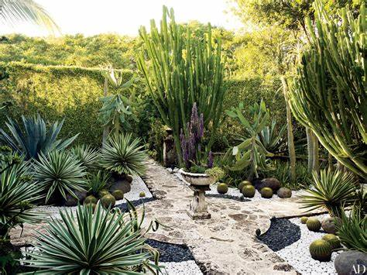
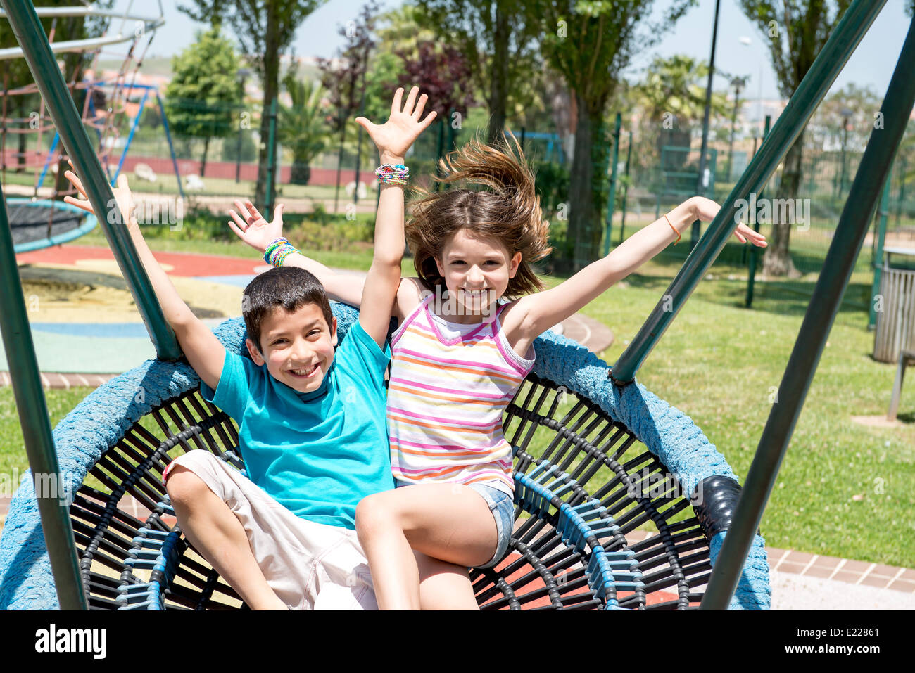
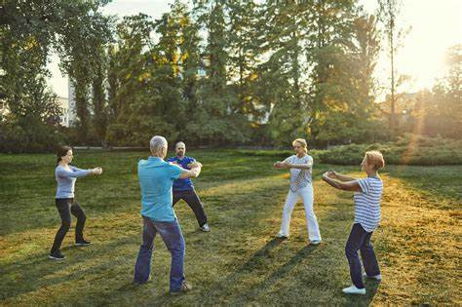
1. 你的作品内容
other...
contents
looking after an injured bird
...
landscape
peaceful lake
green trees
frgrant flowers
unique plants
entertainment
people
swinging
playing on the pirate ship
playing hide and seek
having a picnic
playing Tai Chi
practicing calligraphy
jogging
taking a walk
doing yoga
meditating
singing Yue Opera
walking a bird
taking exercise

Slide 11
2. 你的感想
1. The painting class in a park spark students’ desire to be surrounded by the beauty of nature to draw inspiration and reconnect with the environment.
2. By conducting the class in a park,students are encouraged to break away from the confines of a traditional class setting and explore their creativity more freely. The natural surroundings may foster a sense of liberation and uninhibited self-expression.
3.The park setting promotes a peaceful and calming environment for students to immerse themselves in the process of painting.

Slide 12
2. 你的感想
4. Holding a painting class in a park provides an opportunity for like-minded individuals to come together, share their passion for art, exchange ideas, and build connections.
5. The park setting offers a unique chance to paint the landscape, capturing the ever-changing light, colors, and scenes. It encourages painters to be present in the moment and strive to depict the essence of the surroundings in their artwork.
6. Painting in a park allows artists to experiment with various techniques, mediums, and subjects. They can study the interplay of light and shadow, practice plein air painting, or try new styles, resulting in a richer and more diverse creative experience.

Slide 13
下水作文一：
Dear Chris,
I'm writing to share with you an art class I had in a park last Friday. In line with the theme of harmony between human and nature, my painting features a little boy looking after an injured bird patiently with other children flying kites near the peaceful lake.
The process of creating art in a natural setting was truly inspiring and impressive, where we were asked to tap into our creativity and think outside the box. The unique experience not only offers us a wonderful chance to express ourselves creatively and enjoy the beauty of nature, but also help improve painting skills, such as how to capture the ever-changing light, colors, and scenes..
Attached to the email is a photo of my painting. Have you ever had similar experiences?
Yours,
Li Hua

Slide 14
类似话题作文
假设你是李华,从小练习国画,你的美国朋友Thompson邀请你参加主题为Amazing Nature 的青少年画展。请给他回复一封邮件，同意参加并介绍你的参展作品。1.写信目的;2.作品简介。
Dear Thompson,
Delighted to receive your letter inviting me to attend the art exhibition, I'm writing to express my sincere gratitude and give you a brief introduction to my exhibition work.
In line with the theme of Amazing Nature, I will create a painting featuring my picturesque hometown. Trees and flowers will be highlighted with bright and vivid colors. The spectacular mountains and the crystal water are certain to impress you. When observing the painting, you will also be amazed at the achievements that have been made in sustainable development.
Attached to the email is a photo of my painting. I hope you will like it.
Yours, Li Hua

Slide 15
下水作文：
Dear Thompson,
Thank you very much for inviting me to the Youth painting exhibition themed Amazing Nature! I’d very much like to attend it and here briefly introduce my work.
To fit into the theme, I'll have a painting of my amazing hometown on exhibition. Painted in ink wash, it will feature the natural beauty, such as the centuries-old azaleas in full bloom floating in the misty clouds and the 350-meter waterfall splashing down into the crystal-blue water. Also, a temple dating back over 1000 years hidden in the natural surroundings will make my work take on a touch of religion.
Attached to the email is a photo of my painting. Hope it can meet with your requirement.
Yours,
Li Hua

Slide 16
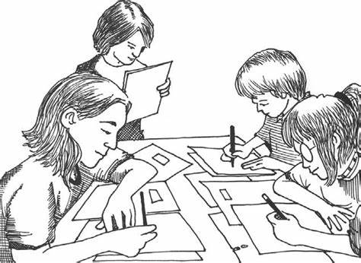
THANKS FOR WATCHING

