Slide 1


感恩遇见，相互成就，本课件资料仅供您个人参考、教学使用，严禁自行在网络传播，违者依知识产权法追究法律责任。
更多教学资源请关注
公众号：溯恩高中英语
知识产权声明

Slide 2
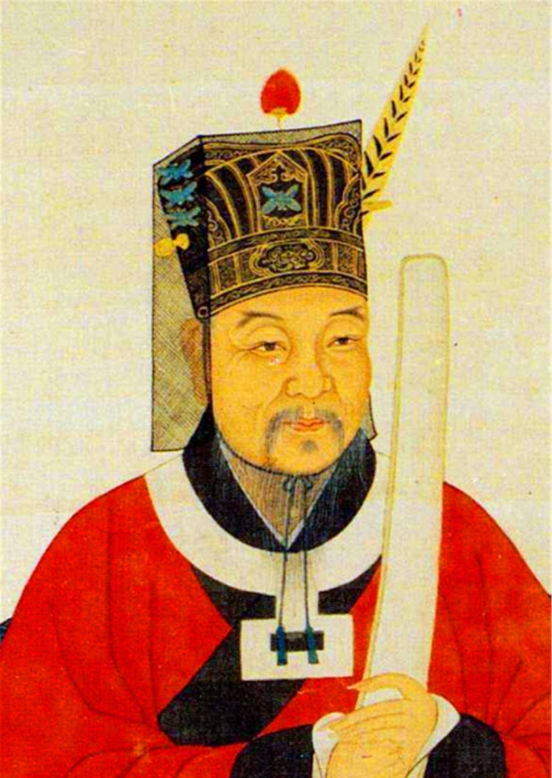
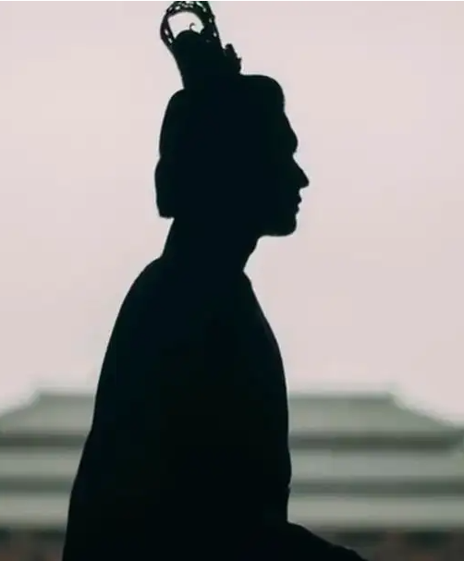
Guessing Game
Who is the figure?
porridge
reforms
a government official
built a sea wall
Northern Song Dynasty
have the people’s best interest at heart
Memorial to Yueyang Tower

Slide 3
FAN ZHONGYAN
人教版选择性必三
Unit4 Workbook
Reading and Writing

Slide 4

Teaching Objectives
Practice reading skills.
Cultivate students’ sense of being self-disciplined, selfless, considerate, diligent，patriotic, upright , committed, responsible, dedicated to one’s duties.
Raise students’ awareness of the structure when describing a person.
Accumulate useful expressions in this passage.

Slide 5
Lead-in
Task 1. Think about what the structure of an essay describing a person is.
Relationships and Influences
Discuss the person's relationships with others .
Explore of how these relationships have shaped and influenced the person's life.
Introduction
Describing the person's most striking or noteworthy qualities
Physical Description
Use of vivid imagery and sensory details.
Structure of an Essay Describing a Person
Accomplishments and Impact
Describe the person's notable accomplishments.
Analyze of the impact they have had on others or the world.
Personality Traits
Use of specific anecdotes or examples.
Conclusion
Summarize of the person‘s most salient显著的 features and qualities.
Reflect on the person's character and the impact they have had on the writer.

Slide 6
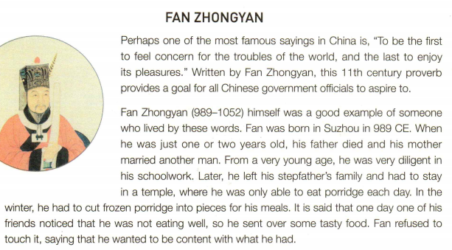

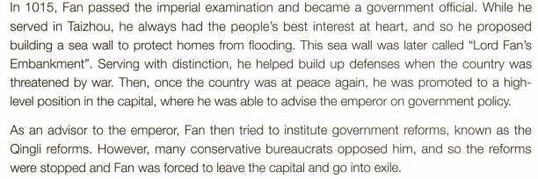
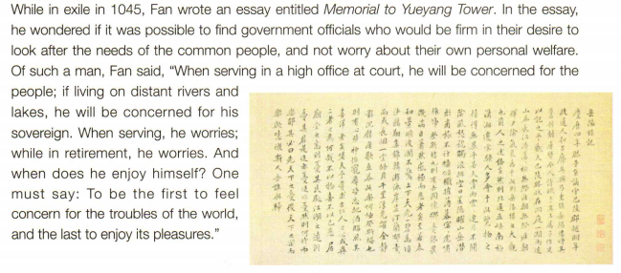
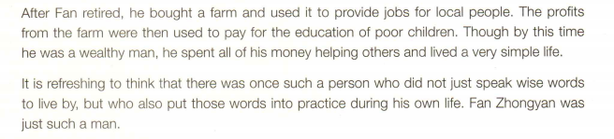
Task 2. Skim the passage about a famous person in ancient China and Put the events in the correct order.
___Fan retired and bought a farm.
___Fan wrote the essay Memorial to Yueyang Tower.
___Fan was demoted.
___Fan passed the imperial examination.
___Fan’s father died.
___Fan built a sea wall in Taizhou.
___Fan helped build up the country’s defenses.
___Fan was only able to eat one serving of porridge a day.
___Fan tried to institute government reforms.
___Fan became a government official.
10
9
8
3
1
5
6
2
7
4

Slide 7
have a strong desire to achieve
1. What do people expect an honest government official to live by?
2. Why does the author cite the proverb at the beginning of the text?
It serves as a captivating hook that introduce Fan and grabs the reader’s attention. Plus, it clearly states the main idea of the essay, describing Fan’s most striking or noteworthy qualities.
to follow a particular belief or set of principles
3. What adversity did he face according to paragraph 2 ?
His father died when he was very young. He lived in a temple when he was young and only had porridge to eat.

Slide 8
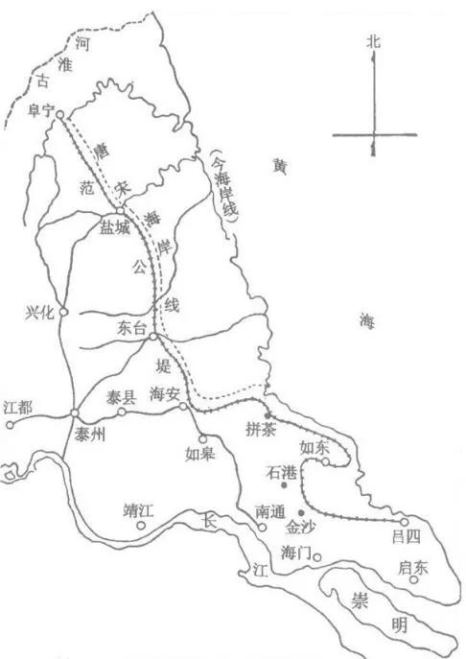
4. What adversity did he face according to paragraph 3 and 4 ?
After he became an advisor to the emperor , he tried to institute some reforms but the reforms were stopped because of the opposition from the conservative bureaucrats and he was forced to go into exile.
5. Why did many bureaucrats oppose Fan’s reforms?
They opposed Fan’s reforms because they wanted to preserve their own power.

Slide 9
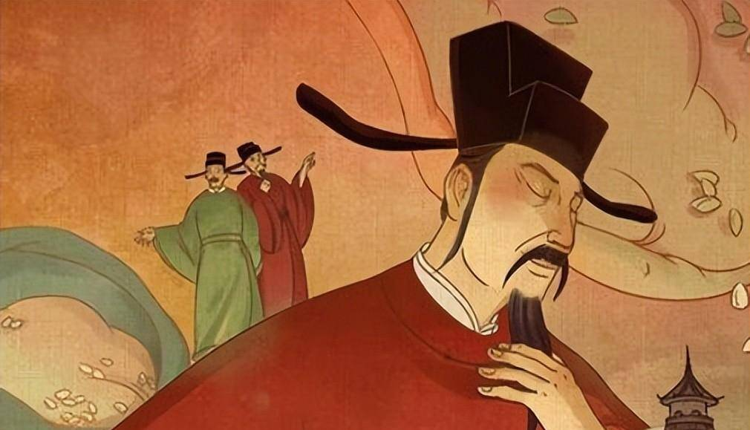
6. What did he express in his famous essay?
In his famous essay he expressed the possibility of finding government officials who would put meeting the needs of the people above their own welfare.

Slide 10
stimulating, encouraging , inspiring
7. How did Fan use his farm to help others?
Fan helped local people by letting them work on his farm. The farm’s profits were also used to pay for the education of poor people.
8. In the opinion of the author, what was refreshing about Fan’s life?
The author thinks Fan’s life was refreshing because he didn’t just speak wise words but lived them also.

Slide 11
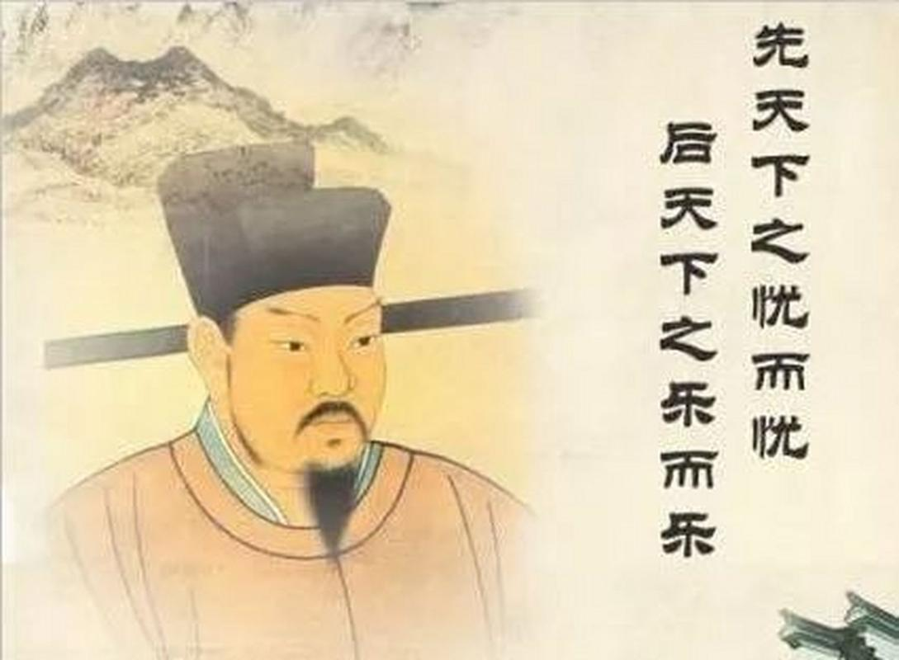
Discussion
According to the passage, what qualities does Fan possess and show the evidence?
EX:
Fan Zhongyan is so considerate, because even after he retired, he helped local people by letting them work on his farm. The farm’s profits were also used to pay for the education of poor people.
…
self-disciplined, selfless, considerate, diligent，patriotic, upright , committed, responsible, dedicated to one’s duties…

Slide 12

Deep thinking
Task 3 In groups, discuss the following questions.
1.How was Fan a good example of the saying?
2. In what ways can we put Fan’s saying into practice?
Suggested answer: Fan was a good example of the saying because, even when he was young, he put seeking his own pleasure behind his duties.
We can put Fan’s saying into practice by not being selfish and by not putting our own desires first. We should understand what our duties are, whether in our family or in our school, work, or society, and make these the priority in any decision we make.

Slide 13
Accumulation
To be the first to feel concern for the troubles of the world, and the last to enjoy its pleasures.
a goal for sb to aspire to
live by these words
be diligent in schoolwork
be content with what sb had
pass the imperial examination and become a government official
serve in Taizhou
have the people’s best interest at heart
Serve with distinction
build up defenses
先天下之忧而忧，后天下之乐而乐
应追逐的目标
以这句话作为生活的信条
勤奋刻苦
知足常乐
通过科举考试，成为官吏
在台州任职期间
把人民的最大利益放在心上
表现出色
建立了防御工事

Slide 14
Accumulation
be at peace again
be promoted to a high-level position in the capital
advise the emperor on government policy
Many conservative bureaucrats opposed him.
be forced to leave the capital and go into exile
write an essay entitled Memorial to Yueyang Tower
be firm in their desire to look after the needs of the common people
worry about their own personal welfare
国家恢复和平
被提拔到首都的高级职位
就政府政策方面向皇帝建言献策
许多官僚保守派极力反对他
被迫离开首都，流亡国外
写一篇题为岳阳楼记的文章
矢志不移为百姓谋利益
担忧个人福祉

Slide 15

Writing
Task 4. Have you ever met or heard of someone who persevered and overcame adversity in his/her life? Write a story about this person. Your story should include the following:
An introduction which tells us the name of the person, what work he/she does, and how you got to know him/her
Some details about the problem he/she faced
The different ways he/she tried to overcome the problem
How he/she felt after overcoming the difficulties
Any lessons that you learnt from this person’s story

Slide 16
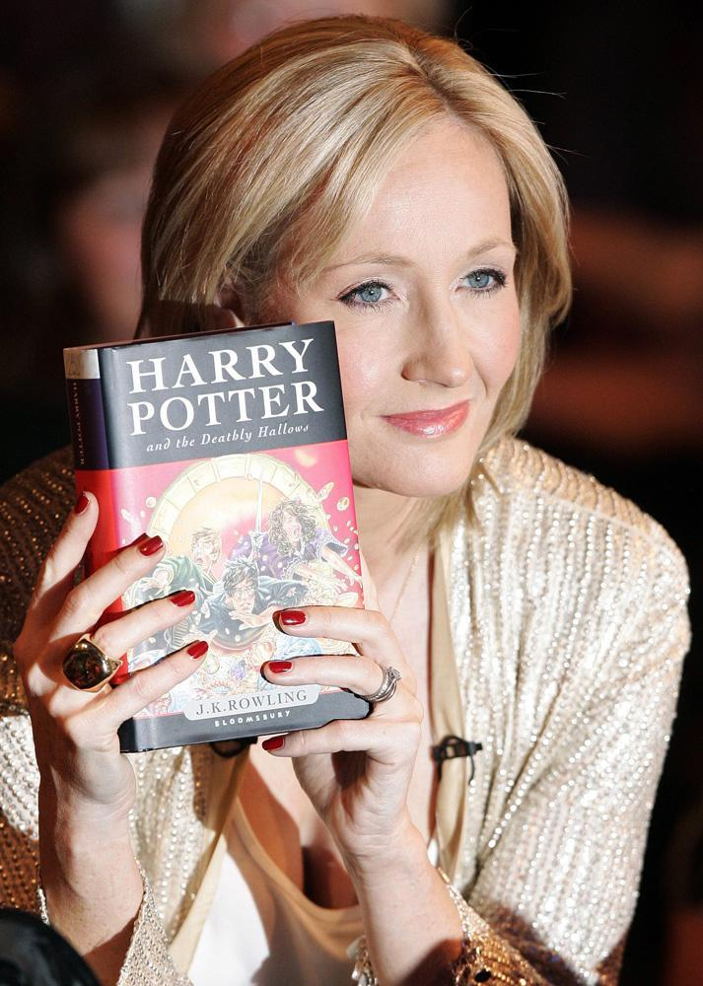
Writing
Sample Writing
Joanne Rowling is an author who I came to know after reading her famous Harry Potter books. She always loved reading and wrote her first book when she was just six. She later got married and had a baby, but her marriage broke up and she was left to look after her daughter with no money. She felt like a failure, but this gave her the chance to keep writing. She received many rejections for her work, and it was also hard to be accepted as a woman. She changed her name to J. K. Rowling, to make her gender ambiguous, and , although she often felt too depressed to continue, she kept going. One publisher eventually gave her a book deal, after giving the first chapter to his daughter to read. She immediately asked for the next one, and the rest is history.
She went on to become the world’s first billionaire author. Her books have now sold more than 500 million copies worldwide and have been made into successful films. She has given a lot of her wealth away and supports many charities. I have learnt a lot from her ”rags to riches” story; if you believe in yourself and keep trying, one day you will succeed against all odds.

Slide 17
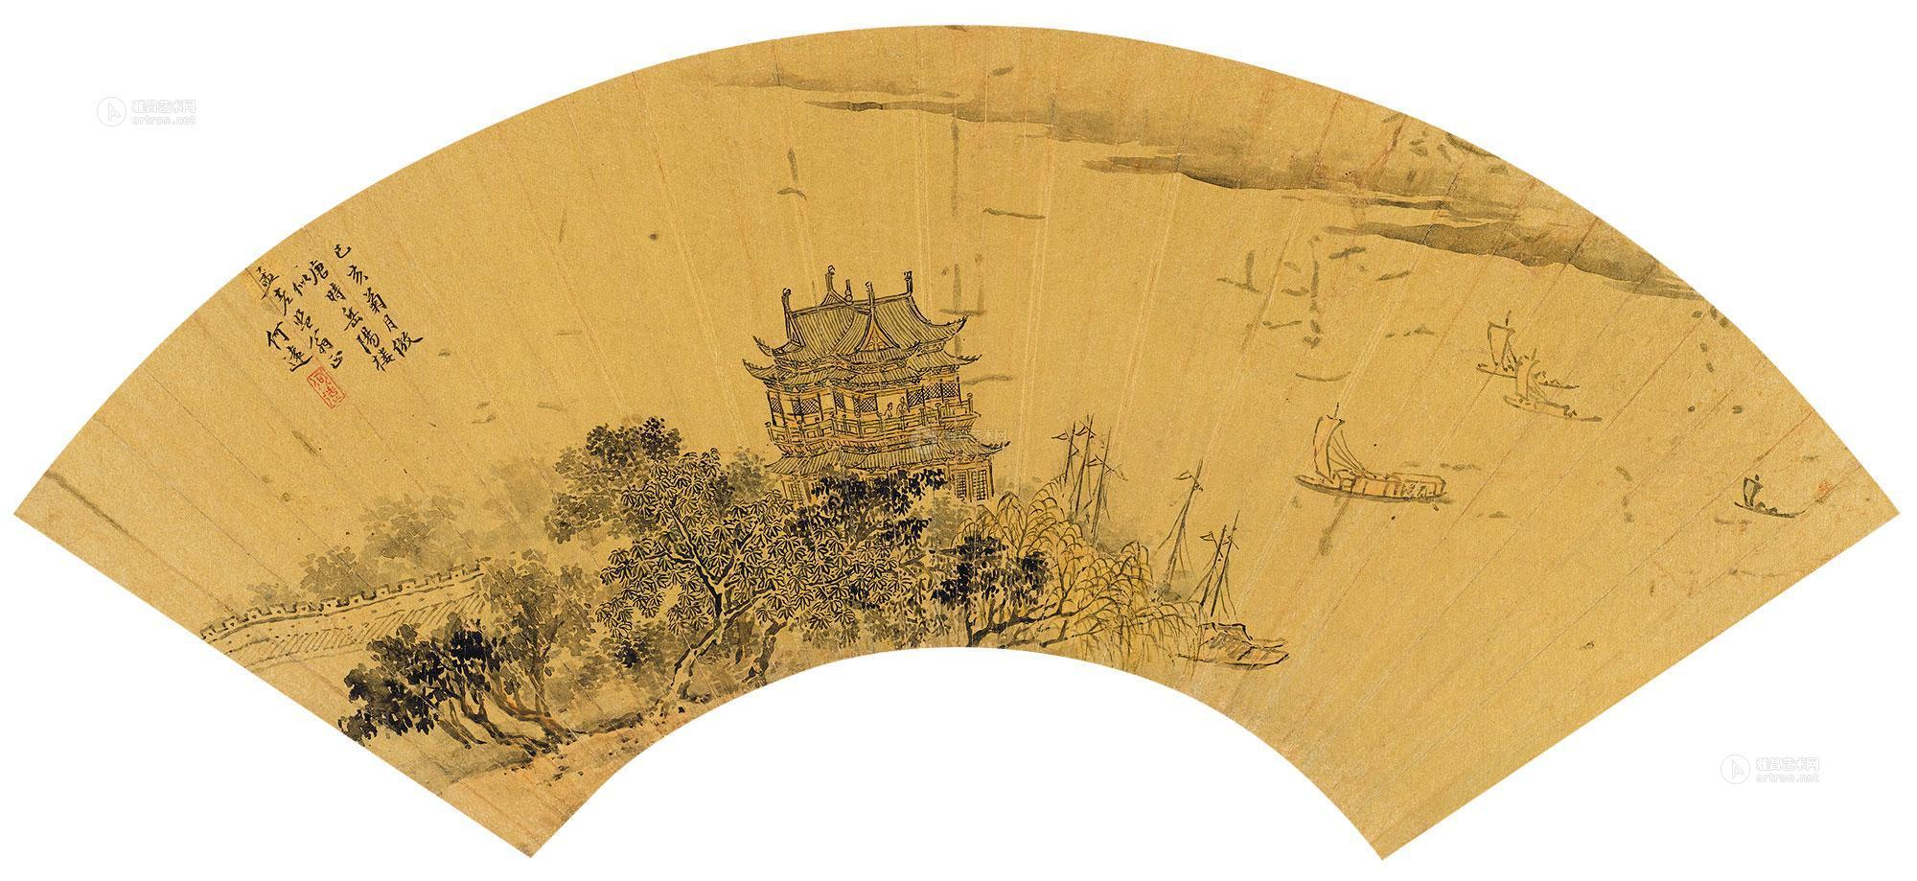

Thank you!

