Slide 1



感恩遇见，相互成就，本课件资料仅供您个人参考、教学使用，严禁自行在网络传播，违者依知识产权法追究法律责任。
更多教学资源请关注
公众号：溯恩英语
知识产权声明

Slide 2

健康生活方式选择
衢州市2024年6月
高二年级教学质量检测
——基于“四维”的应用文讲评
常山一中 吴俊峰

Slide 3

目录
CONTENTS
聚能前行不负韶华
01
审题和构思的四个维度
02
评价和赏析的四个维度
03
命题的新教材立意
04
命题的新高考立意

Slide 4
审题和构思的四个维度
聚能前行不负韶华
01

Slide 5
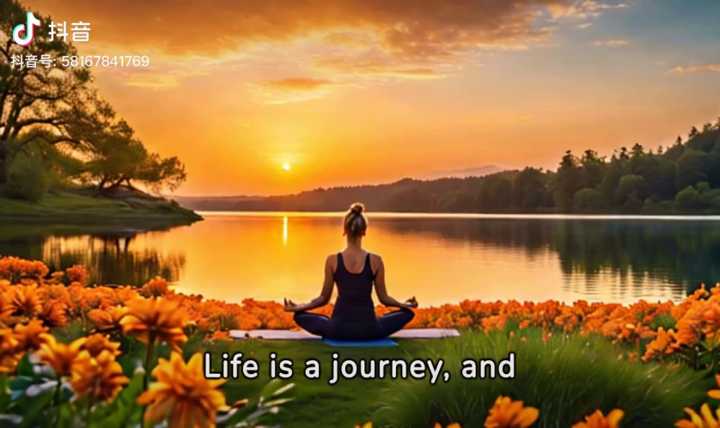
01
-1. 核心概念的建立
假定你是李华，一个月前参加了“Healthy Life”杂志社组织的“健康生活方式选择”主题夏令营活动。请你给该杂志社编辑写封信反馈你参加夏令营前后的变化，内容包括： 1. 之前的困扰； 2. 采取的行动； 3. 收获和感受。 注意： 1. 写作词数应为80左右； 2. 请按如下格式在答题卡的相应位置作答。 Dear Editor,
Yours truly,
Li Hua
1.What is Healthy Life?
2.How to choose a healthy lifestyle?

Slide 6
01
-2审题和构思的四个维度
1. 观点有理有据 Clear levels
2. 语言准确丰富 Complete points
3.语篇合理建构 Logic bridges
4.交际真实得体 Authentic emotions
“困扰→行动→收获”，要逻辑关联，不能牛头不对马嘴。“感受”要基于以上事实的评议和情感升华，突出“勇于改变”的正能。
假定你是李华，一个月前参加了“Healthy Life”杂志社组织的“健康生活方式选择”主题夏令营活动。请你给该杂志社编辑写封信反馈你参加夏令营前后的变化，内容包括： 1. 之前的困扰； 2. 采取的行动； 3. 收获和感受。 注意： 1. 写作词数应为80左右； 2. 请按如下格式在答题卡的相应位置作答。 Dear Editor,
Yours truly,
Li Hua
尽量来自人教版X3U2教材的单元话题词汇，要求语言简洁、忌华而不实的大段描述，故意堆砌辞藻。态度积极、方向明确、展示正确的价值观，自信自强和勇于改变的良好品格。
篇章模式“提出问题→解决问题→反馈评议”，条理清晰、层层递进。
这是一封学生写杂志社负责人的反馈信，遣词造句要比较正式，说话语气要礼貌得体。反馈的语气要突显感恩这段经历，感谢组织方的精心安排。

Slide 7
评价和赏析的四个维度
聚能前行不负韶华
02

Slide 8

02
评价的四个维度-Version 1
试题呈现 Unique presentation | 观点有理有据 Clear levels | 语言准确丰富 Complete points | 语篇合理建构 Logic bridges | 交际真实得体 Authentic emotions
假定你是李华，一个月前参加了“Healthy Life”杂志社组织的“健康生活方式选择”主题夏令营活动。请你给该杂志社编辑写封信反馈你参加夏令营前后的变化，内容包括： 1. 之前的困扰； 2. 采取的行动； 3. 收获和感受。 | Dear Editor, Having experienced the Summer Camp themed “Choosing a healthy life style”, I deeply realize that health plays an essential role in life. Previous to this, I was always in bad condition, both physically and psychologically, because of lack of sleep and unhealthy diet. Luckily, after attending your camp, I have made a shift from sugary drinks and biscuits to more green vegetables and fruits. In addition, I prefer to go to bed early rather than stay up late playing video games. Better still, I get refreshed through running for an hour every day. The results have been fantastic. I feel more dynamic and stronger than ever. Not merely do I harvest a healthy body, but it also boosts confidence in myself—I CAN change myself. I just need to try. Yours truly, Li Hua

Slide 9
02
评价的四个维度-Version 2
试题呈现 Unique presentation | 观点有理有据 Clear levels | 语言准确丰富 Complete points | 语篇合理建构 Logic bridges | 交际真实得体 Authentic emotions
假定你是李华，一个月前参加了“Healthy Life”杂志社组织的“健康生活方式选择”主题夏令营活动。请你给该杂志社编辑写封信反馈你参加夏令营前后的变化，内容包括： 1. 之前的困扰； 2. 采取的行动； 3. 收获和感受。 | Dear Editor, After participating in the “Choosing a Healthy Lifestyle” summer camp, I have gained a profound understanding of the essential role health plays in our lives. Previously, my physical and mental well-being suffered due to insufficient sleep and a poor diet. Fortunately, the camp inspired significant changes in my lifestyle. I’ve transitioned from consuming sugary drinks and snacks to including more vegetables and fruits into my diet. I’ve also replaced late-night gaming sessions with a healthier habit of going to bed early. Additionally, I’ve started running for an hour daily, which has greatly invigorated me. These changes have yielded remarkable results. I feel more energetic and stronger than ever before. Not only have I achieved a healthier body, but I’ve also gained confidence in my ability to transform myself. It’s clear now that change is possible with determination and effort. Yours truly, Li Hua

Slide 10
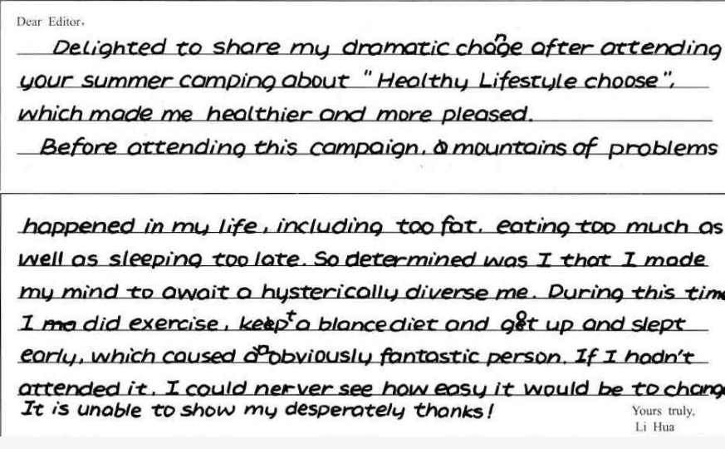
02
评价的四个维度-学生习作 1
试题呈现 Unique presentation | 观点有理有据 Clear levels | 语言准确丰富 Complete points | 语篇合理建构 Logic bridges | 交际真实得体 Authentic emotions
假定你是李华，一个月前参加了“Healthy Life”杂志社组织的“健康生活方式选择”主题夏令营活动。请你给该杂志社编辑写封信反馈你参加夏令营前后的变化，内容包括： 1. 之前的困扰； 2. 采取的行动； 3. 收获和感受。

Slide 11
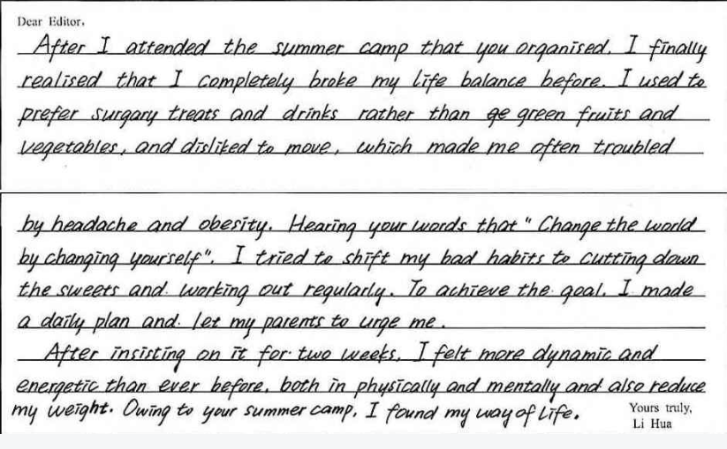
02
评价的四个维度-学生习作 1
试题呈现 Unique presentation | 观点有理有据 Clear levels | 语言准确丰富 Complete points | 语篇合理建构 Logic bridges | 交际真实得体 Authentic emotions
假定你是李华，一个月前参加了“Healthy Life”杂志社组织的“健康生活方式选择”主题夏令营活动。请你给该杂志社编辑写封信反馈你参加夏令营前后的变化，内容包括： 1. 之前的困扰； 2. 采取的行动； 3. 收获和感受。

Slide 12
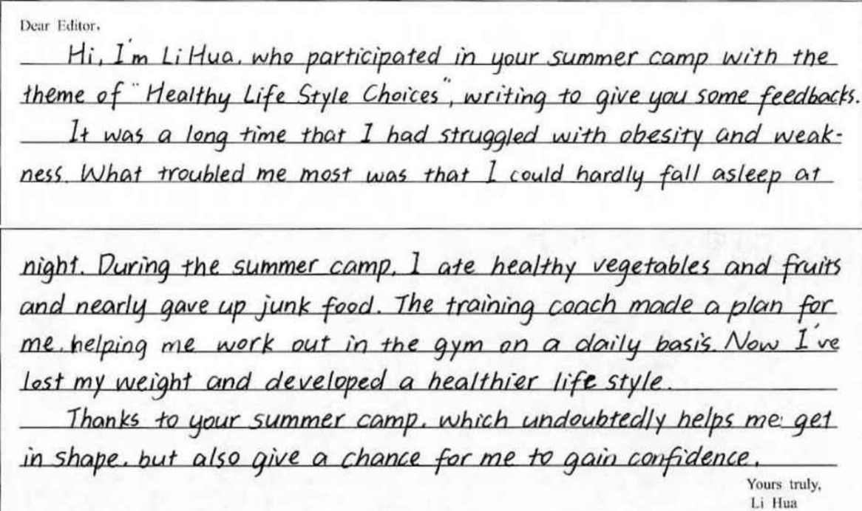
02
评价的四个维度-学生习作 1
试题呈现 Unique presentation | 观点有理有据 Clear levels | 语言准确丰富 Complete points | 语篇合理建构 Logic bridges | 交际真实得体 Authentic emotions
假定你是李华，一个月前参加了“Healthy Life”杂志社组织的“健康生活方式选择”主题夏令营活动。请你给该杂志社编辑写封信反馈你参加夏令营前后的变化，内容包括： 1. 之前的困扰； 2. 采取的行动； 3. 收获和感受。

Slide 13
命题的新教材立意
聚能前行不负韶华
03

Slide 14
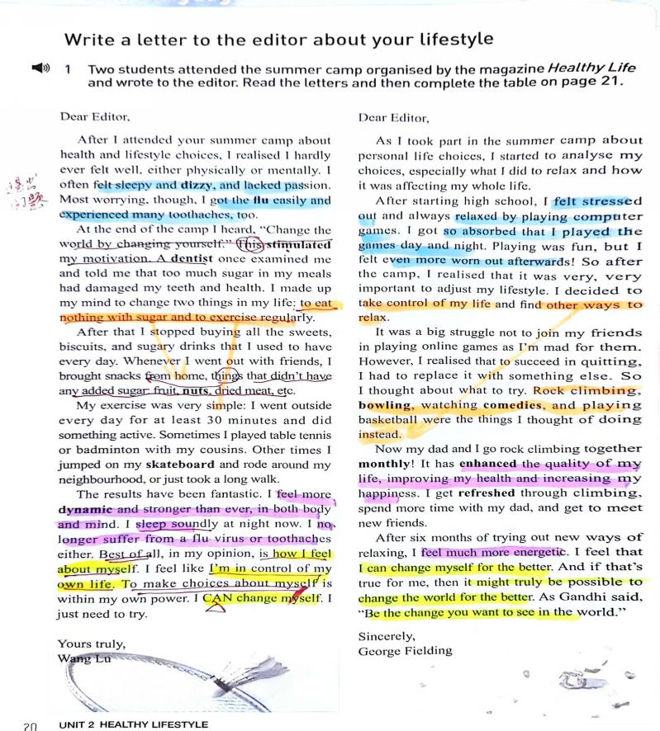

03
命题的新教材立意—困扰
1. I often felt sleepy and dizzy, and lacked passion. Most worrying, though, I got the flu easily and experienced many toothaches, too.
2. A dentist once examined me and told me that too much sugar in my meals had damaged my teeth and health. I made up my mind to change two things in my life: to eat nothing with sugar and to exercise regularly.
3.I felt stressed out and always relaxed by playing computer games. I got so absorbed that I played the games day and night. Playing was fun, but I felt even more worn out afterwards!

Slide 15
03
命题的新教材立意—困扰
1. I often felt sleepy and dizzy, and lacked passion. Most worrying, though, I got the flu easily and experienced many toothaches, too.
2. A dentist once examined me and told me that too much sugar in my meals had damaged my teeth and health. I made up my mind to change two things in my life: to eat nothing with sugar and to exercise regularly.
3.I felt stressed out and always relaxed by playing computer games. I got so absorbed that I played the games day and night. Playing was fun, but I felt even more worn out afterwards!

Slide 16
03
命题的新教材立意—困扰和行动
8. I realised that to succeed in quitting, I had to replace it with something else. So I thought about what to try. Rock climbing, bowling. watching comedies, and playing basketball were the things I thought of doing instead.
9.Now my dad and I go rock climbing together monthly! It has enhanced the quality my life, improving my health and increasing my happiness. I get refreshed through climbing, spend more time with my dad, and get to meet news friends.

Slide 17
03
命题的新教材立意—收获和感想
10.The results have been fantastic. I feel more dynamic and stronger than ever, in both body and mind. I sleep soundly at night now. I no longer suffer from a flu virus or toothaches either. Best of all, in my opinion, is how I feel about myself.
11. I feel much more energetic. I feel that I can change myself for the better.
12. "Change the world by changing yourself. " This stimulated my motivation.
“
13.I feel like I'm in control of my own life. To make choices about myself is within my own power. I CAN change myself. I just need to try.
14. And if that's true for me, then it might truly be possible to change the world for the better. As Gandhi said, "Be the change you want to see in the world."

Slide 18
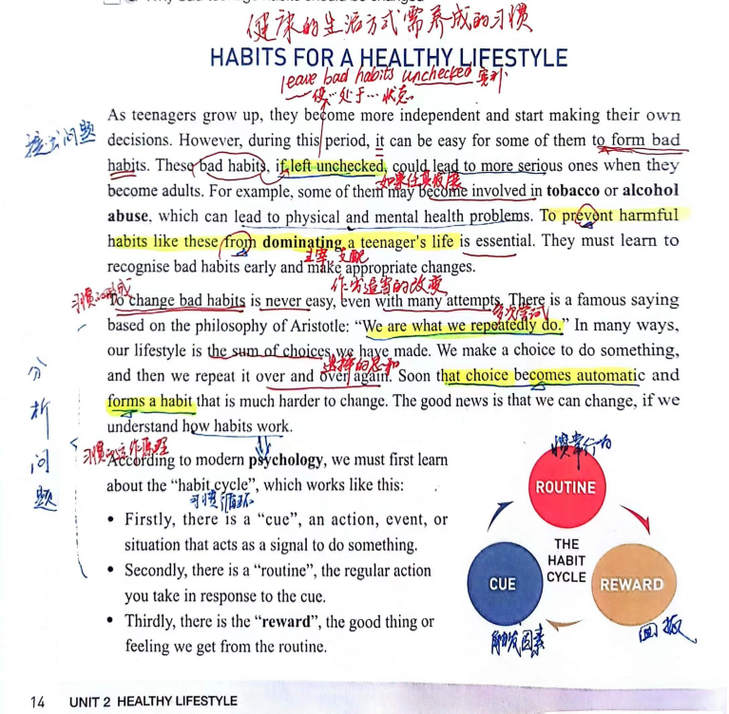
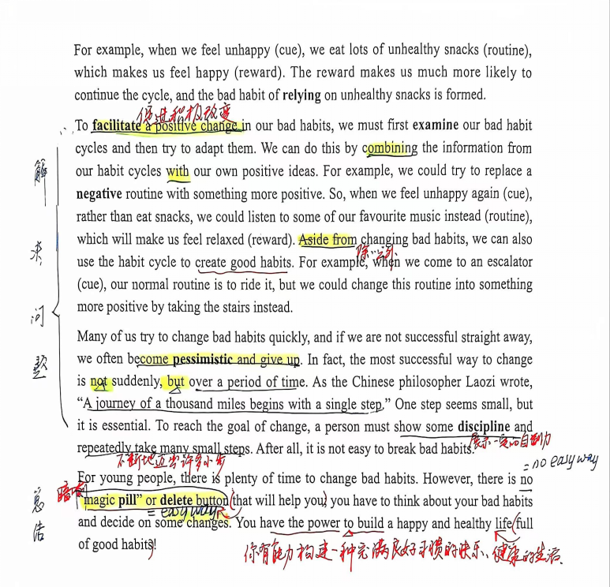
03
命题的新教材立意
15. These bad habits, if left unchecked, could lead to more serious ones when they become adults. For example some of them may become involved in tobacco or alcohol abuse, which can lead to physical and mental health problems. To prevent harmful habits like these from dominating a teenager's life is essential. They must learn to recognise bad habits early and make appropriate changes.
如果不加以控制，这些不良习惯长大后可能会导致更严重的问题。例如，有些青少年会沉溺于烟酒不能自拔，造成生理和心理健康问题。防止这些不良习惯支配青少年的生活是至关重要的。他们必须学会及早发现不良习惯并做出适当的改变。
16. As the Chinese philosopher Lao Zi wrote, "A journey of a thousand miles begins with a single step. " One step seems small, but it is essential. To reach the goal of change, a person must show some discipline and repeatedly take many small steps. After all, it is not easy to break bad habits.
正如中国哲学家老子所言:“千里之行始于足下。”第一步看似渺小，却是必不可少的。为了达到改变的目标，人必须表现出一定的纪律性，并不断地迈出许多小步毕竟，改掉不良习惯并不容易。
17. However, there is no"magic pill" or delete button that will help you; you have to think about your bad habits and decide on some changes. You have the power to build a happy and healthy life full of good habits!
然而，没有可以帮助你的“神奇药丸”或删除按钮; 你必须考虑自己的不良习惯并做出一些改变。你有能力建立充满良好习惯的幸福健康的生活.

Slide 19
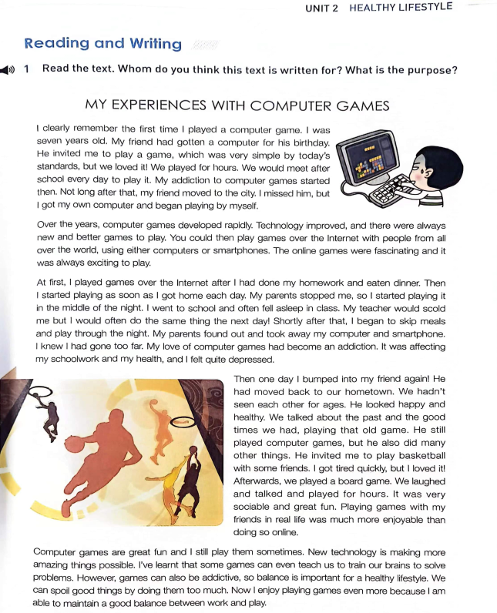
03
命题的新教材立意
人教版X3U2 workbook reading and writing）
18.So I started playing it in the middle of the night. I went to school and often fell asleep in class.
19. Shortly after that, I began to skip meals and play through the night.
20. My love of computer games had become an addiction. It was affecting my schoolwork and my health, and I felt quite depressed.
21.He invited me to play basketball with some friends. We laughed and talked and played for hours.lt was very sociable and great fun. Playing games with myfriends in real life was much more enjoyable than doing so online.
22.So balance is important for a healthy lifestyle. We can spoil good things by doing them too much. Now l enjoy playing games even more because l am able to maintain a good balance between work and play.
健康的生活方式
文中讲述了作者沉迷电脑游戏，并影响了其学业和健康，深感愧疚却无所改变。
作者来到好友David的家中，回忆一起玩电脑游戏的美好时光，但David的健康生活方式改变了作者，并醒悟自律并健康的生活才更有利成长，平衡好学习和生活，积极向上的生活态度使得年轻人更具活力去面对压力，幸福生活。

Slide 20
命题的新高考立意
聚能前行不负韶华
04

Slide 21

04
命题的高考立意
^{衢州市2024年6月高二年级教学质量检测} 假定你是李华，一个月前参加了“Healthy Life”杂志社组织的“健康生活方式选择”主题夏令营活动。请你给该杂志社编辑写封信反馈你参加夏令营前后的变化，内容包括：1. 之前的困扰；2. 采取的行动；3. 收获和感受。
着重培养以下几方面能力：——程晓堂《2023年高考英语全国卷的新动向》
用英语描述事件、描述个人经历和事物特征的能力；
描述、概括真实的经验和事实的能力；
传递信息、论证观点、表达情感的能力；
对观点、事件、经验进行阐释和评论的能力等。
更要有创造，要使学生能够用英语进行真实表达。
^{2024年6月全国Ⅰ卷 & Ⅱ卷} 假定你是李华，你们班上周五在公园上了一节美术课，请给英国好友
Chris写一封邮件分享你的经历，内容包括：1. 你完成的作品 2. 你的感想。
^{2024年6月全国Ⅰ卷 & Ⅱ卷} 假定你是李华，外教Ryan准备将学生随机分为两人一组，让大家课后
练习口语，你 认为这样分组存在问题。请你给外教写一封邮件，内容包括：1. 说明问题；2. 提出建议。
^{2022年6月全国Ⅰ卷 & Ⅱ卷} 假定你是校广播站英语节目“Talk and Talk”的负责人李华，请给外
教Caroline写邮件邀请她做一次访谈。内容包括：1. 节目介绍；2. 访谈的时间和话题。

Slide 22
04
同话题作文-1
^{（台州市2022学年第二学期高二年级期末质量评估）}假定你是李华，你刚参加了学校举办的为期一周的“健康生活方式”主题系列活动。请给英国朋友 Allen 写一封邮件，分享此事。内容包括：1.活动内容；2.你的感受。
Dear Allen,
Last week witnessed a week-long series of activities themed with "Healthy Lifestyle". I am writing to share them with you.
Different departments from my school came together to give birth to the great variety of activities. The Student Union invited a renowned expert from the People's Hospital to give lectures on healthy life, the P.E. Office organized basketball and volleyball games, the Mental Health Club carried out a series of large-scale group guidance, and the 3 grades held class meetings to talk about healthy lifestyle. Realization swept through me that as a student, only by living a healthy lifestyle could I free myself from the intense study, balance my study and life, and get twice the result with half the effort.
Do you have anything interesting to share recently? Looking forward to hearing from you.
Yours,
Li Hua

Slide 23
04
同话题作文-2
^{（2022·湖北·高二阶段练习）}假定你是李华，你注意到许多学生进入高中以来在学习的重压之下养成了一些不良的生活方式，如熬夜很晚、吃饭匆忙、体育锻炼少等等。请代表学生会为校“英语天地”宣传栏写一份倡议书，呼吁大家积极养成健康的生活方式，内容包括：
1.倡议的原因；2.倡议的具体内容。
Health Matters Most
Hello, everyone! ____________________________________________________________________
Health Matters Most
Hello, everyone! As you can see, an increasing number of students in our school have been under tremendous pressure ever since senior high school, thus developing an unhealthy lifestyle, such as staying up deep into night，rushing through meals, taking little physical exercise and so forth. Not only will these bad living habits do harm to our health, but they will have a negative impact on our study. Hence, it’s high time that we should take immediate action and say no to the unhealthy lifestyle.
First of all, we should form the good habit of keeping early hours. As the saying goes, early to bed and early to rise make a man healthy, wealthy and wise. In addition, we’re supposed to take meals slowly and regularly, which contributes to good digestion and health. Last but not least, it’s strongly recommended that we should spare as much time as possible to work out. Only in this way can we live a happy and healthy life and make our study more productive.

Slide 24
04
同话题作文-3
（2022·广东·北京师范大学珠海分校附属外国语学校高三期末）假定你是李华，报名参加了学校以 “Be Sporty, Be Healthy”为主题的演讲比赛。请你写一份英文演讲稿。内容包括：1.问题：因为学习紧张，疏于活动；2.建议：要合理安排，正常锻炼。
Be Sporty, Be Healthy
Hello, everyone! ____________________________________________________________________
Be Sporty, Be Healthy
Hello, everyone!
Now a common problem among students is that the vast majority of students are not engaged in activities due to their intense studies. Many students complain that they have no time for exercise, but we have all have heard of a famous saying that time is like water in a sponge, and if you squeeze, there will always be some. In my opinion, we should balance the relationship between study and exercise. Let’s insist on combining work and rest and spare time to do exercise every day.
That’s all. Thank you.

Slide 25

THANK YOU
聚能前行不负韶华
衢州市2024年6月高二年级教学质量检测

