Slide 1


感恩遇见，相互成就，本课件资料仅供您个人参考、教学使用，严禁自行在网络传播，违者依知识产权法追究法律责任。
更多教学资源请关注
公众号：溯恩英语
知识产权声明

Slide 2


2024年新高考I卷、II卷、甲卷七选五讲评
利用语篇分析和衔接理论突破2024年高考七选五真题

Slide 3
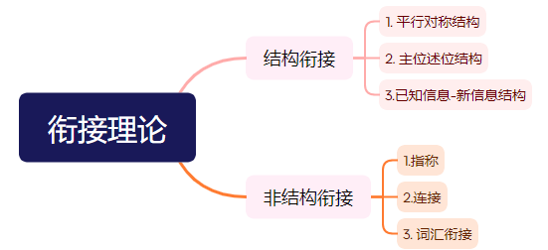
衔接理论：衔接是一种语义概念，指某个语篇里的各个语言成分之间的语义联系，当一个成分依赖另一个成分得以解释时就产生了衔接。

Slide 4
解题步骤
05
01
代入复查
有保障
略读文章抓大意
04
02
03
通读段首析结构
衔接理论定答案
快速扫读七选项

Slide 5
新高考I卷
01 略读文章 抓大意
Not all great writers are great spellers. If you want to be published, it’s vital to submit a perfect, professionally presented manuscript (原稿). 36 No editor is likely to tolerate a writer who does not take the trouble to spell words correctly. I keep two reference books close-by on my desk: dictionary and thesaurus (同义词词典). I don’t trust my laptop’s spellchecker. 37 Of course, these days there are plenty of online dictionaries and thesauruses, but I’m old-fashioned enough to prefer a hard cover and pages I can leaf through with my fingers. I use the Concise Oxford Dictionary and the Collins Thesaurus. 38 It should give you a precise definition of each word, thus differentiating it from other words whose meanings are similar, but not identical. It will also usually show how the word is pronounced. In addition, I have an old two-volume copy of the Shorter Oxford Dictionary, picked up a few years ago in a bookshop sale for just 99 pence. Of course, with its 2,672 pages, it’s not exactly short. It contains around 163,000 words, plus word combinations and idiomatic phrases. 39 However, if I need to check the origin of a word or to look up examples of its usage, there’s nothing better. For well over a hundred years the most influential English dictionary was Samuel Johnson’s Dictionary of the English Language published in 1755. “To make dictionaries is dull (乏味) work,” wrote Johnson, illustrating one definition of “dull”. 40 A few minutes spent casting your eye over a page or two can be a rewarding experience.
语篇类型：
主题语境：
主旨大意：

Slide 6
新高考I卷
01 略读文章 抓大意
Not all great writers are great spellers. If you want to be published, it’s vital to submit a perfect, professionally presented manuscript (原稿). 36 No editor is likely to tolerate a writer who does not take the trouble to spell words correctly. I keep two reference books close-by on my desk: dictionary and thesaurus (同义词词典). I don’t trust my laptop’s spellchecker. 37 Of course, these days there are plenty of online dictionaries and thesauruses, but I’m old-fashioned enough to prefer a hard cover and pages I can leaf through with my fingers. I use the Concise Oxford Dictionary and the Collins Thesaurus. 38 It should give you a precise definition of each word, thus differentiating it from other words whose meanings are similar, but not identical. It will also usually show how the word is pronounced. In addition, I have an old two-volume copy of the Shorter Oxford Dictionary, picked up a few years ago in a bookshop sale for just 99 pence. Of course, with its 2,672 pages, it’s not exactly short. It contains around 163,000 words, plus word combinations and idiomatic phrases. 39 However, if I need to check the origin of a word or to look up examples of its usage, there’s nothing better. For well over a hundred years the most influential English dictionary was Samuel Johnson’s Dictionary of the English Language published in 1755. “To make dictionaries is dull (乏味) work,” wrote Johnson, illustrating one definition of “dull”. 40 A few minutes spent casting your eye over a page or two can be a rewarding experience.
语篇类型：
主题语境：
主旨大意：
说明文
人与自我—学习(语言学习的规律、方法等)
作者介绍自己使用纸质词典的经验、心得和乐趣。

Slide 7
新高考I卷
02 通读段首 析结构
总
Not all great writers are great spellers. If you want to be published, it’s vital to submit a perfect, professionally presented manuscript (原稿). 36 No editor is likely to tolerate a writer who does not take the trouble to spell words correctly. I keep two reference books close-by on my desk: dictionary and thesaurus (同义词词典). I don’t trust my laptop’s spellchecker. 37 Of course, these days there are plenty of online dictionaries and thesauruses, but I’m old-fashioned enough to prefer a hard cover and pages I can leaf through with my fingers. I use the Concise Oxford Dictionary and the Collins Thesaurus. 38 It should give you a precise definition of each word, thus differentiating it from other words whose meanings are similar, but not identical. It will also usually show how the word is pronounced. In addition, I have an old two-volume copy of the Shorter Oxford Dictionary, picked up a few years ago in a bookshop sale for just 99 pence. Of course, with its 2,672 pages, it’s not exactly short. It contains around 163,000 words, plus word combinations and idiomatic phrases. 39 However, if I need to check the origin of a word or to look up examples of its usage, there’s nothing better. For well over a hundred years the most influential English dictionary was Samuel Johnson’s Dictionary of the English Language published in 1755. “To make dictionaries is dull (乏味) work,” wrote Johnson, illustrating one definition of “dull”. 40 A few minutes spent casting your eye over a page or two can be a rewarding experience.
并不是所有伟大的作家都擅长拼写。如果你想发表，提交一份完美的、专业的原稿是至关重要的。____36____任何编辑都不可能容忍一个不用心把单词拼写正确的作家。
我桌上放着两本参考书:词典和同义词词典。
分
它应该给出每个单词的精确定义，从而将其与其他含义相似但不相同的单词区分开来。
一百多年来，最有影响力的英语词典是1755年出版的塞缪尔·约翰逊的《英语词典》。

Slide 8

新高考I卷
03 快速扫读 七选项
A. I don’t often use this dictionary.
B. It takes no account of the context.
C. But I still don’t want to replace them.
D. But a dictionary can be a pleasure to read.
E. Of course, a dictionary is not only for spelling.
F. That means good grammar and no spelling mistakes.
G. Dictionaries don’t always give you enough information.
Tip:扫读选项划出关键词：逻辑连接词、指代词、话题相关词

Slide 9
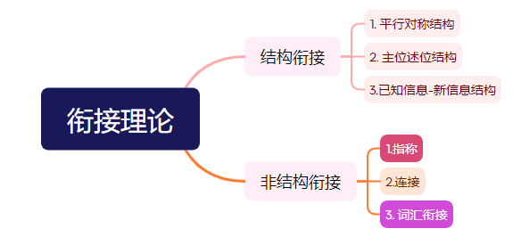
新高考I卷
04 衔接理论定答案
Not all great writers are great spellers. If you want to be published, it’s vital to submit a perfect, professionally presented manuscript (原稿). 36 No editor is likely to tolerate a writer who does not take the trouble to spell words correctly.
A. I don’t often use this dictionary.
B. It takes no account of the context.
C. But I still don’t want to replace them.
D. But a dictionary can be a pleasure to read.
E. Of course, a dictionary is not only for spelling.
F. That means good grammar and no spelling mistakes.
G. Dictionaries don’t always give you enough information.
F
that 指代上句话，是对上面的进一步解释
原词、同源词复现

Slide 10
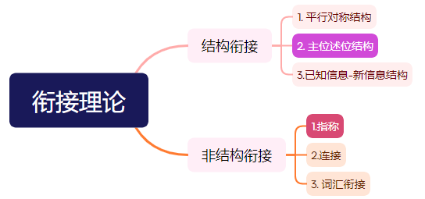
新高考I卷
04 衔接理论定答案
I keep two reference books close-by on my desk: dictionary and thesaurus (同义词词典). I don’t trust my laptop’s spellchecker. 37 Of course, these days there are plenty of online dictionaries and thesauruses, but I’m old-fashioned enough to prefer a hard cover and pages I can leaf through with my fingers. I use the Concise Oxford Dictionary and the Collins Thesaurus.
A. I don’t often use this dictionary.
B. It takes no account of the context.
C. But I still don’t want to replace them.
D. But a dictionary can be a pleasure to read.
E. Of course, a dictionary is not only for spelling.
G. Dictionaries don’t always give you enough information.
B
前面一句主位点明自己不喜欢电脑拼写检查程序，述位围绕这个点展开。
it 指代原文章的laptop’s spellchecker

Slide 11
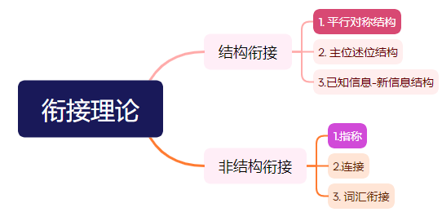
新高考I卷
04 衔接理论定答案
A. I don’t often use this dictionary.
C. But I still don’t want to replace them.
D. But a dictionary can be a pleasure to read.
E. Of course, a dictionary is not only for spelling.
G. Dictionaries don’t always give you enough information.
E
38 It should give you a precise definition of each word, thus differentiating it from other words whose meanings are similar, but not identical. It will also usually show how the word is pronounced. In addition, I have an old two-volume copy of the Shorter Oxford Dictionary, picked up a few years ago in a bookshop sale for just 99 pence. Of course, with its 2,672 pages, it’s not exactly short. It contains around 163,000 words, plus word combinations and idiomatic phrases. 39 However, if I need to check the origin of a word or to look up examples of its usage, there’s nothing better.
空后两句话为平行结构，都是讲词典的功能和作用。
it 指代dictionary

Slide 12
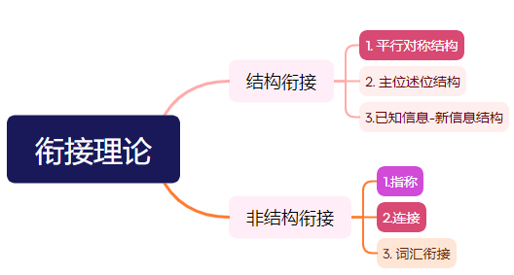
新高考I卷
04 衔接理论定答案
A. I don’t often use this dictionary.
C. But I still don’t want to replace them.
D. But a dictionary can be a pleasure to read.
G. Dictionaries don’t always give you enough information.
38 It should give you a precise definition of each word, thus differentiating it from other words whose meanings are similar, but not identical. It will also usually show how the word is pronounced. In addition, I have an old two-volume copy of the Shorter Oxford Dictionary, picked up a few years ago in a bookshop sale for just 99 pence. Of course, with its 2,672 pages, it’s not exactly short. It contains around 163,000 words, plus word combinations and idiomatic phrases. 39 However, if I need to check the origin of a word or to look up examples of its usage, there’s nothing better.
A
此处几个句子都是围绕着Shorter Oxford Dictionary 开展的平行结构
it 指代dictionary； I 人称一致，都是关于我与词典的事情。
however 前后转折，前面为词典的不足，后面为其优势

Slide 13
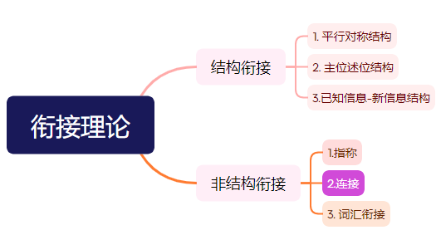
新高考I卷
04 衔接理论定答案
For well over a hundred years the most influential English dictionary was Samuel Johnson’s Dictionary of the English Language published in 1755. “To make dictionaries is dull (乏味) work,” wrote Johnson, illustrating one definition of “dull”. 40 A few minutes spent casting your eye over a page or two can be a rewarding experience.
C. But I still don’t want to replace them.
D. But a dictionary can be a pleasure to read.
G. Dictionaries don’t always give you enough information.
D
空前后词意相反，设空处为转折

Slide 14
新高考I卷
05 代入复查 有保障
Not all great writers are great spellers. If you want to be published, it’s vital to submit a perfect, professionally presented manuscript (原稿). 36______________________________________________ No editor is likely to tolerate a writer who does not take the trouble to spell words correctly. I keep two reference books close-by on my desk: dictionary and thesaurus (同义词词典). I don’t trust my laptop’s spellchecker. 37 _____________________________________ Of course, these days there are plenty of online dictionaries and thesauruses, but I’m old-fashioned enough to prefer a hard cover and pages I can leaf through with my fingers. I use the Concise Oxford Dictionary and the Collins Thesaurus. 38 ____________________________________________ It should give you a precise definition of each word, thus differentiating it from other words whose meanings are similar, but not identical. It will also usually show how the word is pronounced.In addition, I have an old two-volume copy of the Shorter Oxford Dictionary, picked up a few years ago in a bookshop sale for just 99 pence. Of course, with its 2,672 pages, it’s not exactly short. It contains around 163,000 words, plus word combinations and idiomatic phrases.
39 __________________________________________ However, if I need to check the origin of a word or to look up examples of its usage, there’s nothing better. For well over a hundred years the most influential English dictionary was Samuel Johnson’s Dictionary of the English Language published in 1755. “To make dictionaries is dull (乏味) work,” wrote Johnson, illustrating one definition of “dull”. 40 _______________________________________________ A few minutes spent casting your eye over a page or two can be a rewarding experience.
F. That means good grammar and no spelling mistakes.
B. It takes no account of the context.
E. Of course, a dictionary is not only for spelling.
A. I don’t often use this dictionary.
D. But a dictionary can be a pleasure to read.

Slide 15
新高考II卷
01 略读文章抓大意
Overtourism Is For Real: How Can You Help?
Travel promotes understanding, expands our minds, makes us better people, and boosts local economies and communities, but the rapid growth of travel has led to overtourism in certain regions and destinations. 36 Certainly not. The loss of what travel offers would be unacceptable in today's world. Here are some tips on making wise decisions to minimize pressure on the places we visit and improve our experience.
●Choose mindfully. Overvisited destinations are that way for a reason: they're special. With so many online posts featuring the same places, it's easy to feel like you're missing out. Go somewhere only when the landscape, culture or food deeply draws you. 37
●Get creative. The best way to ease pressure on over-touristed destinations is to go somewhere else. Though overtourism is described as a problem affecting the entire world, it's actually concentrated to a small number of extremely popular spots. That means you have tons of less-visited options to choose from. 38 Why not try a regional alternative or check out a popular destination's lesser-known sights?
● 39 Minimize impact and maximize experience by skipping major holidays or rush hour. You'll compete with fewer tourists, save money, experience a different side of a popular place, and boost the economy when tourism is traditionally slower.
Visiting a place that others call home is a privilege(荣幸). Do your part to preserve what makes a destination special in the first place. 40 You may be amazed how much closer you'll feel to the people there.
语篇类型：
主题语境：
主旨大意：
说明文
人与社会—社会（社会热点话题）
文章介绍了如何避免过度旅游问题

Slide 16
新高考II卷
02 通读段首 析结构
Overtourism Is For Real: How Can You Help?
Travel promotes understanding, expands our minds, makes us better people, and boosts local economies and communities, but the rapid growth of travel has led to overtourism in certain regions and destinations. 36 Certainly not. The loss of what travel offers would be unacceptable in today's world. Here are some tips on making wise decisions to minimize pressure on the places we visit and improve our experience.
●Choose mindfully. Overvisited destinations are that way for a reason: they're special. With so many online posts featuring the same places, it's easy to feel like you're missing out. Go somewhere only when the landscape, culture or food deeply draws you. 37
●Get creative. The best way to ease pressure on over-touristed destinations is to go somewhere else. Though overtourism is described as a problem affecting the entire world, it's actually concentrated to a small number of extremely popular spots. That means you have tons of less-visited options to choose from. 38 Why not try a regional alternative or check out a popular destination's lesser-known sights?
● 39 Minimize impact and maximize experience by skipping major holidays or rush hour. You'll compete with fewer tourists, save money, experience a different side of a popular place, and boost the economy when tourism is traditionally slower.
Visiting a place that others call home is a privilege(荣幸). Do your part to preserve what makes a destination special in the first place. 40 You may be amazed how much closer you'll feel to the people there.
总
分
总

Slide 17
新高考II卷
03 快速扫读 七选项
A. Visit during off-peak times.
B. So, should we stop traveling?
C. Travel for you and no one else.
D. Can overtourism be avoided then?
E. You can still find relatively undiscovered places.
F. You'll find yourself virtually alone, or close to it.
G. Consider giving back to the communities you're visiting.

Slide 18
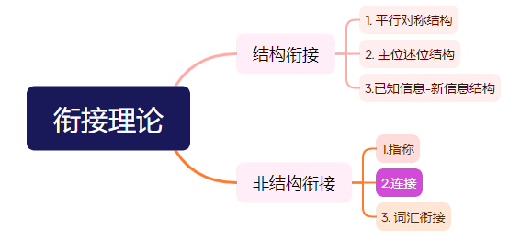
新高考II卷
04 衔接理论 定答案
Overtourism Is For Real: How Can You Help?
Travel promotes understanding, expands our minds, makes us better people, and boosts local economies and communities, but the rapid growth of travel has led to overtourism in certain regions and destinations. 36 Certainly not. The loss of what travel offers would be unacceptable in today's world. Here are some tips on making wise decisions to minimize pressure on the places we visit and improve our experience.
A. Visit during off-peak times.
B. So, should we stop traveling?
C. Travel for you and no one else.
D. Can overtourism be avoided then?
E. You can still find relatively undiscovered places.
F. You'll find yourself virtually alone, or close to it.
G. Consider giving back to the communities you're visiting.
B
36空前与so构成因果关系，而空后certainly not 又是对问句的回答。

Slide 19
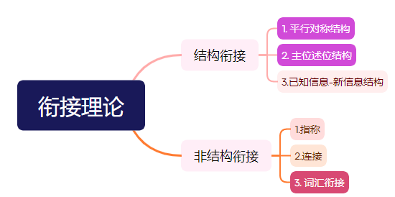
新高考II卷
04 衔接理论 定答案
A. Visit during off-peak times.
C. Travel for you and no one else.
D. Can overtourism be avoided then?
E. You can still find relatively undiscovered places.
F. You'll find yourself virtually alone, or close to it.
G. Consider giving back to the communities you're visiting.
●Choose mindfully. Overvisited destinations are that way for a reason: they're special. With so many online posts featuring the same places, it's easy to feel like you're missing out. Go somewhere only when the landscape, culture or food deeply draws you. 37
●Get creative. The best way to ease pressure on over-touristed destinations is to go somewhere else. Though overtourism is described as a problem affecting the entire world, it's actually concentrated to a small number of extremely popular spots. That means you have tons of less-visited options to choose from. 38 Why not try a regional alternative or check out a popular destination's lesser-known sights?
● 39 Minimize impact and maximize experience by skipping major holidays or rush hour. You'll compete with fewer tourists, save money, experience a different side of a popular place, and boost the economy when tourism is traditionally slower.
C
E
A
39 结构一致，同义复现
37 only when...draws 作为述位发展出新的主位 travel for you
37 词汇复现：you 人称一致
38 词汇复现：同义词复现

Slide 20
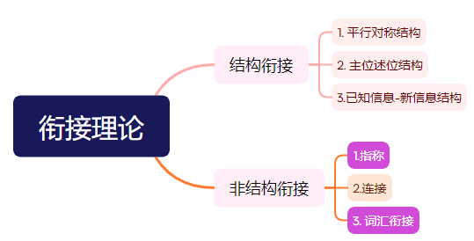
新高考II卷
04 衔接理论 定答案
Visiting a place that others call home is a privilege(荣幸). Do your part to preserve what makes a destination special in the first place. 40 You may be amazed how much closer you'll feel to the people there.
D. Can overtourism be avoided then?
F. You'll find yourself virtually alone, or close to it.
G. Consider giving back to the communities you're visiting.
G
there 指代community
preserve和give back to 同义复现

Slide 21
新高考II卷
05 代入复查 有保障
Overtourism Is For Real: How Can You Help?
Travel promotes understanding, expands our minds, makes us better people, and boosts local economies and communities, but the rapid growth of travel has led to overtourism in certain regions and destinations. 36 __________________________________Certainly not. The loss of what travel offers would be unacceptable in today's world. Here are some tips on making wise decisions to minimize pressure on the places we visit and improve our experience.
●Choose mindfully. Overvisited destinations are that way for a reason: they're special. With so many online posts featuring the same places, it's easy to feel like you're missing out. Go somewhere only when the landscape, culture or food deeply draws you. 37_______________________________________________
●Get creative. The best way to ease pressure on over-touristed destinations is to go somewhere else. Though overtourism is described as a problem affecting the entire world, it's actually concentrated to a small number of extremely popular spots. That means you have tons of less-visited options to choose from. 38___________________________________________________ Why not try a regional alternative or check out a popular destination's lesser-known sights?
● 39______________________________________________ Minimize impact and maximize experience by skipping major holidays or rush hour. You'll compete with fewer tourists, save money, experience a different side of a popular place, and boost the economy when tourism is traditionally slower.
Visiting a place that others call home is a privilege(荣幸). Do your part to preserve what makes a destination special in the first place. 40 _____________________________________________________You may be amazed how much closer you'll feel to the people there.
B. So, should we stop traveling?
C. Travel for you and no one else.
E. You can still find relatively undiscovered places.
A. Visit during off-peak times.
G. Consider giving back to the communities you're visiting.

Slide 22
全国甲卷
01 略读文章 抓大意
What is moderation(适度)? Basically，it means eating only as much food as your body needs. You should feel satisfied at the end of a meal, but not too full. ______36______ But it doesn't mean saying goodbye to the foods you love.
Take your time. It's important to slow down and think about food as something nutritious rather than just something to eat in between meetings._____37_____It actually takes a few minutes for your brain to tell your body that it has had enough food, so eat slowly and stop eating before you feel full.
Eat with others whenever possible. Eating alone, specially in front of the TV or computer, often leads to mindless overeating. And be careful about the foods you keep at hand. It's more challenging to eat in moderation if you have unhealthy snacks at the ready, like cookies._____38______
Control emotional(情绪的)eating._____39______Many of us also turn to food to deal with unpleasant emotions such as sadness, loneliness, or boredom. But by learning healthier ways to manage emotions, you can regain control over the food you eat and your feelings.
______40______ A healthy breakfast can start your metabolism (新陈代谢)，while eating small， healthy meals keeps your energy up all day. Avoid eating late at night. Try to eat dinner earlier and fast for 14 -16 hours until breakfast the next morning. Studies suggest that eating only when you're most active and giving your digestive system a long break each day may help to regulate weight.
语篇类型：
主题语境：
主旨大意：
说明文
人与自我—健康的生活方式
讲述适度饮食的概念以及相关建议

Slide 23
全国甲卷
02 通读段首 析结构
总
What is moderation(适度)? Basically，it means eating only as much food as your body needs. You should feel satisfied at the end of a meal, but not too full. ______36______ But it doesn't mean saying goodbye to the foods you love.
Take your time. It's important to slow down and think about food as something nutritious rather than just something to eat in between meetings._____37_____It actually takes a few minutes for your brain to tell your body that it has had enough food, so eat slowly and stop eating before you feel full.
Eat with others whenever possible. Eating alone, specially in front of the TV or computer, often leads to mindless overeating. And be careful about the foods you keep at hand. It's more challenging to eat in moderation if you have unhealthy snacks at the ready, like cookies._____38______
Control emotional(情绪的)eating._____39______Many of us also turn to food to deal with unpleasant emotions such as sadness, loneliness, or boredom. But by learning healthier ways to manage emotions, you can regain control over the food you eat and your feelings.
______40______ A healthy breakfast can start your metabolism (新陈代谢)，while eating small， healthy meals keeps your energy up all day. Avoid eating late at night. Try to eat dinner earlier and fast for 14 -16 hours until breakfast the next morning. Studies suggest that eating only when you're most active and giving your digestive system a long break each day may help to regulate weight.
分

Slide 24
全国甲卷
03 快速扫读 七选项
A. Eat properly throughout the day.
B. We don't always eat just to satisfy hunger.
C. Don't swallow a meal on the way to work.
D. Most of us need to double the amount we eat.
E. Instead, surround yourself with healthy choices.
F. For many of us,moderation means eating less than we do now.
G. That won't lead to cheating or giving up on your new eating plan.

Slide 25
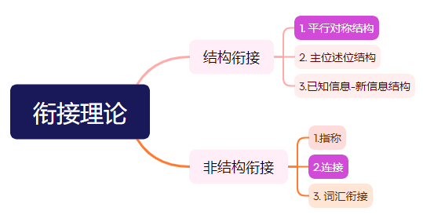
全国甲卷
04 衔接理论定答案
A. Eat properly throughout the day.
B. We don't always eat just to satisfy hunger.
C. Don't swallow a meal on the way to work.
D. Most of us need to double the amount we eat.
E. Instead, surround yourself with healthy choices.
F. For many of us,moderation means eating less than we do now.
G. That won't lead to cheating or giving up on your new eating plan.
What is moderation(适度)? Basically，it means eating only as much food as your body needs. You should feel satisfied at the end of a meal, but not too full. ______36______ But it doesn't mean saying goodbye to the foods you love.
F
句式一致
but前后意思转折

Slide 26
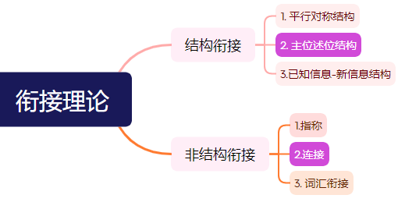
全国甲卷
04 衔接理论定答案
A. Eat properly throughout the day.
B. We don't always eat just to satisfy hunger.
C. Don't swallow a meal on the way to work.
D. Most of us need to double the amount we eat.
E. Instead, surround yourself with healthy choices.
G. That won't lead to cheating or giving up on your new eating plan.
Take your time. It's important to slow down and think about food as something nutritious rather than just something to eat in between meetings._____37_____It actually takes a few minutes for your brain to tell your body that it has had enough food, so eat slowly and stop eating before you feel full.
Eat with others whenever possible. Eating alone, specially in front of the TV or computer, often leads to mindless overeating. And be careful about the foods you keep at hand. It's more challenging to eat in moderation if you have unhealthy snacks at the ready, like cookies._____38______
C
E
后面的句子围绕主位take your time 展开
instead前后含义相反

Slide 27
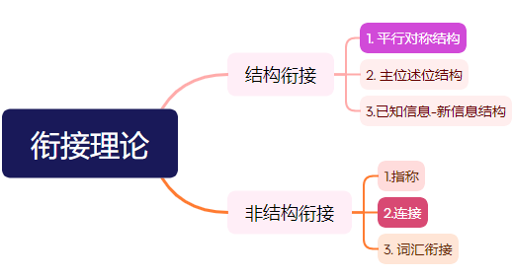
全国甲卷
04 衔接理论定答案
A. Eat properly throughout the day.
B. We don't always eat just to satisfy hunger.
D. Most of us need to double the amount we eat.
G. That won't lead to cheating or giving up on your new eating plan.
B
Control emotional(情绪的)eating._____39______Many of us also turn to food to deal with unpleasant emotions such as sadness, loneliness, or boredom. But by learning healthier ways to manage emotions, you can regain control over the food you eat and your feelings.
______40______ A healthy breakfast can start your metabolism (新陈代谢)，while eating small， healthy meals keeps your energy up all day. Avoid eating late at night. Try to eat dinner earlier and fast for 14 -16 hours until breakfast the next morning. Studies suggest that eating only when you're most active and giving your digestive system a long break each day may help to regulate weight.
A
由also看出39与后面的句子为平行结构，过度饮食的原因
结构一致
but转折含义

Slide 28
05 代入复查 有保障
全国甲卷
What is moderation(适度)? Basically，it means eating only as much food as your body needs. You should feel satisfied at the end of a meal, but not too full. ______36__________________________________ But it doesn't mean saying goodbye to the foods you love.
Take your time. It's important to slow down and think about food as something nutritious rather than just something to eat in between meetings._____37_________________________________________________It actually takes a few minutes for your brain to tell your body that it has had enough food, so eat slowly and stop eating before you feel full.
Eat with others whenever possible. Eating alone, specially in front of the TV or computer, often leads to mindless overeating. And be careful about the foods you keep at hand. It's more challenging to eat in moderation if you have unhealthy snacks at the ready, like cookies._____38___________________________________________________________
Control emotional(情绪的)eating._____39_____________________________________________Many of us also turn to food to deal with unpleasant emotions such as sadness, loneliness, or boredom. But by learning healthier ways to manage emotions, you can regain control over the food you eat and your feelings.
______40__________________________________ A healthy breakfast can start your metabolism (新陈代谢)，while eating small， healthy meals keeps your energy up all day. Avoid eating late at night. Try to eat dinner earlier and fast for 14 -16 hours until breakfast the next morning. Studies suggest that eating only when you're most active and giving your digestive system a long break each day may help to regulate weight.
F. For many of us,moderation means eating less than we do now.
C. Don't swallow a meal on the way to work.
E. Instead, surround yourself with healthy choices.
B. We don't always eat just to satisfy hunger.
A. Eat properly throughout the day.

Slide 29
谢
谢
读

