Slide 1


感恩遇见，相互成就，本课件资料仅供您个人参考、教学使用，严禁自行在网络传播，违者依知识产权法追究法律责任。
更多教学资源请关注
公众号：溯恩英语
知识产权声明

Slide 2


2024
杭州市高二质量检测应用文
Body Language
课堂活动设计

Slide 3

2024年6杭州市高二质检应用文
假定你是李华，你校外教Ian分配给你一个任务，以 Body Language 为主题设计一项课堂活动。请你给他写一封电子邮件，介绍你的设计内容，包括: 1、活动方式 2。设计意图
Dear Ian，
I can't wait to share with you my idea for the class activity on the topic of “Body Language”.
选择得体功能语句
审体裁，确定应用文格式
01
03
建议信功能语句
邮件书信类：
建议信 推荐信
建议信
审人称时态，
关注语气得体
审要点，关注五育主题表达
02
04
时态：一般现在时，一般将来时；
语气：对上级,真诚谦虚
智育：
1、活动方式 2。设计意图

Slide 4
建议信，推荐信
首段：目的 ：总起（已给）I can‘t wait to share with you my idea for the class activity on the topic of “Body Language”.
尾段：建议信功能语句：下级对上级的建议语气
非常感谢您考虑我关于课堂活动的建议。我渴望看到它们能给学生的学习体验和整体课堂氛围带来积极的影响。（定语从句）
Thank you very much for considering my suggestions for the class activities. I am eager to see the positive impact they could bring to the students' learning experience and the overall classroom atmosphere.
我衷心希望我关于课堂活动的提议对您的规划和组织有所帮助。您的领导和决策肯定会带来一个更具吸引力和高效的课堂。
I sincerely hope that my proposals for the class activities will be helpful to you in planning and organizing. Your leadership and decision-making will surely lead to a more engaging and productive classroom.

Slide 5
建议信，推荐信
尾段：建议信功能语句：下级对上级的建议语气
感谢您给我机会分享我对课堂活动的想法。我相信在您的智慧和指导下，以及这些建议的实施，课堂将变得更有活力，对所有人都更有益。
Thank you for giving me the opportunity to share my thoughts on the class activities. I am confident that with your wisdom and guidance, and the implementation of these suggestions, the class will become more dynamic and beneficial for all.
感谢您花时间关注我关于课堂活动的建议。我相信它们有可能提高教育质量和学生的参与度。期待看到课堂上的积极变化。
I appreciate your time and attention to my suggestions regarding the class activities. I believe that they have the potential to enhance the quality of education and student participation. Looking forward to seeing positive changes in the classroom.

Slide 6


中间段：细节拓展 -- 课堂活动方式
A successful English classroom activity should have the following characteristics:
Clear Objectives: The activity should have well-defined and achievable goals that are relevant to the learning outcomes of the course.
Engaging and Interactive: It should capture students' interest and encourage active participation. Students should have the opportunity to interact with each other and the teacher.
Cultural Awareness: Incorporating elements of different cultures can enhance students' understanding and appreciation of the diversity in the English language.
Time Management: The activity should be appropriately timed to ensure it is completed within the allocated class period without rushing or leaving too much spare time.
Fun and Enjoyable: Making the activity enjoyable helps create a positive learning environment and motivates students to learn.

Slide 7
中间段：细节拓展
活动方式
Body language charades
01
Educational Entertaining Engaging
Interactive
Enriching
Motivating Challenging
Cooperative
Fun-filled
Skill-developing
Knowledge-enhancing Creativity-boosting
Confidence-building Teamwork-fostering
Guess the emotion
Guess the sport
Act and guess the job
02
English classroom games suitable for the theme of "Body Language" ：
03
Imitate the animal
04
Body language relay
05
Pantomime

Slide 8
中间段：细节拓展
活动方式
Best body language interpretation competition
01
Competitive Motivating
Challenging
Skill-enhancing Knowledge-boosting Confidence-building Focused Goal-oriented Productive
Engaging
Thought-provoking
Performance-driven
Fastest body language response race
02
English classroom competitions on the theme of "Body Language"：
03
Accurate body language communication challenge
04
Body language vocabulary spelling bee
05
Body language emotion recognition championship

Slide 9
中间段：细节拓展
活动方式
Research on cultural differences in body language
01
Study of the impact of body language on communication effectiveness
Insightful
Enriching
Informative
Thoughtful
Analytical
Exploratory
Intellectual
Inquisitive
Investigative
Knowledgeable Progressive
02
English classroom research activities on the theme of "Body Language"：
03
Investigation of body language in different professional fields
04
Analysis of body language in public speaking
05
Research on the evolution of body language over time

Slide 10
中间段：
细节拓展
设计意图
To enhance students' understanding of non-verbal communication. Enriches students' language learning experience.
01
To improve students' ability to interpret and use body language accurately. Promotes students' critical thinking and research skills.
02
03
Investigation of body language in different professional fields. Improves students' confidence and performance in real-life communication.
活动意图
活动方式和活动意图要匹配
04
To cultivate students' awareness of cultural differences in body language.
05
To help students develop better communication skills

Slide 11
中间段：细节拓展
我设计的活动方式是进行三轮游戏：“猜情绪”、“猜运动”和“表演并猜职业”（总起 ）
The way I've designed the activity is to have three rounds of games: "Guess the emotion", "Guess the sport", and "Act and guess the job".
对于“猜情绪”，一些学生会通过肢体语言展示不同的情绪，其他人则要进行猜测。在“猜运动”中，一名学生会用肢体语言展示某项运动的动作，其余人要努力猜出来。“表演并猜职业”意味着学生要模仿与某个职业相关的动作，其他人进行猜测。（平行结构介绍活动）
For "Guess the emotion", some students will show different emotions using body language, and others have to guess. In "Guess the sport", one student will demonstrate the movements of a certain sport with body language, and the rest will try to figure it out. "Act and guess the job" means students have to imitate the actions related to a certain job, and the others make guesses.

Slide 12
中间段：细节拓展
首先，展示一些公开演讲的视频片段。然后，学生们将被分成小组，观察并分析视频中演讲者的肢体语言。他们需要讨论并记下关键的肢体语言线索及其可能的含义。（时间顺序设计活动）
First，show some video clips of public speeches. Then, students will be divided into groups to observe and analyze the body language of the speakers in the videos. They need to discuss and note down the key body language cues and their possible meanings.
设计意图有两个方面。一方面，它帮助学生理解肢体语言在公开演讲中的重要性。他们能够了解恰当的肢体语言如何增强交流的效果以及给观众留下的印象。另一方面，它提高了学生的观察和分析能力，以及他们用英语表达自己想法和观点的能力。（层次分明）
The design intention has two parts. First of all, it helps students know how important body language is in public speaking. They can learn that proper body language can make communication more effective and leave a better impression on the audience. Secondly, it makes students better at observing and analyzing things, and also helps them express their thoughts and opinions in English.

Slide 13
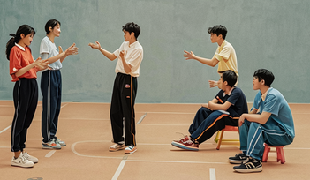
下水作文
Dear Ian，
I can't wait to share with you my idea for the class activity on the topic of “Body Language”.
The way I've designed the activity is to have three rounds of games: "Guess the emotion", "Guess the sport", and "Act and guess the job". For "Guess the emotion", some students will show different emotions using body language, and others have to guess. In "Guess the sport", one student will demonstrate the movements of a certain sport with body language, and the rest will try to figure it out. "Act and guess the job" means students have to imitate the actions related to a certain job, and the others make guesses. These three rounds of games are supposed to help students be better at interpreting and using body language precisely and develop better communication skills in real life.
Thank you so much for taking my suggestions into consideration. I truly hope that they can have a positive effect on the students' learning experience and the overall atmosphere in the classroom.

Slide 14
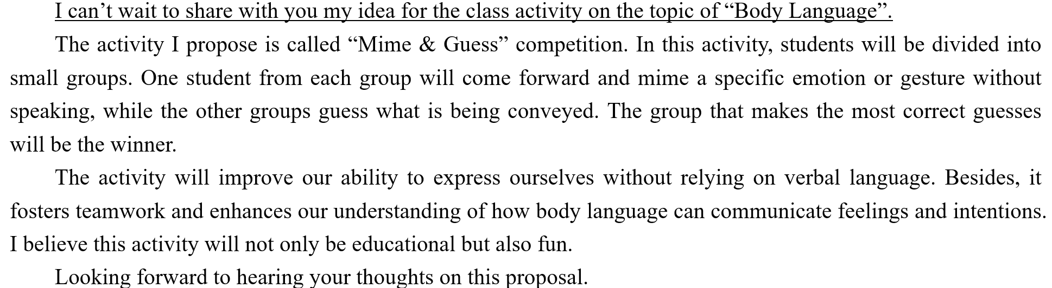
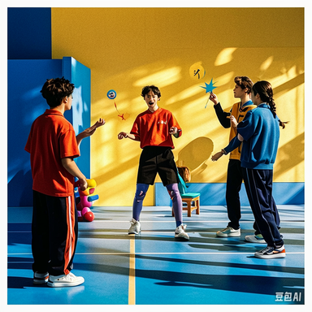
参考范文

Slide 15
高三加油！

