Slide 1


感恩遇见，相互成就，本课件资料仅供您个人参考、教学使用，严禁自行在网络传播，违者依知识产权法追究法律责任。
更多教学资源请关注
公众号：溯恩英语
知识产权声明

Slide 2

The World
June 1st-15th, 2024

Slide 3
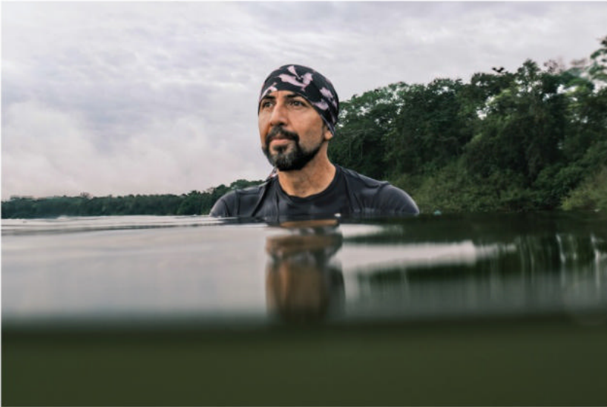
1. Explorer of the Year: Fernando Trujillo
国家地理年度探险家

Slide 4
Text Completion
National Geographic (June 2024 P12)
Colombian marine biologist Fernando Trujillo has been named the 2024 Rolex National Geographic Explorer of the Year. This award _______ (give) by the National Geographic Society to an intrepid Explorer who highlights vital ______ (issue) facing our planet and inspires others to act. “His work in South America enhances protections for endangered wildlife and supports __________ (sustain) practices for the betterment of local communities,” says Jill Tiefenthaler, CEO of the Society.
Trujillo has dedicated his life to ______ (save) the Amazon’s river dolphins, and he was given another name by the Tikuna Indigenous people who live along the Amazon River in Colombia: omacha. At first he didn’t understand why. But after Trujillo figured out the reason, he realized the moniker was so apt he adopted ___ for his conservation organization. Omacha, in Tikuna culture, is the name of a dolphin that can transform ____ a man.
“For me, it’s a kind of magic ______ (find) dolphins in the forest,” he says. But these freshwater mammals are threatened by fisheries, mining, and deforestation. Trujillo, who’s part of the National Geographic and Rolex Perpetual Planet Amazon Expedition—___ two-year scientific exploration of the river basin—collaborates with residents to develop dolphin-friendly practices that won’t interfere _____ subsistence fishing. He’s also helped create policies such as the 2023 Global Declaration for River Dolphins, ______ aims to preserve cetaceans in rivers around the globe.
is given
issues
sustainable
saving
it
into
to find
a
with
which

Slide 5
Vocabulary
1. intrepid: (formal, often humorous) very brave; not afraid of danger or difficulties 勇敢的；无畏的
Even just a decade ago, Antarctica was reserved for the intrepid.
就在十年前，南极洲还是勇敢者的领地。
2. subsistence: the state of having just enough money or food to stay alive 勉强维持生活
The standard of living today is on the edge of subsistence.
现在的生活水平几乎快要无法维持生计。
Translation
他的梦想是成为一名勇敢的太空旅行者。
His dream is to become an intrepid space traveller.
Translation
许多家庭难以度日。
Many families are living below the level of subsistence.

Slide 6
Translation
Colombian marine biologist Fernando Trujillo has been named the 2024 Rolex National Geographic Explorer of the Year. This award is given by the National Geographic Society to an intrepid Explorer who highlights vital issues facing our planet and inspires others to act.
哥伦比亚海洋生物学家费尔南多·特鲁希略被评为2024年劳力士国家地理年度探险家。这个奖项是由国家地理学会颁发给勇敢无畏的探险家，他们指出我们星球面临的重要问题，并激励其他人采取行动。
Trujillo, who’s part of the National Geographic and Rolex Perpetual Planet Amazon Expedition—a two-year scientific exploration of the river basin—collaborates with residents to develop dolphin-friendly practices that won’t interfere with subsistence fishing. He’s also helped create policies such as the 2023 Global Declaration for River Dolphins, which aims to preserve cetaceans in rivers around the globe.
特鲁希略是国家地理和劳力士永久地球亚马逊探险队的一员，这是一个为期两年的亚马逊流域科学探险，他与当地居民合作，发展对海豚友好的做法，而不会干扰生计渔业。他还帮助制定了诸如《2023年全球河豚宣言》等政策，该宣言旨在保护全球河流中的鲸目动物。

Slide 7
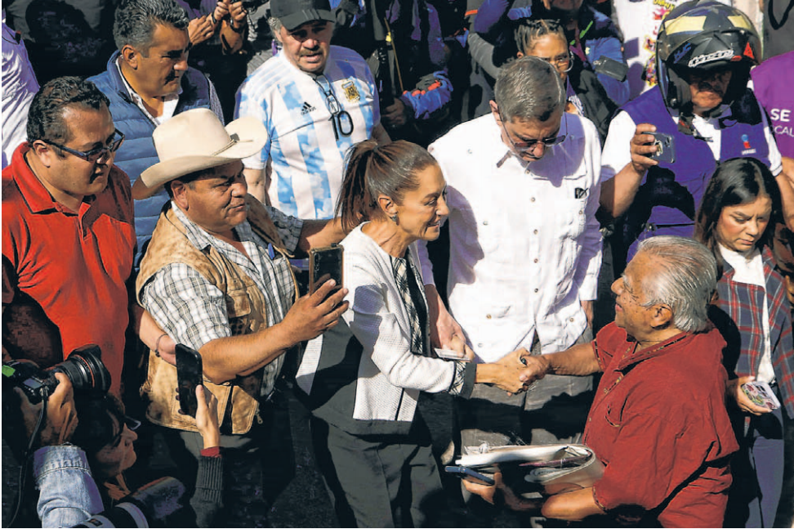
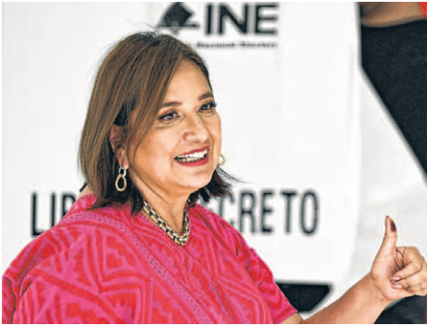
2. Mexico to Elect First Female President
墨西哥将迎来首位女总统

Slide 8
Text Completion
The Wall Street Journal (June 3, 2024 A6)
MEXICO CITY—Mexicans went to the polls on Sunday as two women face off in an election that will result in the country ______ (have) its first ever female head of state.
Close to 100 million Mexicans are eligible to cast ballots amid a public-security crisis and ________ (politics) polarization. The vote ______ (see) as a referendum on the government of nationalist President Andrés Manuel López Obrador, who has maintained approval ratings above 60% throughout his term. Mexican law doesn’t allow for re-election.
Voters are also electing a new Congress, nine state governors and thousands of state and municipal officials.
Polls give Claudia Sheinbaum, ___ former mayor of Mexico City and the candidate of the ruling Movement of National Regeneration—_______ (know) as Morena—around a 20-point lead over her _______ (close) rival. The ruling party was founded by López Obrador.
Sheinbaum, a 61-year-old energy engineer ______ Jewish grandparents emigrated to Mexico fleeing persecution in Eastern Europe before World War II, is widely seen ___ the president’s protégée who will continue his popular social-welfare programs. Sheinbaum says she wants the state guiding the economy for the benefit of the poor and controlling the energy industry.
Sheinbaum _____ (lead) Xóchitl Gálvez, the candidate of a coalition of three opposition parties. Gálvez is a senator with indigenous roots who rose from poverty to become a successful businesswoman. Another candidate, Jorge Álvarez Máynez from the center-left Citizen Movement, is a distant _____ (three) in the polls.
having
political
is seen
a
known
closest
whose
as
leads
third

Slide 9
Vocabulary
1. eligible: someone who is eligible to do something is qualified or able to do it, for example because they are old enought. 有资格的；符合条件的；有能力的
Almost half the population are eligible to vote in today’s election.
大约有一半人有资格参加今天的选举投票。
2. coalition: a government formed by two or more political parties working together （两党或多党的）联合政府
It took 5 months for the coalition to publish an economic programme.
联合政府花了5个月的时间才公布了一项经济计划。
Translation
在你们国家多大才有资格投票选举呢？
When are you eligible to vote in your country?
Translation
从6月份起，该国一直由一个联合政府执掌政权。
Since June the country has had a coalition government.

Slide 10
Translation
Close to 100 million Mexicans are eligible to cast ballots amid a public-security crisis and political polarization. The vote is seen as a referendum on the government of nationalist President Andrés Manuel López Obrador, who has maintained approval ratings above 60% throughout his term. Mexican law doesn’t allow for re-election.
在公共安全危机和政治两极分化的情况下，近1亿墨西哥人有资格投票。这次投票被认为是对民族主义总统安德烈亚斯·曼努埃尔López奥夫拉多尔政府的公投，他在整个任期内的支持率一直保持在60%以上。墨西哥法律不允许连任。
Sheinbaum, a 61-year-old energy engineer whose Jewish grandparents emigrated to Mexico fleeing persecution in Eastern Europe before World War II, is widely seen as the president’s protégée who will continue his popular social-welfare programs. Sheinbaum says she wants the state guiding the economy for the benefit of the poor and controlling the energy industry.
现年61岁的希恩鲍姆是一名能源工程师，他的祖父母是犹太人，二战前为了逃离东欧的迫害而移民到墨西哥。外界普遍认为，希恩鲍姆是总统的得意门生，她将继续推行总统广受欢迎的社会福利计划。希恩鲍姆说，她希望国家为穷人的利益引导经济，并控制能源工业。

Slide 11
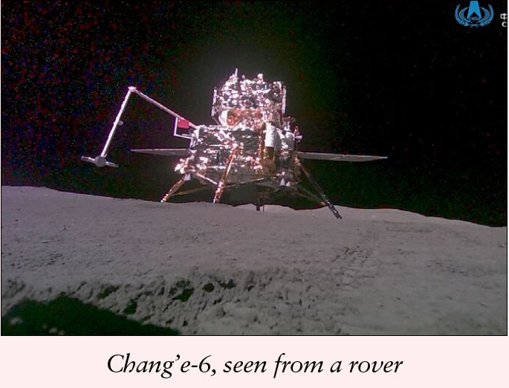
3. First rocks from far side of the moon
人类首次月背取壤

Slide 12
Text Completion
The Week (June 21, 2024 P21)
A Chinese lunar probe has extracted the first-ever rock samples from the far side of the moon and is flying _____ back to Earth. The unmanned Chang’e-6 craft ______ (land) on the lunar surface last week in the Apollo basin, a giant crater near the South Pole. It spent two days using a mechanical arm and drill ________ (gather) up 4.5 pounds of material, briefly raised a Chinese flag, then blasted off with the rocks ______ (seal) in a vacuum container. If all goes well, reports CNN.com, the probe will return to Earth on June 25. Scientists are excited about the mission because it is likely that the South Pole has ice—a potential game-changer for hopes of one day ___________ (establish) a permanent lunar base—and because the samples may contain some of the ______ (old) moon rocks ever collected. “The enigmatic lunar far side is so different from the lunar nearside in so many ways,” says James Head, a geologist at Brown University who has worked with the Chinese scientists leading the Chang’e mission. “_______ returned samples, lunar scientists can’t fully understand the moon as an entire planetary body.” ________ (remote) operating the craft on the far side of the moon—______ always faces away from Earth but is not always dark—was a challenge. Since radio waves can’t pass through the thick rock, scientists in China had to use __ relay satellite to ping signals to and from the spacecraft.
them
landed
to gather
sealed
establishing
oldest
Without
Remotely
which
a

Slide 13
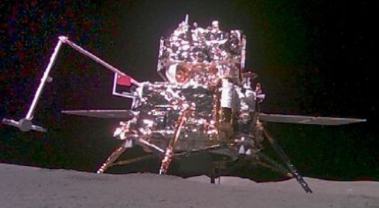
Reading Comprehension
Which of the following statements is correct?
A. Chang’e-6 is the first lunar probe to have gathered rock samples from the moon.
B. A permanent lunar base could be built because there is evidence of life on the moon.
C. The samples collected by Chang’e-6 are of critical importance in fully understanding the moon.
D. The remote control of Chang’e-6 doesn’t require a specifically designed communications technique.

Slide 14
Vocabulary
1. blast off: (of spacecraft) to leave the ground （宇宙飞船）发射升空
The space shuttle was scheduled to blast off at 04:38.
航天飞机计划在4点38分发射升空。
2. enigmatic: mysterious and difficult to understand
神秘的；费解的；令人困惑的
Haley studied her, an enigmatic smile on his face.
Haley打量着她，脸上带着神秘的笑容。
Translation
航天飞机按时发射升空。
The space shuttle blasted off on schedule.
Translation
这是我读过的最令人费解的书了。
This is the most enigmatic book I have ever read.

Slide 15
Translation
A Chinese lunar probe has extracted the first-ever rock samples from the far side of the moon and is flying them back to Earth. The unmanned Chang’e-6 craft landed on the lunar surface last week in the Apollo basin, a giant crater near the South Pole.
中国一架月球探测器首次从月球背面提取了岩石样本，并将其送回地球。无人驾驶的嫦娥六号探测器上周在月球表面阿波罗盆地着陆，阿波罗盆地是月球南极附近的一个巨大陨石坑。
If all goes well, reports CNN.com, the probe will return to Earth on June 25. Scientists are excited about the mission because it is likely that the South Pole has ice—a potential game-changer for hopes of one day establishing a permanent lunar base—and because the samples may contain some of the oldest moon rocks ever collected.
据CNN网站报道，如果一切顺利，探测器将于6月25日返回地球。科学家们对这次任务感到兴奋，因为月球南极很可能存在冰——这可能会加强有朝一日建立永久月球基地的希望——还因为样本中可能包含迄今为止收集到的最古老的月球岩石。

Slide 16

4. BBC News 06/04/2024

Slide 17

Dictation
Parliament in Spain has begun debating a ___________ amnesty law for nationalists from the Catalonia region. The bill presented by the socialist government seeks to ________ pending legal action for separatist activity, including an illegal and failed secession attempt in 2017. This law is expected to ___________ by a narrow majority.
A mayoral candidate in western Mexico has been murdered at his closing campaign event ahead of elections this weekend. Alfredo Cabrera was about to _______ his supporters at a final rally when he was shot in the head, prompting ______ in the crowd. Will Grant reports from Mexico.
The murder was ________ on mobile phone footage which has been posted online. In the video, a series of around 15 shots can be heard. And state _________ later announced that the gunman had been shot at the scene. Mr. Cabrera’s coalition condemned the killing on social media, urging the authorities to __________ the crime and apprehend those responsible. They also blamed the ruling party Morena for as they put it, not having made even the most minimal effort to _________ the safety of the candidates in this campaign. The killing came on the final day of what has been the most ______ election in modern history in Mexico.
controversial
withdraw
be approved
address
panic
captured
authorities
investigate
guarantee
violent

Slide 18
Vocabulary
1. footage: part of a film showing a particular event (影片中的)连续镜头，片段
They are planning to show exclusive footage from this summer’s festivals.
他们准备播放今年夏天节日庆典的独家镜头。
2. apprehend: to catch sb and arrest them 逮捕；扣押
Within hours, police apprehended the thief.
几个小时之内，警察就逮捕了小偷。
Translation
我看了一段登月的老影片。
I watched old film footage of the moon landing.
Translation
警察还未抓获谋杀她的凶手。
Police have not apprehended her killer.

Slide 19
Translation
A mayoral candidate in western Mexico has been murdered at his closing campaign event ahead of elections this weekend. Alfredo Cabrera was about to address his supporters at a final rally when he was shot in the head, prompting panic in the crowd.
墨西哥西部一名市长候选人在周末选举前的竞选活动中被谋杀。Alfredo Cabrera在最后一次集会上正要向支持者发表讲话时，头部中枪，引发了人群的恐慌。
The murder was captured on mobile phone footage which has been posted online. In the video, a series of around 15 shots can be heard. And state authorities later announced that the gunman had been shot at the scene. Mr. Cabrera’s coalition condemned the killing on social media, urging the authorities to investigate the crime and apprehend those responsible.
这起谋杀案被手机拍摄下来，并发布在网上。在视频中，可以听到大约15声枪响。州当局随后宣布，枪手已在现场被击中。Cabrera的联盟在社交媒体上谴责了这起杀戮事件，敦促当局调查这起罪行并逮捕肇事者。

Slide 20
5. BBC News 06/21/2024

Slide 21
Dictation
The US Secretary of State Antony Blinken says the government is continuing to ________ consignment of bombs from Israel over concerns about their possible use in __________ of Gaza. He said the issue remained under review. An hour before he spoke, the Israeli Prime Minister Benjamin Netanyahu claimed Mr. Blinken had privately assured him that Washington was working to _______ what he called ‘bottlenecks’ in arms deliveries.
A mysterious, _________ monolith has appeared in a remote mountain range in the Nevada desert in the United States, sparking speculation about how it got there. The Las Vegas police department said they _______ the three-metre tall rectangular structure over the weekend. They heartbeat on such a rescue mission near Gass Peak, a popular hiking area in the desert about an hour north of Las Vegas. Their pictures on social media showed the object in rugged terrain, _________________ a bright blue sky. The shining prism is similar to other metal installations that appeared around the world in 2020. All of the structures ___________ as quickly as they popped up.
One of baseball’s greatest ever players, Willie Mays has died. He was 93. Over 22 seasons, Mays became a huge star thanks to his batting power, _____________, and athleticism in the field. He made a spectacular _____ in the 1954 World Series that remains one of the sport’s best known plays. Mays was among the first generation of African Americans who were allowed to ________ in Major League Baseball. And that’s the latest BBC news.
withhold
urban areas
remove
reflective
spotted
standing tall against
disappeared
lightning speed
catch
compete

Slide 22
Vocabulary
1. consignment: a quantity of goods that are sent or delivered somewhere
装运的货物；运送物
A consignment of medicines has arrived here.
运送的一批药物已经到达这里。
2. installation: An installation is a place that contains equipment and machinery which are being used for a particular purpose. 设施
The building was turned into a secret military installation.
该建筑被改造成了一处秘密军事设施。
Translation
运送的第一批食品已经离开了伦敦。
The first consignment of food has already left London.
Translation
我们的房子里有供暖设施。
There is a heating installation in our house.

Slide 23
Translation
A mysterious, reflective monolith has appeared in a remote mountain range in the Nevada desert in the United States, sparking speculation about how it got there. The Las Vegas police department said they spotted the three-metre tall rectangular structure over the weekend.
在美国内华达沙漠的一个偏远山区出现了一块神秘的反光巨石，引发了人们对它是如何到达那里的猜测。拉斯维加斯警察局表示，他们在周末发现了这座三米高的矩形建筑。
One of baseball’s greatest ever players, Willie Mays has died. He was 93. Over 22 seasons, Mays became a huge star thanks to his batting power, lightning speed and athleticism in the field. He made a spectacular catch in the 1954 World Series that remains one of the sport’s best known plays.
棒球史上最伟大的球员之一威利·梅斯去世。享年93岁。在22个赛季里，梅斯凭借他的打击力、闪电般的速度和在球场上的运动能力成为了一名巨星。他在1954年的世界职业棒球大赛中做出了一次精彩无比的接球，这一接球至今仍是这项赛事中最著名的场景之一。

