Slide 1


感恩遇见，相互成就，本课件资料仅供您个人参考、教学使用，严禁自行在网络传播，违者依知识产权法追究法律责任。
更多教学资源请关注
公众号：溯恩英语
知识产权声明

Slide 2
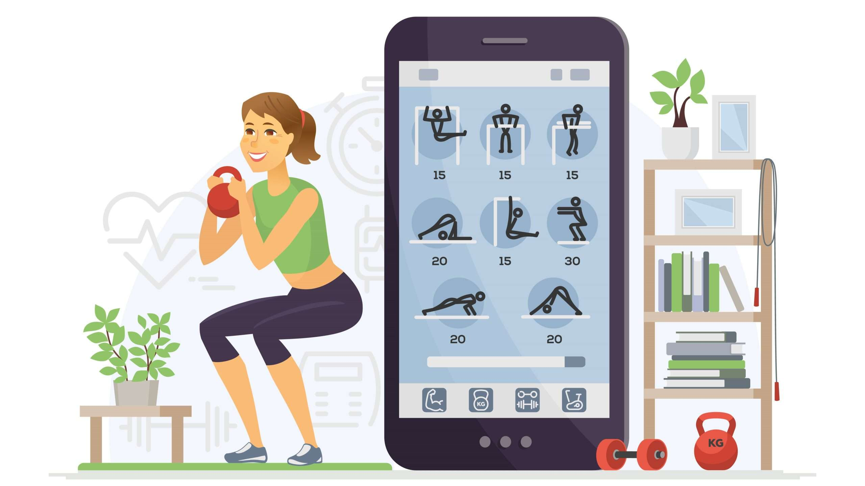
2024.7 绍兴市高二期末考试
应用文：
Using Fitness Apps to Monitor Health
浙江省春晖中学 宣晔霏

Slide 3
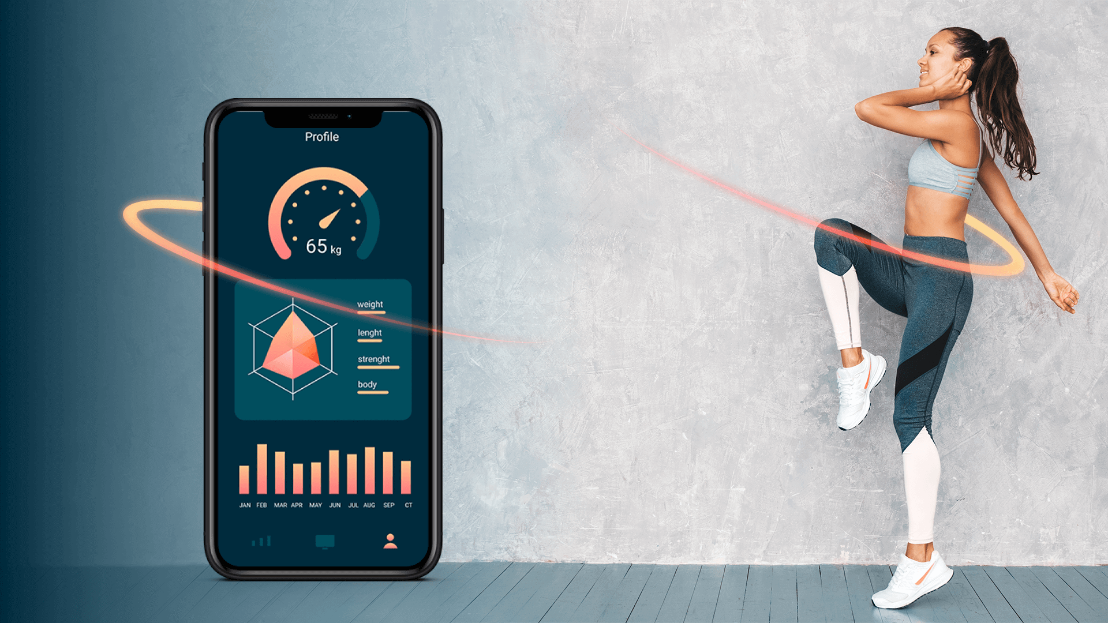
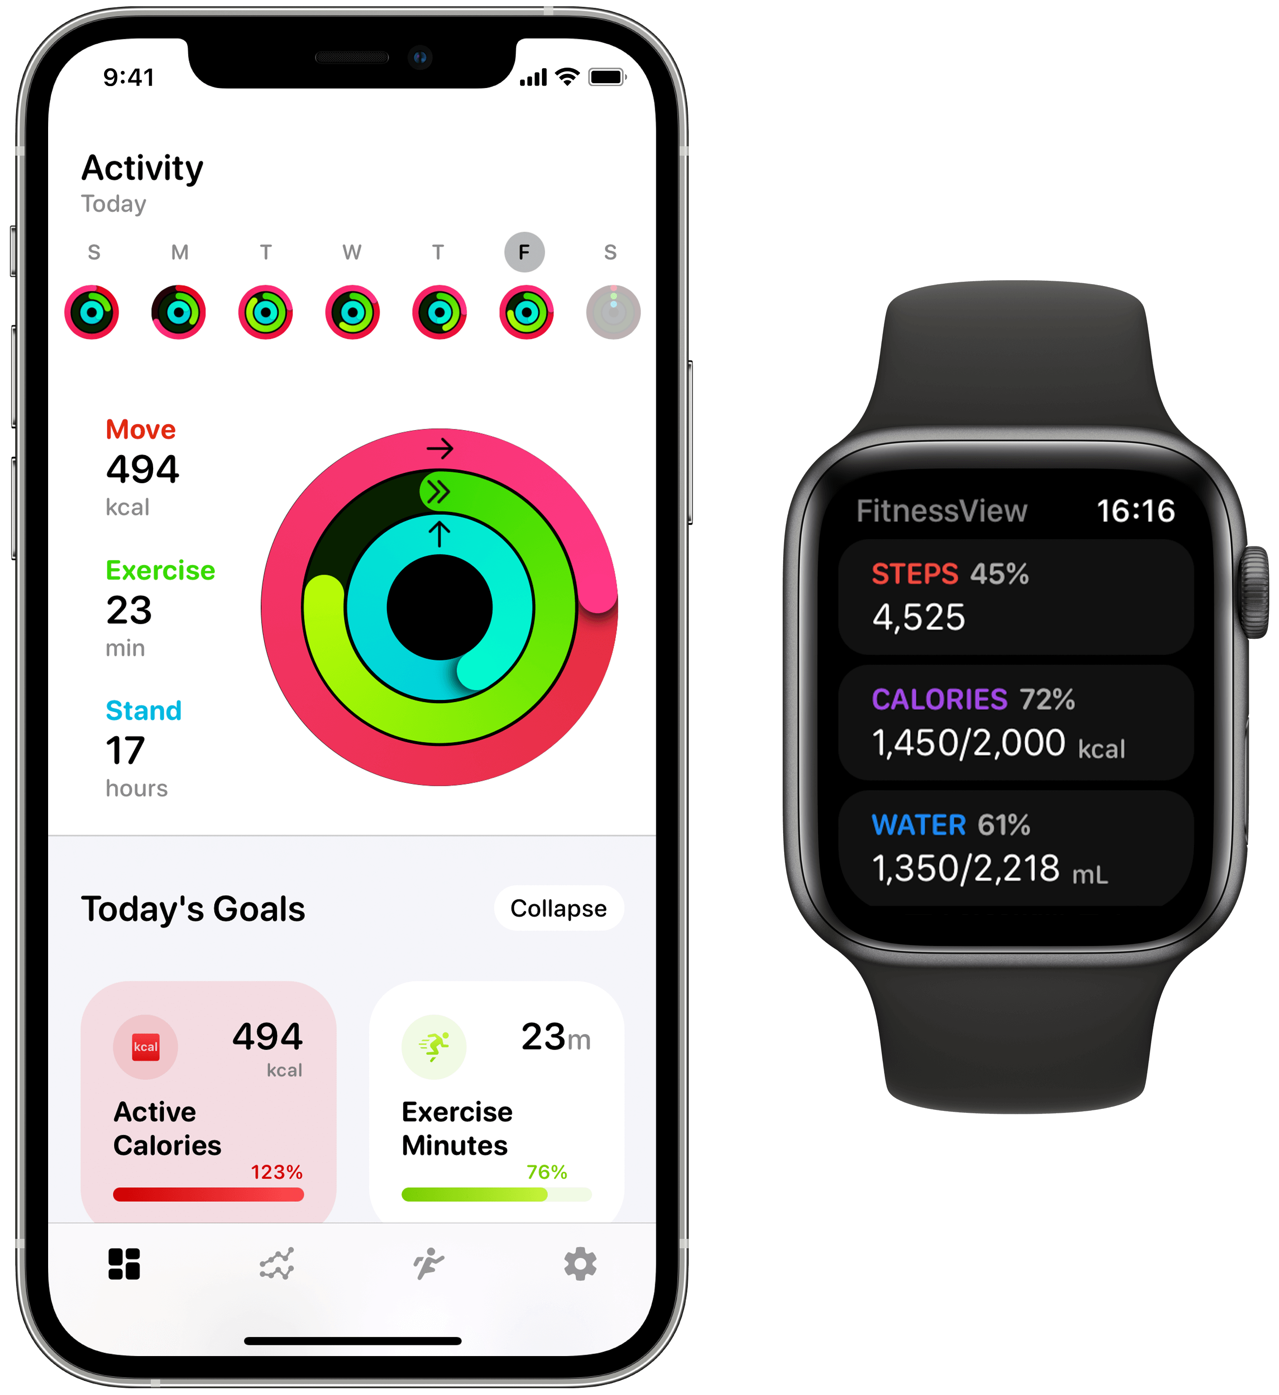
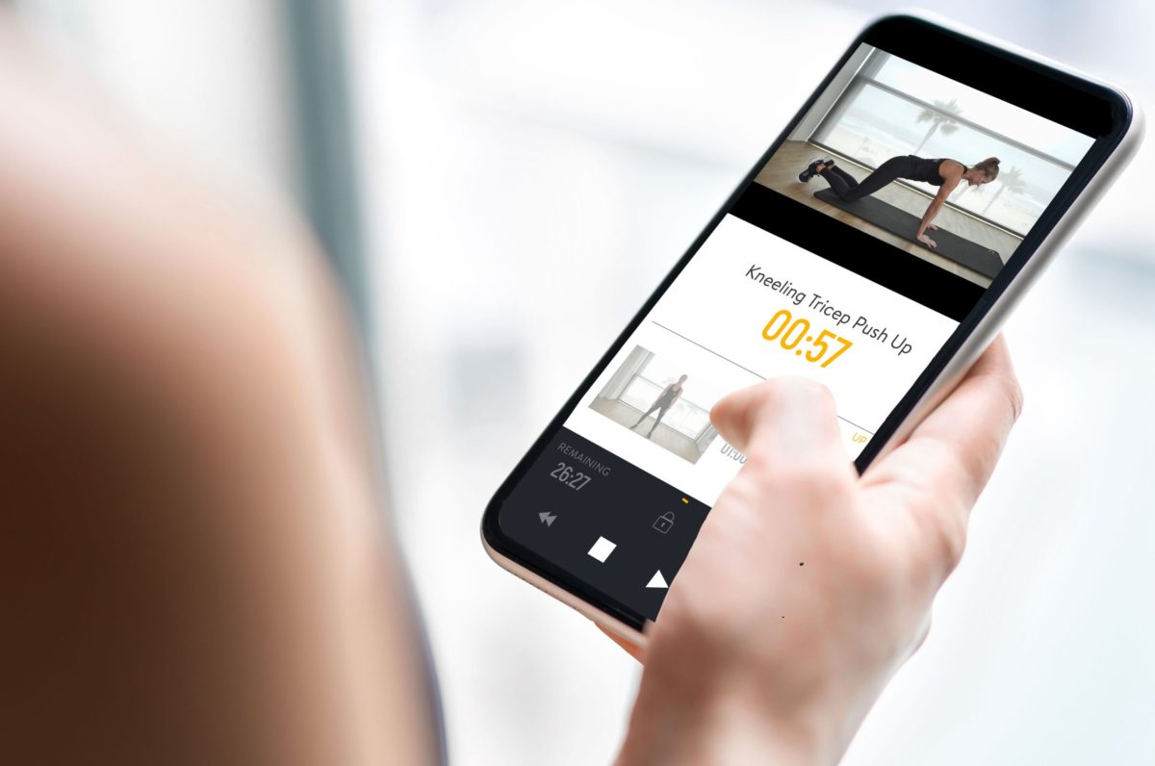
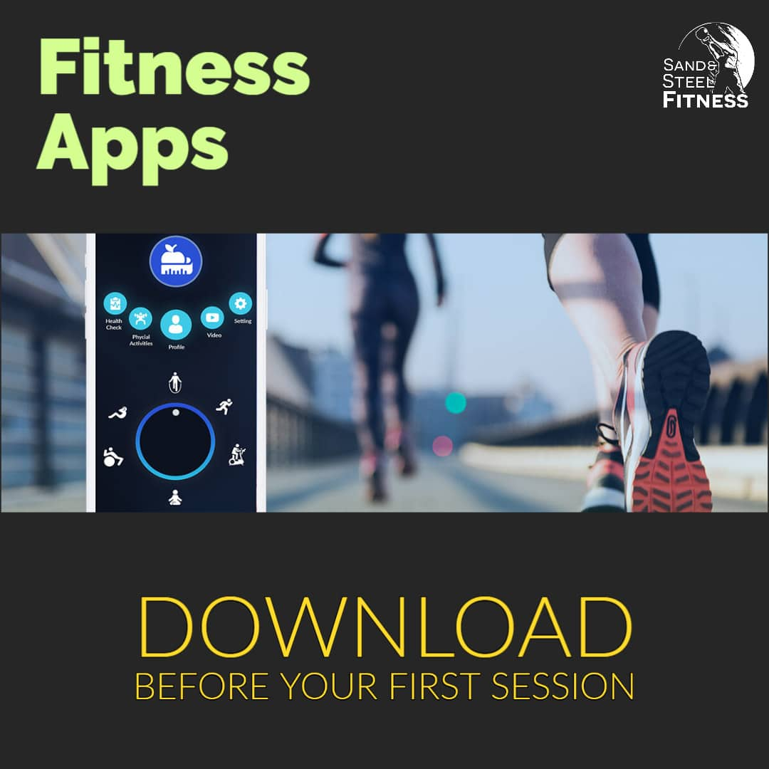
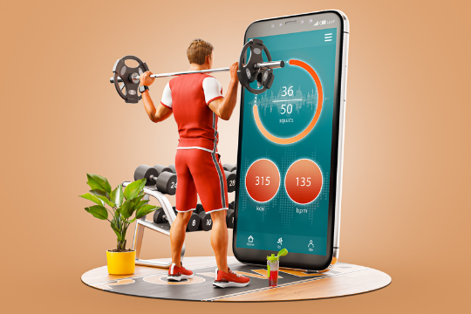
Fitness apps are easily downloadable on handheld devices like your phone, smartwatch, or tablet. While some are free and others require a subscription, most fitness apps were created to help provide consistency and discipline as you work toward your goals.

Slide 4
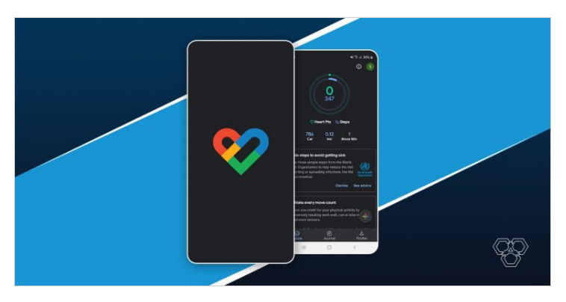
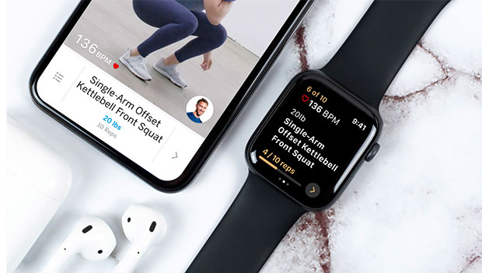
1. Google Fit
Once you set up your profile on the app, it will improvise 即兴创作suggestions for you. For example, it will start recording your move minutes and heart points. In addition, you can track your number of daily steps and check them against the recommended count for your age, gender, etc.
You can always view your daily, weekly, or monthly activity overview and plan workouts and walks/jogs accordingly. One of the intriguing吸引人的 features of Google fit includes its compatibility共存 with other health and fitness apps.

Slide 5
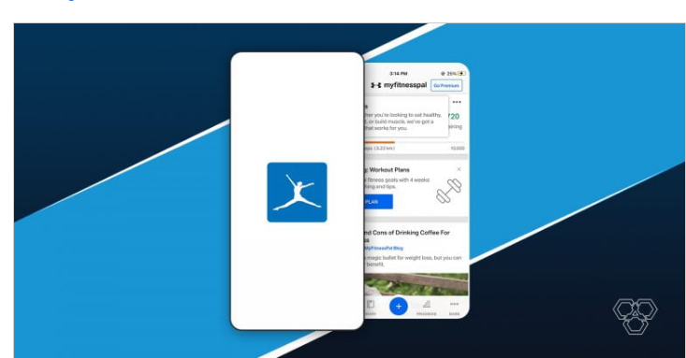
2. MyFitnessPal
One of the most downloaded fitness apps, My Fitness Pal, always comes through whenever you decide to take up a health goal. The app offers a variety of exercise sessions, including several cardio ones. Each workout session is tailored to meet your fitness goal accordingly.
One of the many reasons we prefer My Fitness Pal is its massive food database that rarely misses out on any food regarding the calorie count. The app is majorly known for its calorie-count feature. You can also set a weight goal and feed in the weight you aim for; the app will do the nutrition math for you.

Slide 6
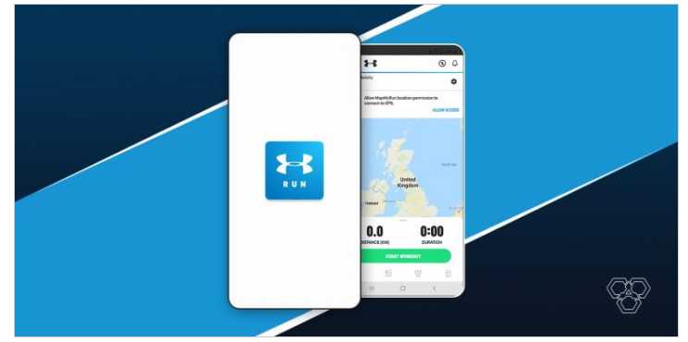
3. Map My Run
Map My Run is not your ordinary running app. Instead, the app lets you record a bunch of fitness activities such as running, cycling, workouts, and other forms of exercise. The app uses the GPS of your phone to track your miles. In addition, the app announces your speed while you run so that you can catch up or slow down if required.
One of this app’s most exciting features is its integration 融合with the Apple music app. You can play songs through the running app while you complete your running target.

Slide 7
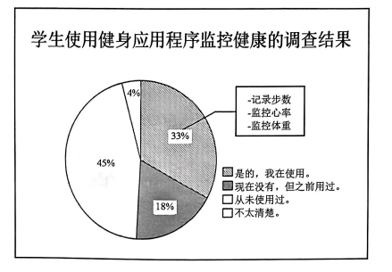
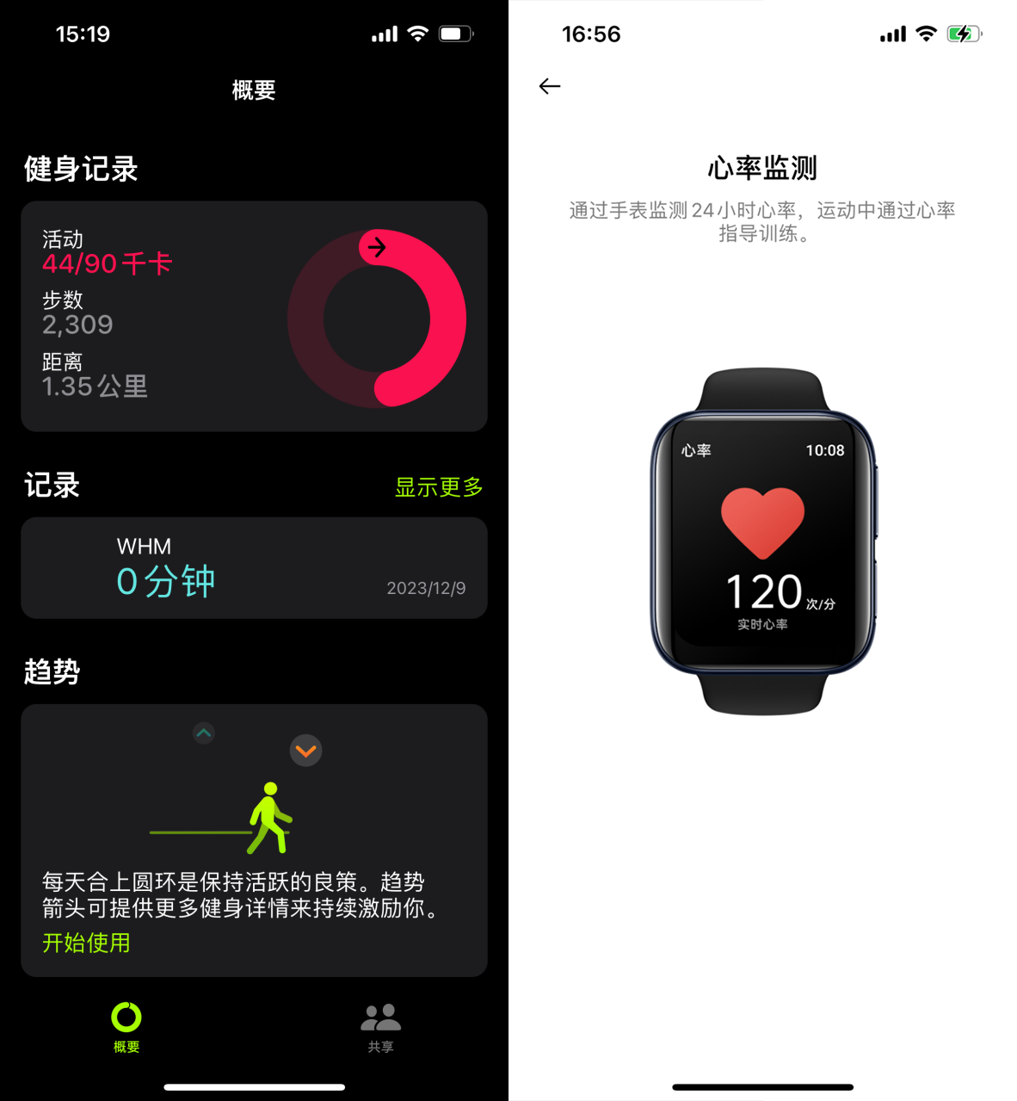
第四部分: 写作（共两节, 满分40分）
第一节: 应用文写作（满分15分）
学校英文报正在开展以“Using Fitness Apps to Monitor Health”为题的调查。请你根据下图调查数据写一篇短文投稿, 内容包括:
1. 描述数据;
2. 简单评论;
3. 提出建议。
人称：第三人称
时态：一般现在时为主
体裁：短文
语气：客观

Slide 8
Are these sentences appropriate?
●Exceedingly intrigued by the survey themed “using fitness apps to monitor health”, I participated in this wonderful project and here is my result.
●Nowadays, exercise is exceeding common among students, and there is a trend to use fitness apps to monitor, so I launch a research in our campus to gain the precise data.
● Having researched students’ use of fitness apps, I conducted the conclusion as follows.
● We have carried out a research on fitness apps, including whether students use it and how they use it. Here’s the result.
● Aiming to help the students have a glimpse of their health conditions, I appeal that all students should use fitness apps.

Slide 9
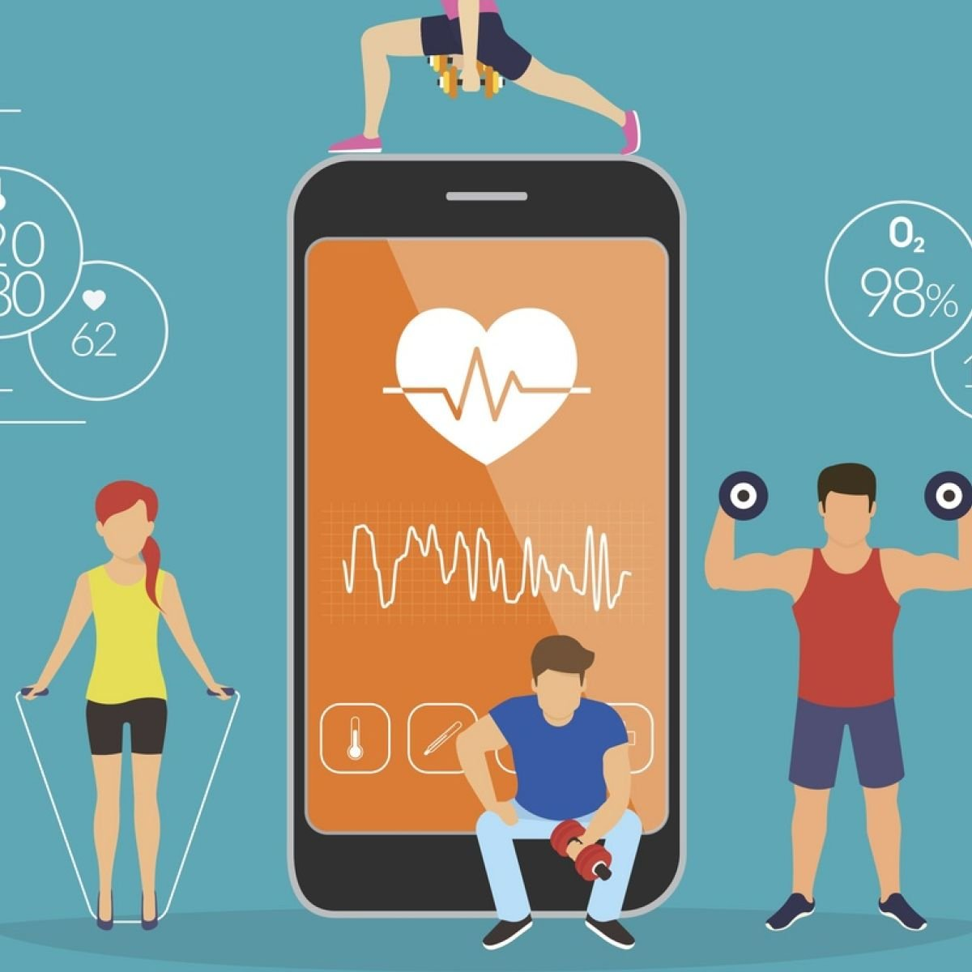
Paragraph 1: 背景介绍+总述
Recently the school English newspaper launched a research entitled “Using fitness apps to monitor health”, the results are as follows.
2. A survey on the usage of fitness apps to monitor health has been carried out by our school’s English newspaper, and here are the results.
3. As public awareness of healthy lifestyle has been aroused recently, dozens of fitness apps come into being. But do our students make full use of them?

Slide 10
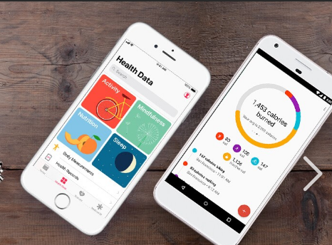
Paragraph 2: 图表描述+评论
What is a graph?
A graph is a visual representation of numerical data. Graphs provide a visual way to summarize complex data and to show the relationship between different variables or sets of data. Graphs are also an excellent way to demonstrate trends and relationships within the data.

Slide 11
Paragraph 2: 图表描述+评论
★Nearly half of the students have never been exposed to these apps, and just one third of students are still using it. It immensely indicated the lack of health of consciousness and there is an urgent need to increase the using rate.
★ The graph showcase that 33percent of students are using fitness apps and 18 percent used to utilize them. Contrary to them, 45 percent have never used them.

Slide 12
★ There are 33% of students say that they are using such apps now, which offer them a way to record their steps and monitor their heart rates and body weight. 18% of students used to use them but have given then up now. however, 45% don’t know have never used them and 4% even don’t know them clearly.
★ Only 51% of students have used fitness apps with 33% still use them now. it’s a pity that 45 percent have never tried them and the rest 4% even don’t know about them.
Paragraph 2: 图表描述+评论

Slide 13
Paragraph 2: 图表描述+评论
★The consequence is surprising because there is an increasing number of students who have focused on their health. At the same time, it is also not optimistic for the remaining students.
★The data reflects the rising awareness of physical health of contemporary teenagers, which renders us a glimpse into their body condition.
★ The result undoubtedly depressed us. Not only does it show us the lack of awareness of keeping fit, but renders us a glimpse of the challenges about advocating living a healthy life.

Slide 14
Paragraph 2: 图表描述+评论
★What is clear to declare that most of the students don’t use fitness apps and have little awareness to live a healthy life.
★ It is such a pity that we peers haven’t recognized the importance of physical health as a key element of happy and successful future.
★To sum up, the data shows that students who have positive and inactive attitude to these apps are nearly half to half, which may not be a good situation.

Slide 15
Paragraph 3: 建议+呼吁
★ Therefore, why not try it and gain a better self? Anyway, it is of great importance to keep a balanced and healthy life.
★ To cope with this situation, we are supposed to adopt smart fitness apps and stick to exercise routes and guidelines given by them. Hopefully, all of us can reach and healthier state by taking advantage of fitness apps.
★ It is high time that we students should put more concentration on our health through the fitness apps. Hopefully, those apps can contribute to facilitating their awareness of health and lead to a healthier life.
★As far as I am concerned, I suggest our fellow students to use the apps as a monitor to encourage us to quit bad habits and keep fit. Subsequently, we can embrace a brighter future with good health conditions.

Slide 16
One Possible Version:
Using Fitness Apps to Monitor Health
The findings of a recent survey reflect the varying attitudes towards fitness apps. While many are embracing the advanced technology, a substantial portion remains either indifferent or uninformed.
As is shown in the chart, one-third of our peers are using this high-tech approach to record their footsteps, monitor their heart rate and body weight. However, 18 percent have tried but no longer continue their use, while 45 percent have never explored these tools, and 4 percent are totally unaware of them, This significant portion of non-users highlights the existing digital divide nowadays, implying we haven't yet fully realized the benefits of these multi-functional tools.
For those who are not using the apps, I suggest probing into深入探究 their features to understand how they contribute to better health management. Just give it a try and live a healthier life!

Slide 17
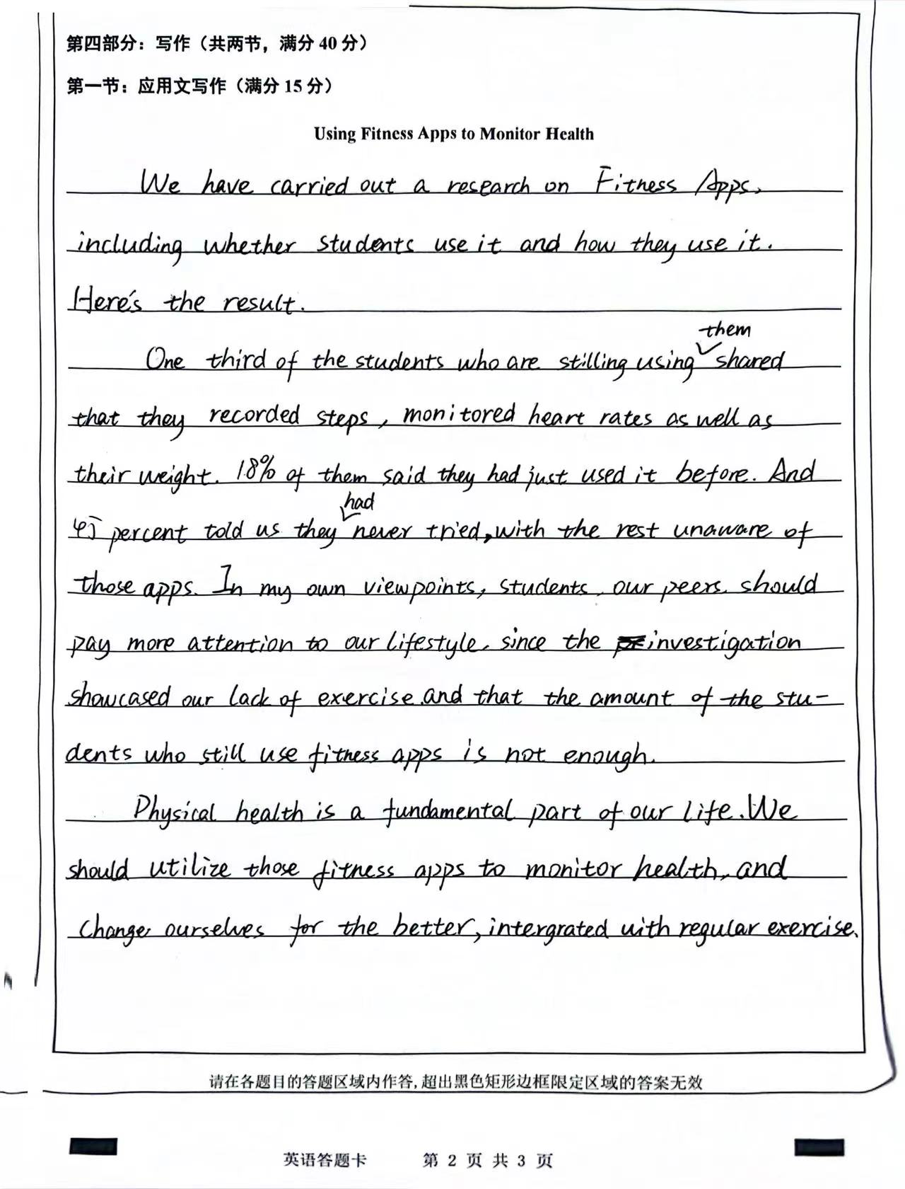
考场作文点评：
卷面整洁，结构清晰，字体可以大一些，字迹显得潦草。增加和涂改也较多
Para1: 开门见山，直截了当。
Para2：数据描写清楚，个人评价到位。
Para3：建议的语句不是非常清楚。

Slide 18
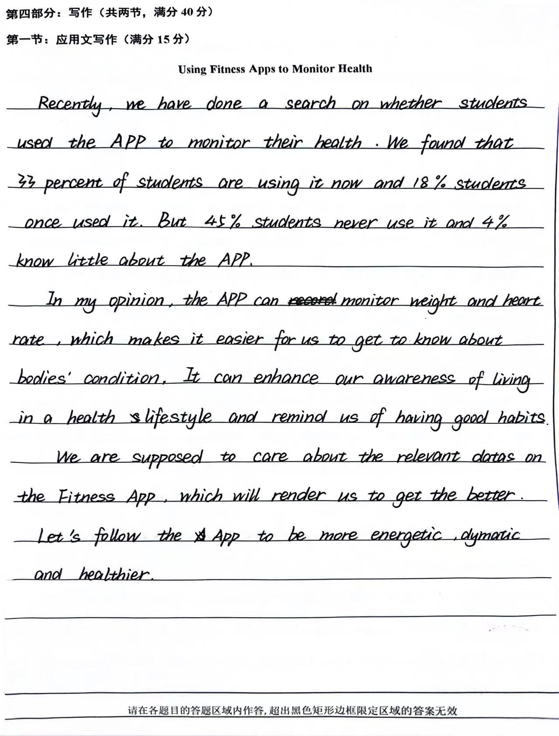
考场作文点评：
字迹美观，卷面整洁，结构布局不太合理。
Para1: 图表数据描写建议写在第二段。
Para2：个人评价过多，注意是简单评价。
Para3：建议只用到be supposed to,并没有体现出给对方的建议。

Slide 19
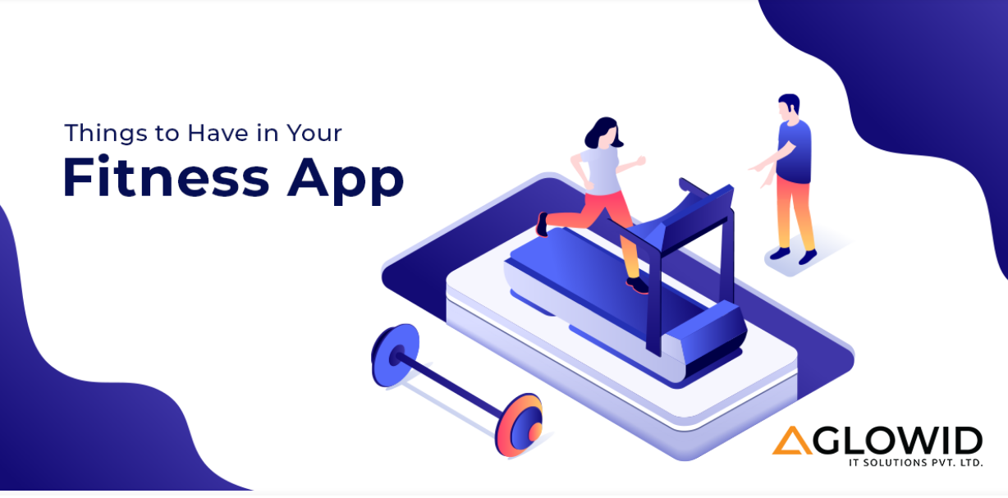
Thank you!

