Slide 1


感恩遇见，相互成就，本课件资料仅供您个人参考、教学使用，严禁自行在网络传播，违者依知识产权法追究法律责任。
更多教学资源请关注
公众号：溯恩英语
知识产权声明

Slide 2


续写·演讲比赛，老师鼓励，自我超越
-2023年上虞区高二下期末调测-

Slide 3




原文再现
It was the beginning of a new year, and I was in the best class, where most of the chatterboxes were. Sadly, I was not one of them. Most of the time, my mouth was zipped very tightly and I hardly had any friends who appreciated my silence.
There was a speech competition three months later. The selection was left to our strict English teacher Mrs.Lee, whom I feared the most because she hardly ever smiled at us. Strangely though, on the day her decision was to be announced to us, she proclaimed, “Jane shall be the one who will join the competition.”
There was silence in our usually-noisy class. “You have to write a speech today and show it to me tomorrow, Jane," Mrs. Lee instructed, thereby breaking the ice.
“我”的处境和现状
“我”被英语老师挑中参加演讲比赛
“我”被要求写一篇演讲稿，给英语老师看

Slide 4


原文再现
The next day, I showed my speech to Mrs. Lee. Reading it, she nodded in satisfaction and grinned at me for the first time. In the sweetest voice, she praised me, “Wonderful work! Why don't you read it to the class?” Instantly, my throat went dry. Butterflies fluttered around in my stomach, crashing against my stomach walls and making me feel sick.
Swallowing hard and taking a deep breath, I began reciting my essay with the worst pronunciation anyone had ever heard. However, I stumbled a little and panicked, unable to go on. The entire class burst into laughter as they shouted discouraging words, saying that they should have been in my place instead. Hot tears stung my eyes as I rushed back to my seat, weeping silently in embarrassment.
“我”得到肯定，并被要求当众展示
糟糕的“展示失败经历”

Slide 5

原文再现
After school, Mrs. Lee called me to her office, where she gave me a few pointers on how to overcome stage fright. Patiently, she went through the speech with me several times until my utterly bad pronunciation was “cured”. It was with much patience that Mrs. Lee worked through those three months with me, ensuring that my words were crisp and clear and teaching me how to put expressions into my sentences.
英语老师帮助“我”练习演讲，克服“stage fright”

Slide 6

Para.1-3: Background information
研读原文，把握情节走向，感知可“呼应”内容
Event:
speech competition
Character: I
not one of the “chatterboxes”
my mouth was zipped very tightly
hardly had any friends
was chosen by English teacher Mrs.Lee to join the speech competition
Mrs. Lee’s decision is out of everyone’s expectation.
该部分交代了主人公“我”在经历关键事件前的人物状态和处境，在后续续写的结尾部分，也可以从“人物变化”的角度构思内容，并与该部分有所呼应，提高续写部分和原文内容的衔接度和一致性。
Strangely though, ...
There was silence in our usually-noisy class.
..., thereby breaking the ice

Slide 7

Para.4-5: The setback I suffered before the competition
Event:
recite the essay to the class
Effect:
was laughed at and became more unconfident
before reciting
while reciting
after reciting
Instantly, my throat went dry.
Butterflies fluttered around in my stomach, crashing against my stomach walls and making me feel sick.
Swallowing hard and taking a deep breath
with the worst pronunciation anyone had ever heard
I stumbled a little and panicked, unable to go on.
The entire class burst into laughter as they shouted discouraging words
Hot tears stung my eyes as I rushed back to my seat, weeping silently in embarrassment.
该部分呈现了“上台-演讲-下台”完整的叙事线以及主人公的情感线，在后续的续写中可以进行参考，适当改编，实现与原文的“呼应”。
anxious, nervous, unconfident
depressed, embarrassed,
hopeless

Slide 8
Para.6: My preparation for the competition under the guidance of Mrs. Lee
Effect:
the improvement of my speech performance
Event:
the guidance of Mrs. Lee
After school, Mrs. Lee called me to her office...
gave me a few pointers...
Patiently, she went through the speech with me several times...
It was with much patience that Mrs. Lee worked through those three months with me...
overcome stage fright
my utterly bad pronunciation was “cured”
my words were crisp and clear
“自我的努力”和“老师的帮助”是正式比赛时我克服恐惧的力量来源，也是需要“呼应”的重要部分。

Slide 9
构思续写内容
审读首句，明确情节框架，
设计与原文“呼应式”的语言表达
Finally, the day of my competition arrived.
重点描写我的比赛过程
（轮到我时、演讲表现、演讲结束后）
How did I feel when it was my turn to deliver the speech?
How did I overcome the anxious feeling or the stage fright?
How about my speech?
How did I feel after I finished my speech?
What did I do before the contest was over?
我的演讲过程是顺利的
When the contest was over, the judges declared me the champion.
I:
the audience/ judges:
stepped on to the stage to receive the award
What will happen next after the announcement of the champion?
cheered and applauded

Slide 10
构思续写内容
Finally, the day of my competition arrived.
比赛日到来
过渡、衔接
After several wonderful performances, it was finally my turn to deliver the speech.
“It’s your turn, Jane,” Mrs. Lee said in an encouraging voice, softly patting my back to calm my nerves.
轮到我演讲
迅速聚焦关键微情节
①直接描述
②借助原文角色之口
开口演讲前的紧张、害怕
Echo the plot (呼应情节):
在英语老师Mrs. Lee的指导下准备此次演讲比赛
Echo the words (呼应语词):
patient, three months, the stage fright, my stomach walls, crash, butterflies.
Despite the fact that I had spared no effort to prepare this competition under the guidance of my patient English teacher Mrs. Lee for three months, I was still seized by the stage fright, my stomach walls were crashed again by butterflies.

Slide 11

Finally, the day of my competition arrived.
开口演讲前的紧张、害怕
“Come on, Jane! You can make it!”I whispered to myself, taking a deep breath. With a confident expression on my face, I began to deliver my speech.
“Just believe yourself! Be confident!”an inner voice echoed in my mind. Having cleared my throat, I gathered all of my strength and courage to begin my speech.
Inner
strength
or
Having seen an encouraging and hopeful look on my English teacher’s face, I gathered all of my courage and confidence to start my speech.
The memory of practicing the speech skills under the guidance of Mrs. Lee came flooding back, which gave me strength and courage to start my speech.
Outer encouragement
开口演讲

Slide 12
Finally, the day of my competition arrived.
比赛日到来
Greatly relieved, I went back to my seat, waiting for the final result.
回到座位
轮到我演讲
Beyond my expectation, I finished my speech with every word crispy and clear, avoiding every bad pronunciation.
Echo the plot (呼应情节):
“等待结果”和后文中的“宣布结果”相呼应。
Echo the words (呼应语词):
crisp and clear,
bad pronunciation
开口演讲前的紧张、害怕
顺利完成，为后续的“Champion”做铺垫
（内心力量or 外界鼓励)
开口演讲
演讲效果

Slide 13
When the contest was over, the judges declared me the champion.
过渡、衔接
Hearing the result, I...
No sooner had I stepped on to the stage to receive the award than thunderous cheers and applause broke out. When I bowed to express my gratitude on stage, I caught sight of Mrs. Lee, who waved her arm excitedly.
我的行动①
I stepped on to the stage to receive the award
获奖后-领奖
观众反应
The audience cheered and warmly applauded my speech.
我的行动②
I bowed to express my gratitude on stage
Never did I think the moment when the dream came true could be so wonderful.
I felt an sense of fulfillment/accomplishment
my face expanded with a big smile
Never did I think the moment when the dream came true could be so wonderful. I felt an sense of fulfillment/accomplishment that I had never experienced before, with my face expanding with a big smile.
我的心情-
高兴、兴奋、成就感...
主题升华
所思所想
回扣式结尾、情景式结尾、感悟式结尾

Slide 14
When the contest was over, the judges declared me the champion.
主题升华
所思所想
Tears of delight and thrill filling my eyes, I would always treasure this experience as a reminder of my courage, perseverance and determination.
感悟式结尾
回扣式结尾
Now I can definitely say that I was no longer that girl whose mouth was always zipped tightly and I would keep this courage in mind to confront whatever challenges ahead.
情景式结尾
Holding the trophy in my hand, I waved excitedly to Mrs. Lee, who gave me great encouragement and helpful guidance, and called out to her, “I made it!”

Slide 15
范文
Finally, the day of my competition arrived. After several wonderful performances, it was finally my turn to deliver the speech. Despite the fact that I had spared no effort to prepare this competition with the assistance of my English teacher for three months, the stage fright still caught me. When standing on the stage, I could clearly feel my heart pounding heavily and my two legs trembling uncontrollably.“Come on, Jane! You can do it!”I whispered to my self, taking a deep breath. Having cleared my throat, I gathered all of my strength and courage to begin reciting my essay. Beyond my expectation, I finished my speech with every word crispy and clear, avoiding every bad pronounciation. Greatly relieved, I went back to my seat, waiting for the final result.

Slide 16
范文
When the contest was over, the judges declared me the champion. No sooner had I stepped on to the stage to receive the award than thunderous cheers and applause broke out. When I bowed to express my gratitude on stage, I caught sight of Mrs. Lee, who waved her arm excitedly. Never did I think the moment when the dream came true could be so wonderful. I felt an sense of fulfillment/accomplishment that I had never experienced before, with my face expanding with a big smile. Tears of delight and thrill filling my eyes, I would always treasure this experience as a reminder of my courage, perseverance and determination.

Slide 17
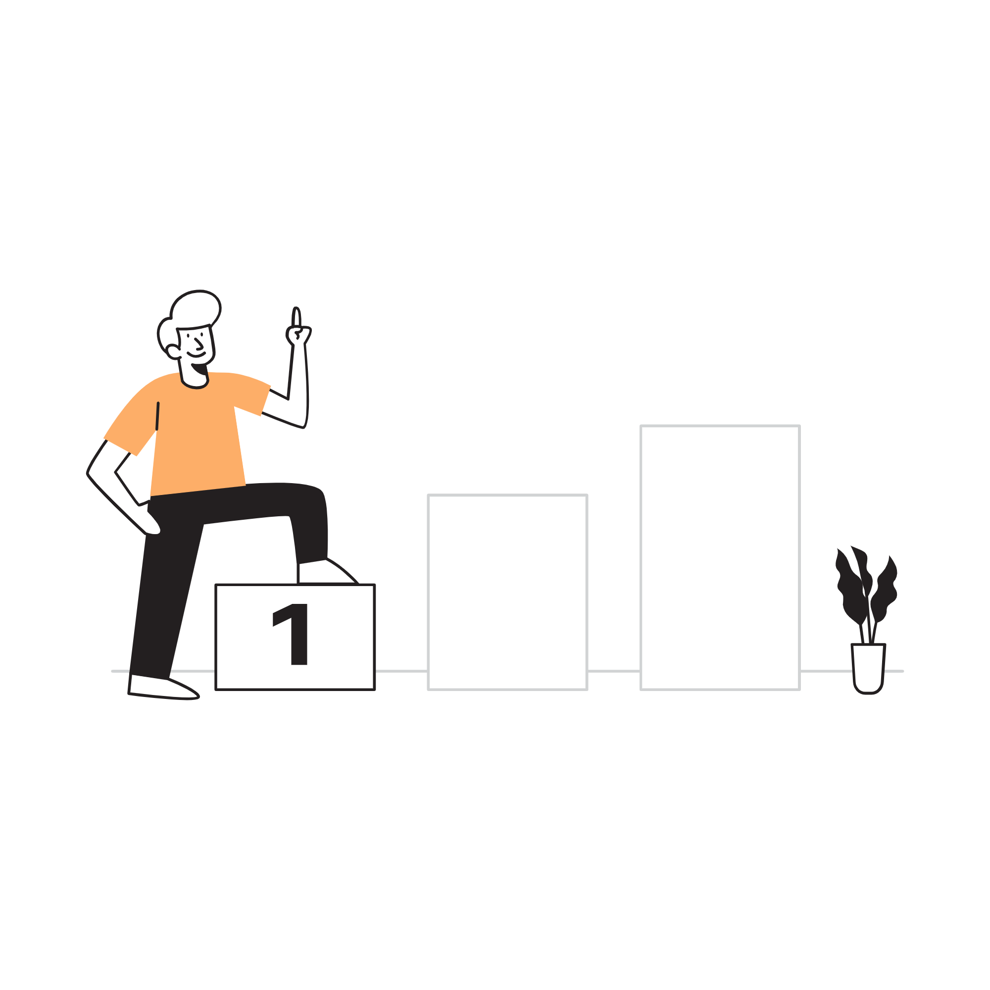
续写·演讲比赛，老师鼓励，自我超越
-2023年上虞区高二下期末调测-

