Slide 1


感恩遇见，相互成就，本课件资料仅供您个人参考、教学使用，严禁自行在网络传播，违者依知识产权法追究法律责任。
更多教学资源请关注
公众号：溯恩英语
知识产权声明

Slide 2
Language study
Book 1
Welcome Unit
Reading &Thinking

Slide 3
The text is written from _________
A. the first point of view (I, We)
B. the second point of view (You)
C. the third point of view (he, she, they)
Para1
Para 4
1) want to make a good first impression
2) Will I make any friends?
3) What if no one talks to me?
anxious
Inner thought
(内心想法)
not worried, not awkward, not frightened confident
I didn’t feel…
I believe I will…
I feel much more…
I think….
Internal sensation
(内部情感)

Slide 4
Para 1
finally
1. So this is it– Senior high school at last!
就是（它）这样
So this is it!----….at last!
Han Jing’s feeing
Han Jing finally had her senior high school.
She was a little anxious and excited.
大学
高中
初中
小学
幼儿园
university/ college
senior high school
junior high school
primary school
nursery school/ kindergarten

Slide 5
senior--junior
senior adj. n higher in rank, older in age
级别较高（的），年纪较大（的）
她的职位比我高。
She is senior to me.
老年人:
senior citizens
senior year 大四，或者高三

Slide 6
2. I want to make a good first ____________(impress)
on
impression
____ the teachers and classmates.
impress vt.
impression n.
impressive adj.
sth impress sb.
他的真诚打动了她。
His sincerity impressed her.
He impressed her with his sincerity.
leave a(n) …impression on sb
make a(n) …impression on sb.
What if 用于疑问句句首，尤用于询问不希望看到的事发生时的结果)
The stillness and silence left a deep impression on visitors.
She is very impressive in the interview.
3. What if no one talks to me?
What if the school bus is late?

Slide 7
Para 2
tell
adv. 连接前一句，同时加强语气
1. What kind of person is the maths teacher?
…, but the teacher was kind and friendly, he even told us a funny story, and everyone laughed so much!
actions
show
humorous

Slide 8
2. I found most of my classmates and teachers friendly and helpful.
find +宾语+宾补 “认为/发现…”
adj.
adv.(地点)
prep.phrase
doing
done
I found Bob very honest.
I found Lucy upstairs.
The teacher found the students in the lecture hall.
He found his son waiting for him at the gate.
He found the door of the classroom locked.
find +宾语（n/pron）

Slide 9
Para 3
on
I couldn’t concentrate ______ the experiment.
concentrate on…
to give all your attention to something and not think about anything else 集中（注意力）；聚精会神
one’s mind
one’s attention
one’s efforts
oneself
concentrate on…专心做，致力于…
We are going to concentrate all our efforts on the project.

Slide 10
Para 3
2. I really wanted to tell him to please be quiet and leave me alone!
leave sb. alone= let sb. alone
1) to stop annoying somebody or trying to get their attention
不打扰；不惊动
莫惹事是非
Leave the sleeping dog alone.
leave sth alone=let sth. alone
to stop touching, changing, or moving something 不碰；不变动；不移动
I've told you before—leave my things alone!
我告诉过你，别碰我的东西！

Slide 11
Para 4
I didn’t feel awkward or frightened at all.
1) adj. not relaxed or comfortable
紧张的，不放松的
The little girl felt awkward she found herself being watched.
2) making sb feel embarrassed adj. 令人尴尬的
There was an awkward silence in the classroom.

Slide 12
2. …and there’s a lot to explore at senior high.
explore v. to travel to or around an area or a country in order to learn about it
勘探；勘查；探索；考察
A day isn’t really long enough to explore the town.
As soon as we arrived on the island we were eager to explore.
3. I feel much more confident than I felt this morning.
feeling sure about your own ability to do things and be successful
自信的；有自信心的
1) Are you confident in his ability?
2) Are you confident about your senior high school life?
confident adj. – confidence n.

Slide 13
Language study
Listening and speaking

Slide 14
Chunks 词块
一位交换生
在报告厅
在注册办公室
在餐厅
一位学校导师
在校园里
在正式场合
an exchange student
in the lecture hall
in the registration office
in the dining hall
a school adviser
on campus
in formal situations

Slide 15
an exchange student
exchange programmes 交流项目
exchange teachers 互派的教师
foreign exchange 外汇（市场）
stock exchange 证券交易所
an exchange of glances 交换眼神
an exchange of information 交换信息in exchange for sth. 作为…的交换
1. an exchange student
ex+change=exchange n. 交流，交换
She is going on an exchange to Paris.
她将去巴黎交流访问。
v. 1) give and receive 交换
All the students exchanged gifts at the graduation ceremony.
2) to change an amount of one currency for an equal value of another
兑换；汇兑
exchange A for B
你可在旅馆把你的钱兑换成美元。
You can exchange your currency for dollars in the hotel.

Slide 16
2. in the lecture hall
1) n. a talk that is given to a group of people to teach them about a particular subject 讲座，讲课，演讲
听讲座：to go to/attend a lecture
做讲座： to give/deliver a lecture
2） a long, angry talk that somebody gives to one person or a group of people because they have done something wrong（冗长的）教训，训斥，谴责
我知道我该停止玩游戏，别再教训我了。
I know I should stop playing computer games—don't give me a lecture about it.
lecture v. give a talk or criticize
他在浙江大学教英国文学。
He lectures on British Literature in Zhejiang University.
lecture somebody about/on something
他对我的衣着总是指手画脚的。
He's always lecturing me about the way I dress.

Slide 17
3. in the registration office
registration n.
the act of making an official record of something/somebody 登记；注册；挂号
registration fees 注册费
the registration of students for a course 学生的选课登记
registration number= license (plate) number 车辆的登记号码；牌照号码
register v. n.
1) to record your/somebody’s/something’s name on an official list 登记；注册
注册公司／商标
to register a company/trademark
注册一门课程
register for a class
挂号信
a registered letter
2) n. list of names 名单
点名
call/take the register
点名册
a class register
收款台
cash register
3) n. machine 机器

Slide 18
Reading for Writing
Language study

Slide 19
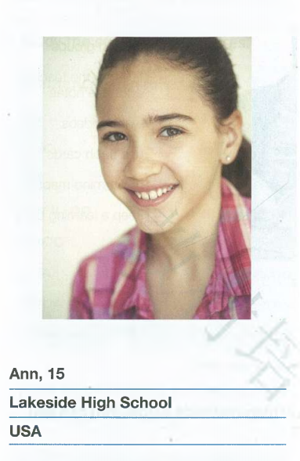
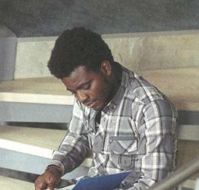
Language features (语言特点)
 | Ann Wells | Thando Gowon
Personality
Learning style
look good,
think fast
play hard
an active person,
am curious about everything
You’ll never see me without a book or a pen.
If I am not in class, I’m either in the library or in the computer lab.
I often ask questions ,but I learn best by doing.

Slide 20
Language features (语言特点)
Show,
not tell.
I’m…
I’m curious about…
I often ask…
I learn best…
My favourite subject is..
…are my hobbies
I like…
I plan…
less impressive
more impressive
I look.. think.. and play…
You’ll never ..without…
I’m either….or….
My dream is…
tell readers about Ann by making a list of related information.
Show readers about Thando by painting a vivid and clear picture of what kind of a person he is.

Slide 21
1. You’ll never seem without a book or a pen.
He nearly always has a book or a pen with him, because he likes to study.
To describe a person’s strong interest or personality.
You’ll never see me without my cell phone.
To describe a person who is very social and needs to feel connected to others.
2. …, I’m either in the library or in the computer lab.
either…or…并列连词 连接两个对等的成分， “要么…… 要么,不是……就是,或者……或者”
When the girl is happy, she either sings or dances.
am
Either you or I ______ (be) going there tomorrow.
either...or...连接两个主语时，其谓语动词应与最近的一个主语在人称和数上保持一致，这就是我们通常说的"就近原则"。

