Slide 1

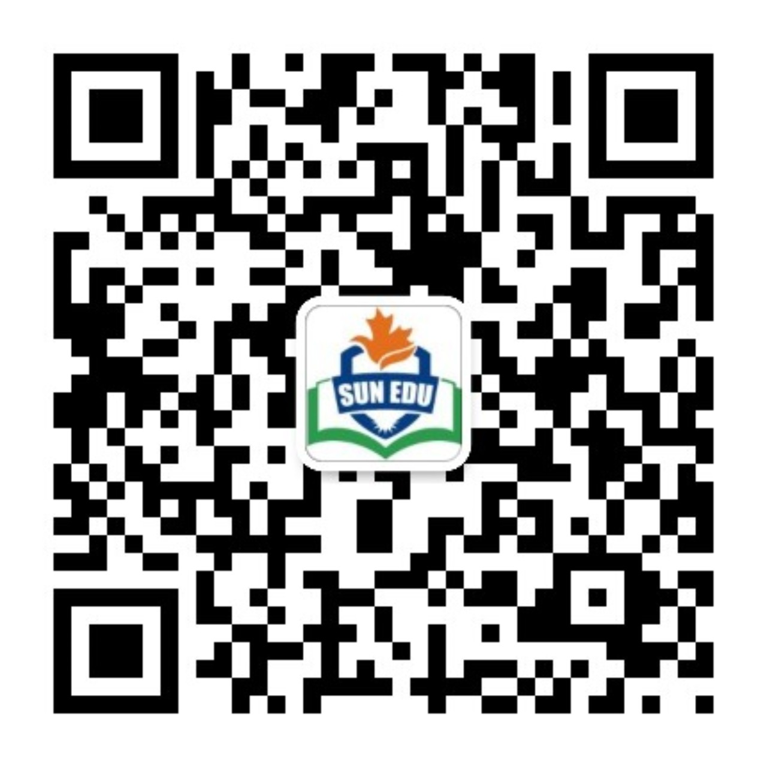
感恩遇见，相互成就，本课件资料仅供您个人参考、教学使用，严禁自行在网络传播，违者依知识产权法追究法律责任。
更多教学资源请关注
公众号：溯恩英语
知识产权声明

Slide 2
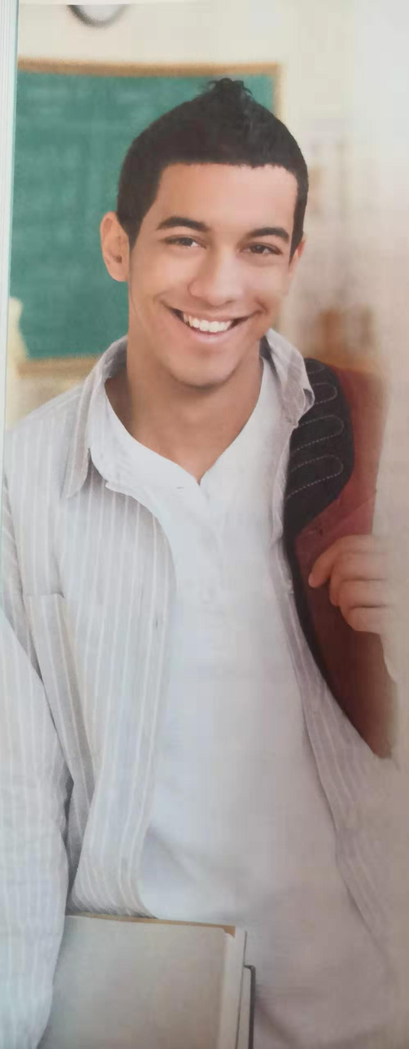
Unit 1 TEENAGE LIFE
Reading and Thinking
Language study

Slide 3
Phrases
1. 新生挑战
2. 高中
3. 报名参加
4. 课外活动
5. 加入足球队
6. 分发食物
7. 习惯于
8. 对……负责
9.跟上
10.做好准备
1. freshman challenge
2. senior high school
3. sign up for
4. extra-curricular activities
5. join the football team/make the football team
6. hand out food
7. get used to
8. be responsible for
9. keep up with
10. be prepared for

Slide 4
1. The first week was a little _________(confuse).
confusing
confuse v. to make somebody unable to think clearly or understand something
使糊涂；使迷惑
confusing: adj. difficult to understand; not clear
难以理解的；不清楚的
confuse A with B （将…）混淆，混同
Don’t confuse Austria with Australia.
confused
People are __________ (confuse) about all the different labels on food these days.
be confused about sth. 对 …感到迷惑

Slide 5
2. Chinese is a very difficult language, but I hope to be ________ when I _________.
fluent
graduate
fluent adj. able to speak, read or write a language, especially a foreign language, easily and well（尤指外语）流利的，流畅的；熟练的
be fluent in …
她的波兰语很流利。
She’s fluent _______ Polish.
in
After she ___________ from university, she worked as a teacher.
graduated
graduating
After ___________ from university, she worked as a teacher.
graduation (n.)
After ___________, she worked as a teacher.
graduate v. /ˈɡrædʒueɪt/
Adam is a high school graduate.
n. /ˈɡrædʒuət/ a person who has a university degree

Slide 6
3. My adviser r__________ that I ___________(sign) up for advanced literature because I like English and I’m good at it.
ecommended
(should) sign
1) =advise 建议，后接引导的宾语从句中的谓语动词用 （should） +do, should 可以省略。
My adviser recommended me ___________(sign) up for advanced literature because I like English and I’m good at it.
to sign
老师建议先看这本书，再去看这部电影。
Our teacher recommended _________ (read) the book before seeing the movie.
reading
doing sth.
sb to do sth.
that sb should do…
recommend

Slide 7
2) to tell somebody that something is good or useful, or that somebody would be suitable for a particular job, etc.推荐；举荐；介绍
我向我所有的学生都推荐Holes这本书。
I recommend the book “Holes” to all my students.
推荐信：
a letter of recommendation
sign up for…:
to arrange to do a course of study by adding your name to the list of people doing it
报名（参加课程）
You can sign up online for language classes.

Slide 8
4. Obviously, I was unhappy, but I won’t quit.
obviously adv. used when giving information that you expect other people to know already or agree with
（用于陈述认为别人已知道或希望别人同意的事）显然，明显地
Obviously, we don't want to spend too much money.
quit– quit—quit: to stop doing something 停止；戒掉
smoking
At last he has quit ___________(smoke).

Slide 9
5. 高级文学
高级课程
advanced literature
advanced courses
advanced adj. (of a course of study课程)
at a high or difficult level高级的；高等的
an advanced student of English 高阶英语学生
1) in advance: before the time that is expected; before something happens（时间上）在…前；预先；事先
advance v. n.
2) v. move towards sb. often in order to attack or threaten them or it
（为了进攻、威胁等）前进，行进
The troops were finally given the order to advance.
部队终于接到前进的命令。
knowledge, technology, etc. advances, it develops and improves
（知识、技术等）发展，进步
Technology is advancing at an incredibly rapid pace.

Slide 10
6. Every Wednesday, we work at a soup kitchen and ___________ food to homeless people in the community.
hand out
hand out: to give a number of things to the members of a group
分发某物
She handed out the exam papers.

Slide 11
on
7. I’ll find a way to improve _____ my own so that I can
______ the team next year.
make
join the team
on one’s own: alone; without anyone else 独自；单独
她一个人生活。
She lives on her own.
make the team: win a place in a team 成为的一员，加入，谋得（职务）
She finally shattered the glass ceiling and made the president of the company.
她最后终于打破了（职业的）玻璃天花板，成了公司总裁。
make it 获得成功
make 110 kilometers per hour 速度达到110千米/小时
make the mountain top by midday 中午前爬到山顶
make the party 参加聚会
make the front page of the local newspapers
（某条新闻）登上当地各家报纸的头版
Good wine can make a meal. 酒美饭亦香。

Slide 12
8. I know I’ll have to study harder as a senior high school student and get used to ________(be) responsible for a lot more.
being
… and it’ll be quite difficult to ____________ all the homework.
get used to
get/become/be used to +n/doing…习惯于
used to do 过去经常
be responsible for …
having the job or duty of doing something or taking care of somebody/something, so that you may be blamed if something goes wrong有责任；负责；承担义务
Both parents are equally responsible for raising the children.
Who was responsible for the mistake?
responsibility n,
2) being able to be blamed for something应受责备；有责任

Slide 13
9. I’m a bit worried about ________________ the other students in my a_______ course…
keeping up with
dvanced
advanced literature
8. Studying hard isn’t always fun, but I’ll be well p________ for university or whatever comes in the future.
repared
be well prepared for…为 …做好充分准备
prepare…for…使某人为…做好准备
The college prepares students for a career in business.
这个学院是培养商务人才的。
prepare for something 为…做准备
We all set about preparing for the party.
prepare for the worst

Slide 14

Reading for Writing
Language study

Slide 15
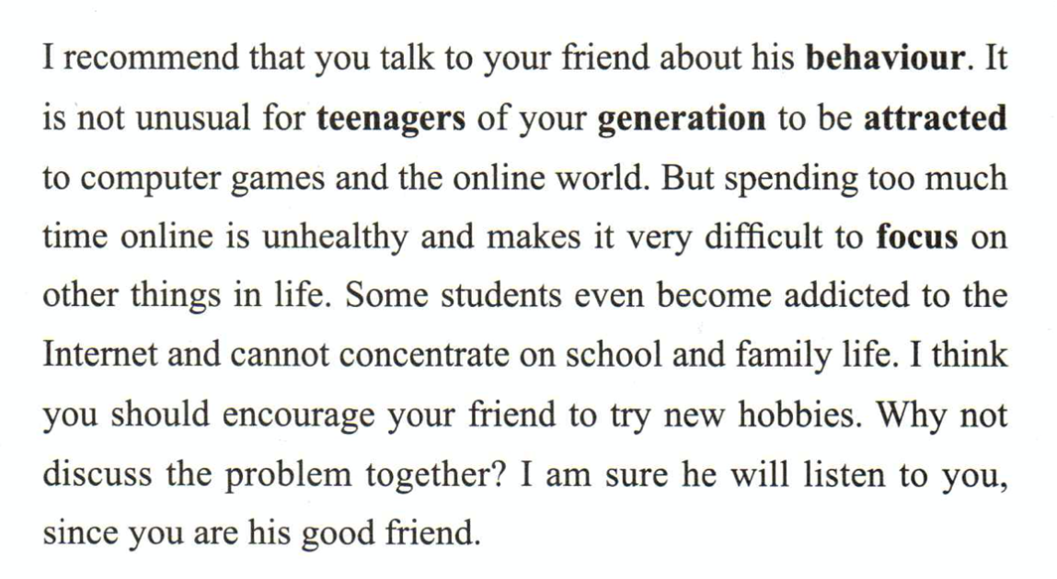
even become addicted to..
focus on
=concentrate on
近义词并加强语气，形成递进
be attracted to..
同义复现
the online world
online
the Internet
Reasons for the advice supporting the key sentence.
In a particular paragraph, there is only one focus. The writer supports the key point of the paragraph with words and phrases following the main line and from different perspectives.

Slide 16
1. It’s not unusual for teenagers of your generation to ________________ computer games and the online world.
be attracted to
It’s not unusual for sb to do sth.
It’s not uncommon for sb to do sth.
It’s usual for sb to do sth.
It’s common for sb to do sth.
=
be attracted to sth. like sth. 喜爱，迷上
addict n. a person who is unable to stop using or doing something as a habit, especially something harmful
吸毒成瘾的人；瘾君子
婴儿喜欢鲜艳的颜色.
Babies are attracted to bright colours.
Another sentence in which a phrase has a similar meaning?
Some students even become addicted to the Internet.
addicted adj. unable to stop using or doing something as a habit, especially something harmful 上瘾；成瘾
be/become/get addicted to sth.对…很入迷

Slide 17
2. But spending too much time online is unhealthy and makes it very difficult to focus ______ other things in life.
on
focus on/upon : to give attention, effort, etc. to one particular subject, situation or person rather than another集中（注意力、精力等于）
我们应该聚焦于真正重要的事情，而不是一些细枝末节。
We should focus on what really matters, not the minor details.
focus…on/upon…把集中在；使（眼睛，照相机）调节焦距
他把照相机的镜头对准青少年们的笑脸。
He focused the camera on the teenagers’ smiling faces.
小孩子很难把注意力长时间集中在一件事情上。
It’s hard for children to focus their minds on one thing for a long time.
focus n.
中心点（指人或事物）；关注
The little girl is the focus of attention at the party.

Slide 18
Unit 1 TEENAGE LIFE
Workbook 练习 答案和讲评

Slide 19
Ex 5 on P 15
recommended 2. challenge 3. confusing 4. sign
5. improve 6. graduate 7. responsible 8. quit
Ex 1 on P 71
Literature does not belong. Others are compound words(合成词).
teenage butterfly fireworks
airline, airman, airsick
countryman, countryside
handmade, homemade
bedroom, bedside
underline, underside (下侧；底面；底部)
homesick, homeroom (学生接受导师指导的教室)

Slide 20
Ex 2 on P 71
online, youth, debate, speech, schedules, signed, recommend, attracts, prefer
What are teenagers into and what turns them off?
be into: to be interested in something in an active way
对…十分感兴趣；很喜欢
turn sb off: to make somebody feel bored or not interested
使厌烦；使失去兴趣

Slide 21
Ex 3 on P 71
challenge me to a game v. accepted the challenge n.
challenge sb to sth. v. to invite somebody to enter a competition, fight, etc.; to suggest strongly that somebody should do something (especially when you think that they might be unwilling to do it)
向（某人）挑战；（尤指在对方不情愿时）强烈建议（某人做某事）
2. schedule too many extra-curricular activities v. to arrange for something to happen at a particular time 安排；为…安排时间；预定
a busy schedule n.工作计划；日程安排
3. need a volunteer n.
want to volunteer v. to offer to do something without being forced to do it or without getting paid for it自愿做；义务做；无偿做
4. focus of today’s meeting n. 焦点
focus on this problem v. 特别关注
5. A Tsinghua University graduate n. 毕业生
After graduating v. 毕业

Slide 22
Ex 4 on P 72
is responsible for
is not suitable for
are attracted to, be addicted to
be concerned about

Slide 23
Using structures– Activity 3
√
We can find a quiet public reading room.
√
She owns a cute small white cat.
Don’t worry. He will do the job well enough.

Slide 24
Ex 3 on P 73
2. A quiet public reading room
4. A cute small white cat
5. He will do the job well enough.
Ex 4 on P 73
(impossible adj. very difficult to deal with 难处理的；很难对付的)
a very difficult test
2. well enough 3. quite silly 4. some of the 5. very bad
6. cross: really angry 7. too many 9. not such a big deal(没什么了不起)
10. really great, very kind
You’re the very kind. 你真是太好了。

Slide 25
Ex 5 on P 73
a group of senior high school students from Hangzhou
quite soon
a lot of exciting activities 4. some of the activities
5. different kinds of tea
6. more interested
(get/make sb interested in…使某人对…感兴趣)
a big international
move over 让开

Slide 26
Using structures– Activity 1
Group discussion (NP, O.) the advanced literature course (NP, O)
quite heavily (Advp, A ) very soon (Advp, A )
very important (AdjP, Attr.) your behavior in society (NP, O)
the joy of trying something new (NP, O)
Strangely enough (AdvP, A ) very much (AdvP, A )

