Slide 1


感恩遇见，相互成就，本课件资料仅供您个人参考、教学使用，严禁自行在网络传播，违者依知识产权法追究法律责任。
更多教学资源请关注
公众号：溯恩英语
知识产权声明

Slide 2
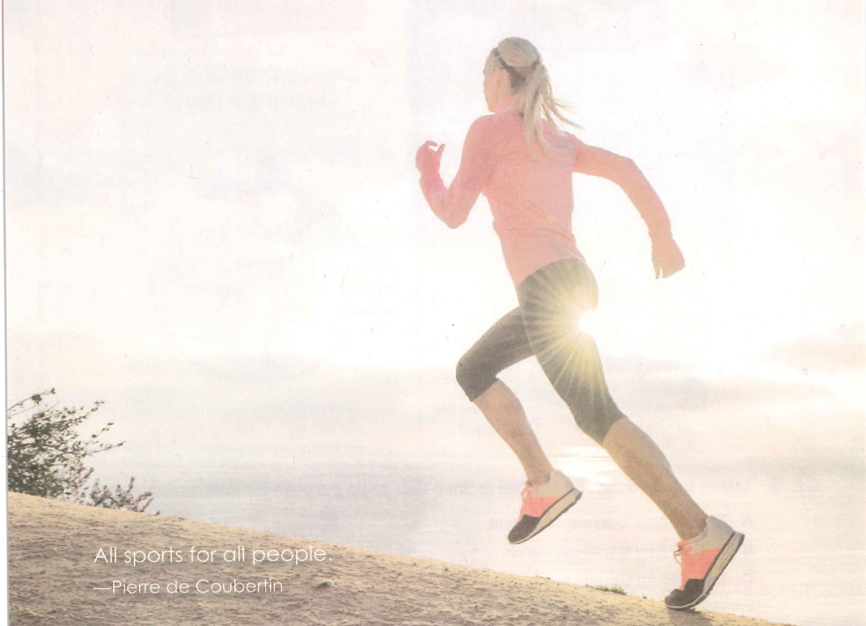
B1 U3
Sports and Fitness

Slide 3
Listening and speaking
Language study

Slide 4
Language study
1. Would you like to come along?
1） to go somewhere with somebody 跟随；跟着来
When the right opportunity comes along, she'll take it.
2）to arrive; to appear 到达；抵达；出现
come
所构成的词组一般不用被动语态
Come along! We're late. 快点！我们迟到了。
3）used in orders to tell somebody to hurry, or to try harder
（用于命令）赶快，加把劲

Slide 5
2. 田径运动会
track meet; track and field meet
track n.1) 赛跑、赛车等的）跑道
2) The train for Chicago is on track 9.
3) It took him a few hours to walk to the school down a muddy track.
4) We followed the bear's tracks in the snow.
5) We continued tracking the plane on our radar.
2) 轨道，站台
3） 小路
4）踪迹，痕迹
5）v. 跟踪

Slide 6
3. Come and work out at a gym!
1) to train the body by physical exercise 锻炼身体；做运动
我经常做运动以保持健康。
I work out regularly to keep fit.
2)to develop in a successful way 成功地发展
我的第一份工作干得不好。
My first job didn't work out.
事情的结果对我们很不错。
Things have worked out quite well for us.
3)to calculate that it will be a particular amount 计算；计算出
我正在尽力算出我每月的开销。
I’m trying to work out how much I spend each month.

Slide 7
4. sweat your way to good health.
一路挥汗， 奔向健康。 sweat n. v.
5. You can make it.
Translate sentences with “make it”.
我们终于成功地到达了山顶。
很抱歉昨晚没能参加你的聚会。
医生认为他能挺过去。
我不知道我是怎么熬过那个星期的。
Finally we made it to the top of the mountain.
I’m sorry I didn’t make it to your party last night.
The doctor thinks that he is going to make it.
I don’t know how I made it through the week.

Slide 8
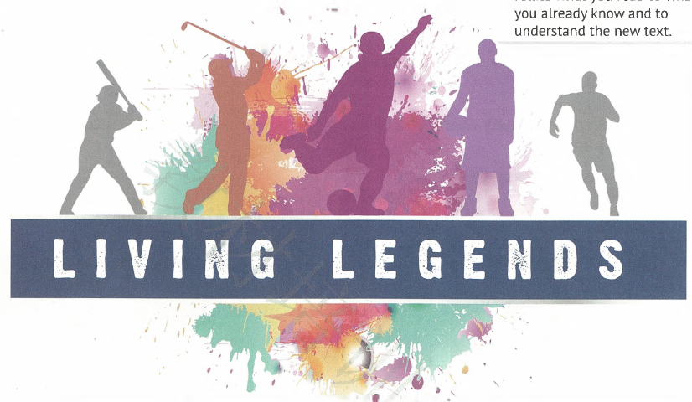
Reading and Thinking
Language study

Slide 9
1. Living legends
alliteration: the use of the same letter or sound at the beginning of words that are close together, as in sing a song of sixpence
头韵，头韵法（相连单词的开头使用同样的字母或语音）
coca cola
safe and sound
hip hop
polly pocket
money matters
sound rhyme
For musical effect
significant emphasis

Slide 10
live/ alive/ lively/ living
lively
活泼的，生动的，有活力的
1) Young children are usually _________.
2) Joe was there, a few meters from their tent,
still___________.
3) The __________ are more important than the dead.
4) We found the snake still _________ after the cold winter.
5)I hope that more people could be _______ in the
accident.
6) I’m planning to watch a __________ show of a concert tonight.
alive
前置定语,修饰人，物
living
alive
表语、后置定语、宾补
alive
live
现场直播的

Slide 11
1. 运动场上的大师
2. 为…树立榜样
3.把…与…相联系
4. 为某人带来荣誉
5. 赢得一枚金牌
6. 国内外的粉丝
7. 有决心做某事
8.破裂
9. 严重受伤
10.队长
11. 丧失信心
12. 通力合作
13. 赢得冠军/成为冠军
1. master n. master a foreign language v.
2. set good examples
3. relate…to; be related to
feel it a honor to do sth;
4.bring honor and glory to sb
5.win a gold medal
6.fans at home and abroad
7. have the determination to do sth
be determined to do sth
8.fall apart; break down
9. be/ get badly injured
10.team captain
11. lose heart
12.work together as a team
become a champion
13. win a championship

Slide 12
2. The team that Lang Ping had built was falling apart.
apart adj. into pieces 成碎片
fall vi. to pass into a particular state; to begin to be something
进入（某状态）；开始变成（某事物）
fall apart 破裂，破碎，崩溃
fall ill 病倒了
fall silent 陷入沉默
fall asleep 睡着了

Slide 13
3. When the Chinese team was preparing for the 2015 World Cup, her ________________ (determine) was tested.
determination
If you are ____________ to do something, you have made a firm decision to do it. As Goethe once said. “The important thing in life is to have a great aim, and the _____________ to attain it.” I ____________ to make efforts to achieve my goal.
determined
determination
determined
be determined to do sth/ determine to do sth 决心做某事
determine/decide on something 决定某事
a determined look 坚定的眼神

Slide 14
4. One of the best players had been _________ (injure), and the team captain had to leave because of heart problems.
injured
She had her arm __________ in the accident. If I hadn’t been wearing seatbelt, I would have been __________, too.
Now, she is suffering from an__________.
injured
injured
injury
be seriously（badly）/ slightly injured 受重伤/受轻伤
the injured 伤员（the + adj.表一类人）
suffer from an injury 负伤

Slide 15
injure/ hurt/ wound
hurt
1) My mindless words must have ________ him deeply.
2) Three people were killed and five _________ in the
accident.
3) A bullet hit the soldier and he was _________ in the leg.
4) When he tried to cut the lifeboat free, it swung against the ship, __________ his hand and arm.
5) You have no idea how she finished the relay race with her foot __________ so much.
6) My chest ________ when I made a deep breath.
injure 正式用语； 意外事故的伤害
injured
hurt 身体的伤害；情感的伤害； 疼痛
wounded
wound战争中打斗，刀枪等的伤害
injuring
injured
hurt

Slide 16
1. 时间似乎停滞了。
2. 作为…而闻名
3.优美的动作和跳跃
4. 精神力量
5. 成功的秘诀
6. 从失败中学习
7. 与某人分享某物
1. Time seemed to stand still.
(personification 拟人)
become known as…
graceful moves and jumps
mental strength
the secret to success
learn from failure
share sth. with sb.

Slide 17
5. …time seemed to stand still.
stand +adj. 双重谓语
stand vi. /link.v
adj. not moving
静止的
阳光下，山谷十分宁静。
她坐在那，一动不动。
河水开始干涸。
他的抱怨无人理会。
The valley lay quiet and peaceful in the sun.
stand, lie, sit, go, run
可以用作双重谓语。
She sat there motionless/still.
The rivers began to run dry.
His complaints went unnoticed.

Slide 18
6. I can accept _______ (fail); every fails at something.
failure
fail v. to not pass a test or an exam; to decide that somebody/something has not passed a test or an exam不及格
to not do something未做；未履行（某事）
She failed to keep her word.=She didn’t keep her word.
Words fail me. I just can’t find the words to describe my feelings.
3) to stop working 出故障；失灵
The brakes on my bike failed half way down the hill.
His eyesight was failing rapidly.

Slide 19
7. give up
give up (on sth)
give in (to sth)
give off
give out
give away
give back
given that…
放弃
(向 …)屈服
发出（光、热、气味）
耗尽；发出光热，信号; 公布
分发；出卖
归还
考虑到,鉴于

Slide 20
1) Body language can ______ a lot about your mood, so standing with arms folded can show your being defensive.
2) What shall we use for power when all the oil in the world ___________?
3) Bicycles are environmentally friendly because they won’t _______ waste gas.
4) __________ she is interested in children, I’m sure teaching is the right career for her.
give away
gives out
give off
Given that

Slide 21
8. compete
competition; competence(=ability 能力); competitive; competitors
compete
Life is like a long race where we _________ with each other to go beyond ourselves. We must maintain our professional _________ to win the _________. Because ________ people want to be best at everything. In the long journey, __________ try their best to do it.
competence
competition
competitive
competitors

Slide 22
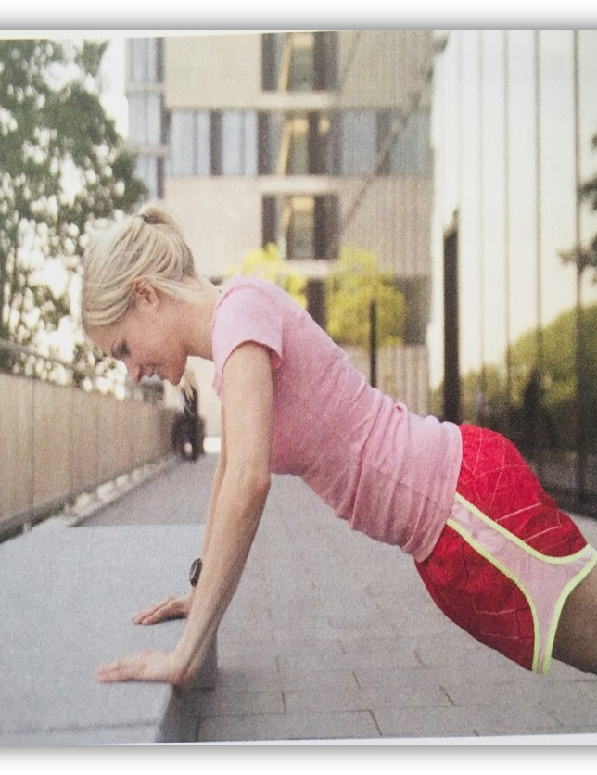
Reading for writing
Language study

Slide 23
go bananas: to become angry, crazy or silly 发怒；发疯；犯傻
He lost his job and just went bananas.
top/big banana
sour grapes
the apple of one’s eyes
as cool as a cucumber
大老板
酸葡萄心理
掌上明珠
镇定自若

Slide 24
Make sentences using the following phrases.
即使
有影响，有作用
而不是
停止食用,剪下
时而，偶尔
与…比较
把…添加到…
even though/if
make a difference
rather than
cut out
now and then
compare…with/to…
add…to…

Slide 25
make a difference
make a, no, some, much difference (to somebody/to something/in something) :to have an effect/no effect on somebody/something
有（或没有、有些等）作用，关系，影响
1) 这场雨对比赛没多大影响。
The rain didn't make much difference to the game.
2) 你能否得到这工作应该与你的年龄无关。
Your age shouldn't make any difference to whether you get the job or not.
3)转学对我的一生有着重大影响。
Changing schools made a big difference to my life.
4)’“我们星期五还是星期六去？” “（我）无所谓。”
Shall we go on Friday or Saturday?’
‘It makes no difference (to me).

Slide 26
make all the difference (to somebody/something)
to have an important effect on somebody/something; to make somebody feel better关系重大；大不相同
青少年养成的好习惯能使人受益终生。
Good habits formed at youth make all the difference.

Slide 27
cut out (of)
to remove something from something larger by cutting, usually with scissors（通常用剪刀）剪下
我从报纸上剪下了这篇文章。
I cut this article out of the newspaper. 2. to stop doing, using or eating something 停止做（或使用、食用）
有人劝我饮食要忌糖。
I've been advised to cut sugar out of my diet.

Slide 28
Pick out the sentences with the phrase “rather than”
I started thinking about fitness rather than weight, things began to change.
Rather than cutting out the foods, I added healthy foods to my meals.
rather than +n
rather than +doing
3) They went for a walk rather than _____________________. ( 看电视)
watch TV
rather than +do
4) They preferred to have a party in the garden rather than ___________________(而不是在房子里)
in the house
rather than +prep.

Slide 29
compare … with/to…
I stopped comparing myself with actresses and models…
1) 我们仔细比较了第一份报告和第二份报告。
We carefully compared the first report with the second.
2) 和其他的孩子比起来，他幸福多了。
Compared to/with other kids, he is much happier.
Compared to/with …和…比起来，做状语

