Slide 1


感恩遇见，相互成就，本课件资料仅供您个人参考、教学使用，严禁自行在网络传播，违者依知识产权法追究法律责任。
更多教学资源请关注
公众号：溯恩英语
知识产权声明

Slide 2
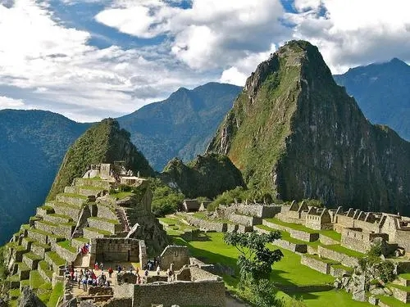
B1U2
Video Time

Slide 3
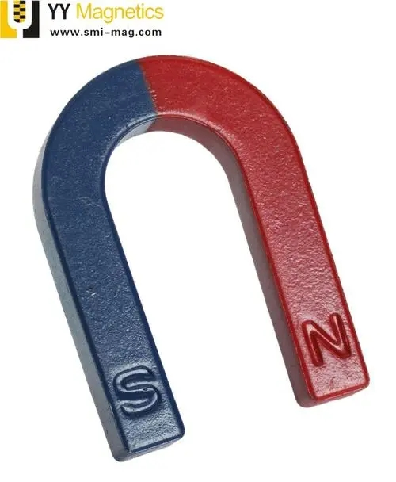
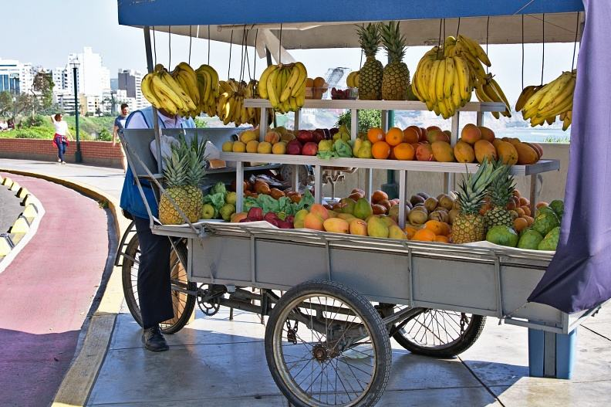
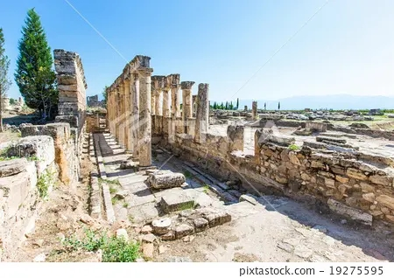
LEAD-IN
magnetic adj. behaving like a magnet 像磁铁的；有磁性的
stall n. a table or small shop with an open front that people sell things from, especially at a market货摊，摊位，售货亭
ruins n. the parts of a building that remain after it has been destroyed or severely damaged 残垣断壁；废墟

Slide 4

Watch a video

Slide 5
Complete the sentences with the words and phrases below.
magnetic centre Inca civilization outside world
stalls business and money ruinsthe sentences with the words and phrases below.
1. Machu Picchu was once part of the _________________________.
2. For many years, Machu Picchu was lost to the ________________.
3. Machu Picchu is now made up of _____________.
4. People believe that Machu Picchu is a(n) _____________, attracting many tourists each year.
5. Apart from being a magical place, Machu Picchu also brings a lot of ______________.
6. Local people sell things at ____________ to tourists.
Inca civilization
outside world
ruins
magnetic center
business and money
stalls

Slide 6
Choose the correct answers on P34.

Slide 7
Group Discussion
Should tourism be stopped in places in like Machu Picchu? Why or why not?
Tourism should not be stopped in places like Machu Picchu. While such places need to be protected, this should be balanced by the need for the world to see and experience their wonders, and the need for local people to make a living.

Slide 8
Facts or opinions?
We will discuss----
the difference between facts and opinions
strategies to distinguish facts from opinions
how to check factual statements
clue words for opinion statements

Slide 9
Facts | Opinions
A fact is a statement that is true.
Facts can be proven.
Anyone who is checking will find or see the same thing.
There can be no other reasonable point of view.
Actually a point of view
How the writer thinks or feels about something– a belief; an idea– a feeling
Common clue words for opinions
How can we check or prove that a statement is a fact?
best
easy
beautiful
great
difficult
ugly
pretty
simple
wonderful
should
maybe
probably
might
perhaps
too
feel
believe
think
idea
if
Look it up in a book
check records or statistics.
ask eye witnesses.
weigh it or measure it
Words that predict the future.
value words

Slide 10
practice
Which sentence contains an opinion?
1.
Mario and I went camping last weekend.
We saw several wild animals.
The weather was terrible.
We had a hole in our tent.
The weather was terrible
2.
The dog jumps on people.
I’ve gone to dog-training lessons
The dog knocked my boss over.
The dog is wonderful.
The dog is wonderful

Slide 11
practice
Jason wants to become a pilot in the Air Force, but the Air Force has turned him down. Some of the possible reason are given below. Decide which of these is fact and which is an opinion.
He’s shorter than Air Force regulations permit.
Jason will make a poor pilot.
He gets sick whenever he boards a plane.
No one would want to fly with him.
Fact
opinion
Fact
opinion
Every man has a right to be wrong in his opinions. But no man has a right to be wrong in his facts.

