Slide 1


感恩遇见，相互成就，本课件资料仅供您个人参考、教学使用，严禁自行在网络传播，违者依知识产权法追究法律责任。
更多教学资源请关注
公众号：溯恩英语
知识产权声明

Slide 2

活用教材词汇，靶向高考写作
B1U0单词拓展
武汉开发区汉阳三中：廖英

Slide 3



exchange/ɪksˈtʃeɪndʒ/ n.&vt.交换;交流;交易;兑换
1.最近，学生们就如何在课外学好英语交换看法，其结果如下。2022全国乙卷图表类应用文“针对课外英语学习调查结果的短文投稿” （应）
Recently students have exchanged ideas about how to learn English well beyond the classroom and the results are as follows.
2.我们班很高兴能以“校园里常见的植物”为主题，发起一场引人入胜的在线交流活动。在活动期间，我们的目标是使这种交流既丰富又愉快。（应）
Our classes are excited to propose an engaging online exchange on the theme of "Common Plants on Our School Campus." During the event, we aim to make this exchange both informative and enjoyable.

Slide 4

exchange/ɪksˈtʃeɪndʒ/ n.&vt.交换;交流;交易;兑换
3.作为一名在英国学校的交换生，我很高兴得知即将开展的汉语工作坊，它可以促进中英文化交流。_{2023年天津卷“中英文化交流活动申请信”} （应）
As an exchange student in a British school, I am excited to hear about the
upcoming Chinese workshop, which aims to promote cultural exchange
between China and the UK.
4.他愿意在这家餐馆工作,以换取一顿免费的饭。（应）
He would like to work in the restaurant in exchange for free meals and accommodation.

Slide 5

lecture/ˈlektʃə(r)/ n.讲座;讲课 vi.(开)讲座
1.上周五在学生中心大讲堂，专家史密斯先生开展了一场意义深远的题为《野生动物保护》的讲座。讲座持续了大约两个小时。（应）
Last Friday witnessed a meaningful lecture titled Wildlife Protection in the
lecture hall of Student Centre delivered by the expert Mr. Smith, who gave this
lecture for around 2 hours.
2. 首先，书籍种类可以更多样化，并且开展更多与阅读相关的讲座，这些会有很大的好处，从而使我们能够做出正确的选择，进而激发我们的阅读兴趣。（应）
Firstly, it will benefit a lot to diversify the categories of books and organize more reading-related lectures, thus enabling us to make proper choices and stimulate our reading interest.
3. 使我恼火的是他老是对我的行为指手画脚。（应、续）
What makes me annoyed is that he is always lecturing
me about my behavior.

Slide 6

registration/ˌredʒɪˈstreɪʃn/ n.登记;注册;挂号
registrate/ˈredʒɪstə(r)/ vt.&vi.登记;注册
1.在你报名参加高级课程之前，你应该先注册你的信息。（应）
Before you sign up for advanced classes, you should first
register your information.
2.如果有兴趣，请在1月20日之前注册。期待您的参与。（应）
If interested, register for it before January 20. Looking
forward to your participation.
3.至于我能帮助的事情，我愿意为游客提供导游，协助登记任务，传单，或帮助任何其他必要的任务。_{2019年高考全国卷I“美术馆志愿者申请信”} （应）
Regarding the things I can help with, I am willing to provide visitors with guided tours, assist in registration tasks, leaflets, or help with any other necessary tasks.

Slide 7
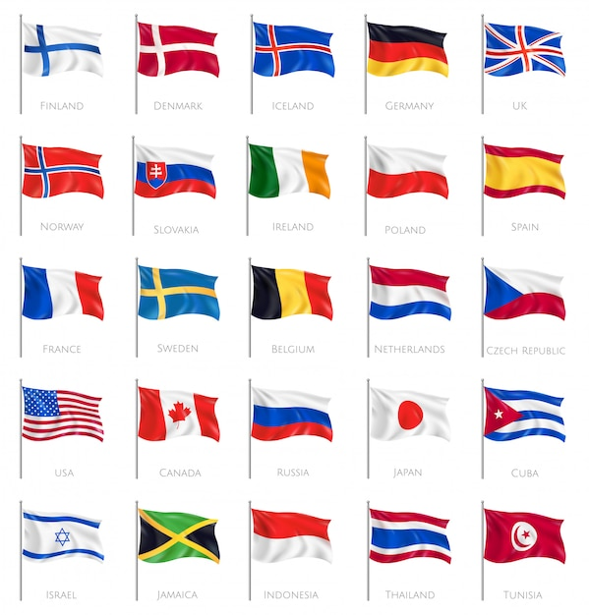
nation/ˈneɪʃn/ n.国家;民族;国民
1.全国人民都为他的事迹所感动。雷锋精神将永远活在我
们心中。^{2023全国甲卷应用文“介绍中国历史人物征文稿”} （应）
The whole nation were moved by his deeds.
Lei Feng’s spirit will live in our hearts forever.
2.优秀传统文化为中华民族的生存、发展和成长提供了丰富的精神养料。（应）
The fine traditional culture has provided rich spiritual
nourishment for the life, development, and growth of the Chinese nation.
3.《归来》改编自一个因战争爆发而被困海外的中国公民撤离的真实故事。这部电影不仅展示了中国外交官的决心和智慧，也展示了在混乱的世界中他们强烈的民族自豪感。_{2023厦门质检“中国电影推荐信”} （应）
Home Coming is based on a real-life story of China’s evacuating Chinese citizens stuck overseas due to the outbreak of war. The movie shows not only the determination and wisdom of Chinese diplomats but also a strong sense of national pride in a chaotic world.

Slide 8

designer/dɪˈzaɪnə(r)/ n.设计者
design/dɪˈzaɪn/ n.设计;设计方案 vt.设计
1.这辆车设计简单，客舱小，车顶平。虽然它不是一个花哨或昂贵的玩具，但它在我心中占有特殊的地位。_{2023年上海卷高考应用文“快乐童年参展物品介绍”} （应）
The car has a simple design, with a small cabin and a flat roof. Although it is not a fancy or
expensive toy, it holds a special place in my heart.
2.设计精美的卡片和美味的早餐让妈妈想起了这个重大日子。_{2021全国卷I读后续写“母亲节惊喜”} （续）
The beautifully designed card and the tasty breakfast reminded Mother of the big occasion.
3.英文报Youth中的许多专栏是专门为高中生设计的,旨在丰富我们单调的校园生活。2021年新高考I卷应用文“youth英语报创刊十周年短文征稿” （应）
Many columns of the English newspaper Youth are specially designed for
senior high school students, and they are designed to enrich our boring
campus lives.
4.作为一个设计师，这是她才华的标志。（应、续）
This is the mark of her real genius as a designer.
5.那家伙故意推他，惹他生气。（续）
The guy pushed him by design/on purpose/deliberately, making him annoyed.

Slide 9

campus/ˈkæmpəs/ n.校园;校区
1.多谢Youth杂志，它不仅开阔了我的视野，丰富了我的校园生活，而且我的英语水平也得到了逐步提高，从而对我的学业有了全面的提升。2021年新高考I卷应用文“Youth英语报创刊十周年短文征稿” （应）
Thanks to Youth, not only were my horizons widely broadened and campus life greatly enriched, but my English was gradually improved, hence contributing to my overall promotion of my study.
2.首先，我们学校以丰富多彩的校园文化活动而闻名，从介绍中国传统文化活动到最先进的技术展示活动都有开展。（应）
To begin with, our school is known for the rich
splendid campus cultural activities, ranging from
introducing traditional Chinese culture to the most
advanced technology displays.

Slide 10

formal/ˈfɔ:ml/ adj.办正式的;正规的
1.如果它是学校项目的正式一部分，那就需要为了学生和老师的共同利益，来建设性地使用评价结果。（应）
If it is a formal part of the school's program it needs to be
used constructively for the benefit of both teachers and
students.
2. 新中国成立后，毽子运动恢复了活力，1956年在广州举行了第一届正式的全国踢毽子比赛。_{2024年浙江1月高考应用文“校园课间体育项目推荐”} （应）
After the establishment of new China, it regained vitality
and the first formal National Shuttlecock Kicking Competition was held in Guangzhou City in 1956.

Slide 11
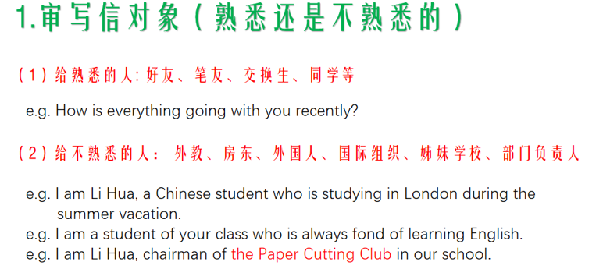
formal/ˈfɔ:ml/ adj.办正式的;正规的
Formal够专业，留出距离，表达认真的态度和恰如其分的诚意,比如写给老师的邮件。
Informal够亲切，消除距离，亲密无间，亲切真挚，比如写给熟识的朋友的信件。
Formal:I am writing with regards to...
Informal:I’m writing to say..../I’m writing about..../I just want to let you know that...

Slide 12

anxious/ˈæŋkʃəs/ adj.焦虑的;不安的
1.一看到他们的父亲，这对双胞胎非常焦急，想得到帮助。他们抬起头来，泪水汪汪地看着父亲。_{2021年全国卷I读后续写“母亲节惊喜”} （续）
On seeing their father, the twins, who were extremely
anxious to get help, looked up at him with watery eyes.
2.他紧紧抓住桌子边缘，焦急地等待着考试结果。（续）
Clutching the edges of the table, he anxiously
awaited the exam results.
3.看到大卫焦虑的表情,我知道他会放弃参加越野队的。
_{2022新高考全国卷I读后续写“脑瘫学生参加跑步比赛”} （续）
Seeing his face filled with anxiety, I knew David would give up participating in the cross-country team.
4.她的心被焦虑攫住了，就像一座火山在她体内喷发。（续）
Her heart was gripped with anxiety, like a volcano erupting inside her.

Slide 13

情感的暗喻手法：
1. 情感是对手：get the better of挫败，get the best of胜过,overwhelm压倒
(1)他的好奇心占了上风。（续）
His curiosity get the better of him.
(2)悲伤压倒了她，使她沉浸在悲伤中。（续）
Grief overwhelmed her, leaving her lost in sorrow.
2. 情感是人手：seize/grasp/grip抓，take hold of抓住，cover覆盖，tear into pieces撕成碎片
(1)恐惧攫住了她的心。（续）
Fear gripped her heart/seized her.
(2)她绝望得心都碎了。（续）
Her heart was torn into pieces with despair.
(3)夜幕降临时，失望和绝望攫住了他。（续）
As the night fell, disappointment and despair held him totally.

Slide 14

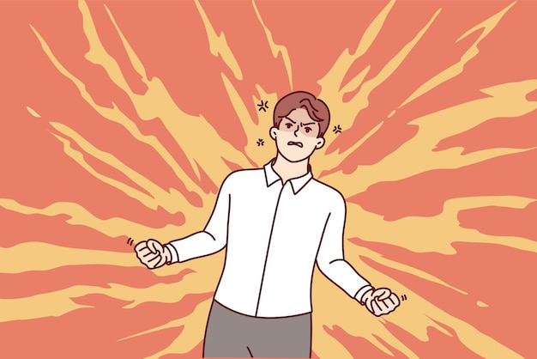
情感的暗喻手法：
3. 情感是动物：crawl/creep爬动，gnaw咬，swallow/devour吞噬
(1)幸福爬上了他的眉梢。（续）
Happiness crawls up to the tips of his brows.
(2)自我怀疑开始侵蚀她的信心。（续）
Self-doubt began to gnaw away her confidence.
4. 情感是水流：well up涌出，surge涌动，sweep冲;卷，fill/brim盛满， boil沸腾
(1)一阵恐慌/内疚席卷了她。（续）
A wave of panic/guilt swept over her.
(2)他怒不可遏。（续）
His anger boiled inside him.
(3)她高兴得跳了起来，感到一阵喜悦。（续）
She jumped with joy, feeling a surge of delight.

Slide 15

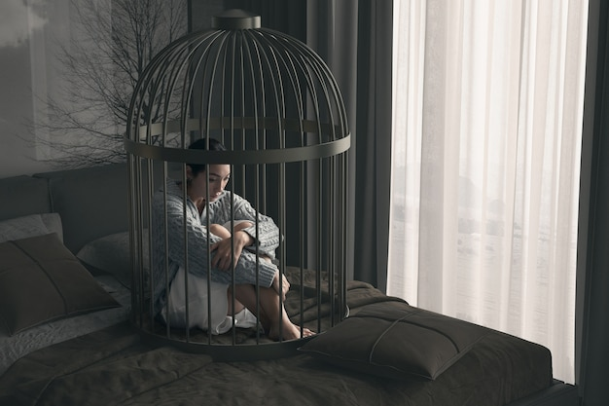
情感的暗喻手法：
5. 情感是光线：spread across传播，light up照亮，cloud罩
(1)他脸上绽开了笑容。（续）
Smile spread across his face.
(2)他因兴奋而容光焕发。（续）
His face was lit/brightened with excitement.
(3)输掉比赛的失望蒙蔽了他的思想。（续）
Disappointment of losing the game clouded his thought.
6. 情感是负担：bear on压在……上面，carry承受
(1)他为忧虑所累。（续）
He was burdened with worries.
(2)悲伤沉重地压在她身上。（续）
Grief bears heavily on her.

Slide 16

annoyed/əˈnɔɪd/ adj.恼怒的;生气的
annoy/əˈnɔɪ/ vt.使恼怒;打扰
1.此外,在图书馆,某些学生大声说话,打扰其他人,令人厌烦。（应）
Besides, in the library, certain students talk aloud, disturbing, and annoying others.
2.对孩子们弄出这么烦人的噪声莎莉很生气,她恼怒地用拳头捶桌子。（续）
Sally was annoyed at the children for making so annoying noise, slamming her fist on the table in annoyance.
3.让我恼火的是，我被分配到一个非常严肃的人一起工作，他总是对别人的工作不满意。_{2022年浙江1月高考读后续写“傲娇学霸与迷糊学渣”} （续）
What annoyed me was that I was assigned to work with an extremely serious guy who always not satisfied with others’ work.

Slide 17

情感名词：介词（in/with）+n
惊：surprise,amazement,astonishement
喜：excitement, joy, happiness,delight,pride,enthusiasm,amusement
怕：nervousness,terror, horror, fear
急：anxiety,worry
怒：anger, rage,annoyance
羞：shame
悔：regret, guilt
尬：embarrassment, awkward(adj)
盼：anticipatition,expectation
悲：sadness, sorrow,bitterness,despair,depression,grief
恩：gratitude,appreciation,thankful(adj)
爱：love,affection,attached(adj)
失：disappointment,frustration
怜：sympathy,pity,empathy
累：tireness,exhausted(adj),be worn out
惑：puzzle,doubt,disbelief
安：relief

Slide 18

情感名词：介词（in/with）+n
1.她心满意足地叹了口气，靠在舒适的椅子上。（续）
Sighing with contentment, she leaned back in the comfortable
chair.
2.人群热情高涨，为他们最喜欢的乐队欢呼。（续）
Roaring with enthusiasm, the crowd cheered for their favourite
band.
3.她悲痛地抽泣着，悼念失去的亲人。（续）
Sobbing with grief, she mourned the loss of a loved one.
4.他们目睹了这不可思议的壮举，惊讶得倒吸了一口气。（续）
Gasping with astonishment, they witnessed the incredible feat.
5.她因期待而颤抖，等待着那激动人心的启示。（续）
Trembling with anticipation, she awaited the thrilling revelation.

Slide 19

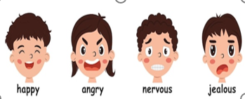
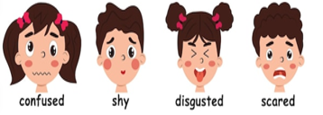
情感名词：介词（in/with）+n
6.他紧张得结结巴巴，发表了衷心的演讲。（续）
Stammering with nervousness, he delivered his heartfelt speech.
7.她回忆起那件有趣的事，不禁咧嘴一笑。（续）
Grinning at the memory in amusement, she recalled the funny incident.
8.听到这个坏消息，她皱着眉头，无比失望。（续）
Frowning at the bad news, she was in great disappointment.
9.妈妈耐心地听着，轻轻地抚摸着我的头，先是惊讶，然后是惊奇， 后来是同情。
（续）
Mum listened patiently, stroking my head in slight surprise, then amazement, and later sympathy.

Slide 20

frightened/ˈfraɪtnd/ adj.办惊吓的;害怕的
1.我来这儿已经一个星期了。起初我有点尴尬和害怕，但我很快就适应了我的学校生活。（应）
It has been a week since I came here. I was a little awkward and
frightened at first, but I adapt to my school life soon.
2.我们朝熊大喊大叫,砸碎玻璃瓶,试图把熊吓跑。（续）
We yelled at the bear and hit glass bottles, seeking to frighten the bear away.
3.既紧张又害怕,我感觉如坐针毡。（续）
Nervous and frightened, I felt as if I were sitting on pins and needles.
4.独自走在黑暗的树林如此吓人，让我毛骨悚然。（续）
Walking alone in the dark forest was so frightening as to make
my hair stand on end.

Slide 21

恐惧的直接描写：
1.她竭力抑制日益加剧的恐慌。（续）
She fought a rising panic.
2.他完全惊慌失措。（续）
He was in a complete panic state.
3.除了盲目的恐惧，她什么也感觉不到。（续）
She could feel nothing but blind terror.
4.他转向我，眼里充满了恐惧。（续）
He turned to me, with his eyes full of horror.
5. Cottle先生冲了进来，一副惊慌失措的样子。（续）
Mr. Cottle dashed in, looking panic-stricken.
6.恐惧慢慢地向我们袭来。（续）
Horror slowly crept on/flooded over/rushed over/swept over us.

Slide 22

恐惧的间接描写：
1.他的手掌开始冒汗。（续）
His palms began to sweat.
2.他的心怦怦直跳。（续）
His heart hammered in his chest.
3.她的心几乎跳到嗓子眼儿了。（续）
Her heart almost leaped into her throat.
4.他的心跳得比奔腾的马还快。（续）
His heart was pounding faster than a galloping horse.
5.她脸色苍白，站在那里说不出话来。（续）
Her face turned pale and stood there tongue –tied.
6.一看到玻璃门外的黑影，莫利感到全身的血液都迅速凝固了。（续）
Molly felt that the blood in her body froze rapidly at the sight of
the dark figure outside the glass door.

Slide 23


p.m./pi: em/ abbr.(源自拉丁)下午;午后
a.m./ə em/ abbr.(源自拉丁)上午;午前
1.如果您方便的话,我们可以在本周日早上8点在我们学校的艺术大厅见面吗? （应）
Could we meet in our school art hall at 8:00 a.m. this Sunday if it is convenient for you?
2. 我们学校图书馆的英语原版图书阅览室位于三楼，平日上午8:00至下午5:30开放，周末上午9:00至下午4:00开放。（应）
The reading room for English original books in our school libraries located on the third floor and opens from 8:00 a.m.to 5:30 p.m. on weekdays and 9:00 a.m. to 4:00 p.m. at weekends.

Slide 24

senior/ˈsi:niə(r)/ adj.级别高的 n.较年长的人
senior high school/ˈsi:niə(r) haɪ sku:l/ (美国)高中
1.它涵盖了所有高年级学生感兴趣的话题，带领我们感受外面的美好。2021年新高考I卷应用文“youth英语报创刊十周年短文征稿” （应）
It involves all topics that senior students are
interested in and leads us to feel the wonderful outside.
2.经过激烈的竞争，高三一班以机智的语言，深刻的见解和综合素质获得了一等奖。（应）
After fierce competition comes the first prize from Class 1, Senior 3 with the witty language, profound insights, and
comprehensive quality.

Slide 25


senior/ˈsi:niə(r)/ adj.级别高的 n.较年长的人
senior high school/ˈsi:niə(r) haɪ sku:l/ (美国)高中
3.1989年，中国政府将重阳节定为老人节，鼓励全国人民尊重、
爱护老人。（应）
In 1989, the Chinese government decided the Double Ninth
Festival as Seniors’ Day, encouraging people to respect, take
good care of and love the seniors around the country.
4.从初中到高中是一个很大的挑战。（应）
Going from junior high school to senior high school is a big
challenge.
5.刘先生长我3岁，并在一家大公司里担任要职。（应、续）
Mr. Liu is three years senior to me, and he held a senior
position in a large company.

Slide 26

at last/ət lɑ:st/ 终于;最终
1.尽管障碍很多，他们终于到达了目的地。（应、续）
In spite of every obstacle,they have at last arrived at the destination．
2.当我在雕刻南瓜的时候，我的头卡在南瓜里了!每个人都想帮忙，但这很棘手。最终，我们找到了把我弄出去的办法。_{2021年浙江1月高考读后续写 “万圣节南瓜趣事”}（续）
While I was carving my pumpkin, I got stuck with my
head inside it! Everyone tried to help, but it was tricky.
At last, we found a way to get me out.
3.最后，我想对您的帮助表示衷心的感谢。（应）
Finally, I’d like to say many thanks for your assistance.

Slide 27


at last/ət lɑ:st/ 终于;最终
4.最终，人工智能的发展应该确保社会福利，并使所有社会成员受益。（应）
Ultimately/Eventually, AI should be developed in a way that ensures social welfare and benefits all members of society.
5.经过五个月的航行，他们终于平安抵达目的地。
（应、续）
After a voyage of five months, they at length
arrived safe and sound．
6.最后，我从比赛中脱颖而出，获得了第一名。（应、续）
In the end, I stood out from the competition and won the first place.

Slide 28

outgoing/ˈaʊtgəʊɪŋ/ adj.爱交际的;外向的
1.首先，作为一个外向，友好和开放的人，我喜欢交朋友，帮助他们学习。（应）
First, as an outgoing, friendly and open person, I love making friends and helping them with their studies.
2. 最后，让我惊讶的是，他对我外向的性格印象深刻。_{2022年浙江1月高考读后续写“傲娇学霸与迷糊学渣”} （续）
At last, what made me amazed was that he was deeply impressed by my outgoing personality.

Slide 29

英语性格词汇表达总结：
outgoing 外向的 ←→ shy 害羞的
reliable , trustworthy可靠的 ←→ irresponsible 不负责任的
organized 有条理的 ←→ sloppy 马虎的
cooperative 乐意合作的 ←→ selfish 自私的
hardworking , diligent, industrious勤奋的 ←→ lazy 懒惰的
generous 大方的←→stingy小气的
patient耐心的←→ impatient不耐烦的
kind, warm 仁慈、温暖的 ←→ cold, rude 冷漠、不礼貌的，confident insecure
humble谦虚的 ←→ arrogant自大的
brave勇敢的←→timid胆小的
witty, humorous风趣幽默的 ←→serious, rigid严肃死板的
optimistic乐观的 ←→pessimistic

Slide 30

英语性格词汇表达总结：
straightforward, candid率直的←→ sly狡猾的
sociable 好交际的；talkative 健谈的←→
reserved 内向；quiet 寡言的
creative 有创意的 ←→ conventional 传统的
contented 知足的 ←→ greedy贪心的
mature成熟的←→ childish幼稚的
decisive 果断的←→indecisive 优柔寡断的
helpful 乐于帮忙的 ←→ self-centered 自私自利
stubborn固执的←→ flexible知变通的
sympathetic 有同情心的 ←→ cold-hearted, cruel无情的
stable 稳定的 ←→ emotional 情绪化的，moody 喜怒无常
sophisticated 精于世故的←→ simple ,innocent, naive 天真的
considerate ， thoughtful体贴周到的←→inconsiderate 不体谅别人的
ambitious 有抱负的； ←→ unenthusiastic 缺乏热情的
extroverted 外向的 ←→ introverted 内向的

Slide 31

英语性格词汇表达总结：
1.十几岁的时候，我非常害羞。（应、续）
As a teenager I was painfully shy.
2.他在逆境中表现出勇气。（应、续）
He showed courage in adversity.
3.马丁遇到了一个非常友好的人。（应、续）
Martin comes across a very friendly person.
4.查尔斯很勇敢，脾气也非常好。（应、续）
Charles was brave and remarkably good-humored.
5.发挥你的想象力，发挥你的创造力。（应、续）
Let your imagination run wild and be creative.
6.我们正在寻找一个可靠和勤奋的人。（应）
We are looking for someone who is reliable and hard-working.
7.责任心和可靠性是必要的条件，同时性格友好外向。（应）
Responsibility and reliability are necessary qualifications, as well as a friendly and outgoing personality.

Slide 32

impression/ɪmˈpreʃn/ n.印象;感想
impress/ɪmˈpres/ vt.使钦佩 vi.留下印象
make an impression/meɪk ən ɪmˈpreʃn/ 留下好印象
1.给我印象最深的是耐心和注意细节的重要性。制作小笼包需要很多的精确度和细心。_{2023全国乙卷应用文“暑假新技能学习投稿”} （应）
What impressed me most was the importance of patience and attention to detail. Making Xiaolongbao requires a lot of precision and care.
2.更重要的是，评委们对演员们的团队精神、奉献精神和追求卓越的精神印象深刻。他们吸引观众的能力是他们真正与众不同的地方。（应）
More importantly, the judges are impressed by the cast members’ teamwork, dedication, and commitment to excellence. Their ability to engage the audience is what truly sets them apart.

Slide 33

impression/ɪmˈpreʃn/ n.印象;感想
impress/ɪmˈpres/ vt.使钦佩 vi.留下印象
make an impression/meɪk ən ɪmˈpreʃn/ 留下好印象
3.这部电影的特效令人印象深刻，增加了整体的沉浸式体验。（应）
The special effects in this film are impressive and add to the overall immersive experience.
4. 这些画作是如此漂亮,画家的才华和中国传统文化的魅力给我留下了深刻的印象。
2022年浙江1月高考应用文“中国—爱尔兰文化节活动中结交好友回国联络信” （应）
So fantastic are the paintings that the talent of the painters as well as the charm of traditional Chinese culture left a deep impression on me.
5. 父亲一直让我牢记:努力总有一天会得到回报。（应）
Father has always impressed on me that hard work will pay off one day.

Slide 34

concentrate/ˈkɒnsntreɪt/ vi.&vt.集中注意;聚精会神
concentrate on/ˈkɒnsntreɪt ɒn/ 集中精力于
1.伊娃开始采用一种心理策略。她集中精力慢跑到跑道弯曲的地方。_{2024年浙江1月高考读后续写“运用心理策略解决路盲问题”} （续）
Eva started using a mind trick on herself. She concentrated on jogging to the spot where the track curved.
2.然而,长时间看屏幕会严重损害我们的视力,更不用说我们因为缺乏自律不能很好地集中精力学习了。
2021年全国乙卷应用文“Be smart online learners演讲稿” （应）
However, long screen time would badly damage our eyesight, not to mention that we fail to concentrate well on learning for lacking self-discipline.
3.太极拳强调集中注意力和内心平静，有助于提高注意力和
心理健康。_{2024年浙江1月高考应用文“校园课间体育项目推荐”} （应）
Tai Chi emphasizes focused attention and inner calm, contributing to improved concentration and mental well-being.

Slide 35

experiment/ɪkˈsperɪmənt/ n.实验;试验
1.爱迪生做了几千次实验才发明了电灯，他的毅力驱使我勇敢地迎接挑战。（应）
Edison did thousands of experiments to invent the lamp, his
perseverance driving me to embrace challenges bravely.
2.动手的科学实验完全吸引了学生的注意力，培养了学生对实践学习的
热爱。（应）
The hands-on science experiment absorbed the students’ attention completely,
fostering a love for practical learning.
3.那个学期我学到了比统计分析和实验程序更多的东西。我的生活因为我们的相遇而变得更加精彩，也因为这个人的挑战而变得更加精彩，他成为了我意想不到的英雄。_{2022年浙江1月高考读后续写“傲娇学霸与迷糊学渣”} （续）
I learned more than statistical analysis and experimental procedures that
term. My life has been enhanced by our encounter and challengbecame my
unlikely hero.

Slide 36

leave... alone/li:v əˈləʊn/ 不打扰;不惊动
1.“管好你自己的事，别烦我。”那人不耐烦地说。（续）
“Just mind your own business and leave me alone,” said the guy impatiently.
2.一想到被单独留在那所黑暗的大房子里，她就毛骨悚然。（续）
The idea of being left alone in the dark big house made her
hair stand on end.
3.他遗漏了一个重要的细节，真是粗心。（应、续）
It was careless of him to leave out an important detail.
4.明天早上8点在校门口集合，一起出发去营地。（应）
Tomorrow we will gather at the school gate at 8 a.m.
and we’ll leave for the camp site together.
5.让我们从停下来的地方重新开始。（应、续）
Let’s start again from where we left off.

Slide 37

awkward/ˈɔ:kwəd/ adj.令人尴尬的;难对付的
1.我很尴尬，但我克制住了想要跑下舞台的冲动。（应、续）
I was awkward, but I fought the urge to run off the stage.
2.接下来的日子里，汉娜和我之间充满了尴尬的沉默。（续）
The days that followed were filled with an awkward silence between Hannah and me.
3.他试图用微笑来消除我们之间的尴尬，然后把书递给了我。（续）
He tried to smile away the awkwardness between us and
handed the book to me.

Slide 38

awkward/ˈɔ:kwəd/ adj.令人尴尬的;难对付的
4. 使我心烦的是我像困兽一样困在南瓜中,而妈妈在拍着我的糗事。_{2021年浙江1月高考读后续写 “万圣节南瓜趣事”} （续）
It bothered me that I was stuck in the pumpkin like a caged
animal while my mom was filming my whole embarrassment.
5.我变得越来越尴尬，可以感觉到我的心狂跳，我的脸烧得很厉害。（续）
I became increasingly awkward and could feel my heart thumping wildly, my face burning badly. （描写句群）
6.听到这些，鲍勃感到很尴尬，他一遍又一遍地扭动和摩擦双手，似乎是为了在这个寒冷的冬天取暖。（续）
On hearing this, Bob became embarrassed, twisting and rubbing his hands over and over again,seemingly to get warm in this
freezing winter. （描写句群）

Slide 39
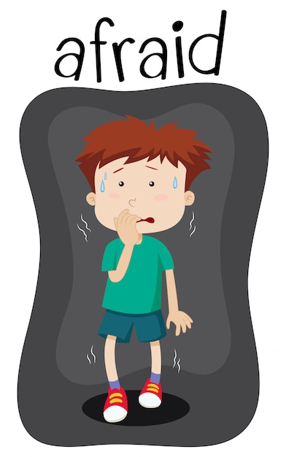
构建描写句群，将单一无亮点的描写句扩充为内容丰富的长句。
1.我感到害怕。I felt scared.
(1)一看到那只凶猛的狼，我感到非常害怕，喉咙发紧，膝盖发软。（续）
At the sight of the fierce wolf, I felt so scared that my throat
tightened and my knees felt weak.
(2)一看到那只凶猛的狼，我吓得僵住了，一动也不敢动。（续）
At the sight of the fierce wolf, I froze with terror, too scared to
move an inch.
(3)一看到那只凶猛的狼，我就被一种强烈的恐惧感攫住了，我的手掌 都在冒汗。（续）
At the sight of the fierce wolf, I was seized by a strong sense of
horror and my palms were sweating.

Slide 40

构建描写句群，将单一无亮点的描写句扩充为内容丰富的长句。
2.她感到悲伤。She felt sad.
(1)听到这个坏消息，她心痛不已，眼泪顺着脸颊流下来。（续）
Upon hearing the bad news, her heart ached, with tears
streaming down her cheeks
(2)听到这个坏消息，她悲痛得说不出话来。（续）
Upon hearing the bad news, she, numb with grief, had trouble
speaking.
(3)听到这个坏消息，她感到一阵悲伤，禁不住痛哭起来。（续）
Upon hearing the bad news, she felt seized by a burst of
sadness and couldn’t help crying bitterly.

Slide 41

构建描写句群，将单一无亮点的描写句扩充为内容丰富的长句。
3.宝宝很高兴。The baby was happy.
(1)当他的母亲亲吻他的脸颊时，这个宝宝似乎高兴极了。（续）
When his mother kissed him on the cheek, it seemed as if the
baby were on top of the world.
(2)当母亲亲吻婴儿的脸颊时，他的脸上洋溢着笑容，他灿烂的微笑 照亮了整个房间。（续）
When the mother kissed the baby on the cheek, his face
beamed and his bright smile lit up the room.
(3)当母亲亲吻婴儿的脸颊时，他的眼睛闪烁着喜悦和甜蜜。（续）
When the mother kissed the baby on the cheek, his eyes
danced with joy and sweetness.

Slide 42
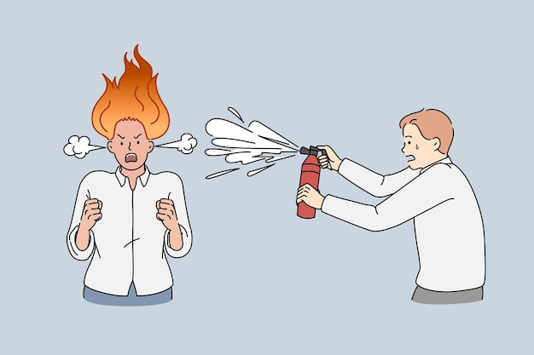
构建描写句群，将单一无亮点的描写句扩充为内容丰富的长句。
4. 他感到非常生气。He felt very angry.
(1)他怒不可遏，向我挥舞拳头。（续）
Boiling with rage, he shook his fist at me.
(2)他气得一句话也说不出来。（续）
Filled with fury, he was unable to utter a single word.
(3)他非常生气，愤然冲出房间，重重地关上身后的门。（续）
He felt so angry that he stormed out of the room
slamming the door furiously behind him.

Slide 43

构建描写句群，将单一无亮点的描写句扩充为内容丰富的长句。
5. 他感到绝望。 He felt hopeless.
(1)他感到被冷落了，孤独使他感到绝望。（续）
He felt left out and was getting desperate
with loneliness.
(2)他突然陷入了一片黑暗，陷入了绝望。（续）
He was suddenly thrown into a world of
darkness and sank into hopelessness.
(3)他积极正向的信念已经消失了。（续）
His beliefs in seeing the positive in
everything deserted him.

Slide 44

junior/ˈdʒu:niə(r)/ adj.地位低的 n.职位较低者
junior high school/ˈdʒu:niə(r) haɪ sku:l/ (美国)初级中学
1.当你向长辈敬酒时，晚辈往往会把酒杯举得低一些。（应）
When you propose a toast to the senior, the junior often
raise their glasses lower.
2.她比他小四岁。（应、续）
She’s his junior by four years.
3.数据显示，14.3%的学龄前儿童患有近视。其中，小学生为35.6%，初中生为71.1%，高中生为80.5%。（应）
Data show that 14.3 percent of pre-school kids are
nearsighted. The rate is 35.6 percent for primary
school students, 71.1 percent for junior high school pupils
and 80.5 percent for senior high school students.

Slide 45

explore/ɪkˈsplɔ:(r)/ vt.&vi.搜索;勘探
1.这不仅是一种探索城市的有趣方式，而且还促进了可持续交通的理念。_{2023北京夏季高考应用文“绿色北京主题社团活动策划建议信”} （应）
This would not only be a fun way to explore the city, but
also promote the idea of sustainable transportation.
2.这部电影以发人深省的方式探讨了歧视和不平等等
社会问题。（应）
The movie explores social issues such as discrimination and inequality in a thought-provoking manner.
.

Slide 46

explore/ɪkˈsplɔ:(r)/ vt.&vi.搜索;勘探
3.这把钥匙似乎是通往历史悠久的世界的入口，艾米丽发现自己是一个几乎被时间遗忘的领域的探索者。（续）
The key, it seemed, was a portal to a world rich with history, and Emily found herself the explorer of a realm that time had almost forgotten.
4.太空探索对我们非常重要。它不仅展示了一个国家的国力，而且还促进了许多领域的技术进步。此外，通过太空探索，我们可以获得在地球上很难找到的新资源。（应）
Space exploration is of great importance to us. It not only demonstrates
a country’s national strength but also promotes the advance of technologies in
many fields. In addition, through space exploration we can obtain new resources
that can hardly be found on earth.

Slide 47

confident/ˈkɒnfɪdənt/ adj.自信的;有把握的
confidence/ˈkɒnfɪdəns/ n.信心;信任
1.在他们的鼓励下，我逐渐变得更加自信地使用自己的声音。我接受了青春期带来的变化，没有恐惧和羞耻。（续）
With their encouragement, I gradually became more confident in using my voice, accepting the changes that came with puberty without fear or shame.
2.比赛前，她突然失去了信心。（应、续）
Before the contest, her confidence suddenly failed her.
3.所以游戏在这里是最受欢迎的，它可以在增强/建立信心和打破僵
局方面发挥神奇的作用。（应）
So games are most welcome here and can work wonders in
boosting/building up confidence and breaking the ice.
4.她从过去的成就和亲人的支持中获得信心。（应、续）
She derives her confidence from her past achievements
and the support of her loved ones.

Slide 48

forward/ˈfɔ:wəd/ adv.向前;前进 adj.向前的
look forward to/lʊk ˈfɔ:wəd tə/ 盼望;期待
1.主人一到，那只狗就跳了起来，高兴地哼着鼻子，向前跳去。（续）
Upon/On his master’s arrival, the dog leapt to its feet, snorted happily, and bounded forward.
2.作为一个喜欢音乐的四人组，我们期待着组建自己的乐队。（应、续）
As a group of four who like music, we are looking forward to setting up our own band.
3.她告诉我，她的家人经常得到陌生人的帮助，现在是时候把善意传递出去了。她的话一直在我脑海中回响。（续）
She told me her family often received help from strangers and it was time to pay the kindness forward. Her words kept echoing in my mind.

Slide 49
forward/ˈfɔ:wəd/ adv.向前;前进 adj.向前的
look forward to/lʊk ˈfɔ:wəd tə/ 盼望;期待
4.从你的角度来看，你最感兴趣的话题是什么?你有什么建议吗?或者如果可能的话，你可以提出另一个方案吗? _{2021年全国甲卷应用文“中国传统文化主题班会内容征求信”} （续）
From your perspective, which topic interests you the most? Do you have any suggestions or can you just put forward another alternative if possible.
5.为了弘扬雷锋精神和积极的生活态度，我们可以帮助打扫校园，维护街道交通秩序，帮助老人做家务等等。（应）
To carry forward Lei Feng Spirit and positive attitude of life, we can help clean up our
campus, maintain traffic order in the street, help the elders with their chores and so on.
6.这段视频是在万圣节前一天发布的。当我在推特上播放视频时，我发现我妈妈已经把这部电影上传到了推特上，得到了数百万的“赞”、“转发”和“评论”。 _{2021年浙江1月高考读后续写 “万圣节南瓜趣事”} （续）
That video was posted the day before Halloween. When I was streaming videos on Twitter, I found my mom had uploaded the film on it, which received millions of “Thumps –up”, “forward” and “comments”.

Slide 50

take notes/teɪk nəuts/ 记笔记
1.他从后门偷偷溜进教室，坐在最后一排，假装在做笔记。（续）
He stole into the classroom from the back door, seated
himself in the last row and pretended to be taking notes.
2.但是我记笔记有困难，而且我不知道如何使用图书馆。我听说学习中心为学生提供帮助，我很想从你那里得到帮助。（应）
But I have some difficulties with note-taking and I have no idea of how to use the library. I was told the Learning Center provides help for students, and I am anxious to get help from you.

Slide 51

flash/flæʃ/ n.光;信号 vi.闪耀;闪光
flash card/flæʃ kɑ:d/ 教学卡片;识字卡
1.他看得越久，看到的闪光越多。数百只萤火虫!它们看起来就像天上的星星。（续）
The longer he looked, the more flashes he saw. Hundreds of fireflies! They look like stars coming down from the sky.
2.每个运动员都站在自己的位置上，听到发令枪响后，像闪电一样向前冲去。_{2022新高考全国卷I读后续写“脑瘫学生参加跑步比赛”} （续）
Every runner was in his position, and then rushed forward like a flash after hearing the starting pistol.
3. 每次回想起万圣节的事,我就笑得要死。_{2021年浙江1月高考读后续写 “万圣节南瓜趣事”} （续）
Every time the memory of the Halloween
crossed/flashed through my mind, I laughed myself to death.

Slide 52

flash/flæʃ/ n.光;信号 vi.闪耀;闪光
flash card/flæʃ kɑ:d/ 教学卡片;识字卡
4. 男孩把最后一个包举到肩上，露出了灿烂的微笑。（续）
The boy lifted the last bag onto his shoulder and flashed a bright smile.
5.“好,大卫!，他看着我，咧嘴一笑，说:“这太简单了!” _{2022新高考全国卷I读后续写“脑瘫学生参加跑步比赛”} （续）
“Good job, David!”, he looked at me, flashed me a toothy grin and said, “That was easy!”
6.刹那间，电闪雷鸣，暴风雨开始下起来了。（续）
In a flash, lighting and thunder broke out, and the storm began to rain.
7.这位母亲用抽认卡帮助女儿学习数学。（应、续）
The mother uses flash cards to help her daughter study math.

Slide 53

organise/'ɔ:gənaɪz/ vt.组织;筹备 vi.组建;成立
organisation/ˌɔ:gənaɪ'zeɪʃən/ n.组织;团体;机构
1.我建议组织一次环京绿色之旅，参观公园、花园和环保建筑等地方。_{2023北京夏季高考应用文“绿色北京主题社团活动策划建议信”} （应）
I suggest organising a green tour around Beijing, visiting places such as parks,
gardens, and eco-friendly buildings.
2.通过参加精心组织的活动，我从中受益良多。_{2021年1月浙江卷应用文“中国画展宣传稿”} （应）
By participating in the well-organized activities, I have benefited a great deal.
3.更重要的是，多年的班长经历使我成为一个出色的组织者，这将有助于保持展览的有序。_{2019年全国卷应用文“伦敦美术馆志愿者申请信”}（应）
What’s more, years of being monitor makes me a brilliant organizer,
which will help a lot to keep the exhibition in order.
4.这个非营利组织倡导可持续的实践来保护环境。（应）
The non-profit organization advocates for sustainable
practices to protect the environment.

Slide 54


goal/gəʊl/ n.目标;球门;射门
1.足球运动员进了一球，他们队赢得了比赛。（续）
The football player scored a goal, and their team won the match.
2.她全神贯注地踢着球，使出浑身解数。裁判吹响了哨子。“进球!”在她周围，男人们欢呼并击掌。（续）
Focused on the ball, she kicked it as hard as she could. The referee blew her whistle. “Goal!” All around her, guys cheered and high-fived.

Slide 55


goal/gəʊl/ n.目标;球门;射门
3.同时，接受自己可以帮助我们意识到自己的优势，这对于设定切实可行的目标至关重要。（应、续）
Meanwhile, accepting ourselves helps us realize our strengths, which is essential for setting practical goals.
4.“哦，我明白了!”看似无法实现的目标，可以分成几个切实可行的小目标。每个小目标都实现了，最终目标自然也就实现了。”意识到这一点，她觉得自己的世界一点一点地变亮了。_{2024年浙江1月高考读后续写“运用心理策略解决路盲问题”} （续）
“Oh, I get it!” The seemingly unattainable goals can be divided into several practical small goals. With each small goal fulfilled, the ultimate goal will be naturally achieved.” Realizing this, she felt her world lighten little by little.

Slide 56

strategy/ˈstrætədʒi/ n.策略;策划
1.活动多种多样，有小组讨论应对压力的策略，也有愉快的心理测试，从中可以揭示个性特征和行为倾向。重庆市南开中学2024高三1月第五次质量检测“校心理社认识自已活动报道”（应）
The activities were diverse, ranging from group discussions on
stress-coping strategies to enjoyable psychological tests that unveiled
personality traits and behavioral tendencies.
2.然而，参与体育运动来改善我们的健康需要一个战略方法。（应）
However, engaging in sports to improve our health requires
a strategic approach.
3. 范仲淹，苏州吴县人，宋代杰出的政治家、文学家。他也是
一位伟大的战略家和教育家。_{2023全国甲卷应用文“介绍中国历史人物征文稿”} （应）
Fan Zhongyan, born in Wuxian, Suzhou, was a prominent politician
and literary figure in Song Dynasty. He was also a great strategist
and educator.

Slide 57

partner/ˈpɑ:tnə(r)/ n.同伴;配偶;合伙人
1.我的建议是根据学生的语言能力分组，或者让学生自愿选择自己的伙伴。_{2023年全国卷I应用文“外教随机分组反馈信}” （应）
My suggestion is to group students based on their language abilities or to let students choose their own partners voluntarily.
2.我希望我们能成为合作伙伴，为他们创造一个富有成效、充满挑战和令人兴奋的学年。（应）
I hope that we can partner to make it a productive, challenging,
and exciting school year for them.

Slide 58

partner/ˈpɑ:tnə(r)/ n.同伴;配偶;合伙人
3.此外，一些学生可能已经组成了学习小组或合作伙伴，被随机分配一个合作伙伴可能会扰乱他们已经建立的常规。_{2023年全国卷I应用文“外教随机分组反馈信”} （应）
Additionally, some students may have already formed study
groups or partnerships, and being randomly assigned a partner could disrupt their established routine.
4.我认为课后将学生随机分组来进行英语口语训练不是个好主意。_{2023年全国卷I应用文“外教随机分组反馈信”} （应）
I don’t think it is a good idea to randomly pair up students for
the spoken English training after class.

Slide 59

improve/ɪmˈpru:v/ vi.&vt.改进;改善
1.我喜欢它的所有专栏，但给我印象最深的是文化专栏。在那里我可以读幽默故事，诗歌，小说等来提高我的英语口语。2021年新高考I卷应用文“youth英语报创刊十周年短文征稿” （应）
I am fond of all its columns, but what impressed me most is culture, where I can
read humorous stories, poems, fictions and so on to improve my oral English.
2.跳绳是一项简单而有效的运动，非常适合学校有限的休息时间。它不仅是一项有趣的活动，而且是改善心血管健康和协调的好方法。
_{2024年浙江1月高考应用文“校园课间体育项目推荐征文投稿”} （应）
Jump Rope, a simple yet effective exercise, is perfect for the
limited time of school breaks. It's not only a fun activity but also
a great way to improve cardiovascular health and coordination.
3.如果您对内容或措辞有任何建议，请随时提出您的意见，以便我改进。
_{2016全国卷I应用文“请求外教修改简历的请求信”} （应）
If you have any suggestions on content or wording, please feel free
to give your opinions so that I can make improvements.

Slide 60

curious/ˈkjʊəriəs/ adj.好奇的;求知欲强的
1.她盘旋徘徊着，急匆匆地对我叫，好像是想带我去某个地方。我既惊讶又好奇，跟着这个小精灵。_{2023年1月浙江高考读后续写“蜂鸟情”}（续）
She hovered, called me in a hurry, which likely wanted to
lead me to some place. Surprised and curious, I followed this
tiny elf.
2. “是你自己做的吗?”妈妈好奇地问。双胞胎点头，脸上露出灿烂的笑容。_{2021年全国卷I读后续写“母亲节惊喜”} （续）
“Did you make it by yourself” My mom asked in curiosity. The twins nodded with smile shining on their faces.
3.也许他们只是想路过，但好奇心控制了他们。（续）
Perhaps they only meant to pass by, but curiosity got the best of them.

Slide 61

curious/ˈkjʊəriəs/ adj.好奇的;求知欲强的
4.首先，比以前更重要的是，不要失去你的好奇心和不断学习的欲望。（应、续）
First, more so than before, do not lose your sense of curiosity and the appetite to continuously learn.
5.科学课上引人入胜的实验完全吸引了学生们的注意力，激发了他们对发现世界的好奇心。（应、续）
The fascinating experiment in the science class absorbed the students’attention
completely, sparking their curiosity about the world of discovery.
6.我忍不住去探索那座神秘的老房子，以满足我的好奇心。（续）
I couldn't resist exploring the mysterious old house to satisfy my curiosity.

Slide 62


表示情感的经典句式
1.主语+be+情感形容词
教授看到这么多人缺席讲座，感到非常失望。
（应、续）
Professor is greatly disappointed to see so many
absences from the lecture.
2.To one’s +情绪名词，主句。
令他失望的是，他考试不及格。（应、续）
To his disappointment, he failed in the exam.
3.adj 1 and adj 2, 主句。
我们满怀渴望和热情，早早地聚集在校门口。（应） Eager and enthusiastic, we gathered at the school
gate early.

Slide 63

表示情感的经典句式
4.表"情感"的介词短语
(1)费尔法克斯太太非常兴奋地宣布，他计划在桑菲尔德举行一次家庭聚会。_{《简·爱》}（续）
Mrs Fairfax announced with great excitement that he was planning a
house party at Thornfield.
(2)当他们的母亲看到眼前美味而完美的早餐时，
她惊讶地睁大了眼睛。_{2021年全国卷I读后续写“母亲节惊喜”} （续）
When their mother saw the delicious and perfect
breakfast in front of her, she widened her eyes in surprise.
(3)他的母亲全神贯注地听孩子们讲，眼里充满了兴奋和感激。_{2021年全国卷I读后续写“母亲节惊喜”} （续） His mother listened attentively to the children, with her eyes full of excitement and
gratitude.

Slide 64

表示情感的经典句式
5.无灵主语句：心理，情绪，行为意义名词，无生命的事物作主语。
(1)他失去了勇气。（应、续）
Courage deserted him.
(2) 我气得说不出话来。（应、续）
Anger choked my words.
(3)一阵喜悦传遍了我的全身。（应、续）
A ripple of delight ran through me.
(4)先前的紧张和不安被轻松和愉快所取代。（应、续）
The previous nervousness and restlessness gave way to relief and pleasure.

Slide 65

表示情感的经典句式
6.特殊句式（部分倒转，强调句，虚拟语气）
(1)我太紧张了，脑子一片空白。（应、续）
So nervous was I that my mind went blank.
(2)查尔斯迫不及待地要把这个激动人心的消息告诉乔。
（续）
Hardly could Charles wait to share the exciting news
with Joe.
(3)直到那时，我才意识到写作的旅程不仅充满了怀疑和自我怀疑，也充满了支持和自 我认可。_{2023新高考I卷读后续写“参加写作比赛”} （续）
It was not until then that I realized the journey of writing was not only filled with
disbelief and self-doubt but also support and self-approval.

Slide 66
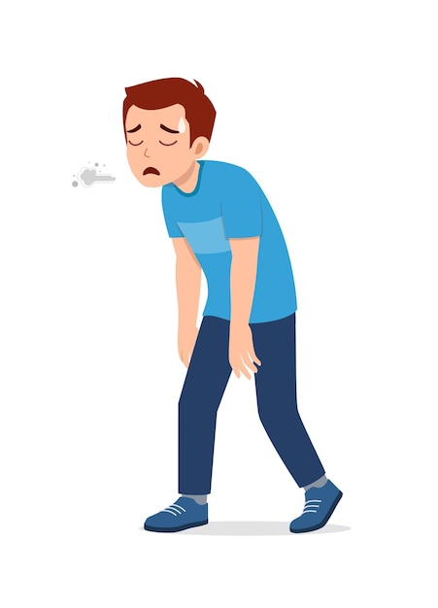

表示情感的经典句式
(4)他感到沮丧和疲惫，仿佛到了世界末日，他的心因绝望而撕裂。（续）
Frustrated and exhausted, he felt as if it were the end of the world, his heart torn with despair.
(5)他非常后悔。要是他再多等两分钟就好了。（续）
He was extremely regretful. If only he had kept waiting for
two more minutes.
(6)如果没有对妹妹的爱，阿里就不会得三等奖，也不会得到他想要的鞋子。（续）
But for /Without the love for his younger sister, Ali wouldn’t
have won the third prize and got his desired shoes.

Slide 67

company/ˈkʌmpəni/ n.公司;商行;陪伴
1.我计划在暑假期间申请一家外企的兼职职位。
_{2016年全国卷应用文“请求外教修改简历的请求信”} （应）
I’m planning to apply for a part-time position
at a foreign company during the summer holiday.
2.就在这时，他想起了在他父亲陪伴下接受的艰苦训练。“我要赢!”他很快镇定下来。（续）
That was when his hard training in his father’s company occurred to him. “I am the winner!” He collected himself quickly.
3.在父母的陪伴下，我们穿过了象征性的成人大门。（应）
With parents’ company, we went through under the symbolic coming-of-age gate.
4.《青春》杂志，被称为我最好的朋友，陪伴我度过了整个高中。
2021年新高考I卷应用文“youth英语报创刊十周年短文征稿”（应）
Youth, referred to as my best friend, accompanied me through my whole high school.
5.我会为它编故事和冒险，它永远是我忠实的伙伴。
_{2023年上海卷高考应用文“快乐童年参展物品介绍”} （应）
I would make up stories and adventures for the car, and it would always be my
loyal companion.

Slide 68


personality/ˌpɜ:səˈnæləti/ n.性格;个性
1.参加课外活动可以展示一个全面发展的个性，在大学申请中留下好印象。（应）
Engaging in extracurricular activities demonstrates a well-rounded personality and makes a good impression on
college applications.
2.所以，你能不能给我们自由选择自己的同伴，让我们更容易自己挑选出理想的伙伴，无论是在性格方面还是在语言技能方面。_{2023年全国卷I应用文“外教随机分组反馈信”} （应）
Therefore, could you please give us the freedom to choose our partner by ourselves so that we are more likely to single out our ideal mate by ourselves, whether in aspects of
personality or language skill.

Slide 69
personality/ˌpɜ:səˈnæləti/ n.性格;个性
3.然后给参与者一张图表，显示他们对每种工作个性的得分。最高的三项得分会用来组成一个代码,以显示参与者的整体职业性格。（应）
The participant is then given a chart showing their score for each type of work
personality. The top three scores are used to make a code that indicates the
participant’s overall work personality.
4.当我11岁的时候，我把太极作为一种爱好，它增强体质和塑造性格。（应）
I took up Tai Chi as a hobby when I was 11 and it builds my strength and character.
5.他的善良吸引了每个人。（应、续）
His good nature engages everyone.
nature 表示：自然；本质；性格；这个词常常用于描述一个人或事物的基本性质和特征，强调性格的内在和无法改变的一面。
personality 表示：人格；性格；名人；这个词常常用于描述一个人的特征，包括他们的行为，情感，态度等，强调展现给人的外在形象，表象人格。
character表示：字符；性格；人物；特征；这个词常常用于描述一个人的道德和精神特质。

Slide 70

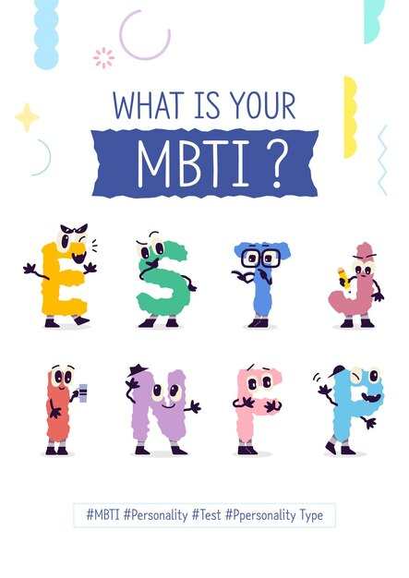
工作人格类型——MBTI人格评估工具
Work personality types ---MBTI personality assessment tool
现实型-R：动手，主动，技术
Realistic-R：Handson，active，technical
研究型-I：敏锐的，聪明的
Investigative-I：Observant，intellectual
艺术型-A：富有创意、想象力、独创性
Artistic-A：Creative，imaginative，original
社交型-S：乐于助人，以人为本，负责任
Social-S：Helpful，people-oriented，responsible
事业型-E：有说服力，自信
Enterprising-E：Persuasive，confident
传统型-C：有条理，注重细节
Conventional-C：Organized，detail-oriented

Slide 71

style/staɪl/ n.方式;作风
1.因此，我建议您考虑根据学生的语言能力或学习方式对他们进行分组。_{2023年全国卷I应用文“外教随机分组反馈信”} （应）
Therefore, I suggest that you consider grouping students based on their language
proficiency or learning styles.
2.这些艺术品的有各种各样的风格，有自由风格的水彩画，也有细致的水墨和毛笔画。_{2021年1月浙江卷应用文“中国画展宣传稿”} （应）
The artworks range in styles from free-style watercolors to meticulous ink and brush.
3.我们的第一个话题是“健康”，欢迎你提出一个困扰你的具体健康问题，
分享一个关于你健康生活方式的轶事或任何与这个话题相关的事情。（应）
Our first topic will be “Health “, and you are welcome
to raise a specific health issue troubling you, share an
anecdote about your healthy lifestyle or anything
related to the topic.

Slide 72

revise/rɪˈvaɪz/ vt.&vi.修改;修订;复习
1.我写信是想请您帮助修改我的求职信和简历中任何拼写、语法、词汇或格式错误。_{2016年全国卷应用文“请求外教修改简历的请求信”} （应）
I am writing to ask for your help in revising my job application letter and resume for any errors in spelling, grammar, vocabulary, or format.
2.此外，您总是主动修改我的写作作品的语言风格，让我接触地道的英语。_{2019年浙江新高考应用文“外国友人回国感谢信”} （应）
Besides you always offered to revise the language style of my writing practice,
which enabled me to savour a dip of authentic English.
3.在视频制作的最后一步，我们进行了大量的修改和完善，
在此期间我们进行了反复的讨论。（应）
The final step of the video production witnessed a lot of
revision and improvements, during which we had
repeated discussions.

Slide 73


http://www.sunedu.com
Thank You!

