Slide 1



感恩遇见，相互成就，本课件资料仅供您个人参考、教学使用，严禁自行在网络传播，违者依知识产权法追究法律责任。
更多教学资源请关注
公众号：溯恩英语
知识产权声明

Slide 2

让细节在你的笔端鲜活
细节描写

Slide 3


细节描写
细节描写是对事件发展和人物的性格、肖像、心理、动作等一些细微而又有典型意义的情节所做的细腻、具体的描写。
写好细节是读后续写中的一个重要技巧。它可以让读者更加深入地理解和感受所描述的场景、人物和情感。

Slide 4


取胜第一招：动用五官进行细节描写
概括+细节
素材摘录1：The inside was horrible; it smelled strongly of seaweed, the wind whistled through the gaps in the wooden walls, and the fireplace was damp and empty. There were only two rooms.
嗅觉
触觉
听觉
视觉
whistle：(v.)吹口哨;呼啸
里面很可怕：房子散发着强烈的海藻味，风从木墙上的缝隙中呼啸而过，壁炉又湿又空。只有两个房间。
and the
Sorcerer’s Stone

Slide 5
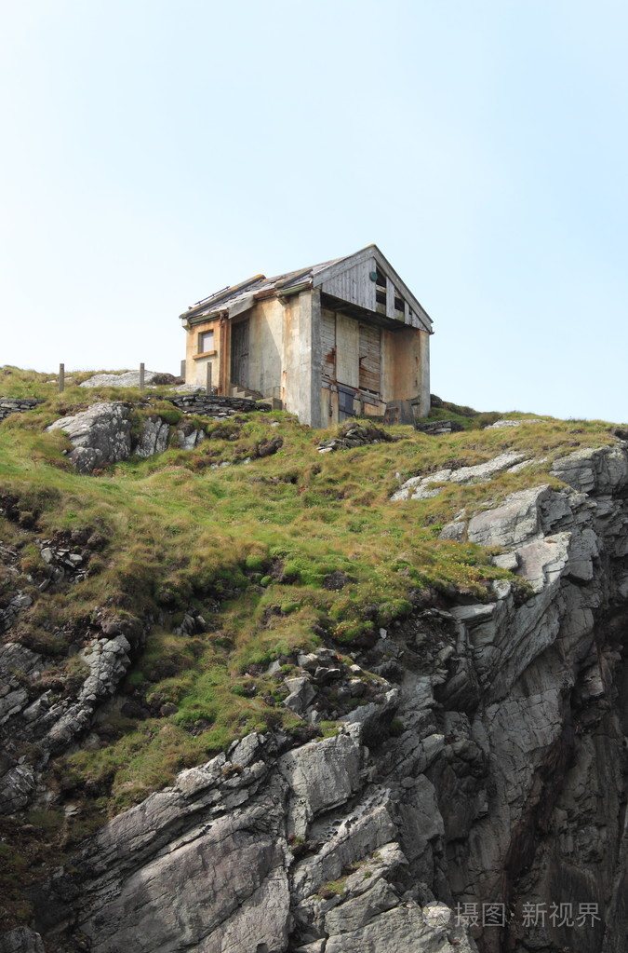
素材背景：To try to ran away from Hagrid, Uncle Vernon led his family and Harry to an isolated island and planned to spend the night in the most miserable little shack.
素材解读：The writer uses five senses to show the inside of the shack is horrible. The sense of reality helps the readers better understand the writing.
Tips：The writer uses five senses to perceive the object she wants to describe, such as hearing, touch, smell, touching etc, which makes the description more vivid and impressive.
Besides, the writer uses a clear structure to describe the scene from the whole to the parts.

Slide 6
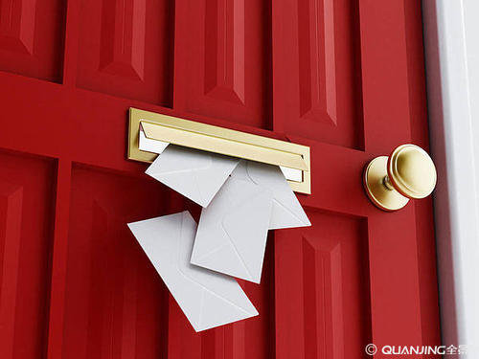

素材摘录2：They heard the click of the mail slot and flop of letters on the doormat.
他们听到邮件槽的咔嗒声和信件掉在门垫上的扑通声。
mail slot:投信口
click咔嗒声
doormat:门口地垫
flop落下
mail slot
doormat
and the
Sorcerer’s Stone
Notes:
llo

Slide 7

素材背景：It is the beginning of the story. Every morning, it is quiet when the mails arrive. After Harry receives his first letter, the calmness has been broken.
素材解读：The writer uses hearing to show how the mails are delivered to the Dursleys’ house. From the two nouns “click” and “flop” , the readers get the impression that the Dursleys’ house is quiet and normal just like others. Then, a letter arrives and everything changes.

Slide 8
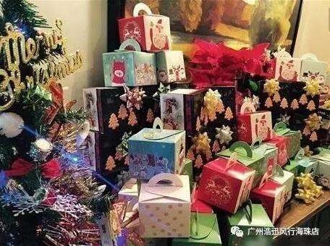
取胜第二招：细节描写表达需细腻
素材摘录1：The table was almost hidden beneath all Dudley’s birthday presents.
桌子差点找不到了，因为它上面堆满了达德利所有的生日礼物。
Happy
Birthday
and the
Sorcerer’s Stone

Slide 9

素材背景：It is Dudley’s birthday and he got mountains of presents. While Harry got nothing on his birthday.
素材解读：The writer uses details to show Dudley has got many presents. She didn’t tell the readers the number of the presents is large, but show the readers that there are so many presents that the table is almost hidden beneath the presents.

Slide 10
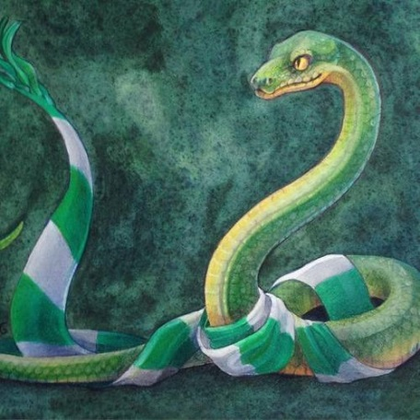
素材摘录2：The snake suddenly opened its beady(圆溜溜的) eyes. Slowly, very slowly, it raised its head until its eyes were on a level with Harry’s.
on a level with:与…一样高
蛇突然张开了它圆溜溜的眼睛。慢慢地，非常缓慢地，它抬起头，直到它的眼睛与哈利的眼睛齐平。
and the
Sorcerer’s Stone

Slide 11
素材背景：Harry met a snake with high intelligence in the zoo.
素材解读：The writer uses adjectives and adverbs to describe the details vividly and delicately.
Tips：Details need to be conveyed through delicate expression. You can convey details by describing a subtle action, expression, or language. This way of expression can make your description more deeply ingrained in people's hearts.
and the
Sorcerer’s Stone

Slide 12

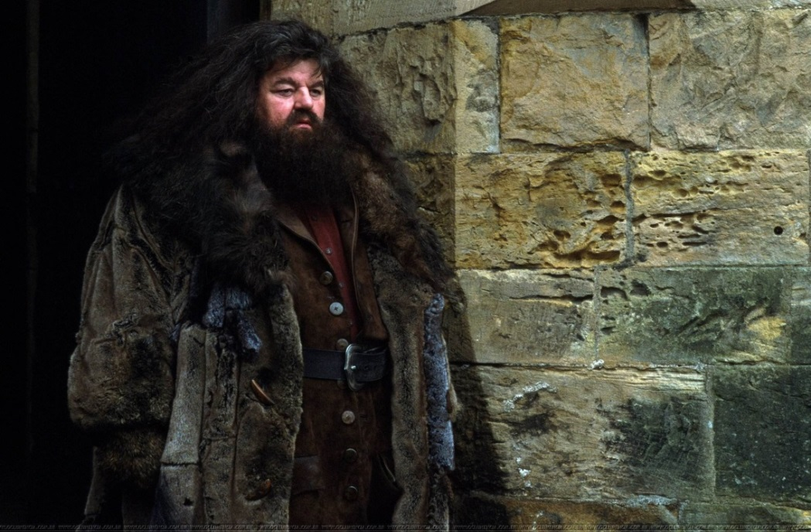
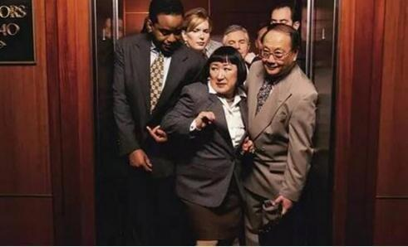
取胜第三招：细节描写表达需具体
素材摘录：The giant squeezed his way into the hut, stooping so that his head just brushed the ceiling. He bent down, picked up the door, and fitted it easily back into its frame.
弯腰
巨人俯身挤进小屋，头刚好碰到天花板。他弯下腰，拿起门，很容易地把它装回门框里。
giant
squeeze: 挤
stoop: 俯身，弯腰

Slide 13
素材背景： To bring Harry back, Hagrid followed Uncle Vernon’s escape route and finally came to the shack.
素材解读：The writer uses three verbs “squeeze”, “scoop” and “brush” to show Hagrid is heavily built. And the adverb “easily” is used to show Hagrid is extremely strong in strength.
Tips：Details need to be specific, and vague language should not be used. Concrete descriptions can help readers better imagine the object or scene you want to describe.

Slide 14
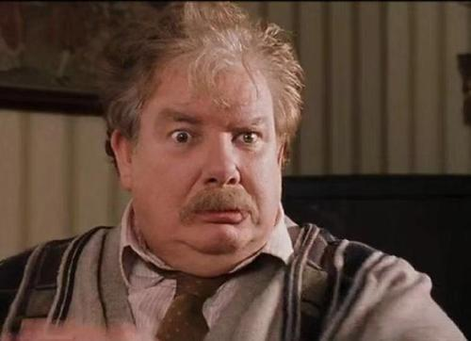
取胜第四招：细节描写需用词精准
素材摘录1：There was a crash behind them and Uncle Vernon came skidding into the room.
只听到身后一片哗啦声，弗农姨父滑进了房子。
skid: 滑行，打滑
and the
Sorcerer’s Stone

Slide 15
素材背景： Hagrid is knocking the door so loud that everyone jerks awake. Holding a rifle in his hands, Uncle Vernon comes to the door in a hurry.
素材解读：From Uncle Vernon’s point of view, he is trying to protect Harry from sorcerers. The floor of the house is wet and slippery, so when Uncle Vernon goes to the door in a hurry, he skids. It precisely describes the situation at that moment.
Tips：When describing details, use precise words and avoid using large and empty words.
and the
Sorcerer’s Stone

Slide 16
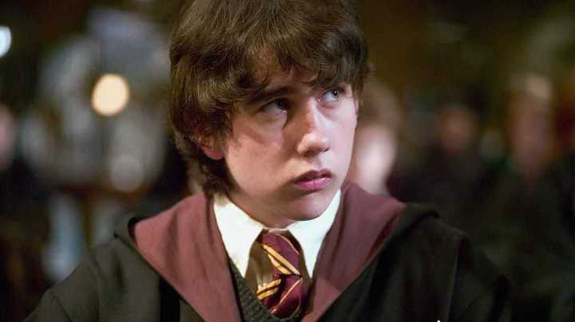
素材摘录2：When Neville Longbottom was called, he fell over on his way to the stool.
叫到纳威·隆巴顿的名字时，他朝凳子跑的路上摔了一跤。
and the
Sorcerer’s Stone

Slide 17
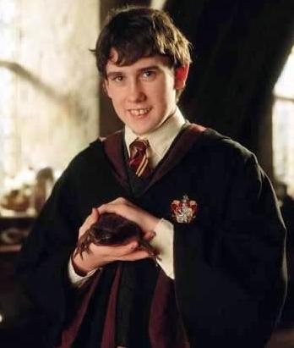
素材背景：After Harry and other first years arrive, they are first sorted into their houses by the sorting hat on the stool.
素材解读：On their way to Hogwarts, Neville Longbottom keeps losing his toad, which shows he is an careless boy. It is strengthened when the writer depicts the detail that he fell over on his way to the stool.

Slide 18
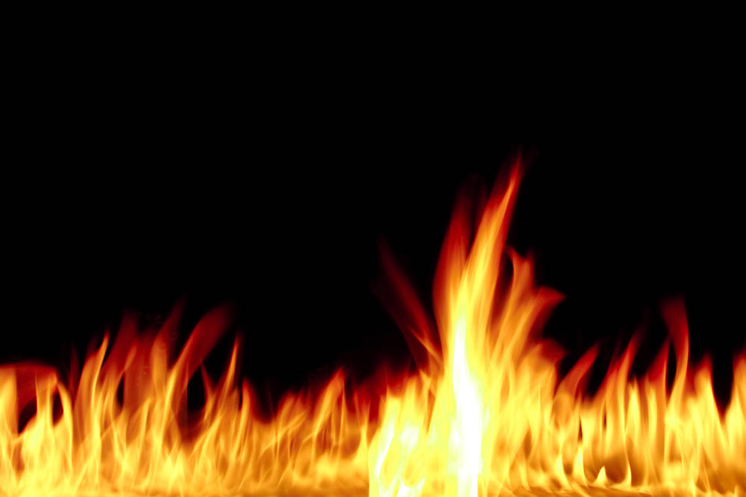
取胜第五招：用修辞强化细节描写
As Harry step forward, whispers suddenly broke out like little hissing fires all over the hall.
当哈利走上前去时，大厅里突然发出的一阵窃窃低语，像小火苗一样咝咝作响。
and the
Sorcerer’s Stone

Slide 19
素材背景：After Harry and other first years arrive, they are waiting in the hall. One after one, they are called to the front to be sorted into their houses by the sorting hat on the stool.
素材解读：The writer uses simile “like little hissing fires” to show every other first years’ surprise and curiosity when they hear Harry’s name is called.
Tips：Rhetoric, such as simile, metaphor, hyperbole and personification, can make the details more vivid and interesting.
and the
Sorcerer’s Stone

Slide 20
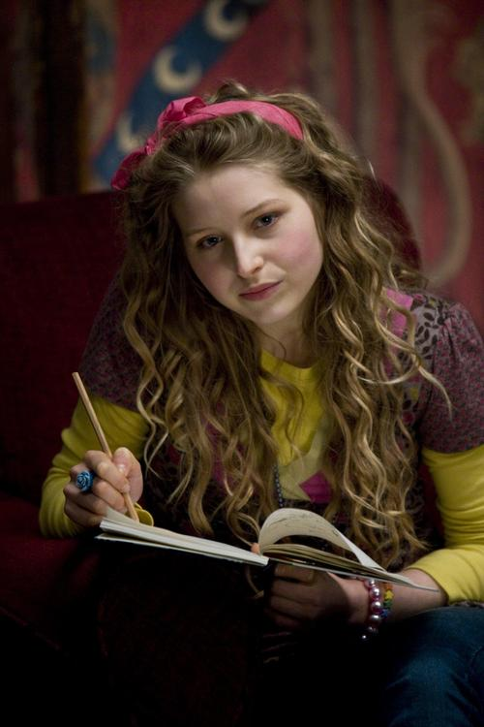
素材摘录2：“Brown, Lavender” became the first new Gryffindor, and the table on the far left exploded with cheers.
拉文德·布朗则成了格兰芬多的第一位新生，左边最远的一张餐桌即刻爆发出一阵欢呼。
and the
Sorcerer’s Stone

Slide 21
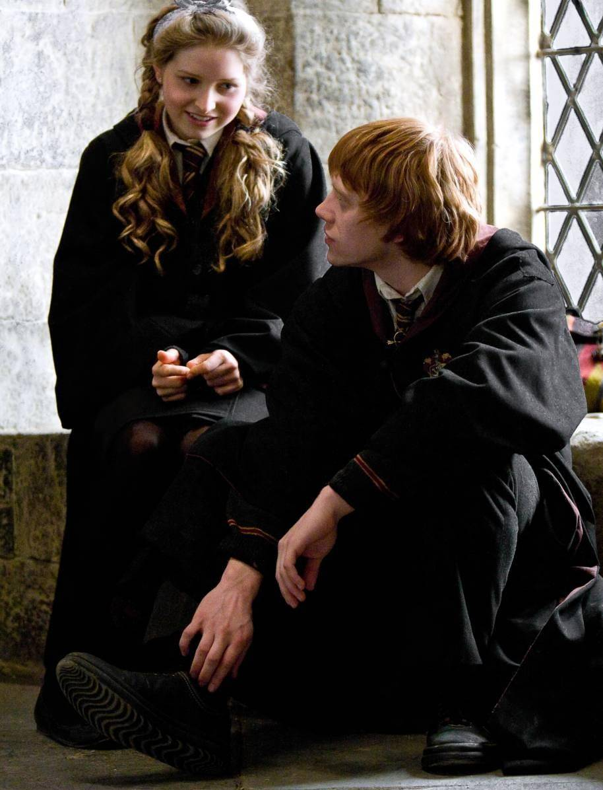
素材背景：All the first years are waiting in the hall. Lavender Brown is the first to be called to the front to be sorted into Gryffindor by the sorting hat on the stool.
素材解读：The writer uses hyperbole to show that Lavender Brown and her friends are extremely excited to know she is sorted into Gryffindor. Here, rhetorical devices is used to enhance the descriptive effect.

Slide 22
五官:真实
没有细节就不可能有艺术品。细节描写是塑造人物，达到典型化的重要手段。
细腻:传神
修辞：强化
精准丰满
具体:生动
精准:确切
精准丰满

Slide 23
Have a practice 1
Fill in the blanks, using the proper words to describe the details. Pay attention to the personality that these details reflect of the characters.
On that particular day, Harry picked up the letters as usual. But this time, he found a letter for him. Turning the envelope over, __________________(颤抖着手), Harry saw a purple wax seal bearing a coat of arms; a lion, an eagle, a badger, and a snake surrounding a large letter H.
“____________(快点), boy!” shouted Uncle Vernon from the kitchen. “What are you doing, checking for letter bombs?” ____________________________(他为自以为是的俏皮话而咯咯地笑了).
Harry went back to the kitchen, still ___________________(瞪着这封信). He handed Uncle Vernon the bill and the postcard, sat down, and ________(慢慢地) began to open the yellow envelope.
Uncle Vernon ____________(撕开) the bill, ________________(厌恶地哼了一声), and ______________ (翻转) the postcard.
his hand trembling
Hurry up
He chuckled at his own joke
staring at his letter
slowly
ripped open
snorted in disgust
flipped over

Slide 24
Have a practice 2
A generalized statement
Fill in the blanks, using the proper words to describe the details. Pay attention to the personality that these details reflect of the characters.
They didn’t stop to eat or drink all day. By nightfall Dudley was ___________(嚎叫). He’d never had such a bad day in his life. 【He was ___________(饿极了), he ______________(错过了) five television programs he'd wanted to see, and he _______________________
__________________________________________________________ (还从来没一整天都没坐到电脑前炸外星人).】
howling
hungry
had missed
had never gone so long without blowing up an alien on his computer
Detailed support

Slide 25
Have a practice 3
Fill in the blanks, using the proper words to describe the details. Enjoy the details that makes the writing vivid.
Whispers _________ (跟随) Harry from the moment he left his dormitory the next day. People _________ (排队) outside classrooms stood __________(踮脚) to get a look at him, or _______________(折回) to pass him in the corridors again, ________(瞪着眼). Harry wished they wouldn't, because he was trying to concentrate on finding his way to classes.
followed
lining up
on tiptoe
doubled back
staring

Slide 26
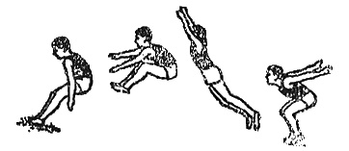

无论是人物性格的刻画，还是故事情节的展开，典型环境的描绘都离不开真实而又生动的细节描写。好的细节描写能把人物或事物最本质的性状鲜明而又逼真的呈现在读者面前，从而增强作品的真实感和艺术感染力。
Thank you

