Slide 1



感恩遇见，相互成就，本课件资料仅供您个人参考、教学使用，严禁自行在网络传播，违者依知识产权法追究法律责任。
更多教学资源请关注
公众号：溯恩英语
知识产权声明

Slide 2
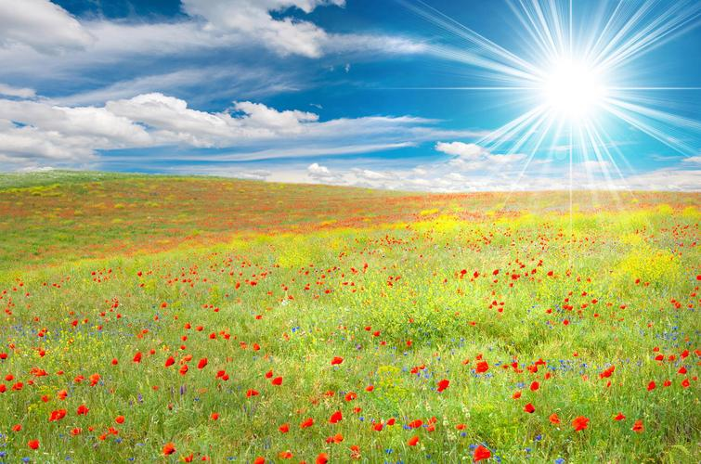
让人物在你的笔端鲜活
修辞手法

Slide 3

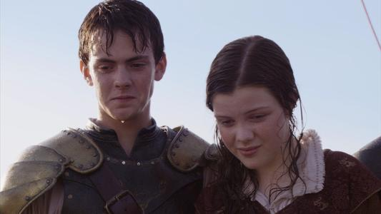
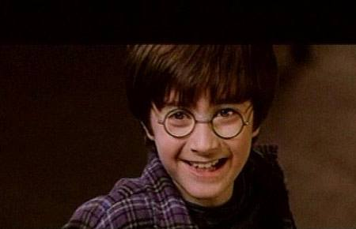
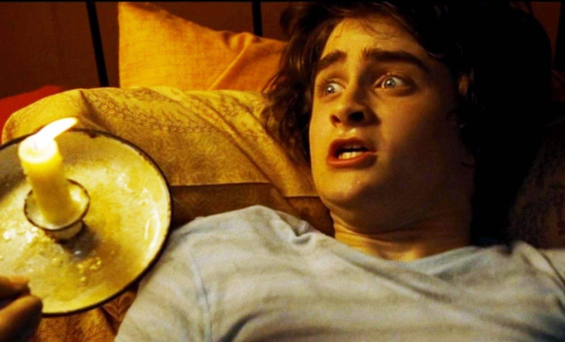
修辞手法
修辞手法是为提高表达效果，用于各种文章或应用文，在语言写作时表达方法的集合。修辞手法的增加了语言的创造力、表现力和趣味性。
这里主要介绍哈利波特与魔法石中出现的明喻、暗喻、拟人、夸张、反讽和双关。

Slide 4
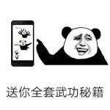
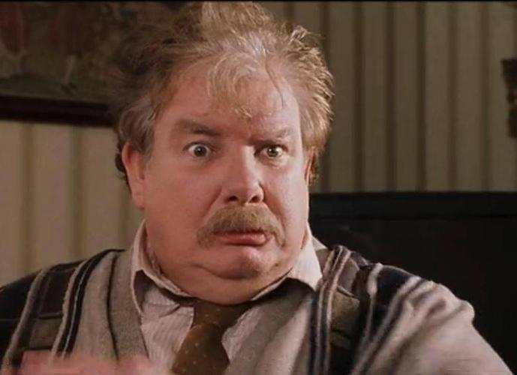
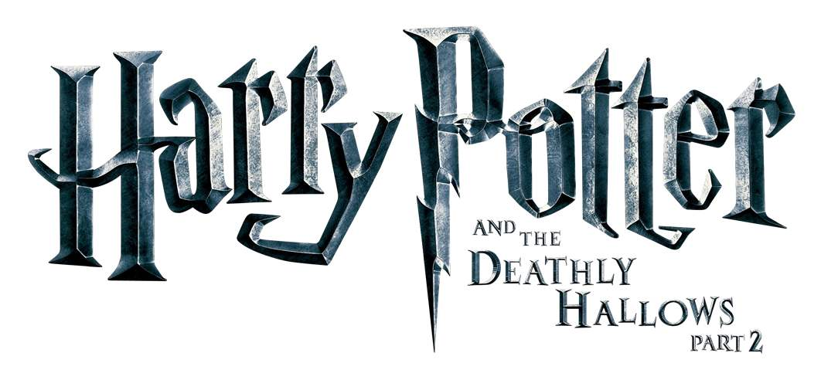
取胜第一招：明喻
素材摘录1： "Ah, shut up, Dursley, yeh great prune," said the giant; he reached over the back of the sofa, jerked the gun out of Uncle Vernon's hands, bent it into a knot as easily as if it had been made of rubber, and threw it into a corner of the room.
明喻
prune /pruːn/n.傻瓜;李子干 vt.修剪
jerk /dʒɜːkt/v.急拉
“哦，闭嘴，德思礼。你这个大傻瓜。”巨人说道。他隔着沙发把枪从德思礼手里抢过来，轻轻一撅，绾成一个结，扔到屋角，仿佛枪是用橡皮做的。
and the
Sorcerer’s Stone

Slide 5
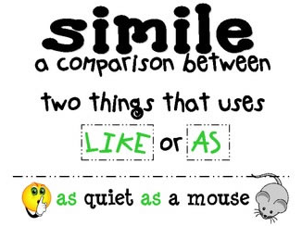
素材背景：Mr. Dursley didn’t want the sorcerers to find Harry, so he took his family and Harry to an isolated island. Still, Hagrid followed them there and broke into the shack. Mr. Dursley used a gun to threat Hagrid, who grabbed the gun from Mr. Dursley and bent it into a knot.
明喻：simile, a word or phrase that compares sth to sth else, using the words “like”, “as” or “as if”.
素材解读：Here the sentence “Hagrid bent the gun into a knot as easily as if it had been made of rubber” uses simile, compare the gun to something made of a rubber, to show Hagrid is a giant with unusual strength.

Slide 6
素材摘录2：Uncle Vernon made another funny noise, like a mouse being trodden on.
明喻
弗农姨夫又发出一声怪叫，好像老鼠被人踩了一样。
素材背景：After Hagrid followed the Dursleys and broke into the shack, Mr. Dursley used a gun to threat Hagrid, who grabbed the gun from Mr. Dursley and bent it into a knot. Mr. Dursley let out a scream like a mouse’s squeak.
tread /tred/ v.踏;踩
过去式： trod
过去分词： trodden
素材解读：Here the writer uses simile, compare Mr. Dursley’ scream to a mouse’s squeak to laugh at Mr. Dursley.
and the
Sorcerer’s Stone

Slide 7
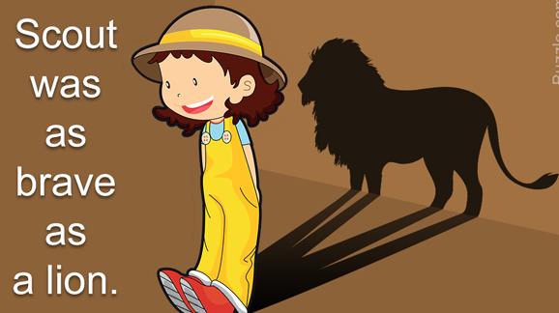
素材摘录3：And the fleet of little boats moved off all at once, gliding across the lake, which was as smooth as glass.
fleet /fliːt/ n.船队；车队
明喻
glide /ˈɡlaɪd/v.滑行;滑翔
一队小船即刻划过波平如镜的湖面向前驶去。
素材背景：The first years needed to take boats to Hogwarts.
素材解读：Here “the lake” is compared to “glass” to show its smoothness.
and the
Sorcerer’s Stone

Slide 8
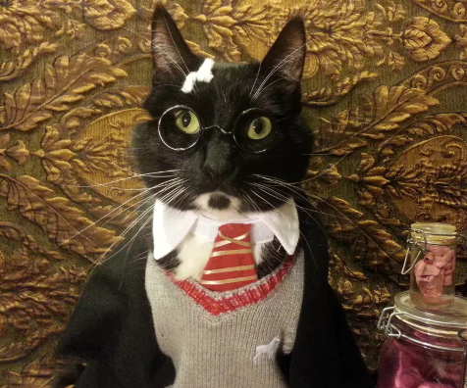
取胜第二招：暗喻
暗喻
素材摘录1：Twelve times he clicked the Put-Outer, until the only lights left on the whole street were two tiny pinpricks in the distance, which were the eyes of the cat watching him.
click /klɪk/ v.发出咔嗒声;单击
pinprick /ˈpɪnprɪks/ n.(光等的)点;针孔
他用熄灯器咔嗒了十二次，整条街上只剩下远处两个小小的光点，那是一直看着他的那只猫的眼睛。
and the
Sorcerer’s Stone

Slide 9
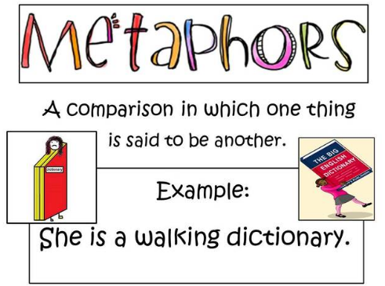
素材背景：At the beginning of the story, Professor McGonagall changed into a cat, sitting on the wall outside number four, Privet Drive, that is Mr. and Mrs. Dursley’s house. During the midnight, Albus Dumbledore appeared.
素材解读：Here, Professor McGonagall’s two eyes are compared to pinpricks to show the brightness of her eyes.
暗喻：metaphor, a word or phrase used to describe sb/sth else, in a way that is different from its normal use, in order to show that the two things have the same qualities and to make the description more powerful.

Slide 10
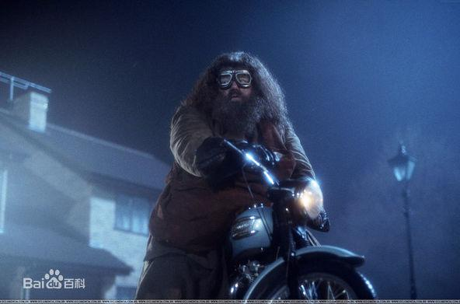
素材摘录2：He had hands the size of trash can lids, and his feet in their leather boots were like baby dolphins.
trash can/ˈtræʃ kæn/ n.垃圾桶
暗喻
明喻
lid /lɪd/ n. 盖子
leather /ˈleðə(r)/n. 皮革
boot /buːt/ n. 靴子
他的那双手有垃圾桶盖那么大，一双穿着皮靴的脚像两只小海豚。
素材背景：Hagrid brought baby Harry to the Dursley’s house.
素材解读：Here the writer uses both simile and metaphor to show the reader Hagrid is a giant. She compares his hands to trash can lids and his boots to dolphins.

Slide 11
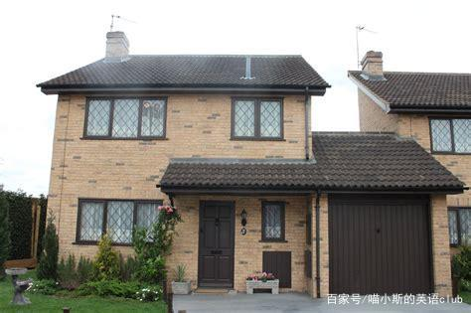
取胜第三招：拟人
拟人
素材摘录1： A breeze ruffled the neat hedges of Privet Drive, which lay silent and tidy under the inky sky, the very last place you would expect astonishing things to happen.
breeze /briːz/ n. 微风
ruffle /ˈrʌfl/ v.弄乱;激怒
hedges /ˈhedʒɪz/ n.树篱
清风吹拂女贞路上整洁的树篱,漆黑的天空下只余下静谧与洁净。这是一个你最不可能有任何惊人事情发生的地方。
and the
Sorcerer’s Stone

Slide 12
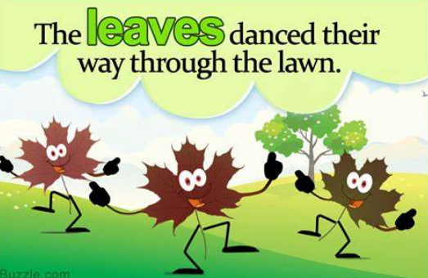
素材背景：Albus Dumbledore decided to put baby Harry here, number four, Privet Drive, to be brought up by his aunt Mrs. Dursley. Because he thought it might be good for Harry to be raised without knowing he was famous and special before he had the ability to take the responsibility.
拟人： personification, the practice of representing objects, qualities, etc. as humans, in art and literature.
素材解读：The breeze doesn’t have hand, but it “ruffles” the hedges. Here the writer uses personification to describe the breeze, giving it the quality of humans. Similarly, “silence” is another quality of humans.

Slide 13
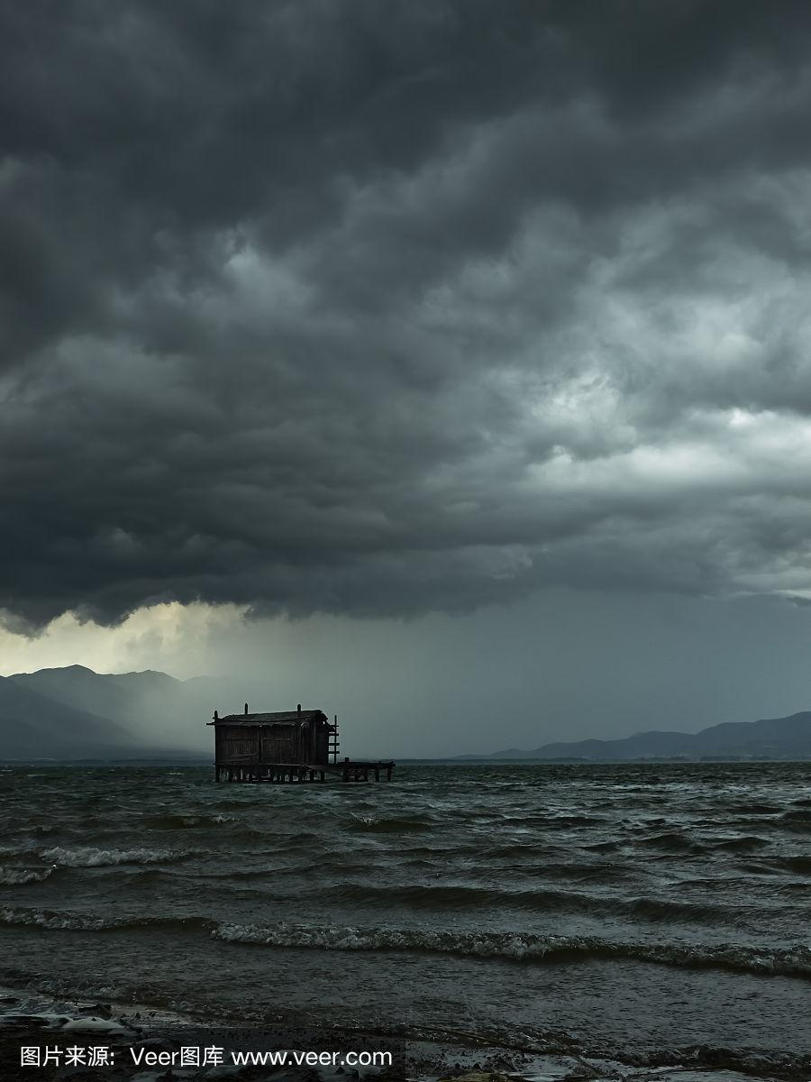
素材摘录2： The storm raged more and more ferociously as the night went on.
拟人
ferociously 凶猛地
rage /reɪdʒ/ v. 发怒
夜越来越深，而暴风雨越发肆虐。
素材背景：Uncle Vernon led his family and Harry to a shack on an island on a stormy night to hide from Hagrid. The storm became more violent with night going on.
素材解读：Storm cannot rage but humans can. The writer uses “rage”, a quality of humans, to show the storm is fierce. The reader will get the impression that it is raining hard and the strong wind is blowing violently, letting out loud noises.

Slide 14
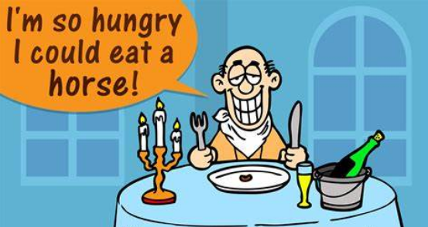
取胜第四招：夸张
夸张
素材摘录1： Wiping his streaming eyes on his jacket sleeve, Hagrid swung himself onto the motorcycle and kicked the engine into life; with a roar it rose into the air and off into the night.
roar /rɔː(r)/ n.&v. 吼叫
stream /striːm/ v.流动 n.溪;河
swing /swɪŋ/ v. 纵身跃向;摆动
海格用夹克袖子揩了揩哗哗流泪的眼睛，跨上摩托，踩着了发动机。随着一声吼叫，摩托车腾空而起，消失在夜色里。
and the
Sorcerer’s Stone

Slide 15

素材背景：After Hagrid put the baby Harry in front the Dursleys’ house, he was very sad and cried. But he had to say goodbye to Harry and leave.
夸张： hyperbole, a way of speaking or writing that makes sth sound better, more exciting, dangerous, etc. than it really is.
素材解读：The writer uses hyperbole “tears are running like a stream” to show Hagrid is extremely sad.

Slide 16
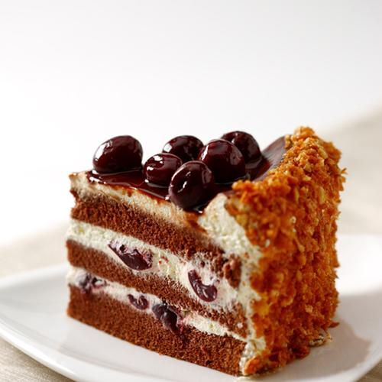
素材摘录2：She let Harry watch television and gave him a bit of chocolate cake that tasted as though she'd had it for several years.
她让哈利看电视，还给了他一小块巧克力蛋糕。这块蛋糕吃起来像已经放了很多年似的。
夸张
素材背景：One day in July, Aunt Petunia took Dudley to London to buy his Smeltings uniform, leaving Harry at Mrs. Figg’s.
素材解读：Here the writer uses hyperbole “as though she had had the cake for several years” to describe that the chocolate cake is stale and has lost its freshness.

Slide 17
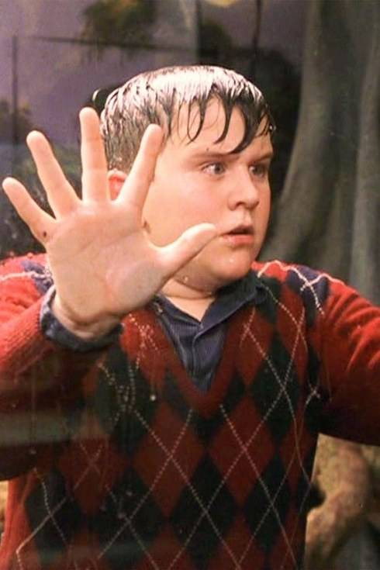
取胜第五招：反讽
反讽
素材摘录1： The Dursleys had a small son called Dudley and in their opinion there was no finer boy anywhere.
德思礼家有个儿子叫达德利。在他们眼里，这世界上再也没有比他更棒的男孩了。
no+比较级，意为“不再，再没有”
素材背景：At the beginning of the story, the writer introduces the family where Harry has been raised.
反讽：Irony is the expression of actual intent in words that carry the opposite meaning.
素材解读：The writer uses irony to show Dudley is actually a bad tempered bully.
and the
Sorcerer’s Stone

Slide 18
素材摘录2：Everywhere Harry went, people pointed and didn't trouble to lower their voices as they insulted him. Slytherins, on the other hand, clapped as he walked past them, whistling and cheering, "Thanks Potter, we owe you one!”
反讽
哈利不管走到哪儿,大家都对他指点点,说一些侮辱他的话时也并不把声音放低。另一方面,每当他从斯莱特林们身边走过时,他们总是又欢呼又吹口哨, 鼓掌:“谢谢你,波特,你帮了我们一个大忙!”
素材背景：Professor McGonagall took a hundred and fifty points from Gryffindor because Harry, Neville and Hermione walked around school at night, put Gryffindor in last place to have a chance to win the House Cup .
素材解读：Harry was suddenly the most hated. Even Ravenclaws and Hufflepuffs turned on him, because everyone had been longing to see Slytherin lose the house cup. So the Slytherin is the biggest winners. The Slytherins use irony to mock Harry.

Slide 19
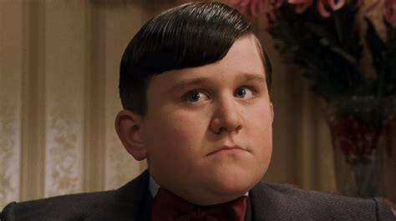
取胜第六招：双关
双关
素材摘录1： Dudley looked a lot like Uncle Vernon. He had a large pink face, not much neck, small, watery blue eyes, and thick blond hair that lay smoothly on his thick, fat head.
thick /θɪk/ adj.1. 浓密的 2. 笨的
达德利长得很像弗农叔叔。他有一张粉红色的大脸，脖子不长，水蓝色的小眼睛，浓密的金发柔顺地贴在他肥厚的脑门上。
素材背景：It is the beginning of the story and the writer introduces the appearance of Dudley, Harry’s cousin, a spoiled boy, who often bullies Harry. His mother thinks he is an angel while Harry thinks he is a pig.

Slide 20
素材解读：Thick has two meanings in this sentence. One is that Dudley has a lot of hair. The other meaning is that he is foolish. In Harry’s eyes, Dudley is a pig in a wig. The writer uses pun to combine the two meanings in one word, letting the readers to taste the humor.
双关：Pun is the clever or humorous use of a word that has more than one meaning, or of words that have different meanings but sound the same.
and the
Sorcerer’s Stone

Slide 21
Have a practice 1
Fill in the blanks, using the proper words to describe the character(s). Please point out which figure of speech is used in the passage.
When Harry and Hermione came back from the astronomy tower at one o’clock in the morning, Neville came to warn them. Professor McGonagall caught three of them. She looked__________ (更有可能) to breathe fire than Norbert(挪威脊背龙) as she ____________________________ (高高耸立在他们三个人面前).
“I would never have believed it of any of you. Explain yourselves.”
It was the first time Hermione ______________________ (不能回答) a teacher's question. She was staring at her slippers, ________________ (像雕像一样一动不动).
夸张
more likely
towered over the three of them
had ever failed to answer
as still as a statue
明喻

Slide 22
Have a practice 2
Fill in the blanks, using the proper words to describe the environment. Please point out which figure of speech is used in the passage.
Christmas was coming. One morning in mid-December, Hogwarts woke _____________________________________ (发现四下里覆盖着好几尺厚的积雪). While the Gryffindor common room and the Great Hall had ____________ (熊熊旺火), the drafty corridors had become icy and ____________ (一阵凛冽的寒风) rattled(咔哒作响) the windows in the classrooms.
拟人
to find itself covered in several feet of snow
roaring fires
a bitter wind
拟人

Slide 23
Have a practice 3
Fill in the blanks, using the proper words to describe the character(s). Please point out which figure of speech is used in the passage.
It was Dudley’s birthday. Aunt Petunia woke up Harry early and ordered him to fry eggs for Dudley. Harry ______________ (正在煎蛋) by the time Dudley arrived in the kitchen with his mother. Aunt Petunia often said that Dudley looked like ____________ (小天使) -- Harry often said that Dudley ____________ (长得像) a pig in a wig.
was frying eggs
a baby angel
b
looked like
b
明喻

Slide 24
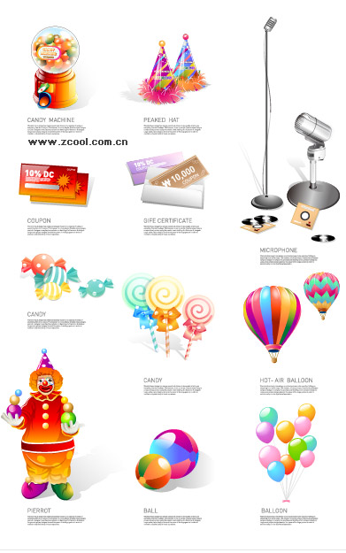
Thanks!

