Slide 1


感恩遇见，相互成就，本课件资料仅供您个人参考、教学使用，严禁自行在网络传播，违者依知识产权法追究法律责任。
更多教学资源请关注
公众号：溯恩英语
知识产权声明

Slide 2
活用教材词汇，靶向高考写作
B1U4单词拓展
Natural Disasters

Slide 3

活用词汇
disaster /dɪˈzɑ:stə(r)/ n.灾难;灾害
1.最近几年自然灾害频发，例如地震、飓风和洪水等，它们是对人们的生命的巨大威胁。
Recent years have seen a big increase in natural disasters,such as earthquakes, hurricanes and floods, which are big threats to people's lives.
2.随着国家防灾减灾日的临近，我校开展了一系列活动。我想分享一些细节。（应用文之向外国友人分享全国防灾减灾日）
With the approaching of National Disaster Prevention and Mitigation Day, our school carried out a series of events. And I would like to share some details.
3.这些活动是有益的。它们不仅提高了我们的自我保护意识，而且还使我们为长期的灾害预防和恢复做好了准备。
The events are beneficial. They not only raise our awareness of self-protection but also prepare us better for long-term disaster prevention and recovery.
The first practice was a disaster. I lost rhythm on my strokes. I messed up my turns.
4.第一次练习是一场灾难。我的动作失去了节奏。我弄乱了我的部分。(续写之舞台表演)

Slide 4


活用词汇
slide /slaɪd/ vi.&vt.(使)滑行;滑动
1.突然，我感到有什么毛茸茸的东西擦过我的脚踝，看见它优雅地滑过。(续写)
Suddenly, I felt something furry brush my ankle and saw him slide past with elegance.
2.然而，任务很无聊:帮助困惑的游客，在孩子们滑下滑梯之前测量他们的身高，诸如此类的事情。(读后续写之志愿者活动)
However, the tasks were boring: helping confused visitors and measuring the height of children before they went down the slide, those sorts of things.
3.第一天，他走进罗老师的教室，无视其他学生，看上去又生气又恼火，然后坐到椅子上，把几本课本打翻在地。(读后续写之动作描写)
The first day he walked into Mr. Rowe’s classroom, he ignored the other students, looking angry and annoyed, and slid into his chair, knocking a couple of textbook onto the floor.
4.我解释了我的立场，然后他微笑着递给我一个信封。“这是给你的，”他说。(续写)
I explained my position, then he smiled and slid me an envelope. “This is for you,” he said.

Slide 5


活用词汇
slide /slaɪd/ vi.&vt.(使)滑行;滑动
5.我不想麻烦任何人重新长途跋涉穿过洞穴，所以我退出了，脱下了潜水服。穿着t恤，我试着再次滑过，但我的屁股被困住了。(续写)
I didn't want to inconvenience anyone by having to make the long trip back through the cave, so I backed out and took off my wetsuit. In just my T­shirt, I tried to slide through again but my hips were trapped.
6.他钻到车底下，然后两分钟后，他溜出来说车修好了。(续写)
He got under the car, and 2 minutes later, he slid out and said it was all fixed.
7.他不声不响地钻进被子。(续写)
He slid into bed.
8.我们从草坡上滑了下来。(续写)
We slid down the grassy slope.

Slide 6
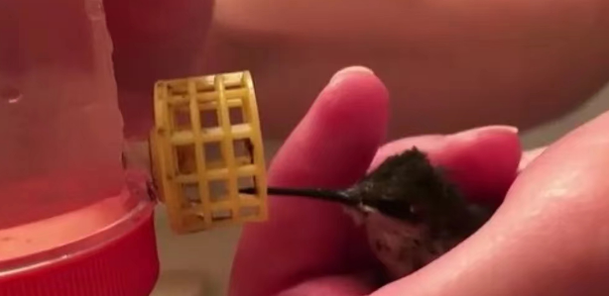

活用词汇
flood /flʌd/ n.洪水;大量 vi.淹没
1. 一种甜蜜的平静像一种祝福一样涌入我的心中，这让我再次充满了希望。(读后续写之社会温情篇：助人亦助己)
A sweet peace flooded into me like a blessing, which made me hopeful again.
2. 当我回到农场时，我的脑海里充满了那天的回忆——那只鸟用感激的眼神看着我，当我小心翼翼地把它从蜘蛛网中解救出来时，它小小的身体在我手中颤抖。(2023浙江英语首考读后续写)
As I returned to the farm, my thoughts were flooded with memories of that day-the way the bird had looked at me with such gratitude, its tiny body trembling in my hands as I carefully freed it from the spider's web.
3.当我在台上领奖的时候，我突然感到兴奋和骄傲。(应用文之学校生活)
When I accepted the prize on the stage, excitement and pride flooded over me all of a sudden.
4.人们笑着涌了进来，捐款来帮助避难所。(续写)
Exploding into wilder laughter, people came flooding in, handing their donations to help the shelter.

Slide 7
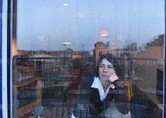

活用词汇
flood /flʌd/ n.洪水;大量 vi.淹没
5.想象着道路破裂，汽车被洪水冲走，我感到更加害怕，感觉到死亡在等着我。“从车上跳出来，向我跑过来!”乔大叫着下了车，等着我的行动。(读后续写之人与自然1：困在洪水中)
Picturing the road cracked and the car was flooded away，I felt more frightened and sensed death was waiting for me."Jump out of the car and ran to me！"Joe yelled and got off the truck，waiting for my action.
6. 她童年的往事涌上心头。(续写)
Memories of her childhood came flooding back .
7.她双颊泛出红晕，视线转向别处。(续写)
She looked away as the colour flooded her cheeks.
8.室内一片暮色。(续写)
The room was flooded with evening light.

Slide 8
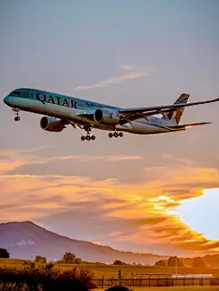
活用词汇
rescue /ˈreskju:/ n.&vt.营救;救援
1.当面对困难和失败时，我必须克服它们。在未来，我将成为一名好医生来救死扶伤，全身心地投入到我的工作中。(2020年天津应用文之成人礼活动介绍)
When faced with the difficulties and failures, I must overcome them. In the future, I will be a good doctor to heal the wounded and rescue the dying, devoting myself to my work.
2. 在橘黄色的天空衬托下，黑点越来越大，他们获救的希望也越来越大。(续写之人与自然—被困在海边)
The black dot grew larger and larger against the orange sky，so was their hope of being rescued.
3.当我的车靠近它时，我的思绪又回到了我从蜘蛛网中救出这只可怜的蜂鸟的那一刻。(2023浙江读后续写)
As my car neared it, my thoughts drifted back to the moment when I had rescued the tiny poor creature－the hummingbird from the spider's web.
4.卢卡一直在鼓励我，而救援队则用特定的工具钻岩石，甚至摩擦岩石的一部分，以解放我的臀部。(续写之海边脱困)
Luca kept on encouraging me while the rescue team used specific tools to drill and even rub part of the rock to free my hips.

Slide 9
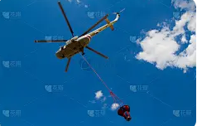
活用词汇
rescue /ˈreskju:/ n.&vt.营救;救援
5.路易丝找到救援人员的梦想实现了，现在她和他们相聚了，她希望能永远保持联系。(续写)
Louise's dream of finding her rescuers came true and now that she'd reunited with them, she hoped to stay connected forever.
6.似乎过了很长一段时间，直升机终于在他们上方停了下来，放下了一名救援人员。(续写)
After what seemed like an eternity，the helicopter finally came to a halt over them and lowered a rescuer.
7.come to our rescue 前来营救，挺身而出
清了清脸上的水，我看见那个大胡子男人过来救我们。(续写)
Clearing the water on my face, I could see the man with heavy beard came to our rescue.

Slide 10
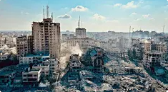

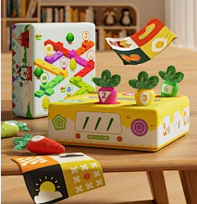

活用词汇
damage /ˈdæmɪdʒ/ vt.损害;破坏 n.损坏;损失
1. 火灾造成了巨大的损失。(续写)
The fire caused extensive damage.
2.知道没有人会碰他的东西并造成任何损害，维克多可以放心地把他的玩具或书放在家里。(续写)
Victor could leave his toys or books around the house with complete ease of mind, knowing that there was no one who would get their hands on his belongings and cause any damage.

Slide 11

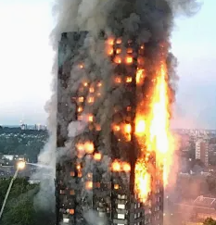
活用词汇
destroy /dɪˈstrɔɪ/ vt.摧毁;毁灭
1.最后，那些故意破坏环境的人应该受到严厉的惩罚。(应用文之世界与环境演讲)
Finally, those who destroy the environment intentionally should be severely punished.
2.我们应该让他们知道，破坏环境意味着毁灭人类自己。(应用文之世界与环境演讲)
We should make them know that destroying environment means destroying mankind themselves.
3.她的曾祖父确实有很多财富，但战争摧毁了一切。(读后续写之祖母的回忆)
Her great grandfather did have much wealth, but the war destroyed everything.
4. 这栋建筑物被大火彻底焚毁了。(续写)
The building was completely destroyed by fire.

Slide 12
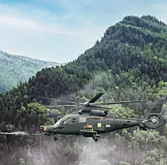
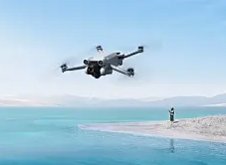
活用词汇
helicopter /ˈhelɪkɒptə(r)/ n.直升机
1.直升机一降落，我们马上就上了飞机，既兴奋又松了一口气。(2020年7月浙江卷续写)
Once the helicopter landed, we got onto it in no time, excited and relieved.
2.突然，一个低沉的嗡嗡声出现了，惠斯顿抬起头，环顾四周，发现远处有一架直升机。(读后续写之人与自然-被困在海边)
Suddenly a low，buzzing sound appearing，Whiston raised his head，glanced around and spotted a helicopter in the distance.
3.然而，直升机的声音淹没了他，直升机盘旋了一会儿，在令人窒息的黑暗中消失了。(续写)
However，the sound of the helicopter drowned him out the helicopter hovered for a while and faded in the suffocating darkness.

Slide 13


活用词汇
death /deθ/ n.死;死亡
1.想象着道路破裂，汽车被洪水冲走，我感到更加害怕，感觉到死亡在等着我。(读后续写之困在洪水中)
Picturing the road cracked and the car was flooded away，I felt more frightened and sensed death was waiting for me.
2.肉丸站在门口，喵喵叫着要出去。我朝她摇了摇头，怕她会被冻死。(续写)
Meatball stood at the door, meowing to go outside I shook my head at her, afraid that she might freeze to death.
3.突然，她听到老虎的叫声，吓得她半死。(2016·浙江卷续写)
Suddenly, she heard the shouts of tigers, which made her scared to death.
4.多亏了一位有见地的编辑，吉姆可以在救母亲命的同时追求自己的艺术家梦想，还能让一家人吃上一日三餐。(续写)
Thanks to an insightful editor, Jim could pursue his dream of being an artist while saving his mom from death and feeding the family three square meals a day.

Slide 14
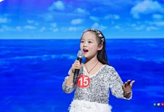

活用词汇
death /deθ/ n.死;死亡
5. 我话到嘴边又缩回去了。(续写)
The words died on my lips (= I stopped speaking) .
6. 她说那话时，我差点给笑死。(续写)
I nearly died laughing when she said that.
7.掌声平息后她便开始演讲了。(续写)
When the applause had died down, she began her speech.
8.他们的笑声渐渐消失了。(续写)
The sound of their laughter died away.

Slide 15

活用词汇
affect /əˈfekt/ vt.影响;(疾病)侵袭
1.他虽然身患重病，但态度积极，相信有康复的希望。(续写)
Although affected with a serious disease, he held a positive attitude and believed there was a hope of recovery.
2. 在这些无私的医生的影响下,我深深地喜欢上了这个职业。（2021天津卷应用文）
Affected by these selfless doctors, I have developed a deep affection for the career.
3. 她强装镇静。(续写)
She affected a calmness she did not feel.
4.因为我不断地质疑我正在上的大学课程将如何影响我的生活时，悲伤吞噬了我。(续写)
My grief consumed me as I continually questioned how the college courses I was taking would affect my life.

Slide 16
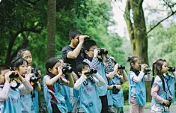

活用词汇
affect /əˈfekt/ vt.影响;(疾病)侵袭
5.为了唤起我们对自然的感情，增强我们的身心，这次观光将于本周日上午8点从我们学校门口开始，在那里我们将乘坐巴士前往国家公园。(应用文之”亲近自然 强我身心”的远足活动)
With the purpose of arousing the affection to nature and strengthen our body and mind, this sightseeing will start at 8:00 a.m. this Sunday from our school gate, where we will board a bus to the National Park.
6.这表明了他们对我的爱和感情，这是我珍惜的宝贵记忆。(2023年6月·上海卷“快乐童年”的展览)
It shows their love and affection for me, and it is a precious memory that I cherish.
7.总的来说，英文报《青年》对我有巨大的影响。(2021新高考全国卷Ⅰ应用文)
In summary, the English newspaper Youth affects me greatly/has a great effect on me.
8. 他深情地抚摩着她的头发。(续写)
He stroked her hair affectionately.

Slide 17
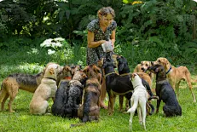
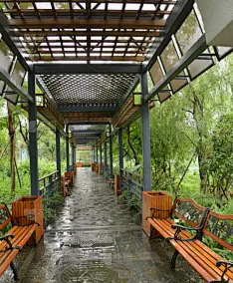
活用词汇
shelter /ˈʃeltə(r)/ n.避难处;居所 vt.保护
1.他开始在一个动物收容所做志愿者，在那里他会帮助照顾受伤和被遗弃的动物。(续写)
He started volunteering at an animal shelter, where he would help care for injured and abandoned animals.
2. 那年冬天，我建立了几个避难所来帮助更多像我这样的人，我认为这是最好的办法来报答你的好意。（读后续写之避难所）
I have set up several shelters to help more people like me that winter, which I think is the best to repay your kindness.
3.我们在一处门廊里避雨。(续写)
We sheltered from the rain in a doorway.

Slide 18


活用词汇
crack /kræk/ n.裂纹;裂缝 vi.&vt.使破裂
1. 他脸上绽出了微笑。(续写)
His face cracked into a smile.
2.他用尺子猛击我的头部。(续写)
He cracked me on the head with a ruler.
3. 他悲恸失声地告诉我们他儿子去世的消息。(续写)
In a voice cracking with emotion, he told us of his son's death.

Slide 19
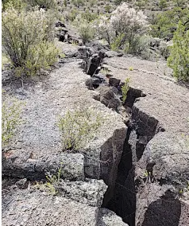

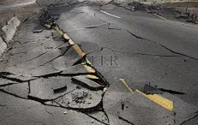
活用词汇
crack /kræk/ n.裂纹;裂缝 vi.&vt.使破裂
4.我们继续往上爬，到达了一个九英寸的裂缝。(续写之洞穴遇险)
After we climbed further, we reached a nine­inch crack.
5. 她透过窗帘的缝隙窥视。(续写)
She peeped through the crack in the curtains.
6. 想象着道路破裂，汽车被洪水冲走，我感到更加害怕，感觉到死亡来临。(读后续写之困在洪水中)
Picturing the road cracked and the car was flooded away，I felt more frightened and sensed death was waiting for me.

Slide 20

活用词汇
as if /əz ɪf/ 似乎;好像;仿佛
1.他表现得若无其事。(续写)
He behaved as if nothing had happened.
2. 一路上，我只是专心地听着，就像我是母亲的忠实听众一样，她正在回忆她过去的美好时光。(续写)
All the way, I just listened attentively as if I were a loyal audience to my mother， who was looking back on her good old days.
3.靠近房子的时候，我注意到我的爸爸和妈妈站在那辆旧卡车旁边，一脸悲伤。好像发生了什么不愉快的事情。(2021浙江卷6月读后续写)
Upon approaching the house, I noticed my dad and mom standing beside the old truck, looking sad. It seemed as if something unpleasant happened.

Slide 21
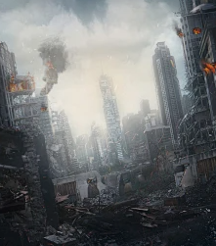
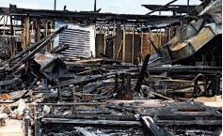
活用词汇
ruin /ˈru:ɪn/ n.&vt.破坏;毁坏
1.地震过后，整个城市成了一片废墟，使我们彻夜未眠。(续写)
The whole city lay in ruins after the earthquake, which made us awake all night.
2.他犯了一个错误，这让他失去了出国的机会。(续写)
He made a mistake, which ruined his chance of going abroad.
=He made a mistake, ruining his chance of going abroad.
3.难怪整座建筑现在都成了废墟;昨晚发生了一场大火。(续写)
It is no wonder that the whole building is now in ruins; it caught so big a fire last night.

Slide 22



活用词汇
percent /pə'sent/ n.百分之… adv.每一百中
1. 如果她今天考了100分，她就会赢得班级的拼写挑战赛第一名，还会得到一本全新的字典，里面还有视频和其他很酷的东西。(续写之拼写测试)
If she got 100 percent today, she’d win her class' First- Quarter Spelling Challenge and a brand-new dictionary that came with videos and other cool stuff.
2.造成干旱的原因有很多。首先，中国大约63%的城市面临水资源短缺。污染和工业化使情况更加恶化。(应用文之分析周围的环境）
The drought can be caused by several factors. Firstly, about 63 percent of the cities in China are facing water shortage. The situation is worsened by pollution and industrialization.
3.我百分之百确信她就是我心爱的小猫。(续写)
I felt one hundred percent sure she was my beloved kitty.

Slide 23

活用词汇
brick /brɪk/ n.砖;砖块
1.它外面的旧砖没有变，但里面却像是一个不同的世界。(续写)
Its old brick outside hadn't changed, but inside it was like a different world.
2.我的胃像一块浸在水里的砖一样沉到了膝盖上。摩根试图劝说我一切都会好的。(续写)
My stomach sank to my knees like a brick in water Morgan tried to convince me it would be fine.
3.当我们到达学校场地时，周围没有人，所以我们开始在两层砖楼的侧面打球。(续写)
When we got to the school ground, no one was around, so we began hitting our balls against the side of the two-story brick building.

Slide 24


活用词汇
metal /ˈmetl/ n.金属
1.冰冷的金属环伤了他的身体。(续写)
The cold metal links hurt his side.
2.入口被一扇锁着的金属门堵住了，以防偶然的洞穴探险者进入。(续写洞穴遇险)
It was dangerous enough that the entrance was blocked by a locked metal door to keep the casual cavers out.

Slide 25
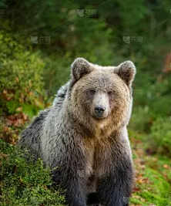

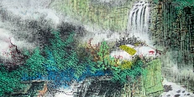
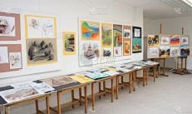
活用词汇
shock /ʃɒk/ n.震惊;休克 vt.(使)震惊
1.熊在篱笆上撕开了一个洞，把头伸了进去。埃利和我都惊呆了。(续写)
The bear tore a hole in the fence and put his head in. Elli and I were shocked.
=What shocked Elli and me was that the bear tore a hole in the fence and put his head in.
=The bear tore a hole in the fence and put his head in， which shocked Elli and me/which made Elli and me shocked.
2.我吓呆了，感觉自己好像被扔进了一个黑暗的世界。(读后续写之心理描写)
I froze with shock, feeling as if I had been thrown into a dark world.
3.最让我震惊的是他们令人震惊的艺术天赋。(2021年6月·浙江卷应用文-参观学生国画展)
What strikes me most is that their gifts for art are extremely shocking.

Slide 26
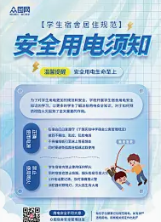
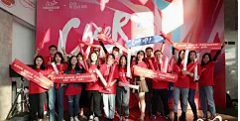
活用词汇
electricity /ɪˌlekˈtrɪsəti/ n.电;电能
1.讲座以一些因忽视安全而导致的令人震惊的案例开始。随后，它提出了应对电力、游泳和极端天气条件的必要规则。此外，还讨论了关于独自旅行和户外冒险的建议。(应用文之暑假安全教育”讲座活动)
The lecture started with some shocking cases resulting from safety ignorance. It then offered necessary rules on dealing with electricity, swimming and extreme weather conditions. Furthermore, suggestions were discussed on travelling alone and venturing outdoors.
2.气氛很热烈。(续写)
The atmosphere was electric.

Slide 27
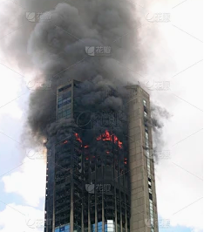
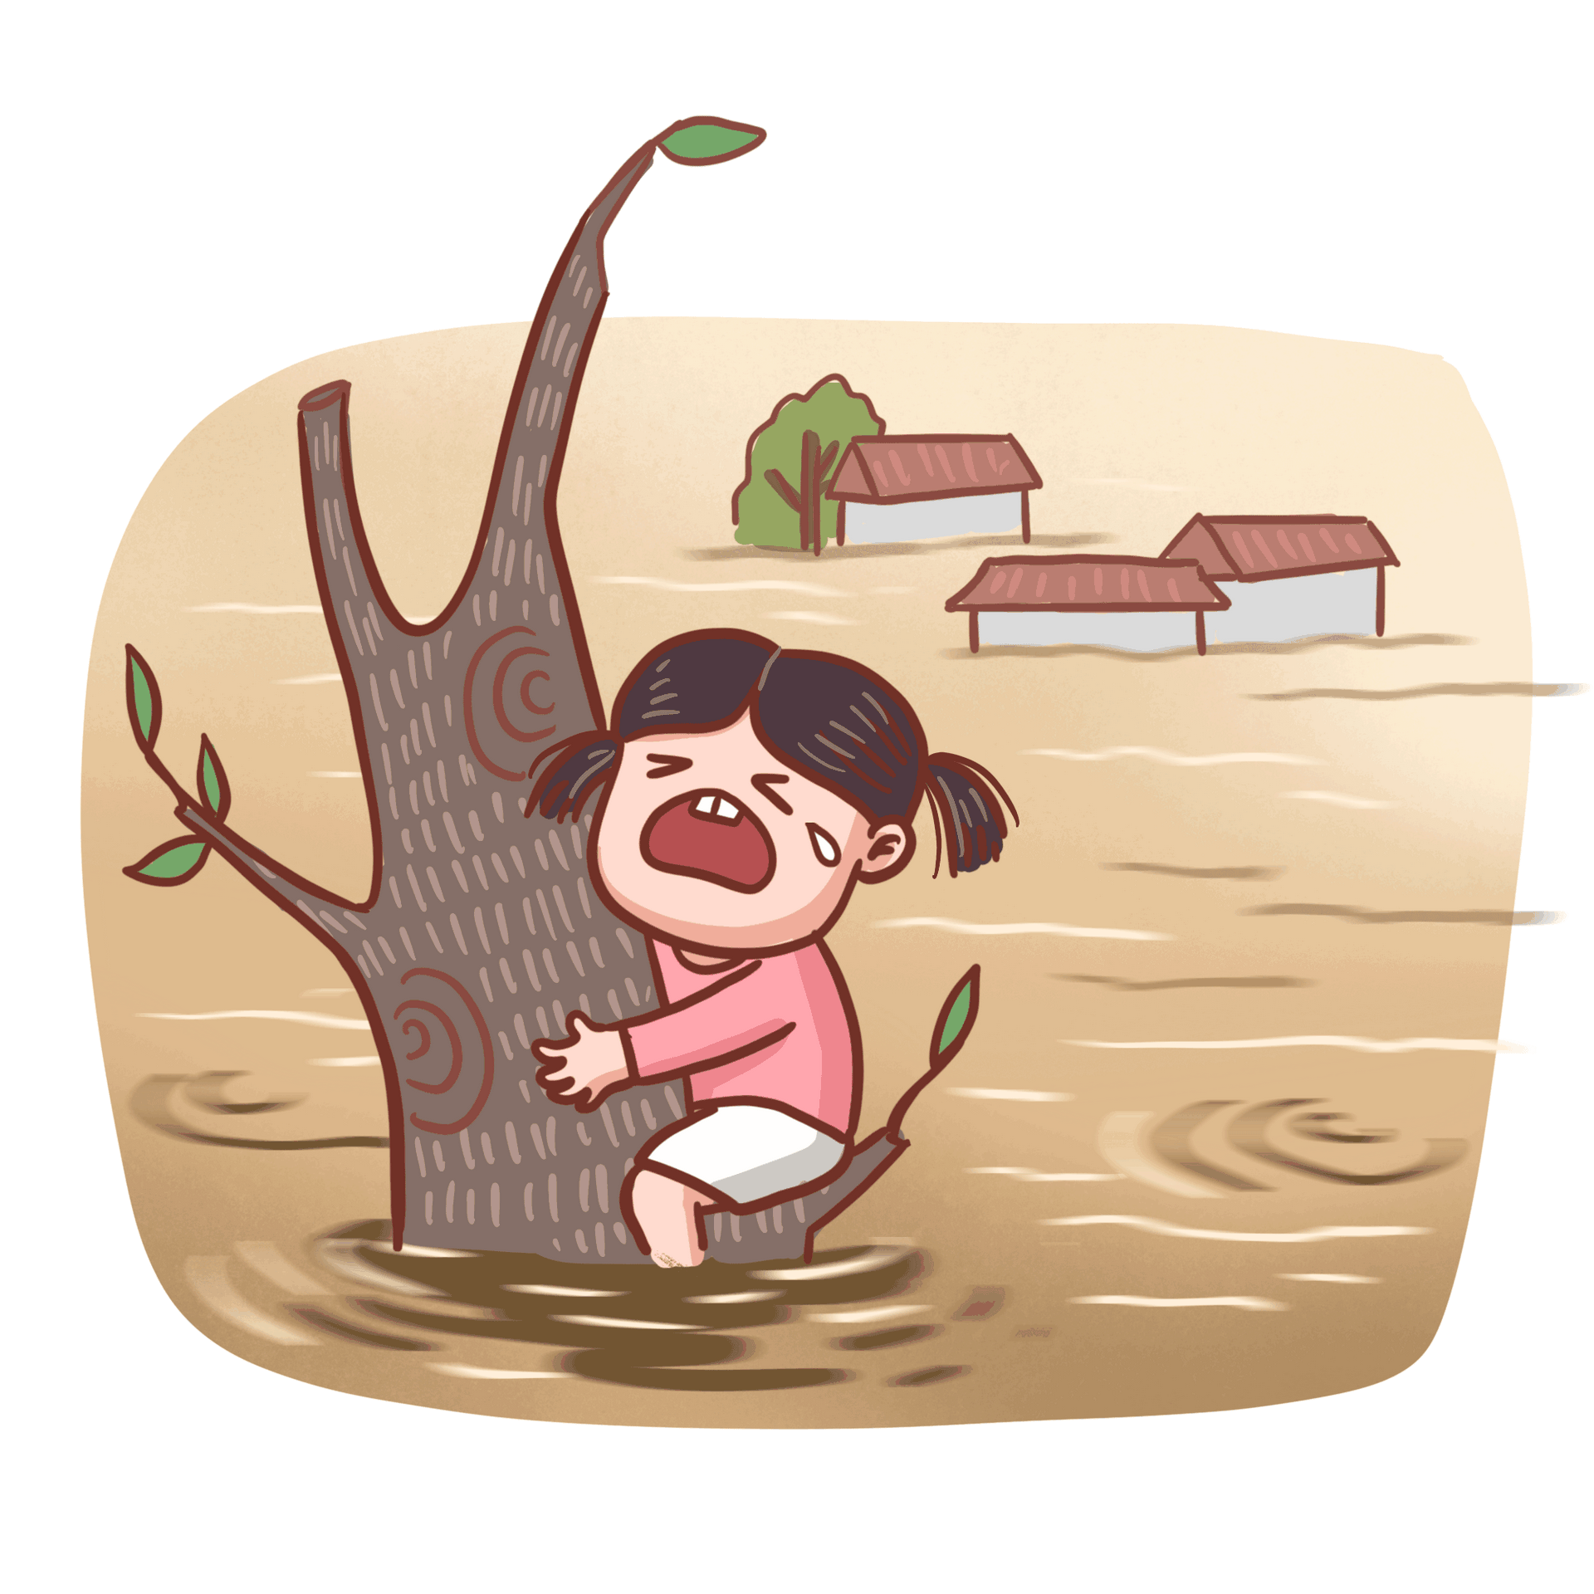
活用词汇
trap /træp/ vt.使落入险境 n.险境;陷阱
1.他们被困在燃烧着的楼房里。(续写)
They were trapped in the burning building.
2.我们被上涨的洪水困住了。(续写)
We became trapped by the rising floodwater.
3.我陷入了两难的境地，心中充满了悲伤，仍然不明白为什么事情会变得那么复杂，不知道如何解决这个问题。(续写)
Trapped in the dilemma, I enveloped by the sense of sadness, still felt confused why things turned out to be that complicated, not knowing how to tackle the problem.
4.十几岁的时候，他曾经用力敲一所着火的房子的门，看看是否有人被困在里面。幸运的是，房子是空的。(续写)
As a teenager, he once knocked fiercely in the door of a house that was on fire to see if anyone was trapped inside. Fortunately, the house was empty.

Slide 28


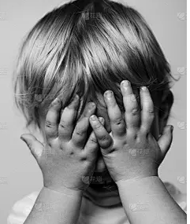
活用词汇
bury /ˈberi/ vt.埋葬;安葬
1.从那时起，我开始把自己埋在英语和英语写作中。正如我的老师所说，我做得很好，我又赢得了几次比赛。(2023新全国I卷续写)
From then on, I began to bury myself in English as well as English writing. Just as what my teacher said, I did it well and I won another several competitions.
2.一个大热天，我忙着做一堆工作，索菲冲进房间问:“妈妈，我能带弗林特船长去池塘吗?”(续写)
One hot day, I buried myself in piles of work when Sophie rushed into the room, asking "Mommy, can I take Captain Flint to the pond?"
3.但是恐惧把她逼了回来，她把头埋在毯子下面。(续写)
But fear drove her back and she buried her head under the blanket.
4. 他双手掩面而泣。(续写)
He buried his face in his hands and wept.

Slide 29
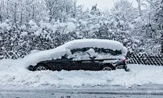
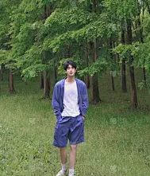
5.卡皮坦被葬在他的主人旁边，家人相信这只皇室狗肯定会和古兹曼住在天堂。(续写)
Capitan was buried beside his owner and the family believe their loyal dog will surely live in heaven with Guzman.
6.第二天早上，汽车被埋在雪里。(续写)
The next morning, the car was buried in snow.
7. 他双手插在口袋里缓步而行。(续写)
He walked slowly, his hands buried in his pockets.

Slide 30

活用词汇
breathe /bri:ð/ vi.&vt.呼吸
1.当他们终于接近爬坡的顶端时，水面和天花板之间只剩下四英寸了。不足以让他们抬起头来呼吸。(续写)
When they finally neared the top of the Crawl, there were barely four inches of air left between the water and the ceiling. not enough for them to keep their heads up to breathe.
2.我的心怦怦直跳，手掌又冷又湿，我感到呼吸困难。(续写)
With a pounding heart and cold, moist palms, I found it was getting hard to breathe.
3.看着这个可爱的小家伙，我们都松了一口气。(续写)
Looking at the cute creature, we both breathed a sigh of relief
4.虽然莫莉很紧张，但她深吸了一口气，回忆起她练习的内容。(续写)
Nervous though Molly was, she took a deep breath and recalled what she had practiced.

Slide 31
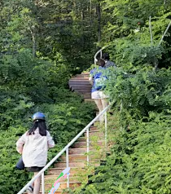

活用词汇
breathe /bri:ð/ vi.&vt.呼吸
5.我们不得不喘口气，然后再登山顶。(续写)
We had to stop for breath before we got to the top.
6.宣读结果时，他屏住了呼吸。(续写)
He held his breath while the results were read out.
7.她靠在门上,大口喘着气。(续写)
Gasping for breath, she leaned against the door.
8.她感到气短,脸也红了。(续写)
She felt short of breath and flushed.

Slide 32
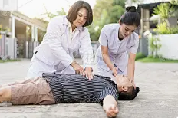
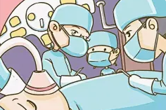
活用词汇
revive /rɪˈvaɪv/ vi.&vt.复活;(使)苏醒
1.她和一个邻居试图使他苏醒过来，却没有成功。(续写)
She and a neighbour tried in vain to revive him.
2.他们拼命地努力让他苏醒过来。(续写)
They made frantic attempts to revive him.

Slide 33
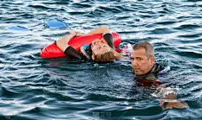
活用词汇
effort /ˈefət/ n.努力;艰难的尝试;尽力
1.他不试图隐瞒自己的失望。(续写)
He made no effort to hide his disappointment.
2.河中救人他费了巨大的努力，对自己也很危险，及时把罗尼带到了岸边。(续写)
With great effort, and with much danger to himself, he brought Ronny to the shore in time.
3.科雷亚从停车场向右猛击，紧跟着那辆本田车，努力想看看车号。(续写之智斗绑匪)
Correa took a hard right out of the parking lot and closely followed the Honda in an effort to see the car number.
4.我们应该特别认可我们的孩子努力推动自己，努力实现目标。但是如果他每天都在那里，努力打球，你应该表扬他的努力，不管他的球队是赢是输。(2019浙江续写)
We should especially recognize our children’s efforts to push themselves and work hard to achieve a goal.But if he’s out there every day and playing hard, you should praise his effort regardless of whether his team wins or loses.

Slide 34

活用词汇
effort /ˈefət/ n.努力;艰难的尝试;尽力
5.在自行车旅行中，我们可以在北京的一些公园和花园停下来，比如颐和园和天坛，了解它们的历史和人们为保护它们所做的努力。(2023年北京卷“绿色北京”应用文)
During the cycling tour, we could stop at some of the parks and gardens in Beijing, such as the Summer Palace and the Temple of Heaven, to learn about their history and the efforts made to preserve them.
6.网上种类繁多的商品可以毫不费力地进行比较，也很容易选择。(应用文之“网上购物”主题发表看法)
The large varieties of goods on the net are effortlessly comparable and easy to choose.
7.创作这个条目的过程充满了艰辛和烦恼，但它值得我不懈的努力。陪审团颁发了一份证书来证明我的努力。(续写)
The process of creating the entry was filled with hardship and annoyance , but it deserved my unremitting effort. The jury issued a certificate to prove my efforts.

Slide 35
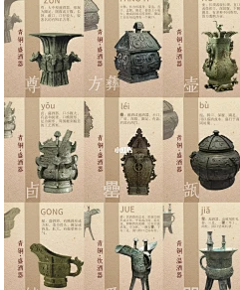
活用词汇
wisdom /ˈwɪzdəm/ n.智慧;才智
1.他们是古代文明的代表，是古人智慧的结晶。(2021天津卷应用文)
They are the representatives of ancient civilization and the wisdom of ancient folks.
2.他明智地决定实话实说。(续写)
He wisely decided to tell the truth.
3.像我这样健忘的人可能会反复失去东西，所以放弃帐篷是不明智的。(2017年11月浙江卷续写)
Forgetful people like me may lose things repeatedly, so it’s unwise to give up the tent.
4.更重要的是，拒绝会见可能会给我们带来危险陌生人是明智的。(应用文之"Stay Safe Online" 为题投稿)
Vhat's more, it is wise to refuse to meet strangers who could put us in danger.

Slide 36
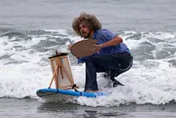
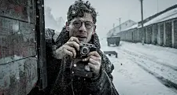
活用词汇
suffer /ˈsʌfə(r)/ vt.遭受;蒙受 vi.受苦
1.在这个科技日新月异的时代，过多的信息使我们应接不暇。(应用文)
In these days of technological change we all suffer from information overload.
2.尽管经历了难以想象的困难，萨尔瓦多还是在旅途中幸存了下来。(续写之海上失联)
Despite suffering unimaginable hardships，Salvador had survived his journey.
3.这件事唤起了他对往昔苦难的回忆。(续写)
The incident woke memories of his past sufferings.

Slide 37


活用词汇
erupt /ɪˈrʌpt/ vi.&vt.火山爆发;岩浆喷出
1.他还没唱完这首歌的最后一个字，观众就爆发了一阵掌声。(续写之选择)
Hardly had he finished the last word of the song when a wave of applause erupted from the audience.
2.我父亲勃然大怒。(续写)
My father just erupted into fury.
3.戴维斯第三次得分，观众欢声雷动。(续写)
When Davis scored for the third time the crowd erupted.
4.然后，突如其来地，她爆发出笑声。(续写)
Then, without warning, she erupts into laughter.

Slide 38
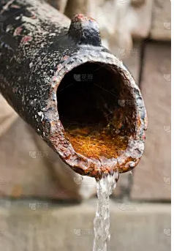
活用词汇
supply /səˈplaɪ/ n.供应;补给 vt.供应;供给
1.此外，这次竞赛将会给你提供一个机会，帮助你培养创造力，与志同道合的同学建立友谊。(应用文)
（1） Moreover，the competition will supply you with a chance to develop your creativity and build friendship with other students who share the same interest with you.
（2） Moreover，the competition will supply a chance to you to develop your creativity and build friendship with other students who share the same interest with you.
2.更重要的是，一些节水工程没有正常运行，因此那里的人们不得不更多地依赖降雨来供水。(应用文之周围的环境)
What's more, some water conservation projects haven't been functioning properly, thus people there have had to rely more heavily on rainfall for their water supply.
3.这些年来，卢奶奶一直为我照料花园，她把一生的爱都塞进了那个古老的石匠罐子里。(续写)
Grandma Lou had been tending a garden for me all these years and had pressed a lifetime supply of love into that old Mason jar.

Slide 39

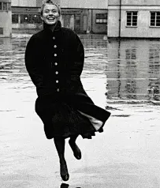
活用词汇
survive /səˈvaɪv/ vi.生存;存活 vt.幸存
1.没有海洋，任何生物都无法生存，包括人类。（2022全国甲卷应用文）
Without the oceans, no living things would survive, humans included.
2.耐克教会了我，在野外生存的游戏中，态度决定一切。(续写)
Nike taught me that attitude is everything in the game of wilderness survival.
3.她能独自活这么久真是个奇迹，我对她的力量和决心充满了钦佩。(续写)
It was a miracle that she had managed to survive on her own for so long, and I was filled with admiration for her strength and determination.
4.生活不在于如何从暴风雨中幸存，而在于学会在雨中翩翩起舞。(读后续写之主旨升华)
Life isn't about how to survive the storm；it's about learning to dance in the rain.

Slide 40
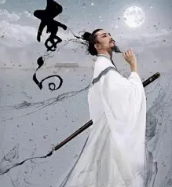
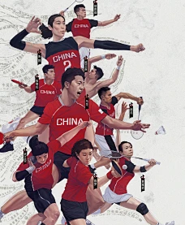
活用词汇
power /ˈpaʊə(r)/ n.电力供应;能量;力量
1.他的诗歌证明了文字的力量和通过艺术表达自己的重要性。(2023全国甲卷应用文之投稿中国历史人物)
His poetry is a testament to the power of words and the importance of expressing oneself through art.
2.一想到赛场上的运动员，我就被他们强大的精神所鼓舞。 (2023全国乙卷应用文之描述在暑假所学到的一项新技能)
The moment I thought of the athletes on the field, I was inspired by their powerful spirits.
3.我将尽全力帮助你。(续写)
I will do everything in my power to help you.
4.他丧失了语言能力。(续写)
He had lost the power of speech.

Slide 41

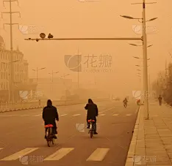
活用词汇
power /ˈpaʊə(r)/ n.电力供应;能量;力量
5.我意识到，真正的圣诞节是为那些深信圣诞老人神奇力量的孩子们准备的。(续写之圣诞节礼物)
I realized that the real Christmas was for the children who had deep belief in the amazing power of Santa Claus.
6.我眼看着事情发生，却无力相助。(续写)
I saw what was happening, but I was powerless to help.
7.空气中弥漫着浓烈的尘土味。(续写)
The air smelled powerfully of dry dust.

Slide 42

活用词汇
tap /tæp/ vi.&vt.轻叩;轻敲 n.水龙头
1.幸运的是，多亏了迪斯利的持续指示，警察封锁了绑匪的道路，并在路上设置了路障，然后就敲击了汽车。(续写)
Fortunately, thanks to Disley’s continuous directions, the police had blocked the path the kidnapper was taking and set up a roadblock on the way, tapping the car soon.
2.他不停地用手指轻轻敲着桌子。(续写)
He kept tapping his fingers on the table.
3.母亲找了另一份工作，挣一半收入，但晚上仍在用那台旧的绿色打字机练习。现在，当我夜里经过她家门口，听到她不停地敲打时，我有一种完全不同的感觉。(续写)
Mother took another job earning half, but the evening practice sessions on the old green typewriter continued I had a very different feeling now when I passed her door at night and heard her tapping away.
4.令我吃惊的是，父亲走到我跟前，拍了拍我的肩膀说:“如果你想要的话，是可以得到的，但我不允许你偷偷摸摸地做事。”(读后续写之学会诚信)
Much to my surprise，my father came up to me，tapped my shoulder and said，"You could have had it if you'd asked for it，but I won't have you being sneaky about things."

Slide 43
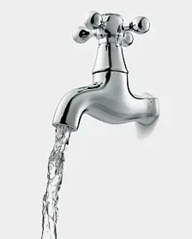
活用词汇
tap /tæp/ vi.&vt.轻叩;轻敲 n.水龙头
5.他觉得有人轻轻拍他的肩膀便转过身来。(续写)
He felt a tap on his shoulder and turned round.
6.我会兴奋地打开水龙头，然后用一把用过的牙刷使劲刷梳子。(续写之爸爸的梳子)
I would excitedly turn the tap on, then brush the comb with a used toothbrush as hard as I could.
7.缓慢的滴答声，滴答声，滴答声一直持续到半夜。(续写)
The slow tap, tap, tap went on some nights until midnight.

Slide 44
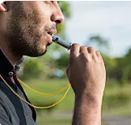
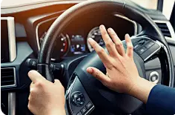
活用词汇
whistle /ˈwɪsl/ vi.&vt.吹口哨 n.哨子(声)
1.然后，哨声响起，我们跳进水里，拼命地向前冲。突然，裁判吹响了哨子，表示我们已经跑到最后一段了。(续写)
Then, the whistle blew and we jumped into the water, stroking forward desperately.Suddenly, the referee blew the whistle which signaled we were on the last leg of our race.
2.他看到早餐时惊奇地吹了一声口哨。(2021新高考全国I卷续写)
He whistled in astonishment when seeing the breakfast.
3.风飕飕地顺着烟囱往下刮。
The wind whistled down the chimney. (续写)
4.随着汽笛的嗡嗡声和喇叭的鸣响，他们加入了热情的骑自行车的队伍，在人群雷鸣般的欢呼声中在船中央飞驰。(续写)
With the whistle buzzing and horns blaring, they joined the stream of enthusiastic cyclists and flew along amidship the thunderous cheers of the crowd.

Slide 45
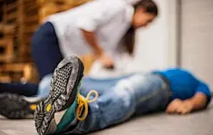
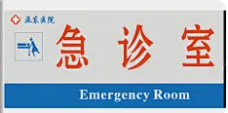
活用词汇
emergency /iˈmɜ:dʒənsi/ n.突发事件;紧急情况
1.提高认识活动包括介绍理论知识的专业研讨会和教授紧急情况下生存技能的讲习班。(应用文之全国防灾减灾日活动)
Awareness events include professional seminars introducing theoretical knowledge and workshops teaching survival skills in time of emergency.
2.我忘记了我从培训中学到的所有关于应对紧急情况的措施。(续写之特殊的面试)
I forgot all I had learned from the training about measures to deal with an emergency.
3.他大声喊道，“这是个婴儿！”莫尔立即做出了决定，实施了紧急刹车，一半的火车仍然绕在弯道上。 (续写)
He yelled, “It's a baby!" Mohr had an instant decision to make, applying full emergency brakes with half the train still wrapped around a curve.
4.瑞恩又担心又焦虑地在急诊室外面焦急地等待着。 (续写)
Worried and anxious, Ryan waited restlessly outside the emergency room.

Slide 46
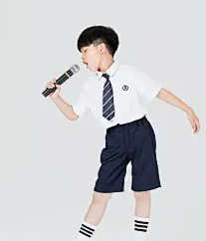
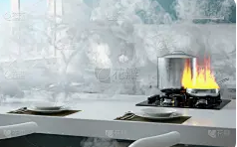
活用词汇
calm /kɑ:m/ a.镇静的;沉着的 vt.使平静
1.明亮的灯光亮起了，德文平静下来，自信地唱着。(续写)
The bright light coming on, Devin calmed down and sang with confidence.
2.她的声音出人意料地平静。(续写)
Her voice was surprisingly calm.
3.他吸了一口气，强自镇定。
He breathes in, forcing calmness.
4.我强忍住怒火，尽量平静地和父母说话。(续写)
Choking back my anger, I tried to speak calmly with my parents.
5.谢天谢地，杰夫保持冷静，迅速关掉了煤气。（2021年新高考全国I&II卷续写）
Thankfully, Jeff stayed calm and turned off the gas quickly.

Slide 47
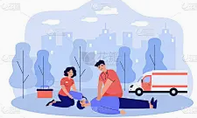
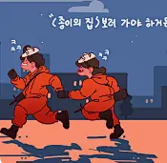
活用词汇
aid /eɪd/ n.援助;帮助 vi.&vt.帮助
1.财政援助顾问看着我，好像我疯了似的。(续写之特别的钢琴曲)
The financial aid advisor looked at me as if I had lost my mind.
2.我毫不犹豫地做了急救，给他口对口呼吸，并按照训练做心肺复苏。(续写)
Without hesitation, I did first aid, giving him mouth-to-mouth breathing and doing CPR as trained.
3.那个可怜的傻瓜没有机会。她向旁观者大声呼救，他们冲过去帮助她。(续写之智斗抢劫犯)
That poor fool didn’t have a chance. She shouted for help to bystanders, and they rushed to her aid.

Slide 48
活用词汇
on hand /ɒn hænd/ 现有(尤指帮助)
1.“300美元，但我们手头只有200美元，”爸爸回答。（2021年6月浙江卷）
“Three hundred dollars, but we have only two hundred on hand,” answered my dad.
by hand （手工制作）
hand in hand （手牵手，紧密相连）
at hand （在手边，近在眼前）
“hand”用法
shake hands （握手）
get out of hand （失控）
on the one hand... on the other hand... （一方面...另一方面...）

Slide 49

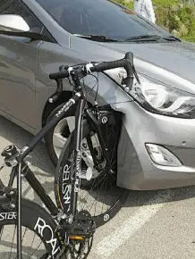
活用词汇
crash /kræʃ/ vt&vi.碰撞;撞击 n.撞车
1.远处的第一声霹雳震撼着天空。
The first distant crash of thunder shook the air.
2.砖块哗啦一声砸入了窗户。
A brick crashed through the window.
3.她愤怒地冲出房间并随手把门砰的一声关上。
She stormed out of the room and crashed the door shut behind her.
4.汽车突然在他面前停住了。麦克砰的一声撞进了车里。结果，他从自行车上摔了下来，左脚踝扭伤了。（2017浙江卷续写）
The car abruptly stopped in front of him. Mac crashed into the car with a loud bang. As a result, he fell off the bicycle and had his left ankle twisted.

Slide 50

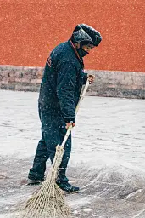
活用词汇
sweep /swi:p/ vt.&vi.打扫;清扫
1.一阵恐慌涌上了她的心头，但她强迫自己平静地离开了房间。(续写)
A wave of panic swept over her, but she forced herself to leave the room calmly.
2.清明节一般在每年的4月5日左右，那天人们根据传统做些特别的事情。(应用文之节假日活动)
Tomb Sweeping Day falls on April 5th or so every year, when people can do something special according to the tradition.
3.麦克泰尔通过扫掉小路上的雪，并放盐来融化冰。(续写)
McTell by sweeping the snow off the path and putting salt down to melt the ice.
4.他的目光把房间扫视了一遍。(续写)
His eyes swept around the room.

Slide 51






活用词汇
“other tradition festivals”
The Spring Festival
The Lantern Festival
The Dragon Boat Festival
The Tana Bata Festival
The Mid-autumn Festival
The Double-ninth Day

Slide 52



活用词汇
sweep /swi:p/ vt.&vi.打扫;清扫
5.他张开双臂舞动着，冲过去迎接她。(续写)
He rushed to greet her, sweeping his arms wide.
6.她再没说话，大模大样地走出房间。(续写)
Without another word she swept out of the room.
7.往事倏地重又浮现在脑海中。(续写)
Memories came sweeping back.
8.雨水从破窗户灌进屋内。(续写)
Rain swept in through the broken windows.

Slide 53


活用词汇
wave /weɪv/ n.海浪;波浪 vi.&vt.挥手
1.一阵恐惧传遍他的全身。(续写)
A wave of fear swept over him.
2.歉疚和恐惧一阵阵涌上她的心头。(续写)
Guilt and horror flooded her in waves .
3.公共汽车开走时他向我们挥了挥手。(续写)
He gave us a wave as the bus drove off.
4.虽然他筋疲力尽，但他仍然试图挥手示意司机，因为他担心自己会随时失去知觉。他疯狂地挥手，大声喊着，但任何汽车都没有回答。(续写之受伤获救)
Although he was exhausted and painful, he still tried to wave down a driver for fear that he might lose consciousness at any time. He waved wildly and shouted loudly but with no reply from any car.

Slide 54


活用词汇
wave /weɪv/ n.海浪;波浪 vi.&vt.挥手
5.风吹得池水起了涟漪。(续写)
The wind made little waves on the pond.
6.我向母亲挥手告别时她哭了。(续写)
My mother was crying as I waved her goodbye .
7.水里有个人大喊大叫，拼命摆动着双臂。(续写)
A man in the water was shouting and waving his arms around frantically.

Slide 55


活用词汇
strike /straɪk/ vi.&vt.侵袭;突击 n.罢工
1.他摔倒了，头碰在桌棱上。(续写)
He fell, striking his head on the edge of the table.
2.阳光照得玻璃窗熠熠闪光。(续写)
The windows sparkled as the sun struck the glass.
3.时钟刚刚敲过12点。(续写)
The clock has just struck twelve.
4.他用拳头打桌子。(续写)
He struck the table with his fist.

Slide 56



活用词汇
strike /straɪk/ vi.&vt.侵袭;突击 n.罢工
5.她被他简洁、富有鼓动性的口才迷住了。
She was struck by his simple, spellbinding eloquence.
6.被他为我所做的事情所感动，我不能自已，感激的泪水顺着脸颊流下来。（读后续写之情感描写）
Struck by what he had done for me， I couldn't contain myself， tears of gratitude flowing down my cheeks.
7.我突然想到我可以通过把我的头塞进南瓜赢得第一名。（2021浙江卷1月读后续写）
It suddenly struck/hit/occurred to me that I could win the first place by forcing my head inside the pumpkin.
8.最让我震惊的是他们令人震惊的艺术天赋。(2021浙江卷应用文之宣传学生国画展)
What strikes me most is that their gifts for art are extremely shocking.

Slide 57


活用词汇
deliver /dɪˈlɪvə(r)/ vi.&vt.传递;传达 vt.发表
1.他沉着地说了他的台词。(续写)
He delivered his lines confidently.
2.开幕式将于上午9点开始，校长将发表讲话。（应用文之校园音乐节）
The opening ceremony will start at 9:00 am, and the schoolmaster will deliver a speech.
3.当他们的检查完成后，两个男孩确定礼物真的是圣诞老人送的，他们把所有的东西都拖到客厅中央。(续写之圣诞节礼物)
When their inspection had been completed, the two boys ensured that the gifts were really delivered by Santa Claus and they dragged everything into the center of the living room.
4.这对夫妇付了15美元，把他们的送货地址告诉了搬运工，然后离开了。(续写)
The couple paid him $15 in advance and left after giving the porter their address for delivery.

Slide 58


活用词汇
summary /ˈsʌməri/ n.总结;概括;概要
1.我们校长做了一个总结，强调安全的重要性。(应用文之紧急逃生疏散演练活动报道)
Our headmaster made a summary, attaching great importance to safety.
2.总而言之，在你的应用上分享我的衣服对别人和我都有好处。(应用文之共享衣服APP发表看法)
To summarize, sharing my clothes on your app benefits others and me.

Slide 59


活用词汇
effect /ɪˈfekt/ n.影响;结果;效果
1.希望我的建议能很快得到落实，解决这些问题。(应用文之建议信)
Hopefully, my recommendations will soon be put into effect to settle these problems.
2.事实上，当别人使用这种方法时，孩子们认为这种方法是有效的。（2022全国乙卷）
In fact, children consider this method effective when others use it.
3.由于温室效应，大气中的气体使地球变暖。(应用文之环境保护)
Because of the greenhouse effect, the earth is warmed by gases trapped in the atmosphere.
4.我深爱我的妈妈，她的言行对我有着积极的影响。(应用文之人物介绍)
I feel much affection for my mum, whose words and actions have a positive effect on me.

Slide 60

活用词汇
length /leŋθ/ n.长;长度
1.经过长时间的讨论，我们同意对空间的触觉-动觉知觉进行研究。我不确定这是什么意思，但至少我们有了一个话题。(2022年1月·浙江卷)
After lengthy discussions，we somehow agreed to do a study on the tactile-kinesthetic perception of space. I wasn’t sure what it meant，but at least we had a topic.
2.挑战是先把你的脚放在裂缝的长度上，然后把你的身体侧向摆动，然后再下降五英尺到下一个空间的地板上。(续写之洞穴遇险)
The challenge is to put your feet first down the length of the crack, and then move your body sideways to swing along, before dropping five feet to the floor of the next space.

Slide 61
Thank You

