Slide 1


感恩遇见，相互成就，本课件资料仅供您个人参考、教学使用，严禁自行在网络传播，违者依知识产权法追究法律责任。
更多教学资源请关注
公众号：溯恩英语
知识产权声明

Slide 2
Welcome unit
First Impressions

Slide 3

Watch a video ：Lost On The First Day Of High School.
What did the girl experience on the first day? What was her feeling?

Slide 4








Choose an emoji to describe your feelings on your first day of senior high school, and why?
excited
happy/joyful
confident
anxious
disappointed
sad/sorrowful
frightened
annoyed/angry
I felt excited/happy/nervous... because/for the reason that…

Slide 5


Reading skills
Reading Strategy
Scanning
(certain information)
Skimming
(main idea)
titles and headings
Read the text for key words and phrase, dates, numbers, etc.
the first and last sentences of paragraphs
the first and last paragraphs
Do not need to read the whole text.
pictures and charts

Slide 6
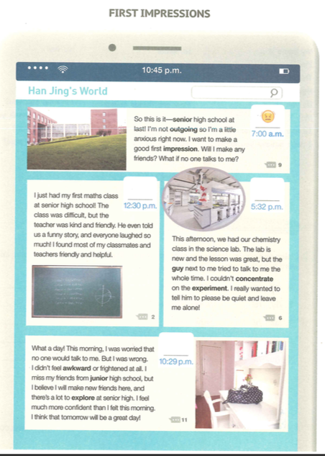
Prediction
Skim the passage and check whether your predictions are right or not.
1.What’s the topic of the passage?
It’s about Han Jing’s first day at senior high school, her experience and her feelings.
1. ☑️ school campus
2. ☑️ new friends
3. ☑️ school subjects
4. ☑️ a new teacher
5. …

Slide 7


2.Can you guess where the text is
taken from?
I guess that this passage is taken from…
because there are…
phone/pad
comments
social networking website!
3.In what order is the passage organized?
content and pictures
A. Time order B. Space order.
√

Slide 8








Fast-reading:Scan the passage to find out time，place and underline
or summarize Han Jing’s feelings.
3.
1.
2.
4.
12:30 p.m.
Time: _______
Place:_______
Emoji:_______
Time: _______
Place:_______
Emoji:_______
10:29 p.m.
Math class
Bedroom
7:00 a.m.
excited
happy
Time: _______
Place:_______
Emoji:_______
5:32 p.m.
School gate
Time: _______
Place:_______
Emoji:_______
anxious
Science lab
annoyed

Slide 9




Detailed reading
Para. 1
I’m not outgoing, so I’m a little anxious right now. I want to make a good first impression.
Will I make any friends? What if no one talks to me?
要是......会怎么样呢？
Why did Han Jing feel anxious before school?
Because she is not outgoing.
Key Words
Link Words

Slide 10



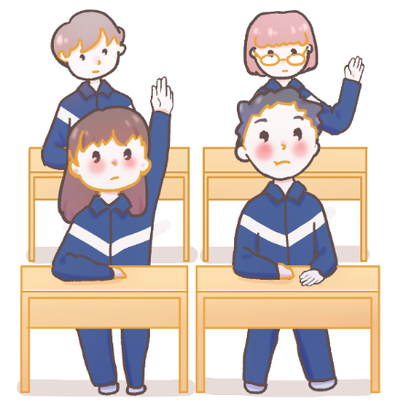
Para. 2
Pay attention to the link words.
I just had my first maths class at senior high school! The class was difficult, but the teacher was kind and friendly. He even told us a funny story, and everyone laughed so much!I found most of my classmates and teachers friendly and helpful.
How was her first maths class?
It was ___________________.
Key Words
Link Words
difficult but interesting.

Slide 11


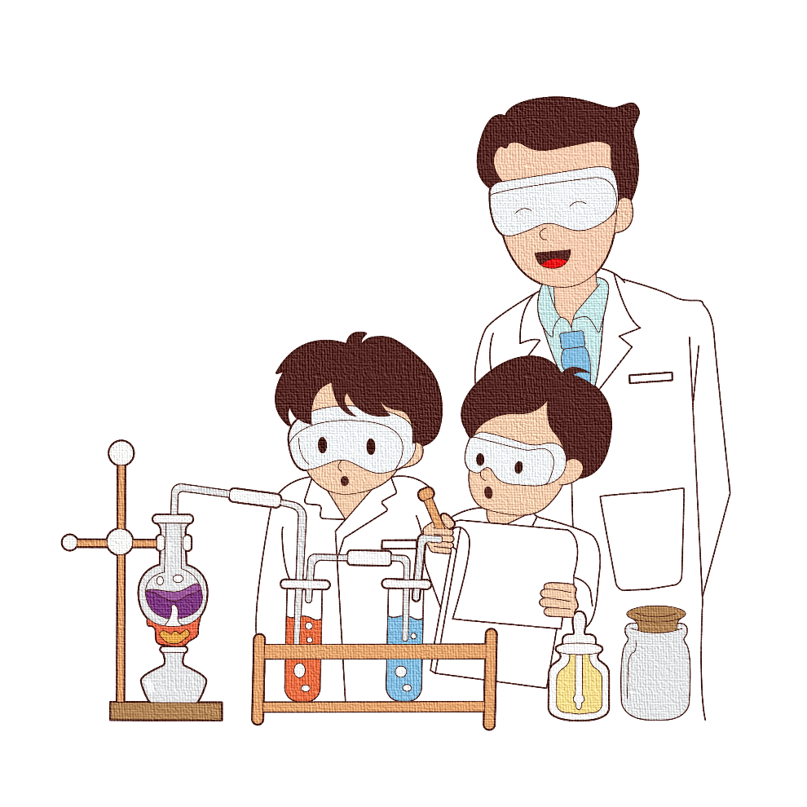
Para. 3
一直，总是
This afternoon, we had our chemistry class in the science lab.
The lab is new and the lesson was great, but the guy next to
me tried to talk to me the whole time. I couldn’t concentrate
on the experiment. I really wanted to tell him to please be
quite and leave me alone .
集中精力于....
不打扰；不惊动....
What happened in the chemistry class?
She couldn’t concentrate on the experiment.

Slide 12
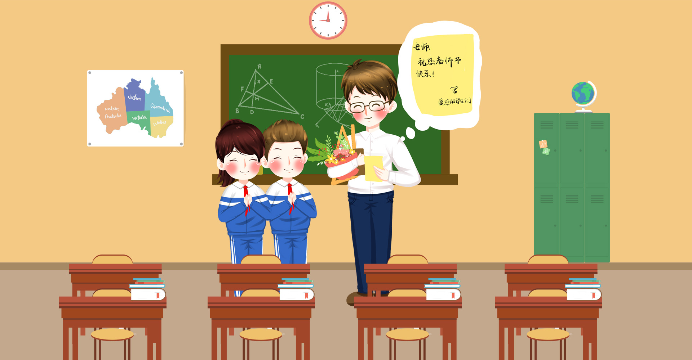
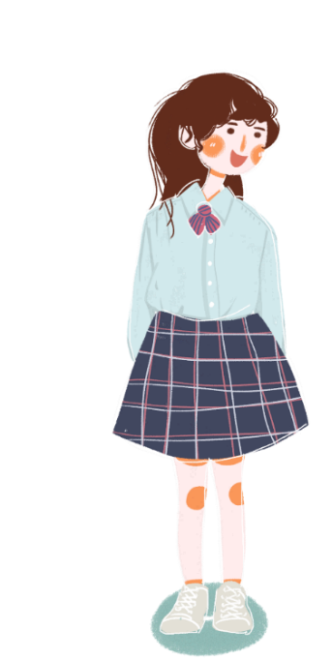
Thinking and talking
If you were a friend of Han Jing's, can you tell her how to deal with the problem?
You should /You had better…

Slide 13



Para. 4
.
positive attitude
initiative
action
Wonderful
school life
❓
Do you think Han Jing will lead a wonderful senior high school life? Why?
What did Han Jing learn from her first day at senior high school?
She learned that she would make new friends there, and there was a lot to explore at senior high school.
Time: _______
Place:_______
Emoji:_______
10:29 p.m.
Bedroom
happy

Slide 14
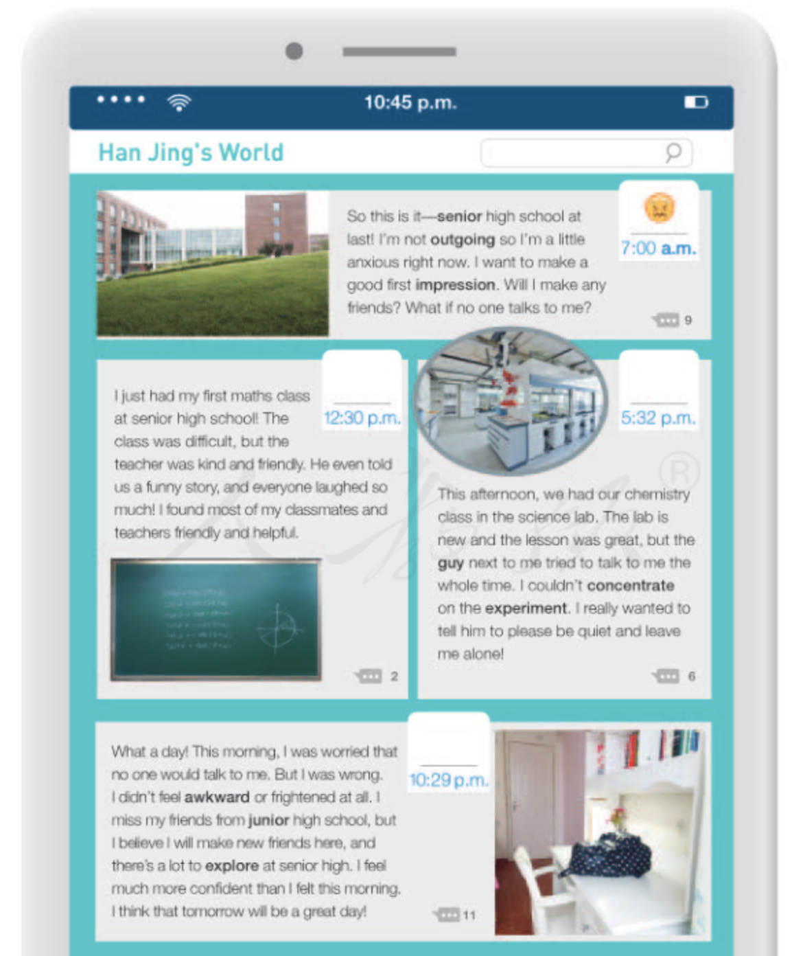



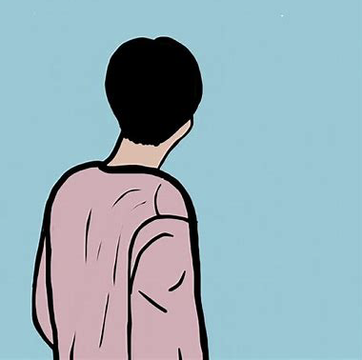

Post-reading
What would you say to Han Jing?

Slide 15

Summary and retell
Han Jing’s First Day
Mood
teacher:
kind and friendly
a funny story
classmates and teachers: friendly and helpful
excited
High
not feel awkward or frightened
a good first impression
annoyed
explore at senior high
not outgoing
happy
anxious
the guy: talked to me
I: not concentrate on the experiment
feel confident
Time
Down
7:00 a.m.
12:30 p.m.
5:32 p.m.
10:29 p.m.
before school
after maths class
during chemistry class
back home
Notes:
对本课件使用有任何疑问，请联系小助手：naodong12
更多优质内容，请关注微信公众号【脑洞英语课堂】

Slide 16


Critical Thinking
According to the writer, the high school life is full of challenges and difficulties.Work in groups, and share your opinions about what kind of attitudes we should have towards the future life?
Life if full of challenges and difficulties ,at the same time it is so mysterious that it is worthwhile for us to explore and face it with hope and confidence, especially for our teenagers ,who are energetic and positive.

Slide 17

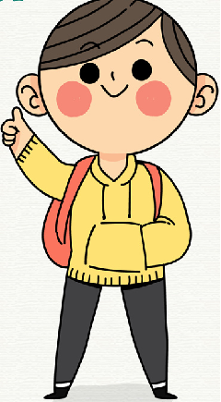
Output ---Role-play/Group work
You are the journalist from the TV Station , you are to interview Han Jing, the newcomer to the school .
Q1:What did you do on your first day of school?
Q2: How did you feel?
Q3: Why did you feel so?
Q4: What are your teachers and classmates like?
Q5: Has your expectations about senior high school changed? How?

Slide 18

Translation
1. So this is it- senior high school at last!
2. What a day !
3. I miss my friends from junior high school, but I believe
I will make new friends here, and there’s a lot to explore at senior high.
Finally I came to study at senior high School.
这一天终于到了——终于上高中了！
What a wonderful day! 很棒的一天。
I miss my old friends and junior high school life, but
I believe I will have wonderful experiences here. 高中会有
很多事物等待着我去探索。

Slide 19
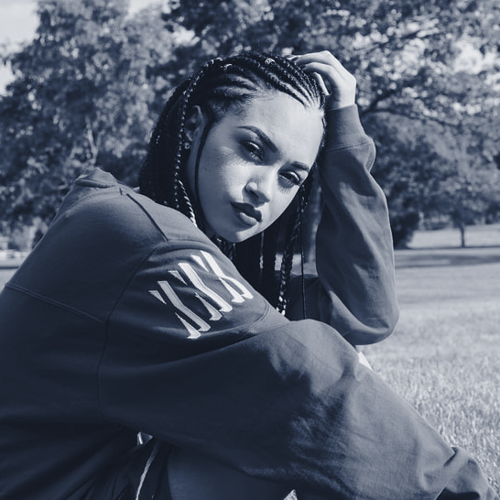
Homework
Rewrite the first-person-form passage in the third person form.

