Slide 1


感恩遇见，相互成就，本课件资料仅供您个人参考、教学使用，严禁自行在网络传播，违者依知识产权法追究法律责任。
更多教学资源请关注
公众号：溯恩英语
知识产权声明

Slide 2


Book 1 Unit 3
Sports and Fitness
Listening and Speaking
你好 夏天
主讲人：XXX
Click here to add words Click here to add add words Click here to add
浙江省衢州第一中学 徐荣仙

Slide 3
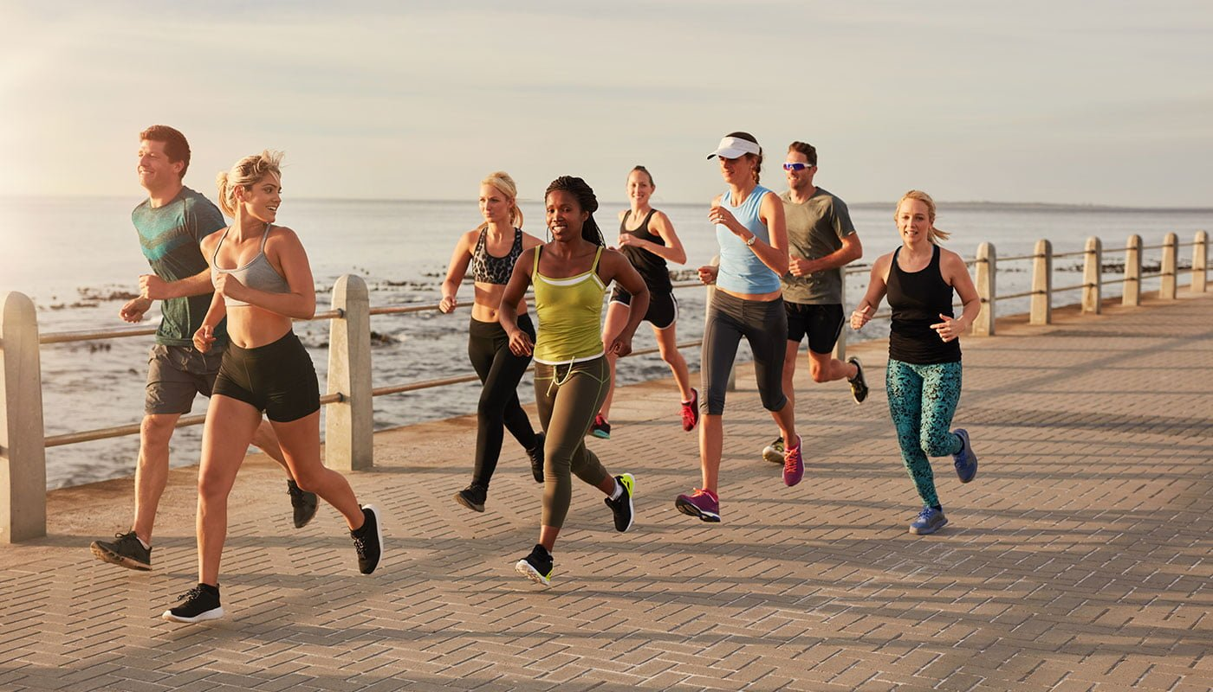
What are they doing?
Why are they taking exercise?
build/strengthen one’s body
enhance/ cultivate friendship
peomote friendship
ease stress from...
help keep fit
watch weight
strengthen one’s immune system
shape one’s willpower
...

Slide 4

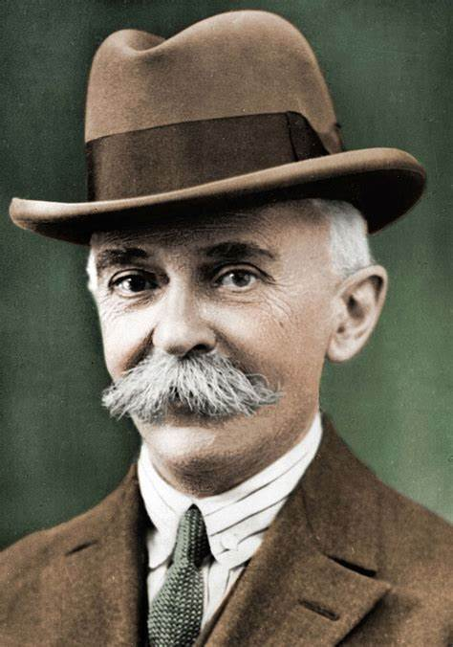
Step 1 Lead-in
Cultural Note
Quote
All sports for all people.
----Pierre de Coubertin
Meaning
全民健身。
-----弗朗西斯·培根

Slide 5
What are they doing?
Why are they taking exercise?
build/strengthen one’s body
enhance/ cultivate friendship
peomote friendship
ease stress from...
help keep fit
watch weight
strengthen one’s immune system
shape one’s willpower
...

Slide 6







Warming-up
Have you heard of these sports events? What are they about?

Slide 7
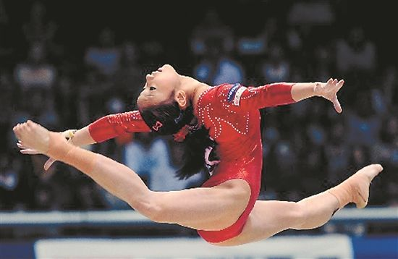
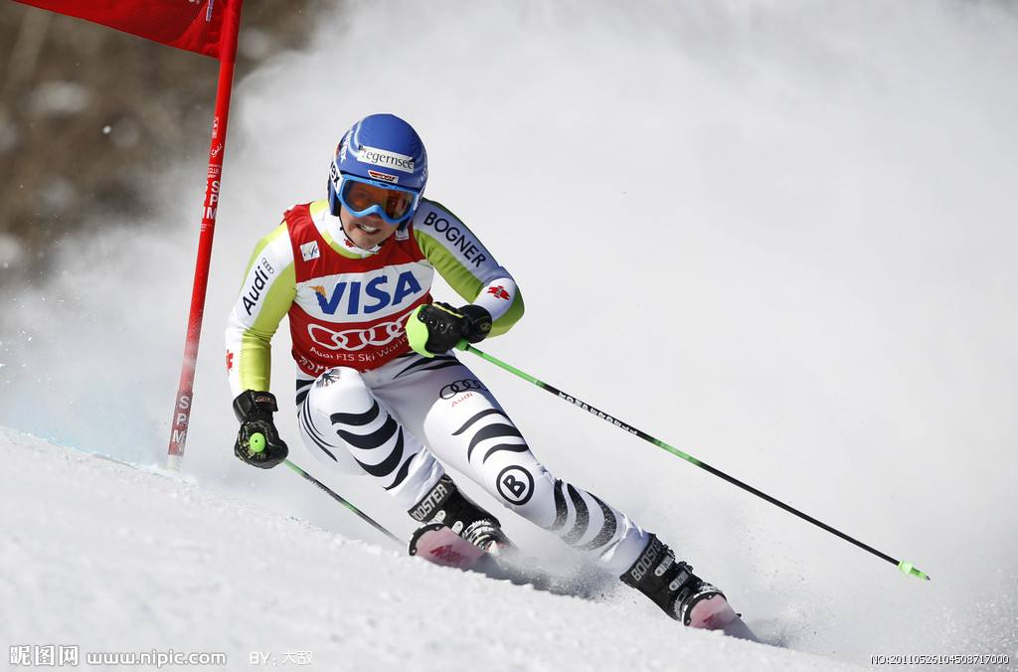
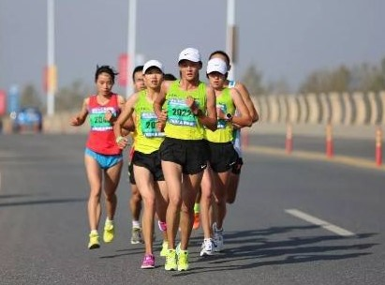
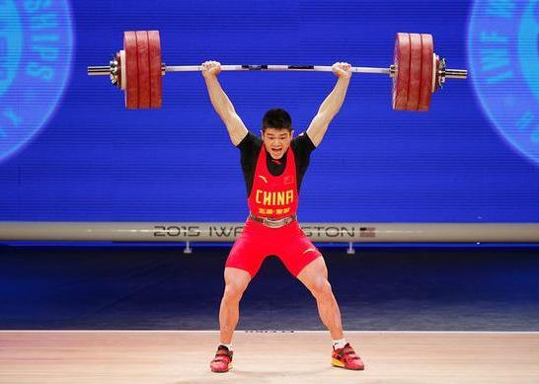
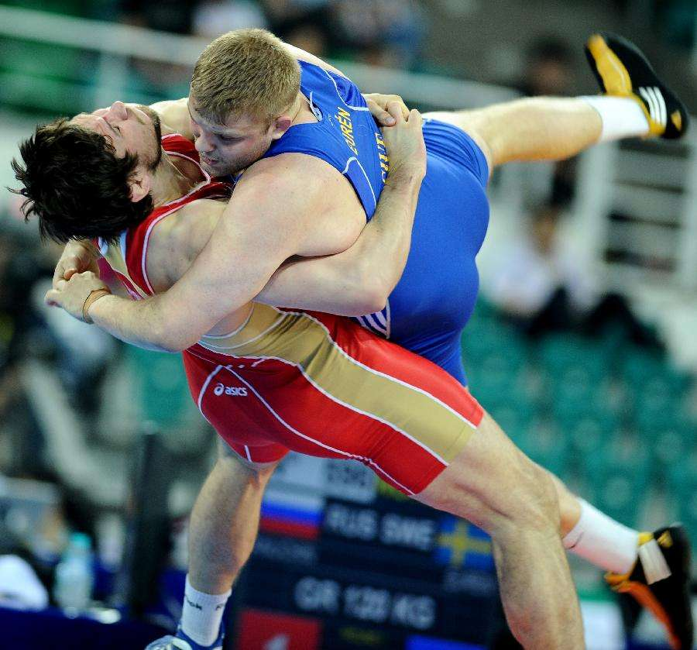
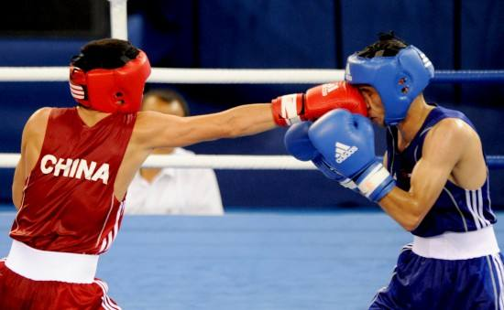
gymnastic
skiing
marathon
lifting
wrestling
boxing

Slide 8
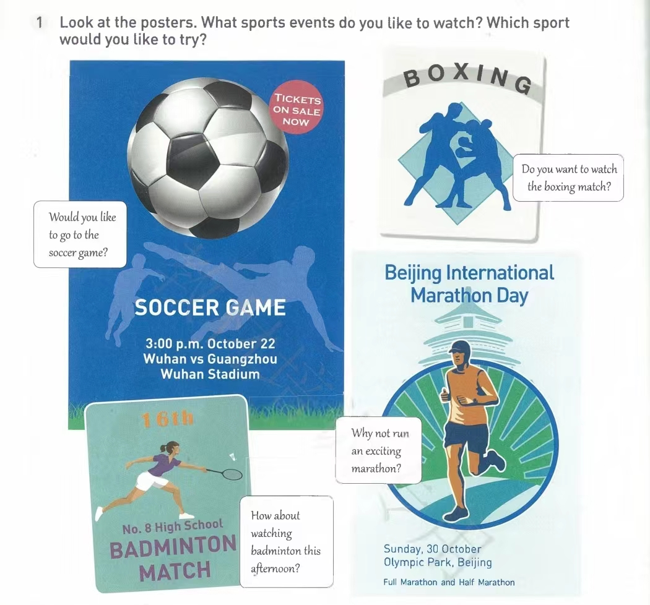

Which sports events do you like to watch? Which sport would you like to try?
Poster

Slide 9
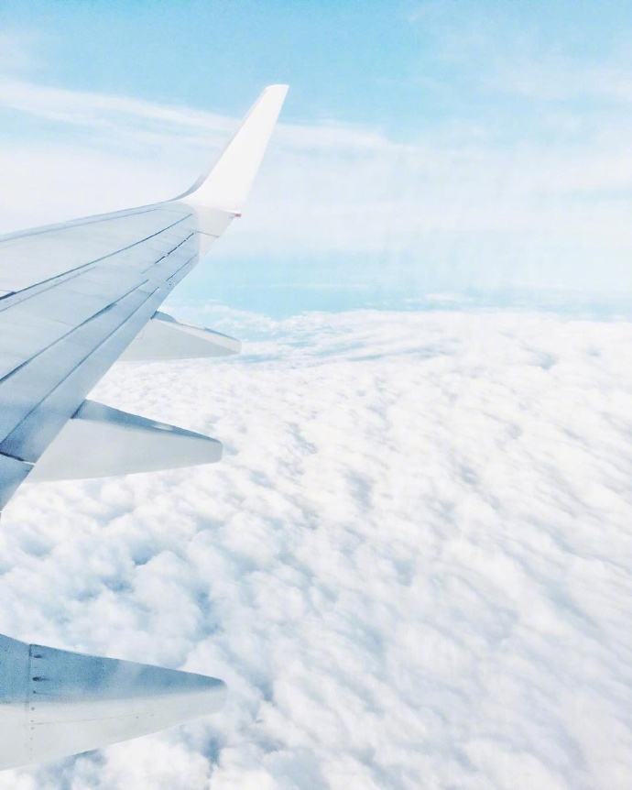

While Listening
Listen to Conversation 1.
What is Shen Qi's main purpose for talking to Amy?
Listen for main ideas
Try to catch the main ideas instead of trying to remember and translate each word you hear.
A. To invite Amy to an e-sports event.
B. To invite Amy to a soccer match.
C. To explain an e-sports event.

Slide 10
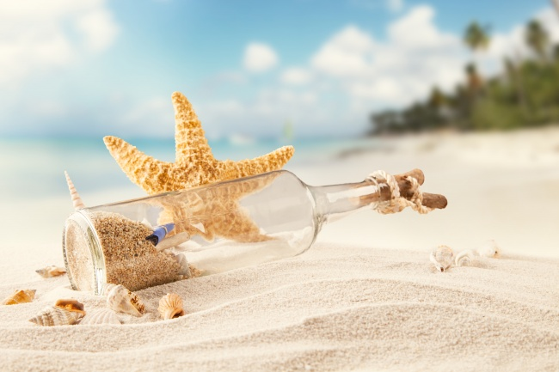
Listen to Coversation 1 again and circle the words that the speaker stresses.
1. Did you hear that there's an e-sports event
this weekend?
2. Would you like to come along?
3. Really? I'd love to!
4. Why don't you join us
this Saturday afternoon?
5. Oh, sorry. I can't.
tips:
stress for content words: noun, verb, adj, num. quantifier, pron
no stress for function words: prep, conj, auxiliary words

Slide 11
Adam is inviting Julie to a sport event. Listen to Conversation 2 and answer the questions.
1. When will the event happen?
The event will happen ___________________.
2. What's a “Blue Paint” run?
A “Blue Paint”run is a fun run that ___________________.
3. Why is it called a “Blue Paint” run?
Beacuse people can buy water balloons filled with _____________ and_________________ the runners.
4. If 200 people take part in the run and 400 balloons are sold,
how much money will they collect?
on Saturday afternoon
helps the community
blue paint
throw them at
6,000 dollars.

Slide 12
Post Listening
Useful languages for inviting、accepting or refusing the invitation
All right(then)!
Yes, I’d love to...
That would be very nice.
I’m looking forward to...
That sounds like a good idea.
That’d be great!
That’s, that’s very nice of you.
I’m sorry/afraid I can’t.
I’d love to, but...
What/How about...?
Why don’t you...?
I’d like to invite you to...
Would you like to...?
Could/Would you please...?
I wonder if you’re interested in...?

Slide 13
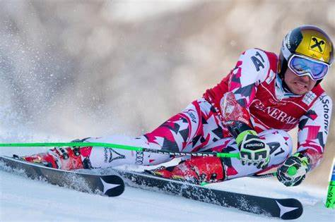
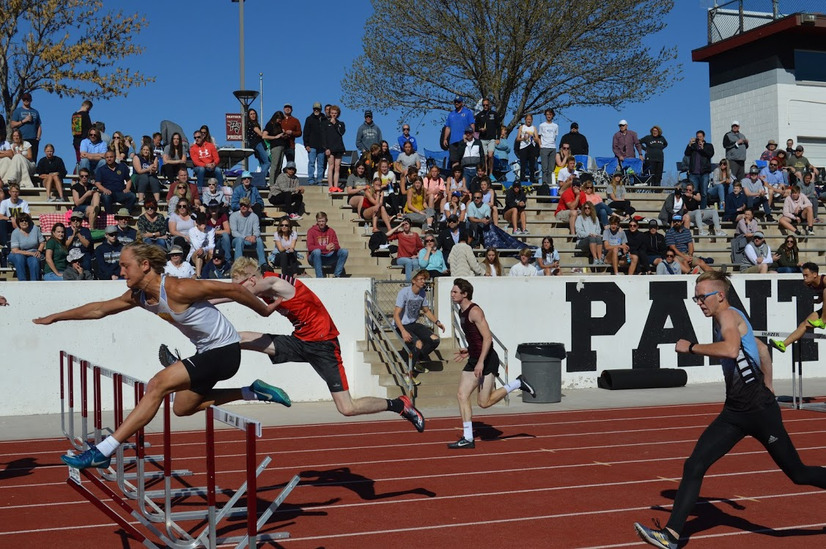
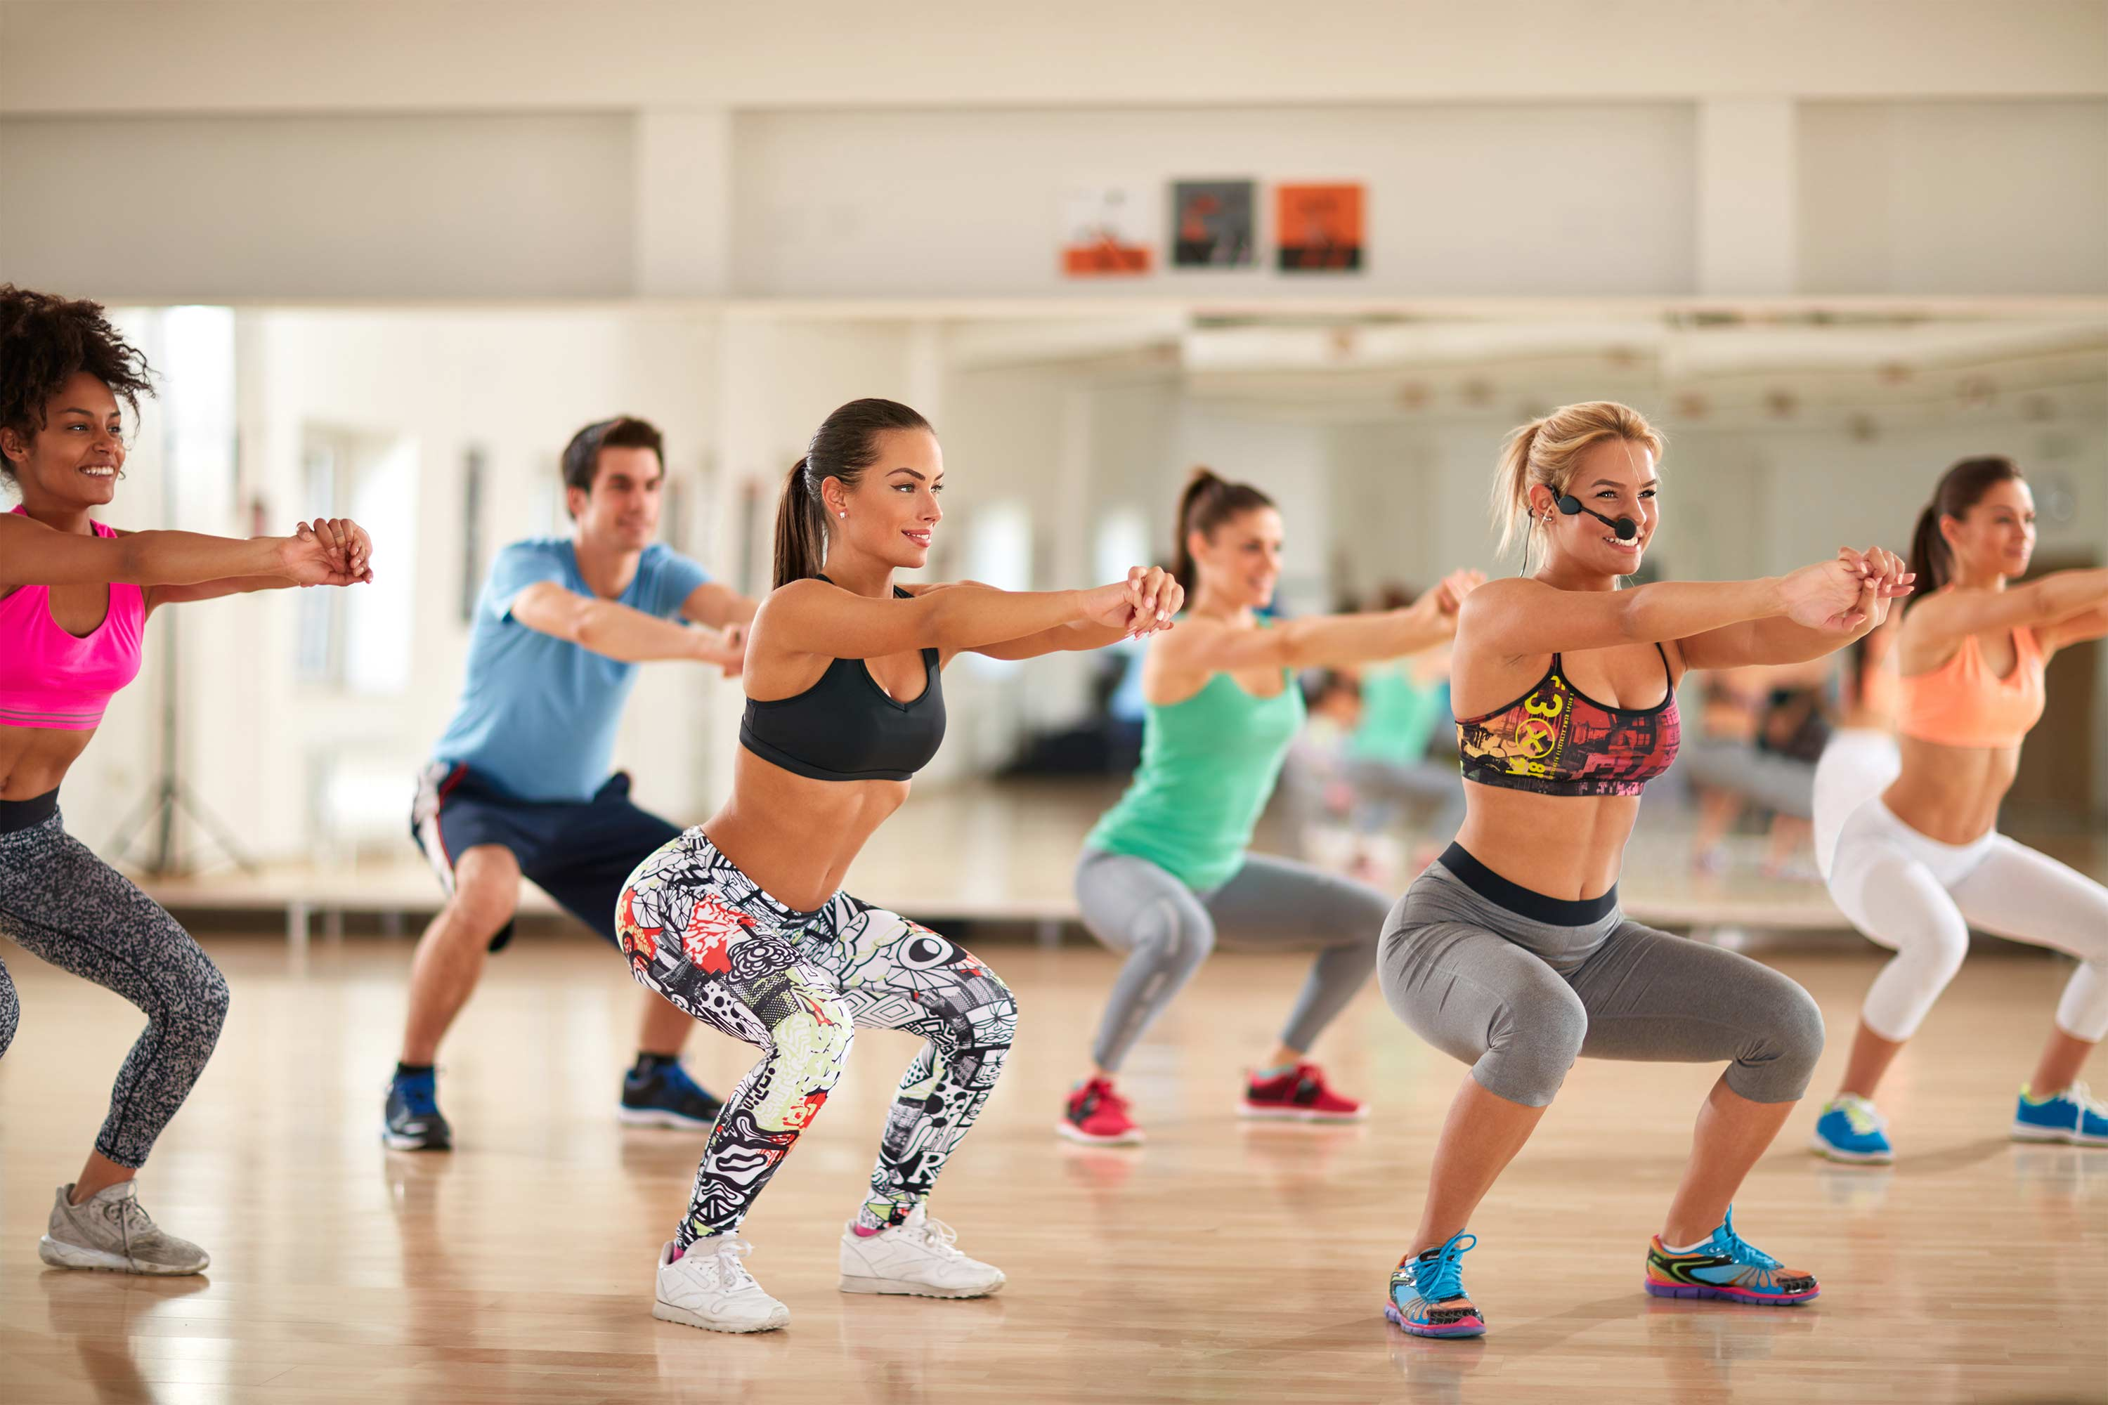
Role Play
What event or actually would you like to invite your friend to? Make a conversation with a partner.
Track Meet: A great event for track-and-field lovers on 26 October.
Ski Race: Zhangjiakou, a beautiful city in northern China, will host the Youth Ski Race in December.
Gym Class: Come and work out at a gym! Sweat your way to good health! You can make it!

Slide 14
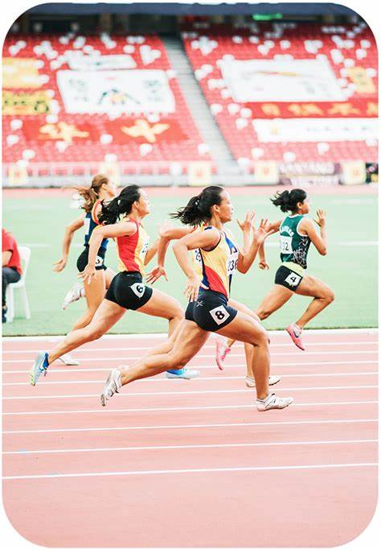
Sample Conversation
Sam: Hey, Ben, it's Sam. What are you up to today? Would you like to come to a gym class?
Ben: Hi,Sam. Sure, I don't have any plans. What time does it start?
Sam: At 2:00. It's at the High Reps Gym in Pudong.
Ben: OK, but do I need to pay for the class?
Sam: No, it's free today. They are giving free classes to help people improve their health!
Ben: That is great! See you there just before 2:00.

Slide 15
Read the conversation. Decide whether the
intonation of the tag question is rising or falling.
Pronunciation
Dave: Wonderful gym,isn't it?
Jack: Er...yes. It's great.
Dave: This isn't your first time here, is it?
Jack: Actually, it is. You come here often, don't you?
Dave: Yep. At least three times a week.
Jack: You've lost some weight, haven't you?
Dave: Yes. All that fat has become muscle now. If
you want to lose weight, too, I recommend
using the spin bike.
(falling)
Teaching tips:
With question tags, intonation rises when a person asking question is not sure of the answer. When they know (or reasonable sure of) the answer to the question, their intonation usually falls.
(rising)
(falling)
(falling)
(rising)
Jack: OK,but it won't make me too tired,will it?
Dave: Maybe at first, but you'll get used to it. I used
to come here every day when I first started.
Jack: Oh, I don't have to come here every day,
do I?
Dave: No. Of course not. It's up to you, isn't it?
(rising)
(falling)

Slide 16

Watch the video and find out
the answers to these questions:
How many Olympic Games has China already held? When and where?
What are the difference about the 2023 Asian Olympic Games compared with other international comprehensive sports events?
What are special about 2023 Asain Olympic Games?
What aree the newly-introduced sports in 2023 Asain Olympic Games?
What are the Asain Games’ three mascots(吉祥物)？

Slide 17

Video about the 2023 Asain Olympic Games

Slide 18
How many Olympic Games has China already held? When and where?
What are the difference about the Asian Olympic Games compared with other international comprehensive sports events?
What are special about 2023 Asain Olympic Games?
What aree the newly-introduced sports in 2023 Asain Olympic Games?
What are the Asain Games’ three mascots(吉祥物)？
Two. In Beijing and in Guangzhou in 1990 and 2010 respectively.
Asain Games have non-Olympic sports.
1. The largest 2. Many new sports
Esports and breaking
Chenchen, Congcong and Lianlian

Slide 19
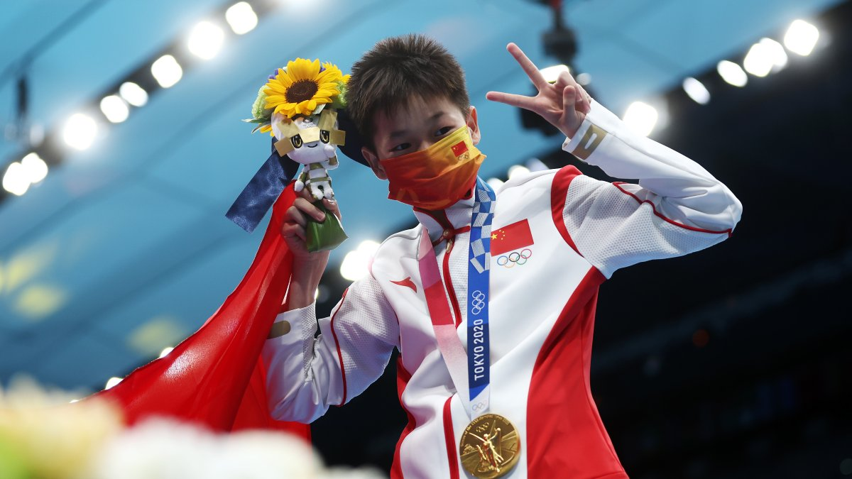
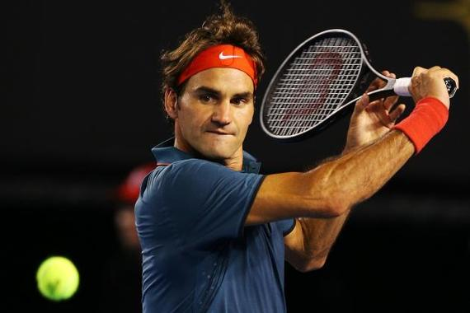
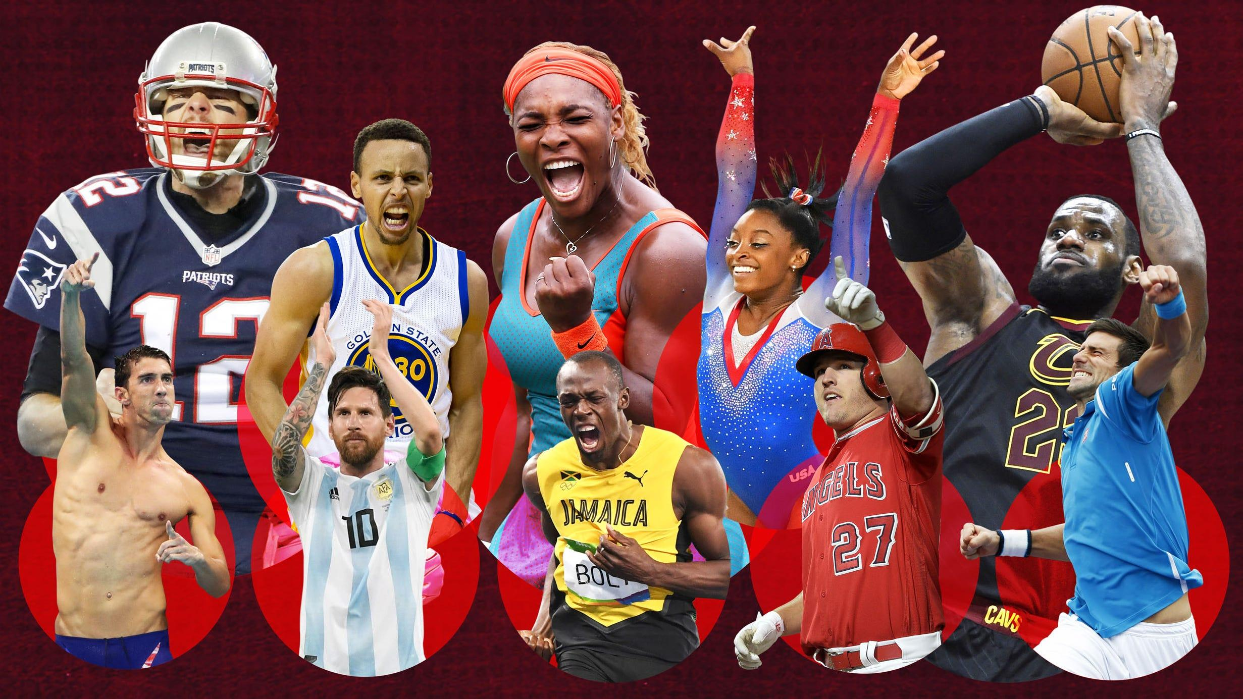
Talking
Which sportsman impresses you most?
And what quality impressed you most?
HOLIDAY
Click here to add words Click here to add words Click here to add words Click here to add words Click here to add words
Click here to add words Click here to add

Slide 20
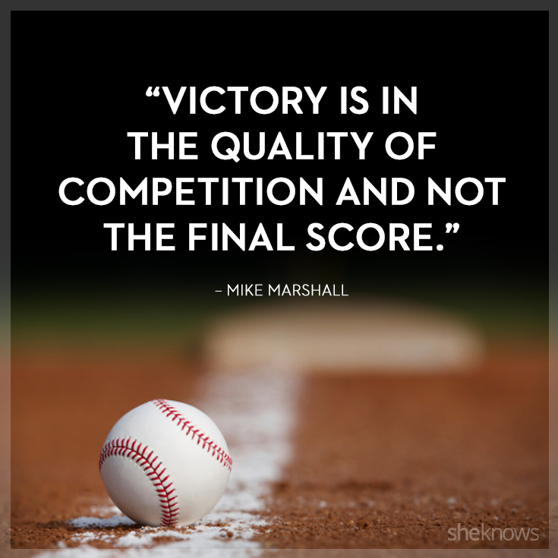
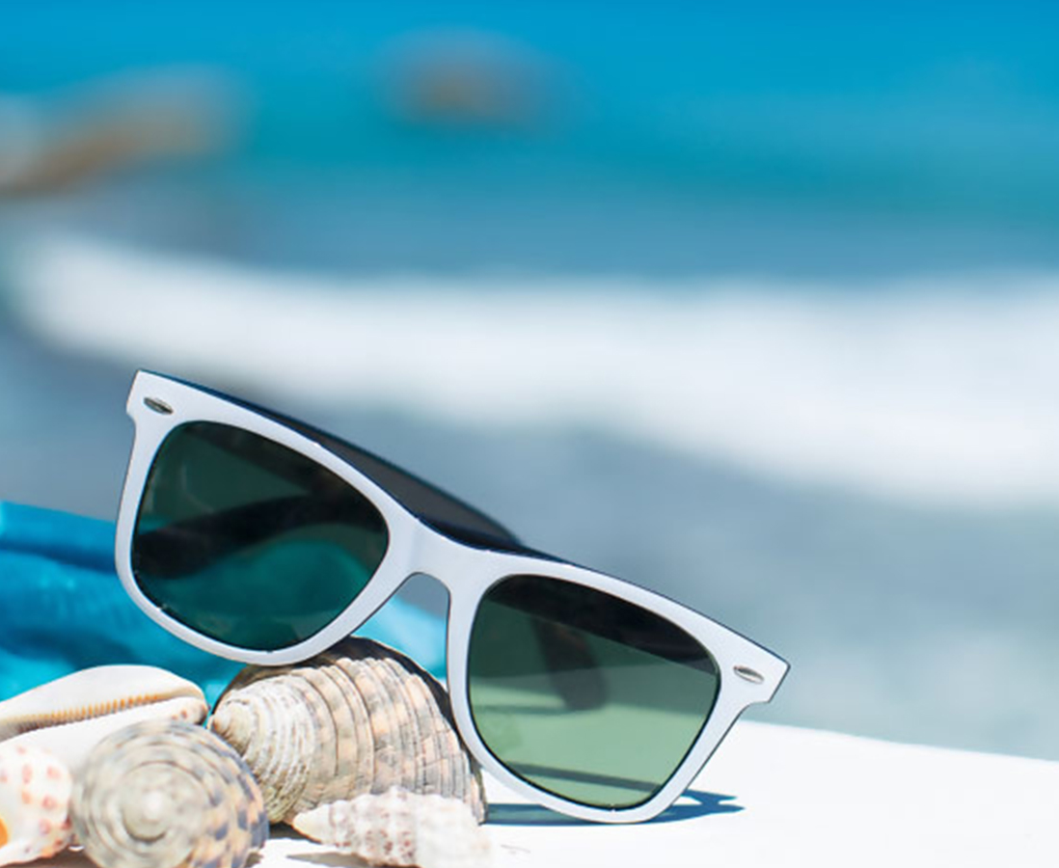
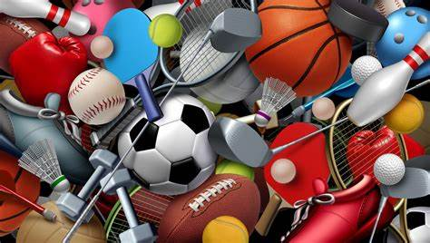
Thank You

