Slide 1


感恩遇见，相互成就，本课件资料仅供您个人参考、教学使用，严禁自行在网络传播，违者依知识产权法追究法律责任。
更多教学资源请关注
公众号：溯恩英语
知识产权声明

Slide 2

The New Term Begins
The First Lesson
2024.8.15 Alicewu

Slide 3

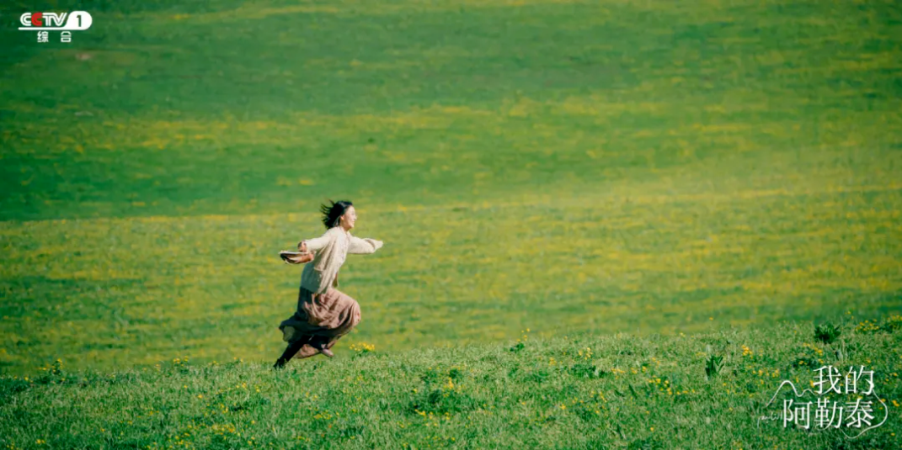
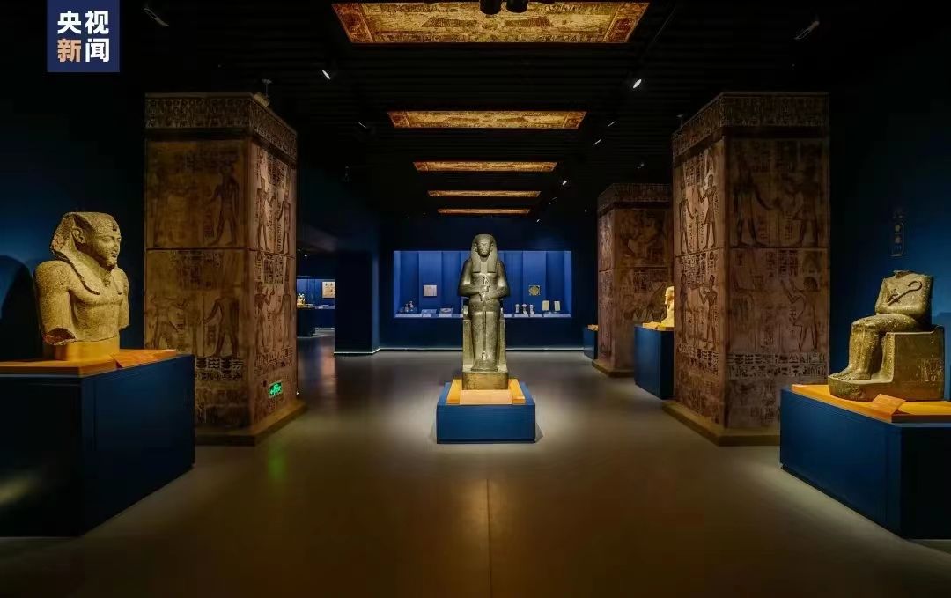
Lead-in
What did you do during summer holiday?
Have a trip?
Visit a museum?

Slide 4
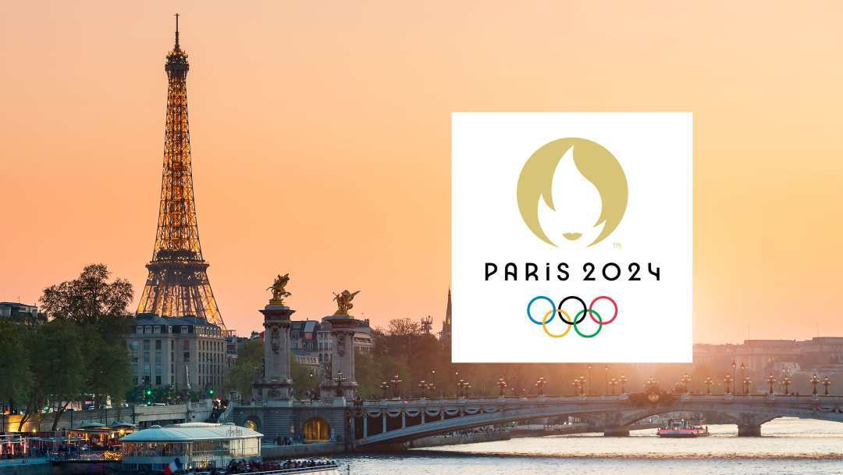
Watch the 2024 Paris Olympic Games
Let’s restart the journey about the 2024 Paris Olympic Games

Slide 5
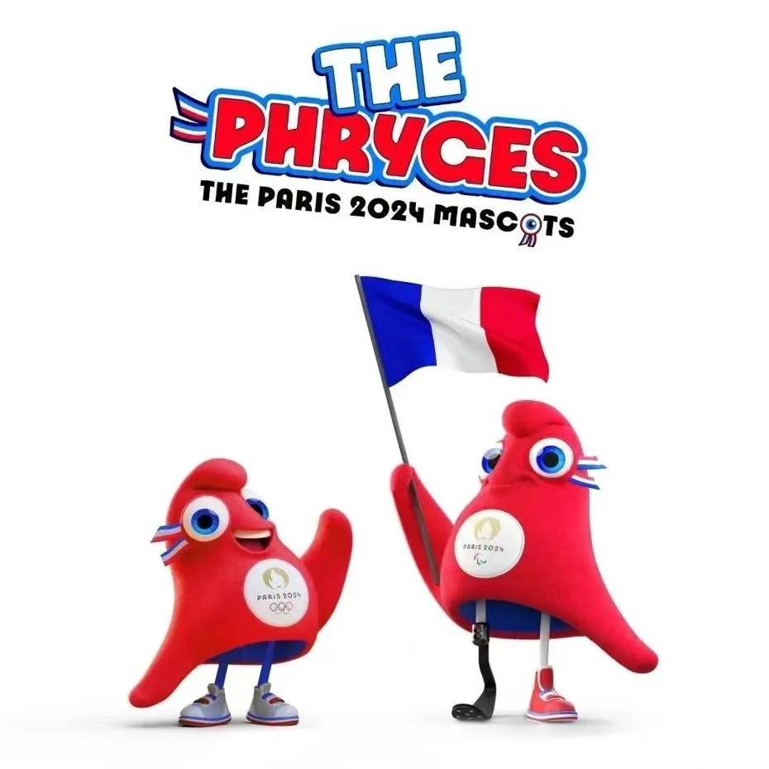
What’s the mascot [ˈmæskɒt]of Paris 2024 Olympic Games?
Mascot
The mascot for the Paris 2024 Olympic Games is named "Olympic Phryge弗里热,"_________ (inspire) by the traditional Phrygian caps that symbolize freedom and are iconic in French history .
The Phryge is characterized by its red color with blue, white, and red trims,_________ (echo) the French tricolor flag, and features the golden Paris 2024 logo on its chest . The mascot___________ (embody) the spirit of revolution through sport and aims____________ ( lead) a movement that demonstrates _________sport can change lives .
inspired
echoing
Phryge
发音类似“freezh”
embodies
to lead
how

Slide 6
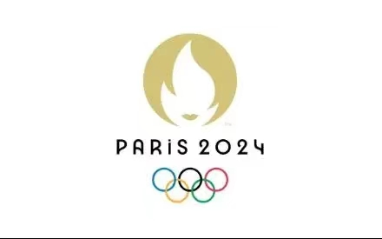
Part 1 Observe &Learn
Logo
2.What do these three separate symbols stand for ?
The gold medal symbolizes________(achieve),which demonstrates that everyone has a chance of winning by excelling themselves and improving their personal bests.
The flame symbolizes the unique energy that drives this ____________(impress) event, encouraging us to be bold and forge a new way to rise to the challenges.
Marianne, symbol of the French Republic, represents the same values we find in sport, the Olympics and the Paralympics — humanism, friendship, ____________(generous) and sharing.Her face is also a respect to female athletes and a nod to history, as it was in 1900 at the Olympic Games in Paris that women were first allowed to compete.
achievement
impressive
1.What can you see in the logo?
the gold medal
generosity
the flame
Marianne

Slide 7

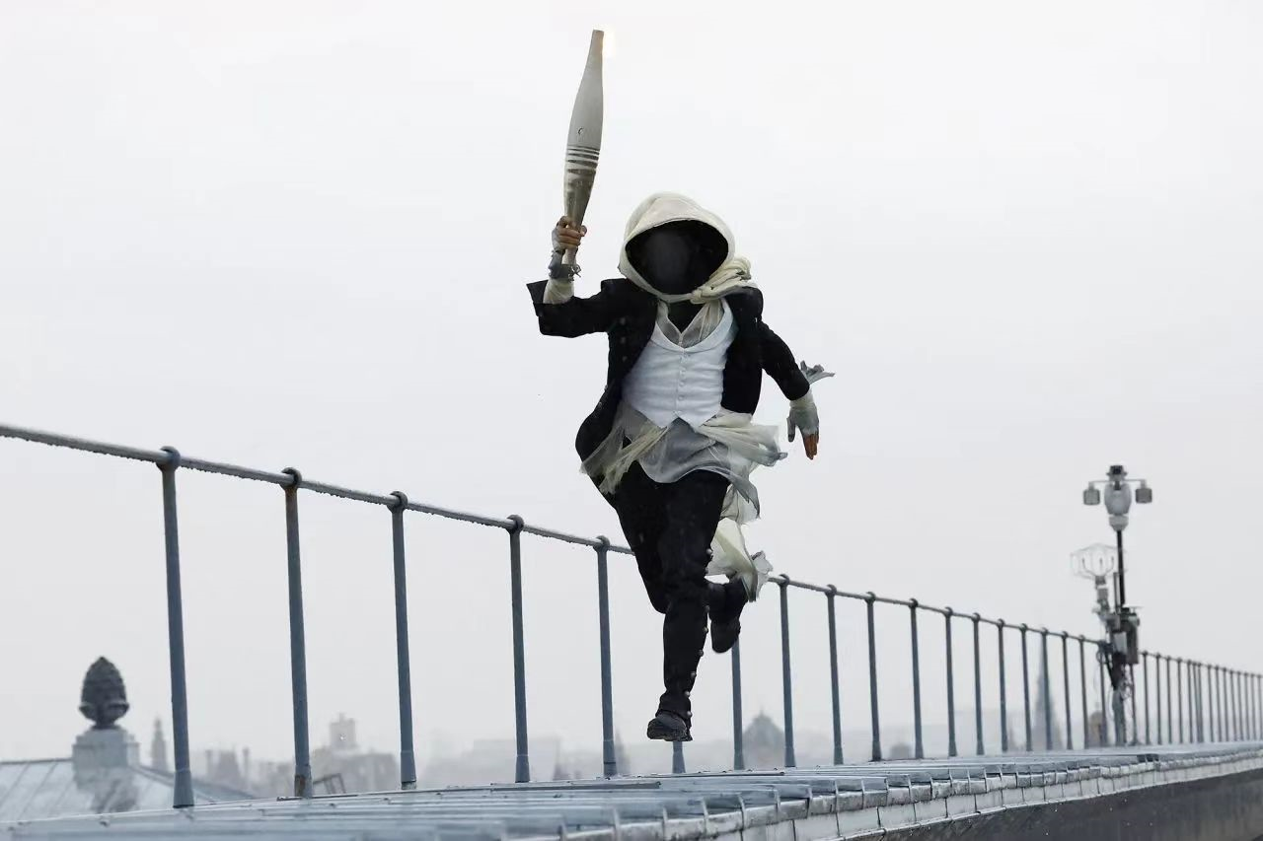
Part 2 Listen &Learn
The Opening Ceremony
1. Where did the Opening Ceremony of the Paris 2024 Olympic Games take place? A. In a stadium B. Along the River Seine C. At the Eiffel Tower 2. What did Lady Gaga's performance involve? A. Singing a popular English song B.Honoring French entertainment with "Mon Truc en Plumes" C.Performing an original song about the Olympics 3. What was special about the Olympic cauldron at the end of the ceremony? A. It was lit in a traditional manner on the ground B. It was underwater and rose to the surface C. It lifted off into the sky after being lit
B
B
C

Slide 8
Part 3 Listen for detail information
The Opening Ceremony
The Opening Ceremony of the Paris 2024 Olympic Games took a historic turn by not taking place in a stadium, but along the River Seine.Starting from the Austerlitz Bridge, ___________ paraded on boats for______ kilometers, passing iconic ____________ like Notre-Dame and the Louvre, culminating at the Trocadero.
Despite the rain, the event showcased the city's culture and history through __________ performances. Lady Gaga's prerecorded act paid tribute to French entertainment with her version of "Mon Truc en Plumes." A mysterious torchbearer, embodying __________from French culture, added an element of mystery. Celine Dion's powerful performance of "Hymn to Love" under the Eiffel Tower, which was adorned with Olympic rings, was a__________ . The ceremony concluded with the Olympic cauldron being lit by Marie-José Pérec and Teddy Riner, followed by a unique spectacle of the cauldron lifting off into the sky.
The event showcased France's culture and history, with a colorful display reflecting the nation's _________ and spirit.
athletes
6
landmarks
various
characters
highlight
diversity

Slide 9
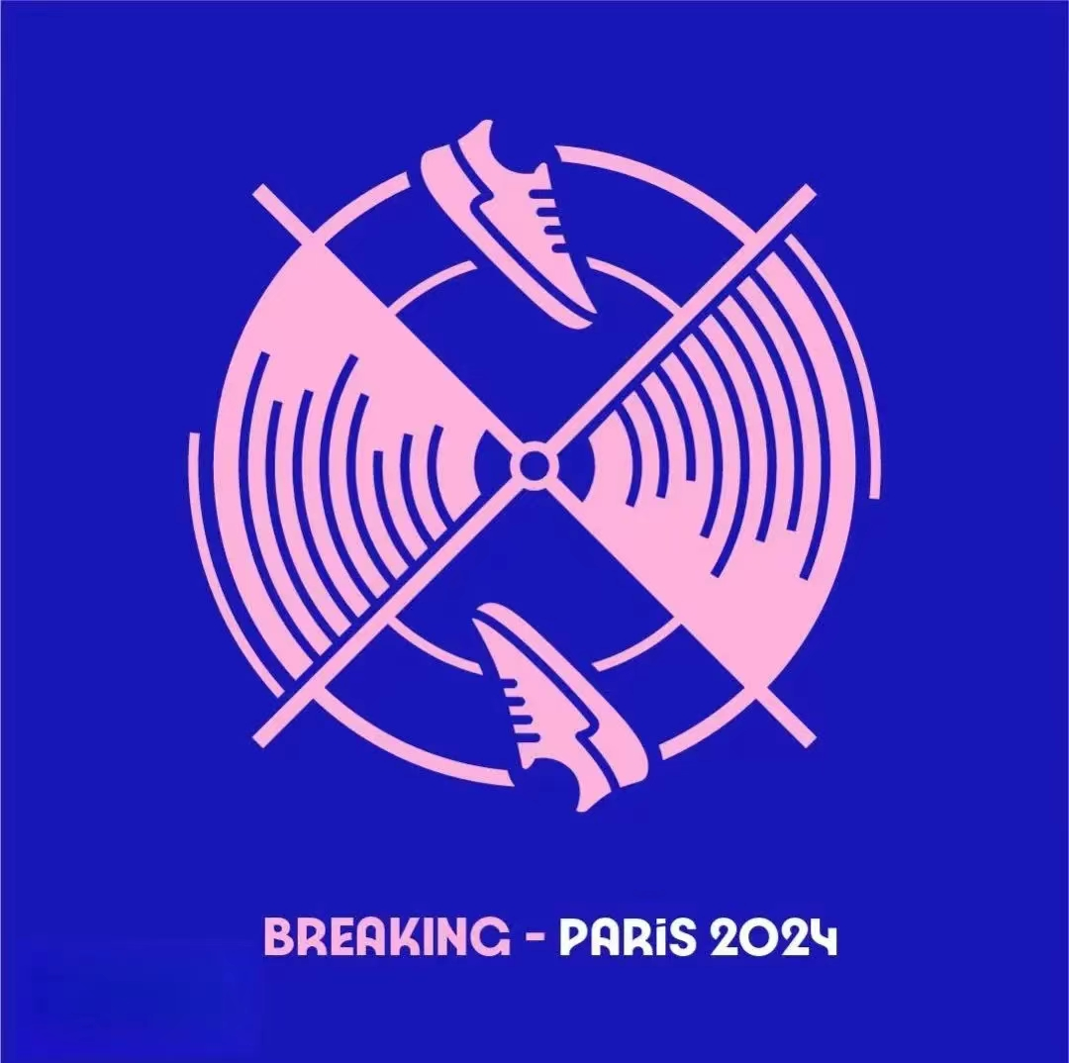
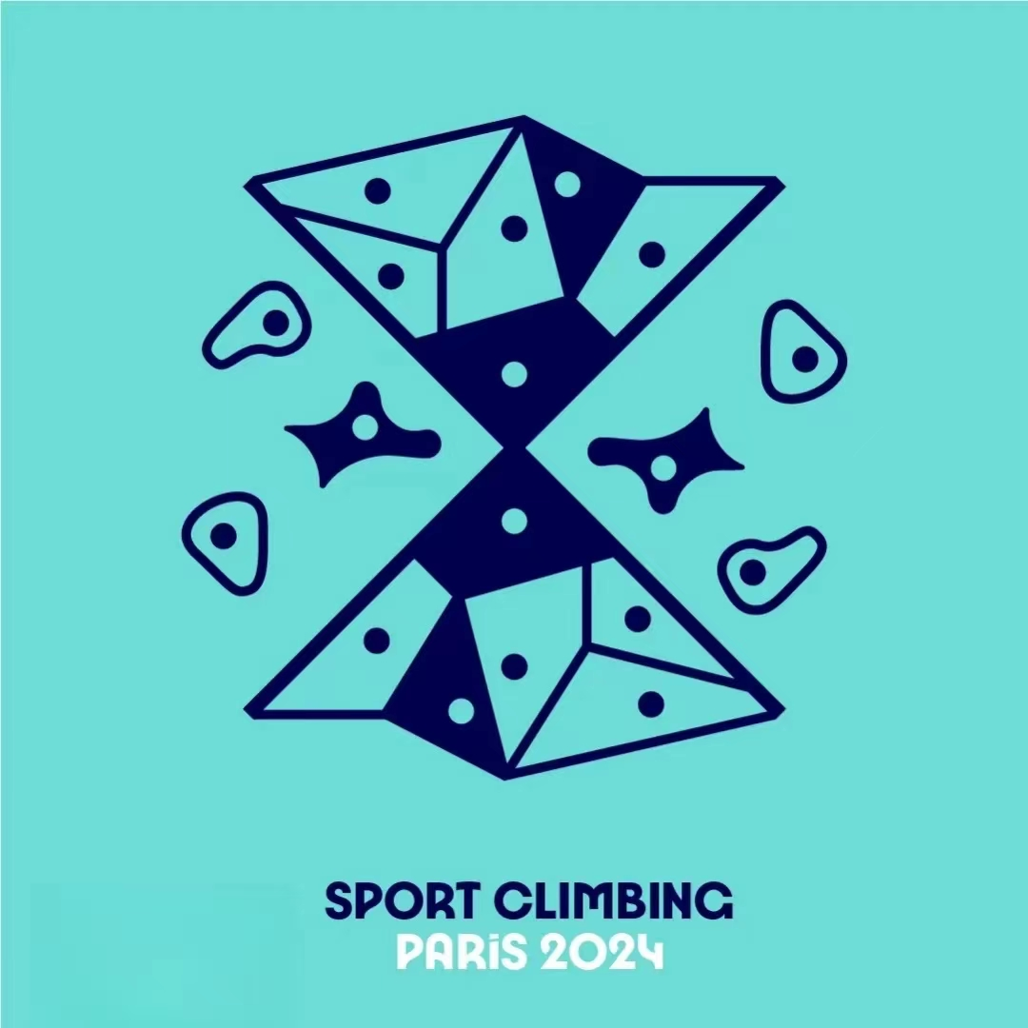
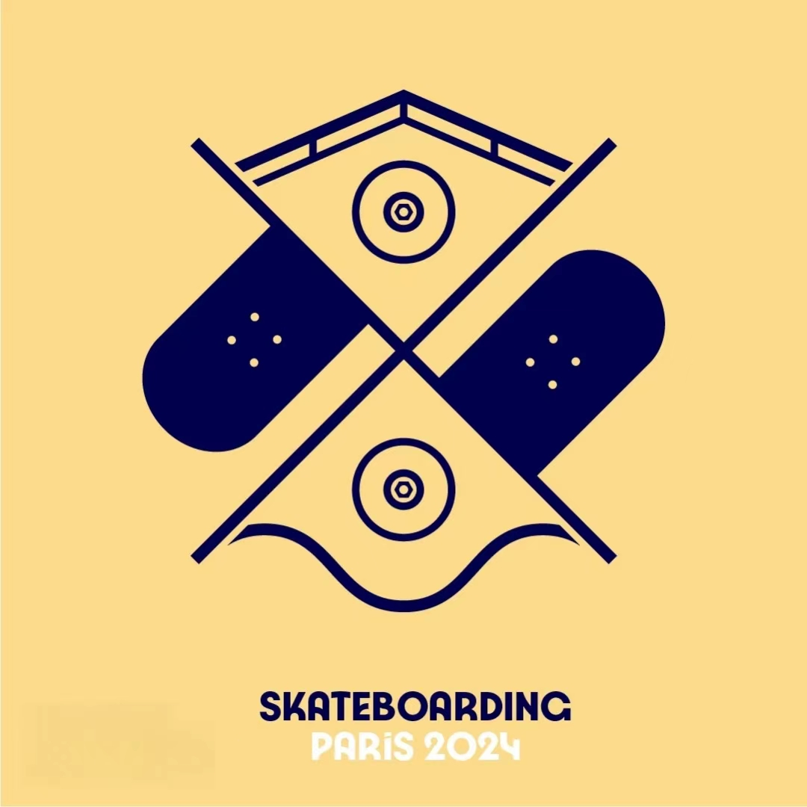
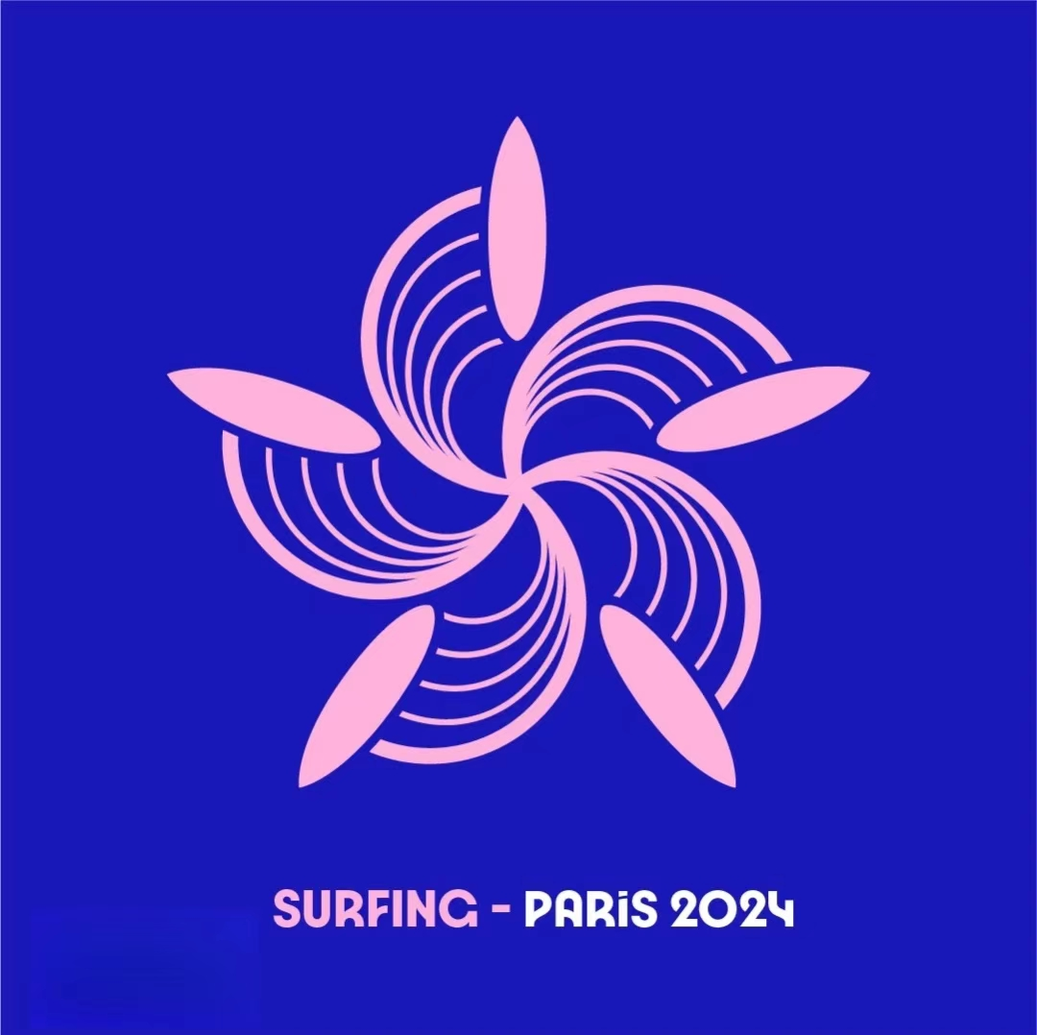
Part 4 Watch &Guess
Pictogram/ˈpɪktəɡræm/项目象形图

Slide 10
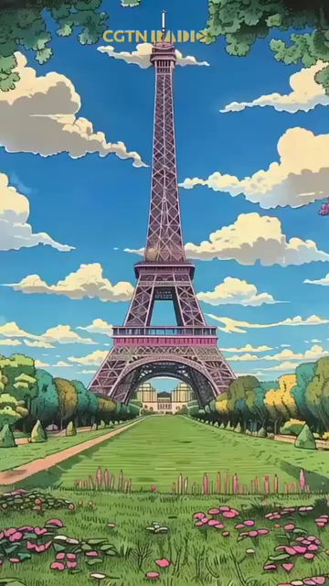
Part 4 Watch &Guess
Clue 2:Watch the following video.
Clue 1:They are the new sports added to the 2024 Paris Olympics.

Slide 11
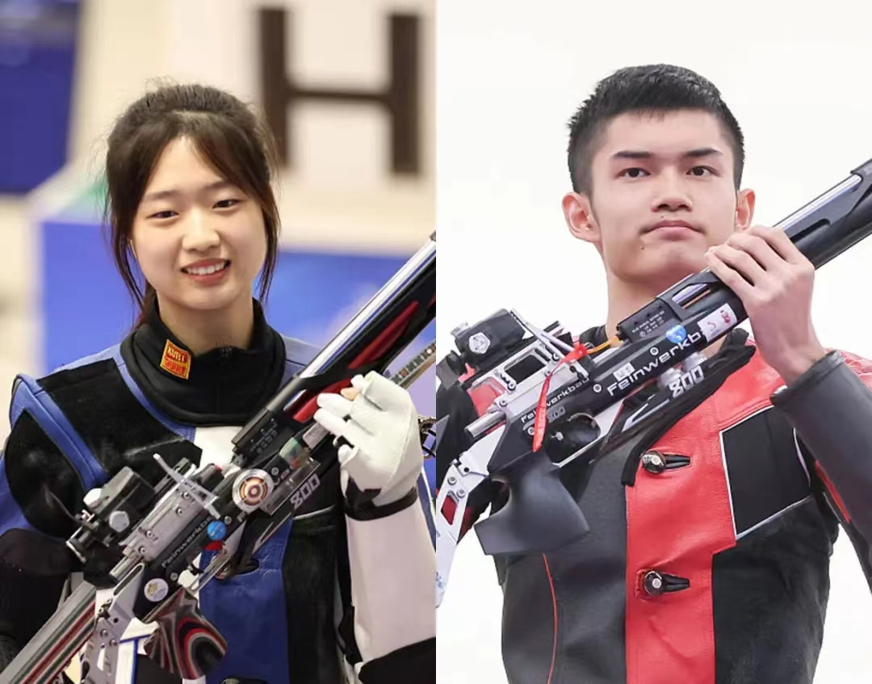


Who impresses you most during the 2024 Paris Olympics?
Part 5 Read &Learn Inspiring figures
Chinese "Post-2000s" shooting duo Huang Yuting and Sheng Lihao, _____ are both under 20 years old, claimed the first gold medal at the Paris Olympics in an event ________their teamwork and precision were on full display. The "relaxed demeanor" of Huang Yuting and Sheng Lihao, _______ names on Weibo are "The Very Tiao" and "Winning the Championship Just by Eating" respectively, was evident throughout the competition. This demeanor,______ is characterized by a state of mind _________that is neither arrogant nor anxious, embodying ease and calmness，was maintained even after their victory, smiling only upon the crowd's request.
who
where
whose
which
that/which

Slide 12
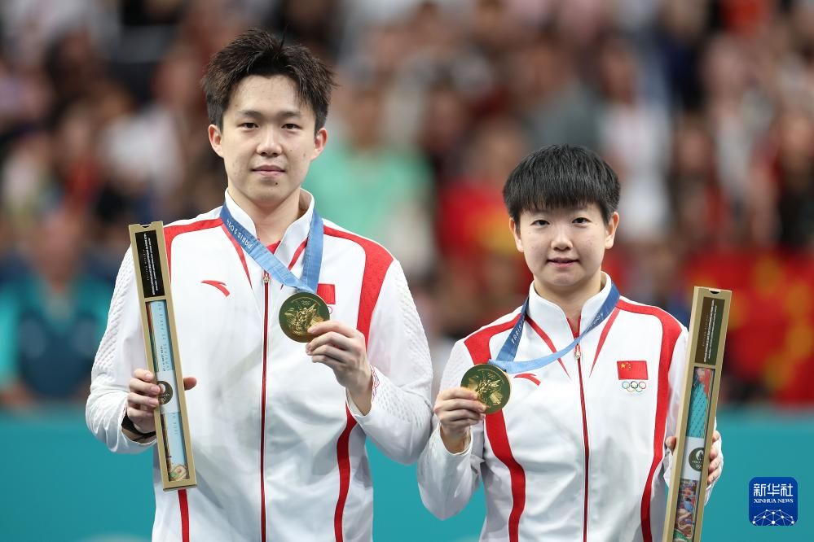
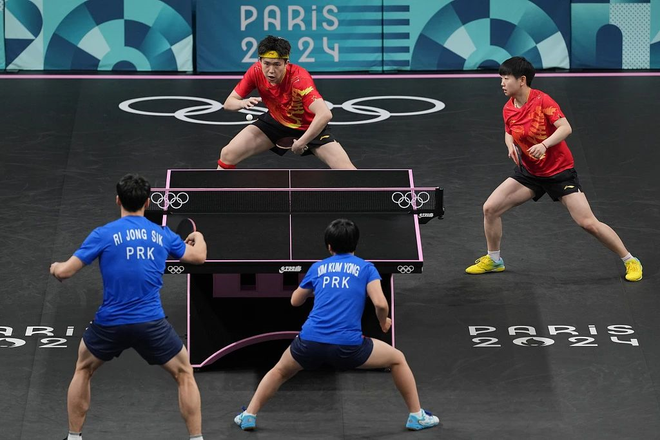
Sun Lisha and Wang Chuqin, ______facing fierce competition in Paris, secured the mixed doubles gold medal for China, showcasing their dominance in table tennis. The pair, even ______under immense pressure, maintained their composure/calmness, beating their North Korean rivals 4-2 in the final.
despite
when
Their win was _____ significant that it strengthened China's quest for a complete sweep of table tennis honors, was a testament to their unwavering dedication. ______ the crowd roared in approval,they played with a finesse that spoke volumes of their years of practice. The more they focused on their game, the _______(clear) their path to victory became, ending in a moment of glory that will be etched in Olympic history.
so
As
clearer

Slide 13
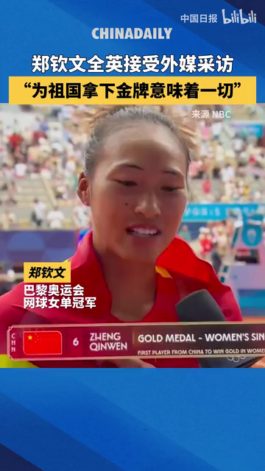
Queen Wen
1.How eager was Zheng Qinwen to win the match?
2.How did Zheng Qinwen feel about overcoming pressure and personal limits?
3.What does winning a gold medal for China mean to Zheng Qinwen?
She was extremely eager to win, but she also understood that giving everything doesn't always guarantee the desired outcome in tennis.
She felt very proud for overcoming the pressure and breaking her personal limits
Winning the gold medal for China is incredibly meaningful to Zheng Qinwen. It's a dream come true and a historic moment for Asian tennis, making her feel extremely happy and proud.

Slide 14
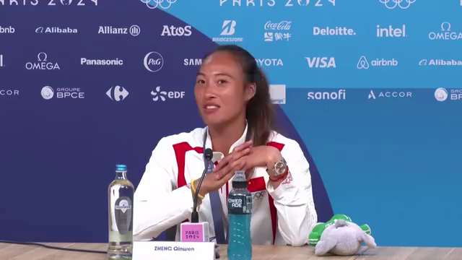
Queen Wen
So I feel this Olympic gold medals can give me a lot of relax because finally I can be able to say to my family, to say to my father, come on, I just_____________ . So in the future, I wish if I lost, I will say this to him and then he will just let me stay quiet and enjoy tennis.
made history
Because I know he always treats Olympic Games more important than any of the slams大满贯. I think all the Chinese fans think so and including me, because you can see the_________ I have in this tournament. The________ , the eyes, the ________ I have is different than all the other tournament that I play. Yeah, I wish in the future I could enjoy more tennis, play, relax, and have some fun on court.
strength
behavior
hunger

Slide 15
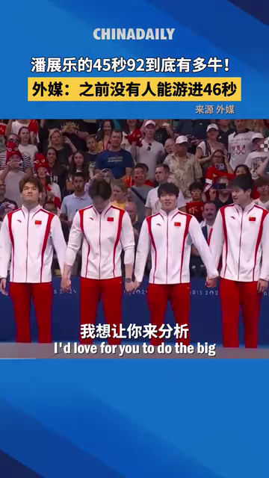
“We can barely see him breathe here, and he's so, so smooth. There's no splash on his hand entry, his body position is great, and you can see he's got massive, powerful quads that generate a massive kick behind him.”
Pan Zhanle
Task：Translate it into Chinese
我们几乎看不到他呼吸，他的动作非常流畅，手部划水时不会溅起任何水花，他的身体姿势非常好。我们可以看到他有非常强壮的股四头肌能在身后形成巨大的推动力.

Slide 16
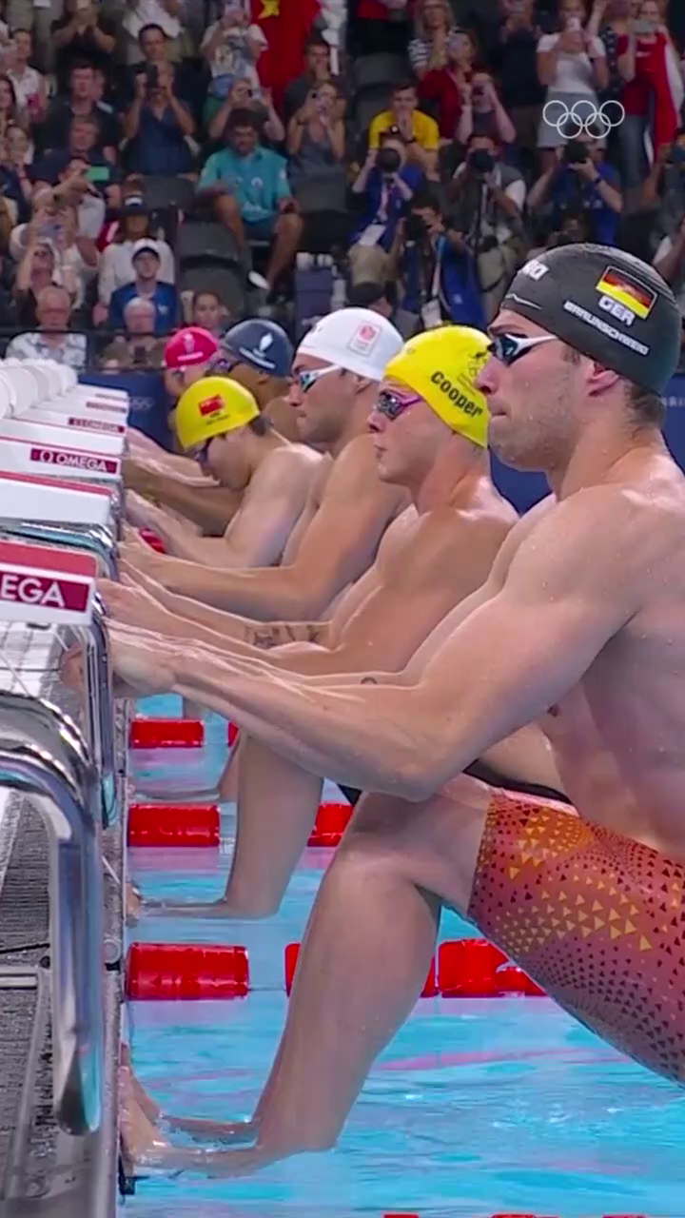
For the first time in 11 Olympics the US has lost this relay... It was first introduced in 1960. Australia won in 1980, and other than that, the USA has won every edition of this relay.
Men's4x100 metres medley
And it took an upset worthy of the Greek gods for China to win the gold. What a swim! What a relay!
希腊神话中的逆袭
仿写句子：她不是一位普通的英雄；她的成就足以媲美希腊诸神的奇迹，她的名字将被镌刻在星辰之中。（应用文中人物的成就描述）
She was no ordinary hero; her feats were an upset worthy of the Greek gods, and her name would be etched in the stars.

Slide 17
Make a title
Champion Swimmer Pan Zhanle Prioritizes Peaceful Training Over Fame
Or
Pan Zhanle: Fame Over Focus? Not on His Watch
Swimmer Pan Zhanle, who won two golds and a silver in Paris, closed his only fan account on Weibo so he could focus more on training. This got huge attention on social media, and was viewed more than 200 million times on Weibo, with fans praising the decision and saying it would make him a better athlete.
“Some people would never contact me, but when I won a gold medal, they sent me a message to congratulate me on the award,” he said. “I usually don't reply to such messages.”
The young athlete won many hearts with his sharp and out of usual comments during interviews. "I hope to be more low-key and peaceful. I would rather not have such outstanding results this time, so that I can continue to focus on training peacefully," Pan said during an interview about his sudden rise to fame.
coming from Chinadaily&21世纪英语报

Slide 18
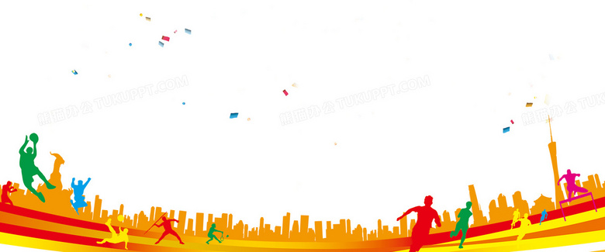
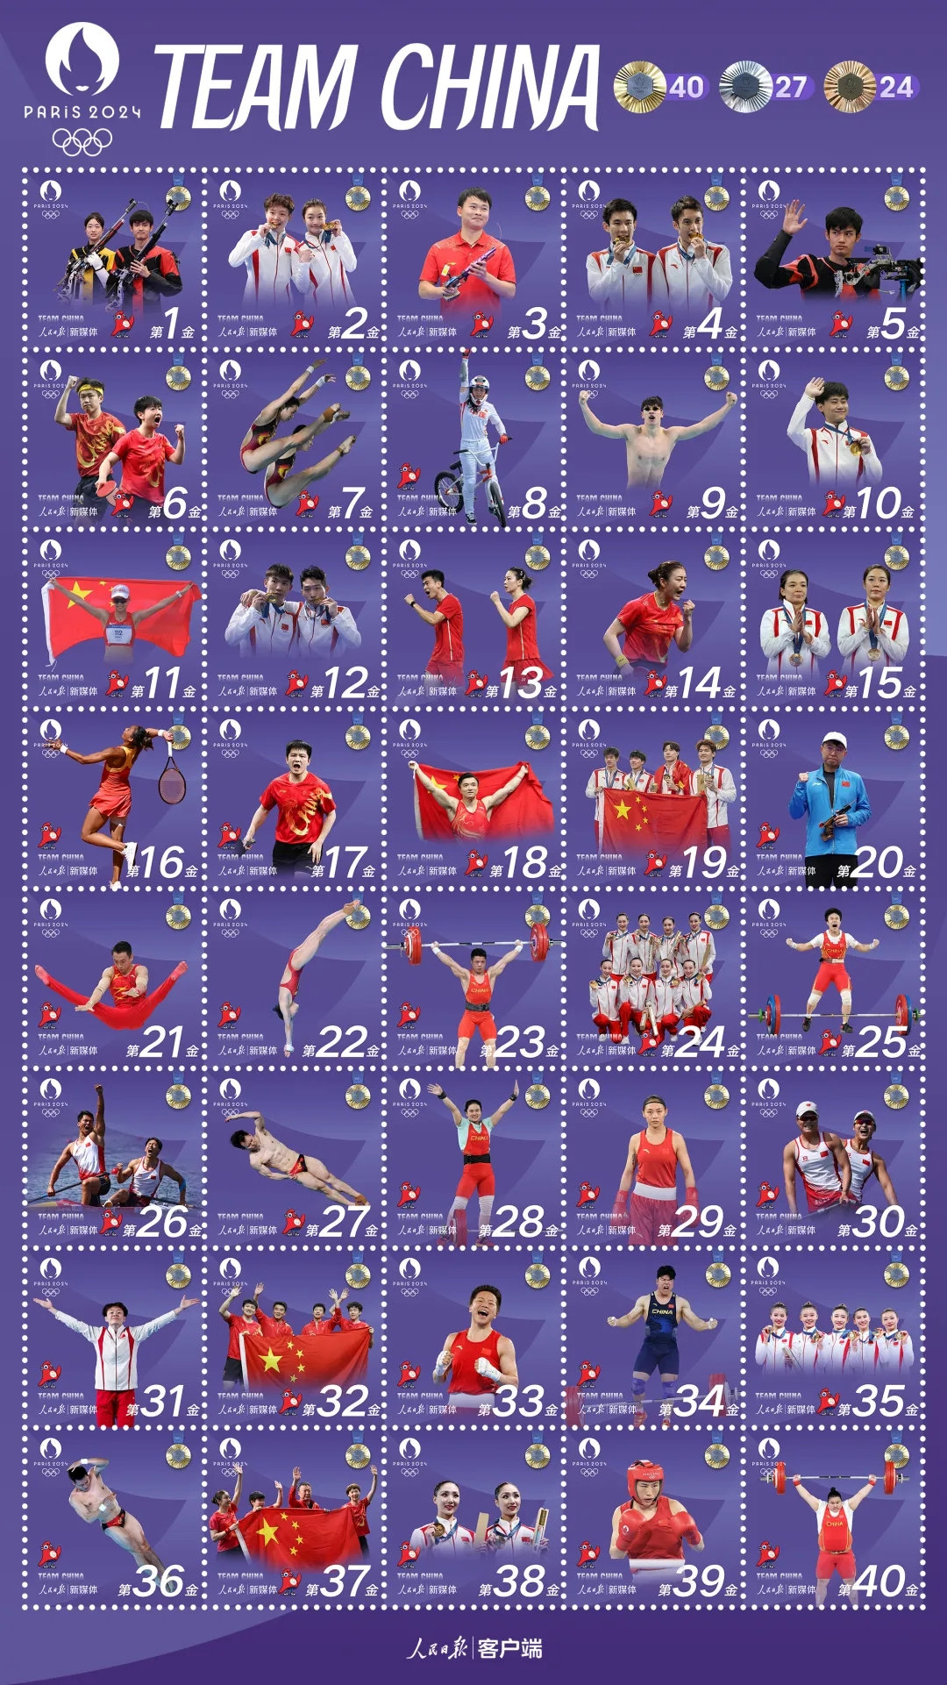
The Closing Ceremony
After 16 days of spectacular competition, the 2024 Olympic Games came to ___ end on August 11th with the traditional closing ceremony.
China's Olympic delegation, consisting ____404 athletes competing in 232 events across 30 sports, clinched 40 gold, 27 silver and 24 bronze medals at Paris 2024, which achieved ____ (it)best overseas performance.
International Olympic Committee President Thomas Bach expressed his overwhelming satisfaction with the event, praising it___ a "sensational" and historic celebration of sport.
an
of
its
as

Slide 19

What qualities can we learn from these inspiring athletes?
teamwork and precision
even when under immense pressure, maintained their composure/calmness
unwavering dedication
The more they focused on their game, the clearer their path to victory became
She was extremely eager to win, but she also understood that giving everything doesn't always guarantee the desired outcome in tennis.
overcoming the pressure and breaking her personal limits
stay quiet and enjoy tennis
more low-key and peaceful

Slide 20

Part 6 Words to collect about Olympic Games & Sports
Olympic Games
Opening Ceremony
court
stadium
relay
mascot
claimed the first gold medal
silver
athletes
Championship
training peacefully
compete
fierce competition
bronze medal
slam大满贯
victory
closing ceremony
tournament

Slide 21
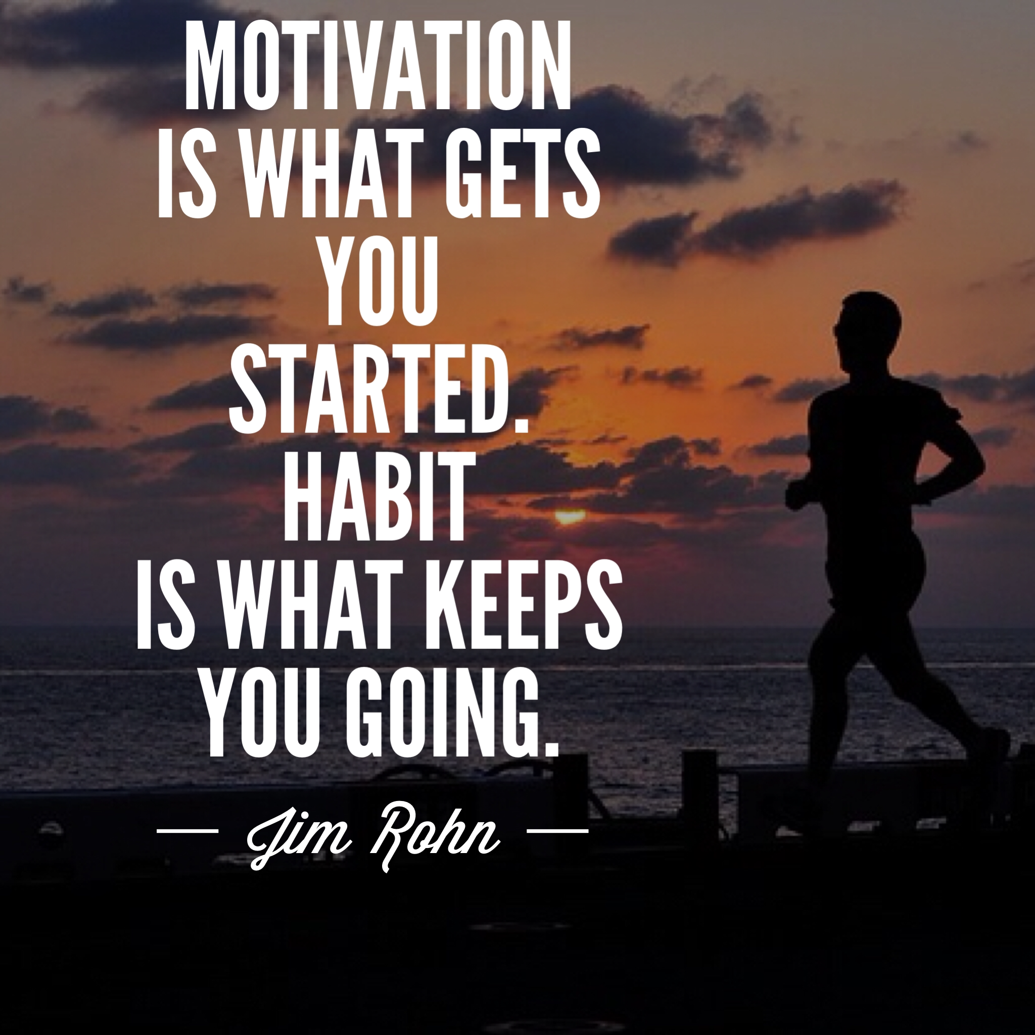

Slide 22
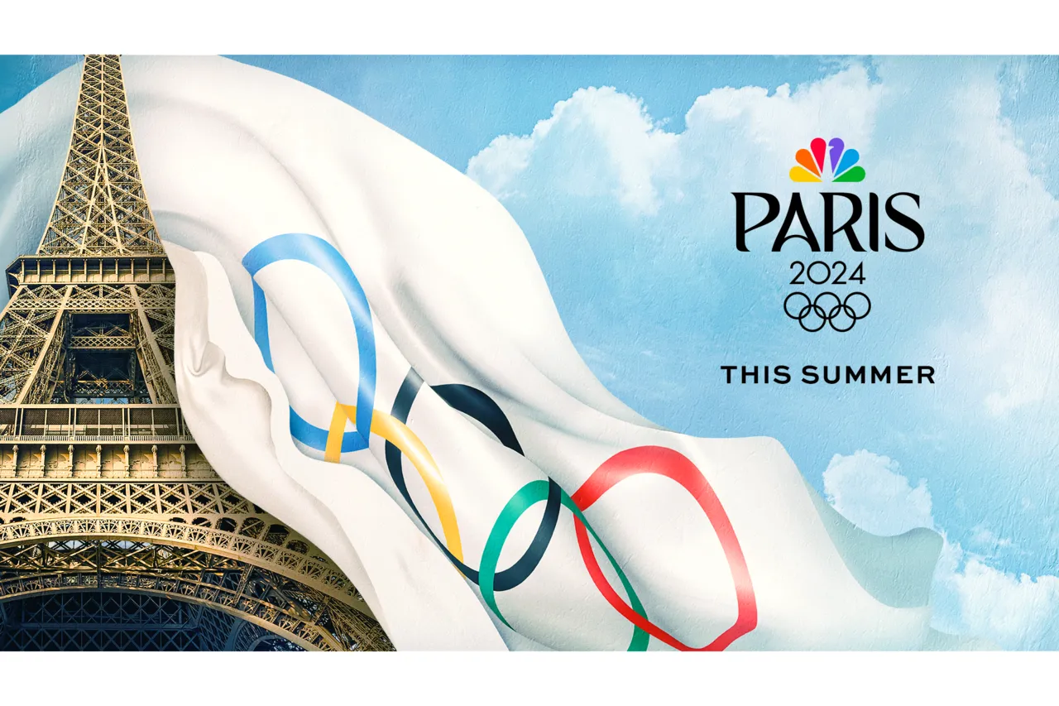
Homework: Writing
在刚刚结束的2024巴黎奥运会上，中国运动员取得佳绩。某英文报开设了“我最喜爱的中国运动员”专栏。请用英语写一篇短文投稿，介绍你最喜爱的中国运动员。
1.该运动员的基本信息；
2.该运动员的主要成绩；
3.你喜欢他/她的原因。
注意：写作词数应为80个左右.
My favourite Athlete

Slide 23
Sample 1
In the recently concluded 2024 Paris Winter Olympics, Chinese athletes shone brightly.Among them,Pan Zhanle, a young and talented swimmer , has captivated my heart with his remarkable achievements.
Born in 2003, he has already claimed a gold medal in the 100m freestyle and another gold medal in men’s 4x100 metres medley, showcasing his unwavering dedication and exceptional teamwork. I admire Pan for his ability to maintain calmness even when under immense pressure, a quality that has been instrumental in his success. His focus on the game, as demonstrated by his precise strokes and strategic planning, has made his path to victory increasingly clear.
Pan Zhanle's journey is one of overcoming personal limits and staying peaceful amidst fierce competition, a testament to his character and the spirit of the Olympic Games.

Slide 24
Sample 2
At the 2024 Paris Olympics, Chinese athletes excelled.Among them, Zheng Qinwen, a rising star in Chinese tennis, has become my favorite athlete after her outstanding performance at the 2024 Paris Olympics.
Born in 2002, she has made a name for herself by finishing runner-up亚军 in the Australian Open, a testament to her peaceful and focused training plan. What I appreciate most about Zheng is her composure/calmness and precision on the court, which she maintains even in the face of intense competition. Her eagerness to win is balanced by an understanding that success is not guaranteed, but striving for it is what defines an athlete.
Zheng's low-key presence at the Olympic Games opening ceremony contrasted beautifully with her fierce gameplay, making her a symbol of resilience and grace in the world of sports.

Slide 25

Thanks for
learning!

