Slide 1


感恩遇见，相互成就，本课件资料仅供您个人参考、教学使用，严禁自行在网络传播，违者依知识产权法追究法律责任。
更多教学资源请关注
公众号：溯恩英语
知识产权声明

Slide 2





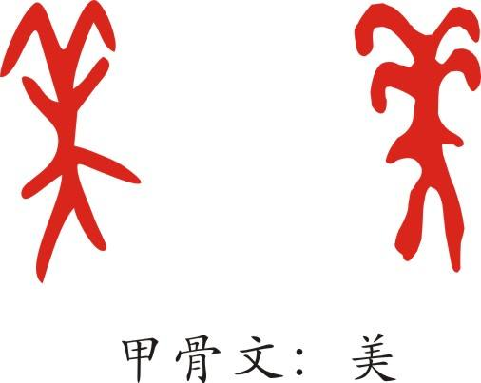
B1U5
Languages Around the World
Language study

Slide 3
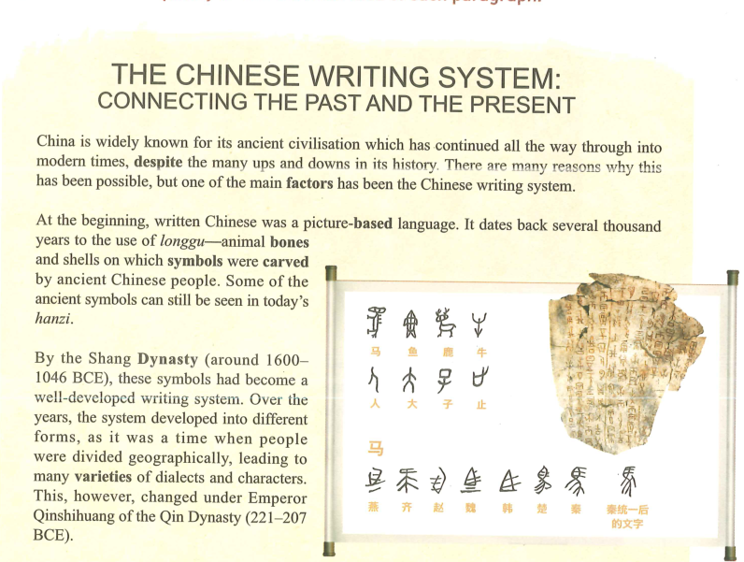
Reading and thinking

Slide 4
Part 1
The Chinese writing system helps Chinese ancient civilisation survive.

Slide 5
1. China _________________(因...闻名于世) its ancient civilisation which has continued __________________(一直) into modern times ,___________________(尽管跌宕起伏) in its history.
is widely known for
all the way through
despite ups and downs
be (widely/well) known for… 因为…而出名
be (widely/well) known as…以…而著称
as
The player who became known ________ “Air Jordan” changed basketball with his graceful moves and jumps.
despite prep. =in spite of…尽管，即使
Although there were many difficulties, she didn’t lose heart.
Despite/In spite of many difficulties, she didn’t lose heart.
ups and downs: 起起伏伏
Life is a roller coaster. It has ups and downs. But it’s your choice to scream or enjoy the ride.

Slide 6
Part 2 （Para 2-3）
The development of the Chinese writing system

Slide 7
Part 2 (Para 2-3)
symbol n.符号；象征；标志
sign n.1） 迹象；征兆 2）招牌；指示牌
3）示意的动作（或声音）；手势 4）符号
v. 签名；签署
signal n. 1）信号；暗号 2）指示灯，信号灯，红绿灯
v. 发信号；发暗号；示意
1. a picture-based language
2. date back to…
3. ancient symbols
4. a well-developed writing system
5. it was a time when…
6. people were divided geographically
7.many varieties of dialects and characters
1. 一种基于图形的语言
2. 追溯到
3. 古时候的符号
4. 发达的书写体系
5. 曾经，一度
6. 人们因为地域而划分开
7. 各种各样的方言和文字
various kinds of…
a variety of…
各种各样的

Slide 8
At the beginning, written Chinese was a picture-based language.
picture-based: 以图片为基础的（象形）
based: adj. 以...为基础的
be based on 根据；以...为基础
base …on …
base n. 底部，根据； 基地
basis n. 基础
The writer based his novel on a true story.
The novel is based on a true story.
There was a hit program, Older Sisters Who Brave Winds and Waves. It __________(由……改编) a Korean program. The hardworking and energetic older sisters in the program left a deep impression on the audience. From the program, we can learn that their success __________(基于；源于) their persistence/great efforts/ characters and talents etc.
is based on
is based on

Slide 9
2. Why were there many varieties of dialects and characters?
varieties
Just like Chinese, there are also many ________（类型）of English, like American English, British English, Australian English.
various/a variety of/varieties of
We are learning English for _______________________________（多种多样的） reasons. Besides English, the Chinese students are learning ____________________________(多种多样的) foreign languages.
various/a variety of/varieties of
There is a wide variety of patterns to choose from.
有种类繁多的图案可供选择。

Slide 10
3. ________ was a time _______ people were divided geographically, __________ led to many varieties of dialects and characters.
It
when
which
a time 一段时间，it 是代词，指一段时间，a time后接when引导的定语从句，
It was a time when he had to beg because he was poor.
which 引导非限定性定语从句，代替主句中所提到的情况。
It was a time when people were divided geographically, __________ (lead) to many varieties of dialects and characters.
leading
现在分词leading 作结果状语

Slide 11
Part 3 （Para 4-6）
The importance of the Chinese writing system

Slide 12
Emperor Qinshihuang united the seven major states into one unified country where the Chinese writing system began to develop in one direction.
major adj.主要的
What is your major problem in learning English?
Vocabulary is my major problem in learning English.
major: n. 主修课程；专业课
v. major in sth. 主修…专业课
majority n. 大多数
a/the majority of … 大多数
Her major is English Teaching.
She majored in English Teaching.

Slide 13
我们班同学将来想要学习各种不同的专业，但是大多数同学想要学医。最主要的原因是他们被医生在疫情期间的无私的奉献打动了。
The students in our class want to ___________ various ________ in the future. But ______________ them wants to _________ medicine. The ________ reason is that they are deeply moved by the selfless sacrifice made by the doctors during the epidemic.
major in
majors
the majority of
major in
major

Slide 14
1.一个统一的国家
2. 朝着一个方向发展
3. 在…方面非常重要
4. 不论住在哪里，不管说着什么方言
5. 成为一个重要手段
6. 与…相联系
7. 传统,经典作品
8. 现在、古代
9.中文汉字
10. 在全球事务中扮演
重要角色
11. 越来越多的人
12. 欣赏中国的文化和历史
1. one unified country
2. develop in one direction
3. be of great importance in doing sth / to do sth
4. no matter where… what…
5. become an important means
6. be connected with
7.classic works
8. in modern/ ancient times
9. Chinese characters
10. play a greater role in global affairs
11. an increasing number of ..students
12. appreciate China’s culture and history
a means of communication/ transportation
by means of / with this method/ in this way
classics 经典作品
classical adj.古典的

Slide 15
The writing system was _______ great importance in uniting the Chinese people and culture.
of
very important
of + (great/much/some/no/little) +抽象名词
表示人或物具有某种特性 可以作表语、后置定语
useful
valuable
helpful
beneficial
interesting
important
significant
of use
of value
of help
of benefit
of interest
of importance
of significance
1) The dictionary is very helpful to learners of English.
2) The dictionary is _____ _____ _____ to learners of English.
of great help
This is a very valuable book.
This is a book ______ _______ _____.
of great value
The medicine is not useful.
2) The medicine is ______ _______ _______.
of no use

Slide 16
age
height
weight
colour
size
shape
type
kind
of
人在年龄、身高、体重等方面的特征
1) Tom is as tall as his younger brother.
2) Tom is __________________as his younger brother.
of the same height
The kids are of an/the same age.
物在度量、大小、颜色、类别等方面的特征
The flowers are _______ many different colours.
of
He prefers movies of this kind --- City Lights and Modern Times.

Slide 17
Written
__________(write) Chinese has also become an important means
_______ ________ China’s present is connected with its past.
by which
先行词 means 在从句中需要添加介词by 作状语
means n. a way of achieving or doing something
方式；方法；途径 单复数同形
Every possible means ________________(try).
All possible means _______________(try).
has been tried
have been tried
by
This weed can be controlled _______ various means.
by this means 通过这种方式
by means of… 通过…的方式

Slide 18
As China plays a greater role in global affairs, an increasing number of international students are beginning to appreciate China's culture and history through this amazing language.
appreciate v.
recognize the good qualities of somebody/something
欣赏；赏识；重视
2) to be grateful for something that somebody has done; to welcome something 感激；感谢
3) to understand that something is true 理解；意识到；领会

Slide 19
I would appreciate it if you could give me the concert ticket of Jay Chou. Her songs are appreciated by all the fans because they are very touching and meaningful. It takes me a long time before I am able to fully appreciate the lyrics.
感激
欣赏
理解

Slide 20

appreciate 表达请求
I would appreciate it if you could do me a favour.
I would appreciate it if you could participate in it.
I would appreciate it if you could contact me as soon as possible.
I would appreciate it if you could take my application into consideration.
I would appreciate it if you could...

Slide 21
The high regard for the Chinese writing system can be seen in the development of Chinese characters as an art form, known as Chinese calligraphy, which has become an important part of Chinese culture.
第一层:主句
The high regard for the Chinese writing system can be seen in the development of Chinese characters…
第二层:定语，修饰Chinese characters
介词短语： as an art form
第三层:定语，修饰an art form
过去分词短语： known as Chinese calligraphy
=which is known as Chinese calligraphy
第三层:定语 修饰Chinese calligraphy
定语从句 which has become an important part of Chinese culture.
中国人对其书写体系推崇备至，这体现再汉字发展为一种艺术形式—书法，书法已经成为中国文化的一个重要组成部分。

Slide 22
regard n. =respect 尊重；尊敬；敬佩
Children have proper regard for their parents and teachers.
regards: （用于信函结尾或转达问候）致意，问候
With best/kind regards, Yours…
Give your mother my regards .
代我向你妈妈问好。
regard…as…=treat…as…=consider…as… 把…看作，认为…是
Abraham Lincoln is regarded as one of the most inspiring figures in the world.

Slide 23
P 60 Listening and speaking
refer to
1. Pronouns (it, they, she, etc) __________ ________ (指的是) something or somebody.
2. Pay attention to the context of words to help you understand what the pronouns ________ ________.(指的是)
refer to
refer to
to describe or be connected to somebody/something
描述；涉及；与…相关
2) to mention or speak about somebody/something 提到；谈及；说起
refer to sb as… 称某人为…
3) =consult, to look at something or ask a person for information
查阅；参考；征询
4) refer…to…to send somebody/something to somebody/something for help, advice or a decision 将…送交给（以求获得帮助等）

Slide 24
Translate the following sentences using “refer to” .
1. 英语演讲时，学生不允许看讲稿。
2. 她的母亲再也没有提起过他。
3.我们把这称之为故事收尾。
4. 我们将会把这个问题提交给教练。
While delivering an English speech, students are not allowed to refer to the notes.
1) refer—referred– referred—referring
reference n.
2) prefer –preferred—preferred
preference n.
3) suffer—suffered– suffered—suffering
His mother never referred to him again.
We refer to this as the Falling Action.
We will refer the matter to the coach.

Slide 25

Reading for writing
Write a Blog about English Study
—How to present problems and give advice

Slide 26
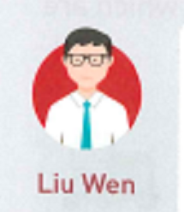
1. I’m having a lot of trouble __________ my listening.
with
have trouble/difficulty (in) doing sth.
have trouble /difficulty with sth.
2. I can catch only a few words.
catch v. to hear or understand something
听清楚；领会

Slide 27
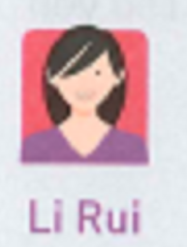
1. ..we’re equals, so I only need a few words to bridge the gap between us.
equal
n. a person or thing of the same quality or with the same status, rights, etc. as another 同等的人；相等物
He regards his staff as equals.
2) adj. equal rights/pay ( 平等的)
3）v. to be the same in size, quantity, value, etc. as something else （ 大小、数量、价值等）与…相等，等于
A metre equals 39.38 inches.
1 米等于 39.38 英寸。
No one equals him in strength.
bridge the gap/gulf between A and B
to reduce or get rid of the differences that exist between two things or groups of people 消除（甲、乙间的）隔阂／鸿沟

Slide 28
1. I think it all depends _________ who you’re talking to.
on/upon
depend on: to be affected or decided by something
受…的影响；由…决定；取决于
Does the quality of teaching depend on class size?
教学质量取决于每个班的人数吗？
Whether we need more food depends on how many people turn up.
我们是否需要更多的食物，这要视到场人数而定。

Slide 29
3. …and I must make it a question, not a demand.
1) demand n. a strong request or order that must be obeyed 要求
加薪的要求
满足某人的需求
供求
非常需要
a demand for higher pay
meet/satisfy one’s demands
supply and demand
in (great) demand
2) v. to ask for sth. firmly 坚决要求
demand to do sth.
demand that sb (should) do
1）她坚决要求见经理。
2） 老师要求她穿校服。
She demanded to see the manager.
The teacher demanded that she should wear the school uniform.
3) v. need 需要
这项工作需要精神力量。
This work demands mental strength.

Slide 30
demanding adj.
Though the book is short, it is demanding.
1) (sth.) needing a lot of effort, skill, care 要求高的，费力气的
2) (sb) expecting a lot of work or attention from others; not easily satisfied
要求极严的；苛求的；难满足的
a demanding boss
苛刻的老板
a demanding child
难满足的孩子

Slide 31
4. If I am talking to someone senior ____ me, then I should say “Would you mind ________(open) the window, please? ”
to
opening
senior adj. high in rank or status; higher in rank or status than others
级别（或地位）高的
antonym（反义词）：junior
5. I can’t keep all the new vocabulary straight in my head.
straight adv. by a direct route; immediately直接；径直；立即
I was so tired I went straight to bed.
我太累，径直上床睡了。
She went straight from college to a top job.
她大学一毕业就干上了一份优越的工作。
I'll come straight to the point—your work isn't good enough.
我开门见山地说吧，你的工作做得不够好。

Slide 32
Workbook Exercises

Slide 33
Activity 5 on P 63
civilization carving, system, dates back , means, classic
Activity 6 on P 63
symbol n. symbolize v. 是…的象征
basic adj. 基本的；基础的 based adj. 以…为基础的
civilized adj. 文明的；开化的 civilization n.
appreciate v. appreciation n.

Slide 34
Activity 3 on P 64
where/in which; when/on which; where/at which; which/that; why
Activity 1 on P 68
native; despite; related to, attitude; struggle; classic, civilizations; point of view
Activity 2 on P 68
way in which; building in which/where; day when;
class in which; someone who/that

Slide 35
Activity 1 on P 95
1. 1) 2) 2. 2) 1) 3. 2) 1) 3) 4. 2) 1) 5. 2) 1) 3)
Activity 2 on P 95
1. related to 2. No matter 3. ups and downs 4. struggling for
5. as if, as if
Activity 3 on P 96
despite, struggle; system; gap; classics; equal; native; demand
close the gap
close v. to move the parts of something together so that it is no longer open 合上；合拢
in great demand: in great need wanted by a lot of people 需求大

Slide 36
Using structures
Activity 2.
1) that/which 2) when/in which 3) where/on which (oracle bone甲骨)
4) why 5) who
Activity 3
which/that; why; who; who; where/in which; where/in which; which/that
in which/where; where/in which
5. Meetings in which/where only two languages are used may need only one interpreter; while larger events (事件, 大事) in which/where leaders from many countries gather may need over 70 interpreters.
7. 8. method n. 方法
First is the method that/which requires the speaker to stop every few sentences, so the interpreter can translate those sentences for the audience.
The second method is the one in which/where the interpreter listens and translates a the same time. (in this method用这种方法)

