Slide 1


感恩遇见，相互成就，本课件资料仅供您个人参考、教学使用，严禁自行在网络传播，违者依知识产权法追究法律责任。
更多教学资源请关注
公众号：溯恩英语
知识产权声明

Slide 2
活用教材词汇，靶向高考写作
选择性必修一unit1
单词拓展
People of Achievement

Slide 3
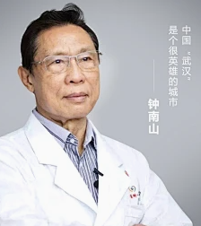
活用词汇
crucial /ˈkru:ʃl/ a.至关重要的;关键性的
1.我相信像中文研讨会这样的活动对于促进跨文化理解和欣赏至关重要，我很高兴有机会分享我自己的技能和经验，作为这项努力的一部分。(应用文之演讲稿)
I believe that events like the Chinese Workshop are crucial for promoting cross-cultural understanding and appreciation, and I am thrilled to have the opportunity to share my own skills and experiences as part of this effort.
2.人们认为他在抗击非典和新冠病毒中起了至关重要的作用。(应用文)
People acknowledge that he played a crucial role in the fight against SARS and COVID-19.
3.紧要关头他却不在那里。(续写)
He wasn't there at the crucial moment (= when he was needed most) .

Slide 4


活用词汇
vital /ˈvaɪtl/ a.必不可少的;极其重要的
1.如果我们想让生活有所不同，至关重要的是我们应该从小事做起。(应用文/续写)
If we are to make a difference to life, it's vital that we should begin with small things.
2.无论结果如何，国与国之间的友谊都是至关重要的，应该得到重视。(应用文之演讲稿)
No matter what the result is, the friendship between countries is of vital significance, which should be attached importance to.
3.在我看来，重视物质文明和精神文明是至关重要的。(应用文)
From my point of view, it is of vital importance to lay stress on both of material and spiritual civilization.

Slide 5

committed /kəˈmɪtɪd/ a.尽心尽力的;坚定的
commit /kəˈmɪt/ vi.承诺;保证 vi.忠于
活用词汇
1.我决定致力于完成这些申请，很快我就成为了一个不断壮大的全球年轻人团队的一员，他们致力于保护自然。(2022北京卷应用文)
I decided to commit to completing the applications, and soon I was a part of a growing global team of young people working to protect nature.
2.我强烈建议你每天抽出一个小时读英语，这将逐渐提高你的英语口语。(应用文之建议信)
I strongly suggest that you should commit one hour a day to reading English，which will gradually improve your spoken English.
3.这次妈妈差点心脏病发作。这时他才意识到自己犯了一个多么大的错误。（续写）
This time mom almost got heart attack.Then he realized what a big mistake he had committed.

Slide 6
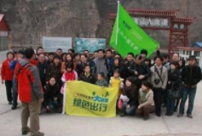
committed /kəˈmɪtɪd/ a.尽心尽力的;坚定的
commit /kəˈmɪt/ vi.承诺;保证 vi.忠于
活用词汇
4.他对工作的奉献精神和对改善他人生活的承诺对我们所有人都是一种鼓舞。(2023全国甲卷应用文之历史人物介绍)
His dedication to his work and his commitment to improving the lives of others are an inspiration to us all.
5.这可以与致力于保护北京自然环境的当地志愿者或环保组织合作。(2023年北京卷应用文之“绿色北京”活动建议)
This could be a collaborative effort with local volunteers or environmental organizations that are committed to the preservation of Beijing's natural environment.
6.她不想在此刻对史蒂夫在感情上作出重大的承诺。(续写)
She doesn't want to make a big emotional commitment to Steve at the moment.

Slide 7
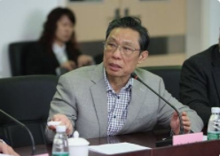
活用词汇
academic /ˌækəˈdemɪk/ a.学业的;学术的
1.在我看来，这一规定肯定会对学生的学习成绩产生深远的影响。(应用文)
From where I stand, this rule will definitely exert a profound and far-reaching effect on students’ academic performance.
2.钟南山是一位杰出的医生,一直致力于学术研究。(应用文)
Zhong Nanshan is an extraordinary doctor,who has been committed to doing academic research.

Slide 8

活用词汇
objective /əbˈdʒektɪv/ n.目标;目的 a.客观的
1.作为一个父亲，他不仅关心我的生活，还激励我树立一个崇高的目标并为之奋斗。要不是他的鼓励，我不可能取得这么大的进步。(2020全国I应用文之介绍身边最尊敬和爱戴的人)
As a father, not only does he care about my life, but also inspires me to set a high objective and strive for it. But for his encouragement, I couldn't have made so much progress.
2.这四个字结合成一个成语，展示了毅力和毅力的力量，这将有助于实现具有挑战性或看似不可能的目标。(应用文之介绍中国成语”水滴石穿“)
Integrated into an idiom, the four characters demonstrate the power of perseverance and persistence, which will contribute to achieving a challenging or seemingly unlikely objective.
3.分级的优点和缺点往往是密切相关的。有必要对分级持客观态度。(应用文)
The advantages and disadvantages of ratings are often closely related. It is necessary to hold an objective attitude towards ratings.

Slide 9
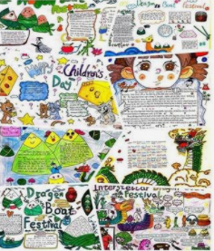
活用词汇
evaluate /ɪˈvæljueɪt/ vt.评价;评估
1.学生可以在排练的整个过程中进一步认识背景，分析原因，评价效果。(2022年上海卷应用文之走进历史活动)
For students can further recognize the background, analyze and the cause and evaluate the effect after the whole process of rehearsal.
2.到目前为止，我们已经收到了多达40份作品，我们将根据评分标准对这些作品进行评估，包括内容的丰富性、布局的创造性和艺术表现力。(应用文之邀请外教评审手抄报)
Till now we've received up to forty submissions, which will be evaluated against rating criteria, including content richness, layout creativity and artistic expressiveness.
3.对于主题的每一方面，都要仔细思考和评估。(应用文)
For each side of the subject, think carefully and evaluate it.

Slide 10
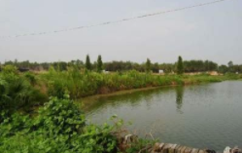
活用词汇
property /ˈprɒpəti/ n.性质;特征;财产
1.她匆匆穿上冬靴,没有穿袜子,冲向这块80英亩土地上的小池塘。(续写)
She threw on her winter boots-without socks-and rushed toward the small pond on the 80-acre property.

Slide 11
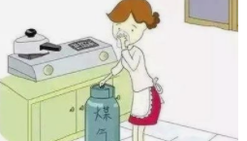
活用词汇
distinct /dɪˈstɪŋkt/ a.清晰的;清楚的;有区别的
1.我个人认为，在这种机制下，英语水平不同的学生在相互理解和有效互动方面无疑会遇到一些障碍，这肯定会给进一步的英语学习带来潜在的问题。(2023年新课标1卷应用文)
I personally hold that under the mechanism, students with distinct English proficiency levels will undoubtedly encounter some obstacles regarding understanding and effectively interacting with each other,which will definitely pose potential problems in further English learning.
2.有一股明显的煤气味。(续写)
There was a distinct smell of gas.
3.他说话声音不大，但字字清晰。

Slide 12
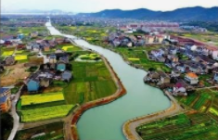
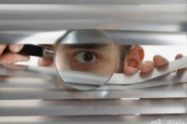
活用词汇
distinct /dɪˈstɪŋkt/ a.清晰的;清楚的;有区别的
4.我们邀请所有学生提交展示家乡独特文化、风景美景和特色的原创照片和文字。(应用文之“最美家乡”图文征集活动)
We invite all students to submit original photos and texts showcasing the unique cultures, scenic beauty, and distinctive characteristics of their hometowns.
5.托尼个子高是个明显的优势。(续写)
Being tall gave Tony a distinct advantage.
6.我确实感到有人在监视我。(续写)
I had the distinct impression I was being watched.

Slide 13

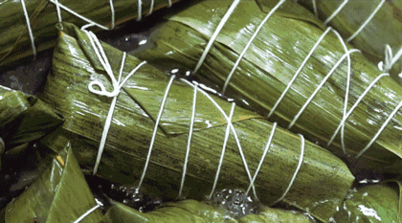
活用词汇
boil /bɔɪl/ v.使沸腾;煮开 n.沸点
1.顿时，全班沸腾起来，有人欢呼“祝贺”，有人哭“难以置信”。(2023新全国I卷续写)
Instantly, the whole class boiled up, some cheering “congratulations” while some crying “unbelievable”.
2.他怒不可遏。(续写)
He was boiling with rage.
3.你知道，每个节日都有自己的典型食品，端午节也不例外。吃粽子，一种由竹叶包的蒸熟的大米，是你不能错过的。(应用文之端午节)
You know, every festival has its own typical food, and the Dragon Boat Festival is no exception. Eating zongzi, boiled rice wrapped by bamboo leaves, is what you can’t miss.

Slide 14
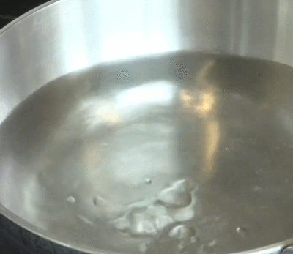
活用词汇
boil /bɔɪl/ v.使沸腾;煮开 n.沸点
4.他们把一些米饭放进一锅水里，让它沸腾，然后做法式吐司。(续写)
They put some rice into a pot of water and left it to boil while they made the French toast.
5.水在咕嘟咕嘟地沸腾着。(续写)
The water was bubbling and boiling away.
6. 我感到怒火中烧。(续写)
I could feel anger boiling up inside me.

Slide 15

活用词汇
liquid /ˈlɪkwɪd/ n.液体 a.液体的;液态的
1.他闻了一下那种液体，就流起泪来了。(续写)
He took one smell of the liquid and his eyes began to water.
2.这对年轻夫妇点了18美元的黑皮诺酒，然后无意中被第二个服务员端上了2000美元的罗斯柴尔德酒。他们第一次喝下了他们认为是便宜的酒，他们开玩笑地假装喝的是昂贵的酒，并模仿葡萄酒专家的所有行为，摇晃酒杯，观察里面的液体，慢慢地品尝，完全被迷住了。(续写)
The young couple, who ordered the $18 pinot noir, were then unintentionally served the $2,000 Rothschild by the second waiter On taking their first drink of what they believed was cheap wine, they jokingly pretended to be drinking an expensive wine and copied all the behaviors of a wine expert, shaking the wine glasses, observing the liquid inside and tasting it slowly, totally fascinated.

Slide 16

活用词汇
obtain /əbˈteɪn/ vt.获得;赢得 vi.存在;流行
1.我只能找一份临时工，薪水很低。(续写)
I can only obtain temporary employment, for a small salary.
2.我真的很想获得这个宝贵的机会，因为通过提供我的服务，我将能够提高我的组织能力，沟通能力以及在公共场合说英语的信心。(2015陕西卷之应聘“英语文化节” )
I really want to obtain this precious opportunity because, by offering my service, I will be able to improve my organizational ability, communication skills as well as my confidence in speaking English in public.

Slide 17
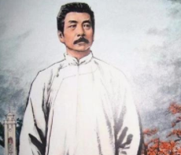
活用词汇
acknowledge /əkˈnɒlɪdʒ/ vt.承认(属实等);感谢
1.大家公认这个越野赛跑是增强我们意志的机会。（2020新高考全国卷续写）
It is acknowledged that the cross-country race is an opportunity to strengthen our will.
2.我感谢我的英语老师，没有他我不可能在英语方面取得如此巨大的进步。 (应用文之感谢信)
I acknowledge my English teacher，without whom I couldn't have made such great progress in English.
3.鲁迅，被公认为中国现代最伟大的作家之一，出生于浙江绍兴。(应用文)
Lu Xun, acknowledged as one of the greatest modern writers in China, was born in Shaoxing, Zhejiang Province.

Slide 18

活用词汇
acknowledge /əkˈnɒlɪdʒ/ vt.承认(属实等);感谢
4.汤姆承认他在英语演讲比赛中失败了，这使我们很沮丧。(续写)
Tom acknowledged being defeated/having been defeated in the English speech competition， which made us quite depressed.
5.我就站在她身边，可是她理都不理我。(续写)
I was standing right next to her, but she didn't even acknowledge me.

Slide 19

活用词汇
defeat /dɪˈfi:t/ n.失败;挫败 vt.击败;战胜
1.昨晚客队被我们的女足打败了，这使我们既兴奋又自豪。(续写)
The visiting team was defeated by our women football team last night，which made us excited and proud.
2.不要因这次失败而气馁。(续写)
Don't let this defeat dishearten you.
3.这操作指南把我完全弄糊涂了。(续写)
The instruction manual completely defeated me.
4.时钟在最后几秒钟滴答作响，第一名的队伍保持不败。(续写)
The clock ticked off the last few seconds and the first-place team remained undefeated.

Slide 20
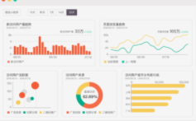
活用词汇
analyse /ˈænəlaɪz/ vt.分析
1.考虑到他的解决方案可能是错误的，我仔细分析了这个问题，并试图用另一种方法解决它。(续写)
Thinking that his solution might be wrong, I carefully analyzed the problem and tried to work it out in a different way.
2.该项目要求每个团队提出一个假设，建立一个实验来验证假设，进行统计分析并展示结果。(续写)
The project required each team to develop a hypothesis, set up an experiment to test the hypothesis, do the statistical analysis and present the findings.
3.那是截止日期的前一天，我忙着做分析和准备报告。(续写)
It was the day before deadline and I drowned myself doing analysis and preparing for the presentation.

Slide 21

活用词汇
apparently /əˈpærəntli/ ad.显而易见;看来;显然
1.他停顿下来，显然陷入了沉思。(续写)
He paused, apparently lost in thought.
2.她接到这消息时显然无动于衷。(续写)
She received the news with apparent unconcern.
3.她不敢抱怨任何事情，显然，既然她的老师这么说，她就必须毫无怨言地跟着做。(续写)
She didn’t dare to complain about anything and it was apparent that since her teacher said so，she had to follow without any unhappiness.

Slide 22

活用词汇
substance /ˈsʌbstəns/ n.物质;物品;事实根据
1.这是恶意造谣，完全没有事实根据。(续写)
It was malicious gossip, completely without substance .
2. 他的话是有一定根据的。(续写)
There is some substance in what he says.

Slide 23
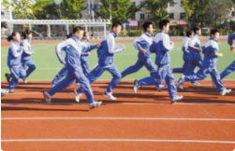
活用词汇
insist /ɪnˈsɪst/ v.坚持;坚决要求
1.学生会坚决要求每个参赛者按时到达学校礼堂。(应用文)
The Student Union insists that every participant should arrive at the school hall on schedule.
2.我并不真的想去，但他硬要我去。(续写)
I didn't really want to go but he insisted.
3.只有当我们坚持经常锻炼身体时，我们才能保持身体健康。(应用文之发言稿)
Only when we insist on working out regularly can we build up our body.

Slide 24

活用词汇
insist /ɪnˈsɪst/ v.坚持;坚决要求
insist on /ɪnˈsɪst ɒn/ 坚决要求
4.爸爸建议买一个新的，而妈妈坚持要我们回去取，说:“像我这样健忘的人可能会反复丢东西，所以放弃帐篷是不明智的。”(续写)
Dad recommended buying a new one, while Mom insisted on our going back to fetch it, saying "Forgetful people like me may lose things repeatedly, so it's unwise to give up the tent."
5.最后但并非最不重要的，我们不应该为我们的成就感到骄傲，我们不遗余力地实现，我们要坚持我们的梦想，不屈服于任何困难。(续写)
Last but not least, we shouldn’t take pride in our achievements we spare no effort to attain, and we’d insist on our dreams not giving in to any difficulties.

Slide 25
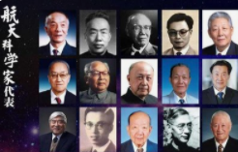
活用词汇
scientific /ˌsaɪənˈtɪfɪk/ a.科学(上)的;关于科学的
1.他们有助于我们更好地理解理科知识，激发我们对科学发现的好奇心。(续写)
They help us understand science subjects better and arouse our curiosity about scientific discoveries.
2.因此，如果您欣赏上述方面的科学家，请在5月20日之前将您的优秀作品提交给学生会@163.com。(应用文之“中国科学家精神"短视频征稿启事)
As a consequence, if you admire a scientist for the above-mentioned aspects, feel free to submit your excellent work to student-union @163.com before May 20th.
3.学校一年一度的科技节上周成功举行，旨在鼓励学生积极参与科学和技术。(应用文之“智创科技触碰未来”报道)
The school's yearly sci-tech festival was successfully held last week, aimed to encourage students'active engagement with science and technology.

Slide 26
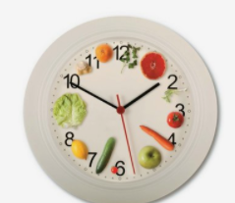
活用词汇
mostly /ˈməʊstli/ ad.主要地;一般地
1.因此，除非我太忙，否则我大部分时间都在家里吃饭，保持均衡的饮食。(应用文之饮食（Food and drink）)
Therefore, I mostly eat at home and go on a balanced diet unless I’m too busy.

Slide 27

活用词汇
conclusion /kənˈklu:ʒn/ n.结论;推论
1.我从自己的经历中得出结论：患难见真情。(续写)
I came to/reached/drew a conclusion from my own experiences that a friend in need is a friend indeed.
2.总之，只有共同努力，我们才能有一个更加美好的明天。 （2022·全国甲卷应用文）
In conclusion, only with joint efforts can we have a better tomorrow.
3.这位著名小说家以一句名言结束了她的演讲:“有志者，事竟成。”(续写)
The famous novelist concluded her speech with a distinguished saying “Where there is a will， there is a way.”

Slide 28
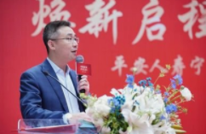
活用词汇
conclusion /kənˈklu:ʒn/ n.结论;推论
4.我来讲几句话作为结束语。(续写)
Let me make just a few concluding remarks.
5. 他讲话结束时祝愿大家回家一路平安。(续写)
He concluded by wishing everyone a safe trip home.

Slide 29

活用词汇
flee /fli:/ v.迅速离开;逃跑
1.前些日子，在去市场的路上，遇到了一只可怕的野兽，她的心狂跳着跑开了。(续写)
Encountering a frightening beast on the way to the market the other day, the servant fled with her heart beating wildly.
2.她突然哭了起来，跑开了。(续写)
She burst into tears and fled.
3.我又尴尬又有点生气，跑回自己的房间，但妈妈阻止了我。(续写)
Embarrassed and a little annoyed, I fled to my room, but Mom stopped me.

Slide 30

活用词汇
circumstance /ˈsɜ:kəmstəns/ n.条件;环境;状况
1.我绝不会错过这个宝贵的机会，这对我未来的发展至关重要。 (续写)
Under/In no circumstances will I miss this precious opportunity， which is vital for my future development.
2.那艘船神秘地沉没了。(续写)
The ship sank in mysterious circumstances.
3.如果情况允许，我将继续谈论这个难以处理的关键问题。(续写)
If circumstances permit， I will go on talking about the crucial problem，which is difficult to cope with.
4.马特习惯了看到无家可归的人要食物和/或钱，看到一个无家可归的人在困难的情况下努力找工作，他感到很惊讶。（续写之求职）
Accustomed to seeing homeless people ask for food and or money, Matt found it surprising to witness a homeless guy making efforts to find a job despite difficult circumstances.

Slide 31
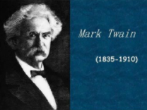
活用词汇
novelist /ˈnɒvəlɪst/ n.小说家
novel /ˈnɒvl/ n.(长篇)小说
1.当我感到沮丧的时候，我经常选择看小说部分，因为小说里有很多充满想象力的故事。(2021全国I卷应用文)
When feeling depressed, I often choose to enjoy the novel part which includes a lot of imaginative stories.
2.听说你开发了一个学生分享衣服的新app，我真的为你的新奇想法感到骄傲。(2019年上海应用文之征集关于共享衣服app的看法)
Hearing that you have developed a new app of students sharing clothes, I feel truly proud of your novel idea.
3.我们想把经典小说《汽船》改编成一部英语短剧，把你们的文化和我们的文化结合起来。(2020全国III卷之请外教指导英文短剧)
We'd like to combine your culture with ours by adapting the classic novel The Steamboat for a short English play.
4.至于我最喜欢的小说家，非马克·吐温莫属，他是十九世纪美国最著名的作家之一。(应用文)
As for my favourite novelist, it must be Mark Twain, one of the best known American writers in the nineteenth century.

Slide 32


活用词汇
flow /fləʊ/ n.流;流动;流畅 vi.流;流动
1.你打断了我的话—我记不得我在说什么了。(续写)
You've interrupted my flow—I can't remember what I was saying.
2.汤姆如常地口若悬河。(续写)
As usual, Tom was in full flow .
3.她试图止住伤口流血。(续写)
She tried to stop the flow of blood from the wound.
4.席间大家一直谈笑甚欢。(续写)
Conversation flowed freely throughout the meal.
5.车流不断通过。(续写)
Constant streams of traffic flowed past.

Slide 33


活用词汇
flow /fləʊ/ n.流;流动;流畅 vi.流;流动
6.汤姆不假思索地脱口而出，出乎意料，听到这些话几乎使他大吃一惊。(续写)
Without thinking, words flowed from Tom's mouth out of expectation so that it almost surprised him to hear them.
7.她伤心，跑回家，把一切都告诉了妈妈，眼泪流下来。(续写)
Broken-hearted, she ran back home and told Mom everything, tears flowing down in flood.
8.我突然感到又恐惧又兴奋。(续写)
Fear and excitement suddenly flowed over me.
9.她的头发垂到肩上。 (续写)
Her hair flowed down over her shoulders.

Slide 34
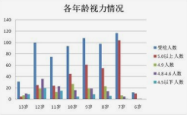
活用词汇
chart /tʃɑ:t/ n.图表 vt.记录;制订计划
1.从柱状图中可以看出，近视率从幼儿园的14.5%稳步上升到高中生的80.5%。(应用文)
As can be seen from the bar chart, the myopia rate increases steadily from kindergarten kids, which is 14.5%, to a dramatic 80.5% among high school students.

Slide 35
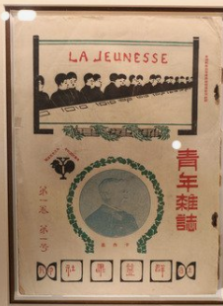
活用词汇
found /faʊnd/ vt.创建;建立;把…建立在
1.《青年》创刊至今已有10年。在我的记忆中，是《青年》陪伴我度过了整个高中生活。(2021年全国I卷应用文)
It has been 10 years since Youth was founded. In my memory, it is Youth that accompanies me through my whole high school.

Slide 36

活用词汇
numerous /ˈnju:mərəs/ a.众多的;许多的
1.到目前为止，我发表的故事已经赢得了国内外无数读者的心，给我带来了一种成就感和幸福感，我把这归功于老师的认可和指导。(2023新全国I卷续写)
So far, my published stories have won the hearts of numerous readers both at domestic and abroad, bringing me a sense of fulfillment and happiness,which I attributed to my teacher’s recognition and guidance.
2.这时，我们才知道，最后一缕晨光很快地消失在茂密的树林中，我们根本找不到我们的踪迹了!我们确实迷路了!(读后续写之丛林迷路)
Not until then did we realize that the last ray of twilight was quickly disappearing among the numerous trees and we couldn't find our track at all！We did get lost！

Slide 37


活用词汇
theory /ˈθɪəri/ n.理论;学说
1.因此，如果你在音乐、节奏、乐理和和声方面有丰富的知识，请不要犹豫，来试一下。(应用文之乐队成员招募)
Hence, if you have abundant knowledge in music, rhythm，music theory, and harmony, don't hesitate to have a try in the audition.
2.提高认识活动包括介绍理论知识的专业研讨会和教授紧急情况下生存技能的讲习班。(应用文之全国防灾减灾日活动介绍)
Awareness events include professional seminars introducing theoretical knowledge and workshops teaching survival skills in time of emergency.

Slide 38

活用词汇
genius /ˈdʒi:niəs/ n.天才;天资;天赋
1.她的主意是天才之举。(续写)
Her idea was a stroke of genius .
2.他有一种能够使人感觉轻松自在的本领。(续写)
He had a genius for making people feel at home.

Slide 39

活用词汇
gentle /ˈdʒentl/ a.温柔的;文静的
1.当我上个月考试不及格，情绪低落时，她轻轻地拍了拍我的肩膀，给了我很大的鼓励。(续写)
When I failed the exam last month and was in low spirits, she patted me gently on the shoulder and gave me great encouragement.
2.经过一阵细心劝说，她表示愿意来。(续写)
She agreed to come, after a little gentle persuasion .
3.她是个极其和蔼的护士。(续写)
She was the gentlest of nurses.
4.他看上去可怕，实际却是个性格温和的巨人。(续写)
He looks scary but he's really a gentle giant .

Slide 40
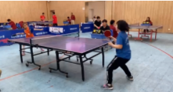
活用词汇
passion /ˈpæʃn/ n.酷爱;激情
1.偶然得知你对乒乓球着迷，我真诚地邀请你加入我们学校的乒乓球队，以激发我们的激情，磨练我们的技能。(应用文之邀请好友参加校乒乓球队)
Occasionally learning that you are addicted to tennis, I am writing to sincerely invite you to join the table tennis team in our school aimed at arousing our passion and honing our skills.
2.接触到他的色彩，形式和想象，我似乎已经到达了他充满激情的内心世界。我希望在未来的展览可以持续更长时间，更多的流派，包括中国的杰作可以展示。(应用文之“遇见艺术家”展览评论)
Exposed to his colors, forms and imagination, I seemed to have reached his passionate inner world. I hope in the future shows can last longer and more schools of pictures including Chinese masterpieces can be displayed.
3.哪怕是有人提到他的名字，她也会勃然大怒。(续写)
She flies into a passion if anyone even mentions his name.

Slide 41
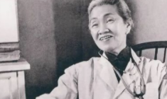
活用词汇
extraordinary /ɪkˈstrɔ:dnri/ a.不一般的;非凡的;想不到的
1.她是位非常杰出的女性。(应用文)
She was a truly extraordinary woman.
2.他们竭力为自己的行为辩解。(续写)
They went to extraordinary lengths to explain their behaviour.
3.对他那种地位的人来说，他的行为很特别。(续写)
He behaves extraordinarily for someone in his position.

Slide 42
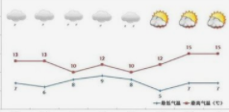

活用词汇
gradually /ˈgrædʒuəli/ ad.逐渐地;逐步地
1.他的成绩逐渐提高，帮助他重拾信心。(续写)
His grades improved gradually, helping him regain his confidence.
2.天气逐渐好转。(续写)
The weather gradually improved.
3.孩子们渐渐开始明白。(续写)
Gradually, the children began to understand.
4.我的心情渐渐好起来。(续写)
My mood gradually lightened.

Slide 43
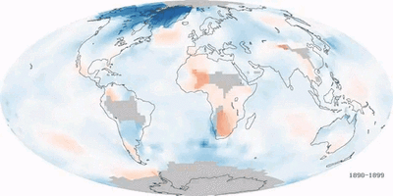
活用词汇
consequence /ˈkɒnsɪkwəns/ n.结果;后果
1.李叔叔不顾被感染的危险，对自己的工作很负责，也很投入。因此，他值得我们尊敬。(应用文之人物介绍)
Regardless of the risk of getting infected, Uncle Li is responsible and devoted to his job. As a consequence, he deserves our respect.
2.众所周知，全球气温上升将会导致严重的后果。(续写)
It is known to us that the rise in globaltemperature will result in serious consequences.

Slide 44
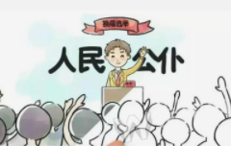
活用词汇
take up a position /teɪk ʌp ə pəˈzɪʃn/ 担任;任职
1.自从他就职以来，他坚持全心全意为病人服务。(续写)
Ever since he took up his position，he has insisted on serving all the patients heart and soul.

Slide 45
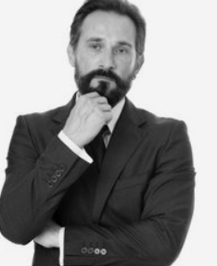
活用词汇
moustache /məˈstɑ:ʃ/ n.上唇的胡子;髭
1.他吻我的时候胡子扎人。(续写)
His moustache prickled when he kissed me.
2.浓密的络腮胡子不见了，换成了一撇密匝匝的小胡子。(续写)
The thick beard had gone, replaced by a bushy moustache.
3.他又浓又厚的小胡子覆盖了他的上唇。(续写)
His full and very thick moustache covers his upper lip.

Slide 46
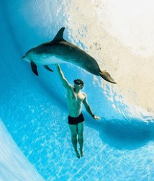
活用词汇
encounter /ɪnˈkaʊntə(r)/ vt.偶然碰到;遇到 n.邂逅
1.在家人惊讶的目光下，吉姆向他们讲述了整个故事，他们很难相信吉姆使家庭摆脱贫困的梦想，仅仅通过一个意想不到的偶遇到个著名的编辑而实现。(续写)
Under the amazed stares of his family members, Jim related to them the whole story and hardly could they believe Jim's dream of lifting the family out of the poverty should be realizedjust through an unexpected encounter with a famous editor.
2,我慢慢抬起头，看到母亲鼓励的目光，于是我做了一个决定。(续写)
Slowly lifting my head, I encountered my mother's encouraging eyes and a decision was made.
3.这个故事描述了一个男人与一只海豚之间的奇遇。(续写)
The story describes the extraordinary encounter between a man and a dolphin.

Slide 47
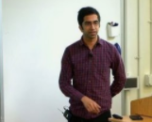
活用词汇
professor /prəˈfesə(r)/ n.教授
1.我也开始去拜访我的教授。随着时间的推移，在大学教授的帮助下，我的悲伤减轻了。(续写)
I also started dropping in to talk with my professor. Over time, with the help from the college professor, my grief decreased.
2.马医生是一位杰出的教授，从事急救研究二十多年，抢救了数百名急救人员，在该领域享有很高的声誉。(续写)
Doctor Ma is a distinguished professor, who has been engaged in first aid research for over two decades and saved hundreds of people in emergency, enjoying a high reputation in this field.

Slide 48

活用词汇
mourn /mɔ:n/ v.哀悼;忧伤
1.他仍然在为哥哥的去世而悲伤。(续写)
He was still mourning his brother's death.
2.她为失去的童年而伤感。(续写)
She mourned for her lost childhood.
3.他看上去很悲伤，几乎要掉泪了。(续写)
He looked mournful, even near to tears.
4.我受不了她脸上那忧伤的神情。(续写)
I couldn't bear the mournful look on her face.

Slide 49
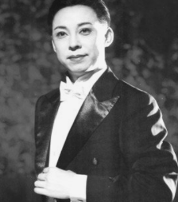
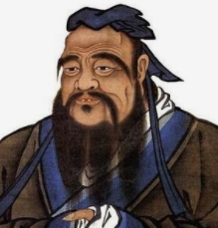
活用词汇
remarkable /rɪˈmɑ:kəbl/ a.非凡的;显著的
1.梅兰芳的卓越成就使京剧走向了世界，并获得了今天的国际地位和认可。(应用文)
Mei Lanfang's remarkable achievements have brought Beijing Opera to the world, leading to the international status and recognition that it has today.
2.总之，孔子是一位杰出的历史人物，他的教诲对中国文化和社会产生了持久的影响。他的哲学继续激励着世界各地的人们，提醒我们教育、道德价值观和尊重他人的重要性。(2023年全国甲卷应用文之中国历史人物)
In conclusion, Confucius was a remarkable historical figure whose teachings have had a lasting impact on Chinese culture and society. His philosophy continues to inspire people around the world, reminding us of the importance of education, moral values, and respect for others.
3.她有非凡的意志力。(续写)
She has a remarkable inner strength.

Slide 50
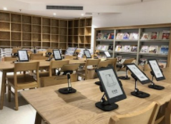

活用词汇
device /dɪˈvaɪs/ n.方法;技巧;装置;仪器
1.此外，由于数字设备易于携带，人们可以随时随地在数字设备上享受阅读的乐趣。(应用文)
Besides, with digital devices easy to carry around, people can enjoy the fun of reading anytime anywhere on digital devices.
2.更重要的是，我们应该重视我们的视觉健康，控制花在电子设备上的时间。(应用文)
What's more, we should attach importance to our visual health and control the time spent on electronic devices.

Slide 51

活用词汇
sum /sʌm/ vi.总结;概括 n.金额;总数 sum up /sʌm ʌp/ 总结;概括
1.综上所述，您的课程，尤其是后两个模块的学习，一定会让我们学生辨别真假新闻，更有效地搜索信息，从而培养扎实的信息素养。没有这些素养，一个现代公民就无法适应未来的社会。(2021年春季上海应用文之“信息素养”（information literacy）的课程建议征求)
To sum up, your course, especially with the latter two modules, will definitely enable us students to distinguish between genuine and fake news, search for information more efficiently and thus develop solid information literacy, without which a modern citizen cannot get adapted to the future society.
2.他们打开手提箱，正如阿瑟所料，里面有一大笔钱。(续写)
They opened the suitcase and there was a large sum of money inside, as Arthur had expected.

Slide 52

活用词汇
draft /drɑ:ft/ n.草稿;草案 vt.起草;草拟
1.我已经写好这封信的草稿。(续写)
I've made a rough draft of the letter.
2.所以您是否可以抽出时间审阅附件中的草稿脚本，并进行必要的修改?(应用文之求助信)
So would you please spare some time to review the draft script attached to this email and make necessary changes?

Slide 53
Thank You

