Slide 1


感恩遇见，相互成就，本课件资料仅供您个人参考、教学使用，严禁自行在网络传播，违者依知识产权法追究法律责任。
更多教学资源请关注
公众号：溯恩英语
知识产权声明

Slide 2
“劳动最光荣”主题班会—短文投稿类
Labor is Glorious
浙江省A9协作体2024年8月开学考应用文讲评

Slide 3
目录
01
审题分析
02
分段语料
03
范文赏析
04
迁移延伸

Slide 4
审题分析
01

Slide 5
原题呈现
Time
Theme
Event
假定你是李华，上周你班举办了一次“劳动最光荣”的主题班会。请你用英语写一篇文章，给校英文报投稿，分享这次经历，内容包括:
(1)活动的内容;
(2)你的感受。
注意:1.写作词数应为80个左右; 2.请按如下格式在答题纸的相应位置作答。
A Memorable Labor Education Class Meeting
Last week, our class held a themed class meeting titled “Labor is Glorious”.
—————————————————————————————————————
Genre
Purpose

Slide 6
和24.6真题比较
假定你是李华，上周你班举办了一次“劳动最光荣”的主题班会。请你用英语写一篇文章，给校英文报投稿，分享这次经历，内容包括:
(1)活动的内容;
(2)你的感受。
假定你是李华，你们班上周五在公园上了一节美术课，请给英国好友Chris写一封邮件分享你的经历，内容包括：
1. 你的作品内容；
2. 你的感想。
 | 左边题目 | 右边题目
情境载体 | 短文投稿 | 分享信
作者立场 | 代表班级 | 代表自己
写作要点 | 活动内容+感受 | 作品内容+感想
语气态度 | 客观叙述事件+主观感受 | 主观感受+思考

Slide 7
总结—破解题目信息
文体体裁 | 短文投稿
写作人 | 学生
目标读者 | 全校学生
写作背景 | 文章背景基于学校教育环境，强调了劳动教育的重要性，这与培养学生全面发展的教育目标相符合。"劳动最光荣"是一个深植于许多文化中的价值观，劳动被视为社会进步和个人发展的基础。
写作目的 | 文章的主要目的是向校报的读者分享上周班级举办的主题班会的经历，传递劳动教育的正面影响。通过叙述班会活动和个人感受，作者希望启发读者对劳动价值的思考，促进对劳动多样性和重要性的认识。
人称时态 | 第三人称 | 第一人称 | 一般过去时

Slide 8
分段语料
02

Slide 9
首段：活动内容介绍
角度1：抽象形式（总分总）
【总起句】The event was meticulously planned by our class committee to emphasize the importance and dignity of labor.
【分句】We started with a series of presentations that showcased the value of various forms of work.
Following the presentations, we participated in a group discussion, where we reflected on our own perceptions of labor and the prejudices we might have held.

Slide 10
首段：活动内容介绍
角度2：具体事务（总分总）
【总起句】We engaged in various activities such as cleaning the classroom, gardening, and helping out in the school canteen.
【分句】
During the class meeting, we shared stories about the significance of labor and how it contributes to society. We also had a group discussion on the different types of labor and the respect it deserves.

Slide 11
学生佳段赏析
The meeting commenced with a series of activities designed to emphasize the dignity and value of labor. We, as a class, rolled up our sleeves and took on tasks such as cleaning, gardening, and assisting in the school's kitchen. Each task was a reminder of the essential role labor plays in our daily lives.
The class meeting began with a variety of engaging activities. We divided into groups and took on different tasks, such as tidying the school grounds, organizing the library, and assisting with maintenance work.

Slide 12
次段：班会感受
角度1：自豪成就感
I felt a sense of accomplishment and pride as we worked together to complete the tasks. It was a humbling experience that reminded me of the value of hard work.
角度2：共鸣尊重
I felt a surge of pride as we worked together, each contributing our share. It was a humbling reminder that every form of labor, no matter how small, is worthy of respect.

Slide 13
次段：班会感受
角度3：开眼经历
This class meeting was an eye-opening experience, reminding us that labor should be honored and cherished.
可用语块
1. experience a deep sense of respect for all forms of labor
2. gain a new perspective on the dignity of work
3. appreciate the value of hard work and dedication
4. realize the profound impact of labor on society's progress
5. feel inspired to contribute actively to the community
6. understand the joy that comes from laboring
7. embrace the idea that every job holds its dignity
8. acknowledge the satisfaction derived from laboring with purpose

Slide 14
范文赏析
03

Slide 15
官方范文
A Memorable Labor Education Class Meeting
Last week, our class held a themed class meeting titled “Labor is Glorious”.During the meeting, we shared personal stories of our labor experiences, which highlighted the value and satisfaction derived from hard work. Additionally, we had group discussions about how labor contributes to personal growth and community development. One of the most engaging parts of the meeting was a hands-on activity where we collectively cleaned our classroom.
Through this experience, I gained a deeper appreciation for the importance of labor and the pride that camewith it. It taught me that even small acts of labor can have a significant impact.
文章内容上涵盖了个人故事分享、小组讨论和实践活动，通过描述集体清洁教室的实践活动，文章传达了作者和其他同学的亲身参与和体验，增加了文章的真实感和感染力。结尾则是通过个人感悟传达了劳动对个人成长和社会贡献的积极影响，传递了正面的价值观。
语言上，语块运用丰富，句式富有层次，整体语言有水平却不冗杂晦涩，开头没有使用themed而用titled更为贴切。

Slide 16
下水范文
A Memorable Labor Education Class Meeting
Last week, our class organized a themed class meeting entitled “Labor is Glorious”. We engaged in various activities such as cleaning the classroom, gardening, and helping out in the school canteen.
The meeting commenced with a series of activities designed to emphasize the dignity and value of labor. We, as a class, rolled up our sleeves and took on tasks such as cleaning, gardening, and assisting in the school's kitchen. Each task was a reminder of the essential role labor plays in our daily lives.
As I reflect on this experience, the word that encapsulates it all is "insight." This class meeting was an eye-opening experience, reminding us that labor should be honored and cherished. It instilled in us a greater appreciation for all types of labor and the people who perform it.
文章内容上列举了 "cleaning the classroom", "gardening", "helping out in the school canteen" 等具体活动，让读者能够清晰地了解班会的实际操作内容。
语言上使用了如 "entitled", "emphasize", "dignity", "value", "rolled up our sleeves", "eye-opening", "instilled" 等词汇，这些词汇增加了文章的文采。句子之间连接自然，使用了一些连接词如 "As", "Each", "reminding" 等，使得文章读起来流畅，逻辑清晰。

Slide 17
迁移延伸
04

Slide 18
类似主题：2024届Z20联盟第一次联考
假定你是校学生会主席李华，你校将于下周开展以 “Labor is the Most Beautiful”为主题的劳动周活动，请你以学生会的名义发起倡议，内容包括：
1.学生目前对劳动的态度；
2.劳动的意义；
3.呼吁参加。

Slide 19
官方范文
Dear fellow students,
Currently, labor education has been increasingly attached great importance to, but some students just bury themselves in books, believing that labor is a waste of time. However, it is necessary for us to do it.
Actually, time spent laboring is rewarding. It can promote our practical skills, strong will, unity and cooperation. Meanwhile, we will also be given the precious chances to contribute our share and rewarded with a spiritual fulfillment.
Therefore, actively engage in labor and take our obligation both at home and at school. It will turn out to be very beneficial and essential.
The Student Union
Your task: 简要评价这篇范文

Slide 20
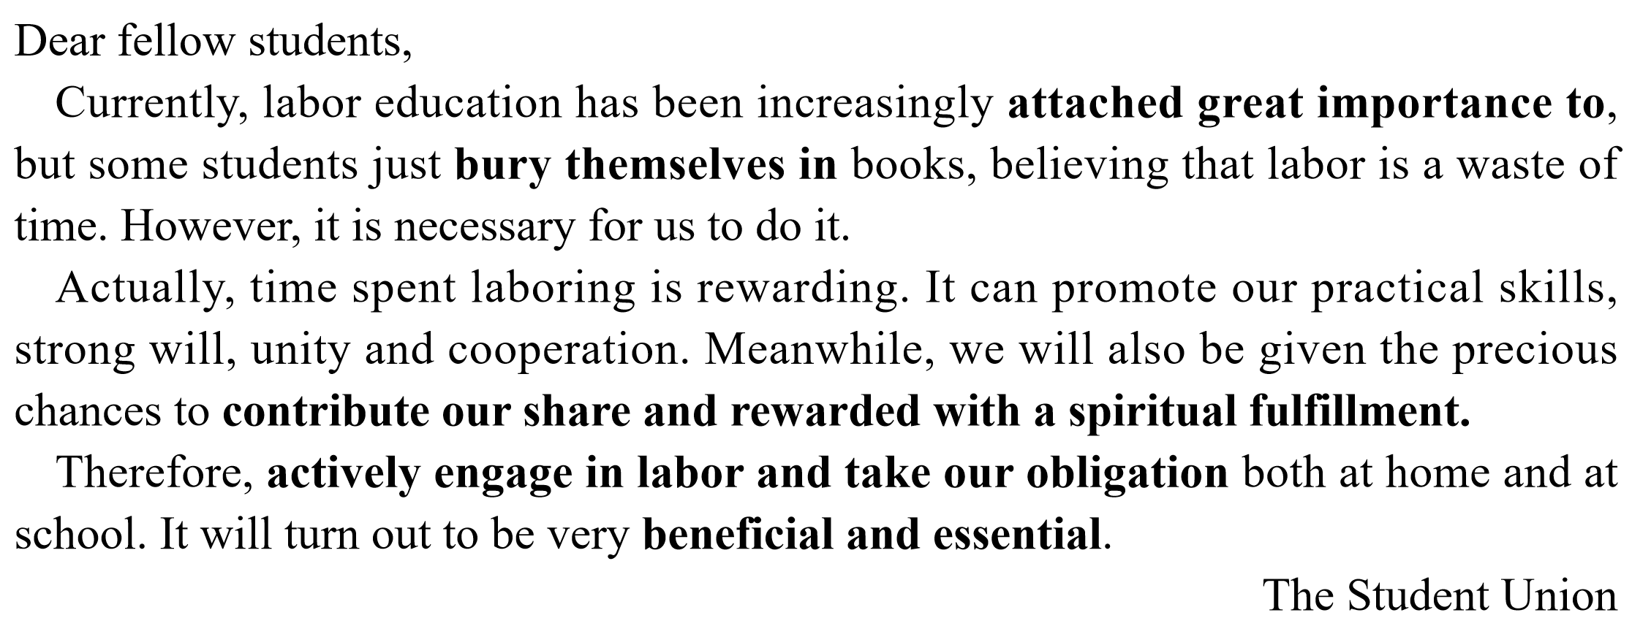
本文结构清晰，围绕“首段提现象—中段述意义—尾段声呼吁”的逻辑结构展开，用词和句型较为丰富多变。但本文不足在于并未提及学校劳动周这一个重要的概念，使第三点“呼吁参加”显得不完整。

Slide 21
THANKS
浙江省A9联盟2024年8月开学考应用文讲评

