Slide 1


感恩遇见，相互成就，本课件资料仅供您个人参考、教学使用，严禁自行在网络传播，违者依知识产权法追究法律责任。
更多教学资源请关注
公众号：溯恩英语
知识产权声明

Slide 2

Amy’s Final Wish
---2025届Z20
人与社会
郑素红

Slide 3
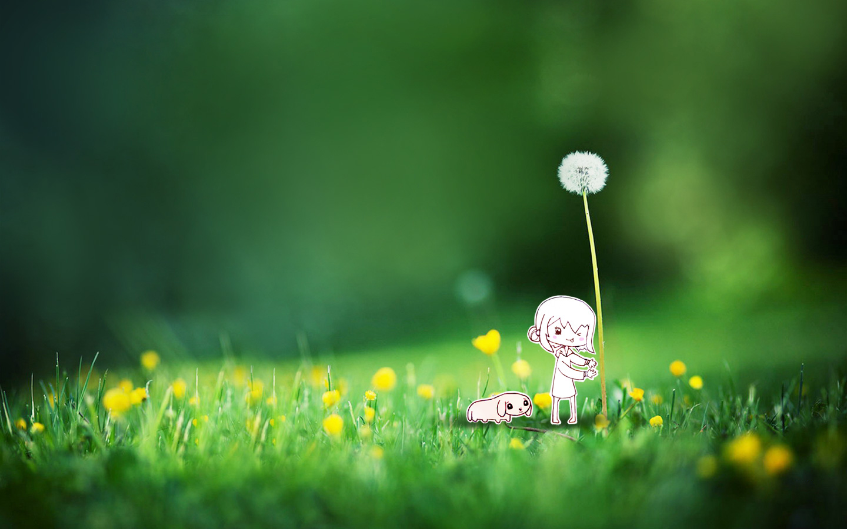

After flying all night, I was tired as I arrived in Denver to hold an event on positive thinking. As I entered the lecture hall, Dr. Fred Vogt asked me, "Do you know about the Make-A-Wish Foundation?"
“Yes,” I replied. “Well, a 17-year-old girl Amy Graham has been diagnosed as having terminal （晚期的）cancer. Doctors gave her three days. Her dying wish was to attend your lecture."
I was shocked. I felt a combination of awe and doubt. I couldn't believe it. I thought kids who were dying would want to go see Disneyland, or suchlike. Why would a kid with only a few days to live want to spend their final days listening to a motivational speaker? Suddenly my thoughts were interrupted...
"Here's Amy." Before me stood a girl wearing a bright red hat to cover her head, which was bald from all of the treatments. Her weak body was a bit bent. She said, "My two goals were to graduate from high school and to attend your lecture. My doctors didn't believe I could do either and they didn't think I'd have enough energy. I have to rely on my parents now."
Tears welled in my eyes; I was choked up. My mind was being shaken. I cleared my throat and smiled, "Thanks for wanting to come." We hugged, wiped our eyes and separated.
That Sunday afternoon I held the workshop that Amy and her parents attended. The audience was packed to overflowing with over a thousand attendees eager to learn, grow and become more fully human. I humbly asked the audience if they wanted to learn a healing process that might serve them for life. From the stage it appeared that everyone‘s hand was raised high in the air. I taught the audience how to vigorously (用力地) rub their hands together, separate them by two inches and feel the healing energy.
Then I paired them off with a partner to feel the healing energy from themselves to another, explaining that everyone had healing potential to support others.
Para1: At that point an idea struck me.
Para2: With a round of applause, Amy's dad led her off the stage.

Slide 4
I
a motivational speaker; shocked to hear Amy’s dying wish
After flying all night, I was tired as I arrived in Denver to hold an event on positive thinking. As I entered the lecture hall, Dr. Fred Vogt asked me, "Do you know about the Make-A-Wish Foundation?"
“Yes,” I replied. “Well, a 17-year-old girl Amy Graham has been diagnosed as having terminal （晚期的）cancer. Doctors gave her three days. Her dying wish was to attend your lecture."
I was shocked. I felt a combination of awe and doubt. I couldn't believe it. I thought kids who were dying would want to go see Disneyland, or suchlike. Why would a kid with only a few days to live want to spend their final days listening to a motivational speaker? Suddenly my thoughts were interrupted...
"Here's Amy." Before me stood a girl wearing a bright red hat to cover her head, which was bald from all of the treatments. Her weak body was a bit bent. She said, "My two goals were to graduate from high school and to attend your lecture. My doctors didn't believe I could do either and they didn't think I'd have enough energy. I have to rely on my parents now."
Tears welled in my eyes; I was choked up. My mind was being shaken. I cleared my throat and smiled, "Thanks for wanting to come." We hugged, wiped our eyes and separated.
Analyze Characters
Amy Graham
Having terminal cancer & making dying wishes –① to attend my lecture ② to graduate from high school

Slide 5
"Here's Amy." Before me stood a girl wearing a bright red hat to cover her head, which was bald from all of the treatments. Her weak body was a bit bent. She said, "My two goals were to graduate from high school and to attend your lecture. My doctors didn't believe I could do either and they didn't think I'd have enough energy. I have to rely on my parents now."
Tears welled in my eyes; I was choked up. My mind was being shaken. I cleared my throat and smiled, "Thanks for wanting to come." We hugged, wiped our eyes and separated.
That Sunday afternoon I held the workshop that Amy and her parents attended. The audience was packed to overflowing with over a thousand attendees eager to learn, grow and become more fully human. I humbly asked the audience if they wanted to learn a healing process that might serve them for life. From the stage it appeared that everyone‘s hand was raised high in the air. I taught the audience how to vigorously (用力地) rub their hands together, separate them by two inches and feel the healing energy.
Then I paired them off with a partner to feel the healing energy from themselves to another, explaining that everyone had healing potential to support others.
Amy’s condition: weak body, not have enough energy to fulfill her wishes
Analyze plot
Amy’s wish was fulfilled.
I led the audience to feel the healing energy in the workshop.

Slide 6
Read for elements
characters：I Amy Amy’s dad audience
2. narrative perspective: first-person ( I )
3. time：That Sunday afternoon
4. place： at the workshop in Denver

Slide 7

5.story line
Climax
Amy attended my workshop.
Para1: At that point an idea struck me.
I learnt about Amy’s two dying wishes.
I was shocked and awed by her courage.
Her dying wish was to attend my lecture.
A 17-year-old girl Amy Graham has been diagnosed as having terminal （晚期的）cancer.
Para2: With a round of applause, Amy's dad led her off the stage.
I arrived in Denver to hold an event on positive thinking.
background
Ending
Beginning

Slide 8
Read for clues and echoes
hidden clues | echoes
After flying all night, I was tired as I arrived in Denver to hold an event on positive thinking. As I entered the lecture hall, Dr. Fred Vogt asked me, "Do you know about the Make-A-Wish Foundation?" “Yes,” I replied. “Well, a 17-year-old girl Amy Graham has been diagnosed as having terminal （晚期的）cancer. Doctors gave her three days. Her dying wish was to attend your lecture." | 1. Hearing her miserable story and her final wishes, the audience suddenly fell silent, heart broken. I felt privileged to fulfill her last wish . Through this special activity, new strength was infused into her heart which would definitely help her pull through the remaining tough journey .

Slide 9
Read for clues and echoes
hidden clues | echoes
I was shocked. I felt a combination of awe and doubt. I couldn't believe it. I thought kids who were dying would want to go see Disneyland, or suchlike. Why would a kid with only a few days to live want to spend their final days listening to a motivational speaker? Suddenly my thoughts were interrupted... | 3. It dawned on me that the reason why Amy want to spend her final days listening to me, a motivational speaker was that she was desperate for power and bravery to face the challenges ahead.

Slide 10
Read for clues and echoes
hidden clues | echoes
"Here's Amy." Before me stood a girl wearing a bright red hat to cover her head, which was bald from all of the treatments. Her weak body was a bit bent. She said, "My two goals were to graduate from high school and to attend your lecture. My doctors didn't believe I could do either and they didn't think I'd have enough energy. I have to rely on my parents now.“ Tears welled in my eyes; I was choked up. My mind was being shaken. I cleared my throat and smiled, "Thanks for wanting to come." We hugged, wiped our eyes and separated. | 4. Weak and pale as she looked, Amy made it to the center of the stage, supported by her father’s two strong arms. 5. I encouraged Amy to share her story with everyone in the hall and exclaimed her desires. Hearing her miserable story and her final wishes, the audience suddenly fell silent, heart broken.

Slide 11
Read for clues and echoes
hidden clues | echoes
That Sunday afternoon I held the workshop that Amy and her parents attended. The audience was packed to overflowing with over a thousand attendees eager to learn, grow and become more fully human. I humbly asked the audience if they wanted to learn a healing process that might serve them for life. From the stage it appeared that everyone's hand was raised high in the air. I taught the audience how to vigorously (用力地) rub their hands together, separate them by two inches and feel the healing energy. Then I paired them off with a partner to feel the healing energy from themselves to another, explaining that everyone had healing potential to support others. | 6. I instructed the entire audience to focus their healing energy on Amy. After they vigorously rubbed their hands together, they raised their hands and directed their healing potential towards Amy. The atmosphere was filled with vigor, love and hope.

Slide 12
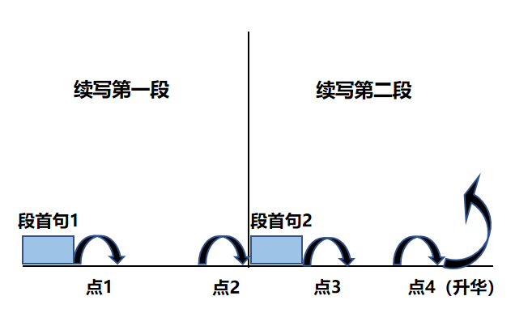
Plot Continuation
点1：位于续写第一段段首，流畅衔接前面的故事（常与原文最后一段呼应）和第一段段首语；
点2：位于续写第一段段尾，流畅衔接第二段段首句；
点3：位于续写第二段段首，续写衔接第二段段首语；
点4：文章结尾升华，给予读者正能量，揭示和强调主题。

Slide 13
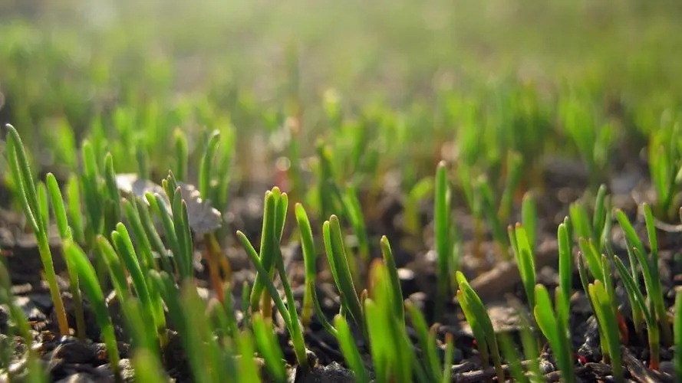
Think :
Why did Amy want to attend my lecture?
Then I paired them off with a partner to feel the healing energy from themselves to another, explaining that everyone had healing potential to support others.
Para1: At that point an idea struck me.
Para2: With a round of applause, Amy's dad led her off the stage.
Para2: With a round of applause, Amy's dad led her off the stage.
Question: What was the idea?
Possible answer: The audience passed their healing potential to support Amy .

Slide 14
Plot the continuation story
Para1: At that point an idea struck me.
Para2： With a round of applause, Amy's dad led her off the stage.
Link1: What did I do?
Body: How did the audience and Amy interact?
Link2: What did Amy get from the interaction?
Link3: What did the crowd do next?
Body: How did I feel? What did I think of this special workshop?
Theme: What lesson did the experience demonstrate?

Slide 15
Design link1
Then I paired them off with a partner to feel the healing energy from themselves to another, explaining that everyone had healing potential to support others.
Para1: At that point an idea struck me.
Link1A: Why not invite Amy to come to the stage and feel the healing potential from the audience present?

Slide 16
Design link1
Then I paired them off with a partner to feel the healing energy from themselves to another, explaining that everyone had healing potential to support others.
Para1: At that point an idea struck me.
Link1B: Standing in front of this audience of over a thousand attendees, with Amy and her parents watching expectantly, I realized that this event was more than a lecture--- it was a moment that could change someone’s life. I signaled Amy to come up to the stage.

Slide 17
Design link2
Para1: At that point an idea struck me.
Amy’s eyes sparkled with complicated emotions and her face lit up. She found new strength to face her challenges. I hugged Amy and whispered my best wishes to her ears.
Para2： With a round of applause, Amy's dad led her off the stage.
Link2 A :

Slide 18
Design link2
Para1: At that point an idea struck me.
Casting a grateful look over the enthusiastic, warm-hearted and lovely audience, Amy promised that she would bravely and fearlessly fight her cancer with the healing potential and love she received in this workshop.
Para2： With a round of applause, Amy's dad led her off the stage.
Link2 B :

Slide 19
Design link3
Para2： With a round of applause, Amy's dad led her off the stage.
Link3A: As they walked out of the hall, Amy looked back over her shoulder at the new friends with tears of gratitude in her eyes.

Slide 20
Design link3
Para2： With a round of applause, Amy's dad led her off the stage.
Link3B: However , the interaction didn’t end there. Many lecture attendees approached Amy and her parents, offering hugs, prayers and promises of continued support.

Slide 21
Design ending
Para2： With a round of applause, Amy's dad led her off the stage.
Ending A:
It dawned on me that the reason why Amy want to spend her final days listening to me, a motivational speaker was that she was desperate for power and bravery to face the challenges ahead.

Slide 22
Design ending
Para2： With a round of applause, Amy's dad led her off the stage.
Ending B: （人与人之间美好的守望相助）
The audience had become an integral part of Amy’s journey, revealing that in times of darkness, we can get together to bring light and hope to someone in need.

Slide 23
Design ending
Para2： With a round of applause, Amy's dad led her off the stage.
Ending C:
Meanwhile, I , together with those one thousand attendees, learned a significant lesson from Amy---face any adversity bravely and fearlessly.

Slide 24
Design ending
Para2： With a round of applause, Amy's dad led her off the stage.
Ending D:
At that moment, I realized that it is through opening our hearts to others that we truly experience the beauty and the power that life offers us.

Slide 25
Para1: At that point an idea struck me.
Why not invite Amy to come to the stage and feel the healing potential from the audience present? Casting an encouraging look at Amy, I signaled her to come up. Weak and pale as she looked, Amy made it to the center of the stage, supported by her father’s strong arms. I encouraged Amy to share her story with everyone in the hall and exclaimed her desires. Hearing her miserable story and her final wishes, the audience suddenly fell silent, heart broken. Then I instructed the entire audience to focus their healing energy on Amy. After they vigorously rubbed their hands together, they raised their hands and directed their healing potential towards Amy. Amy’s eyes sparkled with complicated emotions and her face lit up. She found new strength to face her challenges. I hugged Amy and whispered my best wishes to her ears.

Slide 26
Para2： With a round of applause, Amy's dad led her off the stage.
However, the interaction didn’t end there. Many lecture attendees approached Amy and her parents, offering hugs, prayers and promises of continued support. Some even exchanged contact information with Amy’s parents, vowing to offer unconditional assistance if necessary. Others discussed how to arrange a grand graduation ceremony for Amy in the hope of achieving her last dying wish. When my eyes fell on those sincere faces, tears of complicated emotions blurred my sight. What I didn’t expect was that this workshop turned out extremely fantastic. I was fully convinced that Amy would carry with her the strength , love and healing power from the generous and warm-hearted people in that hall to conquer the unpredictable obstacles in her final days. Meanwhile, I , together with one thousand attendees, learned a significant lesson from Amy---face any adversity bravely and fearlessly.

Slide 27
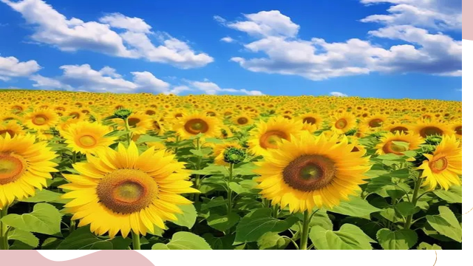
人与社会
本文通过“艾米陷入困境（患癌症晚期），陌生人我以及参加讲座的听众友好帮助（我邀请她参加励志讲座），困境化解（艾米获得面对未来挑战的力量、爱）” 来铺排叙事；同时，我和参与讲座的人也从艾米身上学到了勇敢这一可贵的品质。大家与Amy互相成就，互相救赎。

