Slide 1


感恩遇见，相互成就，本课件资料仅供您个人参考、教学使用，严禁自行在网络传播，违者依知识产权法追究法律责任。
更多教学资源请关注
公众号：溯恩英语
知识产权声明

Slide 2
Vocabulary Revision in Thematic Contexts
--Environment and Protection
基于主题意义引领的高三英语词汇复习教学
盘州市第二中学 陈翠媚

Slide 3
Learning objectives:
01
Classify some topic-related words and expressions from 4 aspects about environment and protection.
02
Apply these words and expressions to different contexts .
03
Express the opinions about how people can protect environment using words and expressions revised in this class.
04
Show correct attitude towards environment and protection.

Slide 4
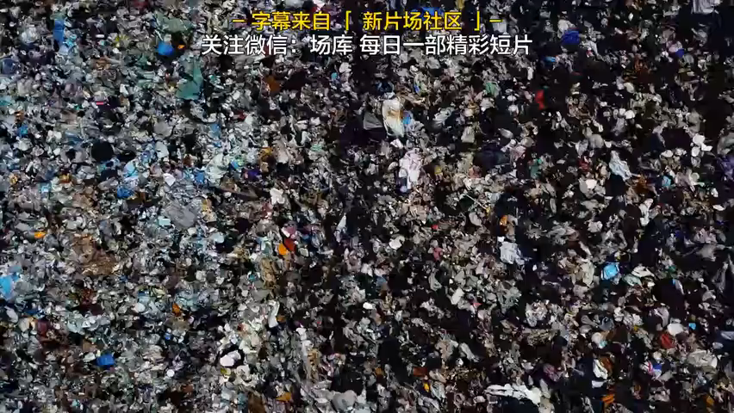
Lead-in
What kind of choice will you make ?

Slide 5
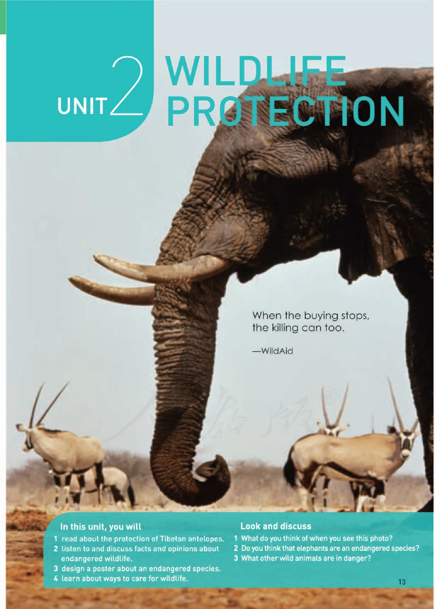
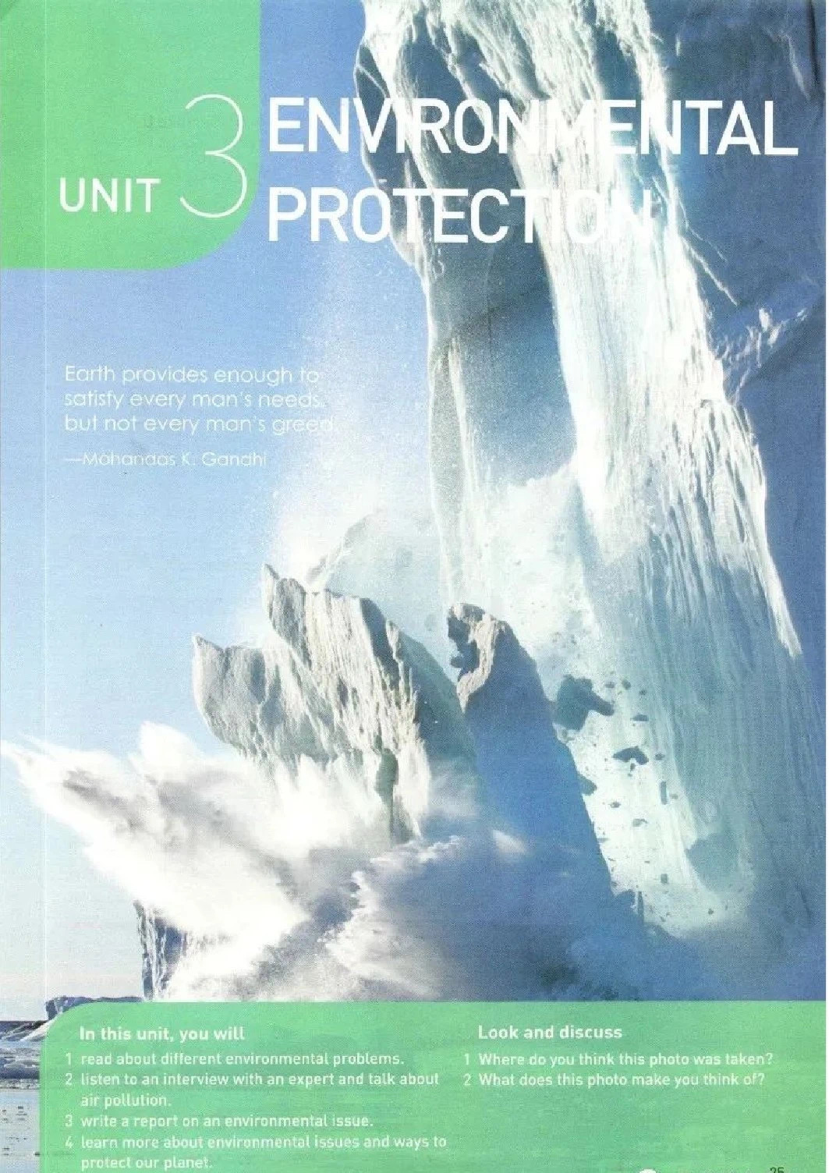
Environment and Protection
教材
高考卷
新人教版必修二 Unit2 Wildlife protection
新人教版选择性必修三
Unit3 Environmental protection
2024年新高考Ⅱ卷：C篇
2023年新高考Ⅰ卷：B篇
2023年新高考Ⅱ卷：D篇
2023年全国甲卷：D篇；语法填空
2022年新高考Ⅰ卷：B篇；语法填空
2022年全国甲卷：语法填空
2021年新高考Ⅰ卷：C篇
2021年新高考Ⅱ卷：语法填空
2021年全国甲卷：B篇；七选五
2021年全国乙卷：C篇
2020年新高考Ⅰ卷：完形填空

Slide 6

“四同”教学法复习环境和保护语篇重点话题词汇
同一主题语境、同类话题、同类语篇、同类结构
思考： 结合所学，总结此类文章通常涉及的词汇类型。
Problems
Causes
Impacts
Solutions

Slide 7
Activity1 Word building based on topic reading
Work in groups to improve your own mind map of the classification from 4 aspects about environment and protection.

Slide 8
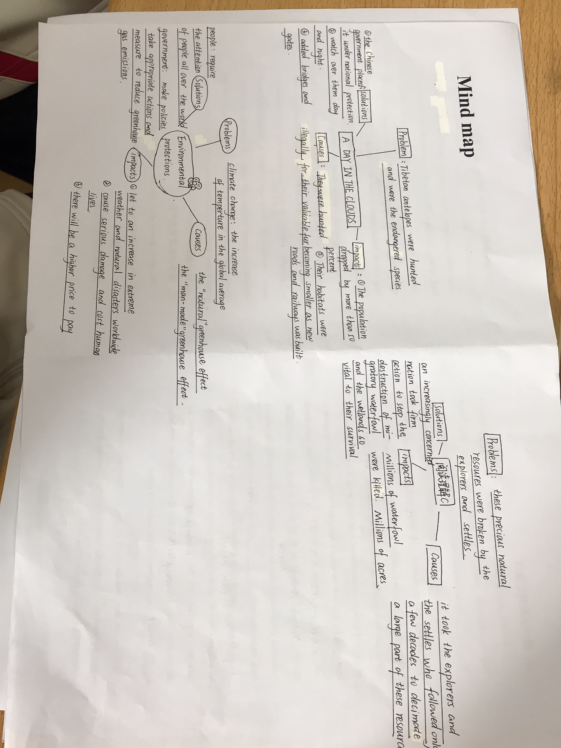

Slide 9
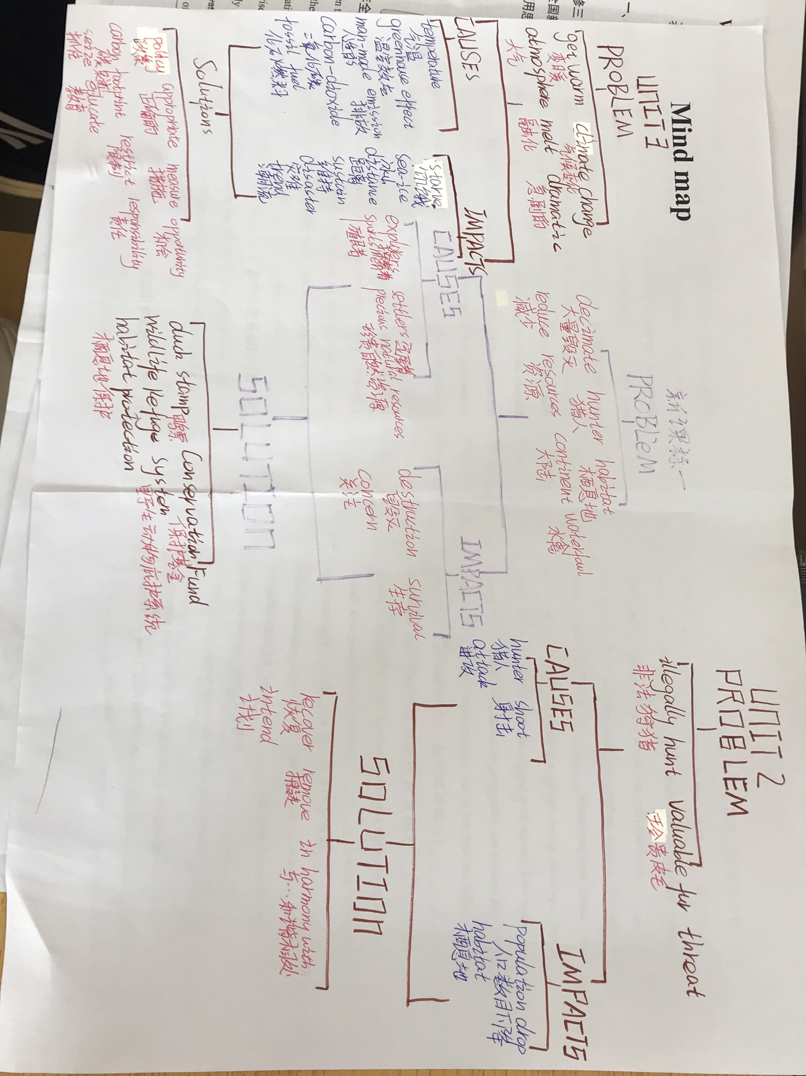

Slide 10
2021年全国新课标I
When the explorers first set foot upon the continent of North America, the skies and lands were alive with an astonishing variety of wildlife. Native Americans had taken care of these precious natural resources wisely. Unfortunately, it took the explorers and the settlers who followed only a few decades to decimate a large part of these resources. Millions of waterfowl (水禽) were killed at the hands of market hunters and a handful of overly ambitious sportsmen. Millions of acres of wetlands were dried to feed and house the ever-increasing populations, greatly reducing waterfowl habitat (栖息地).
In 1934, with the passage of the Migratory Bird Hunting Stamp Act (Act), an increasingly concerned nation took firm action to stopthe destruction of migratory (迁徒的) waterfowl and the wetlands so vital to their survival. Under this Act, all waterfowl hunters 16 years of age and over must annually purchase and carry a Federal Duck Stamp. The very first Federal Duck Stamp was designed by J.N. “Ding” Darling, a political cartoonist from Des Moines, lowa, who at that time was appointed by President Franklin Roosevelt as Director of the Bureau of Biological Survey. Hunters willingly pay the stamp price to ensure the survival of our natural resources.
About 98 cents of every duck stamp dollar goes directly into the Migratory Bird Conservation Fund to purchase wetlands and wildlife habitat for inclusion into the National Wildlife Refuge System-a fact that ensures this land will be protected and available for all generations to come. Since 1934, better than half a billion dollars has gone into that Fund to purchase more than 5 million acres of habitat. Little wonder the Federal Duck Stamp Program has been called one of the most successful conservation programs ever initiated.
Problems
Causes
introduce a policy
Solutions
collect money for the habitat
Result

Slide 11
Activity1 Word building based on topic reading
wildlife protection
Problems
01
03
Pollution
02
Global warming

Slide 12
Activity1 Word building based on topic reading
wildlife protection
Causes
01
03
Pollution
Wildlife species lost
Wildlife is dying out at an alarming rate
Mass extinction
Endangered wildlife
The danger they are in
economic boom
deplete; emission
disposable products
fertilizer
dump; pesticide ; pile up; fossil fuel; deforestation; urbanization
02
Global warming
greenhouse effect
continued greenhouse gas emissions
annual carbon dioxide emissions
throw garbage into the river
smog

Slide 13
Activity1 Word building based on topic reading
Impacts
have an impact on Earth's ecology 对地球生态造成影响
increase in extreme weather and natural disasters 极端天气和自然灾害增多
cause serious damage 造成严重损失
cost human lives 付出人类生命
be a higher price to pay 付出更高的代价
cause deaths and economic losses 造成死亡和经济损失
severe water quality issues 严重的水质问题
damage the natural environment 损坏自然环境
coastal cities submerged 沿海城市被淹没

Slide 14
Activity1 Word building based on topic reading
01
02
wildlife protection
Global warming & Pollution
National Nature Reserve
Protecting the wildlife
Trying to save the animals
Save this species from extinction
Place...under national protection
Watch over...to keep them safe from attacks
Bridges and gates were added to let antelopes move easily and keep them safe from cars and trains.
The protection programmes
Exist in harmony with nature
Change our way of life
make policies
take appropriate
reduce our carbon footprint
promote a harmonious relationship
advocate a ... lifestyle
set up strict regulations
spread environmental awareness
encourage greater use of clean energy
carry out inspections
fine tourist organizations for abuses
Measures
Solutions

Slide 15
Activity1 Word building based on topic reading
Results
Improve the water quality and water conservation
The beauty of...will be preserved for generations to come
Head towards a clean and sustainable future
The measures were effective
The population has recovered
...was removed from the endangered species list

Slide 16
Activity2 Thematic vocabulary application
ecological
Wildlife plays a vital role in keeping the ____________(ecology) balance, however, many wild animals are facing the danger of__________ (extinct); there are several possible reasons for this. Above all, some wild animals are being hunted illegally, for food or money each year, causing their population__________________(急剧下降).Besides, as the human population grows rapidly, a growing number of people came to live where wild species have been living. Habitats_______(lose) , many of the wild animals are confronted with food crisis. A lot of wild animals _______________(die) out, and we should recognize how serious the situation is and ___________________(立即采取行动）. To protect these endangered species,____________________(国家自然保护区) have been established. Protection programmes aim to save animals from extinction by placing them under national___________( protect) and watching over them to ______________________(保护他们免受攻击keep...from..). These measures have been effective, as the population has recovered and some species have been removed from the_________( endanger) list .Only when we learn to exist______________(与......和谐相处) nature can we stop being a _____________ (threaten) to wildlife and to our planet.
extinction
dropping dramatically
lost
have died/ are dying
take immediate actions
national nature reserves
protection
keep them safe from attacks
endangered
in harmony with
threat

Slide 17
Activity2 Thematic vocabulary application
No one can deny that the world we live in is becoming increasingly intolerable because of the effects of global warming. There are numerous causes that contribute to this problem. On one hand, ______________________(与人类有关的碳排放) ,such as the________________ (燃烧化石燃料), into the air, deforestation and land__________( destruct) because of the urbanization, are blamed for the continued greenhouse gas .On the other hand, more _________(化肥) are used to increase the food production to meet the need of the increasing global population, which, in turn,___________________(对......造成严重损害) the natural environment. What’s more, global warming leads to_______________(极端天气) , natural disasters, and even causes deaths and_____________ (经济损失). It is urgent that immediate and effective actions should be taken right way. First of all, stricter laws concerning global warming and irresponsible use of fuel resources have to be___________(实行；实施) . What’s more, we ought to ___________________(培养.....的意识）environmental protection and cherish forests resources. We should also promote a__________( harmony) relationship between humans and nature, advocate an eco-friendly lifestyle, and encourage the use of clean energy. By doing so, we can improve water quality, conserve resources, and head towards a clean and ___________(sustain) future.
human-related carbon emissions
burning of fossil fuels
destruction
fertilizers
causes serious damage to
extreme weather
economic losses
come into effect
develop an awareness of
harmonious
sustainable

Slide 18
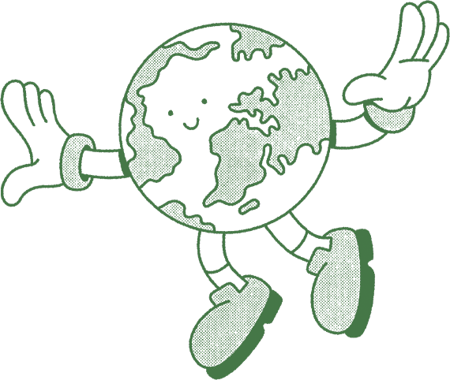
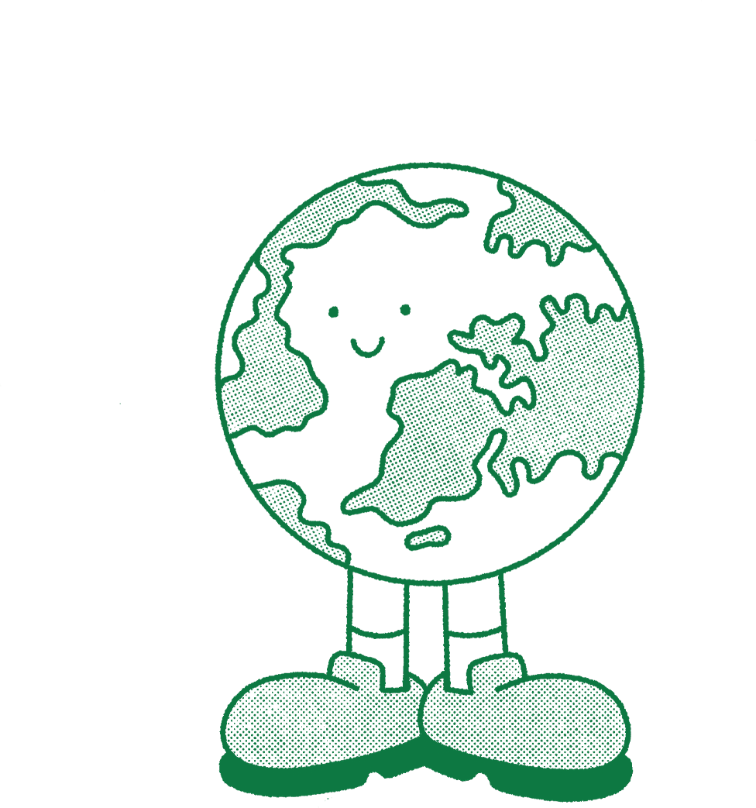
Activity3 Discussion & Production
Discuss in groups about how we can protect environment using words and expressions revised in this class and present your opinions.

Slide 19


Assignment
假如你是学生会主席李华，环境保护与我们息息相关，请你代表学校学生会以“爱护环境”为主题，向全校同学写一封倡议书。
要点如下：
1） 环境现状;
2） 保护环境的具体措施;
3） 呼吁投入环境保护。
注意：1.词数100左右；2．可以适当增加细节，以使行文连贯；3. 使用到该主题意义下的词汇及表达。
Useful sentence patterns:
1. It is ...that...(强调句）
2. garbage piles up, polluting...(非谓语)
3. When it comes to...
4. There is no doubt that...
5. only by...can we... (部分倒装）
6. It's advocated that...
7. It is of great significance that...
8. people hold the belief that...
9. It is high time that sb should do/did sth.

Slide 20
Thank you

