Slide 1


感恩遇见，相互成就，本课件资料仅供您个人参考、教学使用，严禁自行在网络传播，违者依知识产权法追究法律责任。
更多教学资源请关注
公众号：溯恩英语
知识产权声明

Slide 2

活用教材词汇，靶向高考写作
—— B2U5 Music 单元词汇拓展
Jie Shang

Slide 3
energy /ˈenədʒi/ n. 能源;能量;精力
1. 音乐给我能量/让我精力充沛。（应）
Music gives me energy. （书本P51）/ Music makes me energetic.
Review: Benefits of music （应；书本P56）
音乐给了我快乐。当我听音乐时，它使我的精神像风筝一样在风中飞翔。音乐给了我力量，并带给我宽慰。这是我依靠的岩石，让我变得坚强，度过那些艰难的时光。此外，音乐给了我希望和满足感。它成了我最好的朋友。它向我内心深处诉说着鼓励的话语。
Music gave me happiness. When I listened to music, it made my spirits fly like a kite in the wind. Music gave me strength and brought me relief. It was the rock I leant on to become strong and to get through those hard times. Moreover , music gave me hope and a sense of satisfaction. It became my best friend. It spoke words of encouragement to the deepest part of my being.
2. 当第一缕淡黄色阳光掠过地平线时，这只鸟鸣唱了一首充满活力的歌。（续；2023 宁波高二联考 “学小鸟早起”）
The bird trilled an energetic song as the first pale yellow rays of sunshine peeked over the horizon.

Slide 4
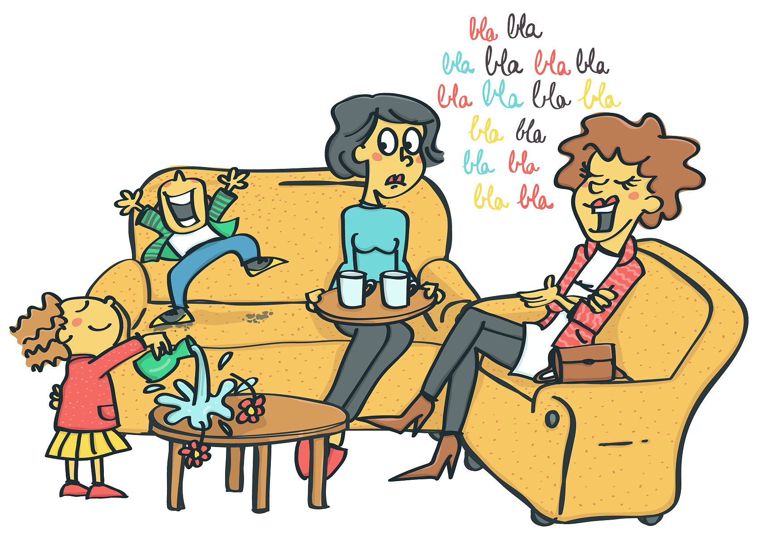
energy /ˈenədʒi/ n. 能源;能量;精力
3. 我把我的全部精力投入到篮球中以成为最佳球员。（应）
I put/apply/devote all my energies into basketball to become the best player.
4.我们应该充分利用其他可再生能源来节约石油和天然气。（应）
We should conserve oil and gas by making full use of other renewable energy.
5. 看到David到达终点线，观众们充满了欢呼和活力。（续；2023全国“David越野跑”）
Seeing David reach the final line, the audience was full of cheers and energy.
6.“加油！你能做到！”他们积极地喊道。（续；2023全国“David越野跑”）
“Come on! You can make it!” they shouted energetically.
7. 她精力充沛地说着话，滔滔不绝。（续；动作描写）
She spoke energetically and her words tripped over
one another as they tumbled out.

Slide 5
soul /səʊl/ n. 灵魂;心灵;人
1. 音乐能触动我的心灵。（应；书P51）
Music can touch my soul/ heart.
2. 音乐赋予宇宙灵魂，赋予心灵翅膀，赋予想象力飞翔，赋予万物生命。（应；from Plato）
Music gives a soul to the universe, wings to the mind, flight to the imagination and life to everything.
3. 她的小提琴就像一个灵魂伴侣，向我低语智慧的话语。（续；2022湖北高二联考“小提琴试镜”）
Her violin was like a soulmate that whispered words of wisdom to me.
4. 怒吼的风如同迷失的灵魂在哀声恸哭。（续；环境描写）
The howling wind sounded like the wailing of lost souls.
5. 我内心深处感到焦躁不安。（续；心理描写）
There was a feeling of restlessness deep in my soul.
6. 母亲的话深深植根于我的内心，我从未怀疑我们会成功。（续；心理描写；2007江苏阅读）
With my mother’s words deeply rooted in my soul, I never doubted we would succeed.

Slide 6
soul /səʊl/ n. 灵魂;心灵;人
7. 我们沿着这条路开了十个小时，但视线里一个人也没有。（续；环境描写）
We had driven ten hours along the road but there was not a soul in sight.
8. 意志坚强的人可以实现目标。（续；主旨升华；2020天津阅读）
A strong-willed soul can reach his goal.
9. 在与Devon教授交谈后，作者决定全心全意地投入到实验室工作中。（应；2023北京阅读）
After talking with Professor Devon, the author decided to put his hear and soul into the lab work.
10. 他们全心全意地投入了这个项目。（应；人物评价）
They threw themselves heart and soul into the project.
11. 屠呦呦全身心投入到奋斗这项事业中去。（应；人物评价）
Tu Youyou committed herself body and soul to fighting for the cause.

Slide 7
opportunity /ˌɒpəˈtju:nəti/ n.机会;时机
1. 抓住机会做某事
have/ get/ take/ use/ seize/ grasp/ grab/ the opportunity to do sth.
想象一下，当你独自一人在家时，有机会和数百名其他人一起唱歌。（应；书P52）
Imagine having the opportunity to sing together with hundreds of other people while you are at home alone.
我想借此机会分享我是如何在互联网上学习英语。（应；2020天津发言稿）
I’d like to take this opportunity to talk about how I learn English on the Internet.
2. 错过机会
miss/ lose/ waste the opportunity
密切关注风景将确保你不会错过一个绝佳的机会。（应；2023全国阅读改）
Keeping your eye on the landscape will ensure you don’t miss an amazing opportunity.

Slide 8
opportunity /ˌɒpəˈtju:nəti/ n.机会;时机
3. 为某人提供机会做某事
give sb. opportunity to do sth.
provide/ offer/ present/ open up an opportunity for sb. to do sth.
在学校分组工作为学生提供了学习团队合作的机会。（应；2011湖北作文改）
Working in groups at school provides an opportunity for students to learn about teamwork.
4. 好的机会
(a(n)) good/ great/ wonderful/ perfect/ golden/ ideal/ rare/ unique/
once-in-a-lifetime opportunity
发展中国家的经济体将受益于小型和家庭企业的黄金机遇。（应；2013上海阅读改）
Economies in developing countries will benefit from golden opportunities for small and home-based business.
5. 他决定尽早离开学校。（续）
He decided to leave school at the first/ earliest opportunity.

Slide 9
perform /pəˈfɔ:m/ vi.&vt.表演;履行;执行
1. 做研究/ 实验/ 分析/ 手术
perform a study/ an experiment/ an analysis/ an operation/ surgery
出生于佛罗伦萨的一个犹太家庭，她搬到巴黎当医生并做手术。（应；人物经历；2023全国阅读）
Born to a Jewish family in Florence, she moved to Paris where she worked as a physician and performed surgery.
(in everday English: = carry out an operation)
2. 履行工作/ 职责/任务
perform work/ a job/ a duty/ a task
人工智能不是一个人，生成性人工智能不能取代成员履行的职责。（应；2023 New York Times改）
Artificial Intelligence is not a person and that generative A.I. cannot replace the duties performed by members.

Slide 10
perform /pəˈfɔ:m/ vi.&vt.表演;履行;执行
3. 所以请不要相信我能创造奇迹，而是相信我不怕困难和逆境。（续；主旨升华）
So please don’t believe that I can perform miracles. Instead, believe that I am not afraid of difficulties and adversity.
4. 在学校成立之前，大多数学生在学业上表现不佳。（应；2023全国阅读）
Most students didn’t perform well in academic study before the school was established.
5. 随着新演出的日子来临，我越来越沮丧。（续；心理描写；2022天津完形）
With the day of the new performance approaching, I grew increasingly upset.
6. 表演者们为观众呈现了一场风格多样、表演丰富多彩的舞蹈盛宴。（应；活动介绍）
The performers presented the audience with a dance feast of diverse styles and colourful performances.

Slide 11
ordinary /ˈɔ:dnri/ adj.普通的;平凡的
1. 然而，在现代社会中，有人不得不做一些普通的工作，比如打扫街道，因为这是社会的组织方式。（应；2013广东写作）
Yet in modern society somebody has to do ordinary jobs such as cleaning streets because this is the way society is organized.
2. 无论一个人多么平凡，他都在社会中起着重要作用，因此值得我们应有的尊重。（应；人物评价；2013广东写作改）
No matter how ordinary a person is, he plays a part in society and therefore deserves our due respect.
3. 这就是红薯，一种长相普通、品性坚韧的植物。（续；主旨升华）
Such is a sweet potato, an ordinary-looking plant with tough characteristics.

Slide 12
prove /pru:v/ vt.证明;展现
1. 只要给我个机会，我会证明给你看。(prove sth. to sb.)（应；申请信）
Just give me a chance and I'll prove it to you.
2. 他听到一个声音告诉他，他应该向世界证明自己。(prove oneself ) （续；2023高一续写“自卑Thomas积极进取”）
He heard a voice telling him that he should prove himself to the world.
3. 不幸的是，我们忘记了在取出它们的内瓤（insides）之前称重，但我决心证明我的观点。（续；2021浙江“南瓜卡头”）
Unfortunately, we forgot to weigh them before taking out their insides, but I was determined to prove my point.
4. 她的一些同事担心不得不承担额外的工作来弥补她做不到的事情，但这位年长的女士证明他们都错了。（prove sth. (to be) adj./n.) （续；2023高三“保洁员奶奶拾金不昧”）
Some of her coworkers worried about having to take on extra work to make up for what she couldn’t do, but the older woman proved them all wrong.

Slide 13
prove /pru:v/ vt.证明;展现
5. ALife的崛起将被证明是不可避免的。(linging verb: prove (to be) sth./ adj.) （应；事物评价；2023北京阅读）
The rise of ALife will prove (to be) unavoidable.
6.郎平，这位传奇的排球教练和前运动员，是一个活生生的证明——无论是场上还是场下，努力工作都能带来非凡的成就。（应；人物评价）
Lang Ping, the legendary volleyball coach and former player, is living proof that hard work can lead to extraordinary achievements, both on and off the court.

Slide 14
award /əˈwɔ:d/ vt.授予 n.奖品
get sth. in the competition
V.
1. 评委会授予我们班一等奖。(award sb. sth./ award sth. to sb.)（应；活动颁奖）
The panel of judges awarded our class the first prize/ awarded first prize to our class.
2. 今年的诺贝尔奖被颁给屠呦呦，她的研究发现了青蒿素。（应；人物评价；选必一U1）
This year’s Nobel Prize has been awarded to Tu Youyou, whose research led to the discovery of artemisinin.
VS reward v. /n. be rewarded = pay off
我们在排练中所做的努力得到了回报。
Our efforts made in the rehearsals were rewarded.
施恩无他图，有德便是报
Virtue is its own reward.
get sth. in return
= paid off

Slide 15

award /əˈwɔ:d/ vt.授予 n.奖品
n.
李华被提名为最佳男主角。（应；获奖过程）
Li Hua was nominated for the best actor award.
李华因其出色的表现而获最佳男主角。
Li Hua won/received/got/picked up/scooped up the best actor award for his striking performance.
李华被颁发最佳男演员奖。
Li Hua was presented with/given the best actor award.
最佳男主角奖颁给了李华
The best actor award went to Li Hua.

Slide 16
stage /steɪdʒ/ n.舞台;(发展或进展的)时期;阶段
1. 当我高中毕业走过舞台时，我会超越他所实现的任何成就。（续；2021浙江“我学会奉献把打工钱交给爸爸”）
I would surpass anything he had accomplished by the time I walked across the stage at high school graduation.
2. 但无论我在家里表演得多么轻松，当我走上舞台的那一刻，每一句话都从我的脑海中消失了。（续；2023高二续写“克服胆小登上舞台”）
But however easily I acted at home, the moment I stepped on stage, every word disappeared from my head.
3. 许多其他技术也经历了激动人心的阶段。（应；介绍成果；2022北京阅读）
Lots of other technologies have gone through stages of excitement.
4. 虽然高中通常不鼓励学生探索生活的新方面，但大学为这种探索奠定了基础。
(set the stage for sth.)（应；介绍原因；2017全国完形）
While high school does not generally encourage students to explore new aspects of life, college sets the stage for that exploration.

Slide 17
capable /ˈkeɪpəbl/ adj.有能力的;有才能的
1. 尽管演出后不久Henry就逐渐失明，但他仍然能够作曲。(be capable of doing sth.) （应；介绍人物能力；必二U5）
Though he was affected by gradual blindness soon after the performance, Henry was still capable of writing compositions.
2. 当招聘委员会看到这一点时，他们看到一个能够在各种环境中工作的候选人。
（应；介绍人物能力；2018上海写作）
When hiring committees see this, they see a candidate who is capable of working in a variety of environments.
3. 智能手机能够跟踪你的健身活动，从而更容易监测你的健康和锻炼进度。(have the capability to do sth.)（应；介绍功能）
Smartphones have the capability to track your fitness activities, making it easier to monitor your health and exercise progress.
4. 我会说法语，但同声传译超出了我的能力。(beyond one’s capabilities)（应；介绍人物能力）
I can speak French, but simultaneous translation is beyond my capabilities.

Slide 18
relief /rɪˈli:f/ n.(焦虑、痛苦)减轻或消除
1. 亨利发现创作音乐是一种宽慰。(sing.) （续；心理描写；必二U5）
Henry found that creating music was a relief.
2. 那一刻，我开始明白我朋友的话是什么意思。真是松了一口气！（续；心理描写；2013重庆阅读）
At that moment, I began to understand what my friend meant by her words. What a relief！
3. 当这个季节结束时，我们大多数志愿者还是松了一口气。(uncountable)（续；心理描写；2019全国阅读）
Most of us volunteers breathe a sigh of relief when the season comes to a close.
4. 让我们松了一口气的是，爸爸拒绝了这个主意。(to one’s relief)（续；心理描写；2018浙江“一家自驾去祖父母家”）
To our great relief, Dad turned down the idea.
5. 我感到如释重负和幸福。(a surge/sense/feeing of relief)（续；心理描写）
I felt a huge surge/sense/feeling of relief and happiness.
6. 他宽慰地看着女孩点点头。(in/with relief)（续；心理描写）
He watched with/in relief as the girl nodded.

Slide 19
relief /rɪˈli:f/ n.(焦虑、痛苦)减轻或消除
7. 非常欣慰得知孩子们是安全的。(It is a relief to see/know that...)（续；心理描写）
It was a great relief to see/know that the children were safe.
8. 然而，只有12%的救灾资金用于提前降低风险，而不是事后的恢复和重建。（应；救灾相关；2016江苏阅读）
However, just 12% of disaster-relief funding has gone on reducing risks in advance, rather than recovery and rebuilding afterwards.
9. 我必须在舞台上表演时放松和释放压力。（续；心理描写；2020浙江七选五改）
I had to relax and relieve your stress while performing on satge.
10. 当他轻轻地涂上药膏时，他能感觉到它开始缓解疼痛。（续；心理描写）
As he gently applied the ointment, he could feel it start to relieve the pain.
11. 我感到十分宽慰，然后突然想到了一个主意。（续；心理描写；2020天津阅读）
I was greatly relieved and then an idea suddenly hit me.
12.世界粮食计划署(the World Food Program)的目的之一是缓解全世界的饥饿。（应；救灾相关；2017江苏单选改）
One of the World Food Program’s purposes is to relieve worldwide starvation.

Slide 20
cure /kjʊə(r)/ n.药物;疗法;对策 vt.治愈;治好(疾病); 应对
n.
1. 亨利发现创作音乐是一种疗愈。（应；必二U5）
Henry found that creating music was a cure for his illness.
2. 它旨在找到治疗痴呆症的方法。（应；2022浙江阅读改）
It aimed to find/discover/search for a cure for dementia.
3. 在机械装置中加一点油是解决发动机噪音的最佳方法之一。（应）
Adding a little oil into the mechanism is one of the best cures for a noisy engine.
V.
4. 它治愈了人们的心血管(cardiovascular)疾病。(cure sb. of sth.)（应；2023全国阅读）
It cured people of cardiovascular disease.
5. 人们选择园艺有很多原因：为了补充预算，或者只是为了应对封锁带来的无聊。（应；2023全国阅读改）
People were looking to garden for a bunch of reasons: to supplement their budget, or just to cure the boredom that came with the lockdown.

Slide 21
(be) absorbed in /əbˈsɔ:bd/ 被……吸引住;专心致志
1. 当他专注于自己的音乐世界时，他觉得自己好像可以“看到”周围世界的美丽，就像他之前的生活一样。（续；心理描写；必二U5）
When he got absorbed in his world of music, he felt as if he could "see" the beauty of the world around him, like he had in his previous life.
2. 成年人在许多场景被描绘为独自的——全神贯注于一卷书，陷入沉思，或者迷失在休闲的时刻。（续；心理描写；2023全国阅读）
Adults are portrayed alone in many settings — absorbed in a volume, deep in thought or lost in a moment of leisure.
3. 你在应用程序中吸收更多信息，
并在它之外继续学习。（应；2020北京阅读）
You absorb more information while in the app
and continue learning outside of it.

Slide 22
previous /ˈpri:viəs/ adj.先前的;以往的
1. 当他专注于自己的音乐世界时，他觉得自己好像可以“看到”周围世界的美丽，就像他之前的生活一样。(only before noun)（续；必二U5）
When he got absorbed in his world of music, he felt as if he could "see" the beauty of the world around him, like he had in his previous life.
2. 没有像预期的那样着手完成一项新任务，我们再次检查了以前的工作。（应；2020江苏单选改）
Instead of getting down to a new task as expected, we examined the previous work again.
3. 这以前，她身体一向很好。(previous to sth.)
Previous to this, she had always been well.
4. 他们可以学习如何读取对方的身体信号，这表明两者可能比我们之前怀疑的有更多的共同点。（2011广东阅读）
They can learn how to read each other’s body signals, suggesting that the two may have more in common than we previously suspected.

Slide 23

unemployed /ˌʌnɪmˈplɔɪd/ adj.失业的;待业的
1. 出乎意料的是，失业让我重新找回了目标感。（应；2009四川阅读）
Unexpectedly, being unemployed gave me back a sense of purpose.
2. 青年激励辅导项目旨在为失业者提供不同的技能。（应；活动目的；2013福建阅读选项）
The Young Inspirations mentoring program aims to equip the unemployed with different skills.
3. 失业的景象在我眼前浮现。（续；2013浙江阅读）
Visions of unemployment marched before my eyes.
4. 一种流传多年的简单文字形式今天仍然可以被运用以引起对重要真理的关注。（应；2023全国语填）
A simple literal form that has been passed down through the ages can still be employed today to draw attention to important truths.

Slide 24


romantic /rəʊˈmæntɪk/ adj.浪漫的 n.浪漫的人
adj.
1. 女孩被他的浪漫话语打动了，所以她接受了他的礼物。（续；必二U5）
The girl was moved by his romantic words, so she accepted his gift.
n.
2. 他内心是一位浪漫的人，渴望历险。（应；人物介绍）
He is a romantic at heart and longs for adventure.
3. 当阳光穿过马扬起的尘土时，非洲的浪漫变得生动起来。（续；环境描写；2015重庆阅读）
As the sun's rays pass through the dust kicked up by the horses, the romance of Africa comes to life.

Slide 25

impact /ˈɪmpækt/ n.影响;撞击 v. 冲击;对...有影响
n.
1. 这一记猛击把Jack打倒失去了平衡。（续；动作描写）
The impact of the blow knocked Jack off balance.
2. 它对我产生了巨大的影响，给了我继续前进的力量。（续；主旨升华；2023天津完形）
It had an enormous impact on me, giving me the strength to keep going.
Collocations:
【VERBS】
对...有影响：have/make an impact on/upon sth.
减轻影响：reduce/lessen/soften the impact
【ADJECTIVES】
大影响：a great/huge/massive/major/significant impact
深远的影响：a profound/lasting/long-term impact
正面影响：a positive impact
小影响：a minimal/negligible impact
短期的影响：a short-term/immediate impact
负面影响：a negative/damaging/adverse/disastrous impact

Slide 26

impact /ˈɪmpækt/ n.影响;撞击 v. 冲击;对...有影响
v.
3. 每一个不及格的分数（F）都会显著影响你在该学年的GPA，限制俱乐部、组织和项目选择，因为竞争性项目需要顶尖的GPA。（应；项目介绍）
Every failing grade (F) significantly impacts your GPA for that academic year, limiting clubs, organizations and program choices, as competitive programs require top GPAs.
4. 父亲的经历对她的事业选择造成巨大影响。（应；人物介绍）
Her father's experience impacted greatly on her career choices.
5. 为了实现她的目标，她想出了一个实用
但有影响力的主意。（续；2023全国阅读）
To achieve her goals, she came up with a practical
but impactful idea.

Slide 27
aim /eɪm/ n.目的;目标 v.力求达到
n.
1. 她去伦敦的目的是找工作。(with the aim of doing sth.) (countable) （应；目的介绍）
She went to London with the aim of finding a job.
2. 该行业还瞄准了作为其替代品出现的产品。(take aim at sb./sth.) (uncountable) （应；2018浙江阅读）
The industry has also taken aim at the product that has appeared as its replacement.
Collocations:
【VERBS】
设立/追求目标：have/set out/pursue an aim
实现目标：achieve/fulfil the aim
v.
3. 他们充满了团队精神，作为一个整体，总是以荣誉为目标。 (aim at/for sth.)（应；人物介绍；必二U5）
Filled with team spirit, they act as a whole, always aiming for/at glory.
【ADJECTIVES】
主要目标：the main/ primary/principal aim
长远目标：the ultimate/eventual/long-term aim
短期目标：the immediate/initial/short-term aim

Slide 28
aim /eɪm/ n.目的;目标 v.力求达到
4. 她创办了Ladybug基金会，这是一个力争做到消除无家可归者的组织。 (aim at doing sth.)（应；目的介绍；2017北京完形）
She started the Ladybug Foundation, an organization aiming at getting rid of homelessness.
5. 青年激励辅导项目争取为失业者提供不同的技能。(aim to do sth.)（应；目的介绍；2013福建阅读选项）
The Young Inspirations mentoring program aims to equip the unemployed with different skills.
6. 他总是目标很高。（应；人物介绍）
He has always aimed high. (= tried to achieve a lot)
7. 这些措施的目的是防止暴力犯罪。(be aimed at doing sth.) （应；目的介绍）
These measures are aimed at preventing violent crime.
8. 针对有年幼孩子的父母，这本充满活力的杂志承诺丰富家庭生活。(aim sth. at sb.) (usually passive)（应；目的介绍；2007浙江阅读）
Aimed at parents with young children, this energetic magazine promises to enrich the lives of families.

Slide 29

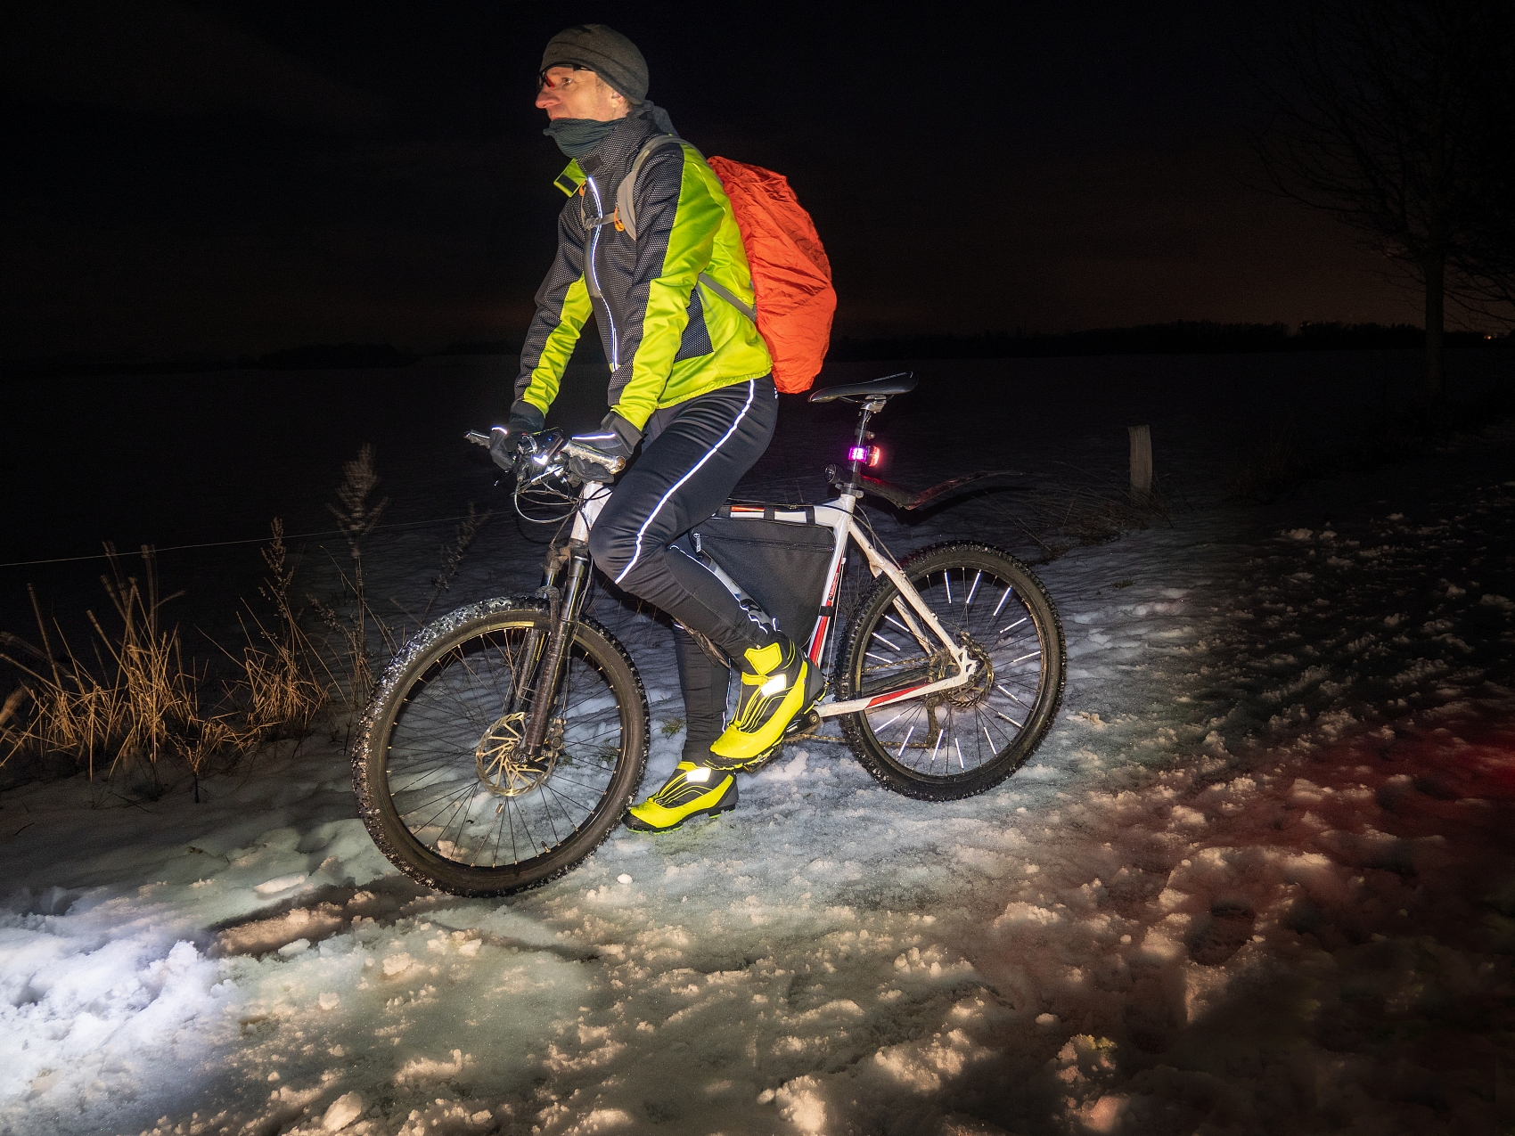
equipment /ɪˈkwɪpmənt/ n.设备;装备
1. Mik的工作是把我的装备带上山，搭建帐篷，到达顶峰后把所有东西都搬回来。(uncountable) （续；动作描写；2023天津完形）
Mik’s job was to carry my equipment up the mountain, set up the tent, and carry everything back down after reaching the peak.
2. 青年激励辅导项目争取为失业者提供不同的技能。(equip sb./sth. with sth.)（应；目的介绍；2013福建阅读选项）
The Young Inspirations mentoring program aims to equip the unemployed with different skills.
3. 所有骑手都配备了反光背心和安全灯。（续；2018全国阅读）
All riders are equipped with reflective vests and safety lights.
4. 该课程旨在为学生提供从事护理工作的能力。(equip sb./sth. for sth.)（应；目的介绍）
The course is designed to equip students for a career in nursing.

Slide 30
talent /ˈtælənt/ n.天才;天资;天赋
1. 你是帮助我发现数学天赋的老师。(talent for sth.) (countable, uncountable)（续；2012广东写作）
You were the teacher who helped me discover my talent for math.
2. 许多青少年喜欢用他们的艺术才能来拼贴杂志上的图片。（应；人物介绍；2018上海阅读）
Many teenagers love using their artistic talents to collage pictures from the magazine.
3. Yolo制片公司和Great Griffon展示了Rajiv Joseph的戏剧，在剧中，一位折纸艺术家邀请一位青少年天才和他的老师进入她的工作室。（应；活动介绍；2019全国阅读）
Yolo Productions and the Great Griffon present the play by Rajiv Joseph, in which an origami artist invites a teenage talent and his teacher into her studio.
4. 即使是最有才华的艺术家、音乐家和作家的第一次尝试也很少是杰作。（2010上海完形）
The first attempt of even the most talented artists, musicians, and writers is seldom a masterpiece.

Slide 31
assume /əˈsju:m/ vt.以为;假设
1. 我认为这个节日的目的是筹集资金。 (assume that ...)（应；观点表达；必二U5）
I assume that the aim of the festival is to raise money.
2. 过了一会儿，他们发现了他们也以为是一只狗在和一个骑自行车的男人一起跑的东西。（续；2017浙江“骑行遇狼”）
A bit later, they spotted what they, too, assumed was a dog running alongside a man on a bike.
3. 据推测，那些志愿者角色是其个人身份的绝大部分的人也最有可能继续从事志愿者工作。(It is assumed that ...)（应；观点表达；2015江苏阅读）
It was assumed that those people for whom the role of volunteer was most part of their personal identity would also be most likely to continue volunteer work.
4. 系统的其余部分被认为运行良好。(sb./sth. be assumed to be (doing) sth.) （应；功能介绍）
The rest of the system is assumed to be functioning well.
5. 别总往最坏处想。（续）
Don't always assume the worst (= that sth bad has happened) .

Slide 32
assume /əˈsju:m/ vt.以为;假设
6. 法庭承担了保障这个女孩福利的责任。（续）
The court assumed responsibility for the girl's welfare.
7. 在这个故事中神以鹰的形象出现。（续）
In the story the god assumes the form of an eagle.
8. 每当提到她的名字，Andy就表现出一副漠不关心的样子。
(assume a(n) manner/air/expression of sth.) （续；神态描写）
Andy assumed a(n) manner/air/expression of indifference whenever her name was mentioned.
9. 我希望明年上大学，当然是在我通过考试的前提下。（应）
I hope to go to college next year, always assuming that I pass my exams.
10. 创造变革的系统方法也建立在系统中每个人都拥有平等权力的假设之上。（应；2022北京阅读）
A systems approach to creating change is also built on the assumption that everyone in the system has equal power.

Slide 33

ache /eɪk/ vi.&n.疼痛
V.
1. 我的身体一直疼痛，所以我想我活不了多久了。（续；必二U5）
My body ached all the time and thus I thought I didn’t have much longer to live.
2. 我的牙齿正疼，而且我和一个朋友吵架了。（续；2013重庆阅读）
My tooth was aching, and I’d been in an argument with a friend.
3. 我渴望睡觉。(ache for sth.) （续；心理描写）
I’m aching for sleep.
4. 他渴望伸出手并紧紧地抱着她。(ache to do sth.) （续；动作描写）
He ached to reach out and hold her close.

Slide 34
ache /eɪk/ vi.&n.疼痛
n.
5. 除了腿部隐隐作痛外，Larsen已经完全从车祸中康复。（续）
Apart from a dull ache in his leg, Larsen has completely recovered from the crash.
6. 当你开始定期锻炼时，你可能会感到轻微的不适，但这是你的身体适应了生活方式的积极变化，疼痛应该会相对较快地消失。（应；运动好处；2014重庆阅读）
You may experience mild discomfort as you begin to exercise regularly, but this is your body adapting to the positive changes in your lifestyle and the aches should disappear relatively quickly.
7. Anya听着，心里因理解感到深深的疼痛。（续；“Anya and the Nightingale”）
Anya listened with a profound ache of understanding in her heart.
8. 无尽的一系列台阶突显了整个冒险过程，并为您提供了一个可以坐下来休息酸痛的双腿的地方。（应；景点介绍；2021全国语填改）
The endless series of steps highlights the whole adventure and offers a place where you can sit down to rest your aching legs.

Slide 35
treatment /ˈtri:tmənt/ n.治疗;对待;处理
1. 我不得不接受两个小时的医疗治疗。(countable, uncountable)（续；必二U5）
I had to go through a two-hour medical treatment.
2. ALRL成立于1992年，专门从事治疗心脏病的新药开发。(countable, uncountable) (treatment of/for sth.)（应；项目介绍；2010四川阅读）
Opened in 1992, ALRL specializes in the development of new medicines for the treatment of/for heart diseases．
3. 我们在学校没有单独挑出来接受特殊待遇。(uncountable)（续）
We were not singled out for special treatment at school.
4. 最近，我的朋友Kyra一直对我沉默以待。(uncountable)（应；青少年困惑）
Lately, my friend Kyra has been giving me the silent treatment.
5. 我认为这本书没有认真处理这个问题。(countable, uncountable)（应）
I didn’t think the book gave the issue serious treatment.

Slide 36
lean /li:n/ vt.依靠;倾斜
leaned/leant-leaned/leant
1. 它是我依靠的岩石去变得坚强并度过那些艰难时期。 (lean on/against sb./ sth.)（应；功能介绍；必二U5）
It was the rock I leant on/against to become strong and to get through those hard times.
2. 他把自行车靠在栅栏上。(lean sth. on/against sth.)（续；动作描写）
He leant his bicycle on/against the fence.
3. Dave身体前倾，蹬得更猛更快。（续；动作描写；2017天津完形）
Leaning forward, Dave pedaled harder and faster.
4. 她向后靠着，把脚放在沙发上以感到舒适。（续；动作描写；2011江西完形）
Leaning back, she put her feet onto the sofa to get comfortable.
5. 他俯身，对那头悲伤的驴子轻声说，好像它是一个值得信赖的朋友。（续；动作描写；“The Many Assassinations of Samir, the Seller of Dreams”）
He leaned over and whispered to the sad donkey as if it were a trusted friend.
6. 我感到乐观，倾向于一份工会工作。(lean toward(s)/to sb./sth.)（应；2023 Washington Post）
I feel optimistic, and I’m leaning toward(s)/to a union job.

Slide 37
get through /get θru:/ (设法)处理;完成;熬过(困难时期);通过
1. 它是我依靠的岩石去变得坚强并度过那些艰难时期。（应；功能介绍；必二U5）
It was the rock I leant on/against to become strong and to get through those hard times.
2. 我终于完成了这项家庭作业。（应）
I finally got through this homework assignment.
3. 我们已经消耗了很多轮胎。（续）
We've got through a lot of tyres.
4. 昨天晚上我给Hnnah打了很多电话，但都打不通。（续；2008湖南单选）
I called Hnnah many times yesterday evening, but I couldn’t get through.
5. 由于温莎城堡是一座正在使用的皇家宫殿，游客和他们的物品应该通过机场式的安全检查。（应；景点介绍；2010天津阅读）
As Windsor Castle is a working royal palace, visitors and their belongings should get through airport style security checks.
6. 我们再一次未能在议会获得通过该法案。
Once again we failed to get the Bill through Parliament.
7. 一位老朋友很可能会理解她并帮助她。
An old friend might well be able to get through to her and help her.

Slide 38
satisfaction /ˌsætɪsˈfækʃn/ n.满足;满意;欣慰
1. 此外，音乐给了我希望和满足感。（应；音乐好处；必二U5）
Moreover, music gave me hope and a sense/feeling of satisfaction.
2. 检查员挥动双臂表示对地板的满意。(satisfaction with)（续；动作描写；2015湖南阅读改）
The inspector waved his arms to show his satisfaction with the floor.
3. 很难想象这个问题如何能被解决得令每个人都满意。(to one’s satisfaction)
It is hard to see how the issue can be resolved to everyone's satisfaction.
Collocations:
【ADJECTIVES】很满意
great/deep/immense/enormous/real/complete satisfaction
【VERBS】从...获得满意
get/gain/derive/take satisfaction from sth.
sth. gives/brings sb. satisfcation
表达满意
express/show satisfaction
【PHRASES】
满意的笑/表情
a smile/look of satisfaction
满意程度
the level of satisfaction

Slide 39

various /ˈveəriəs/ adj.各种不同的;各种各样的
1. 与此同时，当我们感到悲伤或孤独时，我们都会经历不同的时期。 （续；必二U5）
At the same time, we all go through various periods when we feel sad or alone.
2. 为了帮助新生适应新环境，学生会每周组织各种活动。（应；活动介绍；2008广东写作改）
To help the freshman get adapted to the new environment, the Students’ Union organizes various activities every week.
3. 参加我们教堂支持的圣诞派对的贫困儿童享用了圣诞食品，享受了精彩的表演，并收到了圣诞老人的各种礼物。当所有的孩子都离开了，我们疲惫地松了一口气。（续；节日活动；2023河北高一期中“圣诞送礼物”）
The poor children who attended our church-supported Christmas party feasted on Christmas foods, enjoyed wonderful shows and received various gifts from Santa. When all the children had left, we breathed a sigh of relief with tiredness.

Slide 40

repetition /ˌrepəˈtɪʃn/ n.重复;重做
1. 习惯是通过学习和重复建立起来的。（应；2023北京阅读）
Habits are built through learning and repetition.
2. 我们不想看到去年的悲剧重演。（续）
We do not want to see a repetition of last year's tragic events.
3. 现在，计算机正被引入这一行业来执行重复性任务。
Computers are now being brought into this profession to perform repetitive tasks.
4. 这个职位在最后一刻被提供，并且我有两周的时间来准备，在这段时间我一直在寻找公文包，然后站在全身镜前，重复着“同学们，你好，我是戴维斯先生。”（续；动作描写；2011广东阅读）
The position was offered at the last minute, and I was given two
weeks to prepare, a period I spent searching for briefcase and
standing before my full-length mirror, repeating the words, “Hello,
class. I’m Mr. Davis.”

Slide 41
outline /ˈaʊtlaɪn/ n.&vt.概述;概要
n.
1. 我记得我们走到一个十字路口，到处都是沙子，和两条交叉路口的轮廓。（续；环境描写； “Everything Sad Is Untrue” ）
I remember we came up to a crossroad, sand everywhere, and the outline of two intersecting roads.
2. 她简略地勾勒出人物的轮廓。（续；动作描写）
She drew the figures in outline.
3. 我们计划的粗略大纲如下。（应）
The broad/rough/general outline of our plan is as below.
v.
4. 在他头顶的远处，在一轮苍白的大月亮的衬托下，他以为自己可以看到滴水兽（gargoyle）的形状！(usually passive)（续；环境描写；“A Game of Thrones”）
Far above him, outlined against a vast pale moon, he thought he could see the shapes of gargoyles.

Slide 42
reaction /riˈækʃn/ n.反应;回血
1. 在第一场演出和观众积极反应的鼓舞下，我继续弹钢琴，每天都更喜欢它。（续；必二U5）
Encouraged by this first performance and the positive/favorable reaction of the audience, I have continued to play the piano and enjoy it more every day.
2. 到目前为止，心理学研究一直认为，男性和女性对压力有着一样的反应，“战斗或逃避”。（应；2012上海阅读）
Until now, psychological research has maintained that both men and women have the same “fight or flight” reaction to stress.
3. 一个紧急基金被设立以应对饥荒。（应）
An emergency fund was set up in reaction to the famine.
4. 她对这种药有严重的过敏反应。
She had/suffer a severe allergic reaction to the drug.
5. 某些食物比其他食物更容易引起过敏反应。
Certain foods are more likely than others to bring on/cause/ trigger allergic reactions.

Slide 43
THANK YOU
Jie Shang

